Slide 1
Section 6.4:
Inference for a Difference in Means
To accompany
Statistics: Unlocking the Power of Data
by Lock, Lock, Lock, Lock, and Lock
Video by: Professor Kathryn Dobeck

Slide 2
SE for Difference in Means
df = smaller of n₁ – 1 and n₂ – 1

Slide 3
SE for Difference in Means
We don’t know the population standard deviations σ₁ or σ₂, so we estimate them with the sample standard deviations, s₁ and s₂

Slide 4
Confidence Interval: Difference in Means
For a difference in means, the degrees of freedom for the t-distribution is the smaller of n₁ – 1 and n₂ – 1
*Smaller sample sizes may be sufficient for symmetric distributions, and 30 may not be sufficient for skewed distributions

Slide 5

Video Games and GPA
210 first-year college students were randomly assigned roommates
For the 78 students assigned to roommates who brought a videogame system to college: average GPA after the first semester was 2.84, with a sd of 0.669.
For the 132 students assigned to roommates who did not bring a videogame system to college, average GPA after the first semester was 3.105, with a sd of 0.625.
How much does getting assigned a roommate who brings a videogame system to college affect your first semester GPA? Give a 90% confidence interval.

Slide 6
78 students whose roommates brought a videogame system to college: average GPA was 2.84, with a sd of 0.669. 132 students whose roommates did not bring a videogame system to college: average GPA was 3.105, with a sd of 0.625. For a 90% confidence interval, what are the degrees of freedom for t*?
77
78
131
132
209

Slide 7
78 students whose roommates brought a videogame system to college: average GPA was 2.84, with a sd of 0.669. 132 students whose roommates did not bring a videogame system to college: average GPA was 3.105, with a sd of 0.625. For a 90% confidence interval, what is t*?
StatKey
1.645
1.960
2.576
1.665
1.678

Slide 8
78 students whose roommates brought a videogame system to college: average GPA was 2.84, with a sd of 0.669. 132 students whose roommates did not bring a videogame system to college: average GPA was 3.105, with a sd of 0.625. For a 90% CI, what is the relevant sample statistic? (Group 1 = Videogame System, Group 2 = No Video Games)
2.84
3.105
-0.265
-1.005
1.678

Slide 9
78 students whose roommates brought a videogame system to college: average GPA was 2.84, with a sd of 0.669. 132 students whose roommates did not bring a videogame system to college: average GPA was 3.105, with a sd of 0.625. For a 90% CI, what is the standard error?
1.960
0.625
-0.265
0.044
0.093

Slide 10

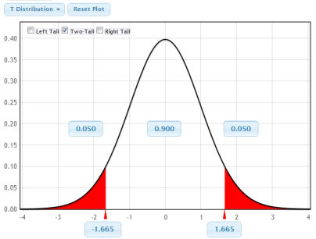
Videogames and GPA
1. Check conditions:
78 ≥ 30, 132 ≥ 30
2. Find t*:
3. Calculate statistic:
4. Calculate standard error:
5. Calculate CI:
${\overline{x}}_{1}−{\overline{x}}_{2}±t^{∗}∙SE$
6. Interpret in context:

Slide 11
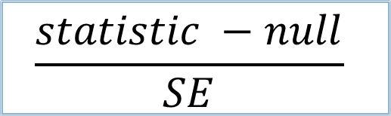
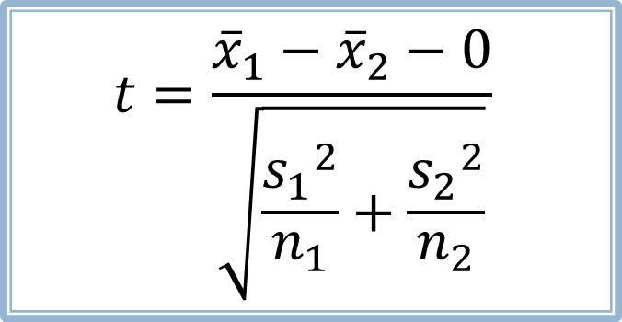
T-Test for a Difference in Means
H₀:μ₁=μ₂
⇔ H₀:μ₁-μ₂ = 0
$$t=\frac{{\overline{x}}_{1}−{\overline{x}}_{2}−0}{\sqrt{\frac{{s_{1}}_{}^{2}}{n_{1}}+\frac{{s_{2}}_{}^{2}}{n_{2}}}}$$
$$\frac{statistic −null}{SE}$$
If the population is approximately normal or if sample sizes are large (n₁ ≥ 30, n₂ ≥ 30), the p-value can be computed as the area in the tail(s) beyond t of a t-distribution with degrees of freedom equal to the smaller of n₁ – 1 and n₂ – 1

Slide 12
The Pygmalion Effect
Teachers were told that certain children (chosen randomly) were expected to be “growth spurters,” based on the Harvard Test of Inflected Acquisition (a test that didn’t actually exist). These children were selected randomly.
The response variable is change in IQ over the course of one year.
Source: Rosenthal, R. and Jacobsen, L. (1968). “Pygmalion in the Classroom: Teacher Expectation and Pupils’ Intellectual Development.” Holt, Rinehart and Winston, Inc.

Slide 13
The Pygmalion Effect
 | n |  | s
Control Students | 255 | 8.42 | 12.0
“Growth Spurters” | 65 | 12.22 | 13.3
Research Question: Does this provide evidence that merely expecting a child to do well actually causes the child to do better?
If so, how much better?
*s₁ and s₂ were not given in the article, so they were selected to ensure the p-value specified in the article.

Slide 14
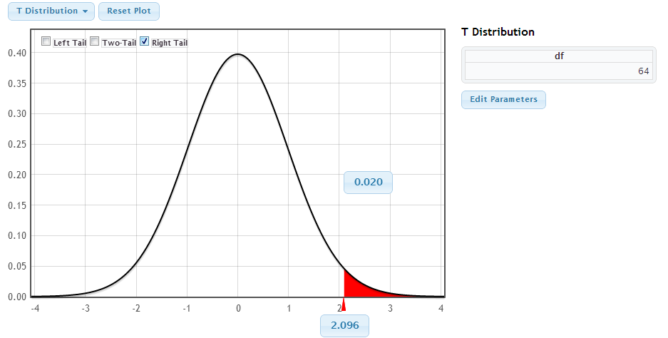
Pygmalion Effect
1. State hypotheses:
2. Check conditions:
3. Calculate t statistic:
4. Compute p-value:
5. Interpret in context:

Slide 15
Parameter | Distribution | Conditions | Standard Error
Proportion | Normal | All counts at least 10: np ≥ 10, n(1 – p) ≥ 10
Difference in Proportions | Normal | All counts at least 10: n₁p₁ ≥ 10, n₁(1 – p₁) ≥ 10, n₂p₂ ≥ 10, n₂(1 – p₂) ≥ 10
Mean | t, df = n – 1 | n ≥ 30 or data normal
Difference in Means | t, df = smaller of n₁ – 1, n₂ – 1 | n₁ ≥ 30 or data normal, n₂ ≥ 30 or data normal

