Slide 1
Section 7.2:
Testing For an Association Between Two Categorical Variables
To accompany
Statistics: Unlocking the Power of Data
by Lock, Lock, Lock, Lock, and Lock
Video by: Professor Kathryn Dobeck

Slide 2
Outline
Test for a relationship between two categorical variables
Hypotheses
Expected counts
Chi-square statistic
Chi-square distribution

Slide 3
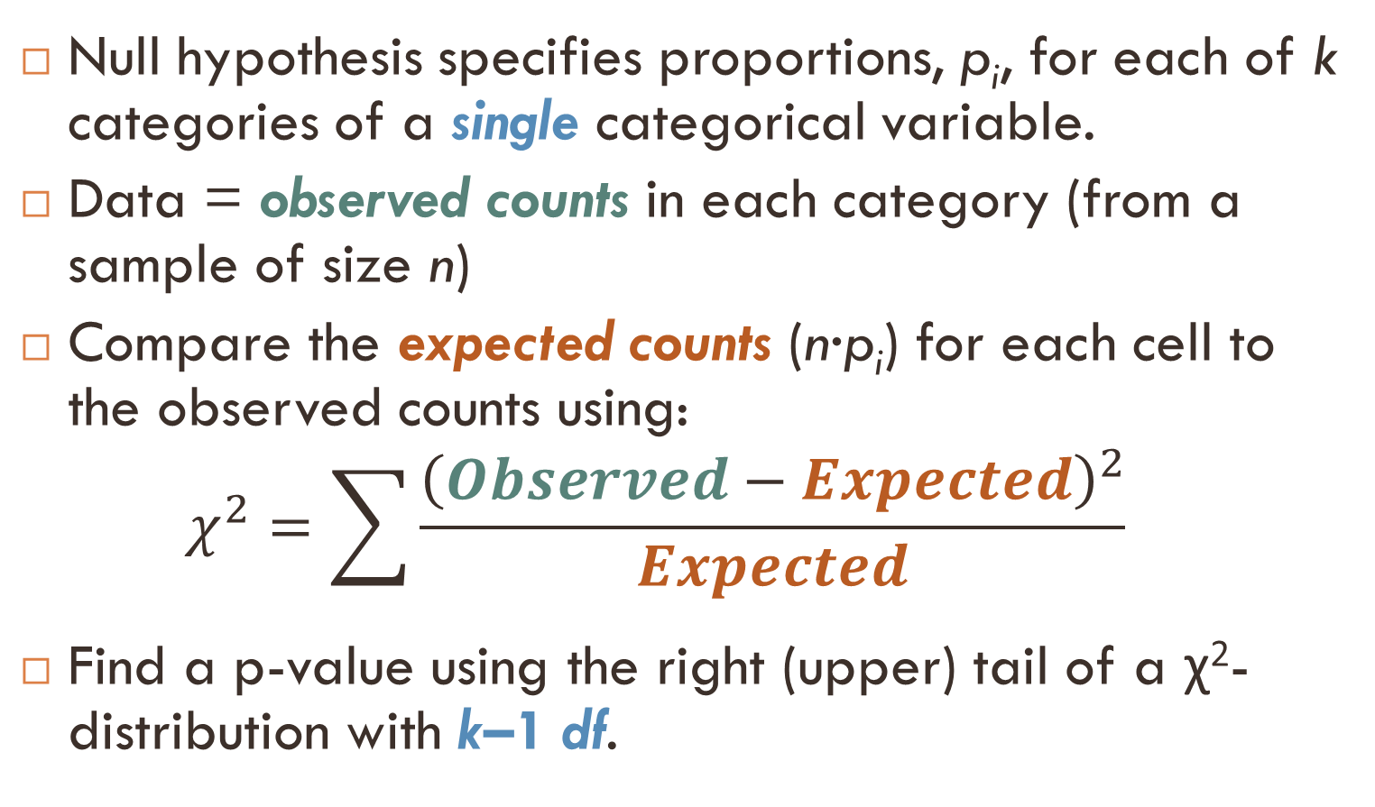
Recap: χ² Goodness-of-Fit Test
Null hypothesis specifies proportions, p_{i}, for each of k categories of a single categorical variable.
Data = observed counts in each category (from a sample of size n)
Compare the expected counts (n·p_{i}) for each cell to the observed counts using:
$$χ^{2}=\sum{\frac{{\left(Observed−Expected\right)}^{2}}{Expected}}$$
Find a p-value using the right (upper) tail of a χ²-distribution with k–1 df.

Slide 4
Two Categorical Variables
The statistics behind a χ² test easily extends to two categorical variables…
A χ² -test for association (often called a χ²-test for independence) tests for an association between two categorical variables

Slide 5
Award Preference & SAT
The data in StudentSurvey includes two categorical variables:
Award = Academy, Nobel, or Olympic
HigherSAT = Math or Verbal
We would like to investigate if there seems to be a relationship between the award preference and which SAT is higher…

Slide 6
Observed Counts and Hypotheses
HigherSAT | Academy | Nobel | Olympic | Total
Math | 21 | 68 | 116 | 205
Verbal | 10 | 79 | 61 | 150
Total | 31 | 147 | 177 | 355
Data are summarized with a 2×3 table for a sample of size n=355.
H₀ : Award preference is not associated with which SAT is higher
H_{a} : Award preference is associated with which SAT is higher
If H₀ is true ⟹ The award distribution is expected to be the same across each row.

Slide 7
Expected Counts and Relative Frequencies
HigherSAT | Academy | Nobel | Olympic | Total | Rel. Freq
Math |  |  |  | 205 | 0.577
Verbal |  |  |  | 150 | 0.423
Total | 31 | 147 | 177 | 355 | 1.0
The expected counts are computed assuming the null hypothesis is true.
If H₀ is true ⟹ The award distribution is expected to be the same across each row.
⟹ We expect 57.7% of all three Award Preference groups to have higher Math SAT scores and 42.3% of all three Award Preference groups to have higher Verbal SAT scores.

Slide 8
Assuming the null hypothesis is true, we expect 57.7% of all three Award Preference groups to have higher Math SAT scores. Find the expected count of students that prefer an Academy Award and have a higher Math SAT score.
HigherSAT | Academy | Nobel | Olympic | Total | Rel. Freq
Math |  |  |  | 205 | 0.577
Verbal |  |  |  | 150 | 0.423
Total | 31 | 147 | 177 | 355 | 1.0
17.89
21
24
118.29

Slide 9
Assuming the null hypothesis is true, we expect 42.3% of all three Award Preference groups to have higher Verbal SAT scores. Find the expected count of students that prefer an Olympic medal and have a higher Verbal SAT score.
HigherSAT | Academy | Nobel | Olympic | Total | Rel. Freq
Math |  |  |  | 205 | 0.577
Verbal |  |  |  | 150 | 0.423
Total | 31 | 147 | 177 | 355 | 1.0
61
63.45
74.87
102.13

Slide 10

Expected Counts and Relative Frequencies
HigherSAT | Academy | Nobel | Olympic | Total | Rel. Freq
Math |  |  |  | 205 | 0.577
Verbal |  |  |  | 150 | 0.423
Total | 31 | 147 | 177 | 355 | 1.0
Looking again at the computation of the expected count for students that prefer an Academy Award and have a higher Math SAT score, we have:
row total
column total
17.89 ≈ 0.577(31)
$$\text{≈ }\frac{205}{355}∙\left(31\right)\text{ = }\frac{205 ∙ 31}{355}$$
sample size
This is an alternate way to compute the expected count that reduces round-off error.

Slide 11
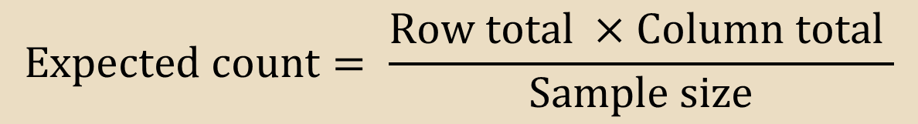
Expected Counts
$$\text{Expected} \text{count}= \frac{\text{Row} \text{total} ×\text{Column} \text{total} }{\text{Sample} \text{size}}$$
HigherSAT | Academy | Nobel | Olympic | Total
Math |  |  |  | 205
Verbal |  |  |  | 150
Total | 31 | 147 | 177 | 355
Calculate the expected counts for each of the cells.
Note: The expected counts maintain row and column totals, but redistribute the counts as if there were no association.

Slide 12
Observed Counts
HigherSAT | Academy | Nobel | Olympic | Total
Math | 21 | 68 | 116 | 205
Verbal | 10 | 79 | 61 | 150
Total | 31 | 147 | 177 | 355
Expected Counts
HigherSAT | Academy | Nobel | Olympic | Total
Math | 17.901 | 84.887 | 102.211 | 205
Verbal | 13.099 | 62.113 | 74.789 | 150
Total | 31 | 147 | 177 | 355
Observed (Expected) Counts
HigherSAT | Academy | Nobel | Olympic | Total
Math | 21 (17.901) | 68 (84.887) | 116 (102.211) | 205
Verbal | 10 (13.099) | 79 (62.113) | 61 ( 74.789) | 150
Total | 31 | 147 | 177 | 355

Slide 13
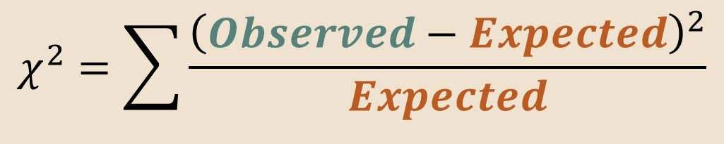
Chi-Square Statistic
$$χ^{2}=\sum{\frac{{\left(Observed−Expected\right)}^{2}}{Expected}}$$
HigherSAT | Academy | Nobel | Olympic | Total
Math | 21 (17.901) | 68 (84.887) | 116 (102.211) | 205
Verbal | 10 (13.099) | 79 (62.113) | 61 ( 74.789) | 150
Total | 31 | 147 | 177 | 355
$$χ^{2}=\frac{{\left(21−17.901\right)}^{2}}{17.901}+\frac{{\left(68−84.887\right)}^{2}}{84.887}+⋯+\frac{{\left(61−74.789\right)}^{2}}{74.789}$$

Slide 14
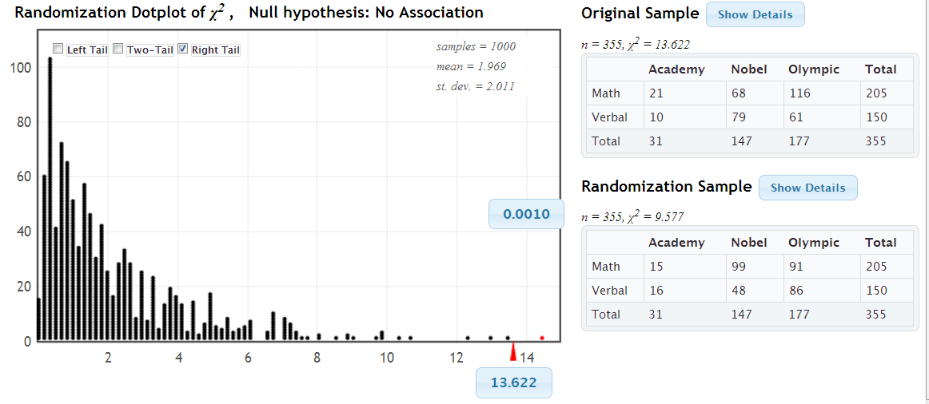
Randomization Test
www.lock5stat.com/statkey
p-value=0.001 ⟹ Reject H₀
The award preference appears to be related to which SAT score is higher.

Slide 15
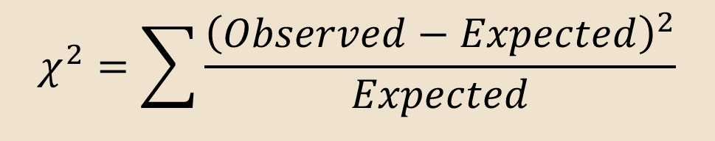

Distribution for a χ²-test for Association
Let: r = # of rows and
c = # of columns
in an $r×c$ two-way table.
If the expected count is at least 5 in each cell of the table, then we can find a p-value for a χ²-test for association by using the right tail of a χ²-distribution with $(r−1)∙(c−1)$degrees of freedom.
$$χ^{2}=\sum{\frac{{\left(Observed−Expected\right)}^{2}}{Expected}}$$

Slide 16
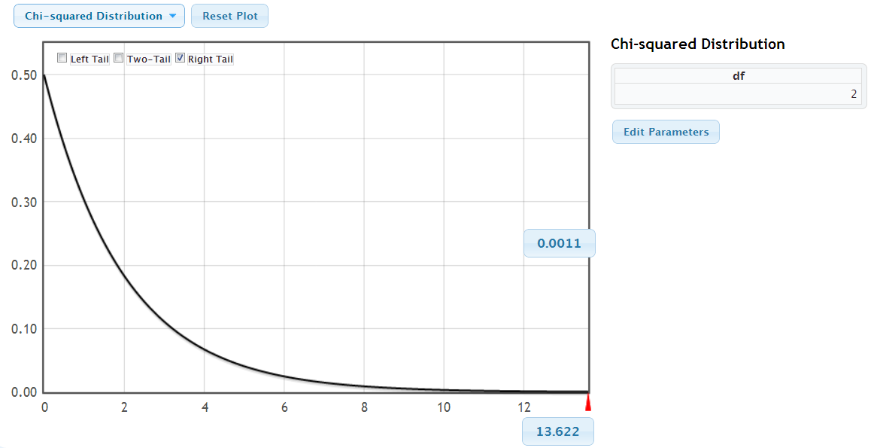
Chi-Square Distribution
StatKey
H₀ : Award preference is not associated with which SAT is higher
H_{a} : Award preference is associated with which SAT is higher
For Higher SAT vs. Award: df =
p-value

Slide 17
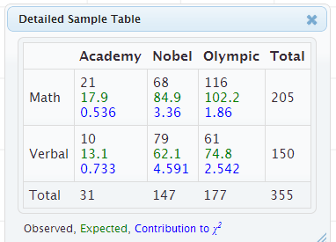
Chi-Square Test for Association
Note: The χ²-test for two categorical variables only indicates if the variables are associated. Look at the contribution in each cell for the possible nature of the relationship.
HigherSAT | Academy | Nobel | Olympic | Total
Math | 21 (17.901) | 68 (84.887) | 116 (102.211) | 205
Verbal | 10 (13.099) | 79 (62.113) | 61 ( 74.789) | 150
Total | 31 | 147 | 177 | 355

Slide 18
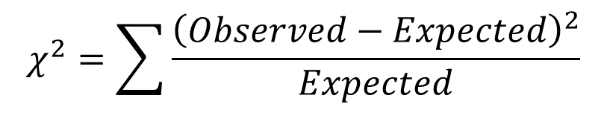
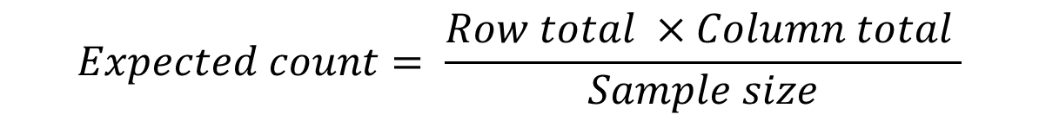
Chi-Square Test for Association
H₀ : The two variables are not associated
H_{a} : The two variables are associated
Calculate the expected counts for each cell:
Check that they are all at least 5 to proceed.
Calculate the χ² statistic:
Compute the p-value as the area in the tail above the χ²
statistic, using a χ²-distribution with df = (r – 1) × (c – 1)
Interpret the p-value in context.
$$Expected count= \frac{Row total ×Column total }{Sample size}$$
$$χ^{2}=\sum{\frac{{\left(Observed−Expected\right)}^{2}}{Expected}}$$

Slide 19
Is there an association between faculty rank and gender? For continuing faculty at many colleges, the ranks are Assistant Professor (aP) for beginning faculty members, Associate Professors (AP) after one promotion, and Professors (P), the highest rank, after another promotion. The data below show faculty rank and gender for all continuing faculty members at one college in 2012. What is the null hypothesis?
 | aP | AP | P | Total
M | 20 | 30 | 33 | 83
F | 20 | 45 | 10 | 75
Total | 40 | 75 | 43 | 158
Faculty rank and gender are associated.
Faculty rank and gender are not associated
The assumed proportions are correct
The assumed proportions are not correct
All ranks are equally likely

Slide 20
Is there an association between faculty rank and gender? For continuing faculty at many colleges, the ranks are Assistant Professor (aP) for beginning faculty members, Associate Professors (AP) after one promotion, and Professors (P), the highest rank, after another promotion. The data below show faculty rank and gender for all continuing faculty members at one college in 2012. What is the expected count for female assistant professors (aP)?
 | aP | AP | P | Total
M | 20 | 30 | 33 | 83
F | 20 | 45 | 10 | 75
Total | 40 | 75 | 43 | 158
20
40
0.50
19.0
24.1

Slide 21
Is there an association between faculty rank and gender? For continuing faculty at many colleges, the ranks are Assistant Professor (aP) for beginning faculty members, Associate Professors (AP) after one promotion, and Professors (P), the highest rank, after another promotion. The data below show faculty rank and gender for all continuing faculty members at one college in 2012. What is the expected count for male associate professors (AP)?
 | aP | AP | P | Total
M | 20 | 30 | 33 | 83
F | 20 | 45 | 10 | 75
Total | 40 | 75 | 43 | 158
20
30
0.40
28.2
39.4

Slide 22
Is there an association between faculty rank and gender? For continuing faculty at many colleges, the ranks are Assistant Professor (aP) for beginning faculty members, Associate Professors (AP) after one promotion, and Professors (P), the highest rank, after another promotion. The data below show faculty rank and gender for all continuing faculty members at one college in 2012. What is the contribution to the χ² statistic for male AP?
Observed (Expected) Values
1.68
2.24
4.41
6.57
20.95
 | aP | AP | P
M | 20 ( ) | 30 ( ) | 33 ( )
F | 20 ( ) | 45 ( ) | 10 ( )

Slide 23
Is there an association between faculty rank and gender? For continuing faculty at many colleges, the ranks are Assistant Professor (aP) for beginning faculty members, Associate Professors (AP) after one promotion, and Professors (P), the highest rank, after another promotion. The data below show faculty rank and gender for all continuing faculty members at one college in 2012. What is the contribution to the χ² statistic for female aP?
Observed (Expected) Values
0.05
0.68
2.41
6.57
8.95
 | aP | AP | P
M | 20 ( ) | 30 ( ) | 33 ( )
F | 20 ( ) | 45 ( ) | 10 ( )

Slide 24
Is there an association between faculty rank and gender? For continuing faculty at many colleges, the ranks are Assistant Professor (aP) for beginning faculty members, Associate Professors (AP) after one promotion, and Professors (P), the highest rank, after another promotion. The data below show faculty rank and gender for all continuing faculty members at one college in 2012. What is the χ² statistic?
Observed (Expected) Values
Contribution
 | aP | AP | P
M | 20 ( ) | 30 ( ) | 33 ( )
F | 20 ( ) | 45 ( ) | 10 ( )
 | aP | AP | P
M
F
1.36
1.68
4.41
6.57
14.91

Slide 25
Is there an association between faculty rank and gender? For continuing faculty at many colleges, the ranks are Assistant Professor (aP) for beginning faculty members, Associate Professors (AP) after one promotion, and Professors (P), the highest rank, after another promotion. The data below show faculty rank and gender for all continuing faculty members at one college in 2012. What are the degrees of freedom?
Observed (Expected) Values
Contribution
 | aP | AP | P
M | 20 ( ) | 30 ( ) | 33 ( )
F | 20 ( ) | 45 ( ) | 10 ( )
 | aP | AP | P
M
F
1
2
3
5
6

Slide 26
Is there an association between faculty rank and gender? For continuing faculty at many colleges, the ranks are Assistant Professor (aP) for beginning faculty members, Associate Professors (AP) after one promotion, and Professors (P), the highest rank, after another promotion. The data below show faculty rank and gender for all continuing faculty members at one college in 2012. What is the p-value?
StatKey
Observed (Expected) Values
Contribution
 | aP | AP | P
M | 20 ( ) | 30 ( ) | 33 ( )
F | 20 ( ) | 45 ( ) | 10 ( )
 | aP | AP | P
M
F
0.00058
0.00076
0.05
0.143
0.251

Slide 27
Is there an association between faculty rank and gender? What is the conclusion?
Observed (Expected) Values
Contribution
 | aP | AP | P
M | 20 ( ) | 30 ( ) | 33 ( )
F | 20 ( ) | 45 ( ) | 10 ( )
 | aP | AP | P
M
F
We find evidence that there is no association between rank and gender
We find evidence that there is an association between rank and gender
We do not find evidence that there is no association between rank and gender
We do not find evidence that there is an association between rank and gender

Slide 28
Is there an association between faculty rank and gender? Which rank (aP, AP, or P) contributes the most to the χ² statistic, and what do the observed and expected counts tell us about that rank?
Observed (Expected) Values
Contribution
 | aP | AP | P
M | 20 ( ) | 30 ( ) | 33 ( )
F | 20 ( ) | 45 ( ) | 10 ( )
 | aP | AP | P
M
F
Assistant professors (aP) and we see that the genders are equally split
Associate professors (AP) and we see that there are more female and fewer male associate professors than we expect.
Professors (P) and we see that there are more female and fewer males professors than we expect.
Professors (P) and we see that there are more male and fewer female professors than we expect.

Slide 29
Is there an association between faculty rank and gender? For continuing faculty at many colleges, the ranks are Assistant Professor (aP) for beginning faculty members, Associate Professors (AP) after one promotion, and Professors (P), the highest rank, after another promotion. The data below show faculty rank and gender for all continuing faculty members at one college in 2012. Can we conclude causation from this study?
Observed (Expected) Values
Contribution
 | aP | AP | P
M | 20 ( ) | 30 ( ) | 33 ( )
F | 20 ( ) | 45 ( ) | 10 ( )
 | aP | AP | P
M
F
Yes
No
Not given enough information to determine

Slide 30

Metal Tags and Penguins
Let’s return to the question of whether metal tags are detrimental to penguins.
Source: Saraux, et. al. (2011). “Reliability of flipper-banded penguins as indicators of climate change,” Nature, 469, 203-206.
 | Survived | Died | Total
Metal Tag | 33 | 134 | 167
Electronic Tag | 68 | 121 | 189
Total | 101 | 255 | 356
Is there an association between type of tag and survival?
H₀ : Type of tag is not associated with penguin survival.
H_{a} : Type of tag is associated with penguin survival.

Slide 31

Metal Tags and Penguins
 | Survived | Died | Total
Metal Tag | 33 | 134 | 167
Electronic Tag | 68 | 121 | 189
Total | 101 | 255 | 356
 | Survived | Died | Total
Metal Tag | 33 (47.379) | 134 (119.621) | 167
Electronic Tag | 68 (53.621) | 121 (135.379) | 189
Total | 101 | 255 | 356
Calculate expected counts.
First cell:
Calculate the chi-square statistic:
$$\frac{Row total ×Column total }{Sample size}=\frac{167×101}{356}=47.379$$
$χ^{2}=$
StatKey

Slide 32
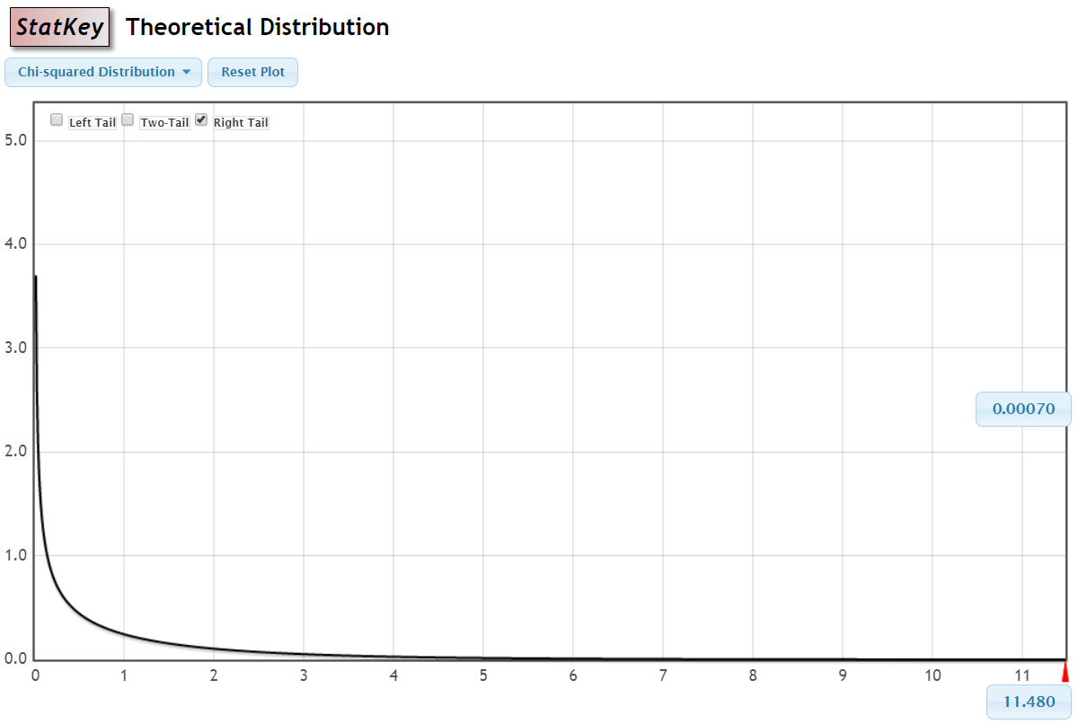
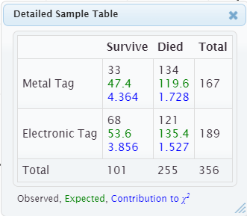
Metal Tags and Penguins
 | Survived | Died | Total
Metal Tag | 33 (47.379) | 134 (119.621) | 167
Electronic Tag | 68 (53.621) | 121 (135.379) | 189
Total | 101 | 255 | 356
p-value = 0.0007 (using a χ²-distribution with 1 df)

Slide 33
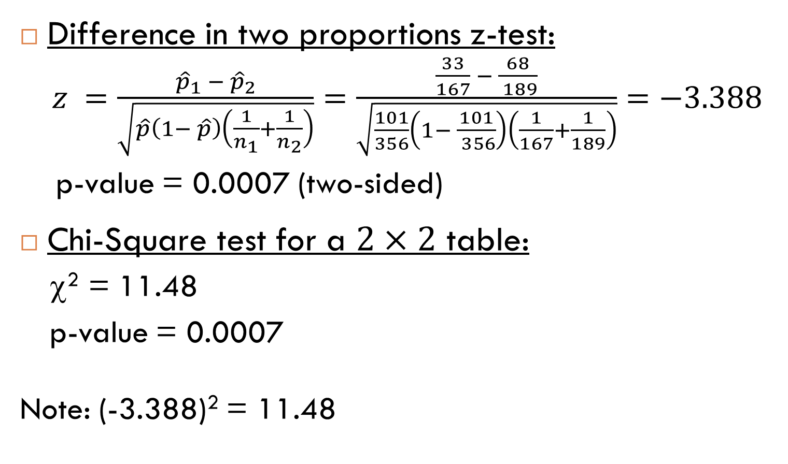
Metal Tags and Penguins
Difference in two proportions z-test:
$z =\frac{{\hat{p}}_{1} − {\hat{p}}_{2}}{\sqrt{\hat{p}\left(1− \hat{p}\right)\left(\frac{1}{n_{1}}+\frac{1}{n_{2}}\right)}}=\frac{\frac{33}{167} − \frac{68}{ 189}}{\sqrt{\frac{101}{356}\left(1− \frac{101}{ 356}\right)\left(\frac{1}{167}+\frac{1}{189}\right)}}=−3.388$
p-value = 0.0007 (two-sided)
Chi-Square test for a $2×2$ table:
χ² = 11.48
p-value = 0.0007
Note: (-3.388)² = 11.48

Slide 34
Two Categorical Variables with Two Categories Each (2x2 Table)
When testing two categorical variables with two categories each (i.e. 2×2 table), the value of the χ² statistic is exactly the same as the squared value of the z-statistic!
The χ² -distribution with 1 df is exactly the square of the normal distribution
Doing a two-sided test for difference in proportions or doing a χ² test for a 2×2 table will produce exactly the same p-value.

Slide 35
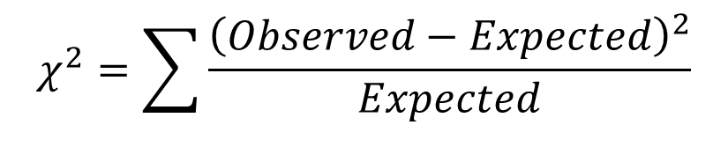
Summary: Chi-square Tests
The χ² -test for goodness-of-fit will test if the distribution of a single categorical variable differs from a hypothesized distribution
The χ² -test for association will test if two categorical variables are associated
For both, calculate the expected counts for each cell, compute the χ² statistic as
and find the p-value as the area above this statistic in a χ² -distribution using 𝑘−1 or (𝑟 − 1)∙(𝑐 − 1) df
$$χ^{2}=\sum{\frac{{\left(Observed−Expected\right)}^{2}}{Expected}}$$

