Slide 1
Section 8.1:
Analysis of Variance (ANOVA)
To accompany
Statistics: Unlocking the Power of Data
by Lock, Lock, Lock, Lock, and Lock
Video by: Professor Kathryn Dobeck

Slide 2
Outline
Test for a difference in means across more than two categories (groups)
Hypotheses
Measuring variability
Between groups
Within groups
Comparing variability, the F-statistic
Finding a p-value, the F-distribution
Putting it all together – the ANOVA table

Slide 3
Multiple Categories
So far, we’ve learned how to do inference for a difference in means IF the categorical variable has only two categories (i.e. compare two groups)
In this section, we’ll learn how to do hypothesis tests for a difference in means across multiple categories (i.e. compare more than two groups)

Slide 4
Multiple Categories
The procedure for testing for a difference in means across multiple categories is quite different from tests that we have performed earlier and may seem strange at first.
Main idea: We compare measures of variability, both between the groups and within each group, as a way to assess how different the groups really are.
We call these tests analysis of variance, or ANOVA for short.

Slide 5
General Hypothesis Testing
State hypotheses
Calculate a test statistic, based on your original sample data
Create a distribution of the statistics that we could obtain just by random chance if the null hypothesis is true
Measure how extreme your test statistic from 2) is, as compared to the distribution generated in 3)

Slide 6
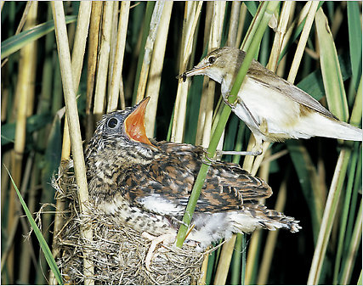
Cuckoo Birds
Cuckoo birds lay their eggs in the nests of other birds
When the cuckoo baby hatches, it kicks out all the original eggs/babies
If the cuckoo is lucky, the mother will raise the cuckoo as if it were her own
Do cuckoo bird eggs found in
nests of different species
differ in size?
http://opinionator.blogs.nytimes.com/2010/06/01/cuckoo-cuckoo/

Slide 7
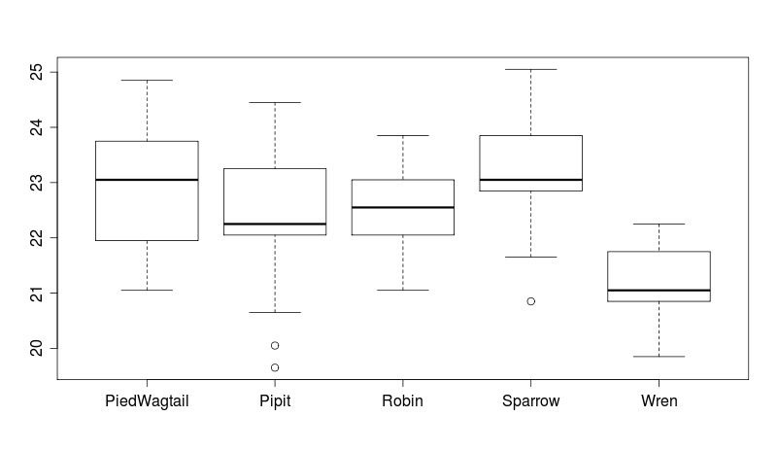
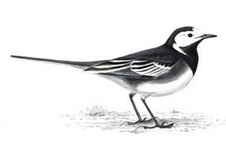
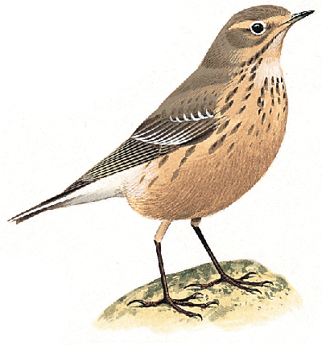
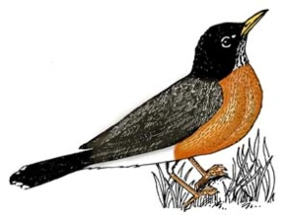
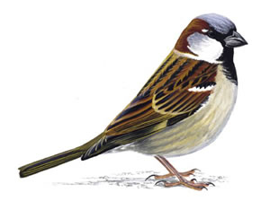
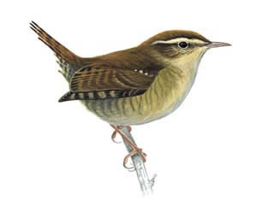
Length of Cuckoo Eggs

Slide 8
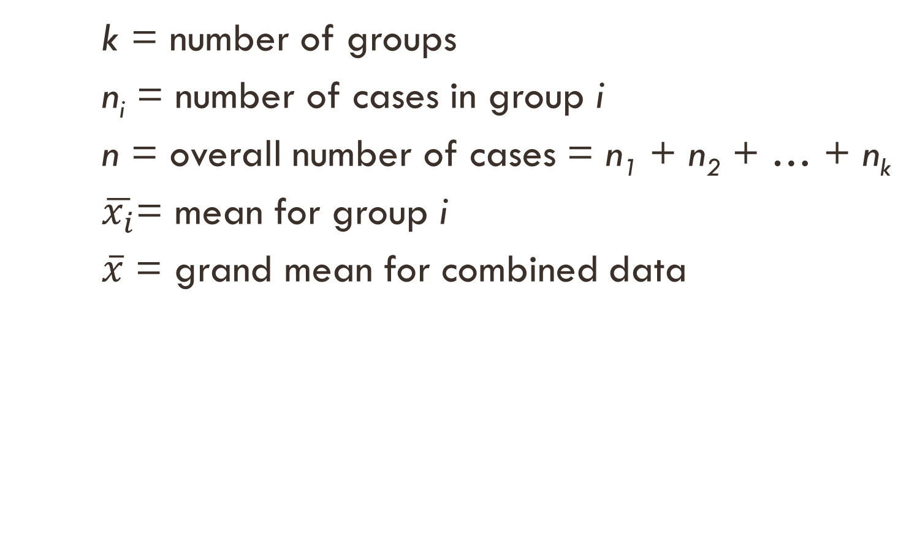
Notation
k = number of groups
n_{i} = number of cases in group i
n = overall number of cases = n₁ + n₂ + … + n_{k}
$\overline{x_{i}}$= mean for group i
$\overline{x}$ = grand mean for combined data

Slide 9
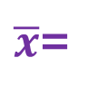
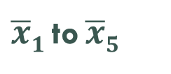
Length of Cuckoo Eggs
Bird | Sample Mean | Sample SD | Sample Size
Pied Wagtail | 22.90 | 1.07 | 15
Pipit | 22.50 | 0.97 | 60
Robin | 22.58 | 0.68 | 16
Sparrow | 23.12 | 1.07 | 14
Wren | 21.13 | 0.74 | 15
Overall | 22.46 | 1.07 | 120
k=5
$\overline{x}$=
s=
n =
$\overline{x}1$ to $\overline{x}5$
s₁ to s₅
n₁ to n₅

Slide 10
Cuckoo Egg Hypotheses
To test for a difference in mean egg length across the 5 groups:

Slide 11
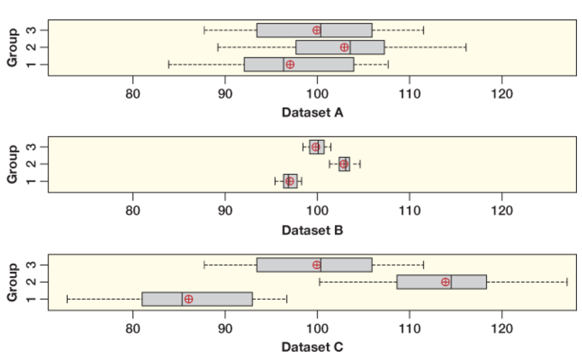
Why Analyze Variability to Test for a Difference in Means?
The group means in Datasets A and B are the same, but the boxes show different spread.
Datasets A and C have the same spread for the boxes, but different group means.
Which of these graphs appear to give strong visual evidence for a difference in the group means?

Slide 12
Why Analyze Variability to Test for a Difference in Means?
Dataset A ⇒ weakest evidence for a difference in means.
Datasets B and C ⇒ strong evidence for a difference in means.

Slide 13
Why Analyze Variability to Test for a Difference in Means?
Conclusion:
An assessment of the difference in means between several groups depends on two kinds of variability:
How different the means are from each other
The amount of variability in the samples.

Slide 14
Analysis of Variance
ANOVA splits the total variability into 2 parts:
Variability between groups
Variability within groups
Total Variability
Variability
Between Groups
Variability
Within Groups
=
+

Slide 15
If the groups are actually different, then…
the variability between groups should be higher than the variability within groups
the variability within groups should be higher than the variability between groups

Slide 16
Sums of Squares
Question: How do we measure the variability between groups? Within groups?
We’ll measure variability as sums of squared deviations, or “sums of squares” for short.
Sound familiar??
Yes! From our sample standard deviation formula!

Slide 17
Sums of Squares
Total Variability
Variability
Between Groups
Variability
Within Groups
=
+
=
+
data value
overall mean
group mean
overall mean
data value
group mean
Sum over all data values
Sum over all groups
Sum over all data values

Slide 18
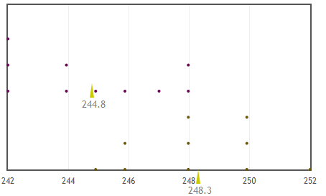

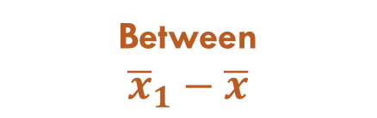
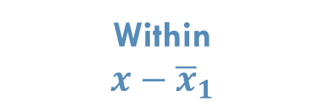
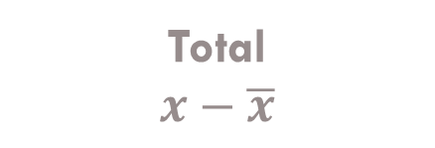

Deviations
Total
$$x−\overline{x}$$
Group 1
Within
$$x−{\overline{x}}_{1}$$
Between
$${\overline{x}}_{1}−\overline{x}$$
$${\overline{x}}_{1}$$
Group 1 Mean
Group 2
$$\overline{x}$$
Overall Mean

Slide 19
Sums of Squares
Total Variability
Variability
Between Groups
Variability
Within Groups
=
+
SSTotal
(Total sum of squares)
SSG
(sum of squares due to groups)
SSE
(“Error” sum of squares)
=
+

Slide 20
Length of Cuckoo Eggs
Sums of Squares:
+

Slide 21
ANOVA Table
The “mean square” is the sum of squares divided by the degrees of freedom
Source
Groups
Error
Total
df
k-1
n-k
n-1
Sum of Squares
SSG
SSE
SSTotal
Mean Square
MSG = SSG/(k-1)
MSE = SSE/(n-k)
average variability
variability

Slide 22
ANOVA Table for Cuckoo Eggs
Source
Groups
Error
Total
df
4
115
119
Sum of Squares
35.90
101.29
137.19
Mean Square
35.9/4 = 8.975
101.29/115 = 0.881
Bird | Sample Mean | Sample SD | Sample Size
Pied Wagtail | 22.90 | 1.07 | 15
Pipit | 22.50 | 0.97 | 60
Robin | 22.58 | 0.68 | 16
Sparrow | 23.12 | 1.07 | 14
Wren | 21.13 | 0.74 | 15
Overall | 22.46 | 1.07 | 120

Slide 23
F-Statistic
Question: How do we compare the variability between groups to the variability within groups?
The F-statistic is a ratio of the average variability between groups to the average variability within groups

Slide 24
ANOVA Table for Cuckoo Eggs
Source
Groups
Error
Total
df
4
115
119
Sum of Squares
35.90
101.29
137.19
Mean Square
35.9/4 = 8.975
101.29/115 = 0.881
F Statistic
8.975/0.881 = 10.19

Slide 25
If there really is a difference between the groups, we would expect the F-statistic to be
Higher than we would observe by random chance
Lower than we would observe by random chance

Slide 26
Determining Significance
Question: How do we determine if the variation between groups is significantly higher than the variation within the groups?
We need a distribution of the F-statistics that we could obtain just by random chance, assuming H₀ is true.
Simulation
Theoretical Distribution of F-statistics

Slide 27
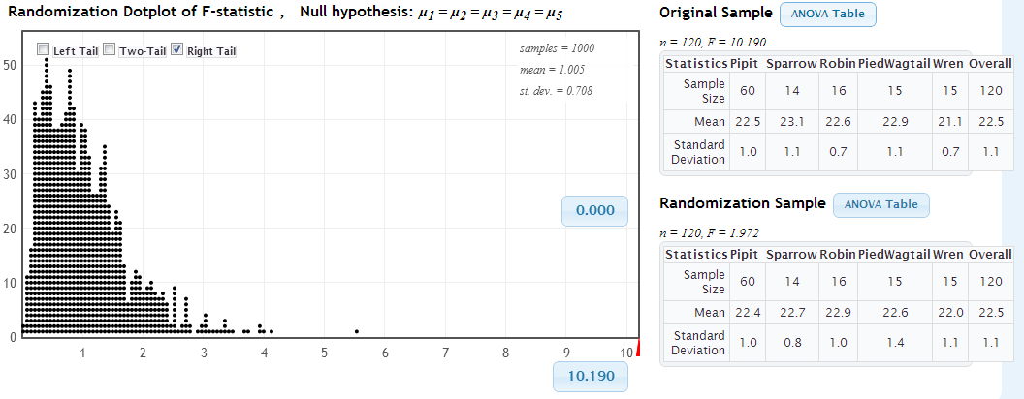
Simulation
StatKey
Because a difference would make the F-statistic higher, calculate proportion in the upper tail

Slide 28
In a test for difference in means, which will have a smaller p-value: Dataset A or Dataset B?
A
B
C
Dataset A
Dataset B

Slide 29
In a test for difference in means, which will have a smaller p-value: Dataset A or Dataset C?
A
B
C
Dataset A
Dataset C

Slide 30
In a test for difference in means, which will have a smaller p-value: Dataset A or Dataset B?
A
B
Group 1 | Group 2 |  | Group 1 | Group 2
6 | 8 |  | 12 | 6
6 | 7 |  | 2 | 10
4 | 8 |  | 3 | 4
5 | 8 |  | 6 | 9
4 | 9 |  | 2 | 11
Mean = 5 | Mean = 8 |  | Mean = 5 | Mean = 8
Dataset A
Dataset B

Slide 31
F-distribution
F-distribution

Slide 32
F-Distribution
If the following conditions hold,
Sample sizes in each group are large (each n_{i} ≥ 30) OR the data are relatively normally distributed
Variability is similar in all groups
The null hypothesis is true
then the F-statistic follows an F-distribution.
The F-distribution has two degrees of freedom, one for the numerator of the ratio (k – 1) and one for the denominator (n – k)
For F-statistics, the p-value (the area as extreme or more extreme) is always the upper tail

Slide 33
Equal Variance
The F-distribution assumes that variability is roughly the same in each of the groups.
As a rough rule of thumb, this assumption is violated if the standard deviation of one group is more than double the standard deviation of another group

Slide 34
Based on the summary statistics pictured here, can we use the F-distribution to calculate the p-value for the Cuckoo bird eggs?
Bird | Sample Mean | Sample SD | Sample Size
Pied Wagtail | 22.90 | 1.07 | 15
Pipit | 22.50 | 0.97 | 60
Robin | 22.58 | 0.68 | 16
Sparrow | 23.12 | 1.07 | 14
Wren | 21.13 | 0.74 | 15
Overall | 22.46 | 1.07 | 120
Yes
No
Need more information

Slide 35
Length of Cuckoo Eggs
Here, we don’t see any clear skewness or extreme outliers, so we proceed with using the F-distribution.

Slide 36
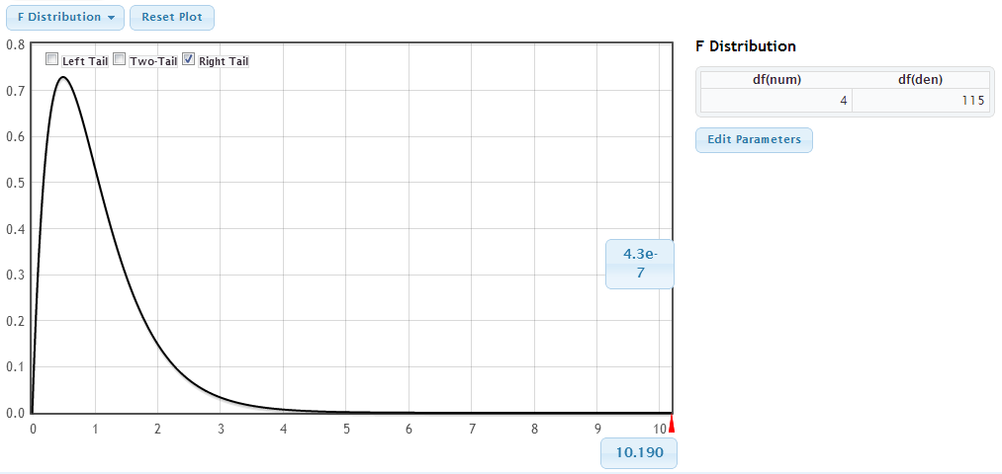
Length of Cuckoo Eggs
df(num) = k-1 = 5–1 = 4
df(den) = n–k = 120–5 = 115
StatKey

Slide 37
ANOVA Table for Cuckoo Eggs
Source
Groups
Error
Total
df
4
115
119
Sum of Squares
35.90
101.29
137.19
Mean Square
8.97
0.88
F Statistic
10.19
p-value
4.3 × 10⁻⁷ =0.00000043
Equal variability
Normal(ish) data

Slide 38
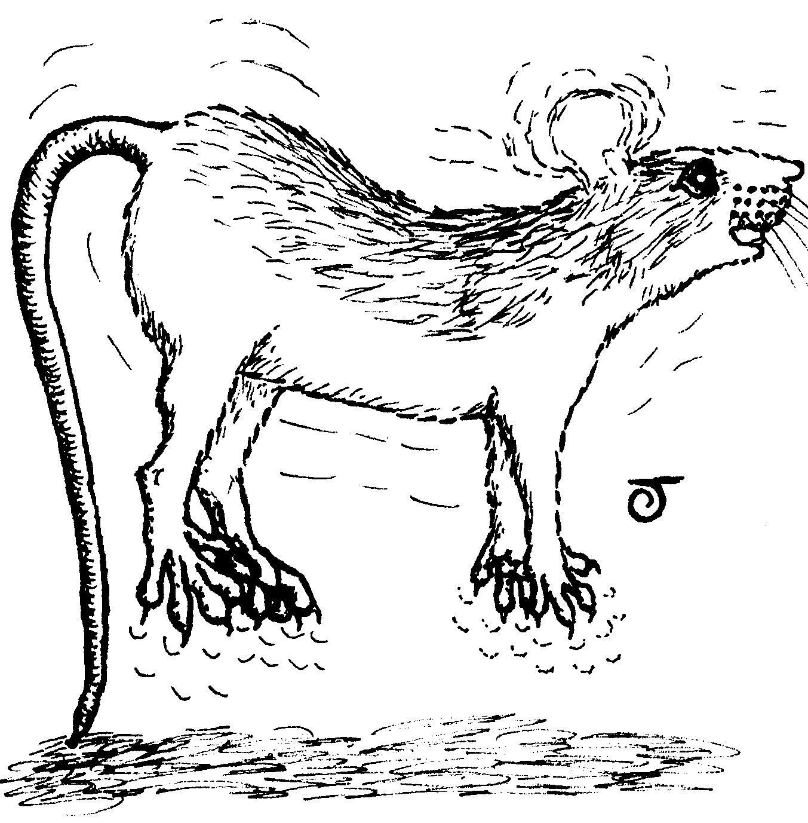
Jumping and Bone Density
Does jumping improve bone density?
30 rats were randomized to three treatment groups:
No jumping (10 rats - group 1)
30 cm jump (10 rats - group 2)
60 cm jump (10 rats - group 3)
Rats performed 10 jumps per day, 5 days per week. Bone density was measured after 8 weeks.

Slide 39
Jumping and Bone Density
We will test to see if the difference in means is significant.
mean sd n
Control 601.1 27.36360 10
Lowjump 612.5 19.32902 10
Highjump 638.7 16.59351 10

Slide 40
In this Analysis of Variance test on jumping and bone density, what goes in the red square?
Source | df | SS | MS | F
Groups
Error
Total
2
3
10
29
30
mean sd n
Control 601.1 27.36360 10
Lowjump 612.5 19.32902 10
Highjump 638.7 16.59351 10

Slide 41
In this Analysis of Variance test on jumping and bone density, what goes in the red square?
Source | df | SS | MS | F
Groups
Error
Total
2
3
10
29
30
mean sd n
Control 601.1 27.36360 10
Lowjump 612.5 19.32902 10
Highjump 638.7 16.59351 10

Slide 42
In this Analysis of Variance test on jumping and bone density, what goes in the red square?
Source | df | SS | MS | F
Groups
Error
Total
9
10
27
28
30
mean sd n
Control 601.1 27.36360 10
Lowjump 612.5 19.32902 10
Highjump 638.7 16.59351 10

Slide 43
Shortcut Formulas
Our goal: To calculate sums of squares from summary statistics!
We know:
We also know:
This means that:
So we can use algebra to solve for SSTotal...

Slide 44
Shortcut Formulas
Our goal: To calculate sums of squares from summary statistics!

Slide 45
Shortcut Formulas
Similarly, we can find the sum of squared deviations from the group mean, within any group, using the formula (n_{i}-1)s_{i}², where n_{i} is the sample size and s_{i} is the standard deviation of the part of the sample in the i^{th} group.
This means that:

Slide 46
Shortcut Formulas
Thus, to calculate sums of squares from summary statistics, we can use the shortcut formulas:
Further, if we have any two of these quantities, we can always find the third using: SSTotal = SSG + SSE
(…Watch out for round off error when using these shortcuts!)

Slide 47
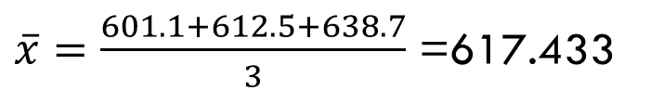
Actual Jumping and Bone Density Sums of Squares
mean sd n
Control 601.1 27.36360 10
Lowjump 612.5 19.32902 10
Highjump 638.7 16.59351 10
$\overline{x}=\frac{601.1+612.5+638.7}{3}$ =617.433

Slide 48
Actual Jumping and Bone Density Sums of Squares
mean sd n
Control 601.1 27.36360 10
Lowjump 612.5 19.32902 10
Highjump 638.7 16.59351 10

Slide 49
In this Analysis of Variance test on jumping and bone density, what goes in the red square?
Source | df | SS | MS | F
Groups | 2 | 7433.867
Error | 27 | 12579.499
Total | 29
7433.867
12579.499
12905.433
20013.366
27363.600
mean sd n
Control 601.1 27.36360 10
Lowjump 612.5 19.32902 10
Highjump 638.7 16.59351 10

Slide 50
In this Analysis of Variance test on jumping and bone density, what goes in the red square?
Source | df | SS | MS | F
Groups | 2 | 7433.867
Error | 27 | 12579.499
Total | 29
256.340
601.1
3716.934
6125.0
6387.0
mean sd n
Control 601.1 27.36360 10
Lowjump 612.5 19.32902 10
Highjump 638.7 16.59351 10

Slide 51
In this Analysis of Variance test on jumping and bone density, what goes in the red square?
Source | df | SS | MS | F
Groups | 2 | 7433.867
Error | 27 | 12579.499
Total | 29
0.13
7.98
16.07
128.17
690.12
mean sd n
Control 601.1 27.36360 10
Lowjump 612.5 19.32902 10
Highjump 638.7 16.59351 10

Slide 52
In this Analysis of Variance test on jumping and bone density, what is the p-value?
StatKey
Source | df | SS | MS | F
Groups | 2 | 7433.867
Error | 27 | 12579.499
Total | 29
0.0019
0.0038
0.0324
0.0850
0.6941
mean sd n
Control 601.1 27.36360 10
Lowjump 612.5 19.32902 10
Highjump 638.7 16.59351 10

Slide 53
So the p-value is _______. What is the conclusion?
Reject H₀ : Jumping does not have an effect on mean bone density.
Do not reject H₀ : Jumping does have an effect on mean bone density.
Reject H₀ : Jumping does have an effect on mean bone density.
Do not reject H₀ : Jumping does not have an effect on mean bone density.

Slide 54
ANOVA Table
Source | df | SS | MS | F | P-value
Groups | 2 | 7433.867 | 3716.934 | _______ | ________
Error | 27 | 12579.499 | 465.907
Total | 29 | 20013.366
We have strong evidence that jumping does increase bone density, at least in rats.

Slide 55
Summary
Analysis of variance is used to test for a difference in means between groups by comparing the variability between groups to the variability within groups
Sums of squares are used to measure variability
The F-statistic is the ratio of average variability between groups to average variability within groups
The F-statistic follows an F-distribution, if sample sizes are large (or data is normal), variability is equal across groups, and the null hypothesis is true.

