Slide 1
Section P.1:
Probability Rules
To accompany
Statistics: Unlocking the Power of Data
by Lock, Lock, Lock, Lock, and Lock
Video by: Professor Kathryn Dobeck

Slide 2
Events
An event is any collection of results or outcomes of a procedure or an experiment
Examples of events:
Drawing a spade from a shuffled deck of cards
Randomly selecting a woman who works in the medical field
Randomly selecting an American who is color blind

Slide 3
Probability
The probability of event A, denoted P(A), is the long run frequency or proportion of times the event occurs
A probability is always between 0 and 1, when expressed as a decimal and, equivalently, between 0% and 100% when expressed as a percentage.
P(A) = 1 means A will definitely happen
P(A) = 0 means A will definitely not happen

Slide 4
Equally Likely Outcomes
When outcomes are equally likely,
Examples:
P(rolling a fair die and getting a five) =1/6 ≈ 0.167
P(rolling a fair die and getting an even #)
= P(rolling a 2, 4, or 6) = 3/6 = 0.5

Slide 5
Rock and Roll Hall of Fame
From its founding through 2012, the Rock and Roll Hall of Fame has inducted 273 groups or individuals (see http://www.rockhall.com/inductees/) The table on the next slide shows how many of the inductees have been female or have included female members and also shows how many of the inductees have been music performers.

Slide 6
What is the probability that an inductee chosen at random is a performer?
 | Female Members | No Females | Total
Performer (MP) | 32 | 149 | 181
Not performer | 9 | 83 | 92
Total | 41 | 232 | 273
181/273 = 0.663
181/232 = 0.780
32/181 = 0.177
I got a different answer

Slide 7
What is the probability that an inductee chosen at random has a female member or is a performer?
 | Female Members | No Females | Total
Performer (MP) | 32 | 149 | 181
Not performer | 9 | 83 | 92
Total | 41 | 232 | 273
222/273 = 0.813
32/273 = 0.117
190/273 = 0.696
I got a different answer

Slide 8





P(A or B): The General Addition Rule
B
A

Slide 9
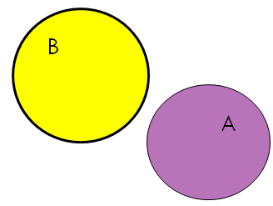
Disjoint Events
Events A and B are called disjoint or mutually exclusive if only one of the two events can happen

Slide 10
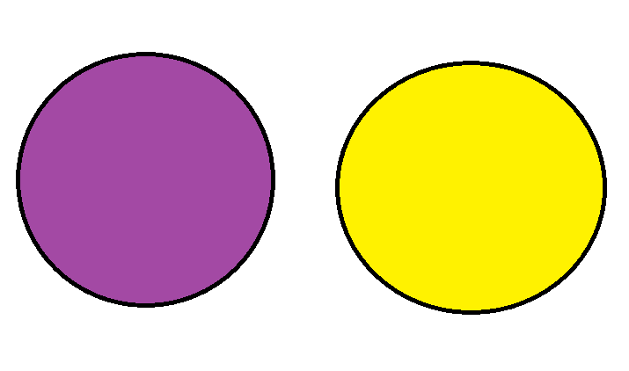
Disjoint Events
Examples of Disjoint Events:
A = Selecting a character from The Lord of the Rings;
B = Selecting a character from Harry Potter
Sam
Ron
A
Gollum
B
Voldemort
Frodo
Treebeard
Harry
Dobby
Éowyn
Gandalf
Hermione
Bilbo
Dumbledore
Gimli…
Neville…

Slide 11
Disjoint Events
Examples of Disjoint Events:
2. When drawing a single playing card
C = Drawing a heart; D = Drawing a spade.
A♥
A♠
C
2♥
3♥
D
2 ♠
3 ♠
4♥
5♥
6♥
4 ♠
5 ♠
6 ♠
7♥
8♥
9♥
7 ♠
8 ♠
9 ♠
10♥
J♥
10 ♠
J ♠
Q♥
K♥
Q ♠
K ♠

Slide 12
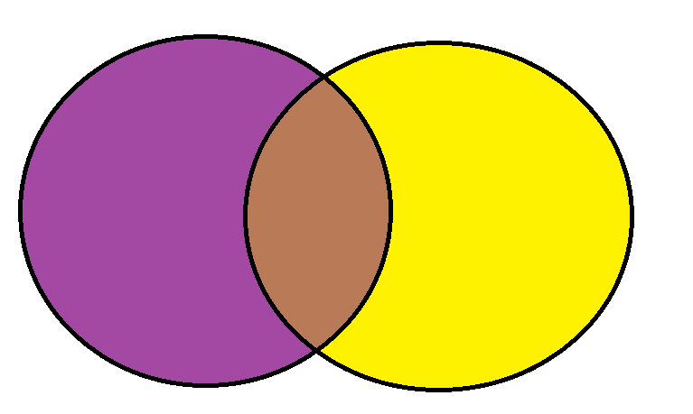
Disjoint Events
Examples of Events that are NOT Disjoint:
A = Selecting a character from The Lord of the Rings;
E = Selecting a character from The Hobbit
A
Sam
Smaug
E
Treebeard
Gollum
Gandalf
Thorin
Éowyn
Bilbo…
Gimli…
Glóin…

Slide 13
Disjoint Events
Examples of Events that are NOT Disjoint:
2. When drawing a single playing card
C = Drawing a heart; F = Drawing a queen
A♥
C
2♥
3♥
Q♦
F
4♥
5♥
6♥
Q♥
Q♠
7♥
8♥
9♥
10♥
J♥
Q♣
K♥

Slide 14
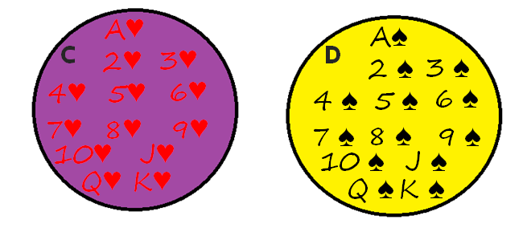
When drawing a single card from a standard 52 card deck, what is the probability that the card is a heart or a spade?
0.063
0.327
0.308
0.5

Slide 15
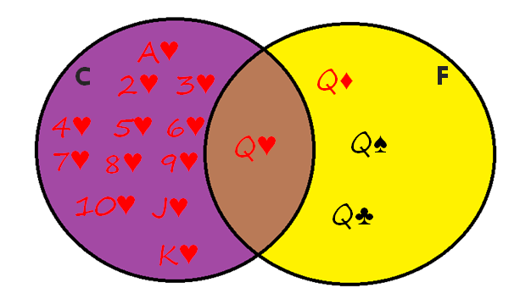
When drawing a single card from a standard 52 card deck, what is the probability that the card is a heart or a queen?
0.063
0.327
0.308
0.5

Slide 16
If A and B are disjoint, then
P(A or B) = P(A) + P(B)
P(A or B) = P(A) + P(B) – P(A and B)
Neither a) nor b) are correct
Both a) and b) are correct

Slide 17
Addition Rules
B
B
A
A

Slide 18
P(not A)
Events “A” and “not A” are disjoint events. Therefore, we can apply our special case of the addition rule:

Slide 19
P(not A)
Moreover, it is certain that either the event A or the event not A will occur. Thus:

Slide 20
P(not A): The Complement Rule
We can use the previous two facts to form what is called the Complement Rule.
Equivalent and more useful forms are:

Slide 21
Based on survey data, 52% of students drink caffeine in the morning, 47% of students drink caffeine in the afternoon, and 37% drink caffeine in the morning and the afternoon. What percent of students do not drink caffeine in the morning or in the afternoon?
63%
38%
0%
37%

Slide 22
What is the probability that an inductee chosen at random has a female member and is a performer?
 | Female Members | No Females | Total
Performer (MP) | 32 | 149 | 181
Not performer | 9 | 83 | 92
Total | 41 | 232 | 273
222/273 = 0.813
41/273 = 0.150
32/273 = 0.117
I got a different answer

Slide 23
Conditional Probability
P(A if B) is the probability of A, if we know B has happened
This is read in multiple ways:
“probability of A if B”
“probability of A given B”
“probability of A conditional on B”
You may also see this written as P(A | B)

Slide 24
What is the probability that an inductee chosen at random has a female member if it is a performer?
 | Female Members | No Females | Total
Performer (MP) | 32 | 149 | 181
Not performer | 9 | 83 | 92
Total | 41 | 232 | 273
181/273 = 0.663
32/41 = 0.780
32/181 = 0.177
I got a different answer

Slide 25
What is the probability that an inductee chosen at random is a performer if it has female members?
 | Female Members | No Females | Total
Performer (MP) | 32 | 149 | 181
Not performer | 9 | 83 | 92
Total | 41 | 232 | 273
181/273 = 0.663
32/41 = 0.780
32/181 = 0.177
I got a different answer

Slide 26
P(A if B): Conditional Probability Rule

Slide 27
P(A if B): Conditional Probability Rule

Slide 28
Conditional Probability Rule

Slide 29
Conditional Probability
P(has female members if performer) = 0.177
P(performer if has female members) = 0.780

Slide 30
Based on survey data, 52% of students drink caffeine in the morning, 47% of students drink caffeine in the afternoon, and 37% drink caffeine in the morning and the afternoon. What percent of students who drink caffeine in the morning also drink caffeine in the afternoon?
77%
38%
71%

Slide 31
Helpful Tip
If the table problems are easier for you than the sentence problems, try to first convert what you know into a table.
52% of students drink caffeine in the morning, 47% of students drink caffeine in the afternoon, and 37% drink caffeine in the morning and the afternoon
 | Caffeine Afternoon | No Caffeine Afternoon | Total
Caffeine Morning
No Caffeine Morning
Total

Slide 32
P(A and B): The Multiplication Rule

Slide 33
Drawing Cards
Suppose we draw two cards (without replacement) from a standard 52 card deck.
a) What is the probability that both the first and second cards are aces?
P(1st card is ace and 2nd card is ace)

Slide 34
Drawing Cards
b) What is the probability that both cards are of the same suit?
P(same suit) = P(both hearts or both diamonds
or both spades or both clubs)
= P(both hearts) + P(both diamonds) + P(both spades) + P(both clubs)

Slide 35
Drawing Cards
b) What is the probability that both cards are of the same suit? (cont’d)

Slide 36
Independence
Events A and B are independent if P(B if A) = P(B).
In other words, knowing that event A happened does not change the probability that event B happened.

Slide 37
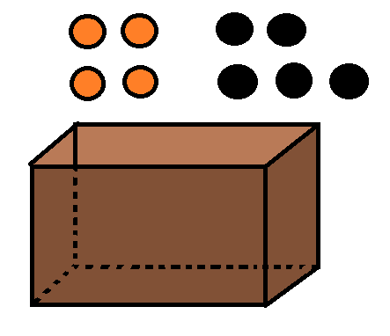
Independence
Examples of Independent Events:
Tossing a coin and drawing a card from a deck of playing cards.
ex) P(flip heads if draw a heart) = P(flip heads) =0.5
Drawing a ball from a box, replacing it, and then drawing a second ball
ex) P(second is orange if first is orange)
= P(second is orange) = 4/9

Slide 38
Independence
Examples of Events That Are Not Independent:
Drawing a card from a deck, not replacing it, and then drawing another card.
ex) P(second card is a heart if first card is a heart)
=
Drawing a ball from a box, not replacing it, and then drawing a second ball.
ex) P(second is orange if first is orange) = 3/8

Slide 39
More Drawing Cards
Suppose we draw two cards (with replacement) from a standard 52 card deck. What is the probability that both the first and second cards are aces?
P(1st card is ace and 2nd card is ace)

Slide 40
If A and B are independent, then
P(A and B) = P(A) · P(B if A)
P(A and B) = P(A) ·P(B)
Neither a) nor b) are correct
Both a) and b) are correct

Slide 41
P(A and B): Multiplication Rules

Slide 42
Summary

