Slide 1


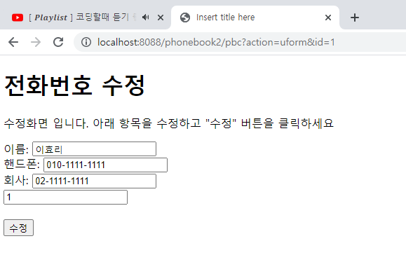



개요 및 분석
01
Rqeust(요청)
분석-포워드 설명
Request header
파라미터: action=uform
id=1
Request body

rquest
파라미터:
action=uform
id=1
어트리뷰트
“pVo”
phonebook2
http://localhost:8088/phonebook2/pbc?action=uform&id=1
contoller(servlet)객체
phoneDao 객체
uform일때
personId
getPerson(personId)
Response(응답)
response
 header
Response body
(html)
*포워드
rquest
updateForm.jsp
객체
response
Rqeust(요청)
Request header
파라미터: action=uform
id=1
Request body
어트리뷰트: “pVo”, personVo
DB
Response(응답)
Response header
Response body
(html)

Slide 2



phonebook2 개요 및 분석
01
분석-수정(post 방식)
action=update&name=이효리&hp=010-2222-2222&company=02-2222-2222&id=1
http://localhost:8088/phonebook2/pbc
Rqeust(요청)
Tomcat
phonebook2
Request header
Request body
(파라미터)
Contoller(servlet)
객체
phoneDao 객체
rquest
update일때
personUpdate(personVo)
response
리스트 요청
Response(응답)
Response header
Response body
(리다이렉트코드)
DB
http://localhost:8088/phonebook2/pbc?action=list

Slide 3
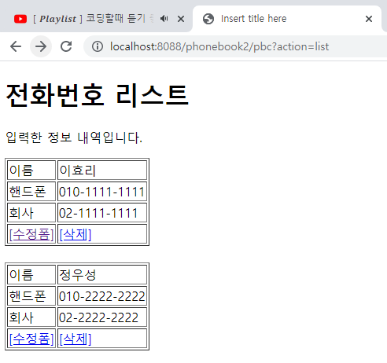

phonebook2 개요 및 분석
01
분석-삭제(post 방식)
action=delete&id=2
http://localhost:8088/phonebook2/pbc
Rqeust(요청)
Tomcat
phonebook2
Request header
Request body
(파라미터)
Contoller(servlet)
객체
phoneDao 객체
rquest
delete일때
personDelete(personId)
response
리스트 요청
Response(응답)
Response header
Response body
(리다이렉트코드)
DB
http://localhost:8088/phonebook2/pbc?action=list

