Slide 1
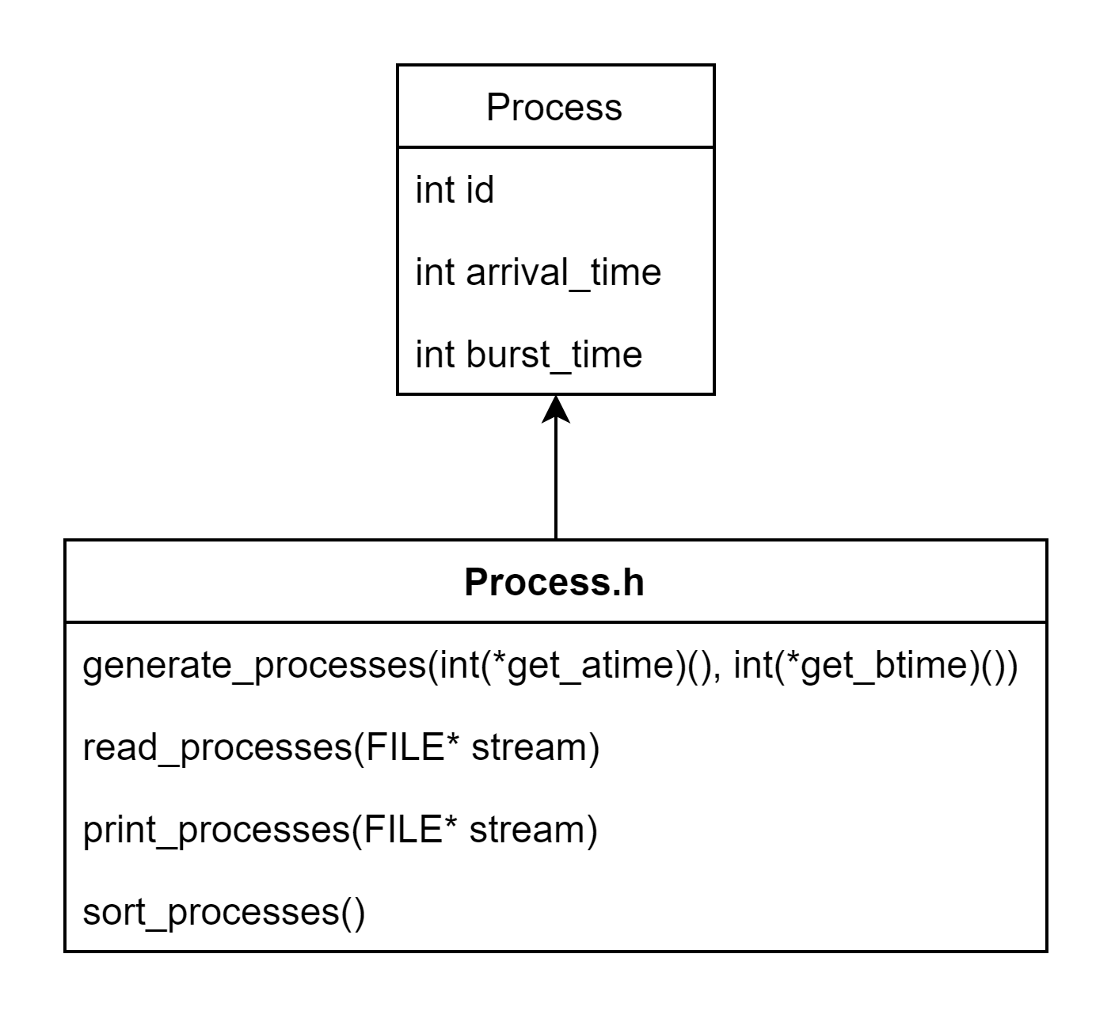
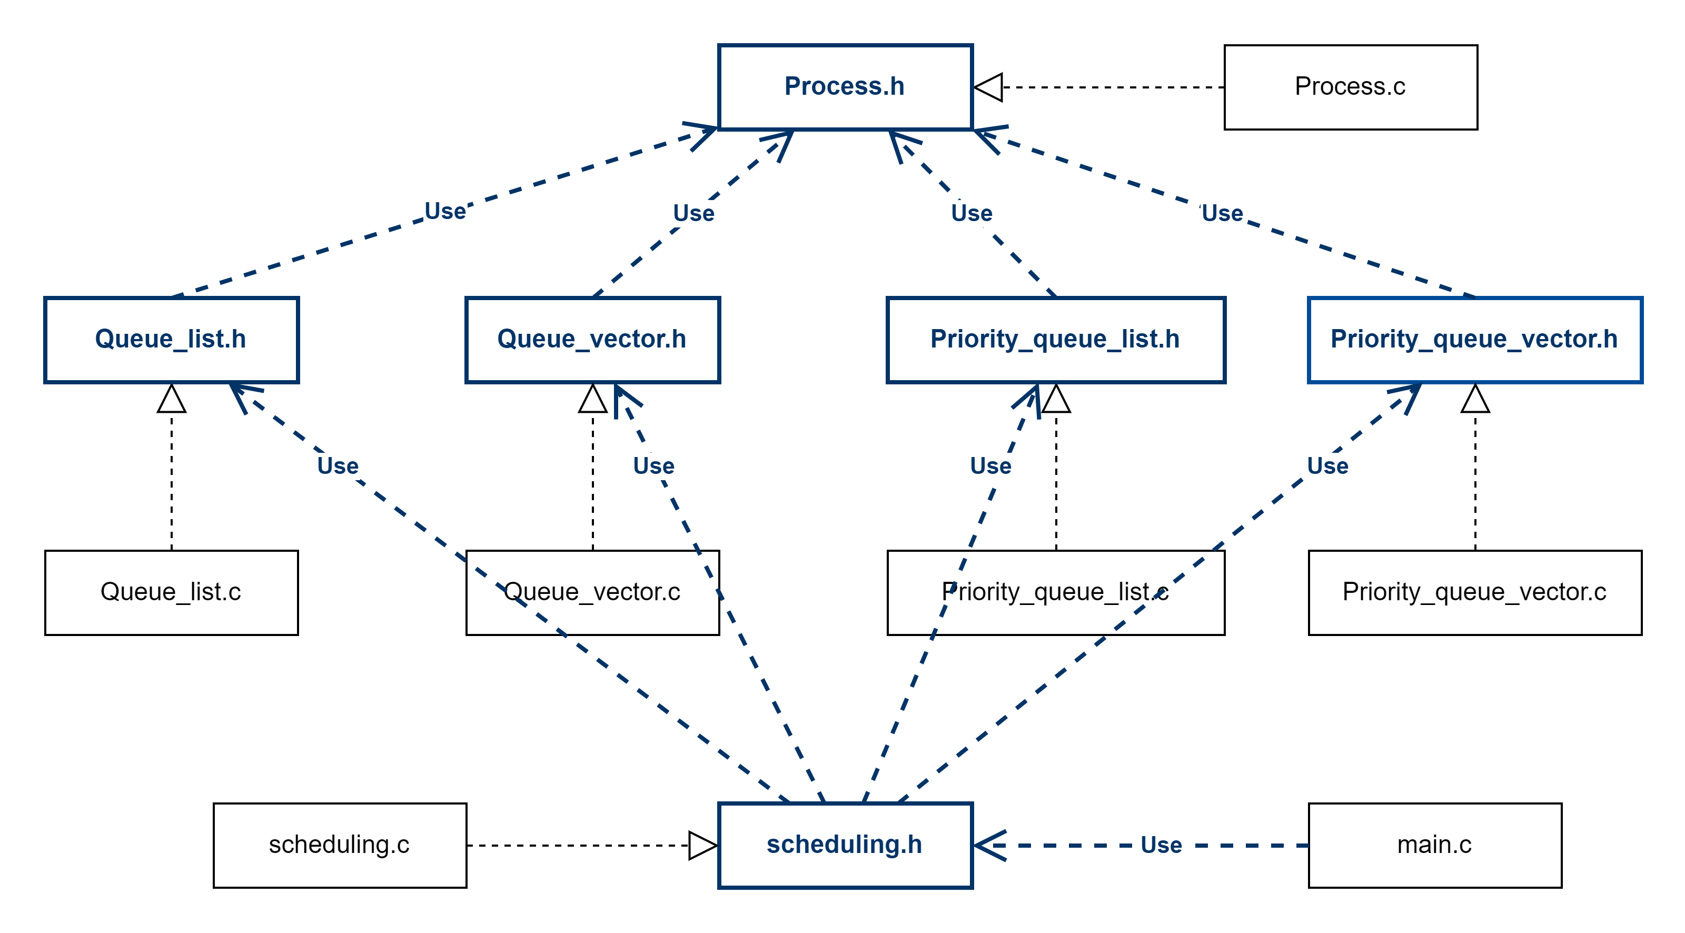
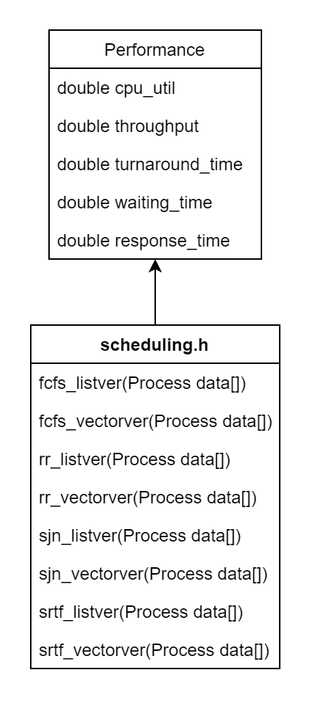
Structure Charts

Slide 2
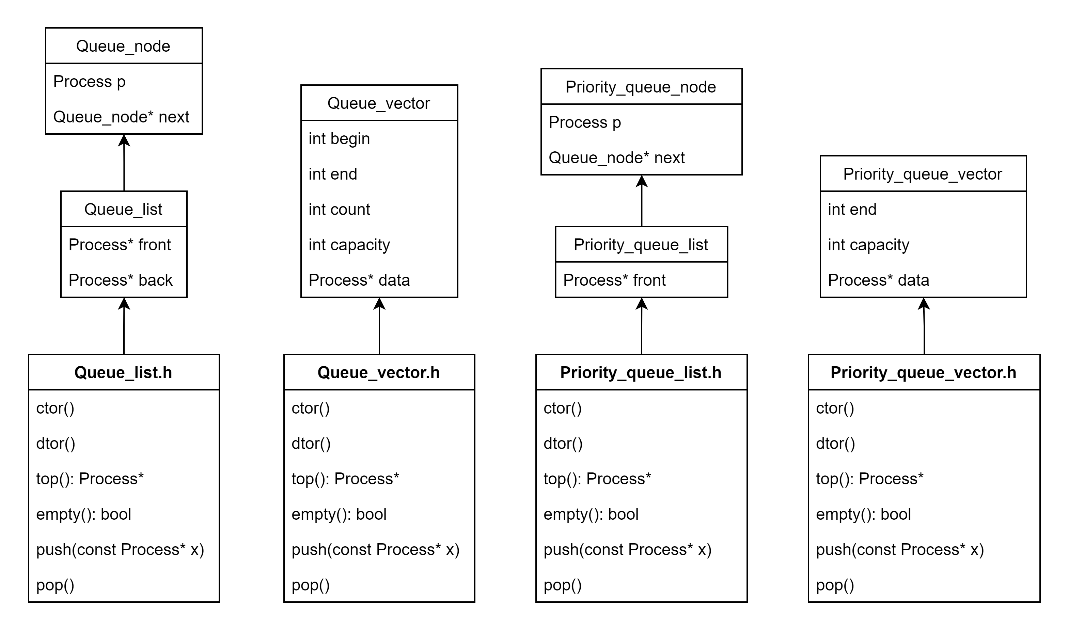

Slide 3
Flow Chart and Pseudo Code

Slide 4
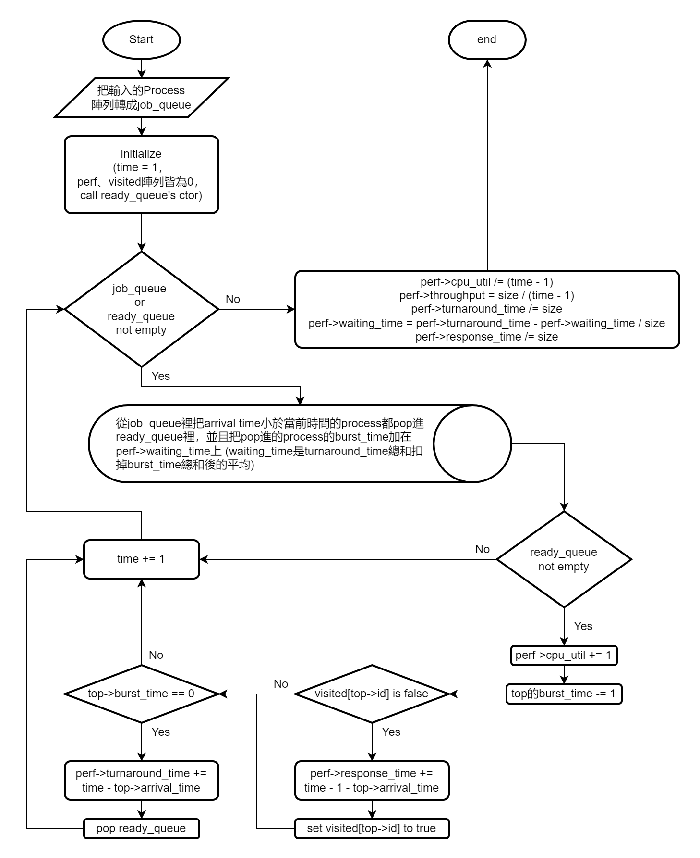
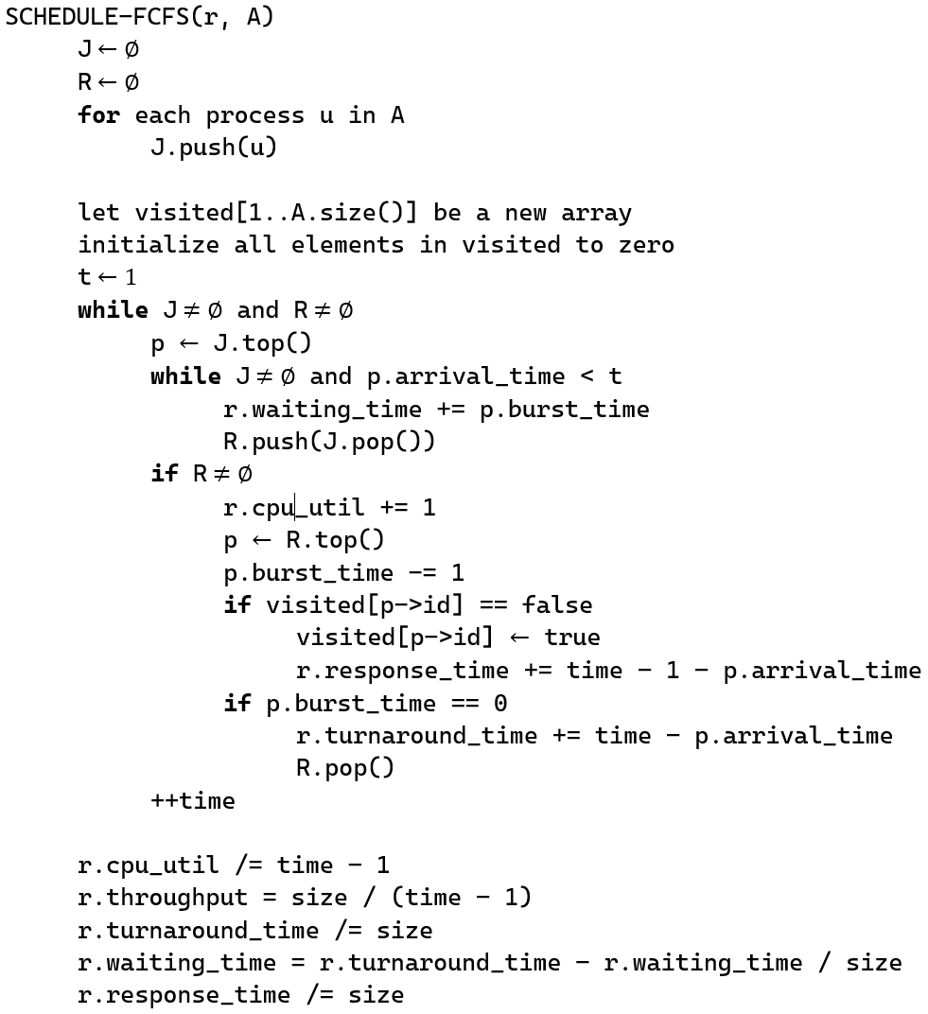
First Come, First Serve Scheduling
job_queue使用Queue
ready_queue使用Queue

Slide 5
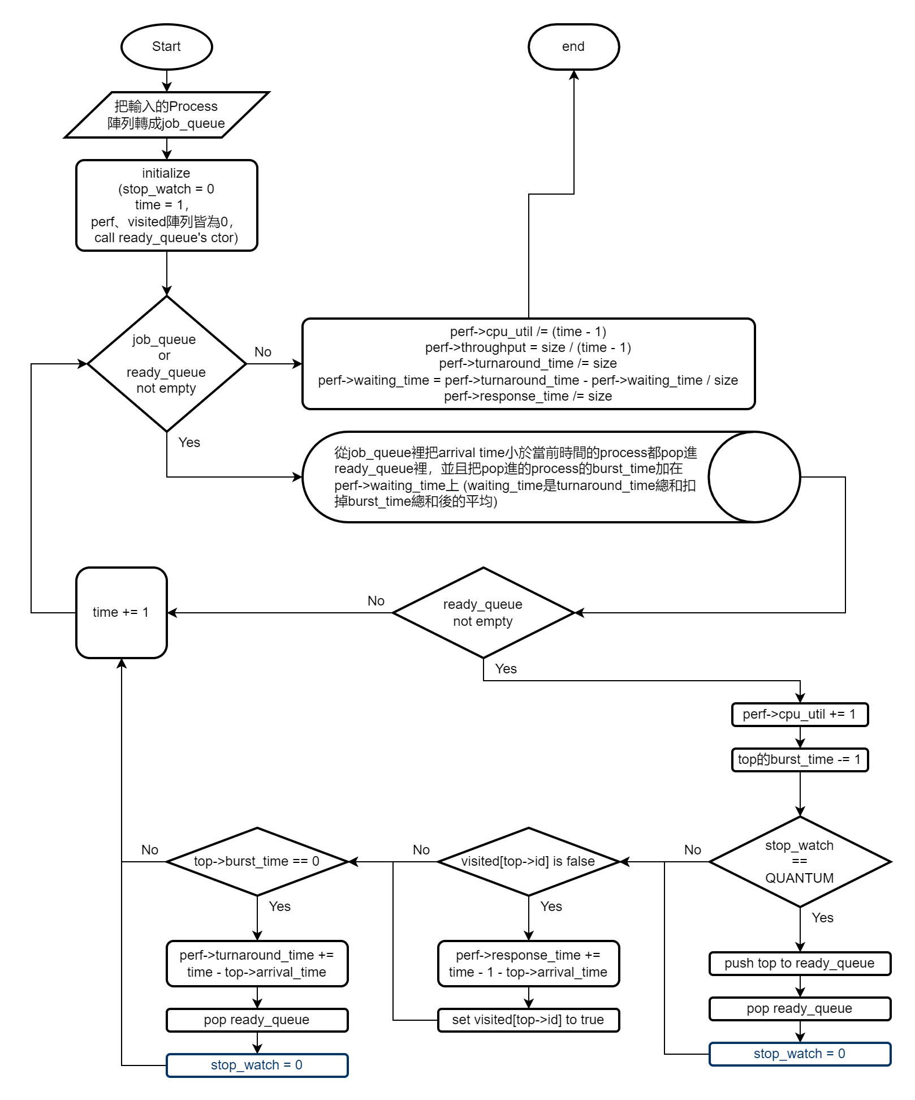
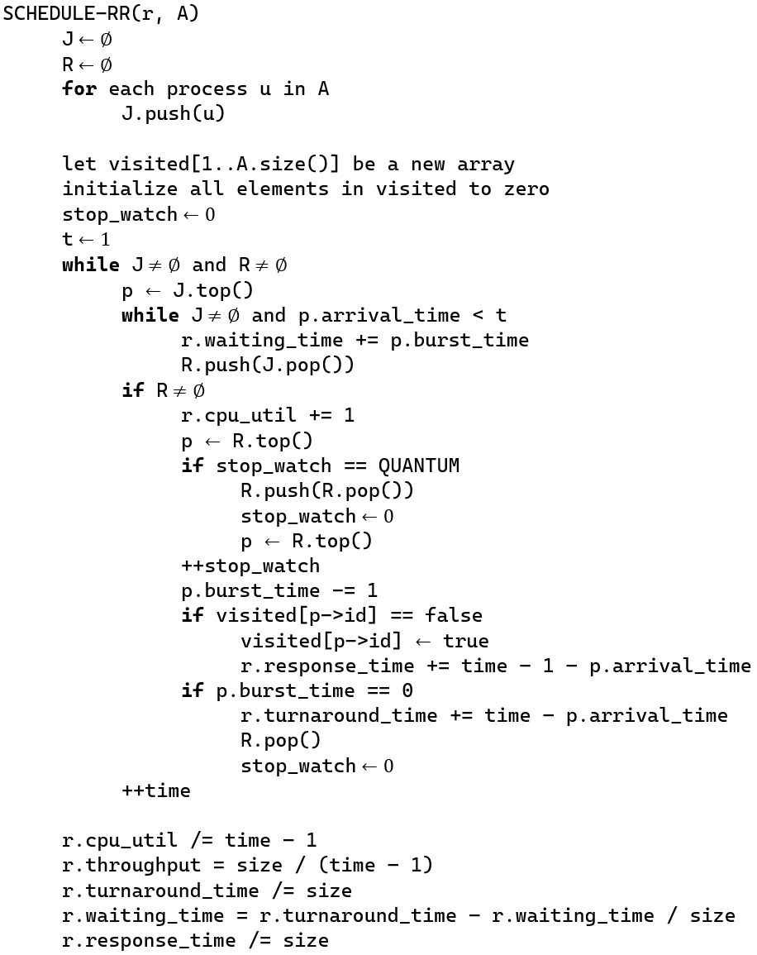
Round Robin Scheduling
job_queue使用Queue
ready_queue使用Queue

Slide 6
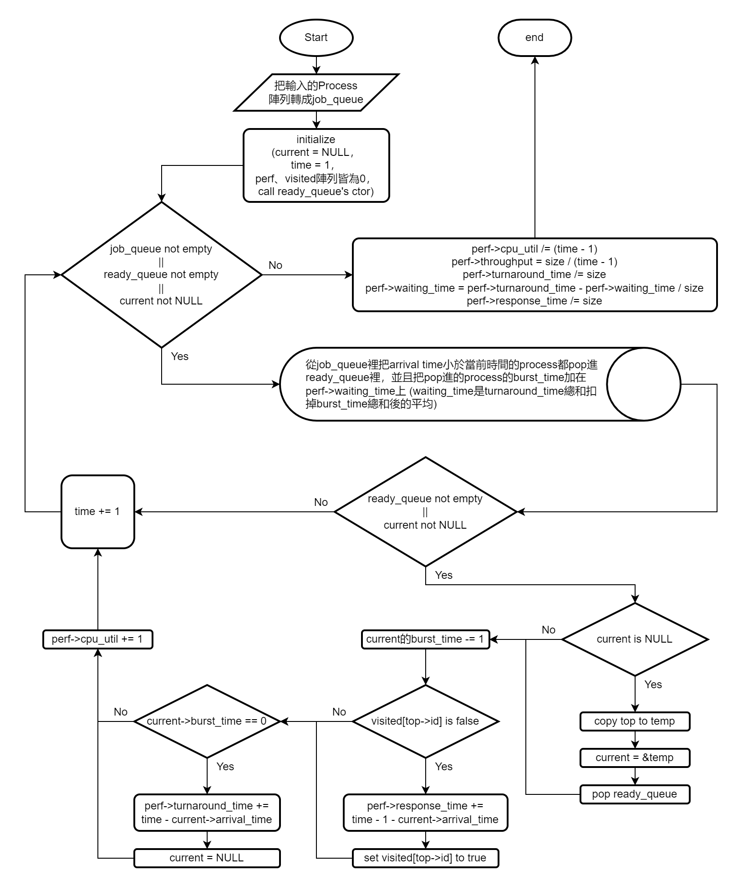
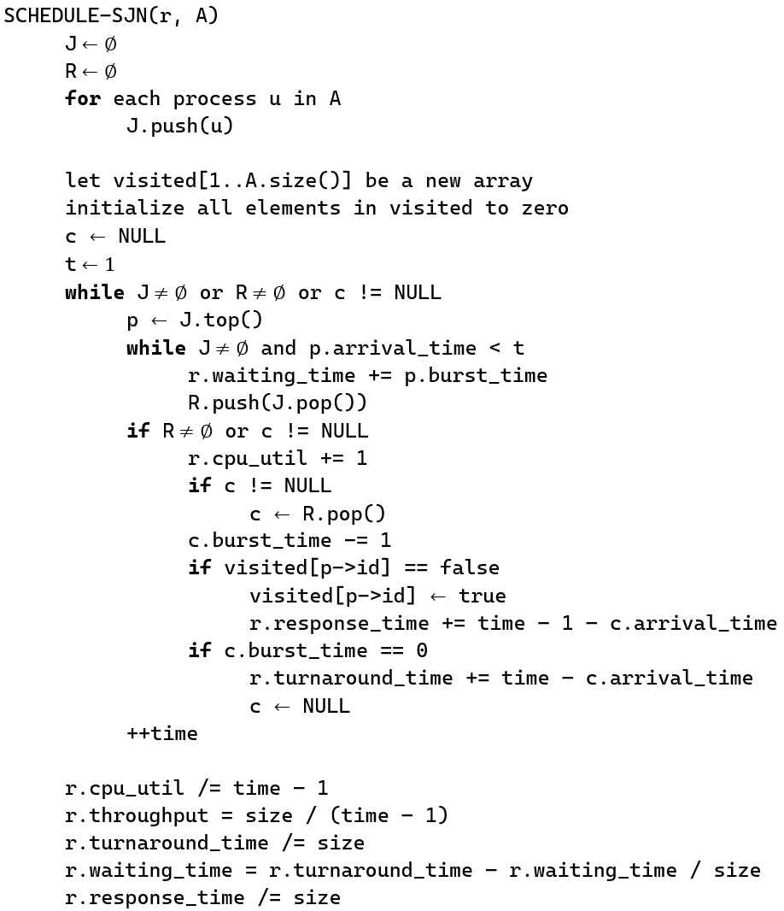
Shortest Job First Scheduling (Preemptive)
job_queue使用Queue
ready_queue使用Priority_queue

Slide 7

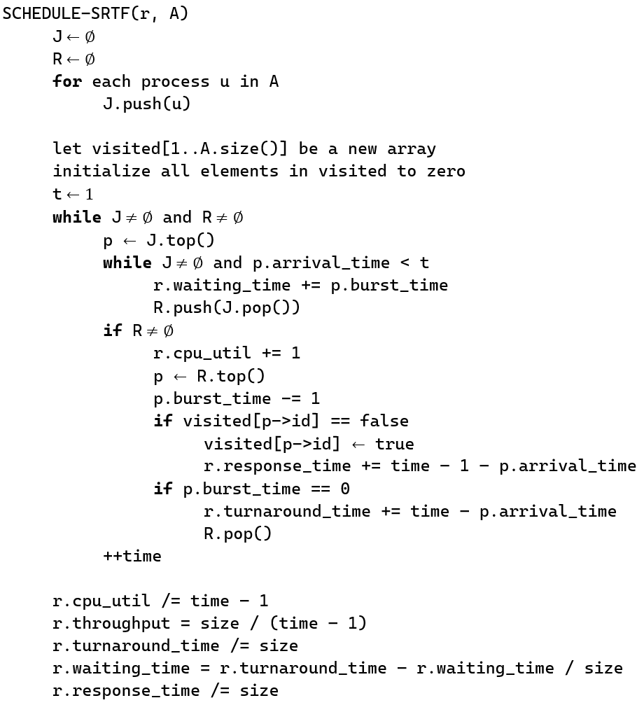
Shortest Job First Scheduling (NON-Preemptive)
job_queue使用Queue
ready_queue使用Priority_queue

Slide 8
Task Schedule
12/1 Draft of structure charts, flow charts and pseudo code
All function’s declaration
12/4 main.c
Queue’s and Priority_queue’s member function definition
12/7 Definition of all scheduling algorithm
12/15 Debug
12/22 Draw the final structure chart, flow charts and pseudo code
12/27 Check the final system

Slide 9
Task Allocation
蔡其均
Half of the flow charts and pseudo code
Structure Chart
Design of all struct and all function’s declaration
Function definition of Queue_vector and Priority_queue_vector
Code in scheduling.c
吳祈恩
Half of the flow charts and pseudo code
Code in main.c
Function definition of Queue_list and Priority_queue_list

