Slide 1
Class Overview

Slide 2
Agenda
Class Overview
First Night
Teaching Staff
What the course covers
Course Coverage FAQs

Slide 3
Agenda
Class Overview …
House Rules
Use of AI
Grading
Development Hardware & Tools
Some more FAQs

Slide 4
First Night
Class Overview
Assignment 01
Azure Overview
App Services Part I
Notes:
Class Overview – 20 min
Assignment 01 – 12 Min
Azure Overview – 20 Min
App Services Part I – 60 Min

Slide 5
Class Overview- Teaching Staff
Who
Instructor
Joseph Ficara
Head TA
Jonathan Franck
TAs
Max Eringros
Jessica Pratt
Nancy Forero
Gustavo Varo

Slide 6
Class Overview - Coverage
In depth coverage
Key Microsoft Azure PaaS offerings
Essentials
Microsoft Azure Serverless
.NET 9
Web API & MVC, Middleware
Entity Framework Core
VNETs
CICD

Slide 7
Class Overview - Coverage
The Fundamentals
REST
Scalable REST Services
Security (Authentication & Authorization)
Multi-tenancy
Architectural Patterns
Cache-Aside
Pushback, Throttling
Retry & Circuit breaker
Command and Query Responsibility Segregation
And more…
Notes:
Cache-Aside: https://docs.microsoft.com/en-us/azure/architecture/patterns/cache-aside
Materialized View: https://docs.microsoft.com/en-us/azure/architecture/patterns/materialized-view
Throttling: https://docs.microsoft.com/en-us/azure/architecture/patterns/throttling
Notification and Pull: A Joe Pattern
And More: https://docs.microsoft.com/en-us/azure/architecture/patterns/ Additional select topics from Microsoft’s azure architecture patters may be covered based on time and interest

Slide 8
Class Overview - Coverage
The Fundamentals …
Azure AI – Open AI
What is offered in Azure
Focus on Azure AI Foundry
Semantic Kernel
Integrating AI into your Applications
AI Orchestration & Agents, Plugins, Prompts & Plans
LLM Overview
Prompt Engineering
Embedding
Fine Tuning
Best practices & Considerations
Notes:
Cache-Aside: https://docs.microsoft.com/en-us/azure/architecture/patterns/cache-aside
Materialized View: https://docs.microsoft.com/en-us/azure/architecture/patterns/materialized-view
Throttling: https://docs.microsoft.com/en-us/azure/architecture/patterns/throttling
Notification and Pull: A Joe Pattern
And More: https://docs.microsoft.com/en-us/azure/architecture/patterns/ Additional select topics from Microsoft’s azure architecture patters may be covered based on time and interest

Slide 9
Class Overview - Coverage
How?
Lectures
Sections
Course Work
Homework assignments
Microsoft Teams
Place to ask async questions
Reading material

Slide 10
Course Coverage FAQ
Can I be successful if ?
I know Java, C++
Some other OO language
Yes, if you are a quick study
You should be able to pickup C# easily
Teaching staff is well versed in C#
We can and want to help you!
In Section we will cover fundamentals of C#

Slide 11
Course Coverage FAQ
Will this class teach me …
Azure (IaaS) Infrastructure as a Service ?
No
Azure (PaaS) Platform as a Service services ?
YES! (Many but not all…)
Azure Serverless
YES! Logic Apps and Azure Functions
How to
Build cloud native applications that run in Azure’s cloud ?
YES!

Slide 12
Course Coverage

Slide 13
Class Overview – House Rules
House Rules
Silence all noise making devices:
Cell phones, Laptop, tablet, etc.
Still rocking a pager ?
Good for you, but please silence it
We are remote
Turn on your camera for a better experience!
Ask questions!

Slide 14
Class Overview - Use of AI
Include Attribution regarding the use of AI
In development of your assignment
In your project notes.txt file
You may not use AI to fully implement your assignment or extra credit
Example: You can’t use it to generate all unit tests
You may use AI as an aid
In development of the assignment.
Implementation of small snippets of code
Explaining how code works

Slide 15
Class Overview - Grading
Students registered for Graduate Credit
Required to complete one extra credit option
Selected option
Must be from the available options on the assignment
Will be included in your base grade calculation
Will not raise your overall score above 100%
Failure to complete an extra credit option
Will result in a deduction
Equivalent to the points assigned to the lowest-value extra credit option available.
Can still implement additional extra credit options
From the available options on the assignment
To earn a score above 100%

Slide 16
Class Overview - Grading
Assignments
Lowest assignment grade is dropped
Upload to canvas by 5:00 PM EST date due
1.5 Points deducted per day late
Assignments more than 14 days late
Receive a grade of 0%
Extra points
1 Point per day early up to 5 points max
See syllabus for more details

Slide 17
Class Overview - Grading
Assignments …
Accepted submission – Canvas Website
Students' responsibility
Complete assignment & submit it to canvas
5:00 PM EST on due date
No excuses accepted…
Corrupted Zip file, Computer Crashed
My clock was off
The internet was broken
My mouse ate it
Still late!

Slide 18
Class Overview - Grading
Assignments …
You are assigned a grading TA per assignment
Posted in Microsoft Teams under the assignment channel
Grading TA changes for each assignment
No resubmits!
Unless requested by your grading TA
If resubmit is required by a TA?
All early submission extra credit points are forfeit

Slide 19
Class Overview - Grading
Evaluation (How you are graded)
Homework is 100% of your final grade
There are 7 assignments
The assignment with lowest grade is dropped
Student can skip a single assignment
Skipped assignment receives a score of zero
Is considered lowest grade and dropped
Uses up the lowest grade dropped benefit

Slide 20
Grading

Slide 21
Class Overview - Logistics
Connectivity Requirements
Internet Access
Email
Your favorite internet browser

Slide 22
Class Overview - Logistics
Sections
Thursday from 5:30 to 6:30 PM EST
Student Q&A & supplemental content
Recorded
Instructor office hours
Typically Saturday or Sunday 1-1.5 Hours
Day & Time posted on Teams and Canvas
Student Q&A & supplemental content
Recorded

Slide 23
Class Overview - Logistics
Class Website
https://canvas.harvard.edu/courses/150243
Your Harvard Key Credentials
Login Name & Password

Slide 24
Class Website
https://canvas.harvard.edu/courses/150243

Slide 25
Development Tools & Environment
Software & Hardware
Windows 10 or 11 Professional
Visual Studio 2022
Community, Pro or Enterprise with latest updates See hardware/software requirements here Download Visual Studio 2022 Community here
Microsoft software is free
For educational use only
Most Azure Resources are also “free”
You have a budget $100.00
We will use several free services

Slide 26
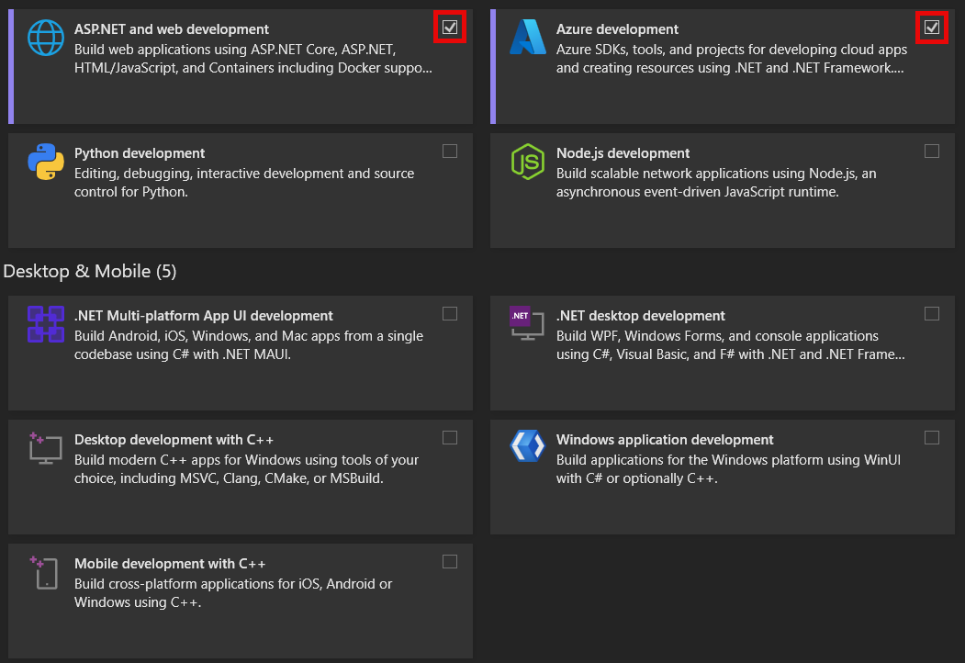
Development Tools & Environment
Visual Studio 2022 Install Selection

Slide 27
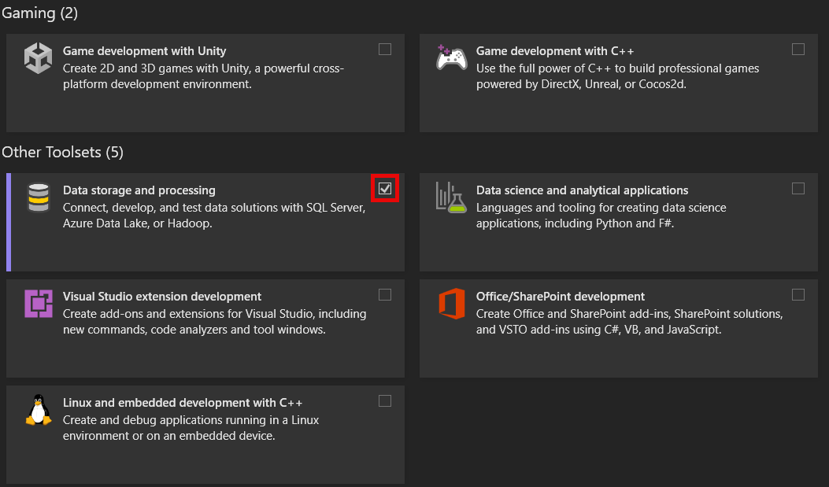
Development Tools & Environment
Visual Studio 2022 Install Selection

Slide 28
Development Tools & Environment

Slide 29
Class Overview – FAQ
How much time do students dedicate to their assignments?
The median student spends between 15 to 20 hours on each assignment.
What do you submit?
Details in each assignment
Don't submit the binary
Include what you did in your projectnotes.txt
Did you get stuck
Did you do extra credit
What didn't you do

Slide 30
Class Overview – FAQ
What assistance is available for students unfamiliar with the technology stack
Several sections include lectures on C# and .NET
Weekly instructor office hours
Sample is code provided
In every lecture pack
Instructor Office Hours & Section supplemental content
Async Q&A regarding lectures and assignments
Take place on Microsoft Teams

Slide 31
Class Overview – FAQ What assistance is available for students unfamiliar with the technology stack ..
Microsoft Teams Assignment Channel
Post your question in the assignment channel
Don't use email
Don't include your full assignment
Do include context
Challenge you are facing
Error messages
What you have tried so far
Other students and TAs can help you

Slide 32
Class Overview – FAQ What assistance is available for students unfamiliar with the technology stack ..
Limited availability for TA 1:1 sessions
Request to your grading TA or Jonathan Franck
To schedule a time that works for you both
Need 2-3 days notice
½ Hour session
First come first serve
TA's schedule may be full
Alternatives
Microsoft Teams async Q&A
Section
Instructor office hours

Slide 33
Class Overview – FAQ
How long before my assignment is graded
It depends, typically, 2 weeks
Make sure your service is working in Azure
TAs will try to restart it, once
If they can't get it working, they will reach out
Respond in 24 hours or less
How do I check on the status of my assignment's grade
Check canvas grading, grades are posted there
Reach out to your grading TA via Microsoft Teams

Slide 34


Class Overview – FAQ
Can I use … |  |  | Support Available
macOS |  | Yes | Yes
Linux |  | Yes | No
Windows 11, 10 |  | Yes | Yes
Windows 7, 8, 8.1 |  | No | No
Visual Studio for Mac |  | No | No
Visual Studio Code |  | Yes Required for Bicep | Yes
Visual Studio 2022 |  | Yes | Yes
JetBrains Rider |  | Yes | No

Slide 35
Class Overview – FAQ
Mac Tip
To run Windows on a Mac
Use: Parallels or VMWare Fusion or Bootcamp
We recommend Parallels if using a Mac
Academic version available for $39.95
http://www.onthehub.com/parallels/
JetBrains Rider License
They offer a free license
See Free Educational Licenses

Slide 36
Class Overview – FAQ
Do I need an Azure account
Yes – See welcome letter for instructions
I already have an Azure account can I use it?
No
We need to have full admin rights to your account
Can I add to my existing Azure account
No, Use a new Microsoft account
Don’t use any special characters in email address
Keep email address small and simple
See: https://account.microsoft.com/account
Use a Private / Incognito tab to do so

Slide 37
Class Overview – FAQ
Will I be charged for my Azure account?
When using academic subscription
No
What happens when I exceed my limit
You will be unable to access paid resources
We won't be able to grade your assignment
Use free resources whenever possible
If I want to pay how much will it cost me?
Depends on usage
Billed monthly

Slide 38
Class Overview – FAQ
Can I use the Azure simulator?
Sometimes
For available services during your development
Not all Azure services have simulations
Must deploy finished solution to Azure cloud
Grading is against your Azure cloud deployment
Recommendation
Use Azure Cloud and remote debugging

Slide 39
Class Overview

