Slide 1
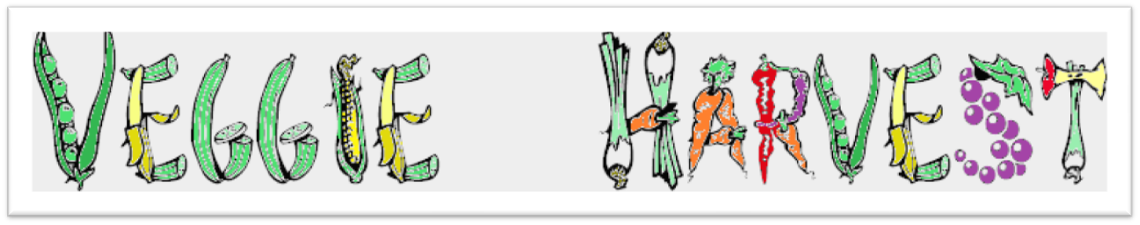
Eric Faust
Todd Dobbs
Joseph Blair
Christine Talbot

Slide 2
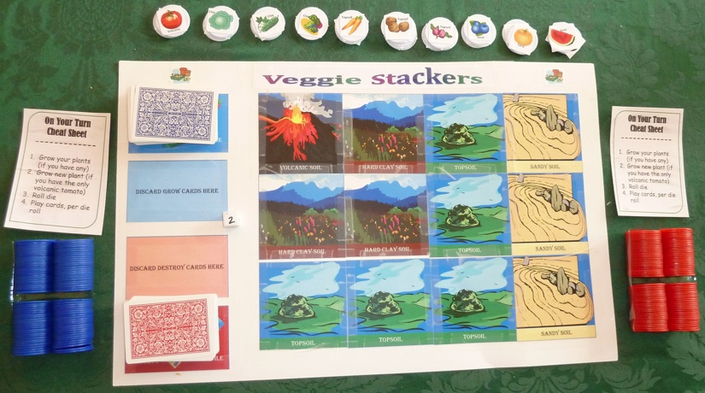
The Board Game
Turn Based
Dice-rolls
Draw cards
Place poker chips

Slide 3
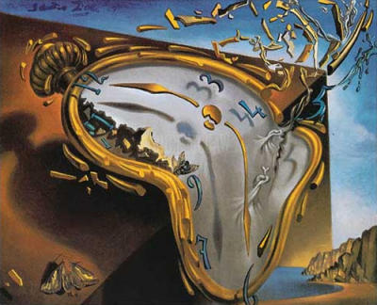
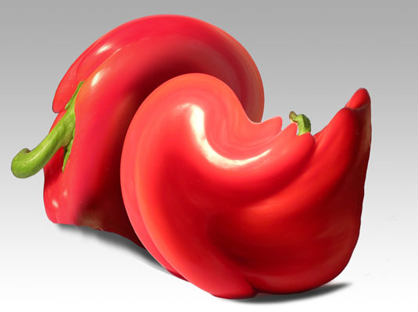
Design Changes
“Not be a board game anymore”
Players won’t read, will just start playing
Keep player busy/active/engaged

Slide 4
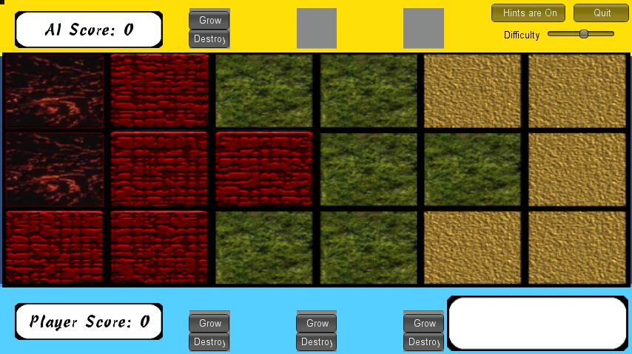
The Changes
Real Time
Player vs AI
Board
Dimensions
Slot choices vs Card Decks

Slide 5
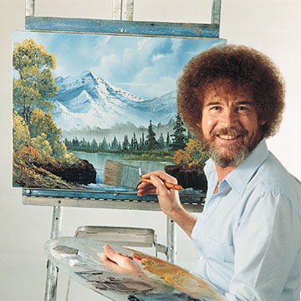
R.O.S.S.

Slide 6
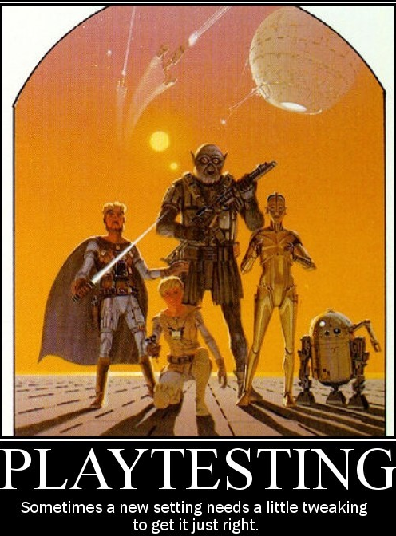
Playtesting
Make it faster
Faster learning
Colors

Slide 7



The Goal
To grow the most Veggies on the board before the board is full.

Slide 8
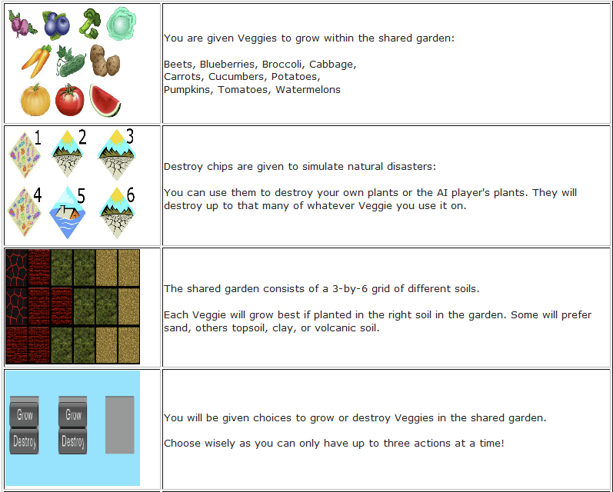
The Play Pieces

Slide 9
The Play Field

Slide 10
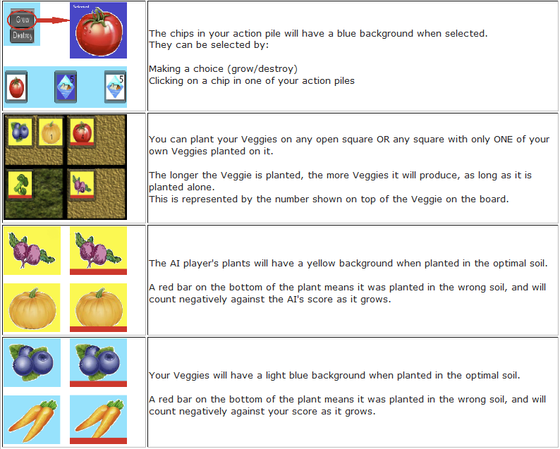
Player Choices

Slide 11
Restrictions

Slide 12
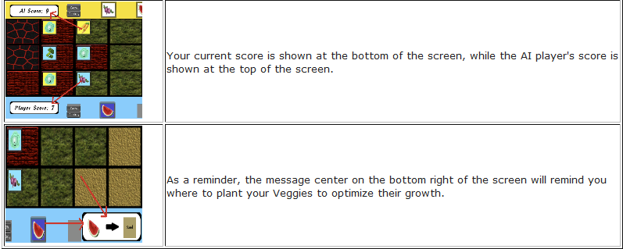
HUD Elements

Slide 13
DEMO

Slide 14
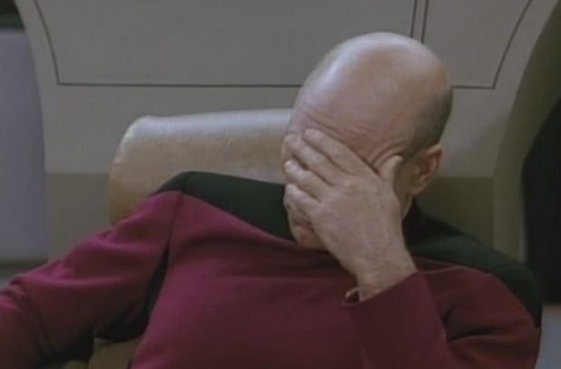
Issues
Making it look good
Turn-based to Real-time
Concurrency
Controller

Slide 15
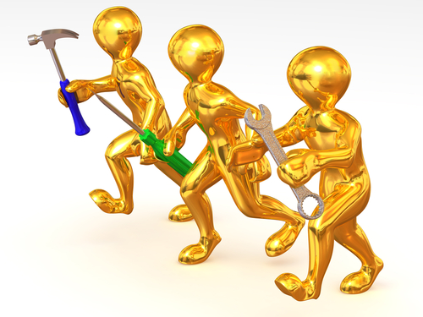
Tools
Unity Engine
jQuery
GIMP
MS Paint
Mp3mymp3
TortoiseHg
Camtasia (Demo video)

Slide 16
Contributions
Executive Producer: Christine Talbot
  Schedules, AI
Producer: Joseph Blair
  Board
Lead Game Developer: Todd Dobbs
  Game State, Controller
Lead Media Developer: Eric Faust
  Pictures, Sounds, Presentation, Timers

