Slide 1

KIDS ROUTINES

Slide 2

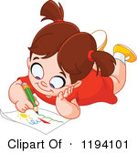



drawing pictures

Slide 3



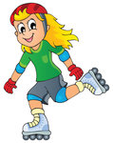
rollerblading
riding a scooter

Slide 4







scuba diving

Slide 5
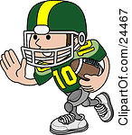

driving a car race
playing football

Slide 6

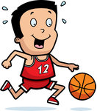

playing basketball

Slide 7


