Slide 1
Calibration and Sensivity Analysis for HPLC

Slide 2
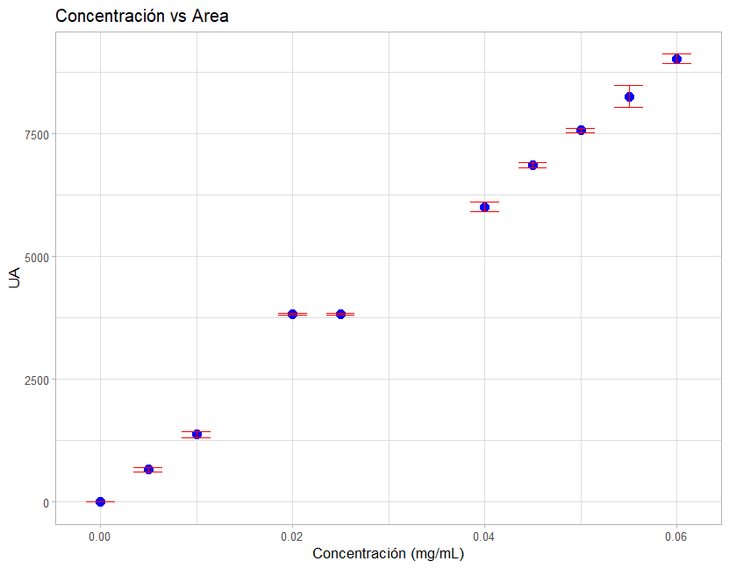
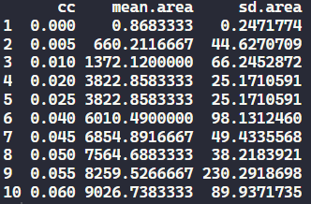
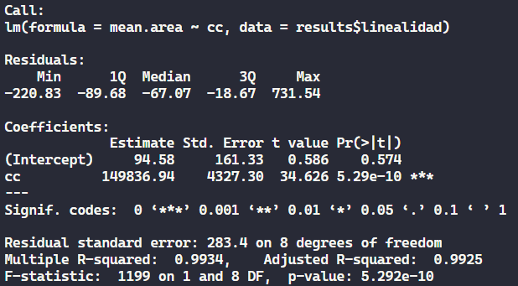
Calibration line
Same mean and SD?
!
y = 94.58 + 149836.94x
R^2 = 0.9925

Slide 3
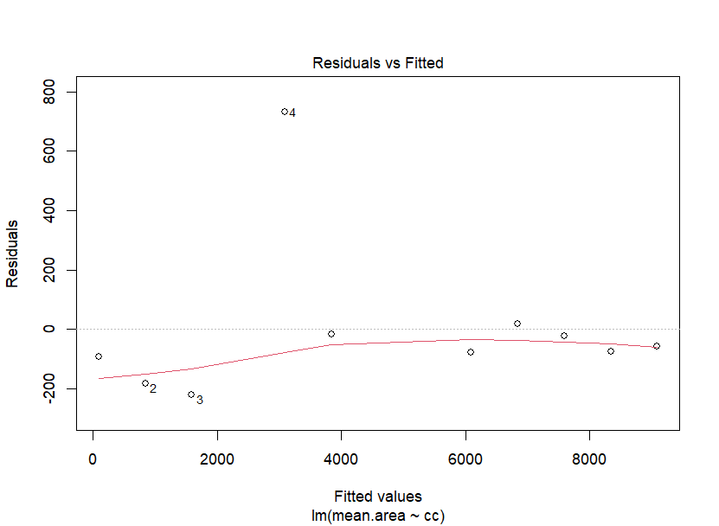
Calibration line – Residual analysis
!

Slide 4
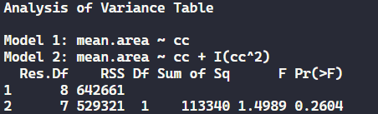

Calibration line – Mandel’s Test
Testing linearity (ANOVA linear model vs quadratic model)
H0: Model 2 does not significantly improve adjustment
P > 0.05 → No rejection to H0
Linear model

Slide 5
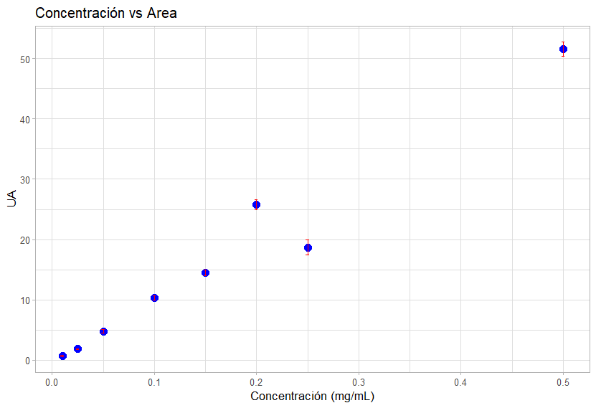
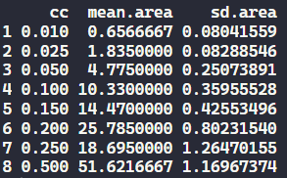
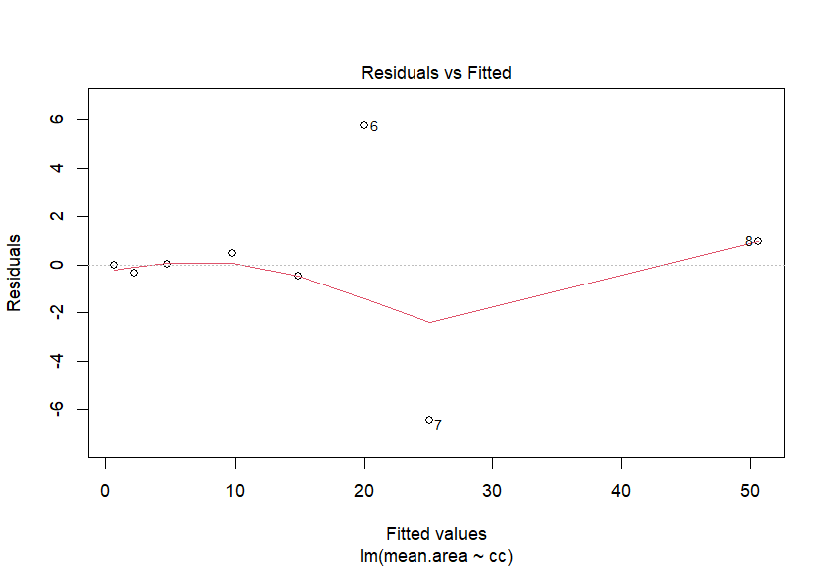
Sensivity Analysis
!
!

Slide 6
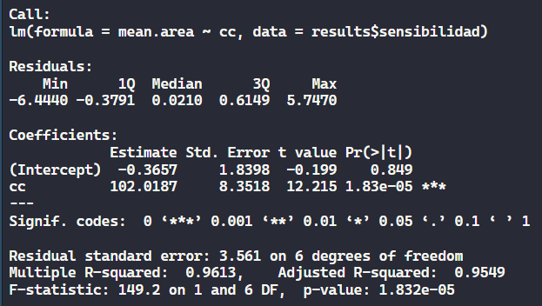
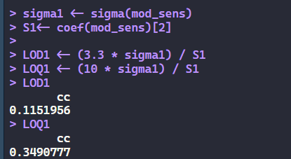
Sensivity Analysis – Estimation LOD & LOQ
A. Considering all datapoints
Model
Calculation
*
LOD = 0.1152
LOQ = 0.3491
* σ estimated from the standard deviation of the curve
Notes:
How to Calculate LOD and LOQ from Regression Data
Here σ is the standard deviation of the response and S is the slope of the calibration curve. S is estimated from the slope of the calibration curve for the analyte. σ can be determined in one of two ways:
Based on the standard deviation of the blank, where blank samples are run and the standard deviation is determined; this is equivalent to the standard deviation of the noise (or root-mean-square, RMS, of the noise).
From the standard deviation of the calibration curve that contains samples in the range of the LOQ; this can be measured as the standard error of the calibration curve or the standard deviation of the y-intercept.
https://www.sepscience.com/hplc-solutions-126-chromatographic-measurements-part-5-determining-lod-and-loq-based-on-the-calibration-curve-6959

Slide 7
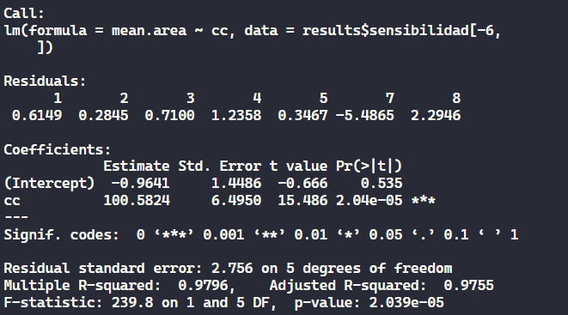
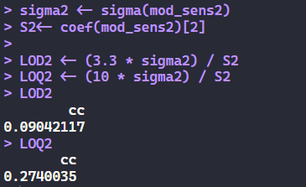
Sensivity Analysis – Estimation LOD & LOQ
B. Omitting datapoint #6
Model
Calculation
*
LOD = 0.0904
LOQ = 0.2740
* σ estimated from the standard deviation of the curve
Notes:
How to Calculate LOD and LOQ from Regression Data
Here σ is the standard deviation of the response and S is the slope of the calibration curve. S is estimated from the slope of the calibration curve for the analyte. σ can be determined in one of two ways:
Based on the standard deviation of the blank, where blank samples are run and the standard deviation is determined; this is equivalent to the standard deviation of the noise (or root-mean-square, RMS, of the noise).
From the standard deviation of the calibration curve that contains samples in the range of the LOQ; this can be measured as the standard error of the calibration curve or the standard deviation of the y-intercept.
https://www.sepscience.com/hplc-solutions-126-chromatographic-measurements-part-5-determining-lod-and-loq-based-on-the-calibration-curve-6959

Slide 8
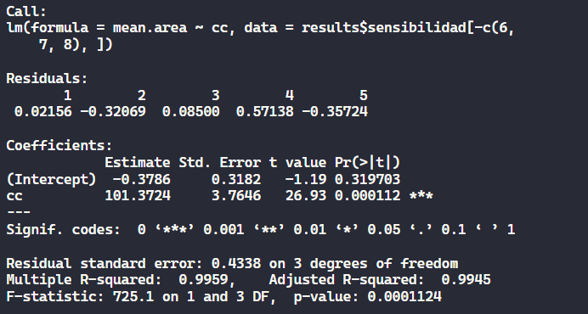
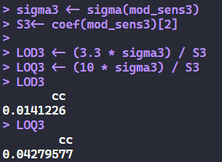
Sensivity Analysis – Estimation LOD & LOQ
C. Omitting datapoints #6, #7, #8
Model
Calculation
*
LOD = 0.0141
LOQ = 0.0428
* σ estimated from the standard deviation of the curve
Notes:
How to Calculate LOD and LOQ from Regression Data
Here σ is the standard deviation of the response and S is the slope of the calibration curve. S is estimated from the slope of the calibration curve for the analyte. σ can be determined in one of two ways:
Based on the standard deviation of the blank, where blank samples are run and the standard deviation is determined; this is equivalent to the standard deviation of the noise (or root-mean-square, RMS, of the noise).
From the standard deviation of the calibration curve that contains samples in the range of the LOQ; this can be measured as the standard error of the calibration curve or the standard deviation of the y-intercept.
https://www.sepscience.com/hplc-solutions-126-chromatographic-measurements-part-5-determining-lod-and-loq-based-on-the-calibration-curve-6959

