Slide 1

Hide and Seek Through Multi-Agent Reinforcement Learning
Team 6:
Ryan Lee, Chris Mullins, Cole Ragone, Chris Ullestad

Slide 2
What is Reinforcement Learning?
Involves 3 critical elements:
Agent – Learning entity that takes actions to maximize reward
Environment – System where agent interacts
Reward – The feedback to the agent (can be +, -, or 0)
Allows agents in AI to learn and improve skills based on trial and error

Slide 3
What is Multi-Agent Interaction?
Behavior exploration involving multiple agents in a simulated environment
Each has their own goals/actions
Run in parallelized code to improve efficiency

Slide 4
Problem Statement
How can AI help improve video game computer characters, past simple patterns?
How would the implementation of Multi-Agent RL change how video games are made?

Slide 5
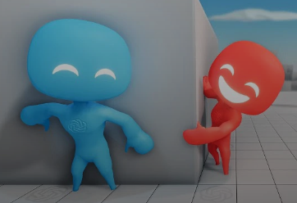
OpenAI Multi-Agent Hide and Seek
Agents play a team-based hide-and-seek game in an environment with movable and immovable objects.
Hiders (blue) avoid line-of-sight from seekers (red), and seekers maintain vision of the hiders.
Hiders and seekers can grab and lock objects in place, and agents must navigate randomly generated rooms and walls.
Hiders receive a reward of +1 if all hiders are hidden and -1 if any hider is seen by a seeker. Seekers receive the opposite reward.
Agents are penalized if they go too far outside the play area, and during the preparation phase, all agents are given zero reward.

Slide 6
OpenAI Multi-Agent Hide and Seek
Strengths:
Agents were able to learn on their own
Tasks and reward incentives were kept simple
Proof of concept of that RL can lead to human behavior
Weaknesses:
Time consuming as millions of simulations are required
Agents exploited faults in the environment
Better algorithms may be needed for more complicated tasks and environments

Slide 7
Demo
Refer to the webpage
https://openai.com/research/emergent-tool-use
https://reverie.herokuapp.com/arXiv_Demo/

Slide 8
Applications
Help better design video games to adhere to the players' skill level.
Allow players to replay video games with constantly improving and evolving "bosses"
Would allow for unique and differing game based on players choices
Would allow for unique and complex DLC (Downloadable Content)

