Slide 1
Experimental Research Methods Lecture 1

Slide 2
Introduction
Course coordinators and lecturers:
Robbie van Aert (R.C.M.vanAert@tilburguniversity.edu)
Caspar van Lissa (C.J.vanLissa@tilburguniversity.edu)
Goals of the course:
Experiments are used very frequently within psychology
How to analyze data obtained with an experiment?
The course teaches you how to analyze data of an experiment → bachelor’s/master’s thesis
And evaluate and interpret the results of other experiments
Organization of the course:
Lectures → explanation of material, connections between topics, theoretical background
Tutorials → discussion of homework, apply theory using assignments, tutorial test
Practicals → discussion of homework, apply theory using assignments in SPSS, individual practice

Slide 3
Introduction
All lectures (12), tutorials (4), and practicals (3) take place on campus and there is ample opportunity to ask questions
Lectures, tutorials, and practicals are not mandatory (but you are strongly advised to attend these!)
The tutorials end with a tutorial test:
Online administered via Canvas → bring a device
20 minutes for answering 8 questions
“Open book”, but preparation is needed
Participation is only possible when you are subscribed for the tutorial group
Inspection one week after all tutorials took place
If you want to pay for it ☹ you can buy SPSS here : https://www.surfspot.nl/spss
There are free alternatives:
PSPP looks and works almost identically: https://www.gnu.org/software/pspp/
JASP looks different, but is easier to use: https://jasp-stats.org/
Lectures, tutorials, and practicals will not be recorded, but one week before the exam recordings of the lectures of last year will be shared

Slide 4
Introduction
The written exam consists of 50 statements (true/false)
Your grade on the tutorial tests can have positive impact on your final grade:
If exam grade ≥ tutorial grade → final grade = exam grade
If exam grade < tutorial grade →
final grade = (2 × exam grade + tutorial grade)/3
Tutorial grade is the average grade of two tutorial tests where
The first test is not taken into account
The lowest grade of test 2, 3, and 4 is discarded
You successfully finish the course if:
Your final grade is at least a 6
You pass the SPSS-test

Slide 5
Introduction
Literature
Warner, R. M. (2021, 3rd edition). Applied statistics I: Basic Bivariate Techniques. Sage.
Warner, R. M. (2021, 3rd edition). Applied statistics II: Multivariable and Multivariate Techniques. Sage.
Heiman (2002, 3rd Edition). Research methods in psychology → Chapter 6
Some material is covered on my YouTube account: https://www.youtube.com/@CJvanLissa
Read the syllabus for more information about the course
We prefer to answer your questions during the lectures or in the breaks of the lectures
Practicing your skills is very important for this course! → Canvas Quizzes

Slide 6
Position ERM within M&S courses
These courses provide necessary basic knowledge and are part of the course material
Introduction to Research Methodology
Introduction to Statistics
Correlational Research Methods
Experimental Research Methods
Applied
Methods & Statistics

Slide 7
Overview lectures
L1: Summary material previous courses and its relation to ERM
L2: Power, effect size, and one-way ANOVA part I
L3: One-way ANOVA part II
L4: Contrasts part I
L5: Contrasts part II
L6: Two-way ANOVA part I
L7: Two-way ANOVA part II
L8: ANCOVA part I
L9: ANCOVA part II
L10: Repeated measures ANOVA
L11: Design
L12: Q&A lecture

Slide 8
Learning goals of L1
After this lecture and studying the materials, students can:
Interpret a frequency distribution
Interpret and calculate central tendencies (i.e., means) and measures of dispersion (i.e., variance)
Explain the logic behind hypothesis testing
Interpret the SPSS-output of a one-sample t-test and an independent samples t-test

Slide 9
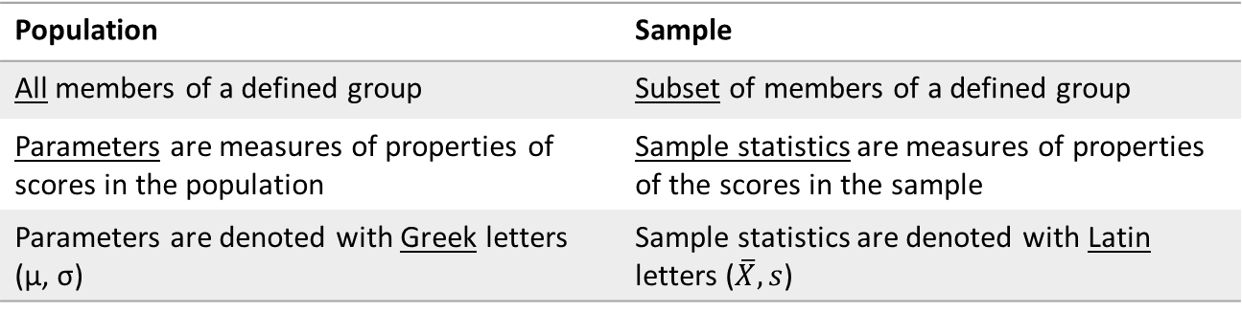
Descriptive statistics
Descriptive statistics = summarize data
Data = numerical information of a population or sample
Population | Sample
All members of a defined group | Subset of members of a defined group
Parameters are measures of properties of scores in the population | Sample statistics are measures of properties of the scores in the sample
Parameters are denoted with Greek letters (µ, σ) | Sample statistics are denoted with Latin letters ($\overline{X}, s$)

Slide 10
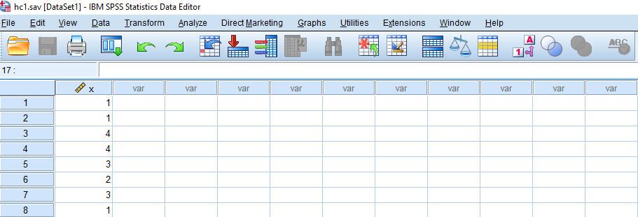
Descriptive statistics
Data from a sample:
1 1 4 4 3 2 3 1 2 1 3 4 4 3 3 4 4 3 1 4 4 4 4 3 4 4 2 3 1 3 4 1 3 4 4 4 2 4 2 4 3 3 1 1 4 3 4 1 3
Descriptive statistics help summarize the data → list of raw data is unclear
Two ways to summarize data:
With a distribution
With sample statistics

Slide 11
Distribution
Data summarized by grouping data with the same score
This can be done by using a frequency distribution or histogram
SPSS syntax to generate frequency distribution and histogram: (syntax is important in this course!):
FREQUENCIES VARIABLES=x /HISTOGRAM /ORDER= ANALYSIS .

Slide 12
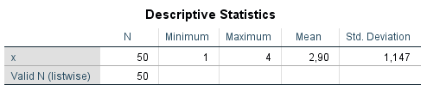
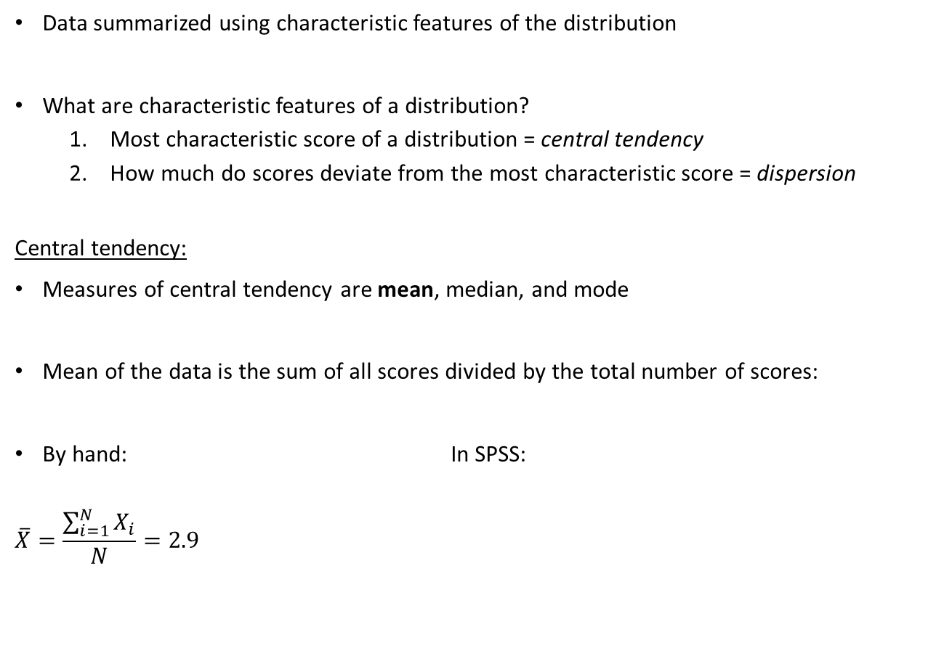
Sample statistics
Data summarized using characteristic features of the distribution
What are characteristic features of a distribution?
Most characteristic score of a distribution = central tendency
How much do scores deviate from the most characteristic score = dispersion
Central tendency:
Measures of central tendency are mean, median, and mode
Mean of the data is the sum of all scores divided by the total number of scores:
By hand: In SPSS:
$$\overline{X}=\frac{\sum_{i=1}^{N}{X_{i}}}{N}=2.9$$

Slide 13

Sample statistics
Dispersion:
Measures of dispersion are range, variance and the standard deviation
Variance of data is the sum of all squared deviation scores divided by the number of scores minus one:
By hand: In SPSS:
$s^{2}=\frac{SS}{N−1}=\frac{\sum_{i=1}^{N}{{{(X}_{i}−\overline{X})}^{2} }}{N−1}=$1.316
Standard deviation is the square root of the variance: $s= \sqrt{s^{2}}=1.147$

Slide 14
Inferential statistics
Descriptive statistics suffices if we have data of the entire population
However, almost always we only have data of a sample and not the population, because:
Too expensive
It takes too long to collect these data
Sometimes impossible
Using inferential statistics, we can draw conclusions about a population based on a sample
There are three “procedures” in inferential statistics:
Hypothesis testing
Point estimation
Interval estimation → confidence intervals
These procedures will be explained using the example on slide 10

Slide 15
Hypothesis testing
Question:
What is the mean of the population from which a sample of 50 cases was drawn?
In hypothesis testing, you examine whether the mean of the population is equal to a certain value or not → hypotheses are exclusive and exhaustive
Example: H₀: μ = 2.5 and H₁: μ ≠ 2.5
Here, we discuss a two-sided test (H₁ contains ≠), later we discuss a one-sided test (H₁ contains > of <)
You test whether you can reject H₀ or not. If you reject H₀, you conclude H₁, i.e. μ is not equal to 2.5
Rules of thumb for creating hypotheses:
H₀ contains “=“ → always the case
H₁ contains expectations of researcher → often, but not always the case

Slide 16
Steps in hypothesis testing
Step 1: Formulate hypotheses H₀: μ = 2.5 and H₁: μ ≠ 2.5
Step 2: Determine decision rule to decide when a result is statistically significant → p ≤ α
Step 3: Determine p-value based on SPSS output
Step 4: Decision on significance and conclusion
Apply to our example: Syntax
T-TEST /TESTVAL=2.5 /MISSING=ANALYSIS /VARIABLES=x /CRITERIA=CIN (.95) .
Output

Slide 17
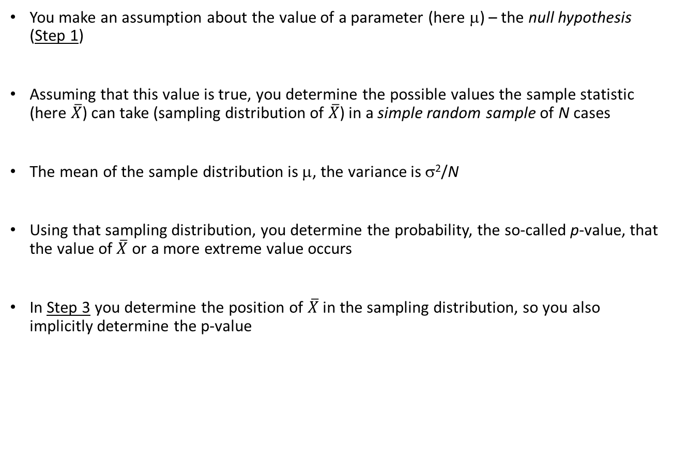
Logic hypothesis testing
You make an assumption about the value of a parameter (here μ) – the null hypothesis (Step 1)
Assuming that this value is true, you determine the possible values the sample statistic (here $\overline{X}$) can take (sampling distribution of $\overline{X}$) in a simple random sample of N cases
The mean of the sample distribution is μ, the variance is σ²/N
Using that sampling distribution, you determine the probability, the so-called p-value, that the value of $\overline{X}$ or a more extreme value occurs
In Step 3 you determine the position of $\overline{X}$ in the sampling distribution, so you also implicitly determine the p-value

Slide 18
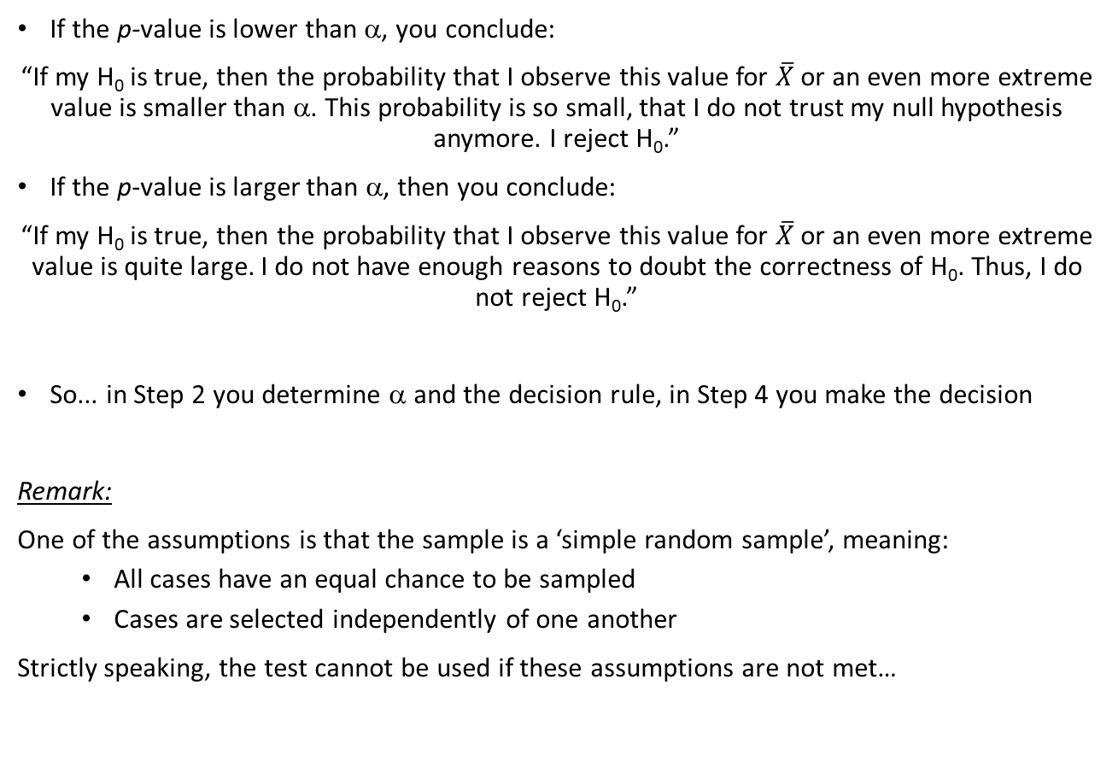
Logic hypothesis testing
If the p-value is lower than α, you conclude:
“If my H₀ is true, then the probability that I observe this value for $\overline{X}$ or an even more extreme value is smaller than α. This probability is so small, that I do not trust my null hypothesis anymore. I reject H₀.”
If the p-value is larger than α, then you conclude:
“If my H₀ is true, then the probability that I observe this value for $\overline{X}$ or an even more extreme value is quite large. I do not have enough reasons to doubt the correctness of H₀. Thus, I do not reject H₀.”
So... in Step 2 you determine α and the decision rule, in Step 4 you make the decision
Remark:
One of the assumptions is that the sample is a ‘simple random sample’, meaning:
All cases have an equal chance to be sampled
Cases are selected independently of one another
Strictly speaking, the test cannot be used if these assumptions are not met…

Slide 19

One-sided vs. two-sided testing
Logic for one-sided and two-sided testing is the same
However, SPSS output is always two-sided, so...
convert two-sided “Sig.” in SPSS output to the correct (one-sided) p-value
We can use the super slide on the next slide for this

Slide 20
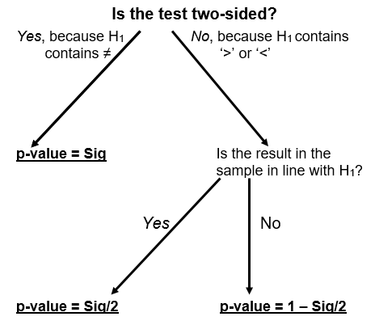
Manual interpretation ‘Sig.’ in SPSS output
In all cases below, the following decision rule holds:
“If p-value ≤ α, reject H₀”

Slide 21

Point estimation
Point estimation is used to answer the following question:
“What is the best guess of this parameter?”
So… which values lies closest to the population value
In the case of the mean µ, the best guess is $\overline{X}$
In the case of the variance $σ^{2}$, the best guess is $s^{2}$

Slide 22

Interval estimation
With confidence intervals, you answer the following question:
“What is the interval in which the value of the parameter lies with …% confidence?”
A 95% confidence interval for μ:
“In 95% of the times I draw a sample of N = 50, the confidence interval will contain μ”
Formula confidence interval: $\overline{X}±t_{cv}×s/\sqrt{N}$
Applied to our example:

Slide 23

Relation confidence intervals and testing
You can use confidence intervals to test two-sided hypotheses:
Decision rule: Two-sided test with significance level α
If $μ_{H_{0}}$ falls in the CI_{(1–α)×100%}, you cannot reject H₀ in favour of a two-sided alternative
If $μ_{H_{0}}$ does not fall in the CI_{(1–α)×100%}, you can reject H₀ in favour of a two-sided alternative

Slide 24

Why does this decision rule work?
Assume H₀ is true (= starting point hypothesis test!):
95% of all possible samples will produce a CI₉₅ in which $μ_{H_{0}}$falls (correctly not rejecting H₀)
5% of all possible samples will produce a CI₉₅ in which $μ_{H_{0}}$ does not fall (incorrectly rejecting H₀ = Type I error)
Alternative interpretation CI in relation with hypothesis testing:
“The CI₉₅ gives all possible hypothetical values for μ that are not rejected by the sample statistics (given α)”

Slide 25
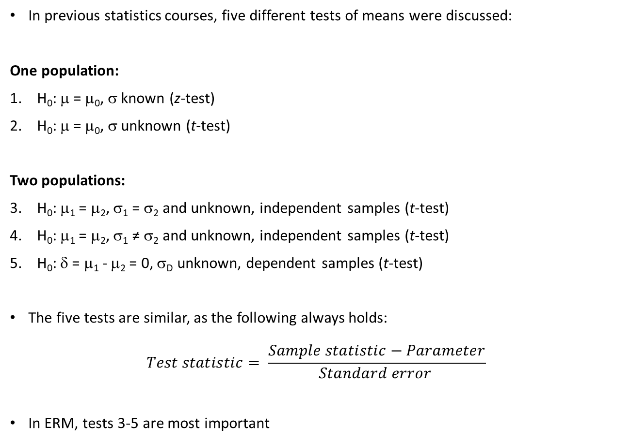
Testing means
In previous statistics courses, five different tests of means were discussed:
One population:
H₀: μ = μ₀, σ known (z-test)
H₀: μ = μ₀, σ unknown (t-test)
Two populations:
H₀: μ₁ = μ₂, σ₁ = σ₂ and unknown, independent samples (t-test)
H₀: μ₁ = μ₂, σ₁ ≠ σ₂ and unknown, independent samples (t-test)
H₀: δ = μ₁ - μ₂ = 0, σ_{D} unknown, dependent samples (t-test)
The five tests are similar, as the following always holds:
$$Test statistic= \frac{Sample statistic−Parameter}{Standard error }$$
In ERM, tests 3-5 are most important

Slide 26
Example test two independent samples
Example from “Survival Manual” from Pallant (Chapter 17)
Research question:
On average, do male and female students differ in their self-esteem?
Step 1: Formulate hypotheses: H₀: μ_{F} = μ_{M} and H₁: μ_{F} ≠ μ_{M}
Step 2: When is a result significant? → p ≤ α = 0.05
Step 3: Determine p-value based on SPSS output

Slide 27
Example test two independent samples
Step 3: Determine p-value based on SPSS output
Always interpret Levene’s test in contrast to Warner’s recommendation (book I, p. 333)
Step 4: Decision on significance and conclusion:
p = 0,105 > 0,05, so H₀ cannot be rejected:
“Average self-esteem does not differ between male and female students”

Slide 28
Exercise
Research question:
On average, are female students less introvert than male students?
Step 1: Formulate hypotheses: H₀: μ_{F} ≥ μ_{M} and H₁: μ_{F} < μ_{M}
Step 2: When is a result significant? → p ≤ α = 0.05
Step 3: Determine p-value based on SPSS-output (hint: use slide 20)
Female
Male

Slide 29
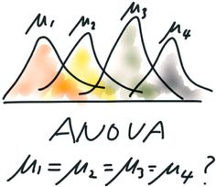
Next week…
Literature
Warner I: Chapters 4, 5.6-5.9, 6-8, 12
Power of a test
Effect size
Start of one-way analysis of variance (ANOVA)

