Slide 1
Experimental Research Methods Lecture 2

Slide 2
Learning goals of L2
Refresh your knowledge about statistical testing: https://youtu.be/-1J2Ge0B3Ro?si=iVOYnnCQlRxDji-5
After today’s lecture and studying the materials, students can:
Calculate the power of a z-test
See also: https://cjvanlissa.github.io/stats12/testing.html#power-of-a-test
Calculate effect sizes (i.e., Cohen’s d) based on SPSS output
Describe the terminology used in ANOVAs (i.e., factor, level, and condition)
Explain what the difference is between an “experiment-wise” and “test-wise” Type-I error

Slide 3
Power of a test
If we test, we want to draw the correct conclusion:
If H₀ is true, do not reject H₀
If H₁ is true, reject H₀
What is the probability for drawing the correct conclusion?
Say a researcher expects that having fewer police officers on the street will decrease safety
 | In reality
Test procedure: | H₀ true (#officers on street does not influence safety) | H₁ true (fewer officers on street decreases safety)
Rejecting H₀ | Type I error (α) | power (1−β)
Not rejecting H₀ | 1−α | Type II error (β)

Slide 4


Power of a test
The power of a test is the probability of correctly rejecting the null hypothesis if this is indeed the correct decision
Therefore, a highly powered test is preferred, as it implies a better probability to correctly reject the null hypothesis

Slide 5
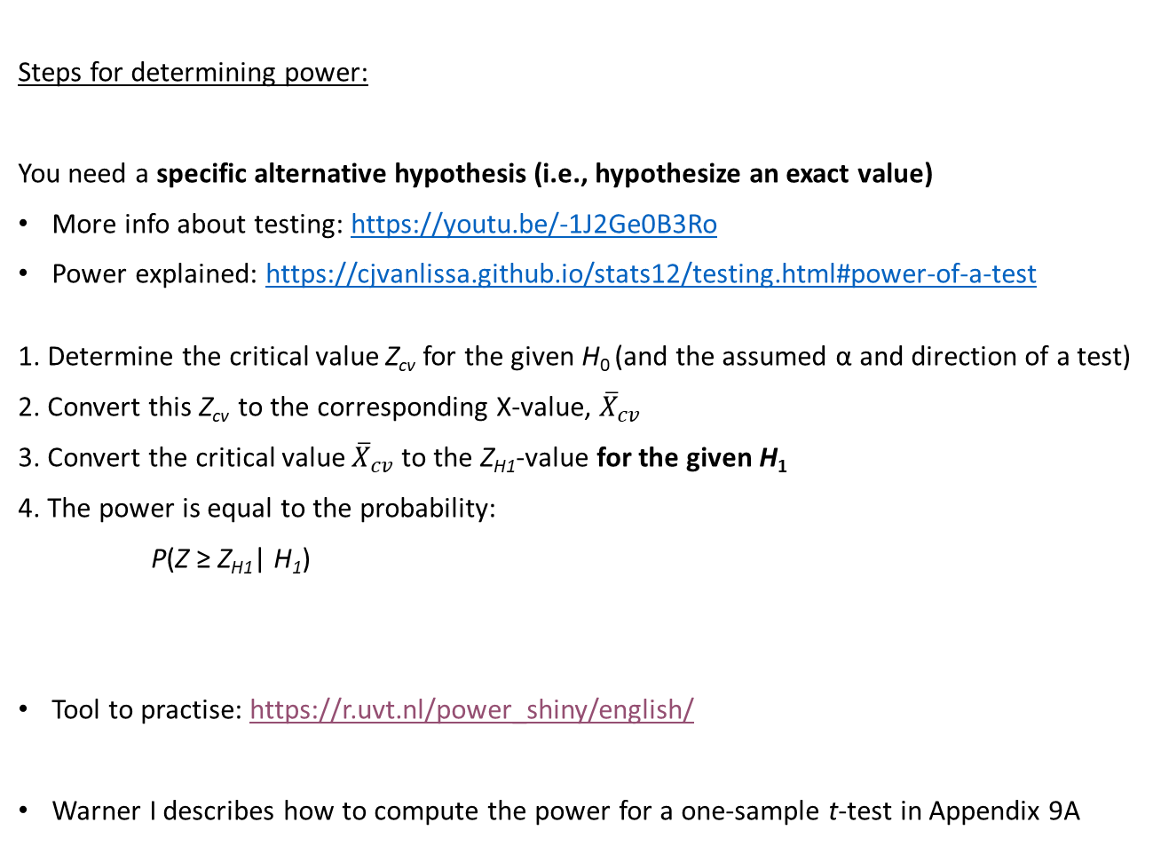
Determining power of a z-test
Steps for determining power:
You need a specific alternative hypothesis (i.e., hypothesize an exact value)
More info about testing: https://youtu.be/-1J2Ge0B3Ro
Power explained: https://cjvanlissa.github.io/stats12/testing.html#power-of-a-test
1. Determine the critical value Z_{cv} for the given H₀ (and the assumed α and direction of a test)
2. Convert this Z_{cv} to the corresponding X-value, ${\overline{X}}_{cv}$
3. Convert the critical value ${\overline{X}}_{cv}$ to the Z_{H1}-value for the given H₁
4. The power is equal to the probability:
P(Z ≥ Z_{H1}| H₁)
Tool to practise: https://r.uvt.nl/power_shiny/english/
Warner I describes how to compute the power for a one-sample t-test in Appendix 9A

Slide 6
Power of a test
Back to the start: we want to have the largest probability of making correct decisions
α small
Power (1-β) large
We determine α ourselves, how do we influence power?
Four factors that influence power:
α (when we conclude “we found something”)
N (how “long” we’re looking: if you check 10.000 participants, you’re more likely to find something than if you check 10 participants)
σ (how “noisy” the data are; more noise makes it harder to find an effect)
The ‘true μ’ in the alternative hypothesis (μ_{H1}) (bigger effects are easier to find)
Practice with calculating power in the first tutorial
Note: Often one question about calculating power on the exam

Slide 7

Effect size
When H₀ is rejected based on a hypothesis test, scientific claims get the label ‘significant’ (... hurray!)
But ‘significant’ does not mean that is has definitively been proven that there is a systematic effect (contrary to what some people make you want to believe). Why not?
And… significant does also not mean that the effect is practically/clinically relevant. Even very small – uninteresting – differences can be significant if you use a very big sample.
… because
If N is small, power is small, statistically not significant, even if effect is large
If N is big, power is large, statistically significant, even if effect is small
Figure Noun project: Adrien Cocquet

Slide 8
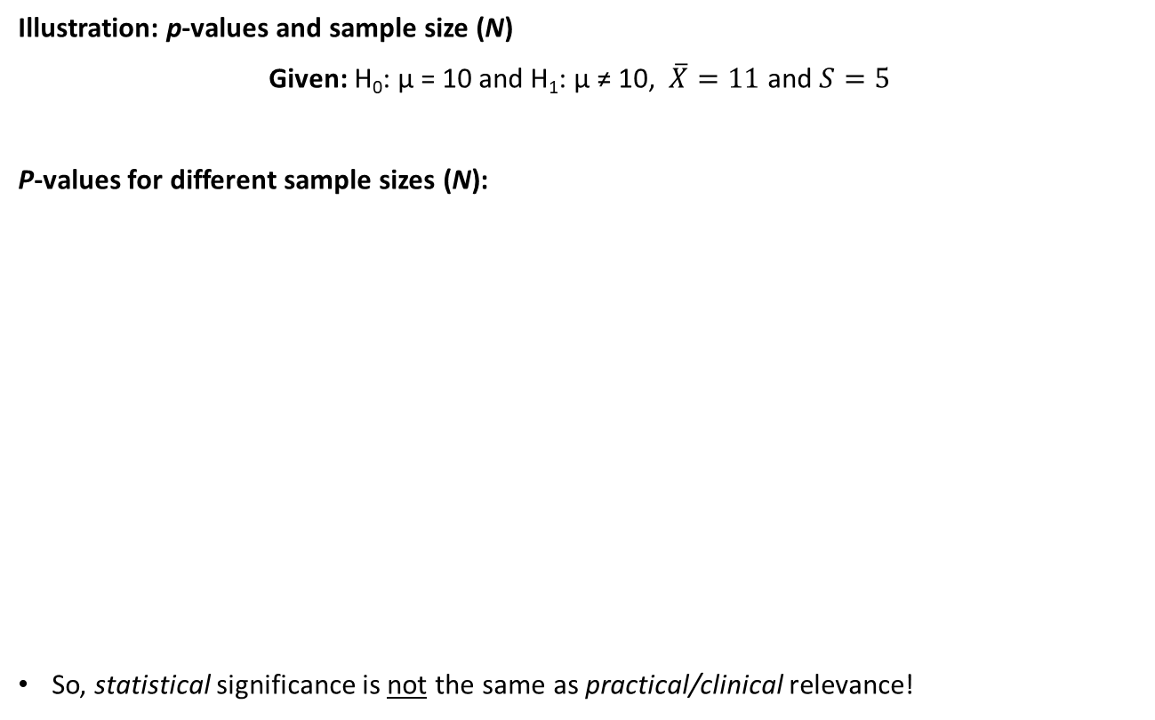
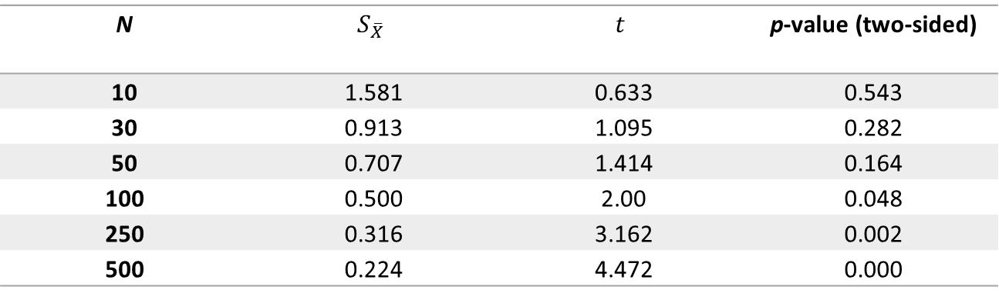
Effect size
Illustration: p-values and sample size (N)
Given: H₀: µ = 10 and H₁: µ ≠ 10, $\overline{X}=11$ and $S=5$
P-values for different sample sizes (N):
So, statistical significance is not the same as practical/clinical relevance!
N | $$S_{\overline{X}}$$ | $$t$$ | p-value (two-sided)
10 | 1.581 | 0.633 | 0.543
30 | 0.913 | 1.095 | 0.282
50 | 0.707 | 1.414 | 0.164
100 | 0.500 | 2.00 | 0.048
250 | 0.316 | 3.162 | 0.002
500 | 0.224 | 4.472 | 0.000

Slide 9
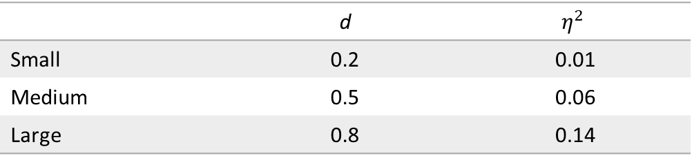
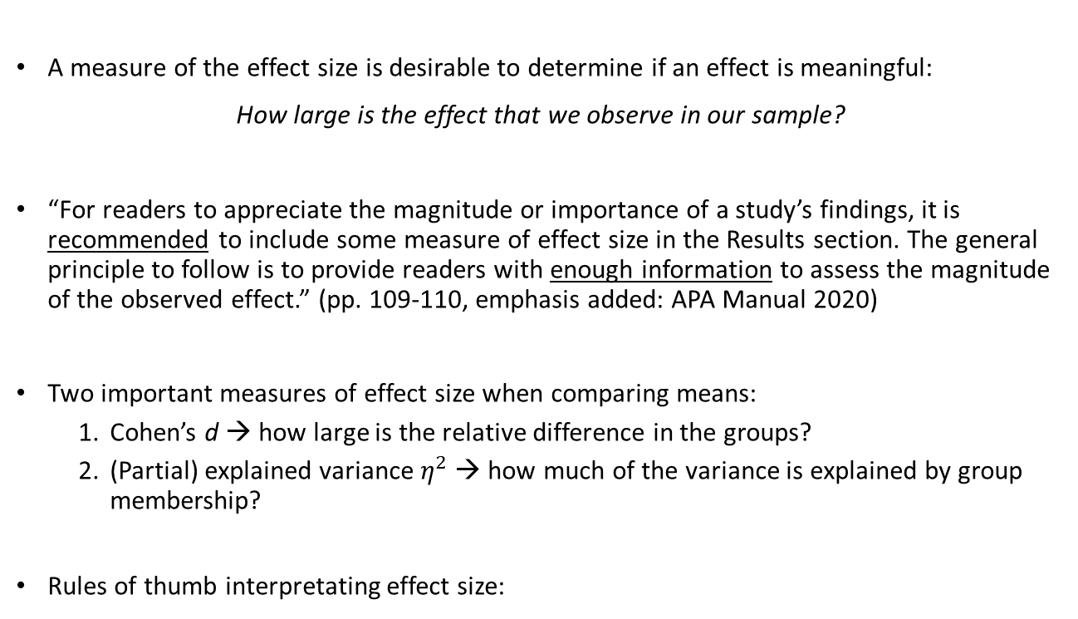
Effect size
A measure of the effect size is desirable to determine if an effect is meaningful:
How large is the effect that we observe in our sample?
“For readers to appreciate the magnitude or importance of a study’s findings, it is recommended to include some measure of effect size in the Results section. The general principle to follow is to provide readers with enough information to assess the magnitude of the observed effect.” (pp. 109-110, emphasis added: APA Manual 2020)
Two important measures of effect size when comparing means:
Cohen’s d → how large is the relative difference in the groups?
(Partial) explained variance $η^{2}$ → how much of the variance is explained by group membership?
Rules of thumb interpretating effect size:
 | d | $$η^{2}$$
Small | 0.2 | 0.01
Medium | 0.5 | 0.06
Large | 0.8 | 0.14

Slide 10
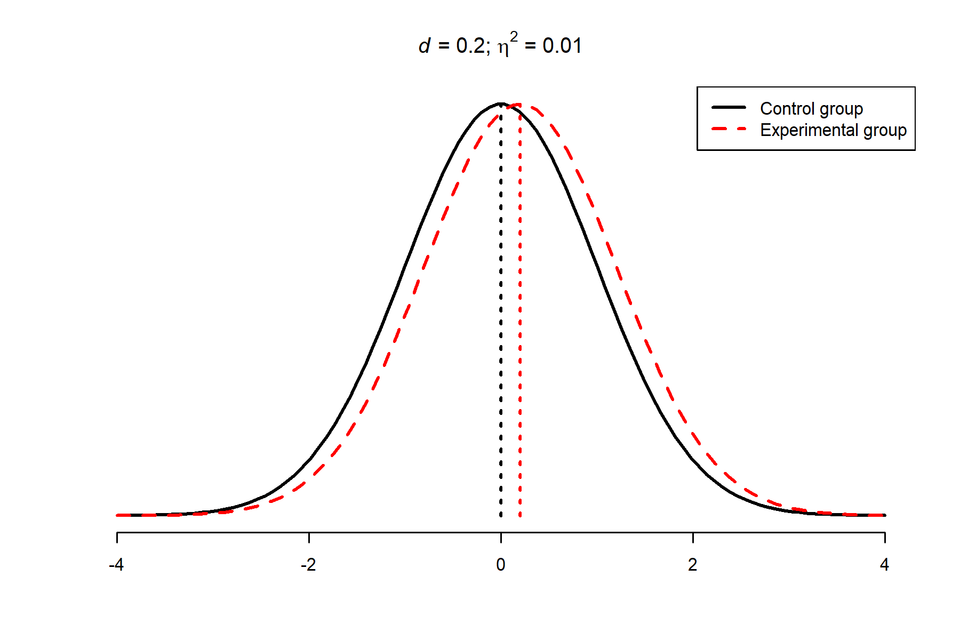
Effect size
Small effect:
58% of the experimental group scores higher than the average of the control group

Slide 11
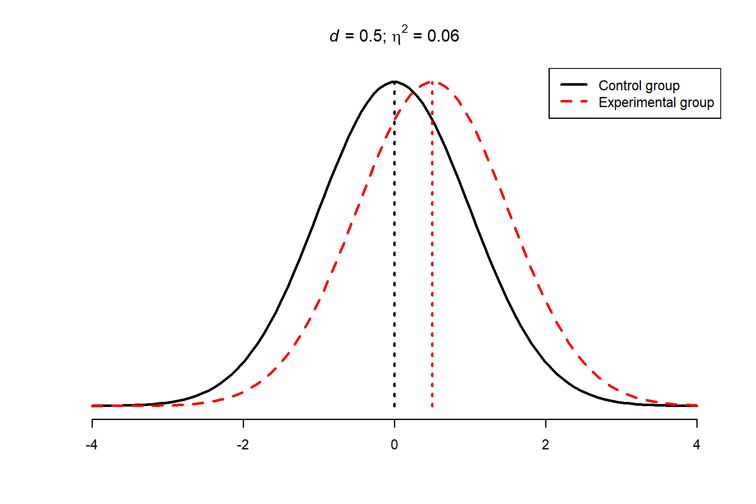
Effect size
Medium effect:
69% of the experimental group scores higher than the average of the control group

Slide 12
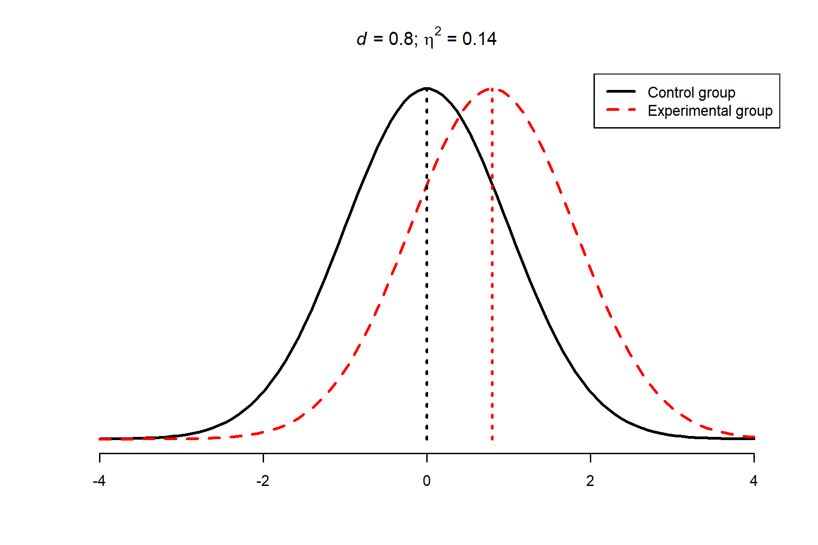
Effect size
Large effect:
79% of the experimental group scores higher than the average of the control group

Slide 13
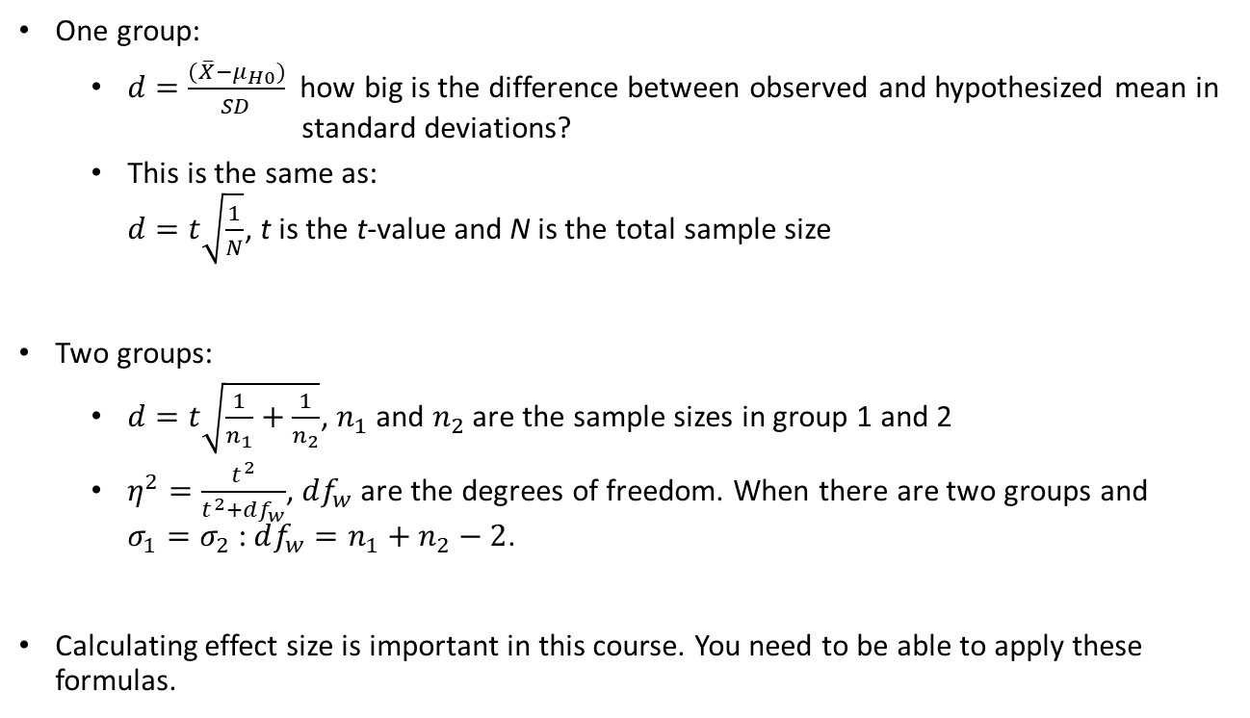
Formulas effect size
One group:
$d=\frac{(\overline{X}−μ_{H0})}{SD}$ how big is the difference between observed and hypothesized mean in standard deviations?
This is the same as: $d=t\sqrt{\frac{1}{N}}$, t is the t-value and N is the total sample size
Two groups:
$d=t\sqrt{\frac{1}{n_{1}}+\frac{1}{n_{2}}}$, $n_{1}$ and $n_{2}$ are the sample sizes in group 1 and 2
$η^{2}=\frac{t^{2}}{t^{2}+df_{w}}$, $df_{w}$ are the degrees of freedom. When there are two groups and $σ_{1}=σ_{2}$: $df_{w}=n_{1}+n_{2}−2$.
Calculating effect size is important in this course. You need to be able to apply these formulas.

Slide 14
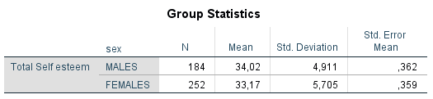
Exercise: Effect size
Apply the formulas to the example about difference in self-esteem between men and women

Slide 15
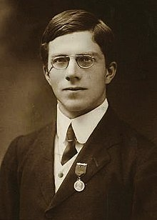
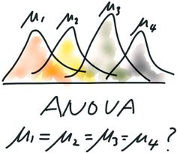
One-way analysis of variance (ANOVA)
ANOVA = ANalysis Of Variance
Originates from experimental research (Fisher’s The Design of Experiments)
Compare means across (experimental) groups (two or more!)
Independent samples t-test only compares two means whereas two or more means can be compared in ANOVA

Slide 16
Some terminology
Between-participants design: for each condition, we have an independent sample of persons (a.k.a. independent groups design)
Within-participants/repeated measures design: participants may be exposed to multiple conditions (repeated measures design)
Note: Compare with the independent samples t-test and the dependent/paired samples t-test
Or sometimes, combinations of between- and within-participants design (!)

Slide 17
Some terminology
The independent variables, which are categorical variables, are called factors. The categories of the factors are called levels. A design with multiple factors is called a factorial design. Each combination of levels is called a condition. E.g., in an experimental design with two factors with three levels each, we have a fully crossed factorial design with 3 x 3 = 9 conditions.
FACTORS
Treatment
 | Drug therapy | Diary | Control
18-35 years
36-60 years
60+ years
LEVELS
Age
CONDITION
LEVELS
Dependent variable: level of depression

Slide 18
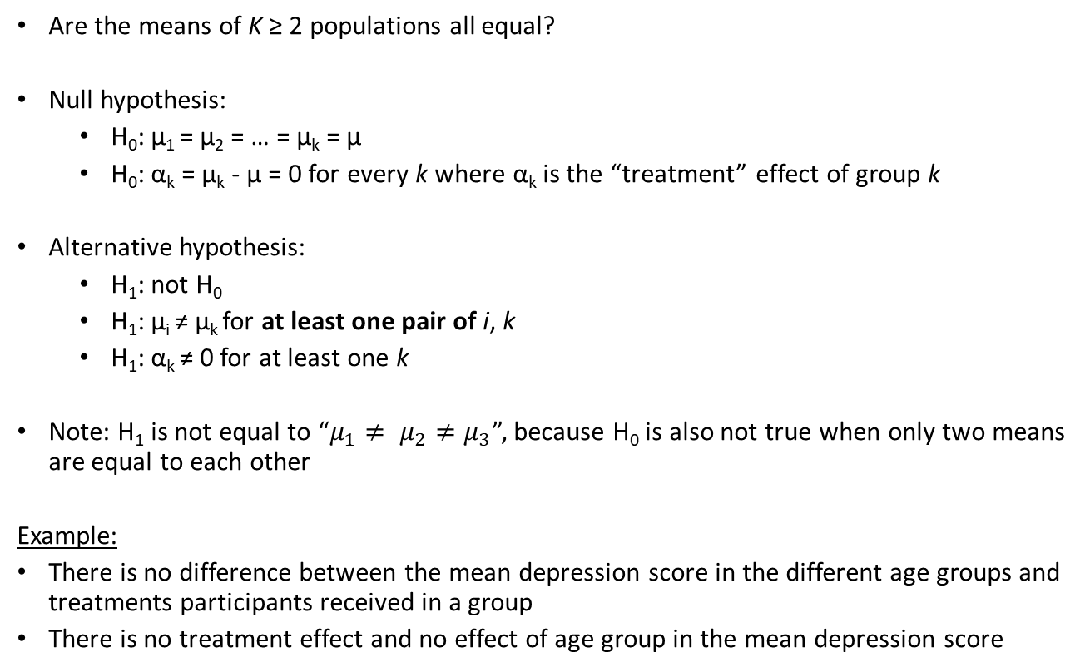
Hypothesis testing in ANOVA
Are the means of K ≥ 2 populations all equal?
Null hypothesis:
H₀: µ₁ = µ₂ = … = µ_{k} = µ
H₀: α_{k} = µ_{k} - µ = 0 for every k where α_{k} is the “treatment” effect of group k
Alternative hypothesis:
H₁: not H₀
H₁: µ_{i} ≠ µ_{k} for at least one pair of i, k
H₁: α_{k} ≠ 0 for at least one k
Note: H₁ is not equal to “$μ_{1}≠ μ_{2}≠μ_{3}$”, because H₀ is also not true when only two means are equal to each other
Example:
There is no difference between the mean depression score in the different age groups and treatments participants received in a group
There is no treatment effect and no effect of age group in the mean depression score

Slide 19
ANOVA in a non-experimental setting
ANOVA was developed to analyze experimental data, but can also be used for non-experimental data
Suppose, we want to compare the cognitive function of memory across three groups (e.g., being stressed out, burn-out, healthy)
Dependent variable = cognitive function of memory
Independent variable = groups that vary on stress levels
Question: How many t-tests are needed to compare all groups with each other?
Condition | Stressed out | Burn-out | Healthy
Group mean

Slide 20
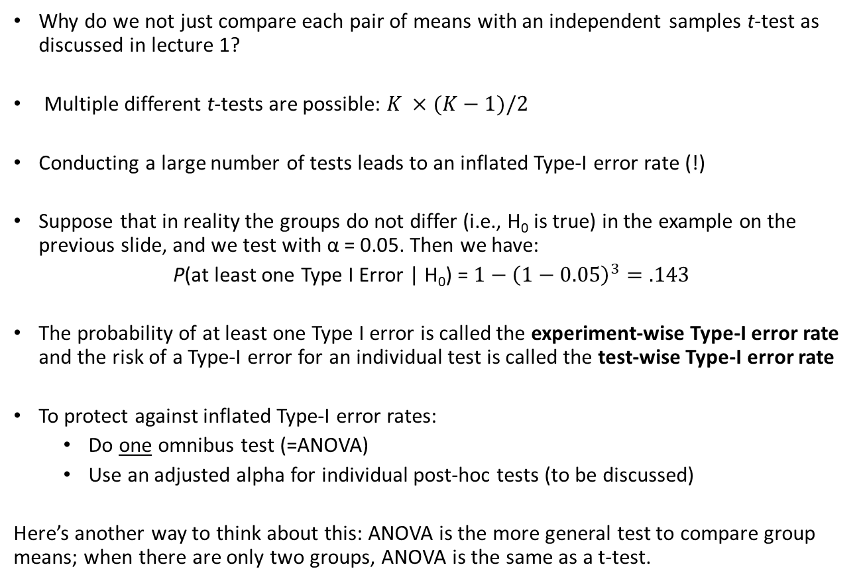
Why do we need ANOVA?
Why do we not just compare each pair of means with an independent samples t-test as discussed in lecture 1?
Multiple different t-tests are possible: $K ×(K−1)/2$
Conducting a large number of tests leads to an inflated Type-I error rate (!)
Suppose that in reality the groups do not differ (i.e., H₀ is true) in the example on the previous slide, and we test with α = 0.05. Then we have:
P(at least one Type I Error | H₀) = ${1−\left(1−0.05\right)}^{3}=.143$
The probability of at least one Type I error is called the experiment-wise Type-I error rate and the risk of a Type-I error for an individual test is called the test-wise Type-I error rate
To protect against inflated Type-I error rates:
Do one omnibus test (=ANOVA)
Use an adjusted alpha for individual post-hoc tests (to be discussed)
Here’s another way to think about this: ANOVA is the more general test to compare group means; when there are only two groups, ANOVA is the same as a t-test.

Slide 21
Logic ANOVA
We are not going to compare all individual means to each other
We need one measure of the degree to which all means differ from each other: dispersion of means
Solution: a measure for the dispersion of means is the variance of means (between-group variance)
So, to test whether the means differ from each other, we need to compute the variance of the means → hence the name analysis of variance
We compare variance between group means with variance within groups
Let’s illustrate this with some figures…

Slide 22
Logic ANOVA
Why do we call it “Analysis of Variance” when we are comparing group means?
We split the total variance: between groups and within groups, and we look at the distance BETWEEN groups compared to the distance WITHIN groups
https://utrecht-university.shinyapps.io/cj_anova/

Slide 23
Logic ANOVA
Split the total variance: Between groups and within groups
Group means = µ₁, µ₂, and µ₃

Slide 24
Logic ANOVA
Split the total variance: Between groups and within groups
Overall mean = grand mean = µ

Slide 25
Logic ANOVA
Differences BETWEEN groups:
Differences between the grand mean and group means (variation between groups) can be explained by group membership

Slide 26
Logic ANOVA
Differences WITHIN groups:
Differences between the observed scores and the group means (the variation in scores within each group) CANNOT be explained here

Slide 27
Summary logic ANOVA
Conducting multiple t-tests increases the experiment-wise Type-I error rate
By studying the variance of means we can draw conclusions about the dispersion of the group means
Participants in the same group receive the same treatment
Differences between participants are random and not related to the treatment
Variance within groups reflects random differences between participants
Participants in different groups receive different treatments
Differences between participants because they are different AND possibly differences in the treatment effect
Variance between groups reflects random differences between participants AND possibly difference in the treatment effect
A larger between than within groups variance is indicative for a treatment effect

Slide 28
Literature
Warner I: Chapters 9 and 13.1-13.3
Testing the null-hypothesis in ANOVA using a F-test
Interpreting the SPSS output of an ANOVA
Statistical power of ANOVA
Next week…

