Slide 1
Experimental Research Methods Lecture 3

Slide 2
Lecture goals lecture 3
Update: Tutorial exercises are now online, it’s important to complete these before the tutorial!
See module “Tutorials” on Canvas
After this lecture and studying the materials, students are able to:
Explain the statistical model of an ANOVA
Compute the F-statistic in an ANOVA
Draw conclusions about the hypothesis tested in an ANOVA using the F-distribution
Compute and interpret a measure of effect size in the context of an ANOVA

Slide 3





Fictitious (!) example: Students and grades
DV: Grade for Statistics exam IV: Performance enhancing substance:
Group 1: Ritalin Group 2: Energy drink Group 3: Chocolate Group 4: Nothing (control)

Slide 4
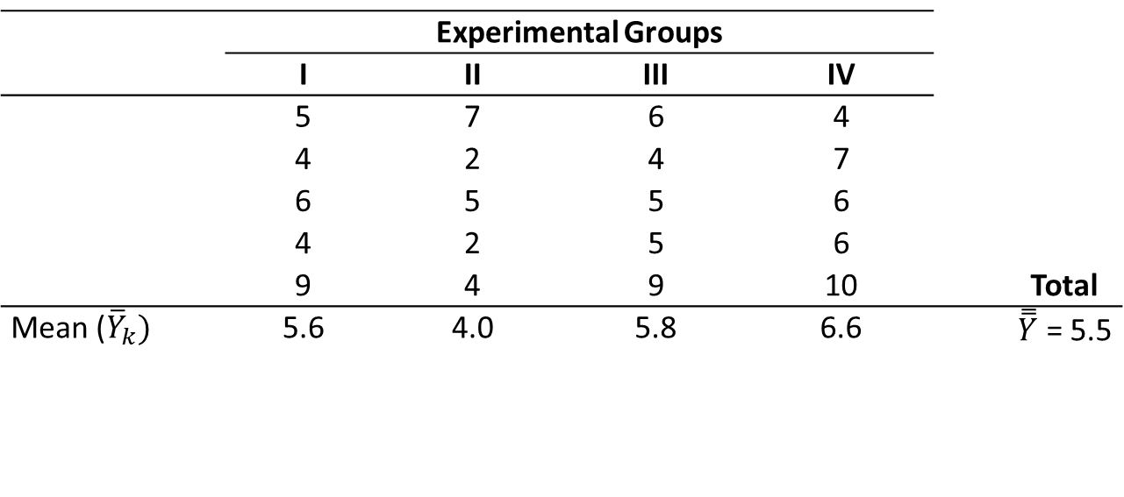
ANOVA: Numerical example
 | Experimental Groups
 | I | II | III | IV
 | 5 | 7 | 6 | 4
 | 4 | 2 | 4 | 7
 | 6 | 5 | 5 | 6
 | 4 | 2 | 5 | 6
 | 9 | 4 | 9 | 10 |  | Total
Mean (${\overline{Y}}_{k})$ | 5.6 | 4.0 | 5.8 | 6.6 |  | $\overset{̿}{Y}$ = 5.5
(${\overline{Y}}_{k}−{\overline{Y}}_{GM}$) | (+.1) | (-1.5) | (+.3) | (+1.1)
$SS_{w}$ | 17.2 | 18.0 | 14.8 | 19.2
$S_{w}^{2}$ | (4.3) | (4.5) | (3.7) | (4.8)
Two sources of variation in the table:
Mean differences between groups (“Systematic effect of groups?”)
Variation within groups: “residual”, “natural variation independent of group membership” → variation “due to collective effect of all other uncontrolled or extraneous variables”

Slide 5
Explained/unexplained variance
Note that residuals are also referred to as errors. Both terms are used interchangeably, but the word residual is more neutral
Y
G
Scores between persons vary:
partly because they were exposed to different (experimental) conditions (= explained part)
partly due to all other (unknown) influences (= residual/unexplained part)
People within the same group are exposed to the same condition → score variance within groups reflect variation to all other factors, and is independent of the group factor
Explained
Residual

Slide 6





ANOVA model
Example
10
12
17
Linear additive model:
We have K groups, indexed by k
In each group, we have $n_{k}$ persons indexed
by $i$, and $N$ in total
$Y_{ik} = μ +α_{k}+ ε_{ik}$
x
13
$Y_{15,3}$ = 19
We have 3 groups with 20 persons each
$K=3$
$n_{1}=20\text{; }n_{2}=20$; $n_{3}=20$;
$N=20+20+20=60$ (total sample size)
Score of person 15 in group 3 = $Y_{15,3}$ = 19
$Y_{15,3}=13+4 +2$ = 19
Actual score of person i in group k
Residual: how much person i in group k deviates from its group mean →
$$Y_{ik}−μ_{k}$$
Grand mean
Group effect: How much group k deviates from the grand mean →
$$μ_{k}−μ$$

Slide 7
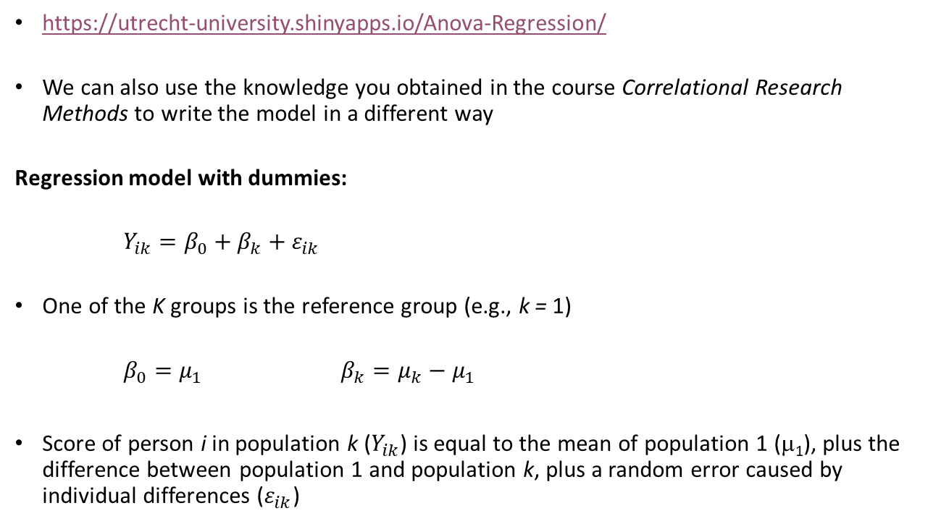
Intermezzo ANOVA model using regression
https://utrecht-university.shinyapps.io/Anova-Regression/
We can also use the knowledge you obtained in the course Correlational Research Methods to write the model in a different way
Regression model with dummies:
$Y_{ik}=β_{0}+β_{k}+ε_{ik}$
One of the K groups is the reference group (e.g., k = 1)
$β_{0}=μ_{1}$ $β_{k}={μ_{k}−μ}_{1}$
Score of person i in population k ($Y_{ik}$) is equal to the mean of population 1 (μ₁), plus the difference between population 1 and population k, plus a random error caused by individual differences ($ε_{ik}$)

Slide 8
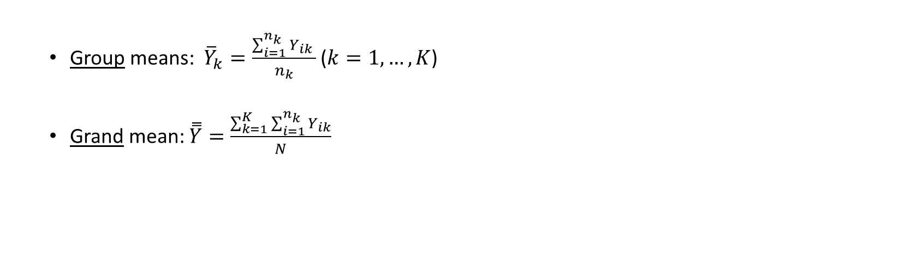
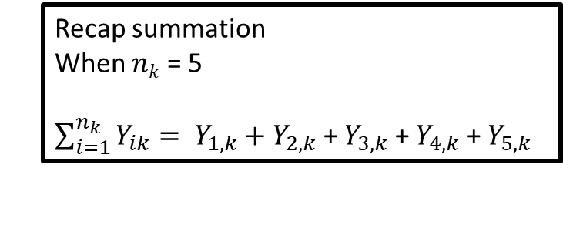
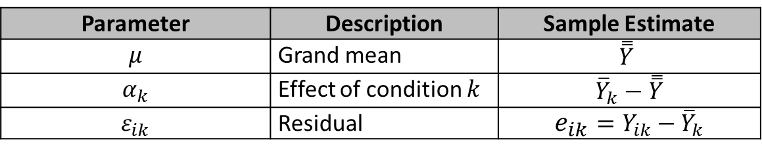
ANOVA model
Notice that $μ$, $α_{k}$, and $ε_{ik}$ are the parameters of the model and refer to the population. We use sample values to estimate the parameters (i.e., come up with the best guess)
Group means: ${\overline{Y}}_{k}=\frac{\sum_{i=1}^{n_{k}}{Y_{ik} }}{n_{k}}$ ($k=1,…,K$)
Grand mean: $\overset{̿}{Y}=\frac{\sum_{k=1}^{K}{\sum_{i=1}^{n_{k}}{Y_{ik}}}}{N}$
Recap summation
When $nk$ = 5
$\sum_{i=1}^{n_{k}}{Y_{ik}}= Y_{1,k}+Y_{2,k}$ + $Y_{3,k}$ + $Y_{4,k}$ + $Y_{5,k}$
Parameter | Description | Sample Estimate
$$μ$$ | Grand mean | $$\overset{̿}{Y}$$
$$α_{k}$$ | Effect of condition $k$ | $${\overline{Y}}_{k}−\overset{̿}{Y}$$
$$ε_{ik}$$ | Residual | $${e_{ik}=Y}_{ik}−{\overline{Y}}_{k}$$
Notes:
Even though the formula might look complicated, calculating a group mean is very straightforward. We calculate the mean of group i, by taking the score of the first person in the group, and adding the score of the second person group, adding the third person, …. All the way to the last person in group i. When all scores are added, we divide by all people in group i. We can do this for all groups in the ANOVA, so in our example we would end up with four group means. Then we can calculate the grand mean. This formula says that we take exactly the same approach as for calculating the group means (this part of the formula is identical), BUT we do this for ALL groups in the ANOVA, and we add all the scores together. In other words, we simply add the scores of ALL participants in the sample, and divide by the TOTAL number of people in the sample.
Difficult way to say that you take the mean of all the scores in one group; or the mean of all scores (of all groups)

Slide 9
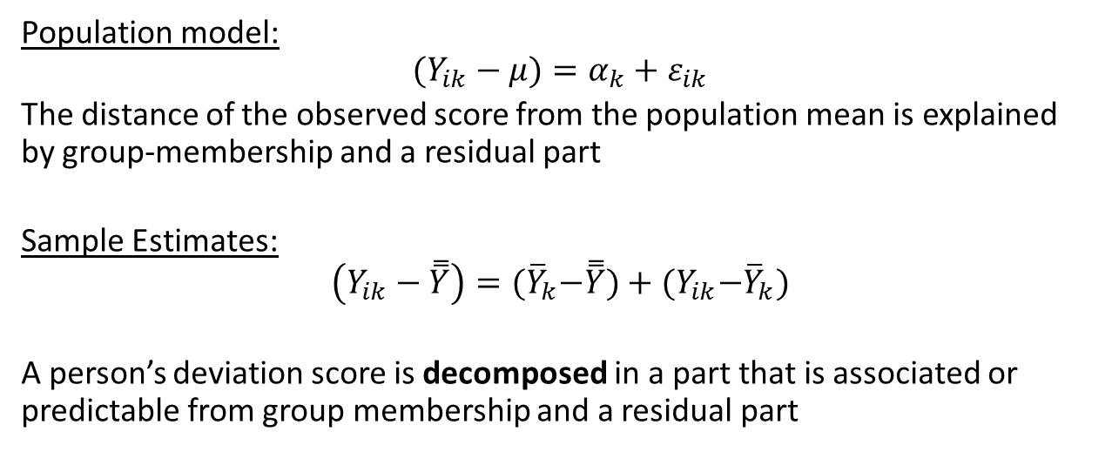
Linear additive model in deviation scores
Population model:
$$(Y_{ik}−μ)=α_{k}+ε_{ik}$$
The distance of the observed score from the population mean is explained by group-membership and a residual part
Sample Estimates:
$$\left(Y_{ik}−\overset{̿}{Y}\right)={(\overline{Y}}_{k}−\overset{̿}{Y})+{(Y}_{ik}−{\overline{Y}}_{k})$$
A person’s deviation score is decomposed in a part that is associated or predictable from group membership and a residual part
Notes:
Instead of just looking at the individual scores, we can also look at the deviation scores. We can calculate the deviation scores by taking the actual score of a person, and subtracting the grand POPULATION mean. We then get the individual deviation from the total mean. This deviation score can be partly be explained by the group effect, so the differences in groups, and partly by individual differences, in other words, a residual part. We use this logic in ANOVA. But here we use the population model. In reality, we DO NOT KNOW the grand mean and we do NOT KNOW the actual group effect. I.e., - READ SLIDE-
So in practice, we look at sample estimates. We can subtract the grand SAMPLE MEAN from the individual score, to get the deviation score. This deviation score can partly be explained by the group effect (AND this group effect can be calculated by taking the group mean and subtracting the grand mean), the part that cannot be explained by group membership is the residual part (calculated by taking the indivual score and subtracting the group mean). I.e., - READ SLIDE-

Slide 10



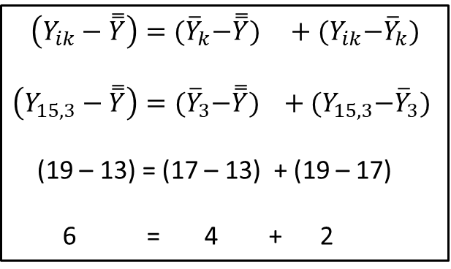






$$\left(Y_{ik}−\overset{̿}{Y}\right)={(\overline{Y}}_{k}−\overset{̿}{Y}) +{(Y}_{ik}−{\overline{Y}}_{k})$$
$$\left(Y_{15,3}−\overset{̿}{Y}\right)={(\overline{Y}}_{3}−\overset{̿}{Y}) +{(Y}_{15,3}−{\overline{Y}}_{3})$$
(19 – 13) = (17 – 13) + (19 – 17)
6 = 4 + 2
${\overline{Y}}_{1}=$10
${\overline{Y}}_{2}=$12
${\overline{Y}}_{3}=$17
$$\left(Y_{ik}−\overset{̿}{Y}\right)$$
x
$\overset{̿}{Y}=$13
$Y_{15,3}$ = 19
$$\left(Y_{ik}−\overset{̿}{Y}\right)$$
Total = between + within
$${(\overline{Y}}_{k}−\overset{̿}{Y})$$
$${(Y}_{ik}−{\overline{Y}}_{k})$$
Between = explained part
Within = unexplained part/residual/error

Slide 11
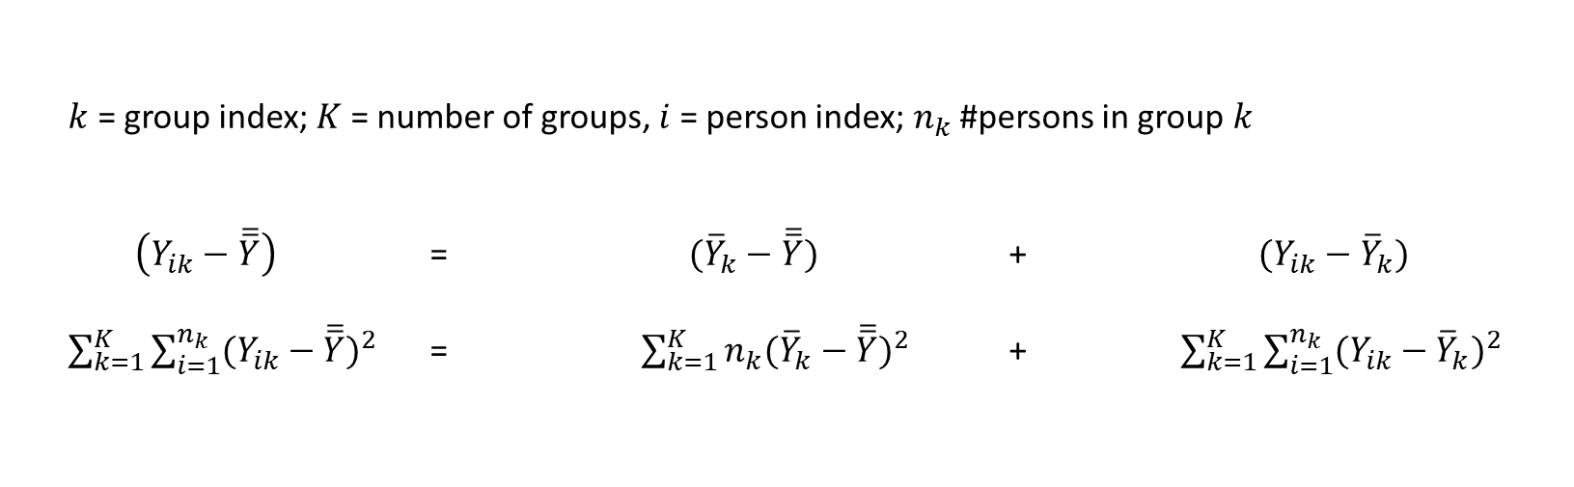
Decompose total Sums of Squares into within and between
$k$ = group index; $K$ = number of groups, $i$ = person index;$n_{k}$ #persons in group $k$
$\left(Y_{ik}−\overline{\overline{Y}}\right)$ = $({\overline{Y}}_{k}−\overline{\overline{Y}})$ + $(Y_{ik}−{\overline{Y}}_{k})$
$\sum_{k=1}^{K}{\sum_{i=1}^{n_{k}}{{(Y_{ik}−\overline{\overline{Y}})}^{2}}}$ = $\sum_{k=1}^{K}{{n_{k}({\overline{Y}}_{k}−\overline{\overline{Y}})}^{2}}$ + $\sum_{k=1}^{K}{\sum_{i=1}^{n_{k}}{{(Y_{ik}−{\overline{Y}}_{k})}^{2}}}$
Total SS (SS_{T}) Between SS (SS_{B}) Within or Residual SS (SS_{W})
variation individuals
w.r.t. grand mean
variation group means
w.r.t. grand mean
variation individuals
w.r.t. group mean
Notes:
We take this logic a step further in ANOVA. In ANOVA, we calculate different sources of variations, called the total sums-of-squares, the within sums-of-squares, and the between sums of squares. Let’s take a look at each of these.
First, again a summary of the notation that we use; - READ SLIDE-
We can calculate the Total sum of squares as follows; -READ SLIDE-.
We can calculate the Within sum of squares as follows; -READ SLIDE-.
We can calculate the Between sum of squares as follows; -READ SLIDE-.
Now, the fun thing is, that the total variation in the sample, can be split in within and between variation. If you add the within and the between variation together, you end up with the total variation again! Isn’t that nice! So, if we calculate the sums of squares between and the sums of squares within, we end of up with the sums of squares total.

Slide 12

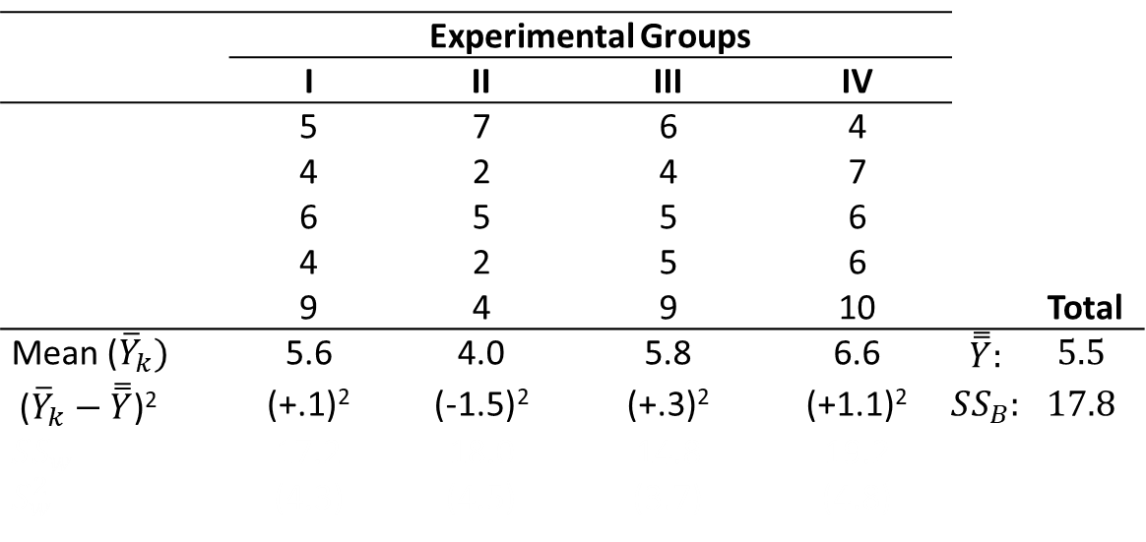
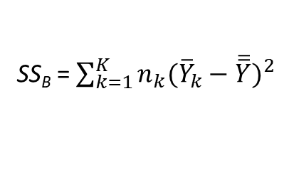
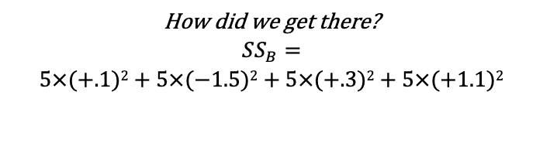
Back to our example with students and grades
 | Experimental Groups
 | I | II | III | IV
 | 5 | 7 | 6 | 4
 | 4 | 2 | 4 | 7
 | 6 | 5 | 5 | 6
 | 4 | 2 | 5 | 6
 | 9 | 4 | 9 | 10 |  | Total
Mean (${\overline{Y}}_{k})$ | 5.6 | 4.0 | 5.8 | 6.6 | $$\overset{̿}{Y}:$$ | $$5.5$$
(${\overline{Y}}_{k}−\overset{̿}{Y}$)² | (+.1)² | (-1.5)² | (+.3)² | (+1.1)² | $$SS_{B}:$$ | $17.8$
$SS_{w}$ | 17.2 | 18.0 | 14.8 | 19.2
$S_{w}^{2}$ | (4.3) | (4.5) | (3.7) | (4.8)
SS_{B} = $\sum_{k=1}^{K}{{n_{k}({\overline{Y}}_{k}−\overline{\overline{Y}})}^{2}}$
How did we get there?
$SS_{B}=$ $$5×(+.1)2+5×(−1.5)2+5×(+.3)2+5×(+1.1)2$$
Notes:
Back to our experiment! We already calculated the four group means and the grand mean. Now, we can calculate the SSb. For that, we first need to know how much each of the group means deviates from the grand mean. So, for group 1, it’s 5.6=5.5=0.1. Then we square this value. Next, we do this for all other groups in the sample. So 4-5.5 is -1.5, and again we need to square this number. For group 3 the deviation score is .3 and for group 4 1.1. The next step is to multiply these squared values with the number of people in the sample → in this case 5 for all of the groups. Finally, we add all these numbers together, and we get the SSb.

Slide 13
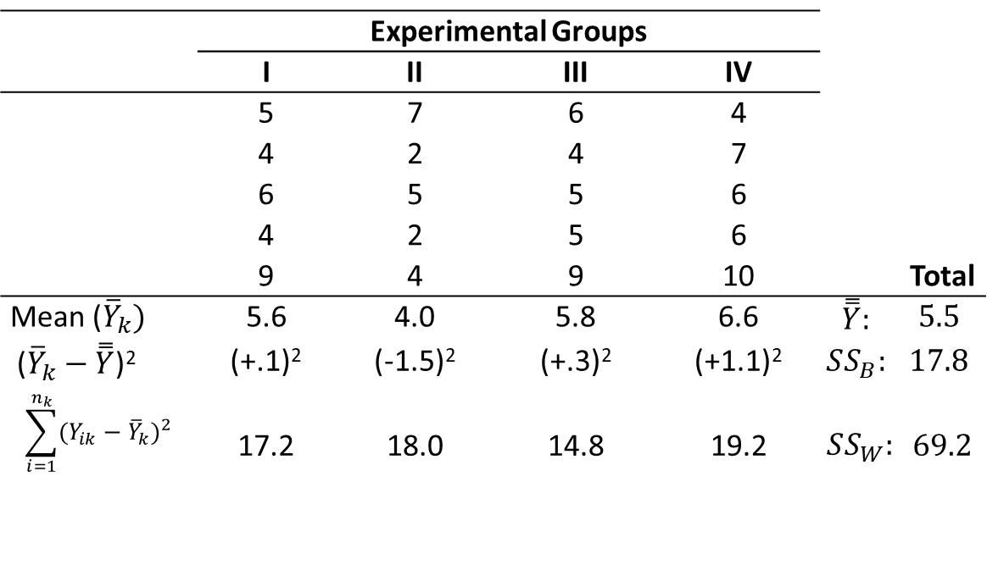
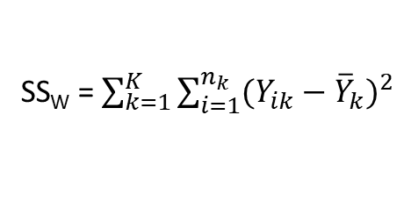
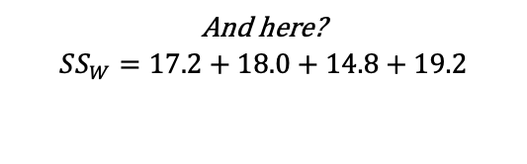
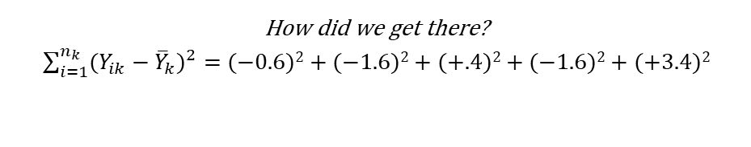
ANOVA: Numerical example
 | Experimental Groups
 | I | II | III | IV
 | 5 | 7 | 6 | 4
 | 4 | 2 | 4 | 7
 | 6 | 5 | 5 | 6
 | 4 | 2 | 5 | 6
 | 9 | 4 | 9 | 10 |  | Total
Mean (${\overline{Y}}_{k})$ | 5.6 | 4.0 | 5.8 | 6.6 | $$\overset{̿}{Y}:$$ | $$5.5$$
(${\overline{Y}}_{k}−\overset{̿}{Y}$)² | (+.1)² | (-1.5)² | (+.3)² | (+1.1)² | $$SS_{B}:$$ | $$17.8$$
$$\sum_{i=1}^{n_{k}}{{(Y_{ik}−{\overline{Y}}_{k})}^{2}}$$ | 17.2 | 18.0 | 14.8 | 19.2 | $SS_{W}:$ | $$69.2$$
$S_{w}^{2}$ | (4.3) | (4.5) | (3.7) | (4.8)
SS_{W} = $\sum_{k=1}^{K}{\sum_{i=1}^{n_{k}}{{(Y_{ik}−{\overline{Y}}_{k})}^{2}}}$
How did we get there?
$\sum_{i=1}^{n_{k}}{{(Y_{ik}−{\overline{Y}}_{k})}^{2}}=$ $(−0.6)2+(−1.6)2+(+.4)2+(−1.6)2+(+3.4)2$
And here?
$$SS_{W}=17.2+18.0+14.8+19.2$$
Notes:
Now, the sum of squares within. We start with group 1. For all people in group 1, we take the individual score and subtract the group mean, and then square this value. So, 5 minus 5.6 is -0.6, and we square this. 4-5.6 is -1.6, we square this. Same for person 3,4, and 5. Than we add all these squared values together. But we do not have 1 group, we have 4 groups. We do the same for group 2, 3 and 4, and we obtain the values 18, 14.8 and 19.2. The SSw is then 69.2 → simply the sum of these four values.

Slide 14
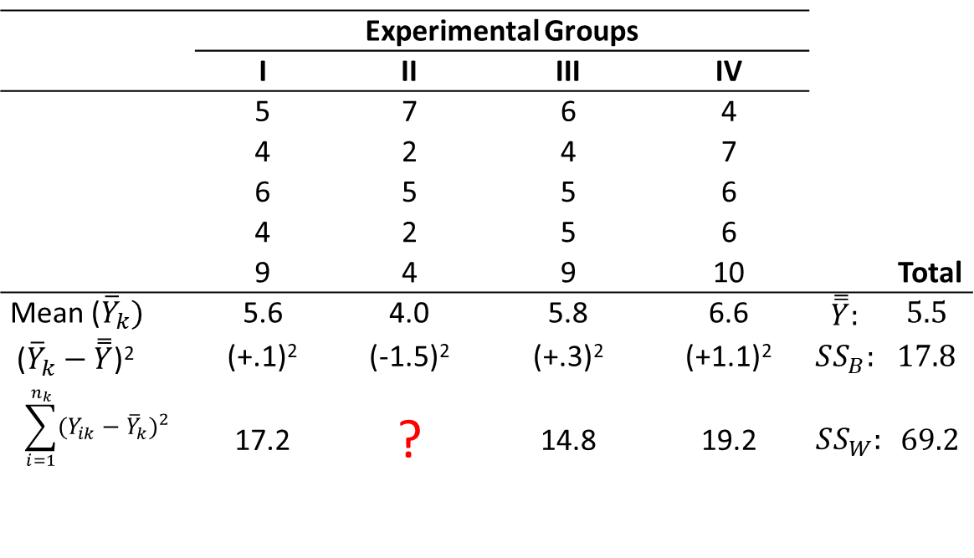
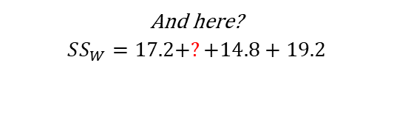
ANOVA: Numerical example
 | Experimental Groups
 | I | II | III | IV
 | 5 | 7 | 6 | 4
 | 4 | 2 | 4 | 7
 | 6 | 5 | 5 | 6
 | 4 | 2 | 5 | 6
 | 9 | 4 | 9 | 10 |  | Total
Mean (${\overline{Y}}_{k})$ | 5.6 | 4.0 | 5.8 | 6.6 | $$\overset{̿}{Y}:$$ | $$5.5$$
(${\overline{Y}}_{k}−\overset{̿}{Y}$)² | (+.1)² | (-1.5)² | (+.3)² | (+1.1)² | $$SS_{B}:$$ | $$17.8$$
$$\sum_{i=1}^{n_{k}}{{(Y_{ik}−{\overline{Y}}_{k})}^{2}}$$ | 17.2 | ? | 14.8 | 19.2 | $SS_{W}:$ | $$69.2$$
$S_{w}^{2}$ | (4.3) | (4.5) | (3.7) | (4.8)
SS_{W} = $\sum_{k=1}^{K}{\sum_{i=1}^{n_{k}}{{(Y_{ik}−{\overline{Y}}_{k})}^{2}}}$
How did we get there?
$\sum_{i=1}^{n_{k}}{{(Y_{ik}−{\overline{Y}}_{k})}^{2}}=$ $(−0.6)2+(−1.6)2+(+.4)2+(−1.6)2+(+3.4)2$
And here?
$$SS_{W}=17.2+?+14.8+19.2$$
Notes:
Now, the sum of squares within. We start with group 1. For all people in group 1, we take the individual score and subtract the group mean, and then square this value. So, 5 minus 5.6 is -0.6, and we square this. 4-5.6 is -1.6, we square this. Same for person 3,4, and 5. Than we add all these squared values together. But we do not have 1 group, we have 4 groups. We do the same for group 2, 3 and 4, and we obtain the values 18, 14.8 and 19.2. The SSw is then 69.2 → simply the sum of these four values.

Slide 15
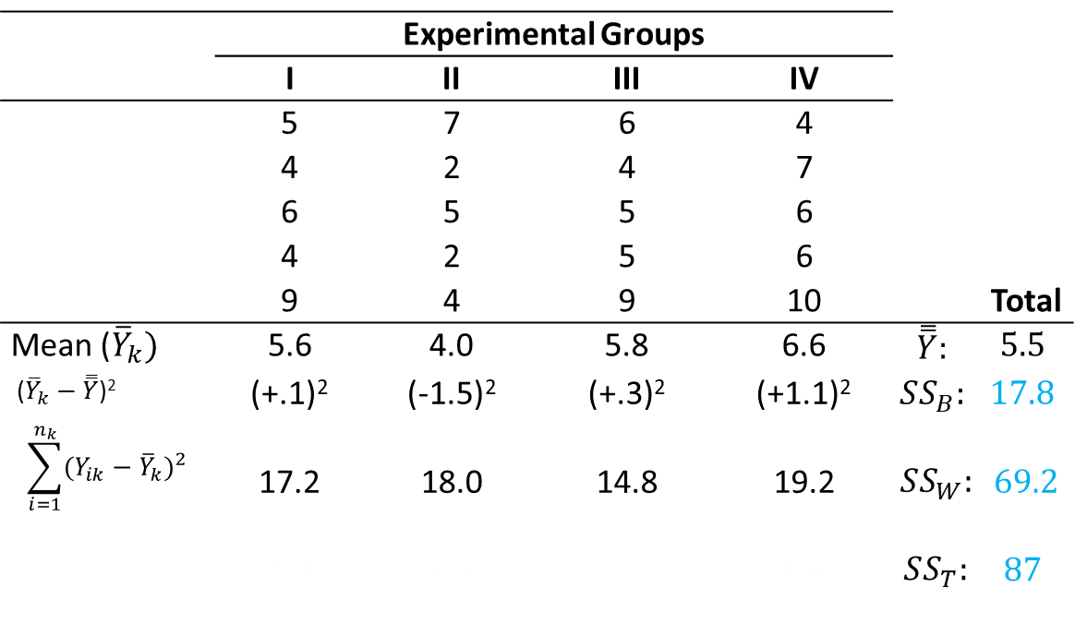
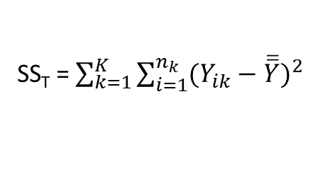

ANOVA: Numerical example
 | Experimental Groups
 | I | II | III | IV
 | 5 | 7 | 6 | 4
 | 4 | 2 | 4 | 7
 | 6 | 5 | 5 | 6
 | 4 | 2 | 5 | 6
 | 9 | 4 | 9 | 10 |  | Total
Mean (${\overline{Y}}_{k})$ | 5.6 | 4.0 | 5.8 | 6.6 | $$\overset{̿}{Y}:$$ | $$5.5$$
(${\overline{Y}}_{k}−\overset{̿}{Y}$)² | (+.1)² | (-1.5)² | (+.3)² | (+1.1)² | $$SS_{B}:$$ | $$17.8$$
$$\sum_{i=1}^{n_{k}}{{(Y_{ik}−{\overline{Y}}_{k})}^{2}}$$ | 17.2 | 18.0 | 14.8 | 19.2 | $SS_{W}:$ | $$69.2$$
 | (4.3) | (4.5) | (3.7) | (4.8) | $SS_{T}:$ | $$87$$
SS_{T} = $\sum_{k=1}^{K}{\sum_{i=1}^{n_{k}}{{(Y_{ik}−\overline{\overline{Y}})}^{2}}}$
How did we get there?
$SS_{T}=$ $$(−.5)2+(−1.5)2+(+.5)2+(−1.5)2+(+3.5)2$$
$$+(+1.5)2+(−3.5)2+(−.5)2+(−3.5)2+(−1.5)2$$
$$+(+.5)2+(−1.5)2+(−.5)2+(−.5)2+(+3.5)2$$
$$+(−1.5)2+(+1.5)2+(+.5)2+(+.5)2+(+4.5)2$$
Notes:
Now, we SSt can be calculated in two ways now. We could take the scores of all 20 individuals, subtract the grand mean, and square the deviation scores (like this). If you would do that, you get a value of 87. BUT, we could also simply add the SSb and the SSw together. You see that in that case, we would also get to 87.

Slide 16
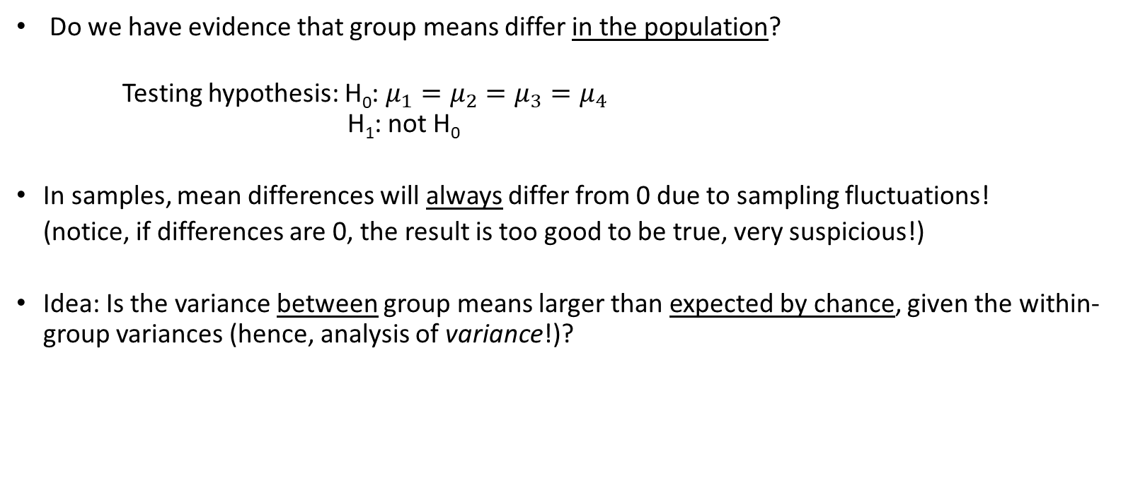
Why do we need all this?
Do we have evidence that group means differ in the population?
Testing hypothesis: H₀: $μ_{1}=μ_{2}=μ_{3}=μ_{4}$ H₁: not H₀
In samples, mean differences will always differ from 0 due to sampling fluctuations!
(notice, if differences are 0, the result is too good to be true, very suspicious!)
Idea: Is the variance between group means larger than expected by chance, given the within-group variances (hence, analysis of variance!)?
Notes:
Now, why are these SSb, SSt and SSw so important? We actually use them to carry out the hypothesis tests in ANOVA, AND we use them to calculate an effect size. First, let’s take a look at the hypothesis testing.
What we want to know when we carry out ANOVA, is…
- READ SLIDE-

Slide 17
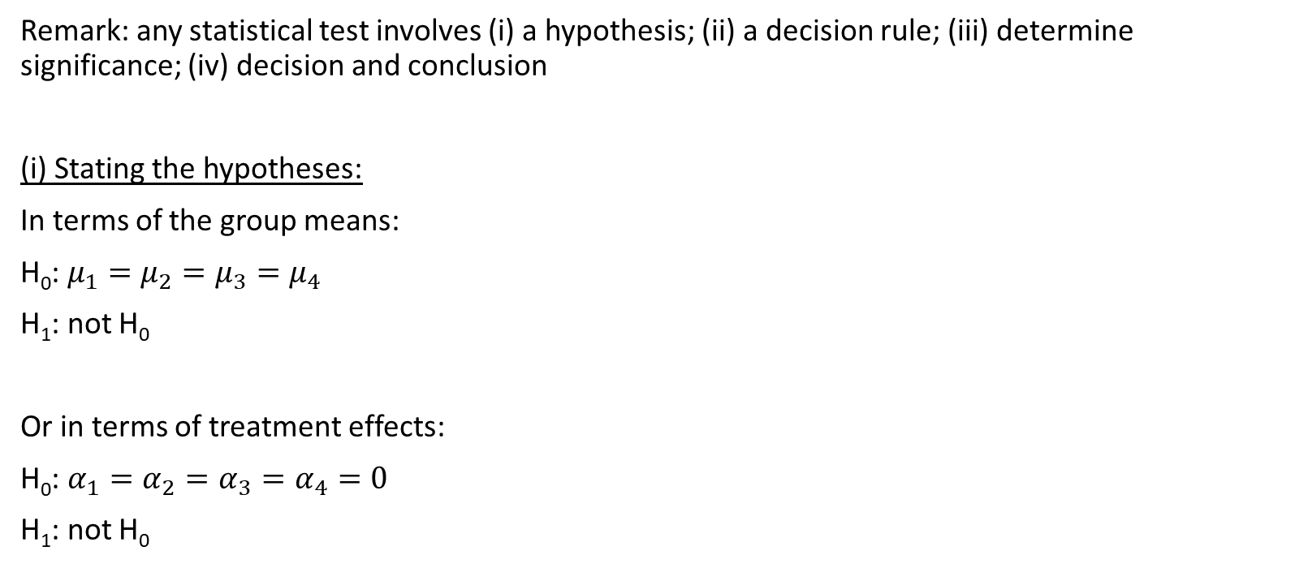
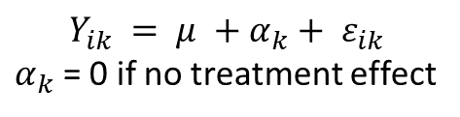
The F-test (hypothesis)
Remark: any statistical test involves (i) a hypothesis; (ii) a decision rule; (iii) determine significance; (iv) decision and conclusion
(i) Stating the hypotheses:
In terms of the group means:
H₀: $μ_{1}=μ_{2}=μ_{3}=μ_{4}$
H₁: not H₀
Or in terms of treatment effects:
H₀: $α_{1}=α_{2}=α_{3}=α_{4}=0$
H₁: not H₀
$$Y_{ik} = μ +α_{k}+ ε_{ik}$$
$α_{k}$ = 0 if no treatment effect
Notes:
To answer that question, we can carry out the F-test. –READ SLIDE-

Slide 18
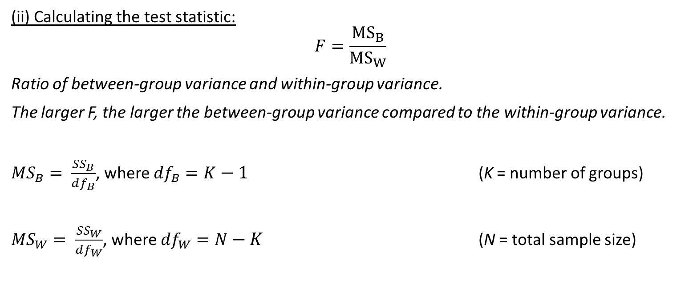
The F-test (test statistic)
(ii) Calculating the test statistic:
$$F=\frac{MS_{B}}{MS_{W}}$$
Ratio of between-group variance and within-group variance.
The larger F, the larger the between-group variance compared to the within-group variance.
${MS}_{B}= \frac{{SS}_{B}}{{df}_{B}}$, where ${df}_{B}=K−1$ (K = number of groups)
${MS}_{W}= \frac{{SS}_{W}}{{df}_{W}}$, where ${df}_{W}=N−K$ (N = total sample size)
Notes:
We can calculate the F statistic, by taking the MSb and divide by the MSw. Now, these two entities are new to us.
The MSb tells us… -READ SLIDE-
The MSw tells us… -READ SLIDE-
Use one value as an estimate of within-group variance that applies to each population: “pooling within-group variances together”

Slide 19
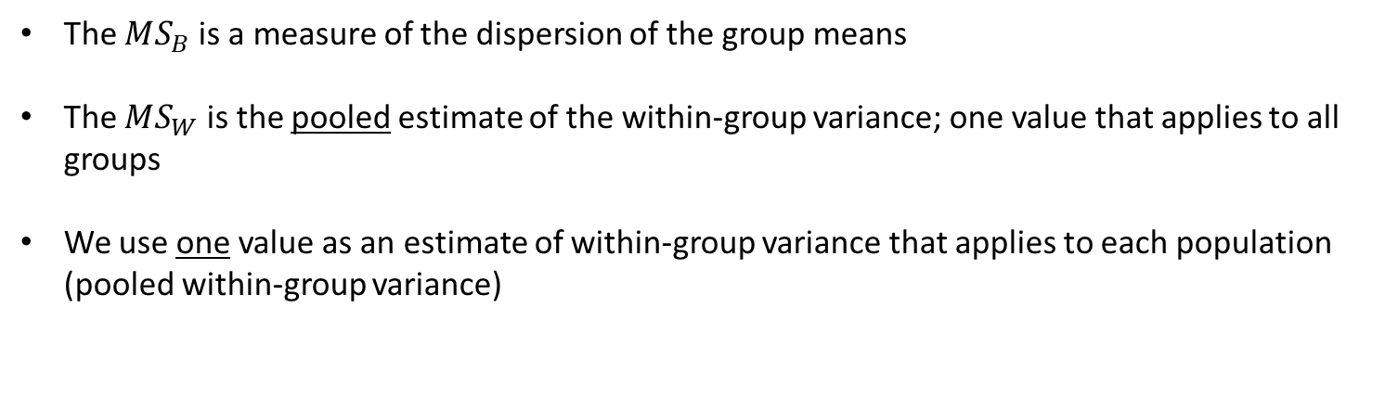
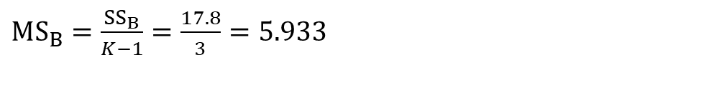

The F-test (test statistic)
The $MS_{B}$is a measure of the dispersion of the group means
The $MS_{W}$ is the pooled estimate of the within-group variance; one value that applies to all groups
We use one value as an estimate of within-group variance that applies to each population (pooled within-group variance)
In our example:
$MS_{B}=\frac{SS_{B}}{K−1}=\frac{17.8}{3}=5.933$
$MS_{W}=\frac{SS_{W}}{N−K}$ $=\frac{69.2}{16}=4.325$
Notes:
We can calculate the F statistic, by taking the MSb and divide by the MSw. Now, these two entities are new to us.
The MSb tells us… -READ SLIDE-
The MSw tells us… -READ SLIDE-
Use one value as an estimate of within-group variance that applies to each population: “pooling within-group variances together”

Slide 20
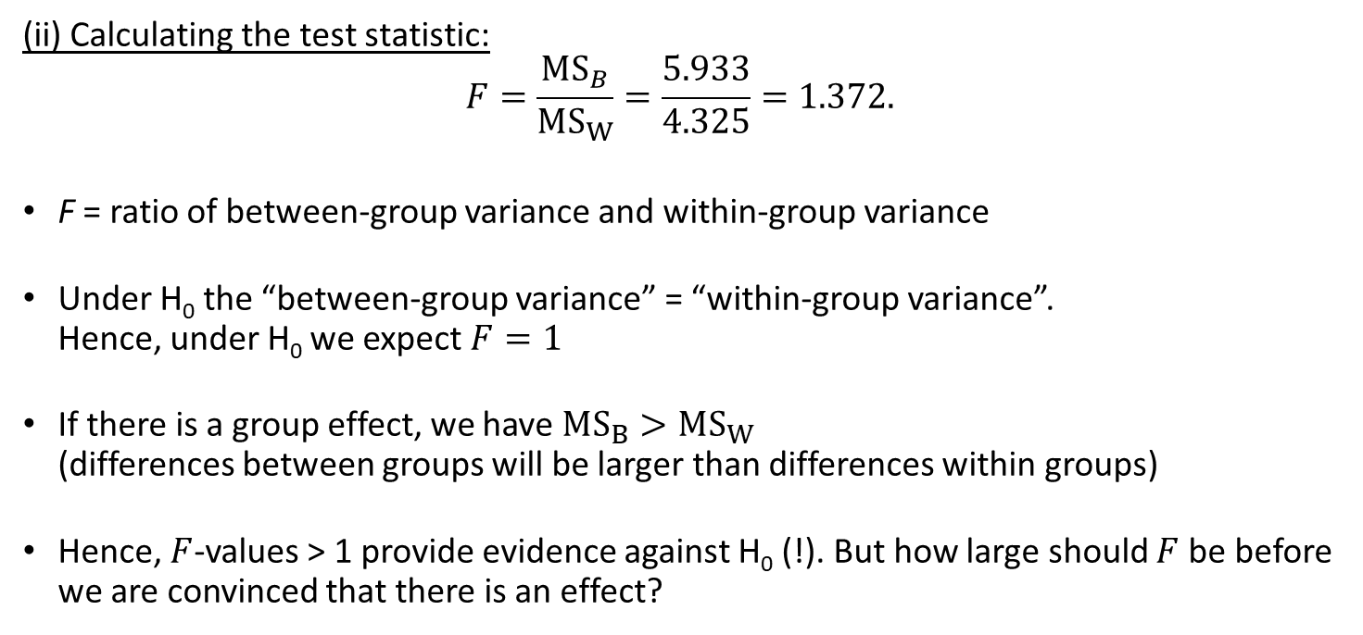
The F-test (test statistic)
(ii) Calculating the test statistic:
$$F=\frac{MS_{B}}{MS_{W}}=\frac{5.933}{4.325}=1.372.$$
F = ratio of between-group variance and within-group variance
Under H₀ the “between-group variance” = “within-group variance”. Hence, under H₀ we expect $F=1$
If there is a group effect, we have $MS_{B}>MS_{W}$ (differences between groups will be larger than differences within groups)
Hence, $F$-values > 1 provide evidence against H₀ (!). But how large should $F$ be before we are convinced that there is an effect?
Notes:
So, we know the MSb and MSw, this means that we can calculate the F statistic. –READ SLIDE-

Slide 21
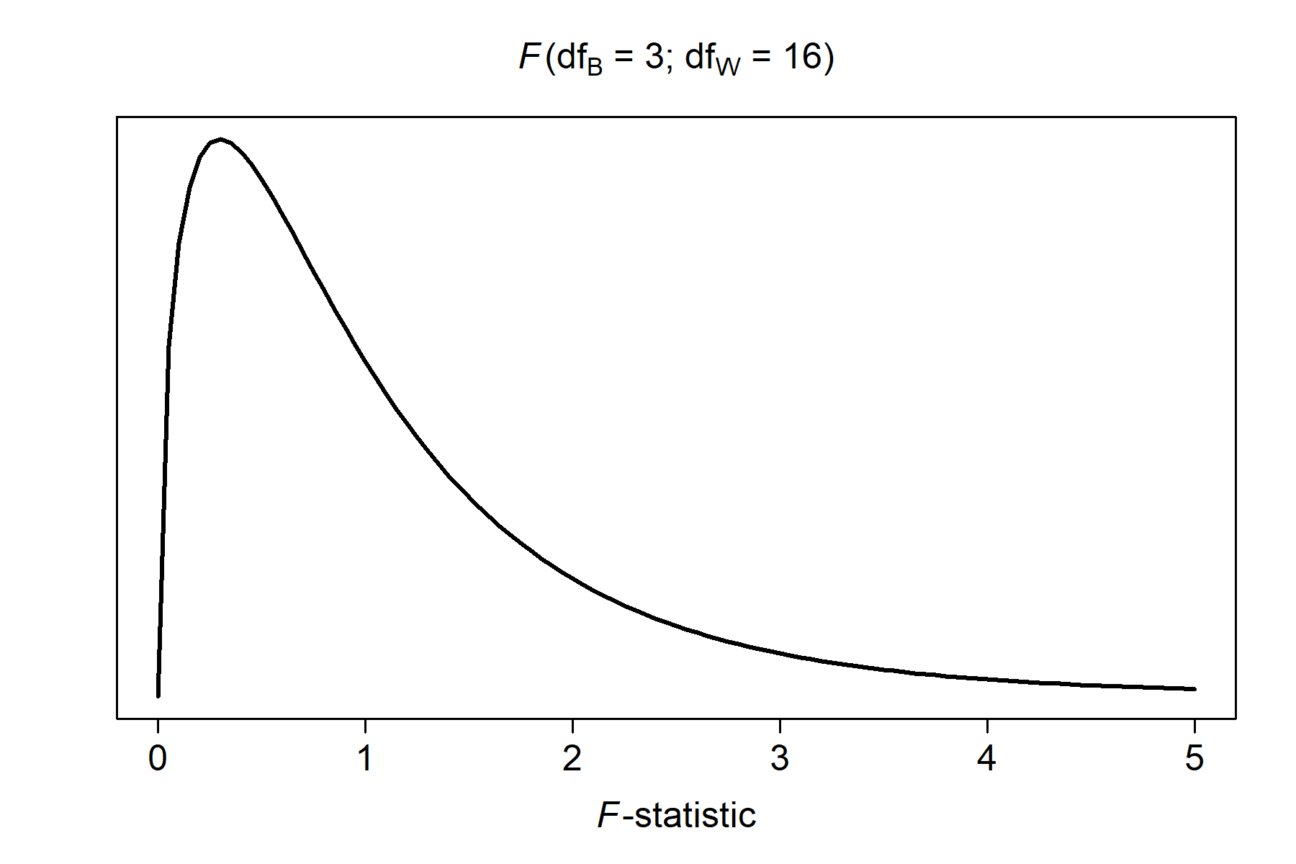

The F-test (F-distribution)
(iii) Use the F-distribution: Test statistic: $F\left(df_{B},df_{W}\right)=\frac{MS_{B}}{MS_{W}}=\frac{\frac{SS_{B}}{df_{B} }}{\frac{SS_{W}}{df_{W}}}=\frac{5.933}{4.325}=1.372$
So, $F$ is a ratio of two variances; The variance in the numerator has $df_{B}$ degrees of freedom; The variance in the denominator has $df_{W}$ degrees of freedom.
Therefore, we need an $F$-distribution with $df_{B}$ and $df_{W}$ degrees of freedom…
More evidence against H₀
Notes:
For that we need to work with a distribution again. When we carry out the F-test, we work with a F distribution. This distribution is a little different from the t-distribution. For the F-distribution, we do not have one type of degrees of freedom, but two! The degrees of freedom are called the degrees of freedom between and degrees of freedom within. The dfb have to do with the number of groups in the analysis (k-1), the dfw have to do with the number of participants within the groups. The shape of the F-distribution depends on the dfb and the dfw.
- READ SLIDE-

Slide 22
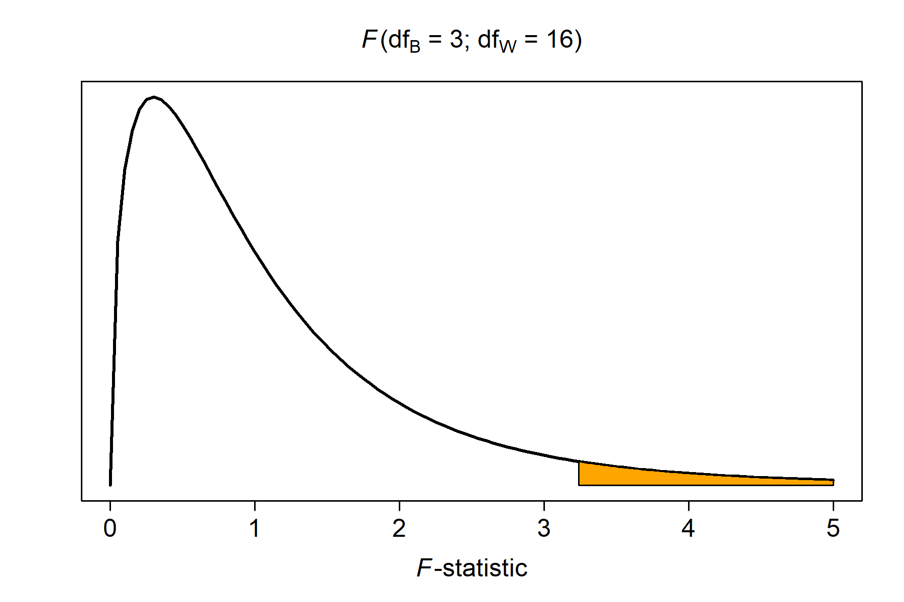
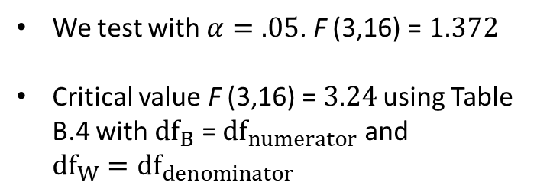
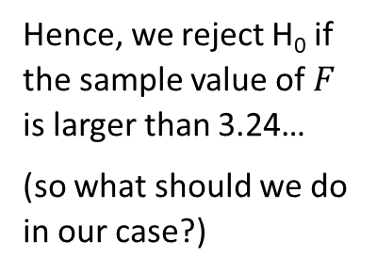
The F-test (critical values)
We test with $α=.05$. F (3,16) = $1.372$
Critical value F (3,16) = $3.24$ using Table B.4 with $df_{B}$ = $df_{numerator}$ and $df_{W}=df_{denominator}$
Hence, we reject H₀ if the sample value of $F$ is larger than 3.24…
(so what should we do in our case?)
Do not reject H₀
Reject H₀
Critical value (3.24)
Notes:
Now, we calculated an F-statistic, but is this F-statistic large or small? We need a criterion to decide. Now this works pretty similar as for the t-test. We want to test with a significance level of .05 or 5%. IF the null hypothesis is true (i.e., the sample means for all groups are equal to each other), then we would expect the sampling distribution to like this (so for a lot of samples we expect an F-statistic close to 1, only for a few samples do we find F-values that are a lot higher. This means that we have a rejection area, this is the area under the curve which contains 5% of the possible sample values of the F-statistic. If our calculated F is larger than the critical value, we reject the null hypothesis, if F is smaller we are not allowed to reject the null hypothesis.
The critical value depends on the dfb and dfw. You can look up the critical value in a table, or calculate it with software. If you need to work with the critical value, I will provide it for you.
Question for you. What should we do with the null hypothesis in our case? Do we reject the null hypothesis? Or do we need to keep it? Everyone who thinks that we should REJECT the null hypothesis, put your hand up. Everyone who thinks that we should NOT reject H0, put your hands up. Well, the F-statistic was pretty small (1.372), so we do NOT reject the null hypothesis. This means that we DO NOT have enough evidence to concljude that the group means differ from one another.

Slide 23
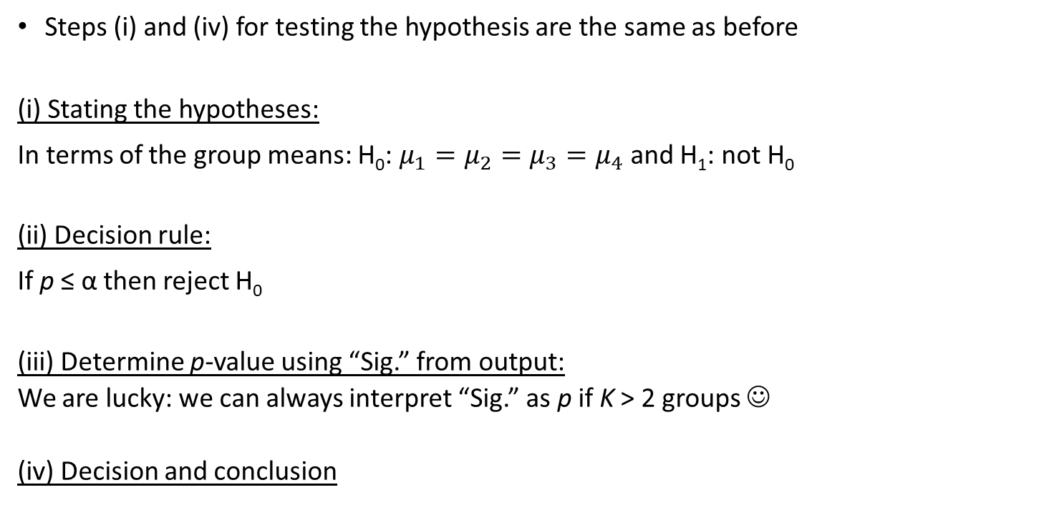
ANOVA using SPSS
Steps (i) and (iv) for testing the hypothesis are the same as before
(i) Stating the hypotheses:
In terms of the group means: H₀: $μ_{1}=μ_{2}=μ_{3}=μ_{4}$ and H₁: not H₀
(ii) Decision rule:
If p ≤ α then reject H₀
(iii) Determine p-value using “Sig.” from output:
We are lucky: we can always interpret “Sig.” as p if K > 2 groups ☺
(iv) Decision and conclusion
Notes:
Now, we calculated an F-statistic, but is this F-statistic large or small? We need a criterion to decide. Now this works pretty similar as for the t-test. We want to test with a significance level of .05 or 5%. IF the null hypothesis is true (i.e., the sample means for all groups are equal to each other), then we would expect the sampling distribution to like this (so for a lot of samples we expect an F-statistic close to 1, only for a few samples do we find F-values that are a lot higher. This means that we have a rejection area, this is the area under the curve which contains 5% of the possible sample values of the F-statistic. If our calculated F is larger than the critical value, we reject the null hypothesis, if F is smaller we are not allowed to reject the null hypothesis.
The critical value depends on the dfb and dfw. You can look up the critical value in a table, or calculate it with software. If you need to work with the critical value, I will provide it for you.
Question for you. What should we do with the null hypothesis in our case? Do we reject the null hypothesis? Or do we need to keep it? Everyone who thinks that we should REJECT the null hypothesis, put your hand up. Everyone who thinks that we should NOT reject H0, put your hands up. Well, the F-statistic was pretty small (1.372), so we do NOT reject the null hypothesis. This means that we DO NOT have enough evidence to concljude that the group means differ from one another.

Slide 24
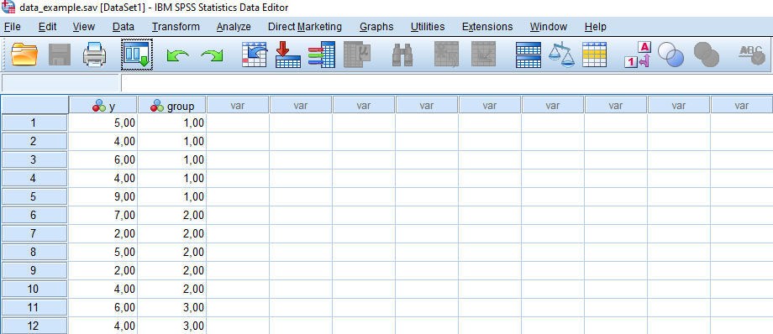
ANOVA using SPSS
Notes:
Now, we calculated an F-statistic, but is this F-statistic large or small? We need a criterion to decide. Now this works pretty similar as for the t-test. We want to test with a significance level of .05 or 5%. IF the null hypothesis is true (i.e., the sample means for all groups are equal to each other), then we would expect the sampling distribution to like this (so for a lot of samples we expect an F-statistic close to 1, only for a few samples do we find F-values that are a lot higher. This means that we have a rejection area, this is the area under the curve which contains 5% of the possible sample values of the F-statistic. If our calculated F is larger than the critical value, we reject the null hypothesis, if F is smaller we are not allowed to reject the null hypothesis.
The critical value depends on the dfb and dfw. You can look up the critical value in a table, or calculate it with software. If you need to work with the critical value, I will provide it for you.
Question for you. What should we do with the null hypothesis in our case? Do we reject the null hypothesis? Or do we need to keep it? Everyone who thinks that we should REJECT the null hypothesis, put your hand up. Everyone who thinks that we should NOT reject H0, put your hands up. Well, the F-statistic was pretty small (1.372), so we do NOT reject the null hypothesis. This means that we DO NOT have enough evidence to concljude that the group means differ from one another.

Slide 25
ANOVA using SPSS
ANOVA van be analyzed with SPSS in 3 ways: Compare Means/Means or with Compare Means/One-way ANOVA or with General Linear Model/Univariate
We will always use the univariate procedure (also in the practicals):
UNIANOVA y BY group /METHOD = SSTYPE(3) /INTERCEPT = INCLUDE /PRINT = DESCRIPTIVE ETASQ HOMOGENEITY /CRITERIA = ALPHA(.05) /DESIGN = group.
Notes:
Now, we calculated an F-statistic, but is this F-statistic large or small? We need a criterion to decide. Now this works pretty similar as for the t-test. We want to test with a significance level of .05 or 5%. IF the null hypothesis is true (i.e., the sample means for all groups are equal to each other), then we would expect the sampling distribution to like this (so for a lot of samples we expect an F-statistic close to 1, only for a few samples do we find F-values that are a lot higher. This means that we have a rejection area, this is the area under the curve which contains 5% of the possible sample values of the F-statistic. If our calculated F is larger than the critical value, we reject the null hypothesis, if F is smaller we are not allowed to reject the null hypothesis.
The critical value depends on the dfb and dfw. You can look up the critical value in a table, or calculate it with software. If you need to work with the critical value, I will provide it for you.
Question for you. What should we do with the null hypothesis in our case? Do we reject the null hypothesis? Or do we need to keep it? Everyone who thinks that we should REJECT the null hypothesis, put your hand up. Everyone who thinks that we should NOT reject H0, put your hands up. Well, the F-statistic was pretty small (1.372), so we do NOT reject the null hypothesis. This means that we DO NOT have enough evidence to concljude that the group means differ from one another.

Slide 26
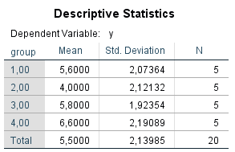
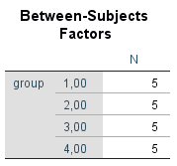
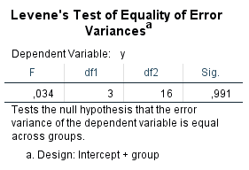
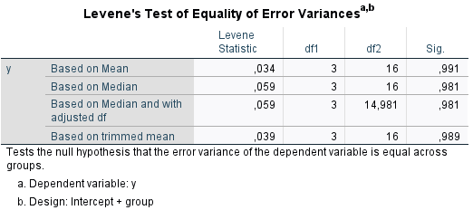
ANOVA using SPSS

Slide 27
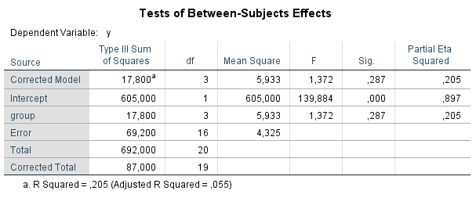
ANOVA using SPSS
(iii) Determine p-value using “Sig.” from output:
= Between
SS_{B}
df_{B}
MS_{B}
MS_{B} = SS_{B}/df_{B}
MS_{W} = SS_{W} /df_{W}
= Within
SS_{W}
df_{W}
MS_{W}
SS_{T}
df_{T}
F = MS_{B}/MS_{W}
p-value
Notes:
Now, we calculated an F-statistic, but is this F-statistic large or small? We need a criterion to decide. Now this works pretty similar as for the t-test. We want to test with a significance level of .05 or 5%. IF the null hypothesis is true (i.e., the sample means for all groups are equal to each other), then we would expect the sampling distribution to like this (so for a lot of samples we expect an F-statistic close to 1, only for a few samples do we find F-values that are a lot higher. This means that we have a rejection area, this is the area under the curve which contains 5% of the possible sample values of the F-statistic. If our calculated F is larger than the critical value, we reject the null hypothesis, if F is smaller we are not allowed to reject the null hypothesis.
The critical value depends on the dfb and dfw. You can look up the critical value in a table, or calculate it with software. If you need to work with the critical value, I will provide it for you.
Question for you. What should we do with the null hypothesis in our case? Do we reject the null hypothesis? Or do we need to keep it? Everyone who thinks that we should REJECT the null hypothesis, put your hand up. Everyone who thinks that we should NOT reject H0, put your hands up. Well, the F-statistic was pretty small (1.372), so we do NOT reject the null hypothesis. This means that we DO NOT have enough evidence to concljude that the group means differ from one another.

Slide 28

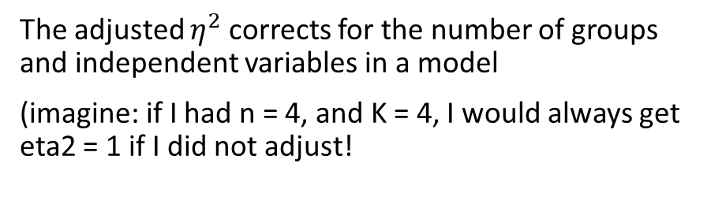
Finally! Is the effect practically important?
How much of the total variation in the dependent variable ($Y$) can be explained by group-membership?
$η^{2}=\frac{SS_{B}}{SS_{T}}=\frac{17.8}{87.0}=0.205$ (20.5%)
Interpretation: rules of thumb
Small | 0.01
Medium | 0.06
Large | 0.14
The adjusted $η^{2}$ corrects for the number of groups and independent variables in a model
(imagine: if I had n = 4, and K = 4, I would always get eta2 = 1 if I did not adjust!
Be careful with rules of thumb!
Look at the context of your study!
Notes:
1-4.325/(87/19) = 0.055 of 1-(1-0.205)*((20-1)/(20-3-1)) = 0.055. It corrects for the number of parameters in a regression model, so here K-1 (3) due to dummy coding.
From https://stats.idre.ucla.edu/spss/output/regression-analysis/:
As predictors are added to the model, each predictor will explain some of the variance in the dependent variable simply due to chance. One could continue to add predictors to the model which would continue to improve the ability of the predictors to explain the dependent variable, although some of this increase in R-square would be simply due to chance variation in that particular sample. The adjusted R-square attempts to yield a more honest value to estimate the R-squared for the population. The value of R-square was .489, while the value of Adjusted R-square was .479 Adjusted R-squared is computed using the formula 1 – ((1 – Rsq)(N – 1 )/ (N – k – 1)). From this formula, you can see that when the number of observations is small and the number of predictors is large, there will be a much greater difference between R-square and adjusted R-square (because the ratio of (N – 1) / (N – k – 1) will be much greater than 1). By contrast, when the number of observations is very large compared to the number of predictors, the value of R-square and adjusted R-square will be much closer because the ratio of (N – 1)/(N – k – 1) will approach 1.

Slide 29
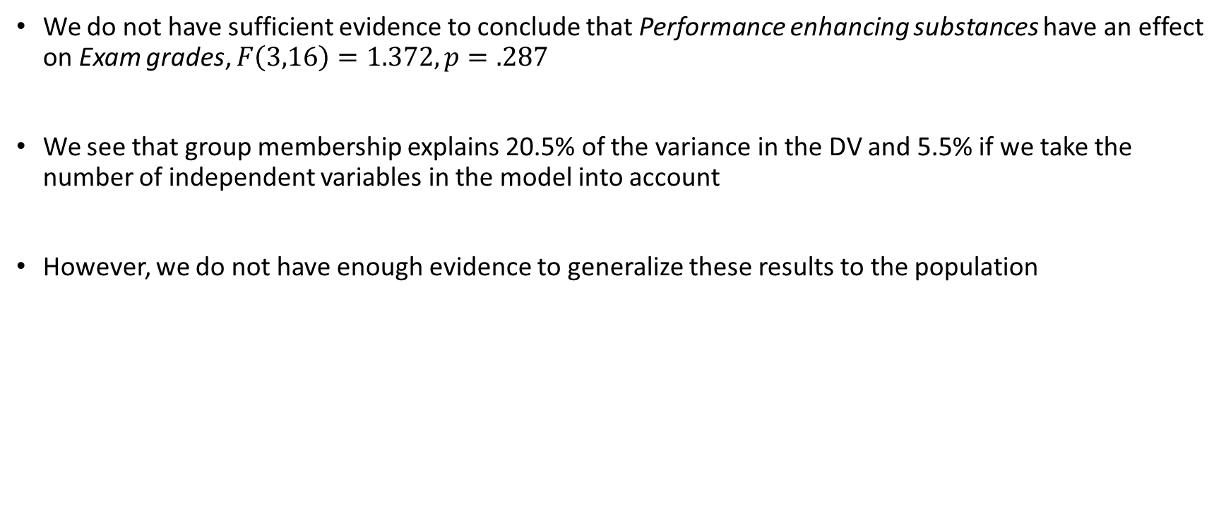
Conclusion
We do not have sufficient evidence to conclude that Performance enhancing substances have an effect on Exam grades, $F\left(3,16\right)=1.372, p=.287$
We see that group membership explains 20.5% of the variance in the DV and 5.5% if we take the number of independent variables in the model into account
However, we do not have enough evidence to generalize these results to the population
Notes:
20.5% is quite a lot -> of total variance in exam grades, you can explain 20.5% by group membership.

Slide 30
Statistical power of ANOVA
Statistical power of a test is the probability of correctly rejecting H₀
The more power, the better (but larger sample size is more expensive)
Factors affecting power in an ANOVA:
α
N
Within-group variance in the population
Effect size
Researchers determine before doing the study how large N should be, given α and the effect size, to achieve a certain power
Power cannot be computed using the approach we used in lecture 2 for the z-test
Notes:
Now, we calculated an F-statistic, but is this F-statistic large or small? We need a criterion to decide. Now this works pretty similar as for the t-test. We want to test with a significance level of .05 or 5%. IF the null hypothesis is true (i.e., the sample means for all groups are equal to each other), then we would expect the sampling distribution to like this (so for a lot of samples we expect an F-statistic close to 1, only for a few samples do we find F-values that are a lot higher. This means that we have a rejection area, this is the area under the curve which contains 5% of the possible sample values of the F-statistic. If our calculated F is larger than the critical value, we reject the null hypothesis, if F is smaller we are not allowed to reject the null hypothesis.
The critical value depends on the dfb and dfw. You can look up the critical value in a table, or calculate it with software. If you need to work with the critical value, I will provide it for you.
Question for you. What should we do with the null hypothesis in our case? Do we reject the null hypothesis? Or do we need to keep it? Everyone who thinks that we should REJECT the null hypothesis, put your hand up. Everyone who thinks that we should NOT reject H0, put your hands up. Well, the F-statistic was pretty small (1.372), so we do NOT reject the null hypothesis. This means that we DO NOT have enough evidence to concljude that the group means differ from one another.

Slide 31
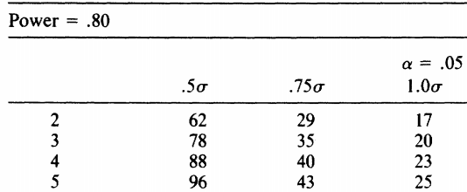
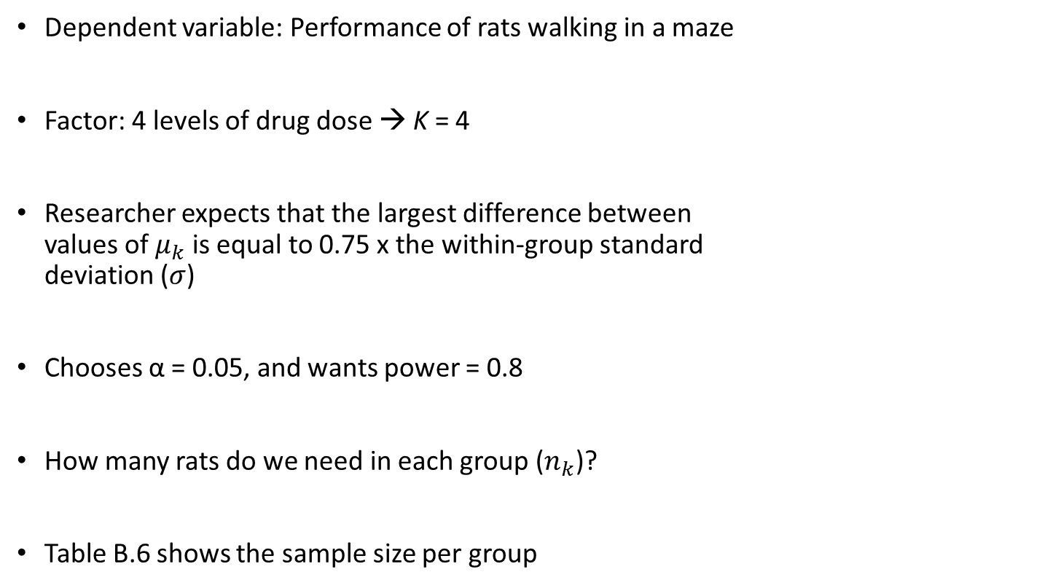
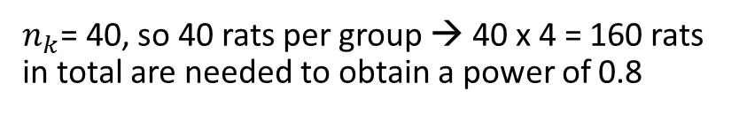
Statistical power of ANOVA: Example
Dependent variable: Performance of rats walking in a maze
Factor: 4 levels of drug dose → K = 4
Researcher expects that the largest difference between values of $μ_{k}$ is equal to 0.75 x the within-group standard deviation ($σ$)
Chooses α = 0.05, and wants power = 0.8
How many rats do we need in each group ($n_{k}$)?
Table B.6 shows the sample size per group
$n_{k}$= 40, so 40 rats per group → 40 x 4 = 160 rats in total are needed to obtain a power of 0.8
Notes:
Now, we calculated an F-statistic, but is this F-statistic large or small? We need a criterion to decide. Now this works pretty similar as for the t-test. We want to test with a significance level of .05 or 5%. IF the null hypothesis is true (i.e., the sample means for all groups are equal to each other), then we would expect the sampling distribution to like this (so for a lot of samples we expect an F-statistic close to 1, only for a few samples do we find F-values that are a lot higher. This means that we have a rejection area, this is the area under the curve which contains 5% of the possible sample values of the F-statistic. If our calculated F is larger than the critical value, we reject the null hypothesis, if F is smaller we are not allowed to reject the null hypothesis.
The critical value depends on the dfb and dfw. You can look up the critical value in a table, or calculate it with software. If you need to work with the critical value, I will provide it for you.
Question for you. What should we do with the null hypothesis in our case? Do we reject the null hypothesis? Or do we need to keep it? Everyone who thinks that we should REJECT the null hypothesis, put your hand up. Everyone who thinks that we should NOT reject H0, put your hands up. Well, the F-statistic was pretty small (1.372), so we do NOT reject the null hypothesis. This means that we DO NOT have enough evidence to concljude that the group means differ from one another.

Slide 32
Literature:
Warner I: 13.5-13.9 and Appendix 13A and 13C
Assumptions of ANOVA
Introduction to contrasts
Next week…

Slide 33
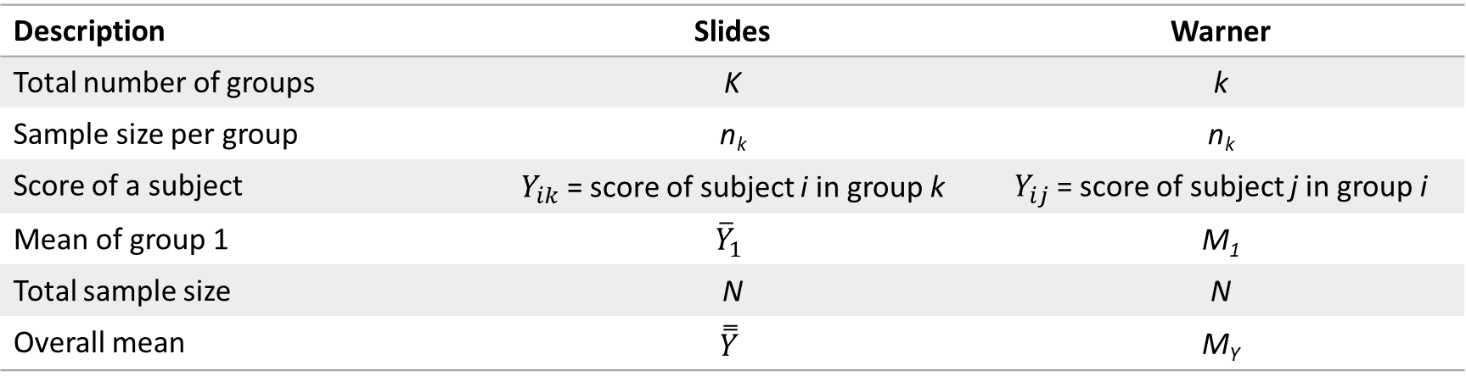
Difference in notation slides and Warner:
Description | Slides | Warner
Total number of groups | K | k
Sample size per group | n_{k} | n_{k}
Score of a subject | $Y_{ik}$ = score of subject i in group k | $Y_{ij}$ = score of subject j in group i
Mean of group 1 | $${\overline{Y}}_{1}$$ | M₁
Total sample size | N | N
Overall mean | $$\overset{̿}{Y}$$ | M_{Y}

