Slide 1
Experimental Research Methods Lecture 4

Slide 2
Lecture goals lecture 4
After this lecture and studying the materials, students are able to:
Explain the assumptions of ANOVA and when ANOVA is robust to violations of these assumptions
Specify simple and complex contrasts
Specify contrasts in case of equal and unequal sample sizes
Interpret the output of SPSS when a hypothesis using a planned contrast is tested

Slide 3
Assumptions of a statistical test
Tests have assumptions
The result of a statistical test is valid if all assumptions of the test are met
There are variants of some tests that are robust to a violation of specific assumptions
A test is robust to the violation if the reported p-value (in SPSS) is approximately equal to the true p-value
A test is not robust if the reported p-value not equal to the true p-value
For example: IQ differences between population sample and sample of Chess masters. In this case, assuming equal variances would make the test significant sooner (i.e., greater risk of Type I error)
If (i) the test is robust to the violation, then the results of the test (the reported p-value) is still considered to be valid
If (ii) the test is not robust to the violation, the results of the test (the reported p-value) is not valid → use a different test
Notes:
-READ SLIDE-

Slide 4
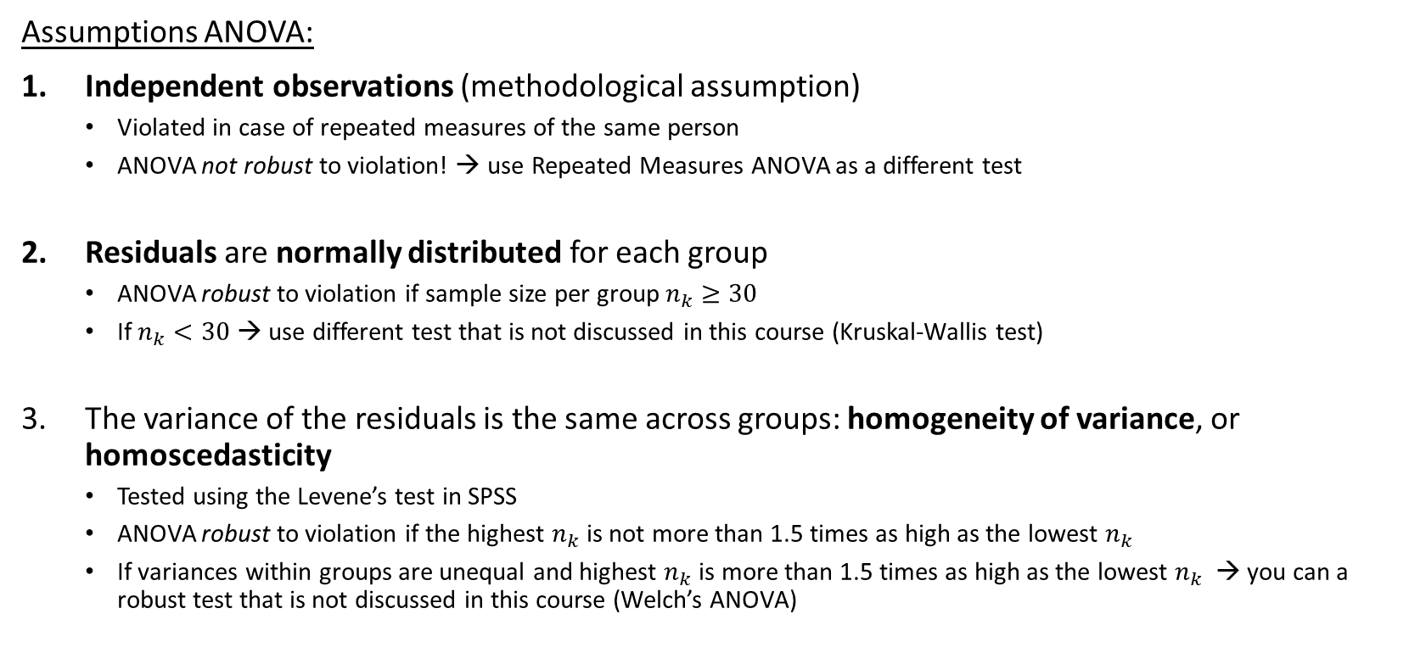
Assumptions ANOVA
Assumptions ANOVA:
Independent observations (methodological assumption)
Violated in case of repeated measures of the same person
ANOVA not robust to violation! → use Repeated Measures ANOVA as a different test
Residuals are normally distributed for each group
ANOVA robust to violation if sample size per group $n_{k}≥30$
If $n_{k}<30$ → use different test that is not discussed in this course (Kruskal-Wallis test)
The variance of the residuals is the same across groups: homogeneity of variance, or homoscedasticity
Tested using the Levene’s test in SPSS
ANOVA robust to violation if the highest $n_{k}$ is not more than 1.5 times as high as the lowest $n_{k}$
If variances within groups are unequal and highest $n_{k}$ is more than 1.5 times as high as the lowest $n_{k}$ → you can a robust test that is not discussed in this course (Welch’s ANOVA)
Notes:
Hier een uitleg waarom we kijken naar het residual en niet naar de scores op de variabele: https://stats.stackexchange.com/questions/11351/left-skewed-vs-symmetric-distribution-observed/11352#11352. De reden is dat de scores normaal verdeeld moeten zijn conditioneel op de predictors, dus daarom kijk je naar de residuals.
Now, when we carry out an ANOVA we make three important assumptions. First, the observations need to be independent from one another. If we draw a random sample, this assumption is usually ok to make. Then, the residuals need to be normally distributed, i.e., if we plot the residuals they should roughly need to follow a normal distribution. The mean of the residuals will be zero and the variance of the residuals is called sigma-squared-e. (This e refers to errors. Residuals are sometimes called errors or prediction errors). Finally, -READ SLIDE-
Residuals -> difference observed score and group mean → score below group mean = negative residual; score above group mean = positive residual. By definition mean residual is 0, because group mean was estimated on the individual scores of the group members. The variance of the residuals is called sigma-squared-e (= prediction error) => and assumed that they are equal across groups.

Slide 5
Assumptions ANOVA
Tests with fewer assumptions also have disadvantages → if assumptions are met, regular ANOVA has more power
We will return to these assumptions in the techniques that will be discussed later
Assumptions are discussed in 13.4 and 12.3 (in the context of an independent samples t-test) of Warner I
Warner I includes as extra “assumptions”:
Scores on the DV are quantitative
No outliers (= already covered by assumptions of normal- and homoscedastic residuals)
Notes:
Now, when we carry out an ANOVA we make three important assumptions. First, the observations need to be independent from one another. If we draw a random sample, this assumption is usually ok to make. Then, the residuals need to be normally distributed, i.e., if we plot the residuals they should roughly need to follow a normal distribution. The mean of the residuals will be zero and the variance of the residuals is called sigma-squared-e. (This e refers to errors. Residuals are sometimes called errors or prediction errors). Finally, -READ SLIDE-
Residuals -> difference observed score and group mean → score below group mean = negative residual; score above group mean = positive residual. By definition mean residual is 0, because group mean was estimated on the individual scores of the group members. The variance of the residuals is called sigma-squared-e (= prediction error) => and assumed that they are equal across groups.

Slide 6
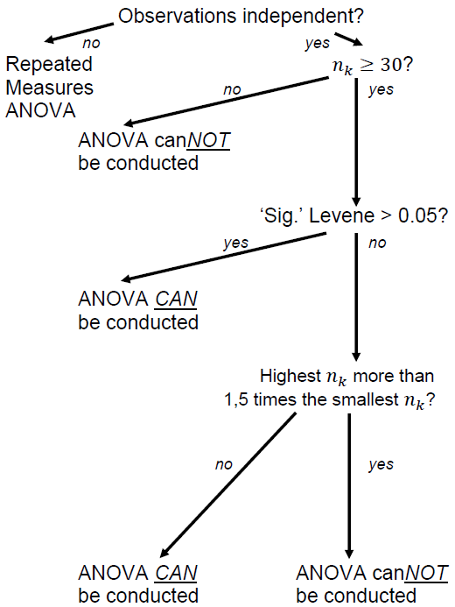
Assumption 1: Independence of observations
Assumption 2: Normally distributed residuals
Assumption 3: Homogeneity of variances
For this course: Use this decision tree.
In real life: Be careful of data-driven analysis decisions
Notes:
Now, when we carry out an ANOVA we make three important assumptions. First, the observations need to be independent from one another. If we draw a random sample, this assumption is usually ok to make. Then, the residuals need to be normally distributed, i.e., if we plot the residuals they should roughly need to follow a normal distribution. The mean of the residuals will be zero and the variance of the residuals is called sigma-squared-e. (This e refers to errors. Residuals are sometimes called errors or prediction errors). Finally, -READ SLIDE-
Residuals -> difference observed score and group mean → score below group mean = negative residual; score above group mean = positive residual. By definition mean residual is 0, because group mean was estimated on the individual scores of the group members. The variance of the residuals is called sigma-squared-e (= prediction error) => and assumed that they are equal across groups.

Slide 7
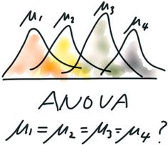
Recap ANOVA
Used to compare multiple group means with one omnibus test
Tests the following null hypothesis: H₀: “all K means are the same” H₁: not H₀
In ANOVA, we can split the total Sum of squares (SS_{T}) into the Sums of squares between (SS_{B}) and the Sums of squares within (SS_{W})
We can calculate the F-statistic using the Mean squares between (MS_{B}) and the Mean squares within (MS_{W})
Notes:
On board: SSt (how far away are scores from the grand mean?) SSb (how far away are the group means from the grand mean?) SSw (how far away are the scores within the groups from the group mean)
To calculate the F-test, we need the Mean squares between and Mean squares within. The MSb gives us the between group variance, and can be calculated by taking the SSb and dividing them by the dfb (k-1). The MSw gives us the withing group variance, and this can be calculated by taking the SSw and dividing this by the dfw (N-K). With the F-test, we can test whether (one of the pair of) group means significantly differ from one another.
Any other important things we need into consideration when carrying out an ANOVA?
Assumptions? (independence of observations, residuals normally distributed, homogeneity of variance)
Effect size? (eta squared)

Slide 8
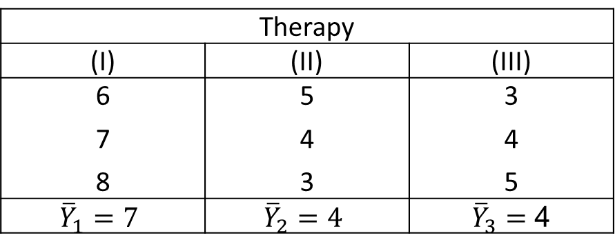
Recurring example
RQ: Is there a difference in the mean anxiety score after Rogerian therapy (I), behavioral therapy A (II), and behavioral therapy B (III)?
Variables:
Independent variable/factor is therapy → 3 levels (I, II, III)
Dependent variable (Y) is anxiety
Hypotheses: H₀: µ_{I} = µ_{II} = µ_{III} H₁: not H₀
Data:
Therapy
(I) | (II) | (III)
6 7 8 | 5 4 3 | 3 4 5
$${\overline{Y}}_{1}=7$$ | $${\overline{Y}}_{2}=4$$ | ${\overline{Y}}_{3}=$ 4

Slide 9
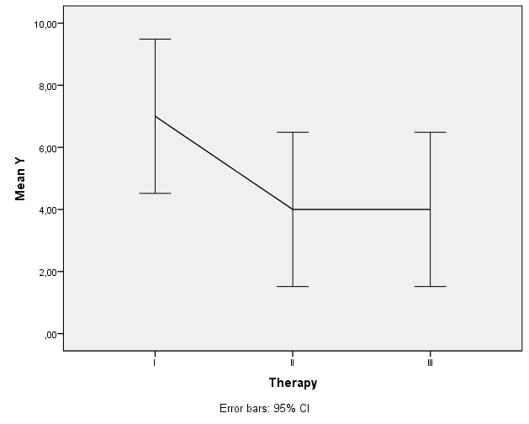
Line plot (including confidence intervals):
What is your first impression?

Slide 10
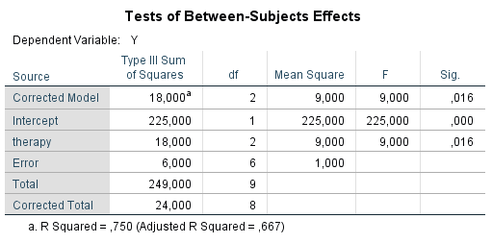
SPSS output ANOVA

Slide 11
On the Nature of Differences among Group Means
Omnibus hypothesis:
H₀: “all K groups have the same mean” H₁: not H₀
Implication: if H₀ is rejected, we have convincing evidence that not all of the K group means are the same, but we don’t know yet which group means differ from each other (could be between all four groups, but it could also be only between two groups)!
To better understand the nature of the group-mean differences, we need a way to decide which individual means do indeed differ from each other → specific groups comparisons
Notes:
But which treatment is the best? We know that there are differences, but we do not know which groups differs significantly from the other groups. The reason for that, is because ANOVA works with an Omniubs hypothesis. –READ SLIDE-

Slide 12
Testing contrasts
Contrast: a specific comparison between group means. For example, we can contrast the mean of Therapy I to Therapy II
Individual comparisons (contrasts) of interest can be a priori (part of the study design; before collecting or seeing the data), or post hoc (i.e., to explore a significant ANOVA)
For example, one can plan in advance to contrast the mean of each experimental method against the mean of the control group
Or, one can – in a post hoc analysis – contrast the method with the highest mean with the experimental group that had lowest mean based on sample results
(But outside of this course: be careful of data-driven analysis decisions)
Notes:
We can find out which groups differ from one another using contrasts. –READ SLIDE-

Slide 13
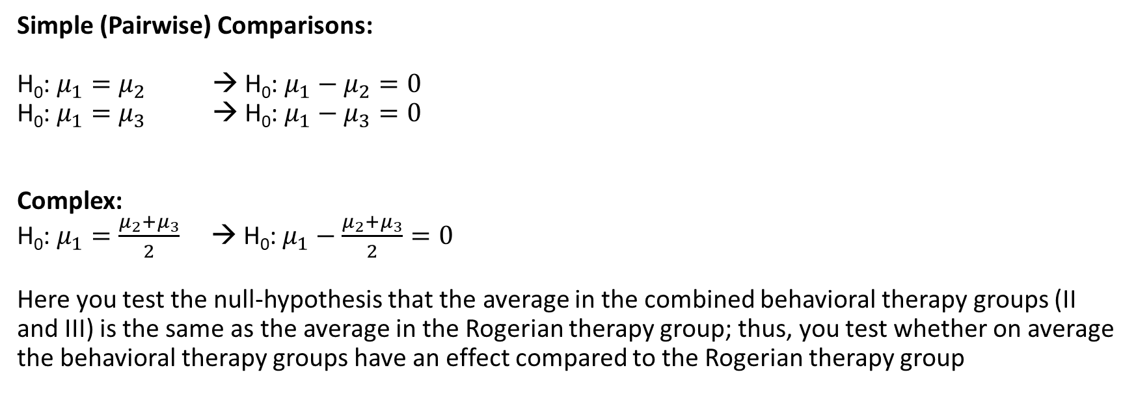
Simple versus Complex Comparisons
Simple (Pairwise) Comparisons:
H₀: $μ_{1}=μ_{2}$ → H₀: $μ_{1}−μ_{2}=0$
H₀: $μ_{1}=μ_{3}$ → H₀: $μ_{1}−μ_{3}=0$
Complex:
H₀: $μ_{1}=\frac{μ_{2}+μ_{3}}{2}$ → H₀: $μ_{1}−\frac{μ_{2}+μ_{3}}{2}=0$
Here you test the null-hypothesis that the average in the combined behavioral therapy groups (II and III) is the same as the average in the Rogerian therapy group; thus, you test whether on average the behavioral therapy groups have an effect compared to the Rogerian therapy group
Notes:
We have a lot of flexibility when working with contrasts. We can make either simple contrast comparisons or complex contrasts.
For the simple comparisons we compare ONE group to ANOTHER group. A bit like a t-test, but the technical details of the analysis are a little different. These are examples of simple comparisons.
We can also carry out complex contrasts, in which we compare multiple groups against each other. It does not matter which combinations you want to make, anything is possible. So here you see an example in which we want to compare the first group, to the other three groups (in other words, in our example, we compare the control group to the experimental groups). We do need to take into account that we compare ONE group with THREE groups. Therefore, we take the average of the means of the three groups, and compare this average to the actual mean of the first group. So this would be one example of a complex contrast, but we could also decide to compare the first two groups to the last two groups. Or the first two groups to the third group, and leave the fourth group out of it. As you can see, there is a lot possible. If you work with PLANNED contrast, you do need to register IN ADVANCE which contrasts you would like to perform.
-READ SLIDE-

Slide 14
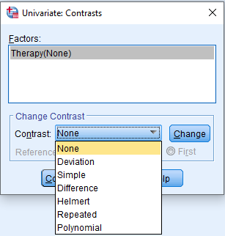
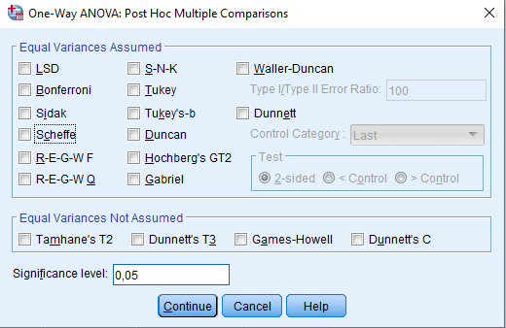
Testing contrasts
The literature on contrasts is a bit of a jungle, because there are many different types
For example, these are the contrasts that are implemented in SPSS:
A priori Post-hoc
Notes:
We can find out which groups differ from one another using contrasts. –READ SLIDE-

Slide 15
Testing contrasts
We will focus on a selection of these contrasts:
We will discuss the general idea of contrasts and planned contrasts in the remaining of this lecture and the other contrasts in next week’s lecture
A priori | Post-hoc
Planned contrast | Tukey → simple contrast (2 groups)
Trend analysis on K groups | Scheffé → complex contrast (≥2 groups)
Helmert contrast

Slide 16
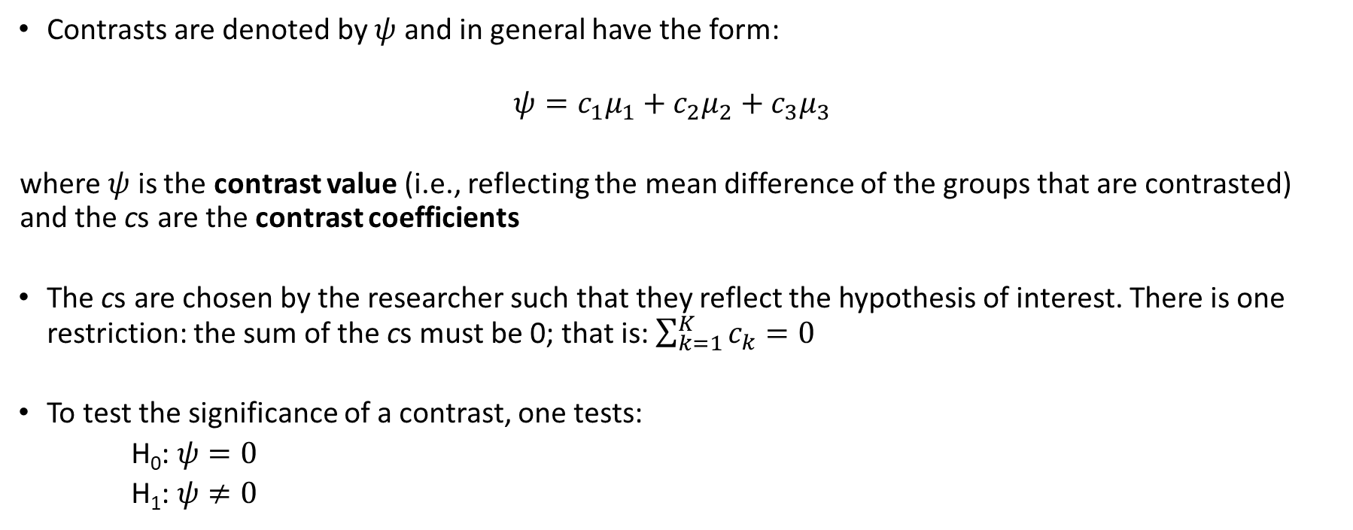
General idea: Specifying contrasts
Contrasts are denoted by $ψ$ and in general have the form:
$${ψ=c}_{1}μ_{1}+c_{2}μ_{2}+c_{3}μ_{3}$$
where $ψ$ is the contrast value (i.e., reflecting the mean difference of the groups that are contrasted) and the cs are the contrast coefficients
The cs are chosen by the researcher such that they reflect the hypothesis of interest. There is one restriction: the sum of the cs must be 0; that is: $\sum_{k=1}^{K}{c_{k}}=0$
To test the significance of a contrast, one tests:
H₀: $ψ=0$
H₁: $ψ≠0$
Notes:
Psi.
- You can see these values of c as weights; we give every mean a certain weight, depending on the contrast that we use.

Slide 17
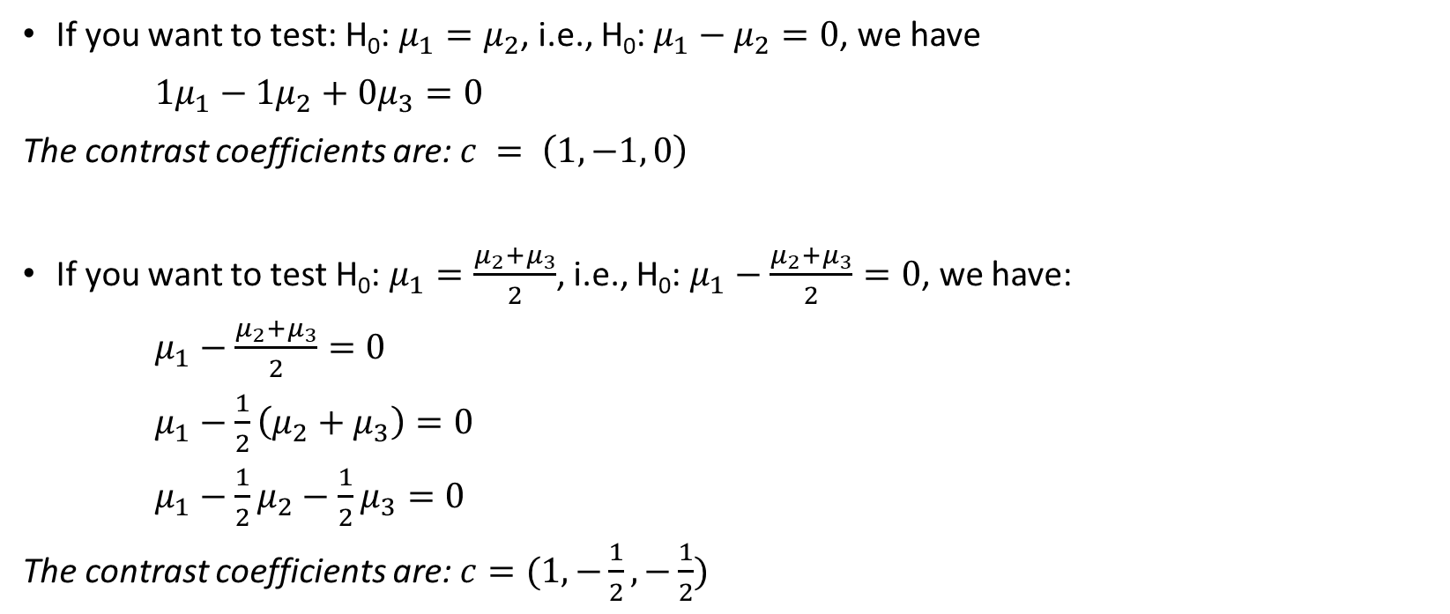
General idea: Examples of specifying contrasts
If you want to test: H₀: $μ_{1}=μ_{2}$, i.e., H₀: $μ_{1}−μ_{2}=0$, we have
$1μ_{1}−{1μ}_{2}+{0μ}_{3}=0$
The contrast coefficients are: $c = \left(1, −1, 0\right)$
If you want to test H₀: $μ_{1}=\frac{μ_{2}+μ_{3}}{2}$, i.e., H₀: $μ_{1}−\frac{μ_{2}+μ_{3}}{2}=0$, we have:
$μ_{1}−\frac{μ_{2}+μ_{3}}{2}=0$
$μ_{1}−\frac{1}{2}\left(μ_{2}+μ_{3}\right)=0$
$μ_{1}−\frac{1}{2}μ_{2}−\frac{1}{2}μ_{3}=0$
The contrast coefficients are: $c=(1,−\frac{1}{2},−\frac{1}{2})$
Notes:
- READ SLIDE-

Slide 18
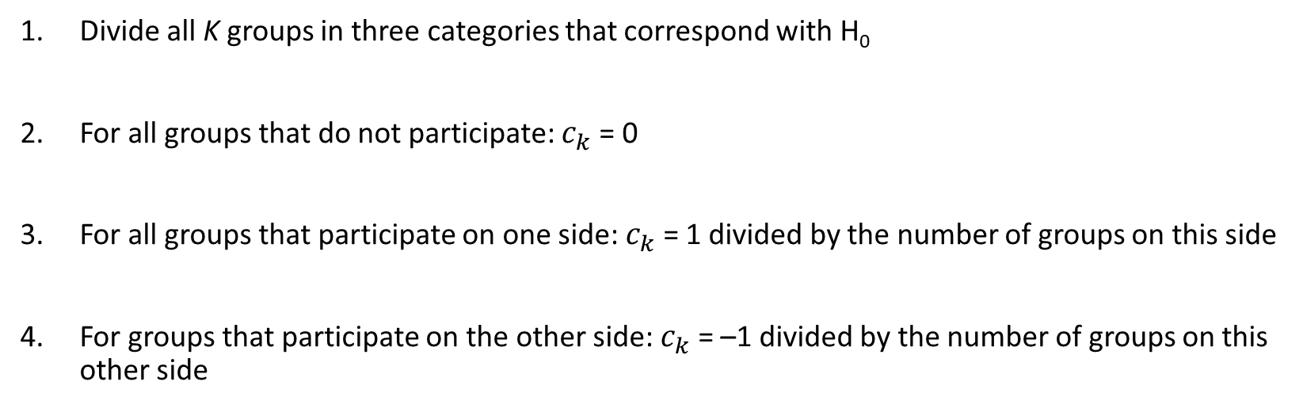
Procedure to determine contrast coefficients when n_{k} are equal
Divide all K groups in three categories that correspond with H₀
For all groups that do not participate: $c_{k}$ = 0
For all groups that participate on one side: $c_{k}$ = 1 divided by the number of groups on this side
For groups that participate on the other side: $c_{k}$ = –1 divided by the number of groups on this other side
Notes:
- READ SLIDE-

Slide 19
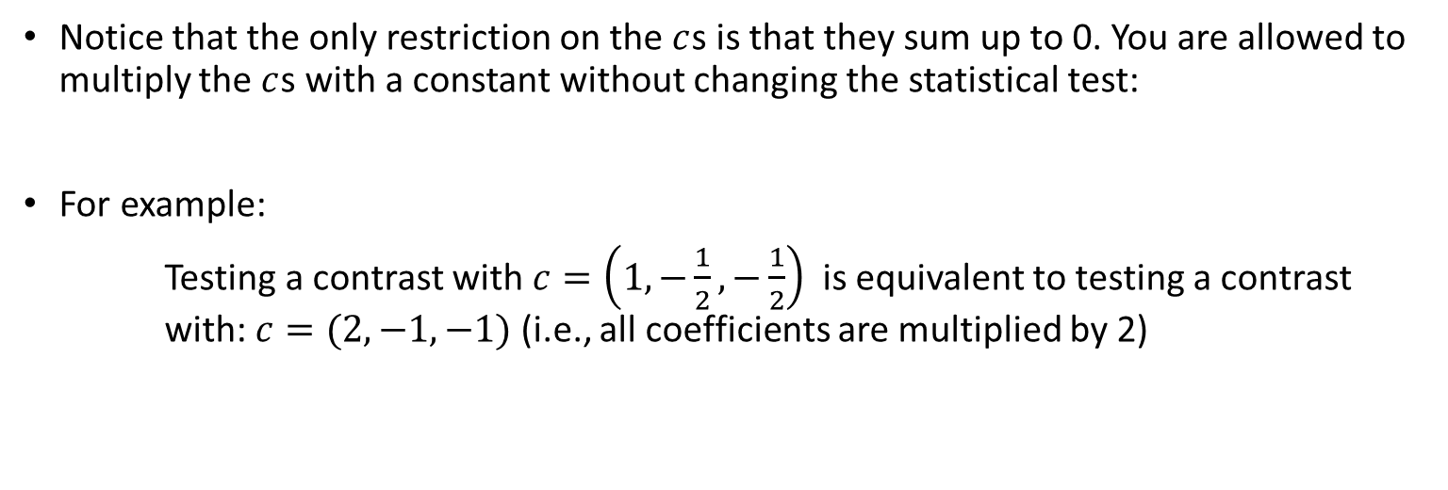
General idea: Remark
Notice that the only restriction on the $c$s is that they sum up to 0. You are allowed to multiply the $c$s with a constant without changing the statistical test:
For example:
Testing a contrast with $c=\left(1,−\frac{1}{2},−\frac{1}{2}\right)$ is equivalent to testing a contrast with: $c=(2,−1,−1)$ (i.e., all coefficients are multiplied by 2)
Notes:
- READ SLIDE-
And of course, the group means that you pool together SHOULD have equal weight.

Slide 20
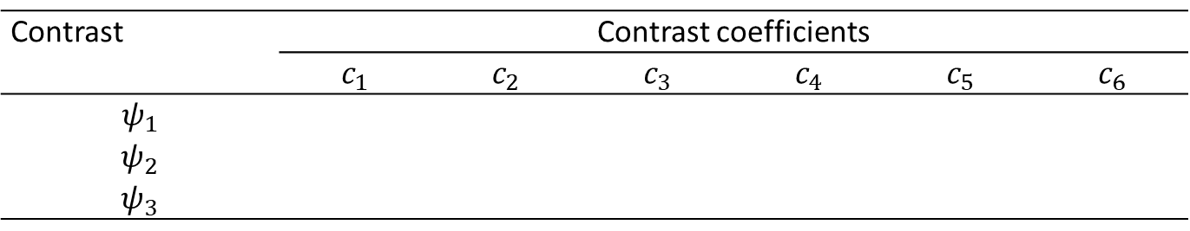
Some examples to practice
Take 6 populations (1-6), from which we draw equally sized samples
Set up the following contrasts:
Mean of population 1 is equal to the mean of population 6
Mean of population 1 is equal to the mean of populations 2 and 3 together
Mean of populations 1 and 2 together is equal to the mean of populations 3, 4, and 5 together
Contrast | Contrast coefficients
 | $$c_{1}$$ | $$c_{2}$$ | $$c_{3}$$ | $$c_{4}$$ | $$c_{5}$$ | $$c_{6}$$
$$ψ_{1}$$
$$ψ_{2}$$
$$ψ_{3}$$
Notes:
- READ SLIDE-

Slide 21
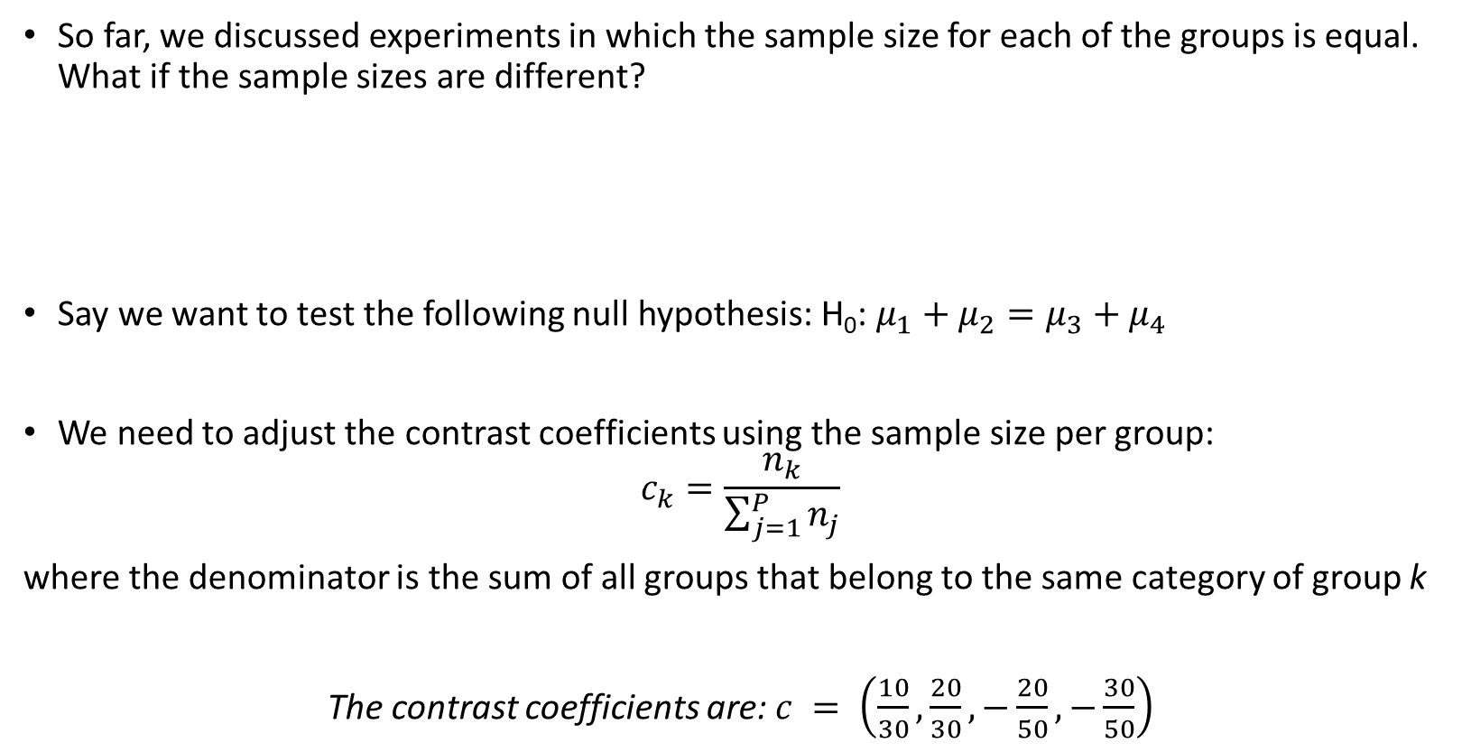
General idea: Specifying contrasts with unequal sample sizes
So far, we discussed experiments in which the sample size for each of the groups is equal. What if the sample sizes are different?
Say we want to test the following null hypothesis: H₀: $μ_{1}+μ_{2}=μ_{3}+μ_{4}$
We need to adjust the contrast coefficients using the sample size per group:
$$c_{k}=\frac{n_{k}}{\sum_{j=1}^{P}{n_{j}}}$$
where the denominator is the sum of all groups that belong to the same category of group k
The contrast coefficients are: $c = \left(\frac{10}{30},\frac{20}{30},−\frac{20}{50}, −\frac{30}{50}\right)$
Group | 1 | 2 | 3 | 4
Sample size (n_{k}) | 10 | 20 | 20 | 30
Notes:
-READ SLIDE-
In that case, we need to take a different approach.
-READ SLIDE-
-READ SLIDE-
Different example;
5 groups; n= 40 25 15 ; 80 20
We want to compare the first three groups with the last two groups.

Slide 22
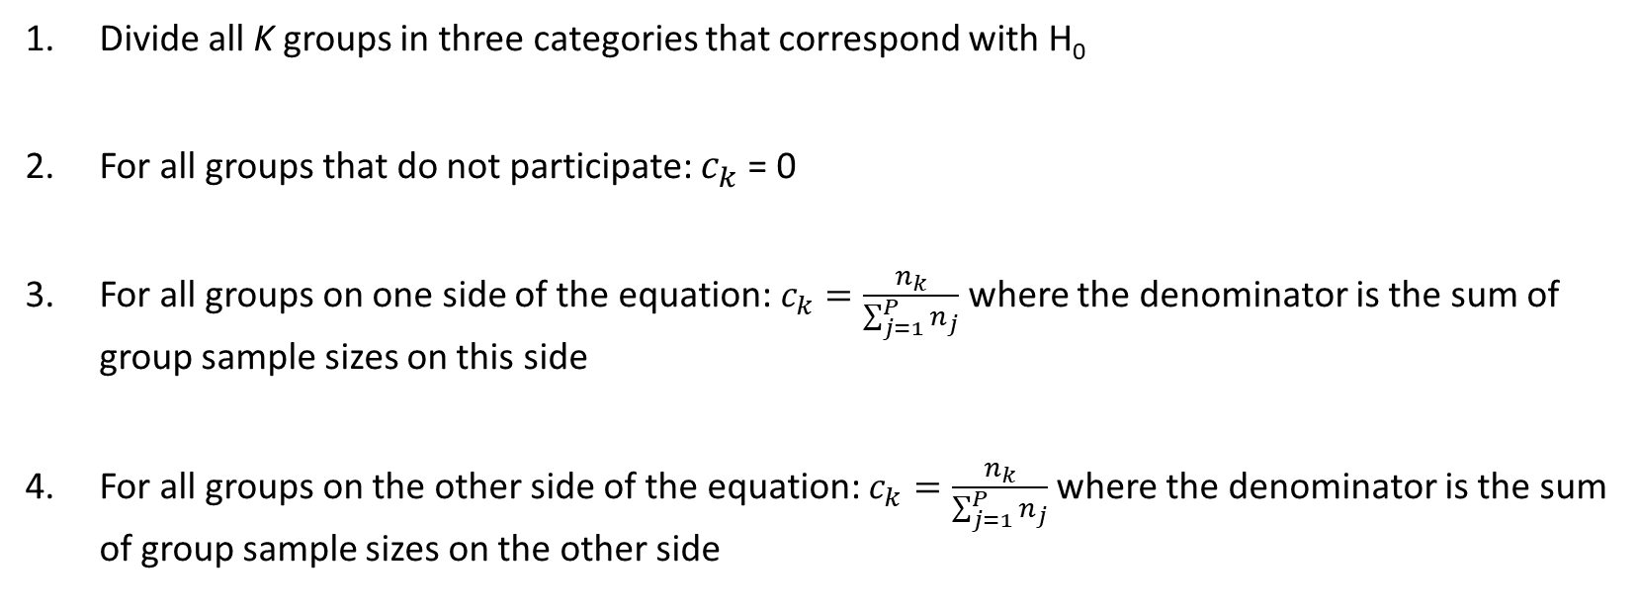
Procedure to determine contrast coefficients when n_{k} are unequal
Divide all K groups in three categories that correspond with H₀
For all groups that do not participate: $c_{k}$ = 0
For all groups on one side of the equation: $c_{k}=\frac{n_{k}}{\sum_{j=1}^{P}{n_{j}}}$ where the denominator is the sum of group sample sizes on this side
For all groups on the other side of the equation: $c_{k}=\frac{n_{k}}{\sum_{j=1}^{P}{n_{j}}}$ where the denominator is the sum of group sample sizes on the other side
Notes:
- READ SLIDE-

Slide 23
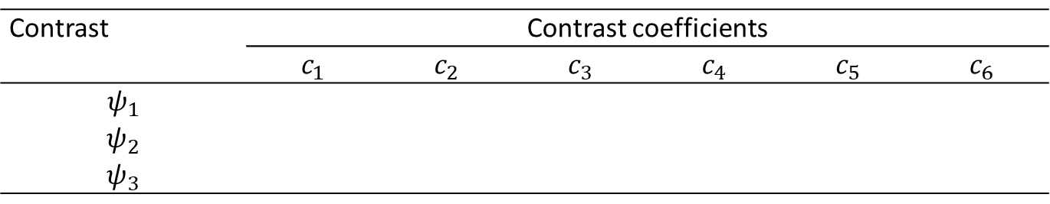
Some examples to practice
Take 6 populations (1-6) with the following sample sizes
30 for groups 1 and 3
20 for groups 2 and 4
10 for groups 5 and 6
Set up the following contrasts:
Mean of population 1 is equal to the mean of population 6
Mean of population 1 is equal to the mean of populations 2 and 3 together
Mean of populations 1 and 2 together is equal to the mean of populations 3, 4 and 5 together
Contrast | Contrast coefficients
 | $$c_{1}$$ | $$c_{2}$$ | $$c_{3}$$ | $$c_{4}$$ | $$c_{5}$$ | $$c_{6}$$
$$ψ_{1}$$
$$ψ_{2}$$
$$ψ_{3}$$
Notes:
- READ SLIDE-

Slide 24
Idea of planned contrasts
Testing of contrast(s) (i) before you have seen the data, and (ii) instead of ANOVA and/or next to ANOVA
Conducting planned contrasts after you have seen the data is a bad idea, just like any other data-dependent analysis decisions
If you test for difference between specific groups because you noticed that those groups are different, your p-value will be negatively biased (i.e., more likely to be significant)
Number of planned contrasts is often small (smaller than the number of groups K)
When we do multiple tests we need to take care of the Type I error rate again! Each time we perform a test, we run again a risk of making a Type I error (claiming the presence of an effect that does not exist)
Notes:
- READ SLIDE-

Slide 25
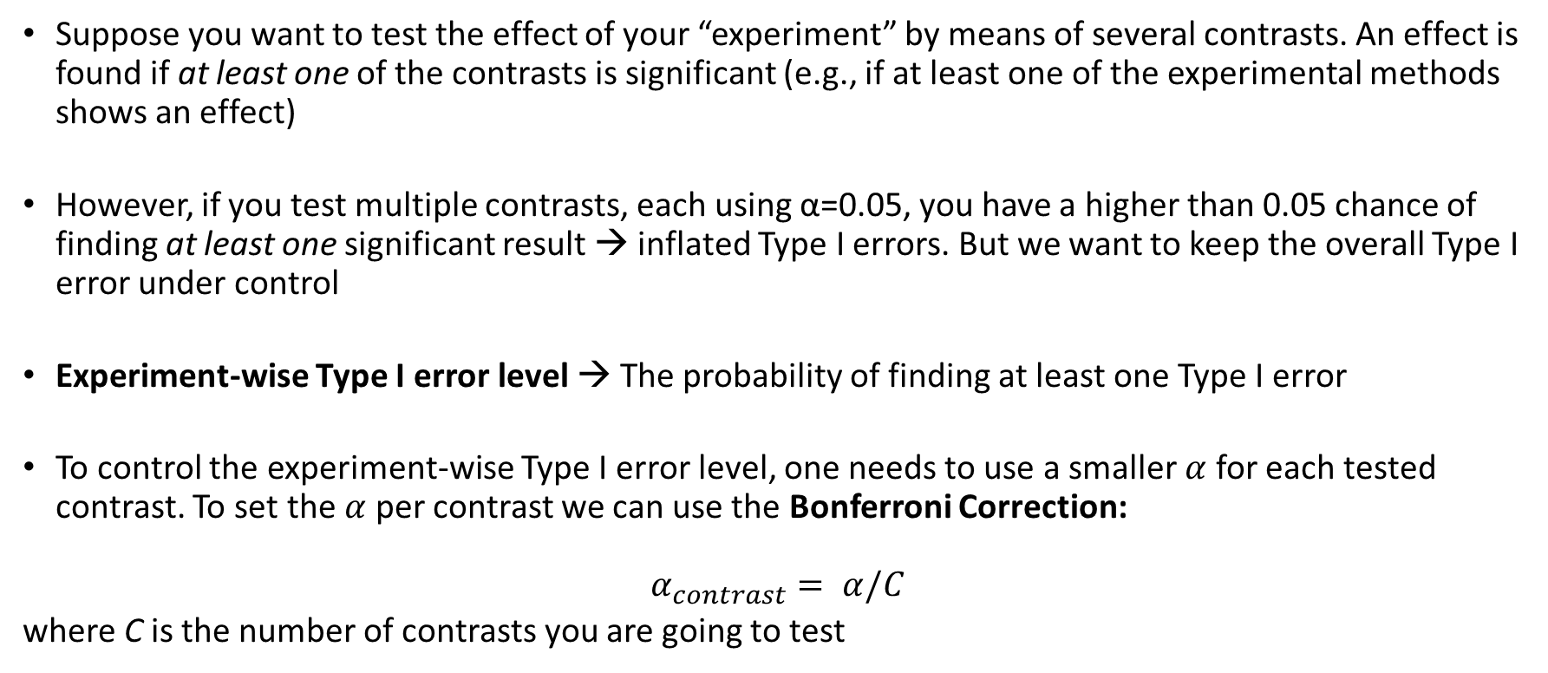
Experiment-wise Type-I error rate
Suppose you want to test the effect of your “experiment” by means of several contrasts. An effect is found if at least one of the contrasts is significant (e.g., if at least one of the experimental methods shows an effect)
However, if you test multiple contrasts, each using α=0.05, you have a higher than 0.05 chance of finding at least one significant result → inflated Type I errors. But we want to keep the overall Type I error under control
Experiment-wise Type I error level → The probability of finding at least one Type I error
To control the experiment-wise Type I error level, one needs to use a smaller $α$ for each tested contrast. To set the $α$ per contrast we can use the Bonferroni Correction:
$$α_{contrast}= α/C$$
where C is the number of contrasts you are going to test
Notes:
- READ SLIDE-

Slide 26
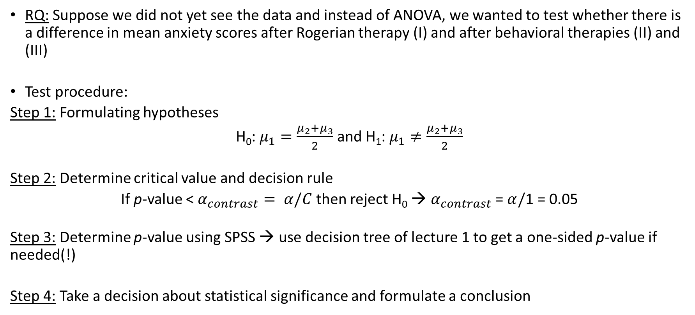
Testing a contrast for our example
RQ: Suppose we did not yet see the data and instead of ANOVA, we wanted to test whether there is a difference in mean anxiety scores after Rogerian therapy (I) and after behavioral therapies (II) and (III)
Test procedure:
Step 1: Formulating hypotheses
H₀: $μ_{1}=\frac{μ_{2}+μ_{3}}{2}$ and H₁: $μ_{1}≠\frac{μ_{2}+μ_{3}}{2}$
Step 2: Determine critical value and decision rule
If p-value < $α_{contrast}= α/C$ then reject H₀ → $α_{contrast}$ = $α/$1 = 0.05
Step 3: Determine p-value using SPSS → use decision tree of lecture 1 to get a one-sided p-value if needed(!)
Step 4: Take a decision about statistical significance and formulate a conclusion
Notes:
- READ SLIDE-

Slide 27
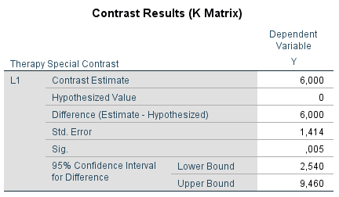
Testing a contrast for our example: SPSS
A planned contrast can only be obtained by modifying the syntax when the General Linear Model/Univariate procedure is used:
UNIANOVA Y BY Therapy
/CONTRAST (Therapy)=Special (2 -1 -1)
/METHOD=SSTYPE(3)
/INTERCEPT=INCLUDE
/CRITERIA=ALPHA(0.05)
/DESIGN=Therapy.
Conclusion?!
Notes:
- READ SLIDE-

Slide 28
Literature:
Warner I: 13.4 and 13.10
Other a priori contrasts (trend analysis and Helmert contrasts)
Post-hoc contrasts (Tukey and Scheffé)
Next week…

