Slide 1
Experimental Research Methods Lecture 5

Slide 2
Lecture goals lecture 5
After this lecture and studying the materials, students are able to:
Assess whether contrasts are orthogonal
Determine whether a trend is linear or quadratic and positive or negative
Interpret the SPSS output for Helmert, Tukey, and Scheffé contrasts as well as trend analysis

Slide 3
Recap contrasts
ANOVA tests the following null hypothesis: H₀: “all K groups have the same mean” H₁: not H₀
Implication: if H₀ is rejected, we have convincing evidence that not all of the K group means are the same, but we do not know yet which group means differ from each other (could be between all four groups, but could also be only between two groups)!
To better understand the nature of the group-mean differences, we need a way to decide which individual means do indeed differ from each other → specific groups comparisons.
A priori | Post-hoc
Planned contrasts | Tukey → simple contrast (2 groups)
Helmert contrasts | Scheffé → complex contrast (≥2 groups)
Trend analysis on K groups

Slide 4
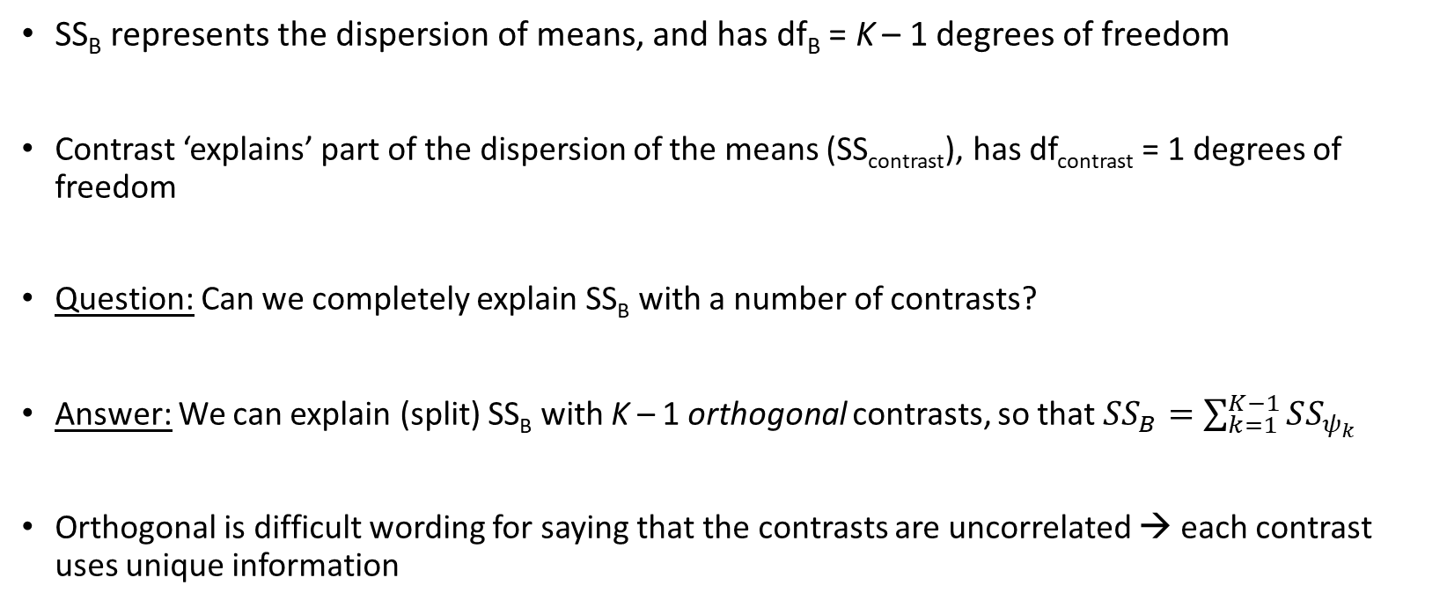
Orthogonal contrasts
SS_{B} represents the dispersion of means, and has df_{B} = K – 1 degrees of freedom
Contrast ‘explains’ part of the dispersion of the means (SS_{contrast}), has df_{contrast} = 1 degrees of freedom
Question: Can we completely explain SS_{B} with a number of contrasts?
Answer: We can explain (split) SS_{B} with K – 1 orthogonal contrasts, so that $SS_{B}=\sum_{k=1}^{K−1}{SS_{ψ_{k}}}$
Orthogonal is difficult wording for saying that the contrasts are uncorrelated → each contrast uses unique information
Notes:
- READ SLIDE-

Slide 5
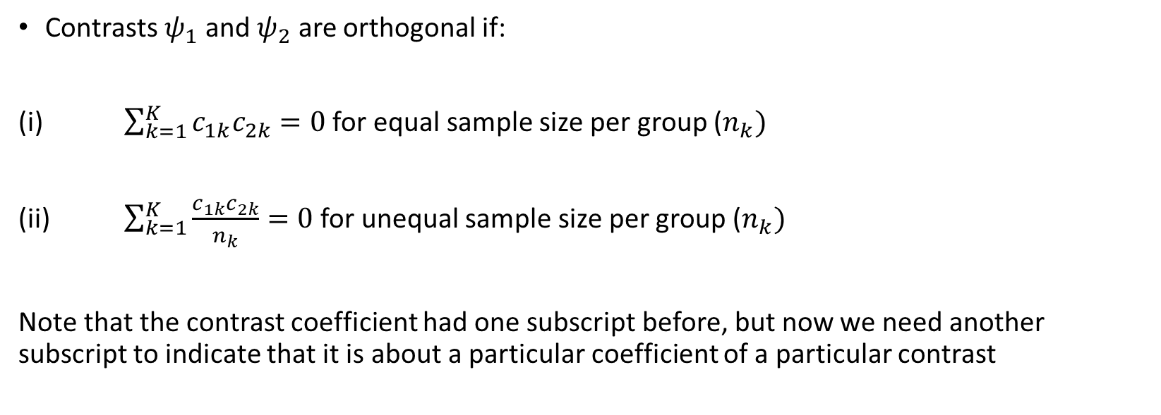
When are contrasts orthogonal?
Contrasts $ψ_{1}$ and $ψ_{2}$ are orthogonal if:
(i) $\sum_{k=1}^{K}{c_{1k}c_{2k}=0}$ for equal sample size per group ($n_{k})$
(ii) $\sum_{k=1}^{K}{\frac{c_{1k}c_{2k}}{n_{k}}}=0$ for unequal sample size per group ($n_{k})$
Note that the contrast coefficient had one subscript before, but now we need another subscript to indicate that it is about a particular coefficient of a particular contrast
Notes:
- READ SLIDE-

Slide 6
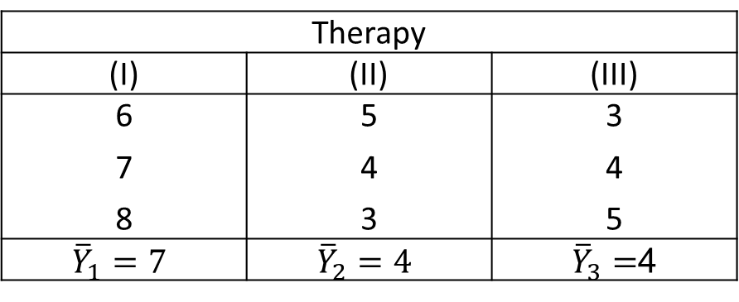
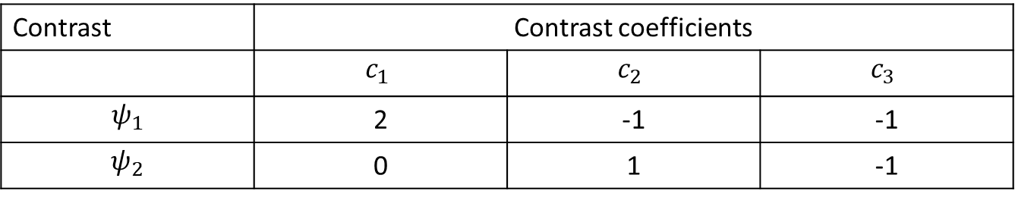
Recurring example
RQ: Is there a difference in the mean anxiety score after Rogerian therapy (I), behavioral therapy A (II), and behavioral therapy B (III)?
Data:
Interesting contrasts:
Therapy
(I) | (II) | (III)
6 7 8 | 5 4 3 | 3 4 5
$${\overline{Y}}_{1}=7$$ | $${\overline{Y}}_{2}=4$$ | ${\overline{Y}}_{3}=$4
Contrast | Contrast coefficients
 | $$c_{1}$$ | $$c_{2}$$ | $$c_{3}$$
$$ψ_{1}$$ | 2 | -1 | -1
$$ψ_{2}$$ | 0 | 1 | -1

Slide 7

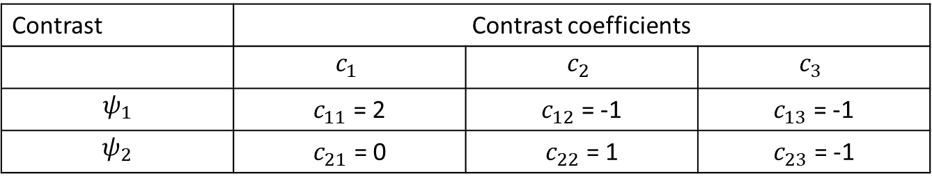
Are the contrasts orthogonal?
Contrasts $ψ_{1}$ and $ψ_{2}$ are orthogonal if:
(i) $\sum_{k=1}^{K}{c_{1k}c_{2k}=0}$ for equal sample size per group ($n_{k})$
Contrast | Contrast coefficients
 | $$c_{1}$$ | $$c_{2}$$ | $$c_{3}$$
$$ψ_{1}$$ | $c_{11}$ = 2 | $c_{12}$ = -1 | $c_{13}$ = -1
$$ψ_{2}$$ | $c_{21}$ = 0 | $c_{22}$ = 1 | $c_{23}$ = -1
Notes:
- READ SLIDE-

Slide 8
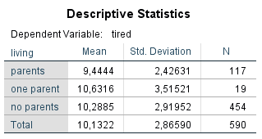
Another example with unequal sample size (n_{k})
RQ: Is there a difference in mean tiredness of students who live with their parents, only one parent, or do not live with their parents?
Variables:
Independent variable/factor is living situation → 1 = with parents, 2 = one parent, 3 = no parents
Dependent variable is tiredness that is measured with a scale
Data: All social science students who followed the statistics course MTO-D-MAW in 2004 (N = 590)
Notes:
- READ SLIDE-

Slide 9
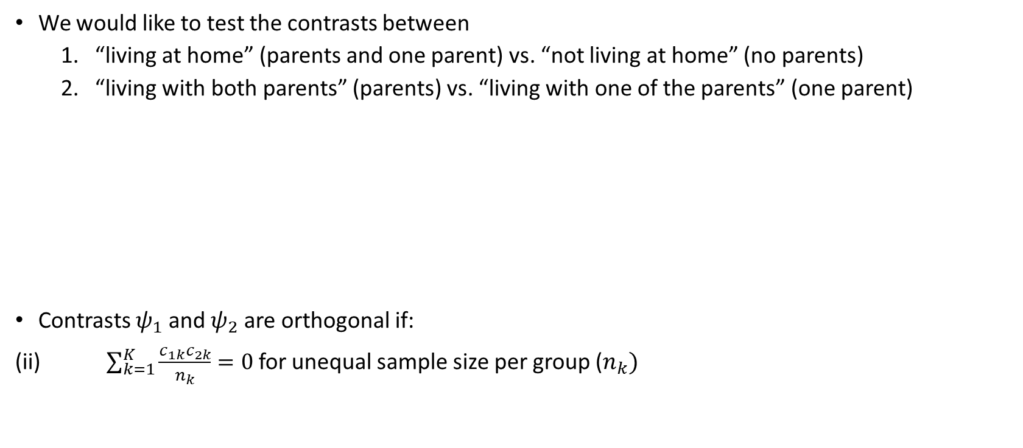
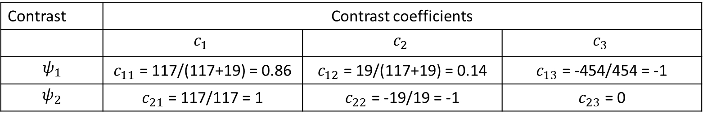
Another example with unequal sample size (n_{k})
We would like to test the contrasts between
“living at home” (parents and one parent) vs. “not living at home” (no parents)
“living with both parents” (parents) vs. “living with one of the parents” (one parent)
Contrasts $ψ_{1}$ and $ψ_{2}$ are orthogonal if:
(ii) $\sum_{k=1}^{K}{\frac{c_{1k}c_{2k}}{n_{k}}}=0$ for unequal sample size per group ($n_{k})$
Contrast | Contrast coefficients
 | $$c_{1}$$ | $$c_{2}$$ | $$c_{3}$$
$$ψ_{1}$$ | $c_{11}$ = 117/(117+19) = 0.86 | $c_{12}$ = 19/(117+19) = 0.14 | $c_{13}$ = -454/454 = -1
$$ψ_{2}$$ | $c_{21}$ = 117/117 = 1 | $c_{22}$ = -19/19 = -1 | $c_{23}$ = 0
Notes:
- READ SLIDE-

Slide 10

Overview contrasts
A priori | Post-hoc
Planned contrasts | Tukey → simple contrast (2 groups)
Trend analysis on K groups | Scheffé → complex contrast (≥2 groups)
Helmert contrasts
Notes:
- READ SLIDE-

Slide 11
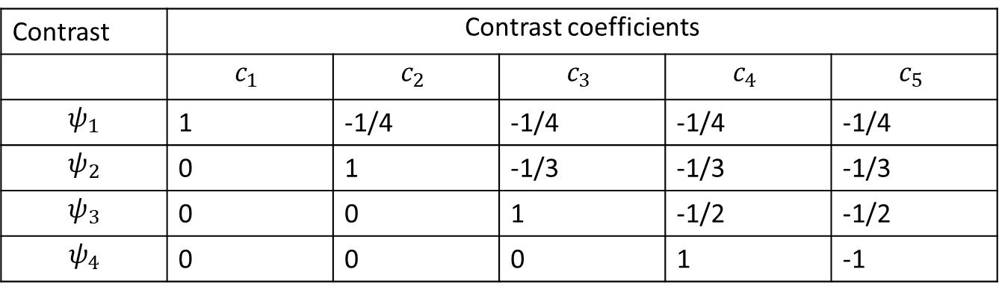
Helmert contrasts
Helmert contrasts are created by comparing each group mean with the mean of the subsequent groups
The number of Helmert contrasts is always equal to K – 1
Note that Helmert contrasts are orthogonal if the sample sizes per group are equal but not when these differ
Contrast | Contrast coefficients
 | $$c_{1}$$ | $$c_{2}$$ | $$c_{3}$$ | $$c_{4}$$ | $$c_{5}$$
$$ψ_{1}$$ | 1 | -1/4 | -1/4 | -1/4 | -1/4
$$ψ_{2}$$ | 0 | 1 | -1/3 | -1/3 | -1/3
$$ψ_{3}$$ | 0 | 0 | 1 | -1/2 | -1/2
$$ψ_{4}$$ | 0 | 0 | 0 | 1 | -1
Notes:
- READ SLIDE-

Slide 12
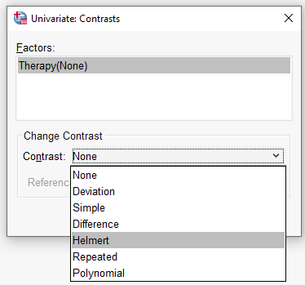
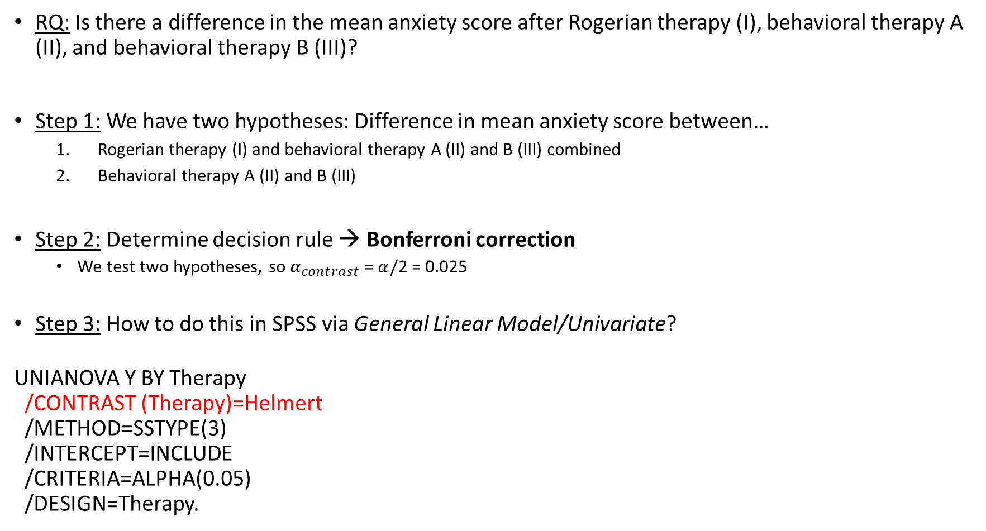
Helmert contrasts in SPSS: Recurring example
RQ: Is there a difference in the mean anxiety score after Rogerian therapy (I), behavioral therapy A (II), and behavioral therapy B (III)?
Step 1: We have two hypotheses: Difference in mean anxiety score between…
Rogerian therapy (I) and behavioral therapy A (II) and B (III) combined
Behavioral therapy A (II) and B (III)
Step 2: Determine decision rule → Bonferroni correction
We test two hypotheses, so $α_{contrast}$ = $α/$2 = 0.025
Step 3: How to do this in SPSS via General Linear Model/Univariate?
UNIANOVA Y BY Therapy /CONTRAST (Therapy)=Helmert /METHOD=SSTYPE(3) /INTERCEPT=INCLUDE /CRITERIA=ALPHA(0.05) /DESIGN=Therapy.

Slide 13
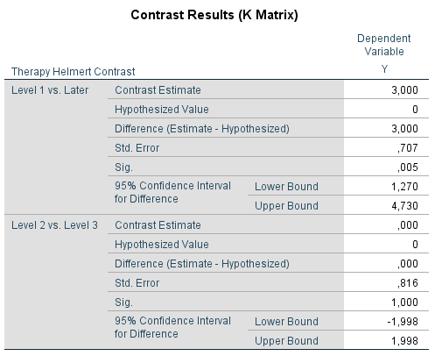
Helmert contrasts in SPSS: Recurring example
Hypotheses: Difference in mean anxiety score between…
Rogerian therapy (I) and behavioral therapy A (II) and B (III) combined
Behavioral therapy A (II) and B (III)
Conclusion?
Notes:
READ SLIDE-
Hier uitleggen dat dit eenzelfde contrast is als een gepland contrast
2 -1 -1
0 1 -1
Want Helmert is:
1 -1/2 -1/2
0 1 -1

Slide 14
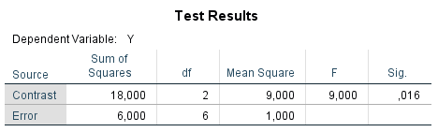
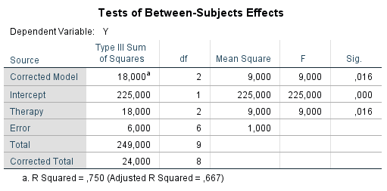
Are Helmert contrasts orthogonal?
SPSS also returns another table for contrasts → “Test Results”
This table shows (i) how much the contrasts explain together (SS = 18), (ii) whether the effect of the contrasts together is significant
We specified the maximum number of contrasts (K – 1) and the contrasts are orthogonal, so SS_{B} is also 18
Notes:
- READ SLIDE-

Slide 15

Trend analysis: Example
The independent variable (factor) is often measured on the nominal level
Sometimes, the independent variable is measured on the interval or ratio level
For example, a memory test for children where they have to remember the number of words after studying these for 1, 2, 3, or 4 minutes (K = 4)
Data:
Minutes/groups | 1 | 2 | 3 | 4
Data | 2 3 1 2 0 4 | 6 8 5 3 7 7 | 6 8 10 5 10 9 | 11 10 7 9 8 9
Notes:
- READ SLIDE-

Slide 16
Trend analysis
If the factor is measured on the interval or ratio level, the SS_{B} is explained by K – 1 orthogonal contrasts that each test a shape of the relation: linear, quadratic, cubic or higher…
Trend analysis contrasts are only orthogonal when the group sizes are equal
We will focus on hypotheses concerning linear and quadratic effects
Positive linear effect → predominantly rising trend
Negative linear effect → predominantly declining trend
Positive quadratic effect → effect increases, sometimes parabola opening upwards visible
Negative quadratic effect → effect decreases, sometimes parabola opening downwards visible
Figures on the next slide illustrate these trends
Notes:
- READ SLIDE-

Slide 17
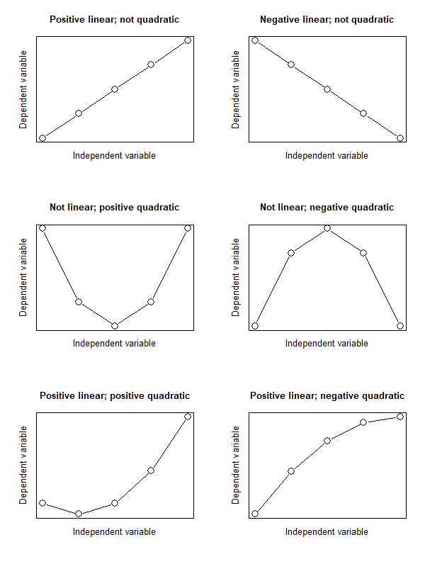
Notes:
Robbie: Op deze slide ook nog met x^2 en –x^2 laten zien hoe tweede rij plaatjes gemaakt wordt. Ook analogie wielrennen als het fietsen even gemakkelijk/moeilijk blijkt dan geen kwadratisch effect. Wordt het moeilijker naar het eind dan positief kwadratisch (berg beklimmen) wordt het gemakkelijker dan negatief kwadratisch.

Slide 18
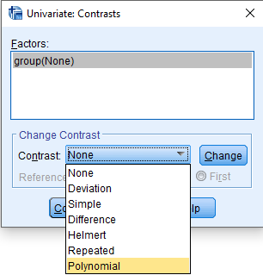
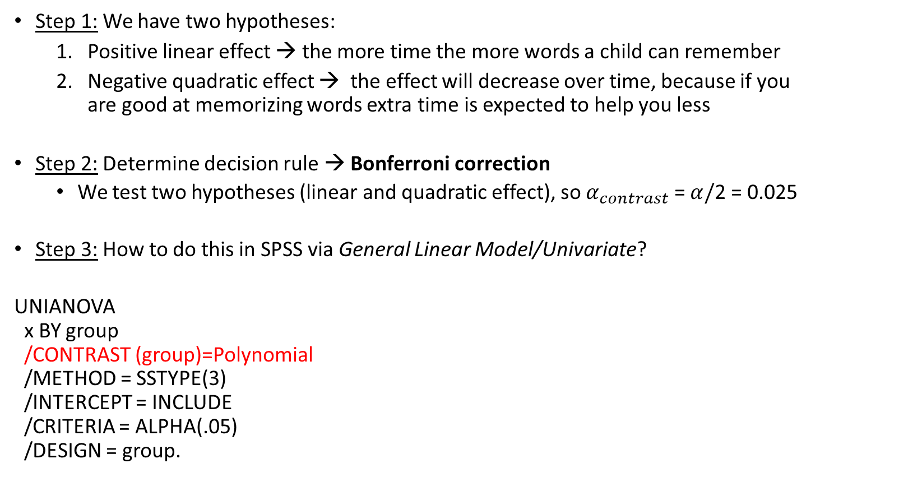
Trend analysis applied to example
Step 1: We have two hypotheses:
Positive linear effect → the more time the more words a child can remember
Negative quadratic effect → the effect will decrease over time, because if you are good at memorizing words extra time is expected to help you less
Step 2: Determine decision rule → Bonferroni correction
We test two hypotheses (linear and quadratic effect), so $α_{contrast}$ = $α/$2 = 0.025
Step 3: How to do this in SPSS via General Linear Model/Univariate?
UNIANOVA x BY group /CONTRAST (group)=Polynomial /METHOD = SSTYPE(3) /INTERCEPT = INCLUDE /CRITERIA = ALPHA(.05) /DESIGN = group.
Notes:
- READ SLIDE-

Slide 19
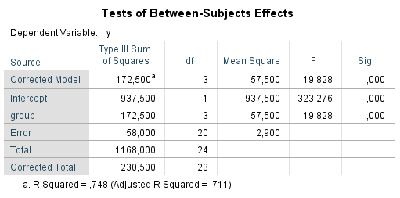
Trend analysis applied to example
Notes:
- READ SLIDE-

Slide 20
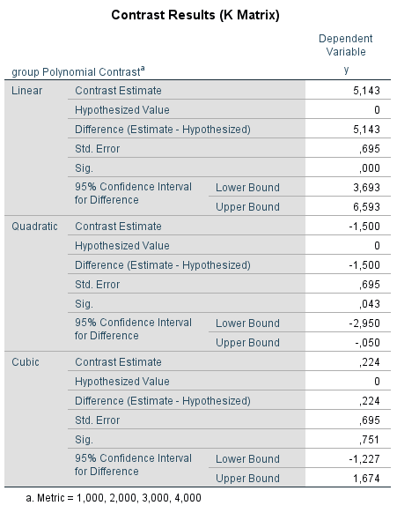
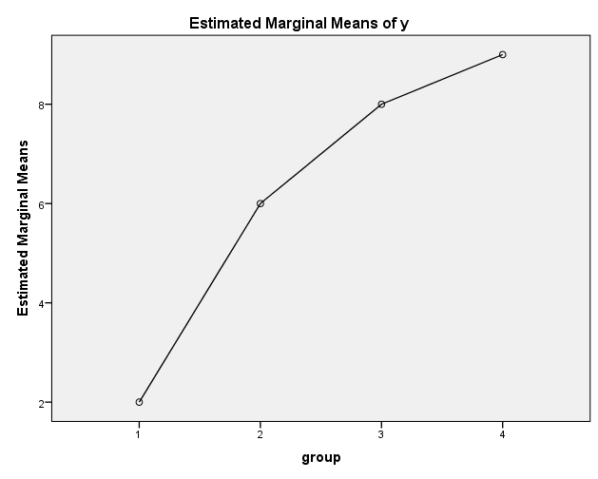
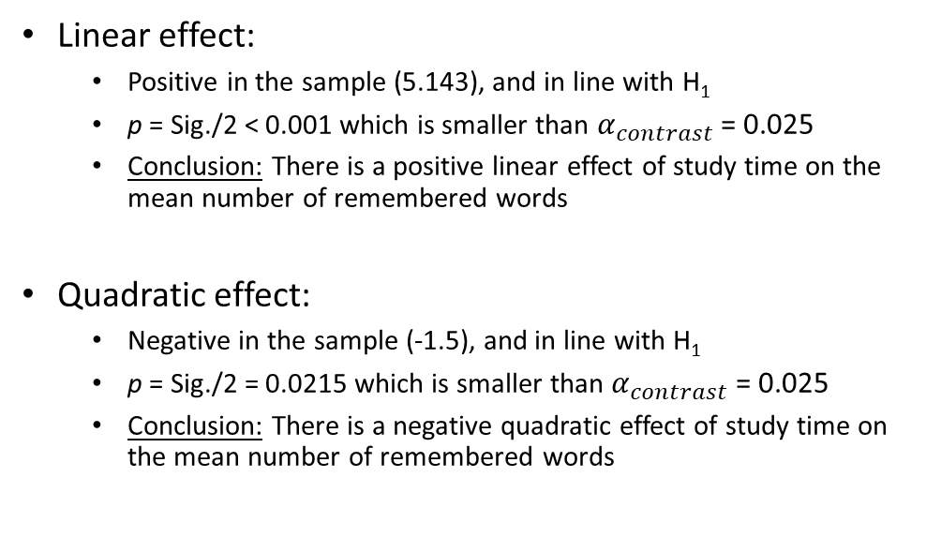
Linear effect:
Positive in the sample (5.143), and in line with H₁
p = Sig./2 < 0.001 which is smaller than $α_{contrast}$ = 0.025
Conclusion: There is a positive linear effect of study time on the mean number of remembered words
Quadratic effect:
Negative in the sample (-1.5), and in line with H₁
p = Sig./2 = 0.0215 which is smaller than $α_{contrast}$ = 0.025
Conclusion: There is a negative quadratic effect of study time on the mean number of remembered words
Notes:
Robbie: Uitleggen dat als er één contrast maar getoetst zou worden dat we dan alpha_contrast = alpha

Slide 21
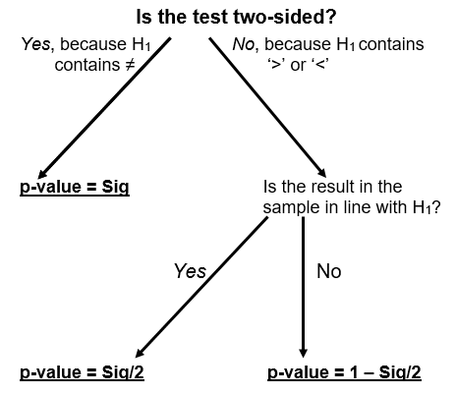
Decision tree interpreting “Sig.” in SPSS output
In all cases below, the following decision rule holds:
“If p-value ≤ α, reject H₀”
Notes:
- READ SLIDE-

Slide 22
Overview contrasts
A priori contrasts need to be specified before seeing the data
When ANOVA ‘says’ that the means differ, one can use post-hoc contrasts (tests) to detect which of the K means differ
A priori | Post-hoc
Planned contrasts | Tukey → simple contrast (2 groups)
Trend analysis on K groups | Scheffé → complex contrast (≥2 groups)
Helmert contrasts
Notes:
- READ SLIDE-

Slide 23
Post-hoc contrasts
The idea is that you (1) can make as many contrasts as you want to detect which means differ
When setting up the contrasts you can (2) let the data guide you, i.e., the values of the means
Because (1) multiple post-hoc contrasts can be conducted and because you can (2) let the data guide you, we need a method to control the probability of at least one Type-I error
How we control the probability of at least on Type-I error depends on the type of post-hoc contrasts: contrasts with 2 means (Tukey) or contrasts with ≥ 2 means (Scheffé)
Notes:
Robbie: Zeg dat bij a priori contrasts we Bonferonni corrective gebruikte om de kans op een Type-I fout the controleren.

Slide 24
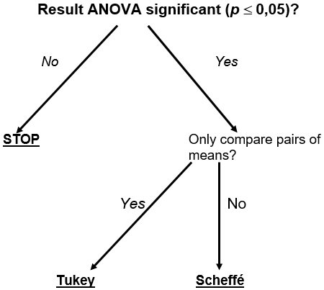
Post-hoc contrasts: Tukey or Scheffé?

Slide 25
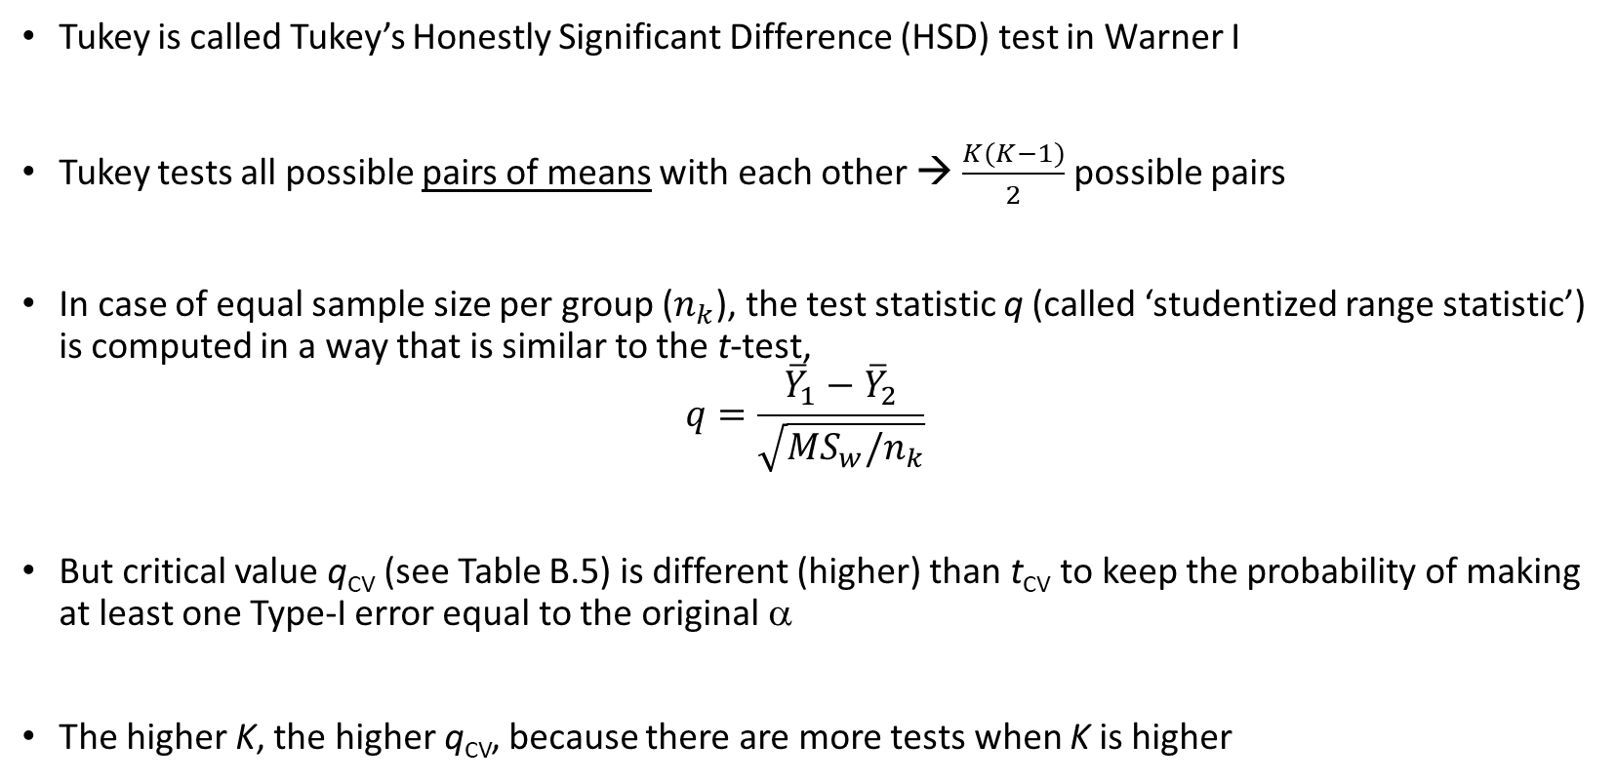
Tukey
Tukey is called Tukey’s Honestly Significant Difference (HSD) test in Warner I
Tukey tests all possible pairs of means with each other → $\frac{K(K−1)}{2}$ possible pairs
In case of equal sample size per group ($n_{k}$), the test statistic q (called ‘studentized range statistic’) is computed in a way that is similar to the t-test,
$$q=\frac{{\overline{Y}}_{1}−{\overline{Y}}_{2}}{\sqrt{MS_{w}/n_{k}}}$$
But critical value q_{CV} (see Table B.5) is different (higher) than t_{CV} to keep the probability of making at least one Type-I error equal to the original α
The higher K, the higher q_{CV}, because there are more tests when K is higher
Notes:
Robbie: Tabel laten zien en uitleggen dat het afhankelijk is van df_w, alpha en K

Slide 26
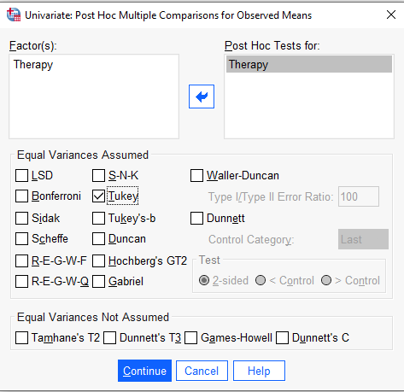
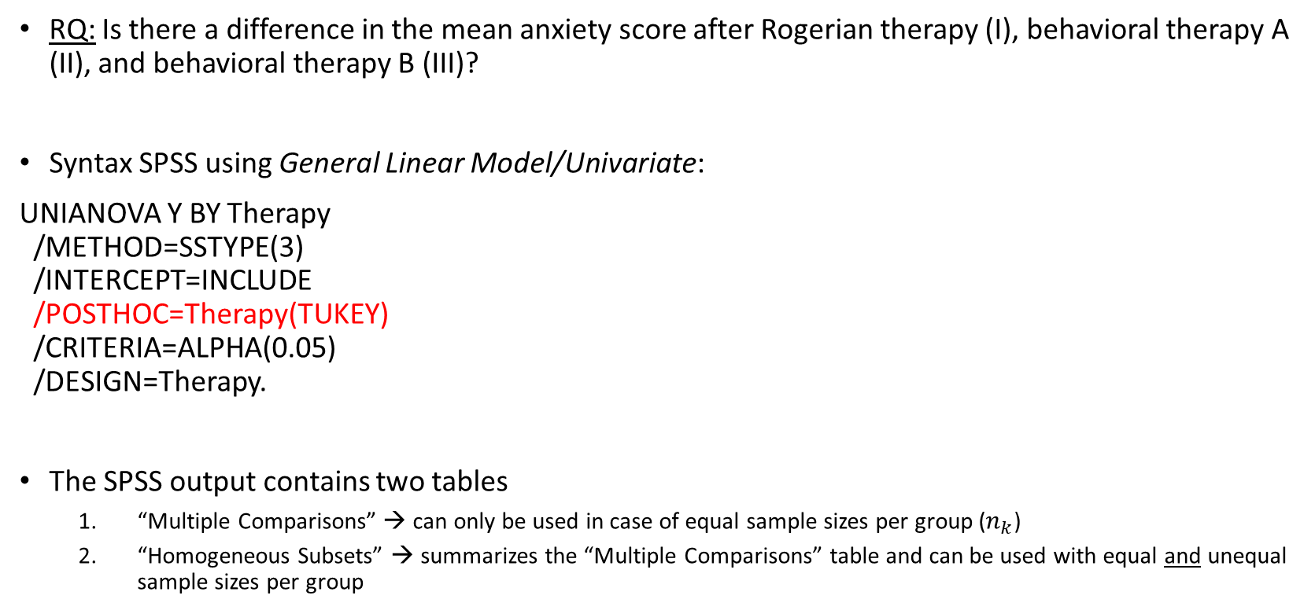
Tukey applied using SPSS to recurring example
RQ: Is there a difference in the mean anxiety score after Rogerian therapy (I), behavioral therapy A (II), and behavioral therapy B (III)?
Syntax SPSS using General Linear Model/Univariate:
UNIANOVA Y BY Therapy /METHOD=SSTYPE(3) /INTERCEPT=INCLUDE /POSTHOC=Therapy(TUKEY) /CRITERIA=ALPHA(0.05) /DESIGN=Therapy.
The SPSS output contains two tables
“Multiple Comparisons” → can only be used in case of equal sample sizes per group ($n_{k}$)
“Homogeneous Subsets” → summarizes the “Multiple Comparisons” table and can be used with equal and unequal sample sizes per group

Slide 27
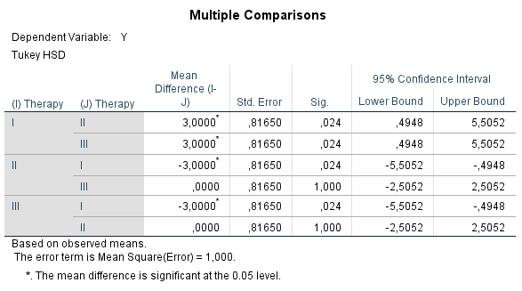
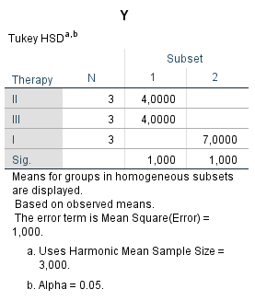
Homogeneous subset: the means of the groups that do not differ significantly from each other
P-value of a homogenous subset corresponds with the lowest p-value of all tests within the same subset
Conclusion: Means of both behavioral therapies (II and III) differ from the mean of the Rogerian therapy (I)

Slide 28
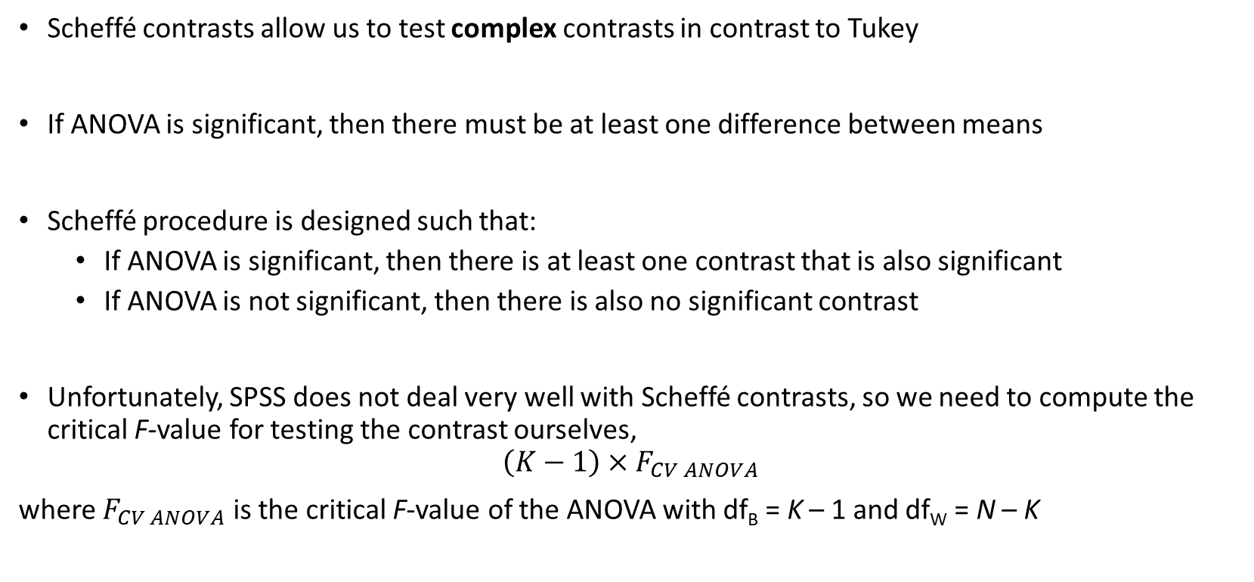
Scheffé
Scheffé contrasts allow us to test complex contrasts in contrast to Tukey
If ANOVA is significant, then there must be at least one difference between means
Scheffé procedure is designed such that:
If ANOVA is significant, then there is at least one contrast that is also significant
If ANOVA is not significant, then there is also no significant contrast
Unfortunately, SPSS does not deal very well with Scheffé contrasts, so we need to compute the critical F-value for testing the contrast ourselves,
$$\left(K−1\right)×F_{CV ANOVA}$$
where $F_{CV ANOVA}$ is the critical F-value of the ANOVA with df_{B} = K – 1 and df_{W} = N – K
Notes:
Robbie: K verwijst naar het total aantal groepen in de ANOVA en niet naar het aantal groepen wat in het contrast zit. Zie ook pagina 395 van Gravetter en Wallnau (2015).

Slide 29
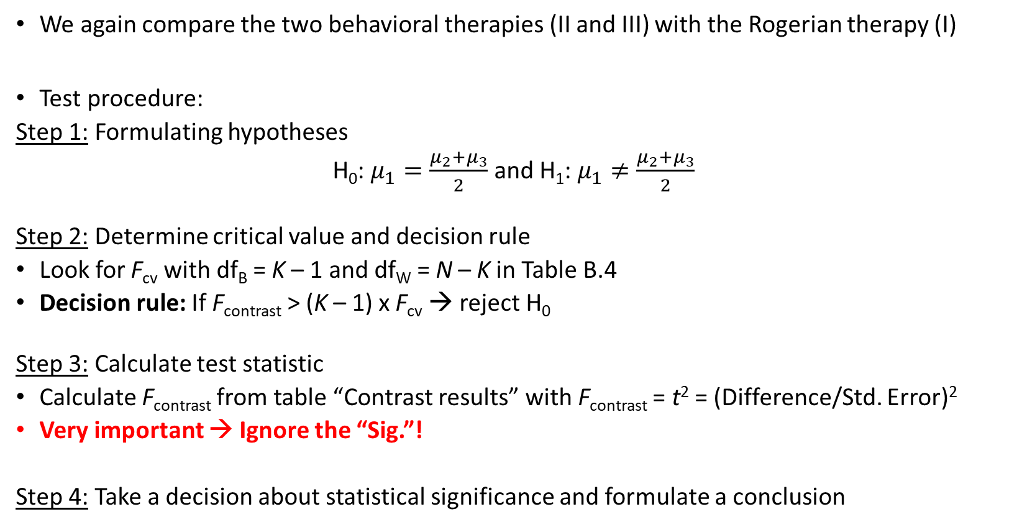
Test procedure Scheffé for recurring example
We again compare the two behavioral therapies (II and III) with the Rogerian therapy (I)
Test procedure:
Step 1: Formulating hypotheses
H₀: $μ_{1}=\frac{μ_{2}+μ_{3}}{2}$ and H₁: $μ_{1}≠\frac{μ_{2}+μ_{3}}{2}$
Step 2: Determine critical value and decision rule
Look for F_{cv} with df_{B} = K – 1 and df_{W} = N – K in Table B.4
Decision rule: If F_{contrast} > (K – 1) x F_{cv} → reject H₀
Step 3: Calculate test statistic
Calculate F_{contrast} from table “Contrast results” with F_{contrast} = t² = (Difference/Std. Error)²
Very important → Ignore the “Sig.”!
Step 4: Take a decision about statistical significance and formulate a conclusion

Slide 30
Scheffé applied using SPSS to recurring example
Syntax SPSS using General Linear Model/Univariate:
UNIANOVA Y BY Therapy /CONTRAST (Therapy)=Special (2 -1 -1) /METHOD=SSTYPE(3) /INTERCEPT=INCLUDE /CRITERIA=ALPHA(0.05) /DESIGN=Therapy.
Notice that the syntax and output on the next slide are the same as the planned contrast we tested in lecture 4, but that was an a priori contrast and this is a post-hoc contrast

Slide 31
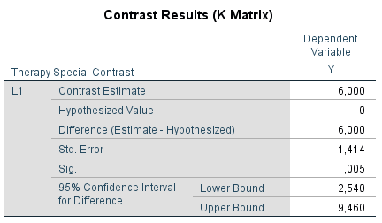
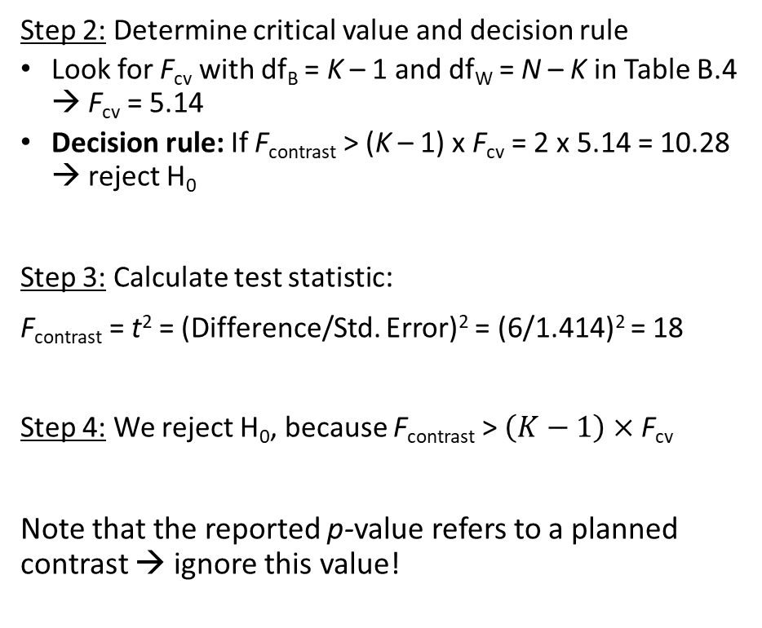
Scheffé applied using SPSS to recurring example
Step 2: Determine critical value and decision rule
Look for F_{cv} with df_{B} = K – 1 and df_{W} = N – K in Table B.4 → F_{cv} = 5.14
Decision rule: If F_{contrast} > (K – 1) x F_{cv} = 2 x 5.14 = 10.28 → reject H₀
Step 3: Calculate test statistic:
F_{contrast} = t² = (Difference/Std. Error)² = (6/1.414)² = 18
Step 4: We reject H₀, because F_{contrast} > $\left(K−1\right)×$ F_{cv}
Note that the reported p-value refers to a planned contrast → ignore this value!

Slide 32
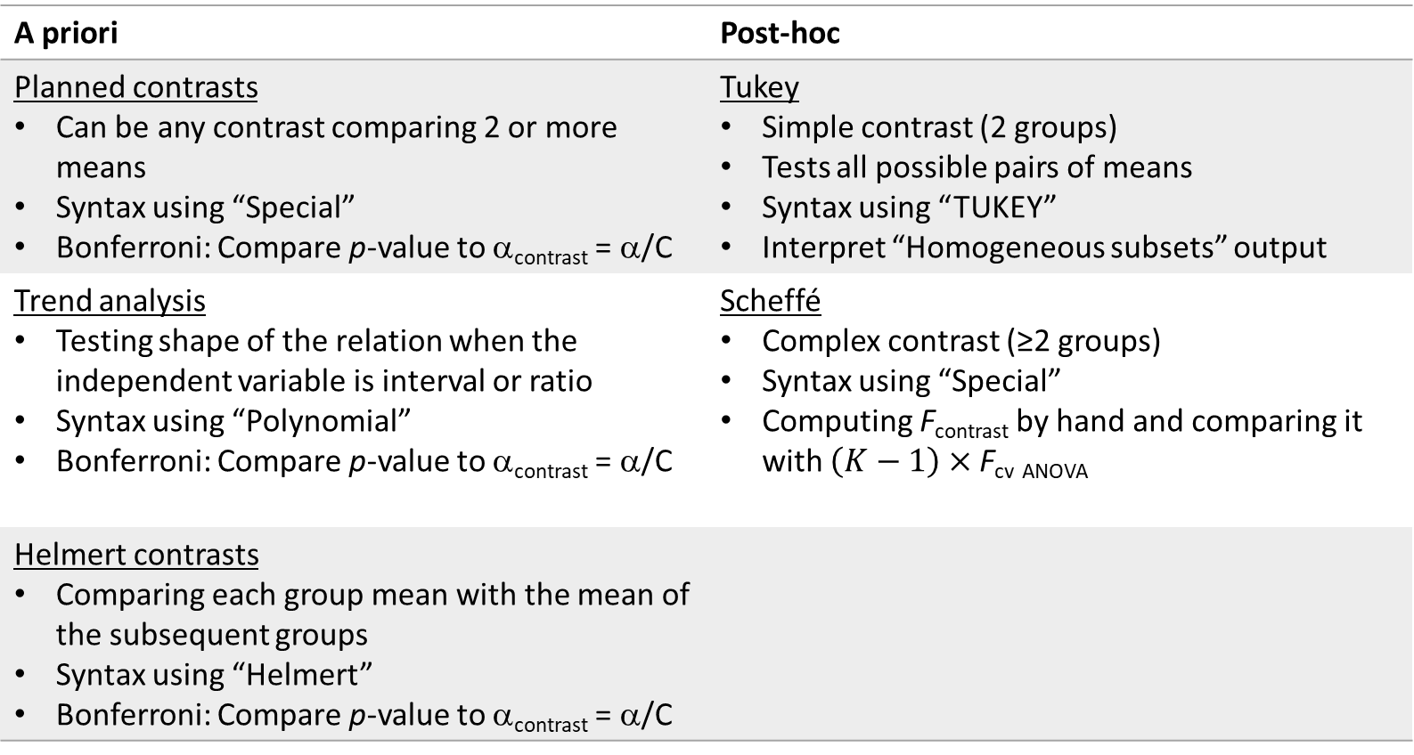
Summary contrasts
A priori | Post-hoc
Planned contrasts Can be any contrast comparing 2 or more means Syntax using “Special” Bonferroni: Compare p-value to α_{contrast} = α/C | Tukey Simple contrast (2 groups) Tests all possible pairs of means Syntax using “TUKEY” Interpret “Homogeneous subsets” output
Trend analysis Testing shape of the relation when the independent variable is interval or ratio Syntax using “Polynomial” Bonferroni: Compare p-value to α_{contrast} = α/C | Scheffé Complex contrast (≥2 groups) Syntax using “Special” Computing F_{contrast} by hand and comparing it with $\left(K−1\right)×$ F_{cv} _{ANOVA}
Helmert contrasts Comparing each group mean with the mean of the subsequent groups Syntax using “Helmert” Bonferroni: Compare p-value to α_{contrast} = α/C
Notes:
- READ SLIDE-

Slide 33
Literature:
Warner I: 13.11-13.16
Two-way ANOVA part I
Next week…

