Slide 1
Experimental Research Methods Lecture 12

Slide 2
Exam Experimental Research Methods
No graphing calculator
Booklet with formulas and tables is attached to the exam (do NOT print it yourself)
You are allowed to note your answers at the back of the cover of the exam. The correct answers will be posted on Canvas.
You can share any remarks about the exam via the Canvas Discussions page (until three days after the exam)
The date and time of the exam inspection will be communicated via Canvas

Slide 3
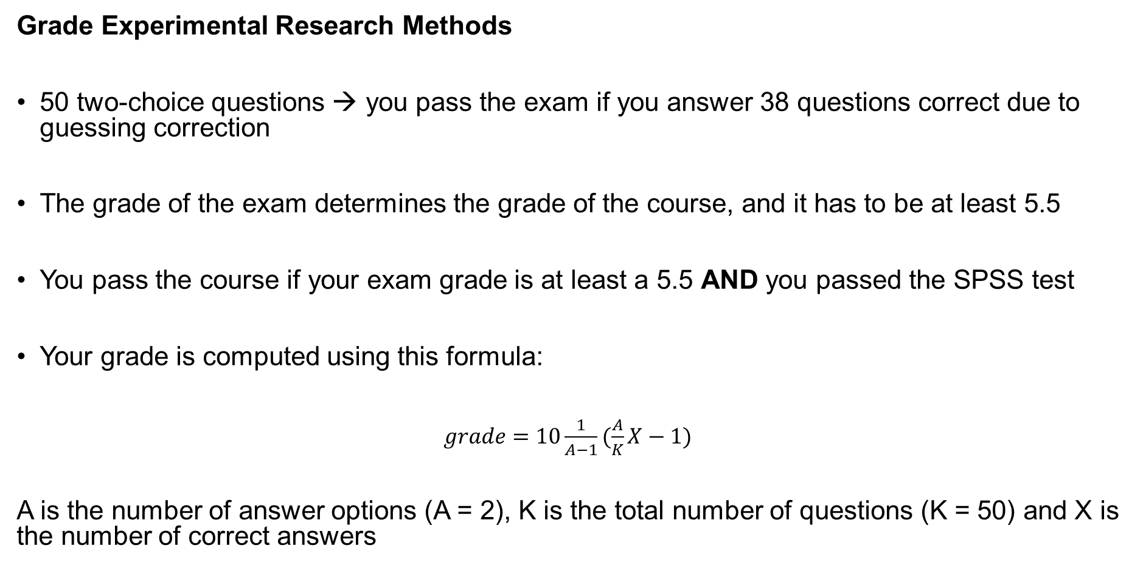
Grade Experimental Research Methods
50 two-choice questions → you pass the exam if you answer 38 questions correct due to guessing correction
The grade of the exam determines the grade of the course, and it has to be at least 5.5
You pass the course if your exam grade is at least a 5.5 AND you passed the SPSS test
Your grade is computed using this formula:
$grade=10\frac{1}{A−1}(\frac{A}{K}X−1)$
A is the number of answer options (A = 2), K is the total number of questions (K = 50) and X is the number of correct answers

Slide 4
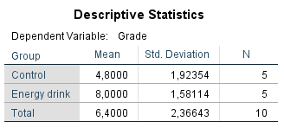
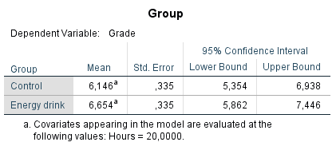
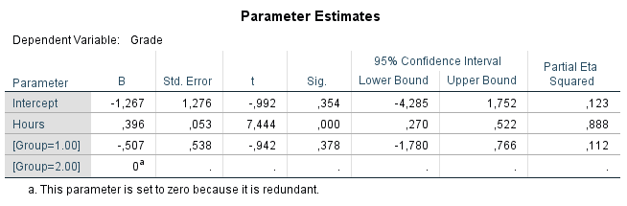
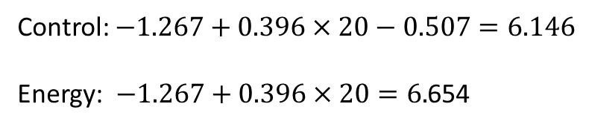
ANCOVA: Example
What are the means in grade when controlling for the covariate Hours?
Unadjusted means: Adjusted means:
Control: $−1.267+0.396×20−0.507=6.146$
Energy: $−1.267+0.396×20=6.$654

Slide 5
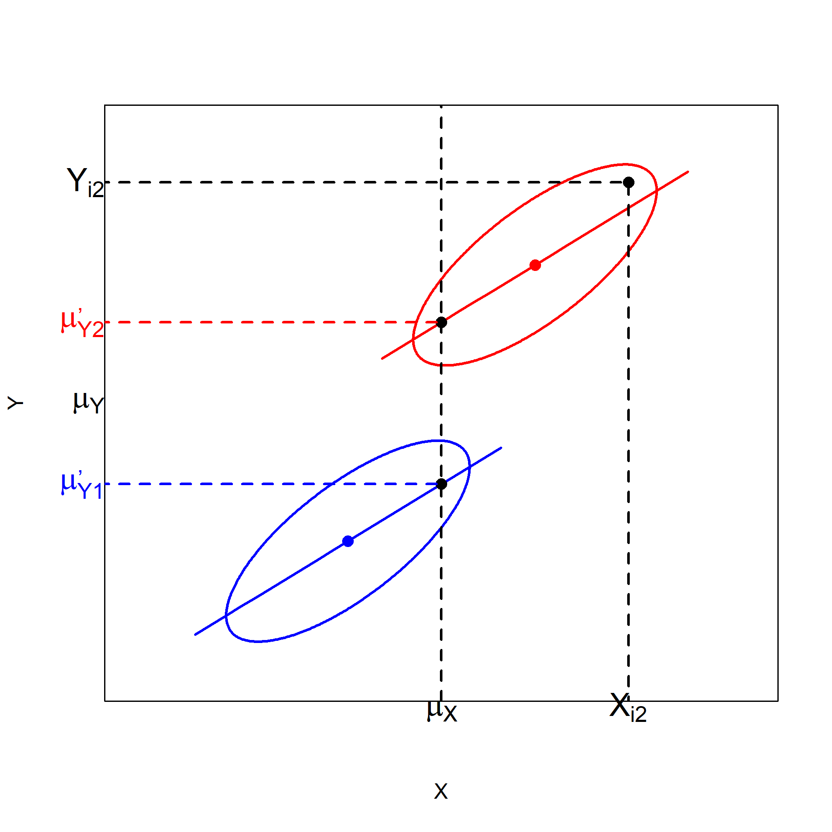

Explanation of eliminating bias using figures
ANCOVA model:
$$Y_{i2} = μ_{Y} +{α′}_{2}+ β_{W}\left(X_{i2}−μ_{X}\right)+ε_{i2}$$

