Slide 1
Experimental Research Methods Lecture 11

Slide 2
Lecture goals lecture 11
After this lecture and studying the materials, students are able to:
Explain that high internal and external validity and power are needed to achieve the goals of experiments
Explain why the commonly used convenience samples within psychology are not ideal
Explain how to control for confounding variables in a between-subjects and within-subjects design
Motivate when an experiment should be a between-subjects and when a within-subjects design

Slide 3
Design of an experiment
Design of an experiment has everything to do with how you setup an experiment
No statistical technique can fix a poorly designed experiment!
Some parts of what I will discuss have already been discussed in the course Introduction to Research Methodology
Warner I and II hardly discuss designing experiments → Chapter of Heiman on Canvas
Note that I will only focus on a selection of topics discussed in Heiman → Read the chapter!

Slide 4
Goal experiments
Determine whether independent variable (IV) has an effect on the dependent variable (DV):
We try to achieve this goal with:
High external validity
High internal validity
High statistical power
Independent variable
Exp. group
Control group
Dependent variable

Slide 5
Goal experiments
External validity → the degree to which the conclusions of a study can be generalized to other people, geographical location, context, time, and duration of effect
Violated if the sample is not representative, experimental setting is not similar to the generalization setting, etc
Internal validity → the degree to which the relationship between the IV and DV indeed (only) reflects the relationship between IV and DV
Violated if the manipulation does not actually target the IV, or participants are not randomly assigned but choose their own condition, or participants talk about the experiment with other participants, etc
Power → maximizing the probability of finding a true effect between IV and DV if there is one, so making an effort to decrease MS_{w}

Slide 6
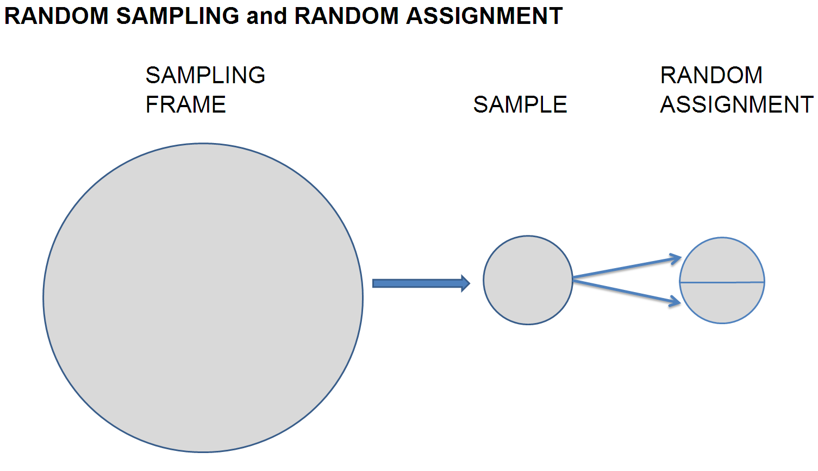
Sampling
Optimal situation → simple random sample
The larger the simple random sample, the less likely it is that you have a nonrepresentative sample → higher external validity of the study

Slide 7
Sampling
A convenience sample rather than a simple random sample is often used in psychology
Criticism on psychology as a science:
“psychology is not the study of humans, but it is the study of first year psychology students”
Large threat to the external validity, because sample is not representative
And…
Volunteer bias → only those subjects are included that are willing to participated in a study
Subject sophistication → subjects are knowledgeable about the topic of the research
And lower power if variance of the DV is lower in a convenience sample than in population (note: could also be higher power)

Slide 8
Sampling: Conclusions
If psychological processes are studied that are expected to be different in different groups of people, a simple random sample is preferable to achieve the goal of an experiment
If psychological processes do not differ between different groups of people, a convenience sample is allowed
Psychologists use convenience samples extremely often, even when psychological processes differ between different groups of people
Psychologists should use simple random samples more often!

Slide 9
Controlling for confounding variables
A confounder influences both the dependent variable and independent variable, causing a spurious association between them
Confounding can occur if participants differ between conditions
For example, if we conduct an experiment to study whether a new teaching method improves students’ performance, but the randomly assigned groups differ substantially in IQ, then IQ could be a confounding variable
Confounding can occur by random chance even if random assignment was used
But if you used random assignment, and measured the confounder before applying the manipulation, then you can be sure that the confounder is not caused by the manipulation and it’s fine to control for it
Confounding variables decrease the internal validity and power

Slide 10
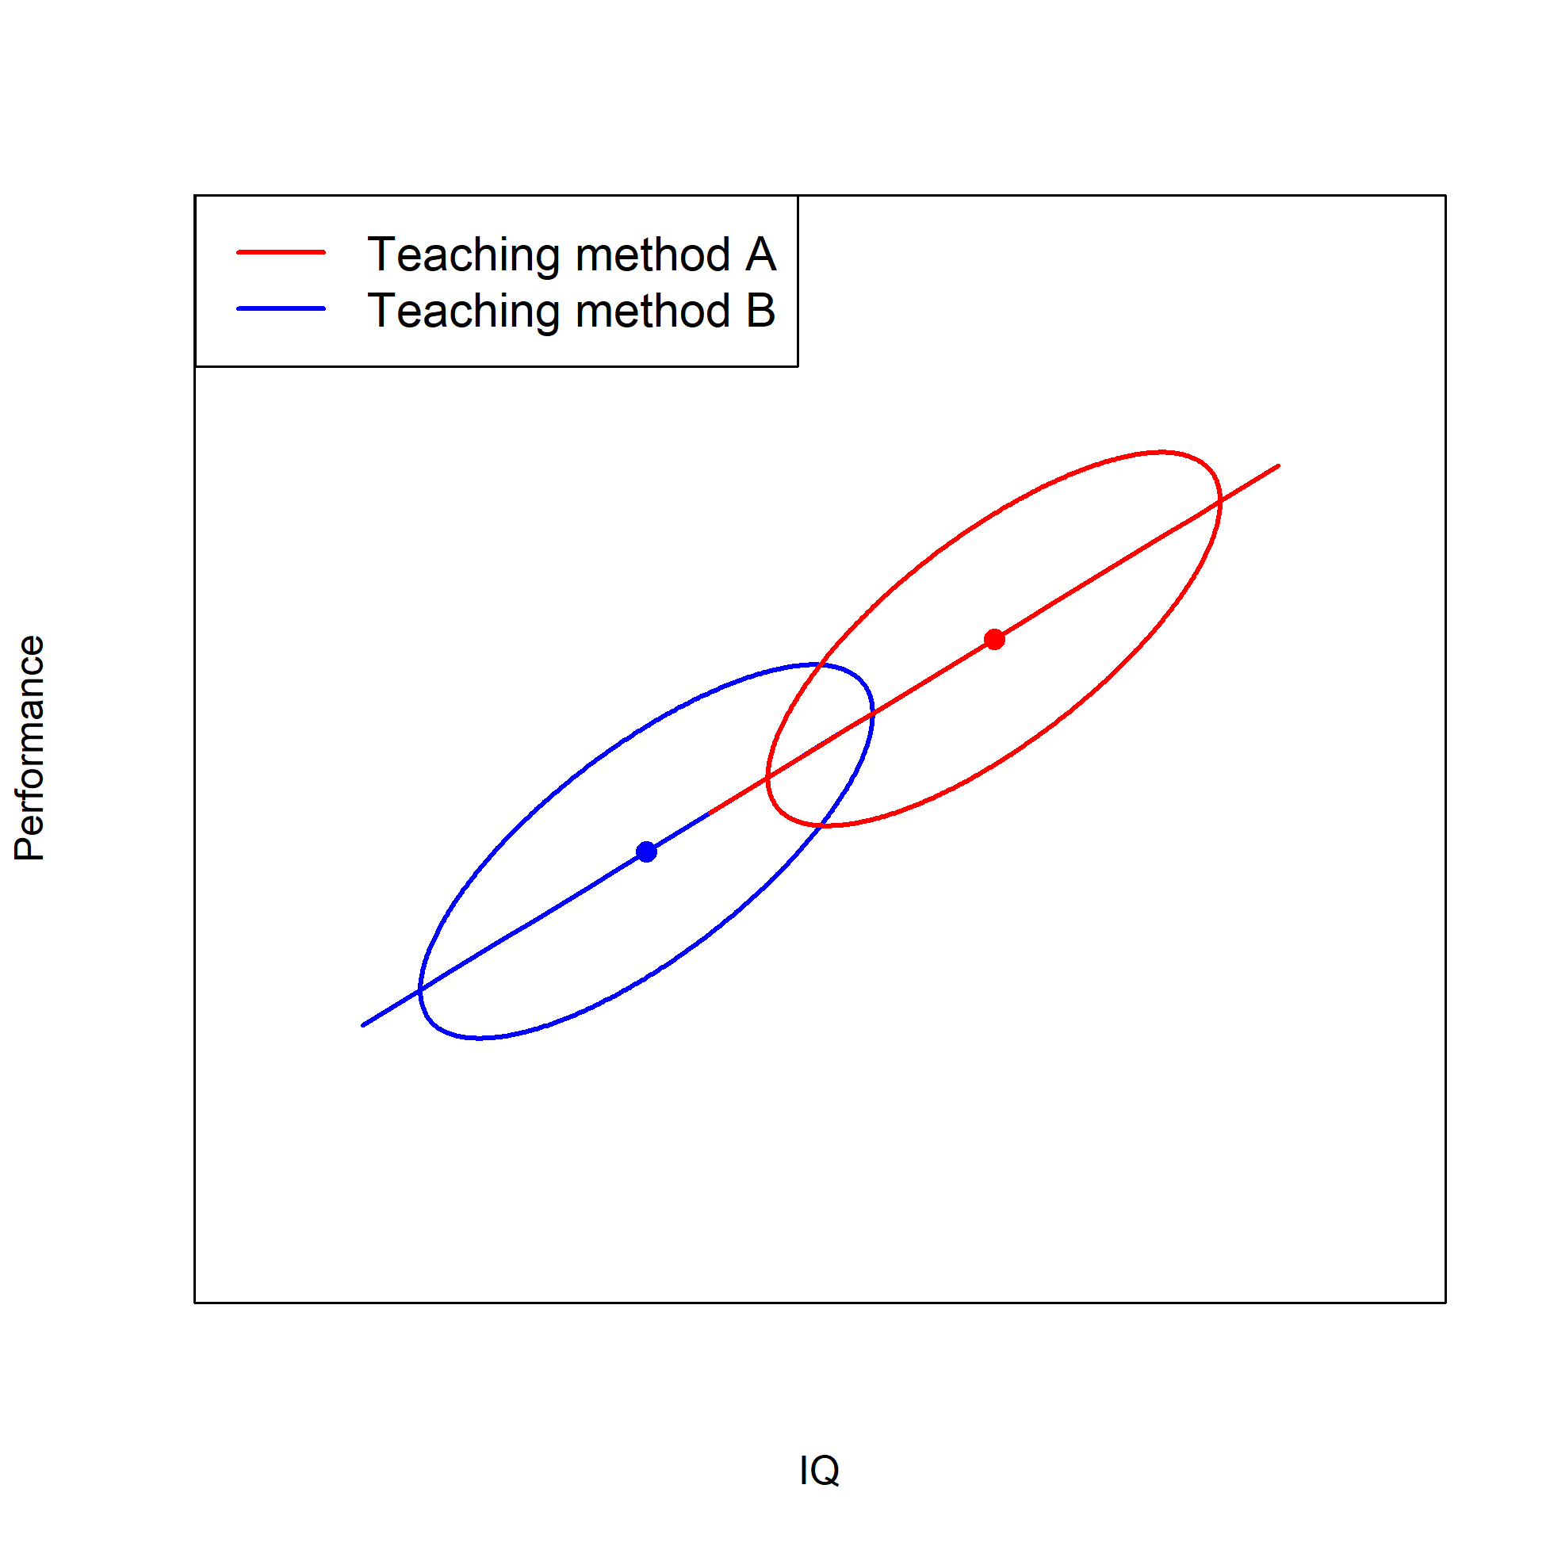
Controlling for confounding variables
Confounding variables decrease internal validity
Suppose that the confounding variable is related to the DV
Persons between levels of the IV differ on the confounding variable
Then there are also differences in the DV between levels, not directly caused by differences in the IV
Therefore, problems with internal validity → relationship is not IV causes DV, but confounding variable causing DV
Notes:
Robbie: Smart student would say that IQ should be incorporated in an ANCOVA

Slide 11
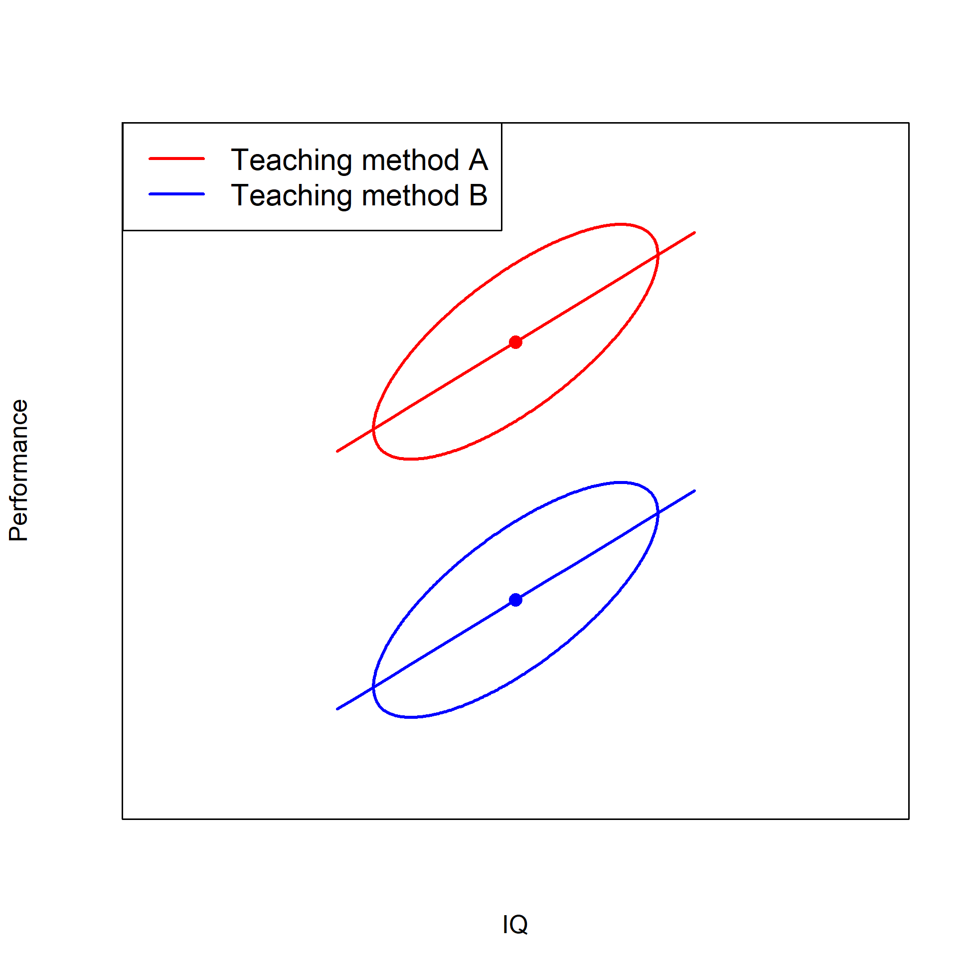
Controlling for confounding variables
Confounding variables decrease power
Suppose that the confounding variable is related to the DV
Persons within one level of the IV differ on the confounding variable
Then also differences in the DV within one level
Therefore, a higher MS_{W} → lower power
Notes:
Robbie: Smart student would say that IQ should be incorporated in an ANCOVA

Slide 12
How to control for confounding variables in BS design?
Random assignment of subjects to conditions
Random assignment breaks the causal link of any potential confounder with the DV. When it is unclear what the confounding variables exactly are, randomization and a large n per cell results in balancing of all these variables
Systematically balance confounding variable
Balance groups with regard to confounding variable → groups are guaranteed to be balanced (in contrast to randomization)
But balancing by ONE variable can introduce bias in OTHER variables
Include confounding variable in the analysis → statistical control
But if the confounding variable is actually a collider, then this introduces bias
Matched group design
Balance groups with regard to confounding variable → one person in one group (exactly) matches one other person in all other groups with regard to the score on the confounding variable
Stronger than balancing because exact match
But balancing by SOME variables can introduce bias in OTHER (unmeasured) variables
Include confounding variable in the analysis → statistical control
Notes:
Robbie: Restricting the sample is also mentioned in Heiman, but very low external validity if you do this

Slide 13
What about a WS design?
Problems of procedures in a between-subjects design can be that (i) it is unclear what variables are confounding and (ii) there are too many confounds
In the ideal situation, all confounding variables are controlled for
This can be done by exposing the same person to all conditions → repeated measures, within-subjects
Another advantage is that there is a larger decrease in MS_{W} for within-subjects designs → larger statistical power
However, there is no free lunch and there are also disadvantages…

Slide 14
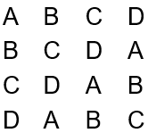
How to control for confounding variables in WS design?
Internal validity in a within-subjects design can be decreased by order effects
Practice effects → getting better at a task when progressing in the experiment
Fatigue effects → if a subject becomes tired
Carry-over effects → the experience obtained with the first condition affects the scores in the second condition
Response sets → developing a habitual response for subsequent tasks
Order effects can be controlled by balancing the order of conditions:
Partial balance → Latin square design
Randomly balance → each participant gets a random order of conditions
Full balance → all orders occur and subjects are randomly assigned to orders of conditions

Slide 15
When WS and when BS design?
 | Between-subjects | Within-subjects
Time experiment | Experiment administered in long period of time | Experiment administered in short amount of time (less affected by sources of interference of internal validity)
Stimuli | Small number of stimuli is sufficient | Large number of stimuli are needed
Confounding variables | Not many confounding variables possible | Many possible confounding variables
Measurement | Confounding variables that are easily measured (reliably and validly) | Confounding variables that are not easy to measure (reliably and validly)
Note that selecting a design generally depends on traditions in disciplines while it should depend on characteristics of the studied variables

Slide 16
Literature:
Chapter of Heiman (see Canvas)
Q&A lecture
Next week…

