Slide 1
Experimental Research Methods Lecture 6

Slide 2
Lecture goals lecture 6
After this lecture and studying the materials, students are able to:
Explain how a one-way ANOVA is different from a two-way ANOVA
Define a main effect and an interaction and identify the patterns of data that produce main effects and interactions
Interpret the SPSS output of a two-way ANOVA

Slide 3
Two-way ANOVA
Our focus so far has been on one-way ANOVA → one independent variable/factor
For example, studying whether different psychological treatments have a positive influence on patients’ health
We can, however, also add another independent variable → two-way ANOVA
For example, studying whether the treatments have a positive influence on patients’ health and whether the efficacy of a treatment is different for men and women → gender as factor
You could even add a third and more independent variables!

Slide 4
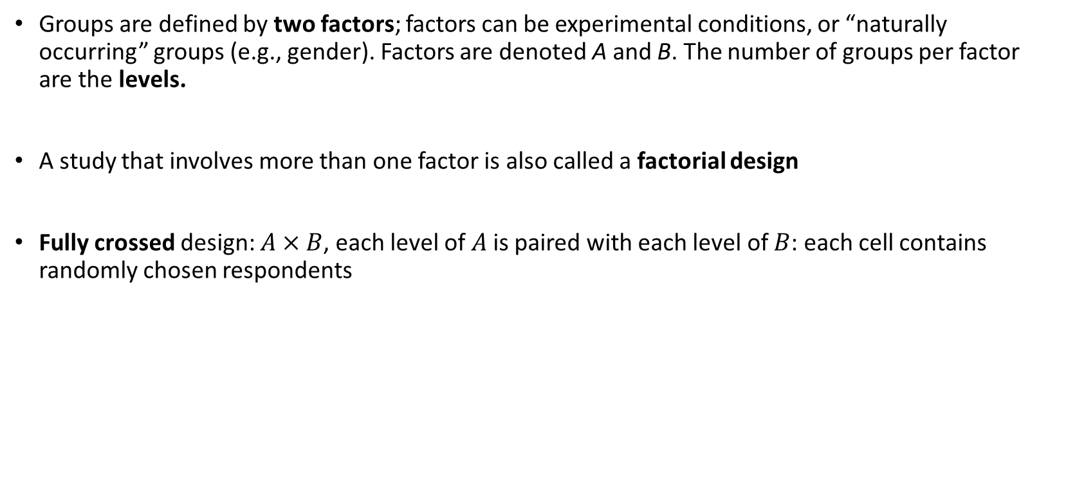
Two-way ANOVA
Groups are defined by two factors; factors can be experimental conditions, or “naturally occurring” groups (e.g., gender). Factors are denoted A and B. The number of groups per factor are the levels.
A study that involves more than one factor is also called a factorial design
Fully crossed design: $A×B$, each level of $A$ is paired with each level of $B$: each cell contains randomly chosen respondents
 |  | Factor B
 |  | B1 | B2
Factor A | A1
 | A2

Slide 5
Two-way ANOVA: Example
RQ: A researcher is interested in the effects of three types of drugs on behavioral improvements of both patients with a depression and schizophrenia
Independent variables/factors:
Type of patient → levels = Depression and schizophrenia
Type of drug → levels = Drug A, B, and C
Data:
 |  | Type of drug
 |  | Drug A | Drug B | Drug C
Type of patient | Depression | 8; 4; 0 | 10; 8; 6 | 8; 6; 4
 | Schizophrenia | 14;10; 6 | 4; 2; 0 | 15;12; 9

Slide 6

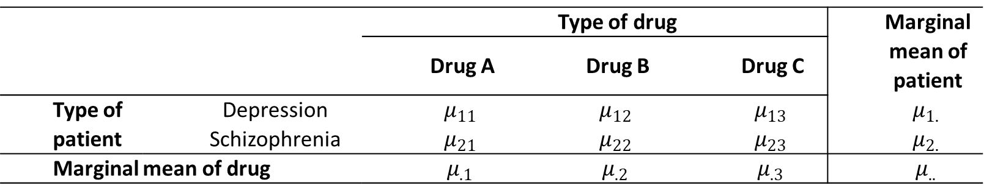
Two-way ANOVA: Hypotheses
Hypothesis 1:
Is there an effect? → Do the population means differ from each other?
$H_{0}:μ_{11}=μ_{12}=μ_{13}=μ_{21}=μ_{22}=μ_{23}$
 |  | Type of drug |  |  | Marginal mean of patient
 |  | Drug A | Drug B | Drug C
Type of patient | Depression | $$μ_{11}$$ | $$μ_{12}$$ | $$μ_{13}$$ | $$μ_{1.}$$
 | Schizophrenia | $$μ_{21}$$ | $$μ_{22}$$ | $$μ_{23}$$ | $$μ_{2.}$$
Marginal mean of drug |  | $$μ_{.1}$$ | $$μ_{.2}$$ | $$μ_{.3}$$ | $$μ_{..}$$

Slide 7

Two-way ANOVA: Hypotheses
Hypothesis 1:
Is there an effect? → Do the population means differ from each other?
$H_{0}:μ_{11}=μ_{12}=μ_{13}=μ_{21}=μ_{22}=μ_{23}$
Population means: No effect
 |  | Type of drug |  |  | Marginal mean of patient
 |  | Drug A | Drug B | Drug C
Type of patient | Depression | 10 | 10 | 10 | 10
 | Schizophrenia | 10 | 10 | 10 | 10
Marginal mean of drug |  | 10 | 10 | 10 | 10

Slide 8
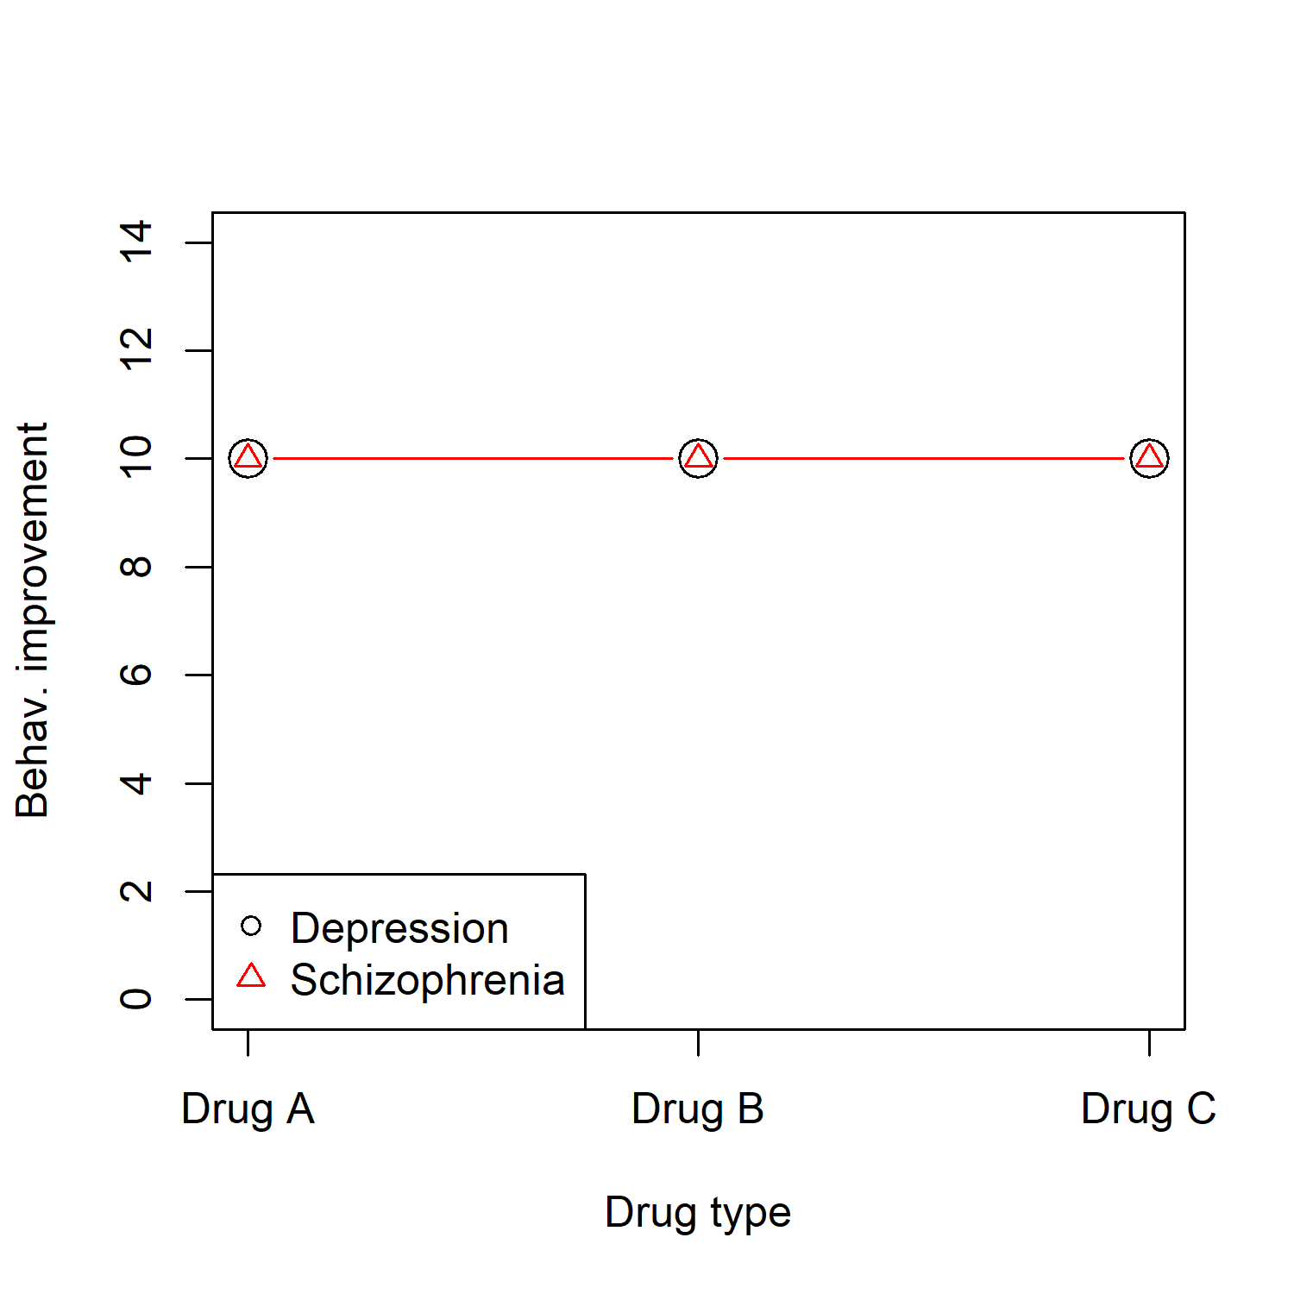
Two-way ANOVA: Hypotheses
Hypothesis 1:
Is there an effect? → Do the population means differ from each other?
$H_{0}:μ_{11}=μ_{12}=μ_{13}=μ_{21}=μ_{22}=μ_{23}$

Slide 9

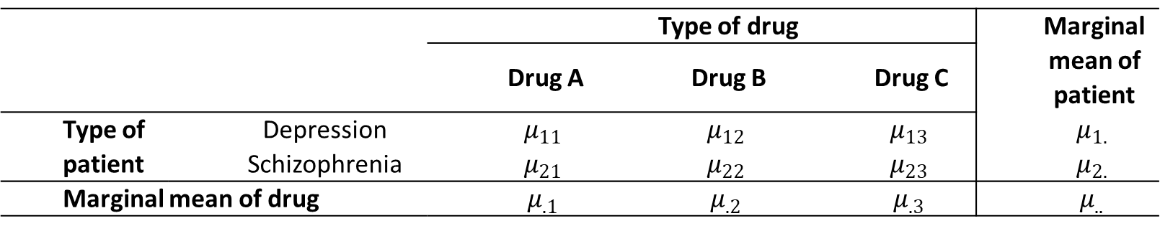
Two-way ANOVA: Hypotheses
Hypothesis 2:
Is there a main effect of type of patient? → Do the two population means for patients with depression and schizophrenia differ from each other?
$H_{0}:μ_{1.}=μ_{2.}$
 |  | Type of drug |  |  | Marginal mean of patient
 |  | Drug A | Drug B | Drug C
Type of patient | Depression | $$μ_{11}$$ | $$μ_{12}$$ | $$μ_{13}$$ | $$μ_{1.}$$
 | Schizophrenia | $$μ_{21}$$ | $$μ_{22}$$ | $$μ_{23}$$ | $$μ_{2.}$$
Marginal mean of drug |  | $$μ_{.1}$$ | $$μ_{.2}$$ | $$μ_{.3}$$ | $$μ_{..}$$

Slide 10

Two-way ANOVA: Hypotheses
Hypothesis 2:
Is there a main effect of type of patient? → Do the two population means for patients with depression and schizophrenia differ from each other?
$H_{0}:μ_{1.}=μ_{2.}$
Population means: Main effect of patient
 |  | Type of drug |  |  | Marginal mean of patient
 |  | Drug A | Drug B | Drug C
Type of patient | Depression | 8 | 8 | 8 | 8
 | Schizophrenia | 12 | 12 | 12 | 12
Marginal mean of drug |  | 10 | 10 | 10 | 10
Notes:
Robbie: Laten zien dat er een effect van patient is effect depress 8-10=-2 en schizo 12-10 = 2 en niet van drug.

Slide 11
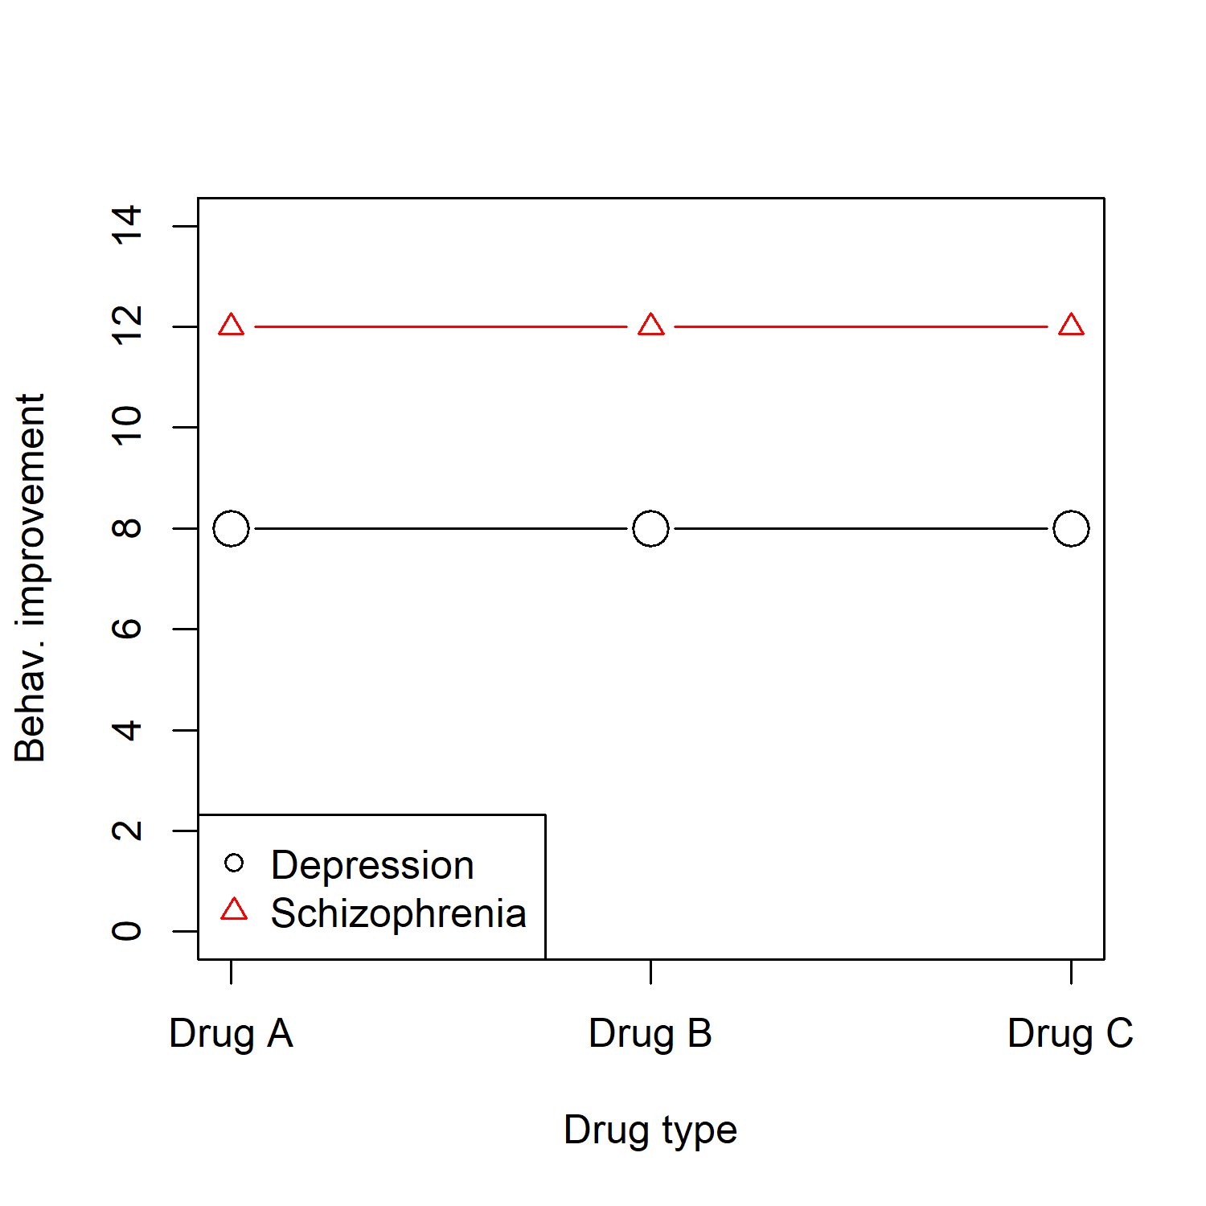
Two-way ANOVA: Hypotheses
Hypothesis 2:
Is there a main effect of type of patient? → Do the two population means for patients with depression and schizophrenia differ from each other?
$H_{0}:μ_{1.}=μ_{2.}$

Slide 12

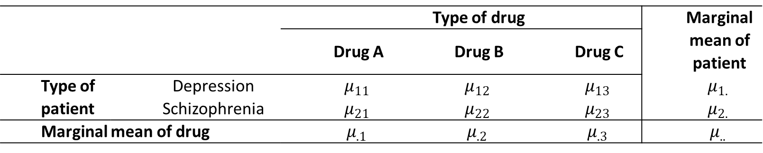
Two-way ANOVA: Hypotheses
Hypothesis 3:
Is there a main effect of type of drug? → Do the three population means of the types of drug differ from each other?
$H_{0}:μ_{.1}=μ_{.2}=μ_{.3}$
 |  | Type of drug |  |  | Marginal mean of patient
 |  | Drug A | Drug B | Drug C
Type of patient | Depression | $$μ_{11}$$ | $$μ_{12}$$ | $$μ_{13}$$ | $$μ_{1.}$$
 | Schizophrenia | $$μ_{21}$$ | $$μ_{22}$$ | $$μ_{23}$$ | $$μ_{2.}$$
Marginal mean of drug |  | $$μ_{.1}$$ | $$μ_{.2}$$ | $$μ_{.3}$$ | $$μ_{..}$$

Slide 13

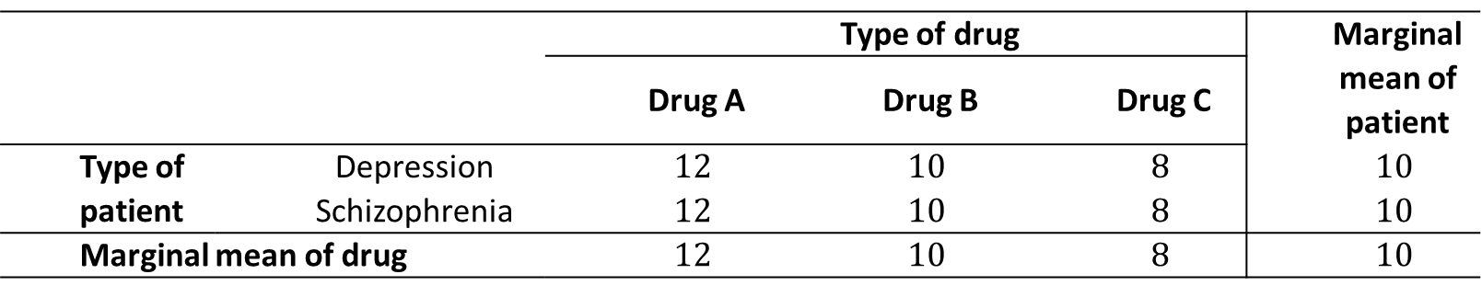
Two-way ANOVA: Hypotheses
Hypothesis 3:
Is there a main effect of type of drug? → Do the three population means of the types of drug differ from each other?
$H_{0}:μ_{.1}=μ_{.2}=μ_{.3}$
Population means: Main effect of drug
 |  | Type of drug |  |  | Marginal mean of patient
 |  | Drug A | Drug B | Drug C
Type of patient | Depression | $$12$$ | $$10$$ | $$8$$ | $$10$$
 | Schizophrenia | $$12$$ | $$10$$ | $$8$$ | $$10$$
Marginal mean of drug |  | $$12$$ | $$10$$ | $$8$$ | $$10$$

Slide 14
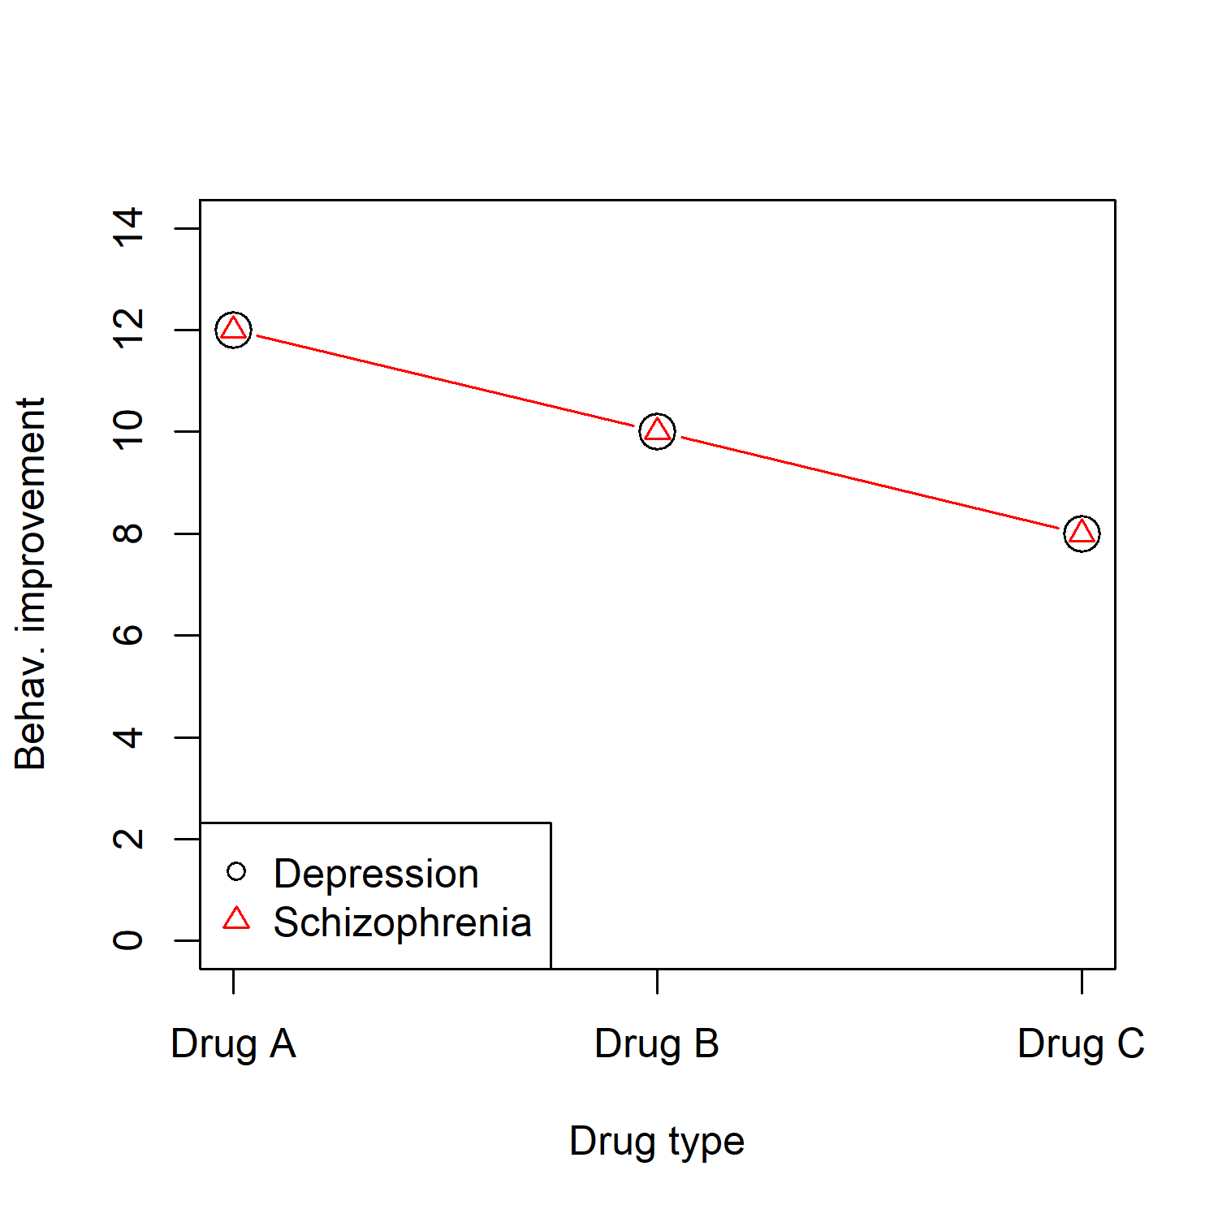
Two-way ANOVA: Hypotheses
Hypothesis 3:
Is there a main effect of type of drug? → Do the three population means of the types of drug differ from each other?
$H_{0}:μ_{.1}=μ_{.2}=μ_{.3}$

Slide 15

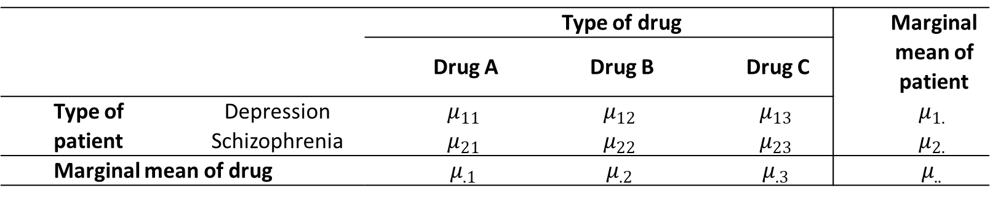
Two-way ANOVA: Hypotheses
Hypothesis 4:
Is there an interaction effect of type of patient and drug? → Does the effect of a factor depend on the level of the other factor?
Is the effect of patient type different for the three drug types? → $H_{0}$: No interaction between factors
Is the effect of drug type different for the two patient types?
 |  | Type of drug |  |  | Marginal mean of patient
 |  | Drug A | Drug B | Drug C
Type of patient | Depression | $$μ_{11}$$ | $$μ_{12}$$ | $$μ_{13}$$ | $$μ_{1.}$$
 | Schizophrenia | $$μ_{21}$$ | $$μ_{22}$$ | $$μ_{23}$$ | $$μ_{2.}$$
Marginal mean of drug |  | $$μ_{.1}$$ | $$μ_{.2}$$ | $$μ_{.3}$$ | $$μ_{..}$$

Slide 16
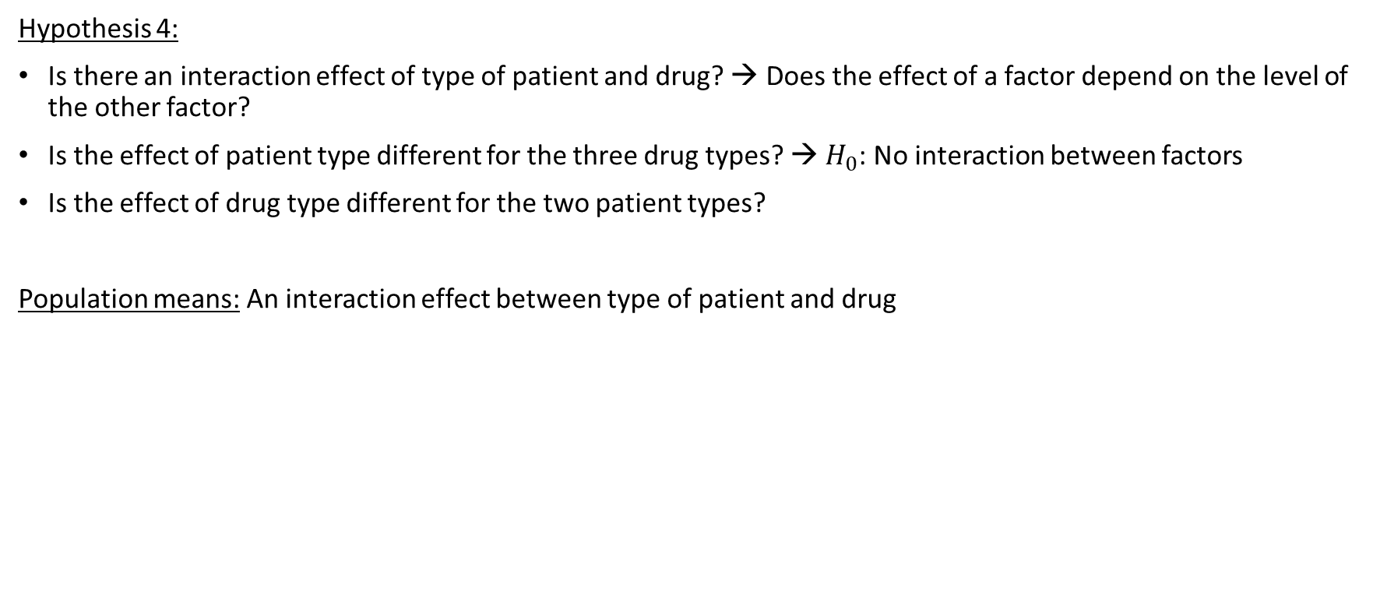
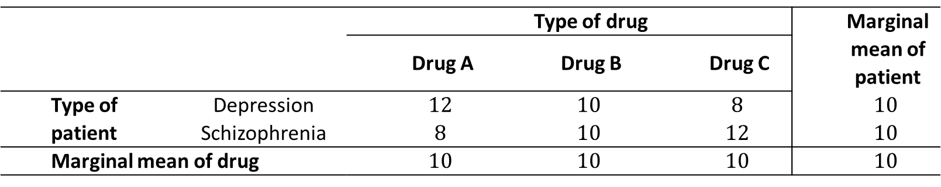
Two-way ANOVA: Hypotheses
Hypothesis 4:
Is there an interaction effect of type of patient and drug? → Does the effect of a factor depend on the level of the other factor?
Is the effect of patient type different for the three drug types? → $H_{0}$: No interaction between factors
Is the effect of drug type different for the two patient types?
Population means: An interaction effect between type of patient and drug
 |  | Type of drug |  |  | Marginal mean of patient
 |  | Drug A | Drug B | Drug C
Type of patient | Depression | $$12$$ | $$10$$ | $$8$$ | $$10$$
 | Schizophrenia | $$8$$ | $$10$$ | $$12$$ | $$10$$
Marginal mean of drug |  | $$10$$ | $$10$$ | $$10$$ | $$10$$

Slide 17
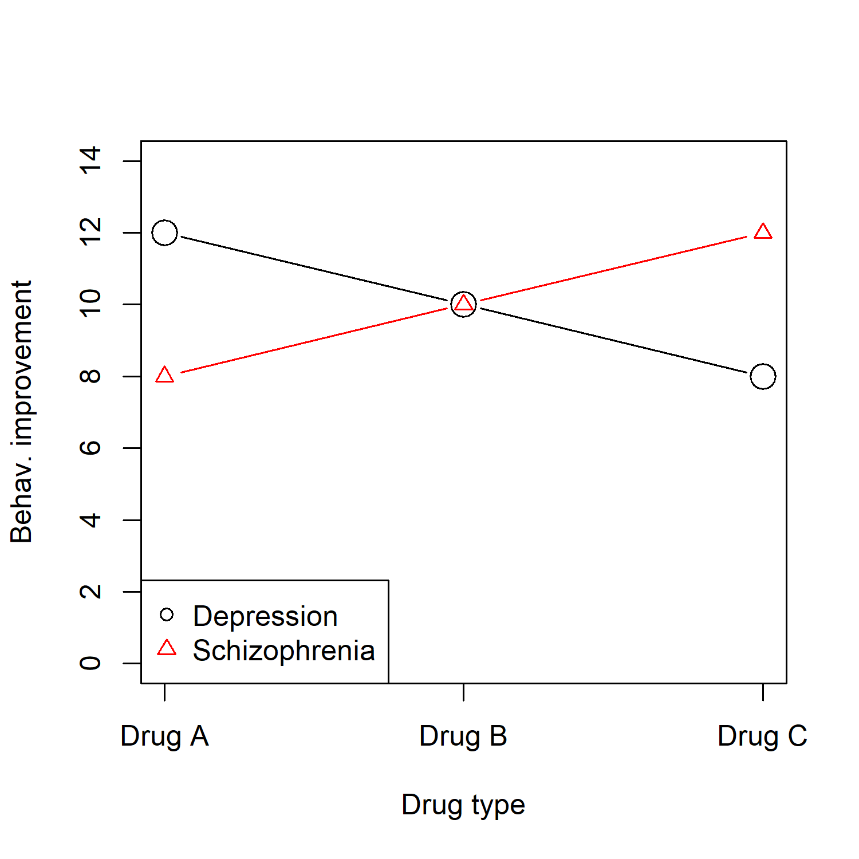
Two-way ANOVA: Hypotheses
Hypothesis 4:
Is there an interaction effect of type of patient and drug? → Does the effect of a factor depend on the level of the other factor?

Slide 18
Two-way ANOVA: Interaction
The concept of interaction is crucial in science in general, and statistics in particular (not just in ANOVA, but also in regression)
The concept of interaction can be explained in three equivalent ways:
In words: The effect of factor A depends on the level of factor B
With numbers
Using a figure: There is an interaction when the lines are not parallel
Another very intuitive example…

Slide 19
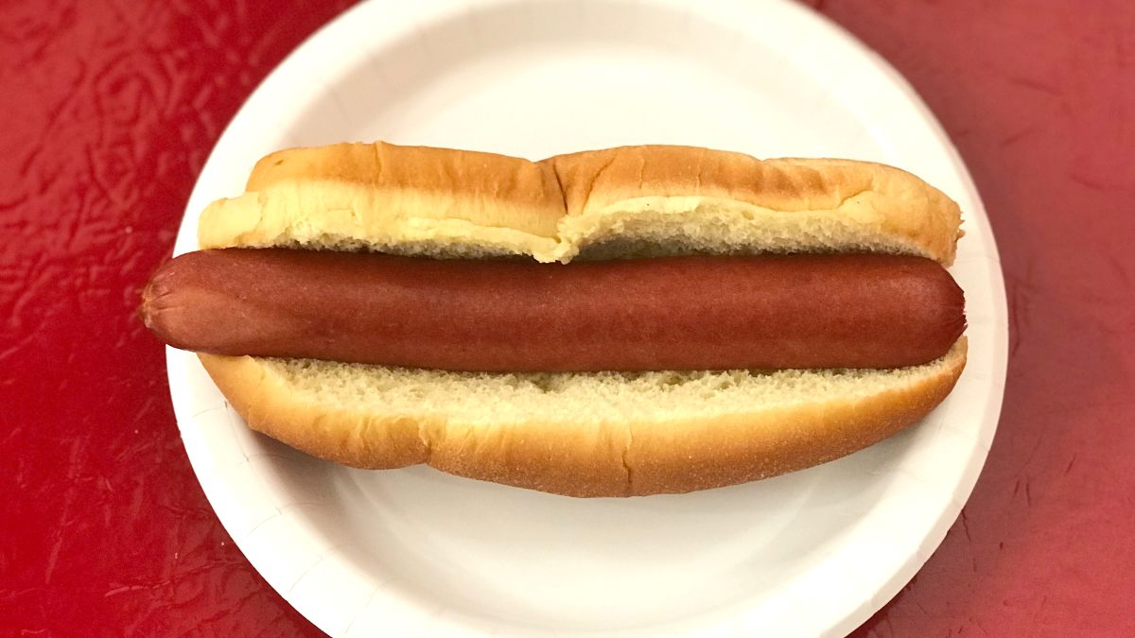

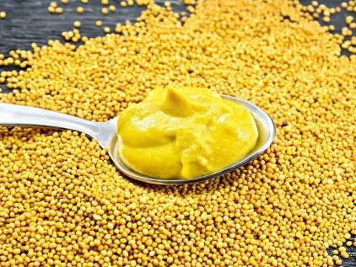

Enjoy your meal!
DV: How much did you enjoy your meal? (range: 0-5)
Factor A: Type of food
Hotdog Ice cream
Factor B: Type of sauce
Mustard Chocolate sauce

Slide 20
Intuitive example interaction effect
Mean enjoyment

Slide 21
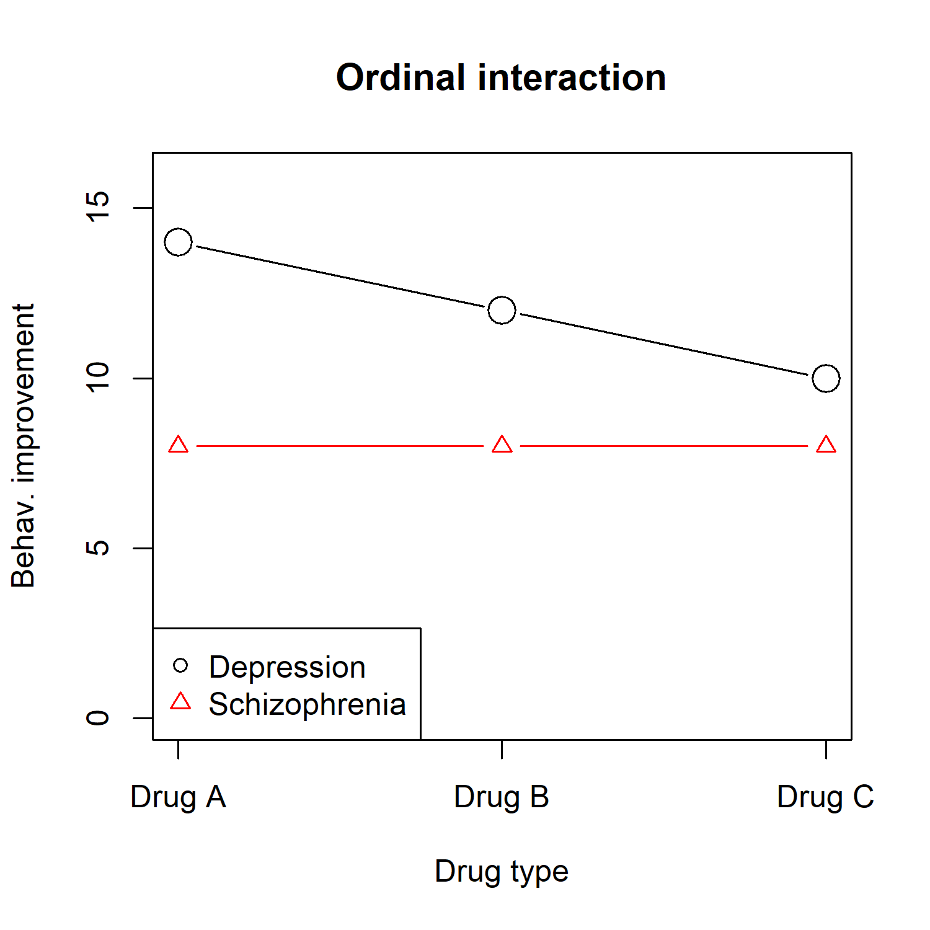
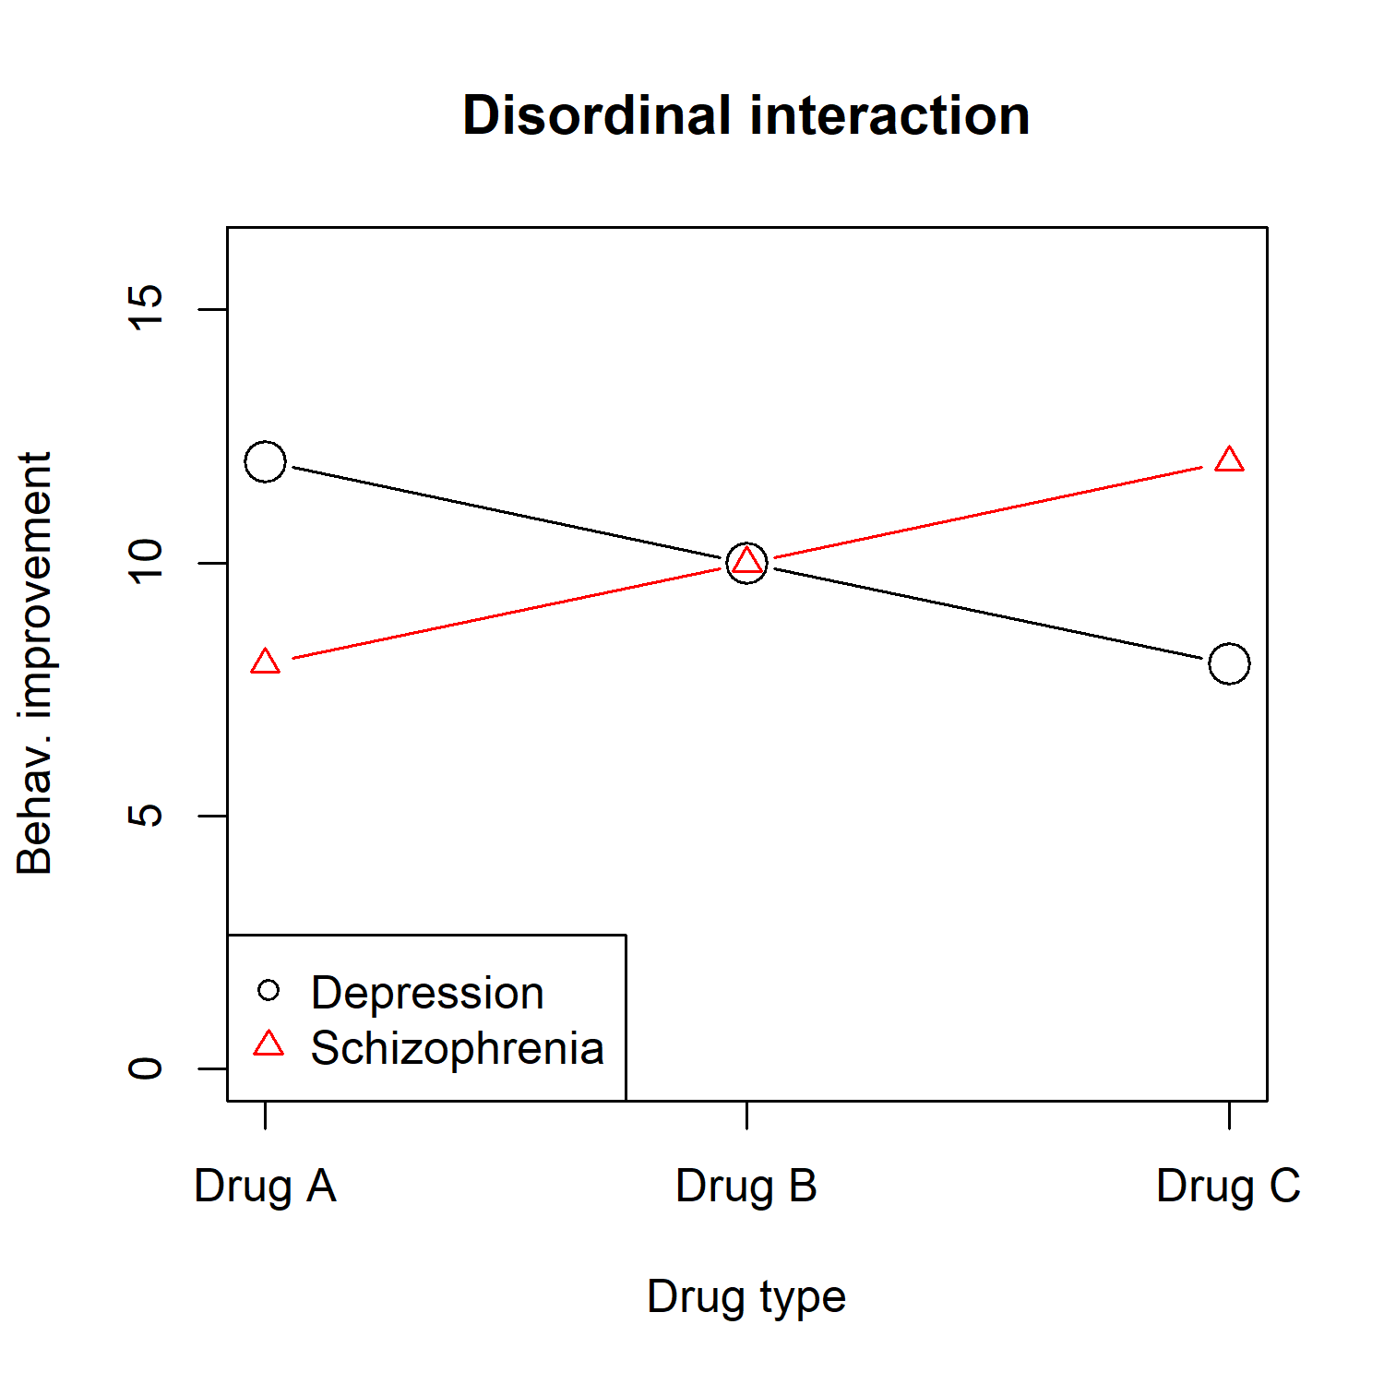
Two-way ANOVA: Interaction
Important terminology:
Ordinal interaction → order of the groups is the same for each level of the other factor, lines do not intersect
Disordinal interaction → order of the groups is not the same for each level of the other factor, lines intersect

Slide 22
Practice
Assignment: Complete the table with population means such that there is no interaction
 |  | Factor B
 |  | B1 | B2
Factor A | A1 |  |  | 36
 | A2 |  |  | 32
 | A3 |  |  | 40
 |  | 33 | 39 | 36
Notes:
Robbie: 33 39
29 35
37 43

Slide 23
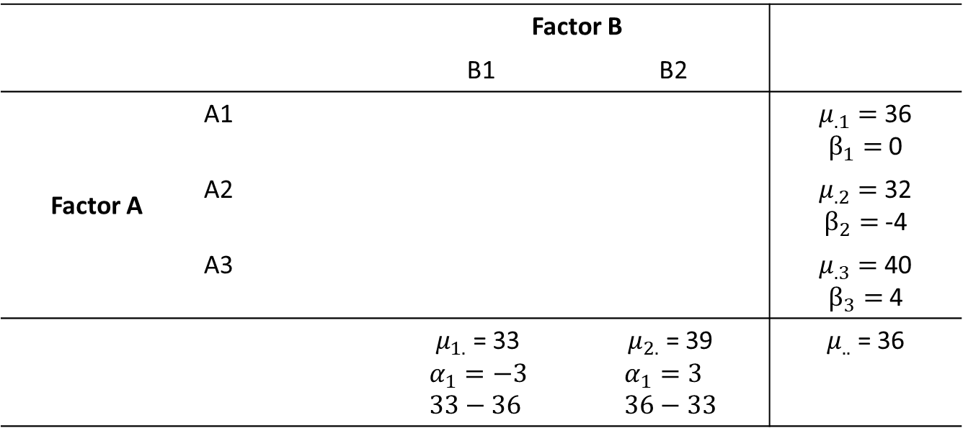
Solution
Assignment: Complete the table with population means such that there is no interaction
 |  | Factor B
 |  | B1 | B2
Factor A | A1 |  |  | $μ_{.1}=$36 $β_{1}=$0
 | A2 |  |  | $μ_{.2}=$32 $β_{2}=$-4
 | A3 |  |  | $μ_{.3}=$40 $β_{3}=$4
 |  | $μ_{1.}$ = 33 $$α_{1}=−3 \\ 33−36$$ | $μ_{2.}$ = 39 $$α_{1}=3 \\ 36−33$$ | $μ_{..}$ = 36
Notes:
Robbie: 33 39
29 35
37 43

Slide 24
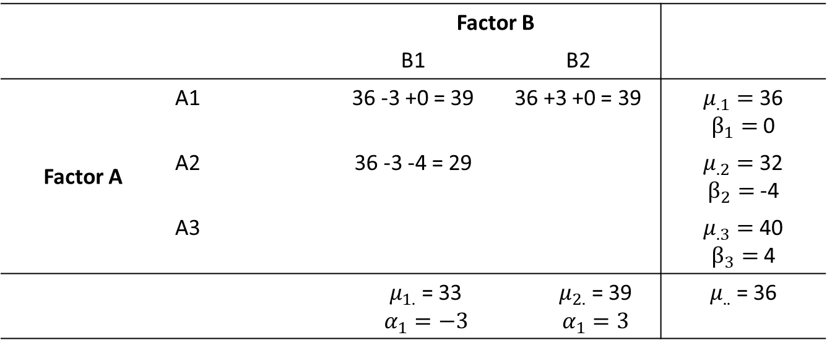
Solution
Assignment: Complete the table with population means such that there is no interaction
 |  | Factor B
 |  | B1 | B2
Factor A | A1 | 36 -3 +0 = 39 | 36 +3 +0 = 39 | $μ_{.1}=$36 $β_{1}=$0
 | A2 | 36 -3 -4 = 29 |  | $μ_{.2}=$32 $β_{2}=$-4
 | A3 |  |  | $μ_{.3}=$40 $β_{3}=$4
 |  | $μ_{1.}$ = 33 $$α_{1}=−3$$ | $μ_{2.}$ = 39 $$α_{1}=3$$ | $μ_{..}$ = 36
Notes:
Robbie: 33 39
29 35
37 43

Slide 25
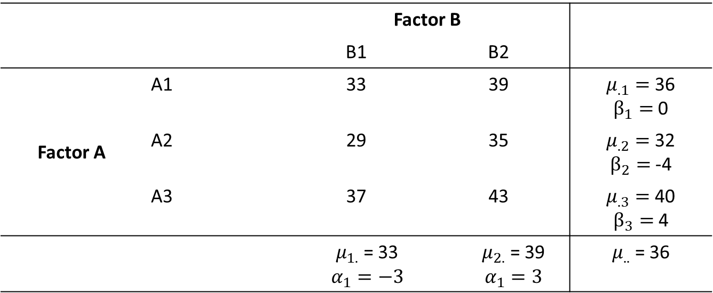
Solution
Assignment: Complete the table with population means such that there is no interaction
 |  | Factor B
 |  | B1 | B2
Factor A | A1 | 33 | 39 | $μ_{.1}=$36 $β_{1}=$0
 | A2 | 29 | 35 | $μ_{.2}=$32 $β_{2}=$-4
 | A3 | 37 | 43 | $μ_{.3}=$40 $β_{3}=$4
 |  | $μ_{1.}$ = 33 $$α_{1}=−3$$ | $μ_{2.}$ = 39 $$α_{1}=3$$ | $μ_{..}$ = 36
Notes:
Robbie: 33 39
29 35
37 43

Slide 26
Practice
Assignment: Create the population means in such a way that there is an overall interaction effect, but the interaction effect in cell A2B1 = 0
 |  | Factor B
 |  | B1 | B2
Factor A | A1 |  |  | 36
 | A2 |  |  | 32
 | A3 |  |  | 40
 |  | 33 | 39 | 36
Notes:
Robbie: 40 32
29 35
30 50

Slide 27
Solution
Assignment: Create the population means in such a way that there is an overall interaction effect, but the interaction effect in cell A2B1 = 0
One way to do it:
* Start with the expected values for a table with NO interaction
* Add a constant to one cell, and subtract it from other cells in that row/column to balance out
* Notice this creates the kind of “diagonal pattern” associated with interactions
 |  | Factor B
 |  | B1 | B2
Factor A | A1 | 33 +2 | 39 -2 | 36
 | A2 | 29 +0 | 35 +0 | 32
 | A3 | 37 -2 | 43 +2 | 40
 |  | 33 | 39 | 36
Notes:
Robbie: 40 32
29 35
30 50

Slide 28
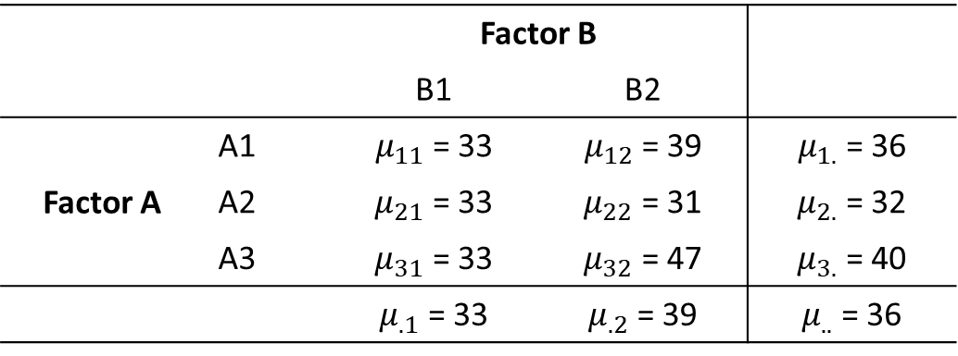
Practice
Assignment: What is the interaction effect in cell A2B1?
 |  | Factor B
 |  | B1 | B2
Factor A | A1 | $μ_{11}$ = 33 | $μ_{12}$ = 39 | $μ_{1.}$ = 36
 | A2 | $μ_{21}$ = 33 | $μ_{22}$ = 31 | $μ_{2.}$ = 32
 | A3 | $μ_{31}$ = 33 | $μ_{32}$ = 47 | $μ_{3.}$ = 40
 |  | $μ_{.1}$ = 33 | $μ_{.2}$ = 39 | $μ_{..}$ = 36
Notes:
Robbie: Interaction effects 0 0
4 -4
-4 4

Slide 29

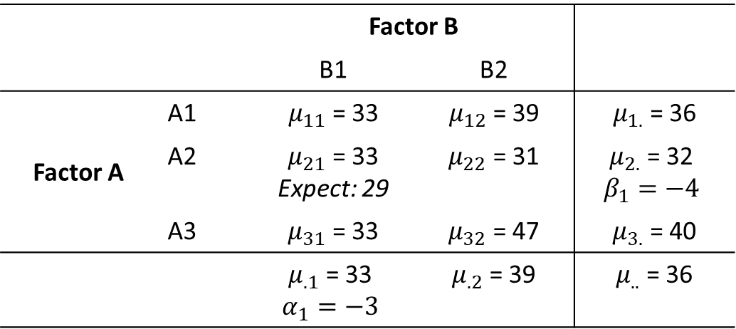
Solution
Assignment: What is the interaction effect in cell A2B1?
The interaction effect is the difference between the expected mean in a table WITHOUT interactions, and the observed value:
If you like formulas:
$$Interaction effect= μ_{jk}−μ_{j.}−μ_{.k}+μ_{..}$$
 |  | Factor B
 |  | B1 | B2
Factor A | A1 | $μ_{11}$ = 33 | $μ_{12}$ = 39 | $μ_{1.}$ = 36
 | A2 | $μ_{21}$ = 33 Expect: 29 | $μ_{22}$ = 31 | $μ_{2.}$ = 32 $$β_{1}=−4$$
 | A3 | $μ_{31}$ = 33 | $μ_{32}$ = 47 | $μ_{3.}$ = 40
 |  | $μ_{.1}$ = 33 $$α_{1}=−3$$ | $μ_{.2}$ = 39 | $μ_{..}$ = 36
Notes:
Robbie: Interaction effects 0 0
4 -4
-4 4

Slide 30
Two-way ANOVA: Idea
Idea is the same as the idea of one-way ANOVA:
Is the variance of the group means (variance between groups) larger than the variance within groups?
We now have four instead of one between group variances/effects:
Total effect → Hypothesis 1: Is there an effect?
Effect of factor A → Hypothesis 2: Is there a main effect of factor A?
Effect of factor B → Hypothesis 3: Is there a main effect of factor B?
Interaction effect → Hypothesis 4: Does the effect of factor A depend on the level of factor B?
Note that the assumptions of a two-way ANOVA are identical to those of a one-way ANOVA → see lecture 4 for the assumptions

Slide 31
Two-way ANOVA: Idea
Variance within groups:
People in the same group have the same treatment: differences between people are random and not related to treatment
Variance within groups reflects random differences between subjects
Because variance is the result of random differences, the within-group variance in the population is referred to as error variance
Variance between groups:
Two people in different groups differ because they are different persons and because they received a different treatment
Variance between groups reflects random differences between subjects and possibly difference in the treatment effect

Slide 32
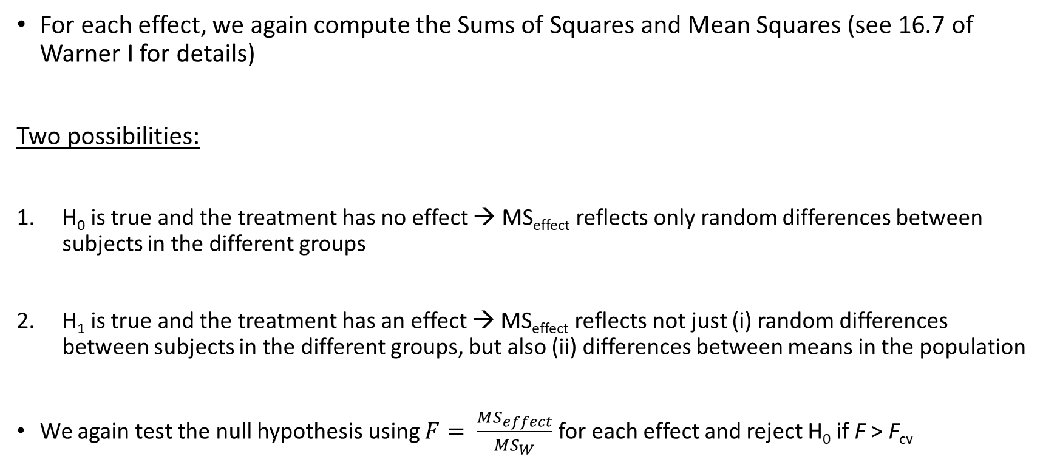
Two-way ANOVA: Idea
For each effect, we again compute the Sums of Squares and Mean Squares (see 16.7 of Warner I for details)
Two possibilities:
H₀ is true and the treatment has no effect → MS_{effect} reflects only random differences between subjects in the different groups
H₁ is true and the treatment has an effect → MS_{effect} reflects not just (i) random differences between subjects in the different groups, but also (ii) differences between means in the population
We again test the null hypothesis using $F= \frac{MS_{effect}}{MS_{W}}$ for each effect and reject H₀ if F > F_{cv}

Slide 33
Two-way ANOVA: Using SPSS
RQ: A researcher is interested in the effects of three types of drugs on behavioral improvements of both patients with a depression and schizophrenia
Independent variables:
Type of patient → levels = Depression and schizophrenia
Type of drug → levels = Drug A, B, and C
Data:
 |  | Type of drug
 |  | Drug A | Drug B | Drug C
Type of patient | Depression | 8; 4; 0 | 10; 8; 6 | 8; 6; 4
 | Schizophrenia | 14;10; 6 | 4; 2; 0 | 15;12; 9

Slide 34
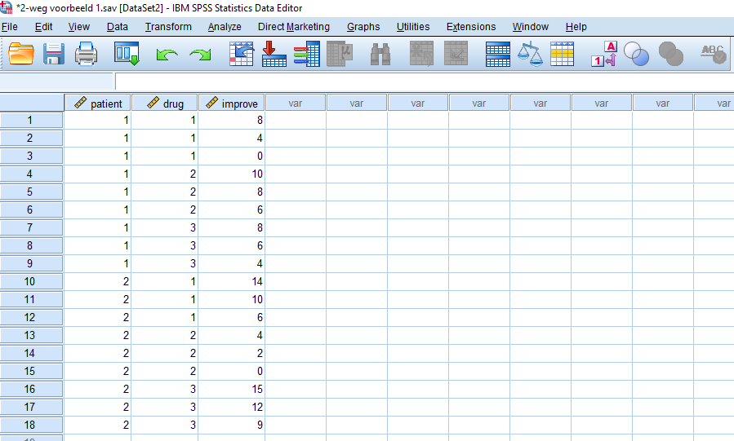
Two-way ANOVA: Using SPSS
 |  | Type of drug
 |  | Drug A | Drug B | Drug C
Type of patient | Depression | 8; 4; 0 | 10; 8; 6 | 8; 6; 4
 | Schizophrenia | 14;10; 6 | 4; 2; 0 | 15;12; 9

Slide 35
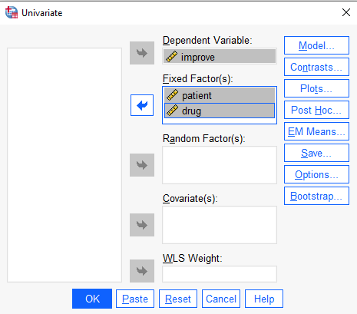
Two-way ANOVA: Using SPSS
Two-way ANOVA can be done in SPSS using the General Linear Model/Univariate procedure
Steps in SPSS:
We include “improve” as Dependent Variable and “patient” and “drug” as Fixed Factor(s)
We need to enable estimates of effect size (ETASQ) to get effect size estimates
Creating a plot of the means (/PLOT) facilitates the interpretation especially in case of an interaction
Syntax:
UNIANOVA improve BY patient drug /METHOD=SSTYPE(3) /INTERCEPT=INCLUDE /PLOT=PROFILE(drug*patient) /PRINT=ETASQ DESCRIPTIVE HOMOGENEITY /CRITERIA=ALPHA(.05) /DESIGN=patient drug patient*drug.

Slide 36
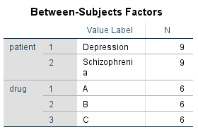
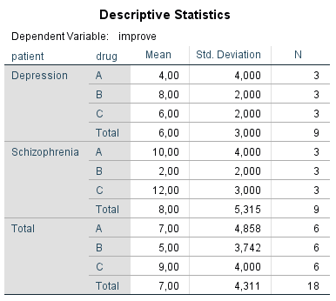
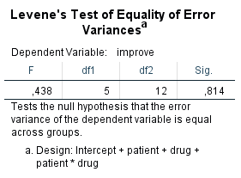
Two-way ANOVA: Using SPSS

Slide 37
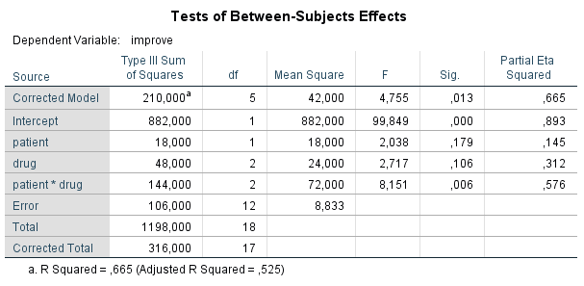

Two-way ANOVA: Using SPSS
Hypothesis 1: Is there an effect?
Hypothesis 2: Main effect of patient?
Hypothesis 3: Main effect of drug?
Hypothesis 4: Interaction effect?
First, test whether the interaction effect is significant. If it is, do NOT interpret main effects, they
are meaningless (and very deceiving) → effect of drug depends on patient!
More about this and how to solve it next week

Slide 38
Two-way ANOVA: Effect size
How much of the variance can be explained by group membership? → Explained variance
Explained variance now of four effects:
Total effect → Hypothesis 1: Is there an effect?
Effect of factor A → Hypothesis 2: Is there a main effect of factor A?
Effect of factor B → Hypothesis 3: Is there a main effect of factor B?
Interaction effect → Hypothesis 4: Does the effect of factor A depend on the level of factor B?

Slide 39

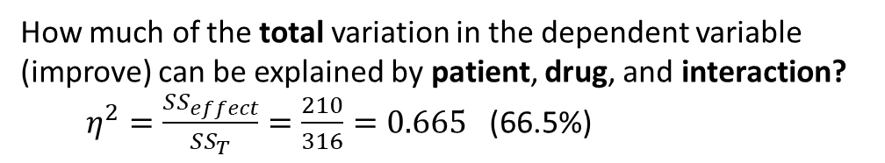
Two-way ANOVA: Using SPSS
Is the effect practically important?
What part of the variance, that is not yet explained by the other variables, is explained by this variable?
Partial $η^{2}=\frac{SS_{drug}}{SS_{drug+SS_{w}}}=\frac{48}{48+106}=0.312$
Explained variance corrected for the number of groups and independent variables in the model
How much of the total variation in the dependent variable (improve) can be explained by patient, drug, and interaction?
$η^{2}=\frac{SS_{effect}}{SS_{T}}=\frac{210}{316}=0.665$ (66.5%)

Slide 40
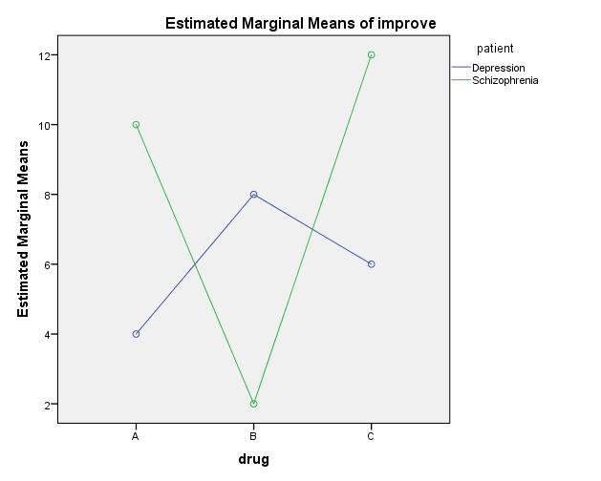
Two-way ANOVA: Using SPSS

Slide 41
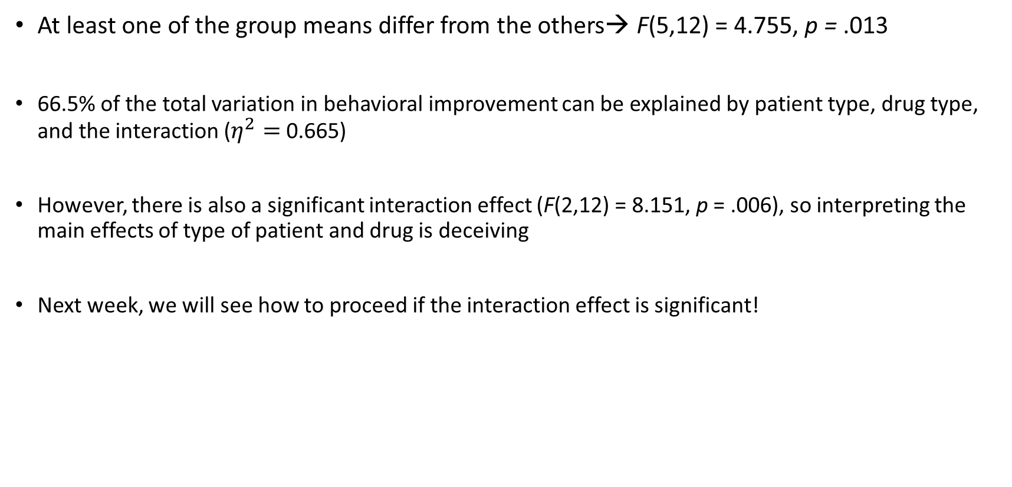

Conclusion
At least one of the group means differ from the others→ F(5,12) = 4.755, p = .013
66.5% of the total variation in behavioral improvement can be explained by patient type, drug type, and the interaction ($η^{2}=$ 0.665)
However, there is also a significant interaction effect (F(2,12) = 8.151, p = .006), so interpreting the main effects of type of patient and drug is deceiving
Next week, we will see how to proceed if the interaction effect is significant!
Interpretation: rules of thumb $η^{2}$
Small | 0.01
Medium | 0.06
Large | 0.14

Slide 42


Literature:
Warner I: 16.1-16.7
Two-way ANOVA part II:
Simple effects
Balanced and unbalanced designs
Next week…

