Slide 1
Experimental Research Methods Lecture 7

Slide 2
Lecture goals lecture 7
After this lecture and studying the materials, students are able to:
Explain the model of a two-way ANOVA
Interpret the SPSS output of simple effects
Determine whether a design is balanced or unbalanced
Explain the advantages of a two-way ANOVA over a one-way ANOVA
Determine whether a factor is a fixed or random factor

Slide 3

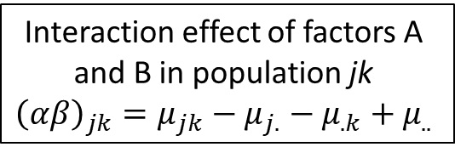
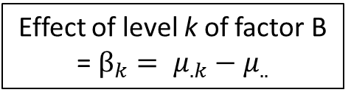
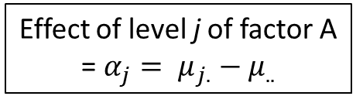
Model two-way ANOVA
Linear additive model:
We have J levels of factor A, indexed by j
We have K levels of factor B, indexed by k
In total, we have J x K groups
$Y_{ijk} = μ_{..} +α_{j}+β_{k}+{\left(αβ\right)}_{jk}+ ε_{ijk}$
Interaction effect of factors A and B in population jk
$${\left(αβ\right)}_{jk}=μ_{jk}−μ_{j.}−μ_{.k}+μ_{..}$$
Actual score of person i in group jk
Residual
Effect of level j of factor A = $α_{j}= μ_{j.}−μ_{..}$
Effect of level k of factor B = $β_{k}= μ_{.k}−μ_{..}$
Grand mean

Slide 4
From Last Week
Assignment: Complete the table with population means such that there is no interaction
 |  | Factor B
 |  | B1 | B2
Factor A | A1 |  |  | 36
 | A2 |  |  | 32
 | A3 |  |  | 40
 |  | 33 | 39 | 36
Notes:
Robbie: 33 39
29 35
37 43

Slide 5
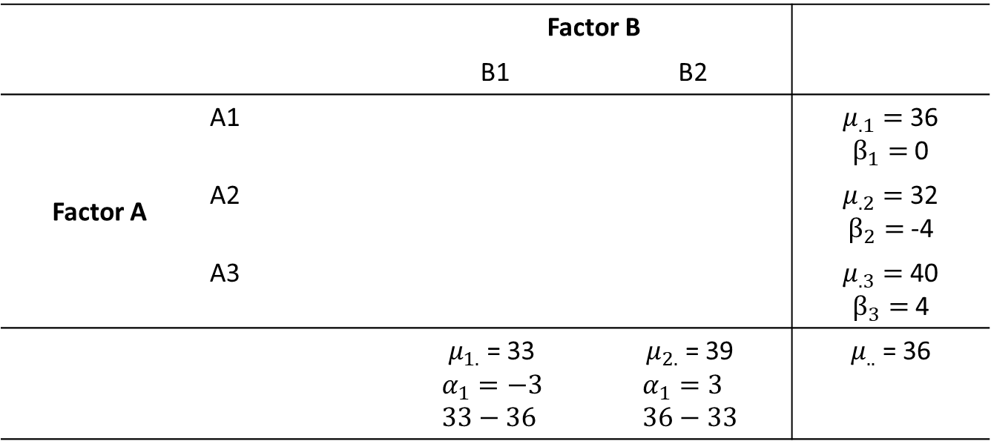
From Last Week
Assignment: Complete the table with population means such that there is no interaction
 |  | Factor B
 |  | B1 | B2
Factor A | A1 |  |  | $μ_{.1}=$36 $β_{1}=$0
 | A2 |  |  | $μ_{.2}=$32 $β_{2}=$-4
 | A3 |  |  | $μ_{.3}=$40 $β_{3}=$4
 |  | $μ_{1.}$ = 33 $$α_{1}=−3 \\ 33−36$$ | $μ_{2.}$ = 39 $$α_{1}=3 \\ 36−33$$ | $μ_{..}$ = 36
Notes:
Robbie: 33 39
29 35
37 43

Slide 6
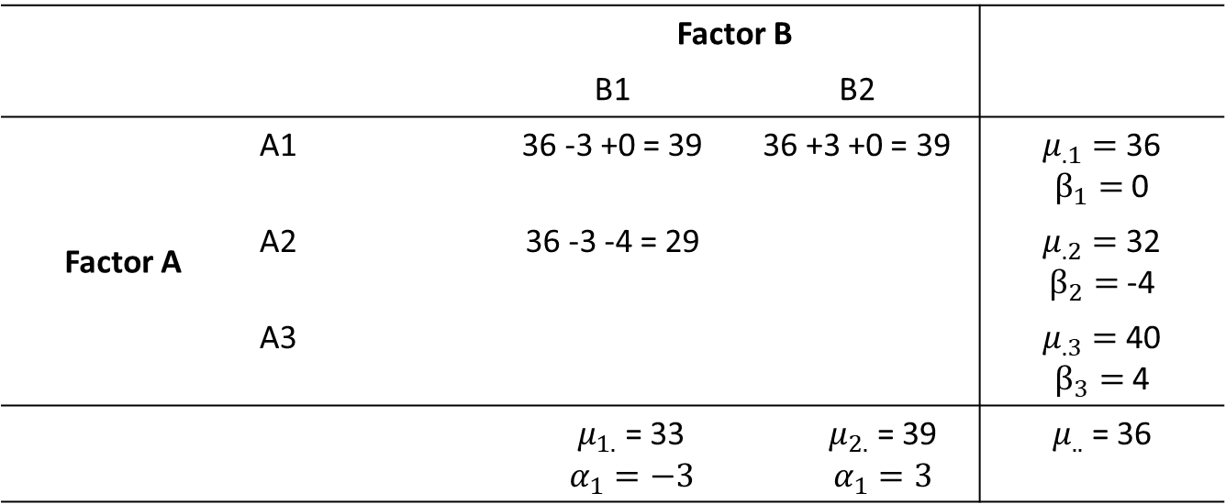
From Last Week
Assignment: Complete the table with population means such that there is no interaction
 |  | Factor B
 |  | B1 | B2
Factor A | A1 | 36 -3 +0 = 39 | 36 +3 +0 = 39 | $μ_{.1}=$36 $β_{1}=$0
 | A2 | 36 -3 -4 = 29 |  | $μ_{.2}=$32 $β_{2}=$-4
 | A3 |  |  | $μ_{.3}=$40 $β_{3}=$4
 |  | $μ_{1.}$ = 33 $$α_{1}=−3$$ | $μ_{2.}$ = 39 $$α_{1}=3$$ | $μ_{..}$ = 36
Notes:
Robbie: 33 39
29 35
37 43

Slide 7
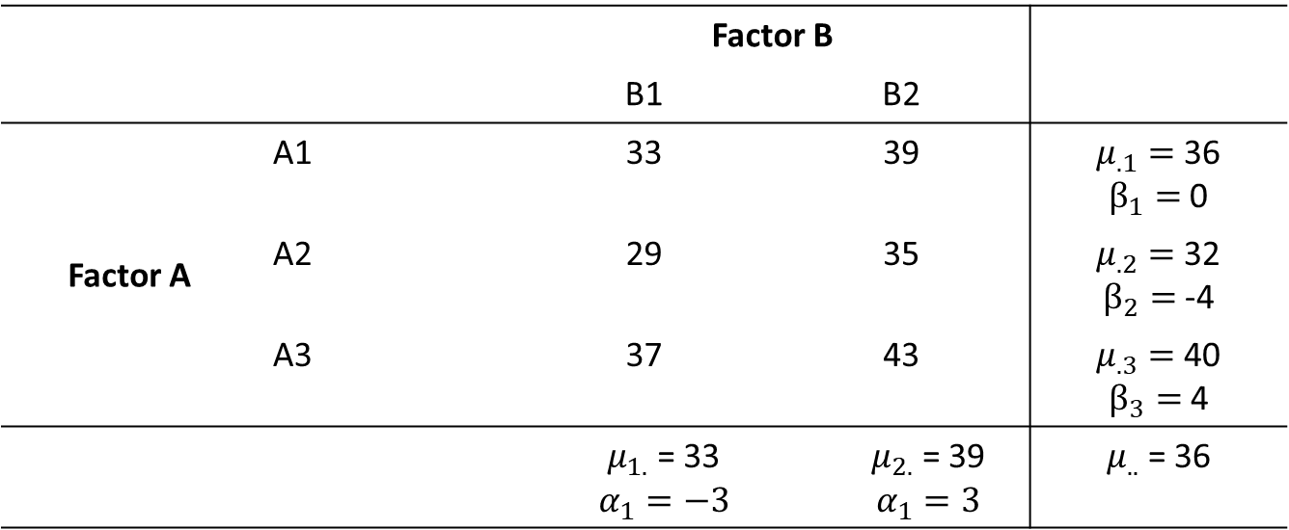
From Last Week
Assignment: Complete the table with population means such that there is no interaction
 |  | Factor B
 |  | B1 | B2
Factor A | A1 | 33 | 39 | $μ_{.1}=$36 $β_{1}=$0
 | A2 | 29 | 35 | $μ_{.2}=$32 $β_{2}=$-4
 | A3 | 37 | 43 | $μ_{.3}=$40 $β_{3}=$4
 |  | $μ_{1.}$ = 33 $$α_{1}=−3$$ | $μ_{2.}$ = 39 $$α_{1}=3$$ | $μ_{..}$ = 36
Notes:
Robbie: 33 39
29 35
37 43

Slide 8
From Last Week
Assignment: Create the population means in such a way that there is an overall interaction effect, but the interaction effect in cell A2B1 = 0
One way to do it:
* Start with the expected values for a table with NO interaction
* Add a constant to one cell, and subtract it from other cells in that row/column to balance out
* Notice this creates the kind of “diagonal pattern” associated with interactions
 |  | Factor B
 |  | B1 | B2
Factor A | A1 | 33 +2 | 39 -2 | 36
 | A2 | 29 +0 | 35 +0 | 32
 | A3 | 37 -2 | 43 +2 | 40
 |  | 33 | 39 | 36
Notes:
Robbie: 40 32
29 35
30 50

Slide 9

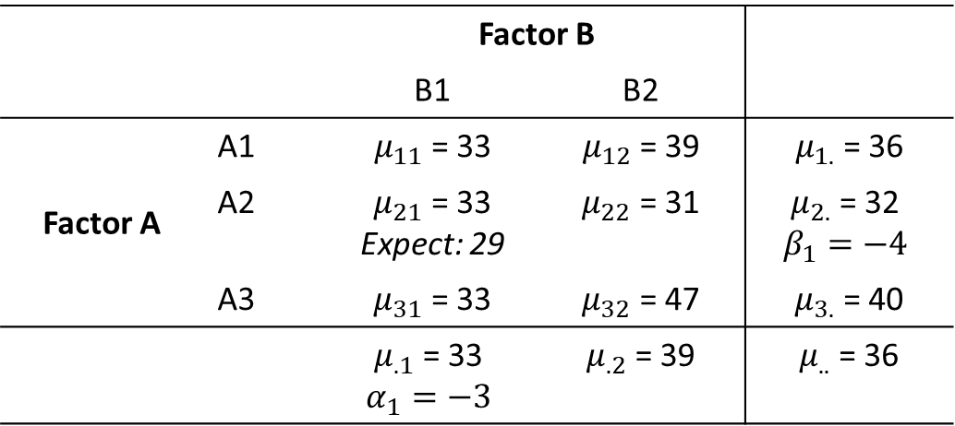
Practice: Last week’s exercise
Assignment: What is the interaction effect in cell A2B1?
The interaction effect is the difference between the expected mean in a table WITHOUT interactions, and the observed value:
If you like formulas:
$$Interaction effect= μ_{jk}−μ_{j.}−μ_{.k}+μ_{..}$$
 |  | Factor B
 |  | B1 | B2
Factor A | A1 | $μ_{11}$ = 33 | $μ_{12}$ = 39 | $μ_{1.}$ = 36
 | A2 | $μ_{21}$ = 33 Expect: 29 | $μ_{22}$ = 31 | $μ_{2.}$ = 32 $$β_{1}=−4$$
 | A3 | $μ_{31}$ = 33 | $μ_{32}$ = 47 | $μ_{3.}$ = 40
 |  | $μ_{.1}$ = 33 $$α_{1}=−3$$ | $μ_{.2}$ = 39 | $μ_{..}$ = 36
Notes:
Robbie: Interaction effects 0 0
4 -4
-4 4

Slide 10
Recap: Two-way ANOVA
Idea is the same as the idea of one-way ANOVA:
Is the variance of the group means (variance between groups) larger than the variance within groups?
We now have four instead of one between group variances/effects:
Total effect → Hypothesis 1: Is there an effect?
Effect of factor A → Hypothesis 2: Is there a main effect of factor A?
Effect of factor B → Hypothesis 3: Is there a main effect of factor B?
Interaction effect → Hypothesis 4: Does the effect of factor A depend on the level of factor B?

Slide 11
Two-way ANOVA: Using SPSS
RQ: A researcher is interested in the effects of three types of drugs on behavioral improvements of both patients with a depression and schizophrenia
Independent variables:
Type of patient → levels = Depression and schizophrenia
Type of drug → levels = Drug A, B, and C
Data:
 |  | Type of drug
 |  | Drug A | Drug B | Drug C
Type of patient | Depression | 8; 4; 0 | 10; 8; 6 | 8; 6; 4
 | Schizophrenia | 14;10; 6 | 4; 2; 0 | 15;12; 9

Slide 12
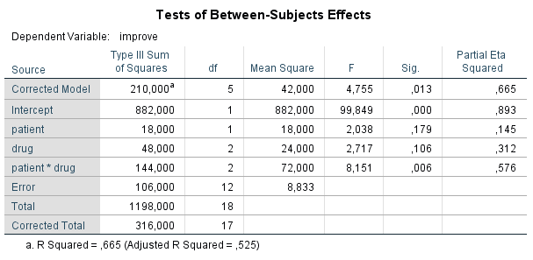

Two-way ANOVA: Using SPSS
Hypothesis 1: Is there an effect?
Hypothesis 2: Main effect of patient?
Hypothesis 3: Main effect of drug?
Hypothesis 4: Interaction effect?
First, test whether the interaction effect is significant. If it is, do NOT interpret main effects, they
are meaningless (and very deceiving) → effect of drug depends on patient!

Slide 13
Two-way ANOVA: Simple effects
How to proceed if the interaction effect is significant?
We cannot interpret the main effects, because the effect of drug depends on the type of patient
Don’t misunderstand me: we can interpret the *significance* of the effect, but not the effect itself, without considering the other interacting variable
There are different ways to interpret the so-called simple effects (effect of one factor conditional on the level of another factor)
In this course: conducting a one-way ANOVA at each level of the other factor
In our example,
A one-way ANOVA with drug as factor for depressed patients
A one-way ANOVA with drug as factor for patients with schizophrenia
The next slide is a super slide describing these steps

Slide 14
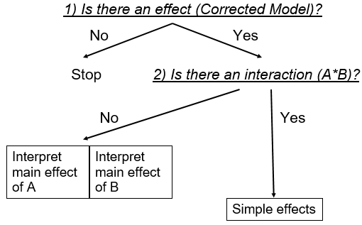
Two-way ANOVA: Simple effects

Slide 15
Simple effects: Using SPSS
New analysis with new syntax
Simple effects can be done using “split file” in SPSS
Interpreting the analysis is easy, because it is a one-way ANOVA for depressed patients and patients with schizophrenia, possibly with post-hoc tests → same as we did in previous lectures ☺
Syntax:
SORT CASES BY patient. SPLIT FILE SEPARATE BY patient.
UNIANOVA improve BY drug /METHOD=SSTYPE(3) /INTERCEPT=INCLUDE /PRINT=ETASQ DESCRIPTIVE HOMOGENEITY /CRITERIA=ALPHA(.05) /DESIGN= drug.
SPLIT FILE OFF.

Slide 16
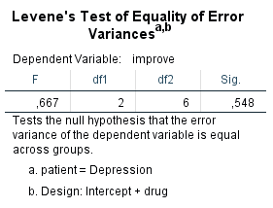
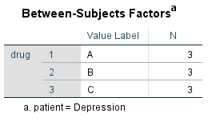
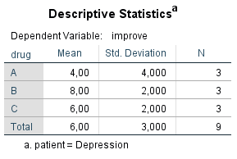
Simple effects: Depressed patients

Slide 17
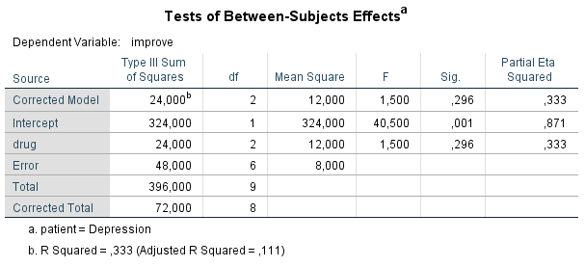
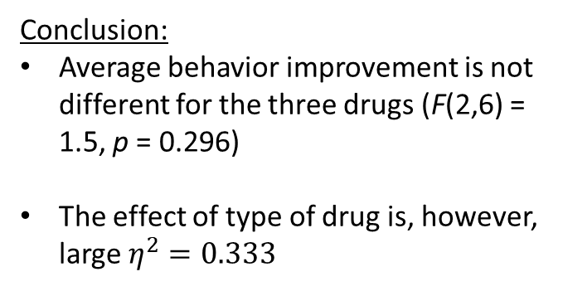
Simple effects: Depressed patients
Conclusion:
Average behavior improvement is not different for the three drugs (F(2,6) = 1.5, p = 0.296)
The effect of type of drug is, however, large $η^{2}=0.333$

Slide 18

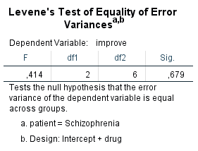
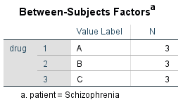
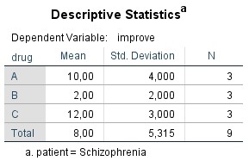
Simple effects: Schizophrenia

Slide 19
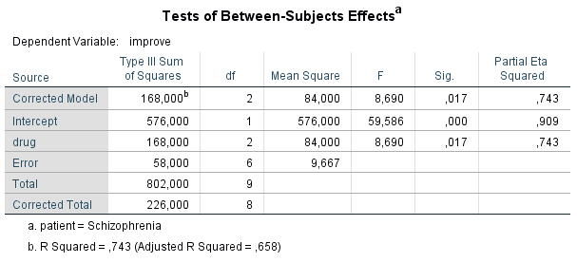
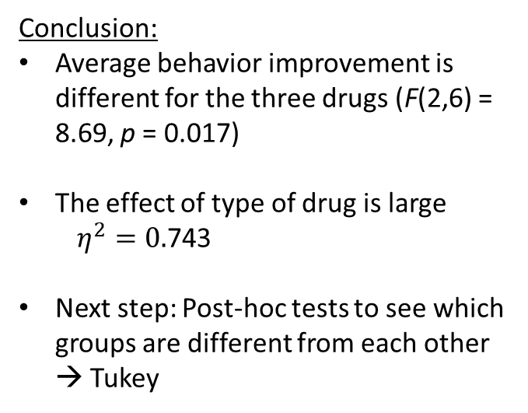
Simple effects: Schizophrenia
Conclusion:
Average behavior improvement is different for the three drugs (F(2,6) = 8.69, p = 0.017)
The effect of type of drug is large
$η^{2}=0.$743
Next step: Post-hoc tests to see which groups are different from each other → Tukey

Slide 20
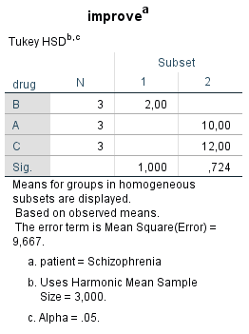
Tukey: Schizophrenia
Syntax:
SORT CASES BY patient.
SPLIT FILE SEPARATE BY patient.
UNIANOVA improve BY drug
/METHOD=SSTYPE(3)
/INTERCEPT=INCLUDE
/PRINT=ETASQ DESCRIPTIVE HOMOGENEITY
/POSTHOC=drug(TUKEY)
/CRITERIA=ALPHA(.05)
/DESIGN= drug.
SPLIT FILE OFF.
Conclusion:
Average behavior improvement of drug B differs from drugs A and C
Drug B is least effective and drugs A and C are equally effective

Slide 21
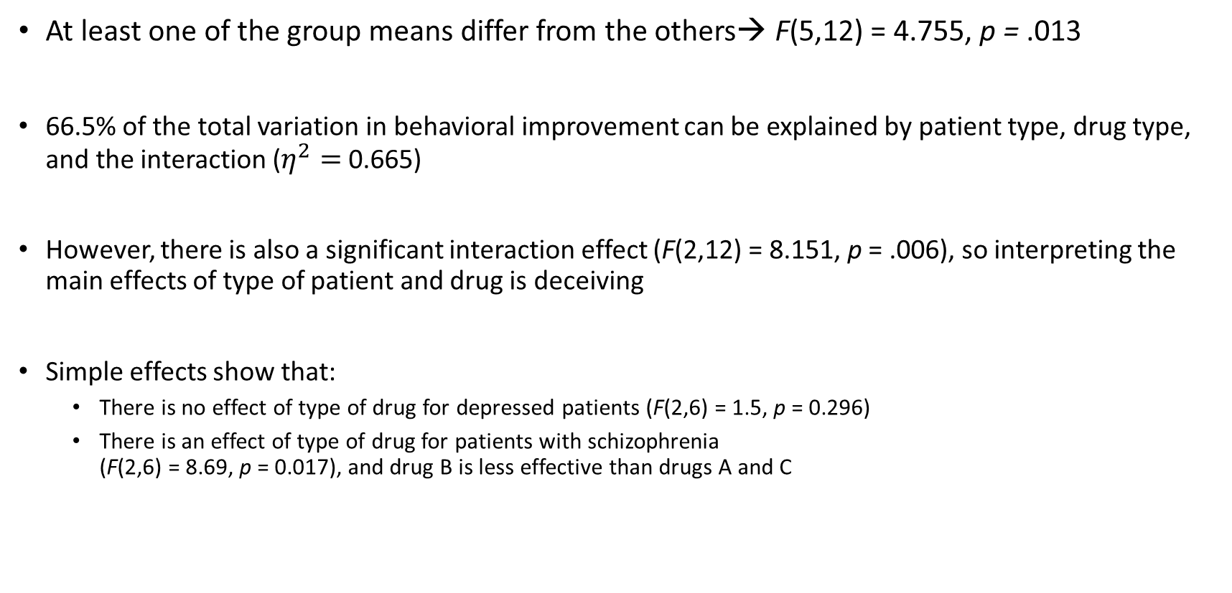

Overall conclusion
At least one of the group means differ from the others→ F(5,12) = 4.755, p = .013
66.5% of the total variation in behavioral improvement can be explained by patient type, drug type, and the interaction ($η^{2}=$ 0.665)
However, there is also a significant interaction effect (F(2,12) = 8.151, p = .006), so interpreting the main effects of type of patient and drug is deceiving
Simple effects show that:
There is no effect of type of drug for depressed patients (F(2,6) = 1.5, p = 0.296)
There is an effect of type of drug for patients with schizophrenia (F(2,6) = 8.69, p = 0.017), and drug B is less effective than drugs A and C
Interpretation: rules of thumb $η^{2}$
Small | 0.01
Medium | 0.06
Large | 0.14

Slide 22


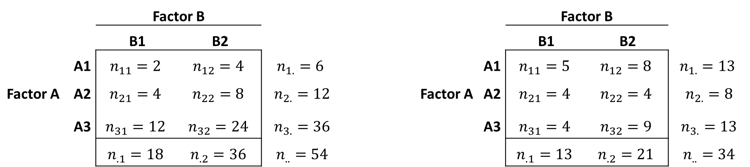
Balanced vs. unbalanced designs
Balanced designs: Equal $n_{jk}$ or cell sizes are proportional to each other
All other cases: Unbalanced designs
Balanced Unbalanced
 | Factor B |  |  |  |  | Factor B
 | B1 | B2 |  |  |  | B1 | B2
A1 | $$n_{11}=2$$ | $$n_{12}=4$$ | $$n_{1.}=6$$ |  | A1 | $$n_{11}=5$$ | $$n_{12}=8$$ | $$n_{1.}=13$$
Factor A A2 | $$n_{21}=4$$ | $$n_{22}=8$$ | $$n_{2.}=12$$ |  | Factor A A2 | $$n_{21}=4$$ | $$n_{22}=4$$ | $$n_{2.}=8$$
A3 | $$n_{31}=12$$ | $$n_{32}=24$$ | $$n_{3.}=36$$ |  | A3 | $$n_{31}=4$$ | $$n_{32}=9$$ | $$n_{3.}=13$$
 | $$n_{.1}=18$$ | $$n_{.2}=36$$ | $$n_{..}=54$$ |  |  | $$n_{.1}=13$$ | $$n_{.2}=21$$ | $$n_{..}=34$$
Notes:
Robbie: Refer to independence test in MTO-B. Row total * column total / total

Slide 23
Balanced vs. unbalanced designs
It is always true that: SS_{T} = SS_{Between} + SS_{w}
Only in a balanced design: SS_{Between} = SS_{A} + SS_{B} + SS_{AB}
The total Sums of Squares can be partitioned in effect A, effect B, and the interaction effect AB

Slide 24
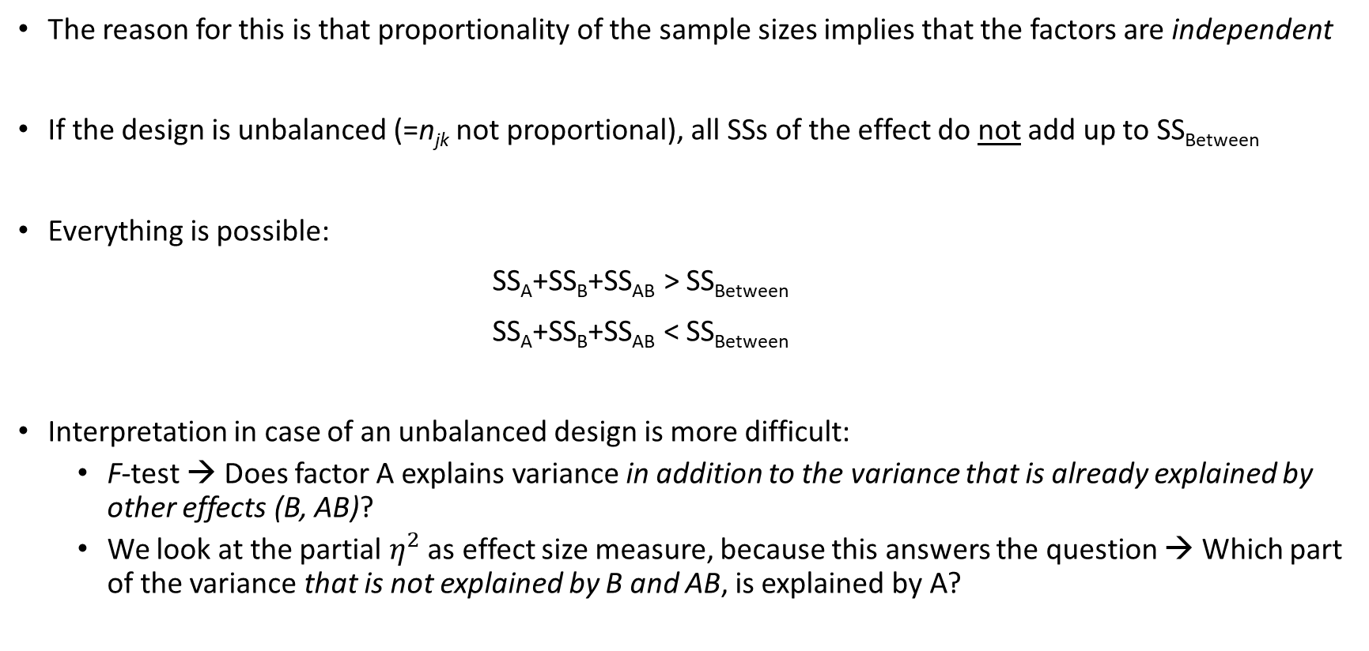
Balanced vs. unbalanced designs
The reason for this is that proportionality of the sample sizes implies that the factors are independent
If the design is unbalanced (=n_{jk} not proportional), all SSs of the effect do not add up to SS_{Between}
Everything is possible:
SS_{A}+SS_{B}+SS_{AB} > SS_{Between}
SS_{A}+SS_{B}+SS_{AB} < SS_{Between}
Interpretation in case of an unbalanced design is more difficult:
F-test → Does factor A explains variance in addition to the variance that is already explained by other effects (B, AB)?
We look at the partial $η^{2}$ as effect size measure, because this answers the question → Which part of the variance that is not explained by B and AB, is explained by A?

Slide 25
Example with an unbalanced design
RQ: Does the mean tiredness of students depend on gender and student’s living situation?
Variables:
Independent variable/factor:
Living situation → 1 = with parents, 2 = one parent, 3 = no parents
Gender → 1 = male, 2 = female
Dependent variable is tiredness that is measured with a scale
Data: All social science students who followed the statistics course MTO-D-MAW in 2004 (N = 590)
Notes:
- READ SLIDE-

Slide 26
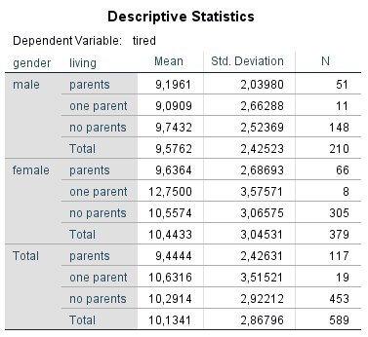
Example with an unbalanced design
Is this an unbalanced design?
Notes:
Robbie: Laten zien dat het unbalanced is.

Slide 27
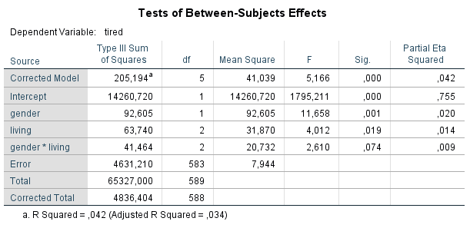
Example with an unbalanced design
We are lucky! → No interaction effect, so we can straightforwardly interpret the main effects

Slide 28
Example with an unbalanced design
Conclusions:
There is an effect of living situation (p = 0.019) controlled for gender and gender*living situation → we need to use post-hoc tests to figure out which groups differ from each other
There is an effect of gender (p = 0.001) controlled for living situation and living situation*gender

Slide 29
One-way vs. Two-way ANOVA
Suppose that we conduct a one-way ANOVA using only the factor drug:
How do the results of a one-way ANOVA compare to those of a two-way ANOVA?
 |  | Type of drug
 |  | Drug A | Drug B | Drug C
Type of patient | Depression | 8; 4; 0 | 10; 8; 6 | 8; 6; 4
 | Schizophrenia | 14;10; 6 | 4; 2; 0 | 15;12; 9

Slide 30
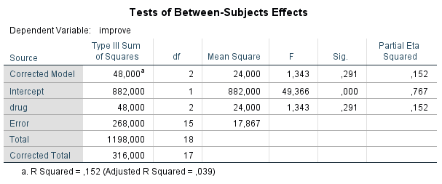
One-way ANOVA:
Comparison:
SS_{drug}, df_{drug}, MS_{drug} are the same
SS_{W} is different in output
SS_{W-1way} =SS_{W-2way} + SS_{pat} + SS_{pat*drug}
268 =106 + 18 + 144
df_{W} is different in output
df_{W-1way} = df_{W-2way} + df_{pat} + df_{pat*drug}
15 = 12 + 1 + 2
Because SS_{W} in two-way (compared to one-way) has decreased relatively more than df_{W}, the MS_{W} in two-way is lower than in one-way
Because MS_{W} is lower in two-way, F_{drug} increases and the p-value of ‘drug’ therefore decreases
Two-way ANOVA:

Slide 31
One-way vs. Two-way ANOVA
Important questions:
Does the p-value of an effect always decrease if extra factors are included in the design?
Does the power of a test always increase if extra factors are included in the design?
Assuming the factors are independent causes of the outcome (e.g., in a randomized controlled experiment):
No, power only increases (p-value only decreases) if at least one of the added effects (B and AB) has an effect
Adding factors to your design is only recommended if you believe that those factors have an effect
In our example: F-value and power of the test increases and p-value decreases, because there is an interaction effect

Slide 32
Benefits two-way ANOVA over one-way ANOVA
Efficiency: 1 instead of 2 experiments
Control: you control for the effect of other variables
Interaction: you can test for an interaction effect
(iv) Power: you increase the power of the test of one variable if at least one of the null hypotheses of the added effects (B, AB) is incorrect (see previous slide)

Slide 33
Two-way ANOVA: Fixed and random factors
(One- and two-way) ANOVA techniques discussed until now only apply to fixed factors
You need to know and be able to apply the definition of fixed, random and mixed
There are fixed-effects, random-effects, and mixed (both fixed and random)-effects models
Fixed factor | Random factor
Only interested in the selected levels of this factor | Also interested in effects of levels that were not selected
Levels are not selected from a larger number of levels that are also interesting | Selected levels are a selection from a larger number of levels that are also interesting
Fixed in our examples: We are only interested in the effects of these three drugs on behavioral improvement of these two types of patients | Example of random-effects models: Effect of a schoolteacher on performance – in design only a few teachers or schools, but you also want to generalize your results to other teachers and schools that were not selected

Slide 34
Literature:
Warner I: 16.6-16.15, Appendix 16A and 16D
ANalysis of COVAriance
Good luck with your exams!
Next lecture…

