Slide 1
Experimental Research Methods Lecture 8

Slide 2
The road so far…

Slide 3
≥ Two groups
(1 factor)
≥ Two groups
(2 factors)
Two groups
Two-way ANOVA
t-test
One-way ANOVA
No
interaction
Yes, an effect!
Interaction
Main effects
Simple effects
Were contrasts specified before data analysis?
Yes
No
A priori
Planned contrast
Helmert
Trend analysis
Post Hoc
Tukey
Scheffé

Slide 4
Lecture goals lecture 8
After this lecture and studying the materials, students are able to:
Explain the differences between one-way ANOVA, two-way ANOVA, and ANCOVA
Interpret the SPSS output of an ANCOVA using a quasi-experimental design
Explain how ANCOVA can eliminate bias

Slide 5
Recap one-way and two-way ANOVA
One-way ANOVA:
Do population means differ from each other?
Does factor A have an effect?
Two-way ANOVA:
Do population means differ from each other?
Does factor A have an effect? Does factor B have an effect? Is there an interaction effect AB?
Often experimental control
Factor A | A1 | A2 | A3
 |  | Factor A
Factor B |  | A1 | A2 | A3
 | B1
 | B2

Slide 6
ANCOVA
ANCOVA:
ANCOVA = ANalysis of COVAriance
Do population means differ from each other after controlling for covariate X?
Does factor A have an effect, controlling for covariate X?
Statistical control rather than experimental control
Experimental control (random assignment) removes the effect of ALL possible covariates
Statistically controlling for a covariate helps IF your model is correctly specified (outside scope of this course, but see https://www.youtube.com/watch?v=wBB4sed9ku0
ANCOVA is interpreted in the same way as one-way ANOVA: the main effect of factor A but then corrected for covariate X
Factor A | A1 | A2 | A3

Slide 7
ANCOVA
You can apply much of what you learned about regression analysis to ANCOVA
In the course Correlational Research Methods, the focus was mainly on continuous variables and factors were included using dummy variables
In this course, the focus is mainly on factors but continuous variables can also be included using ANCOVA
Notes:
Robbie: Refer to regression and control variable over here.

Slide 8
ANCOVA: Idea
You are interested in the effect of one factor, but you want control for the covariate as well
For example, the effect of type of education on learning performance controlled for IQ
Covariate = continuous variable that is related to the dependent variable that was not experimentally controlled for
When levels of a factor, on average, differ on the covariate, there will also be a mean difference on the DV (=bias) that has nothing to do with the factor
IF the model is correctly specified, using an ANCOVA eliminates bias, and we can answer the questions:
Would the means of the dependent variable be different across the levels of the factor, if the means of the covariate were equal?
Is there an effect of the factor, controlled for the covariate?

Slide 9
ANCOVA: Idea
Possible consequences of including a covariate that is related to the dependent variable:
Elimination of bias (see previous slide)
Reduction of error variance → increase of power for the test of the factor
But: if the causal model is misspecified, including a covariate actually created bias
Whether 1. and/or 2. occurs depend on the study design: Experiment or quasi-experiment
Experiment:
Random assignment to conditions means any differences between groups are due to chance
→ virtually no elimination of bias
Reduction of error variance will occur
Quasi-experiment:
No random assignment to conditions and using existing groups → bias could be large
Reduction of error variance will occur

Slide 10
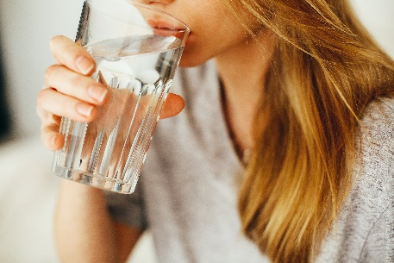
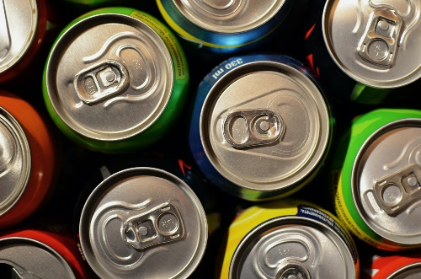
ANCOVA: Example
RQ: What is the effect of drinking energy drink on exam grade?
We use a quasi-experimental design for answering the research question → reduction of error variance and elimination of bias
Data:
Observation: Participants who drank energy drink scored on average 3.2 points higher on the exam
Control Group |  |  | Energy drink
Grade | #hours preparation |  | Grade | #hours preparation
2 | 12 |  | 6 | 17
4 | 14 |  | 7 | 22
5 | 15 |  | 8 | 25
6 | 20 |  | 9 | 25
7 | 22 |  | 10 | 28
Mean=4.8 | 16.6 |  | Mean=8.0 | 23.4
Notes:
Say we want to carry out an ANOVA, in which we want to know whether there is an effect of drinking Red Bull on memorizing words. As covariate, we want to include covariate age. We see in the data that the average age for the two groups is equal. By eyeballing the scores, we see that there is a negative relationship between the DV words and the variable age. –READ SLIDE-

Slide 11
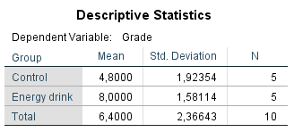
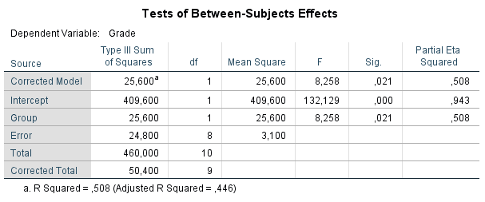
Example: One-way ANOVA
Notes:
So we start with a new example –READ HEADER-. And in this quasi experiment we compare students of one group to students of another group. For instance, say that we want to compare the grade of LAS students. We give red bull to five students of the CNS group, and we DO NOT give red bull to 5 students of the SS group. Then we let all 10 students make the exam, and calculate their grades. These are the results.
-Read SLIDE- ….the groups ALSO differ on a covariate. Any idea what that covariate could be?

Slide 12
Example: One-way ANOVA
Conclusion: The mean difference between the control group and the group who drank energy drink is 3.2, and this difference is statistically significant at the 5% significance level, F(1, 8) = 8.258, p = .021. This means that we have convincing evidence that drinking energy drink has an effect on grade.
Grade
Group
SS_{w}
SS_{b}
24.8
25.6
Notes:
Again, -READ SLIDE-
In the Venn diagrams, we displayed the variance in the DV. We can split up the total variation in a part that can be explained by group membership (the SS of squares between, this was 22.5) and in a part that cannot be explained by group membership (this is the SS within, 69.6).

Slide 13
Example: Preparation hours as a covariate
The groups do not only differ in whether they drink energy drink or not, but also the mean preparation hours was different. The students who drank energy drink were on average much better prepared. But did they perform better because they were drinking energy drink, or just because they were better prepared?
That is, to what extent is the effect of energy drink confounded with the difference in (mean) hours preparation per group?
Main idea of ANCOVA:
What is the predicted mean difference in average performance would the two groups be equally prepared? Is the adjusted mean difference significant?
Remark: in practice, when we run an ANCOVA we address both questions at once, so it’s not that we have to do two separate analyses
Notes:
- READ SLIDE-

Slide 14
ANCOVA: Example
RQ:
Do the means on exam grade differ between the groups when both groups score the same on preparation hours?
What is the effect of drinking energy drink on exam grade controlled for the number of preparation hours?
Data:
Observation: Participants who drank energy drink scored on average 3.2 points higher on the exam but were also better prepared!
Control Group |  |  | Energy drink
Grade | #hours preparation |  | Grade | #hours preparation
2 | 12 |  | 6 | 17
4 | 14 |  | 7 | 22
5 | 15 |  | 8 | 25
6 | 20 |  | 9 | 25
7 | 22 |  | 10 | 28
Mean=4.8 | 16.6 |  | Mean=8.0 | 23.4
Notes:
Say we want to carry out an ANOVA, in which we want to know whether there is an effect of drinking Red Bull on memorizing words. As covariate, we want to include covariate age. We see in the data that the average age for the two groups is equal. By eyeballing the scores, we see that there is a negative relationship between the DV words and the variable age. –READ SLIDE-

Slide 15
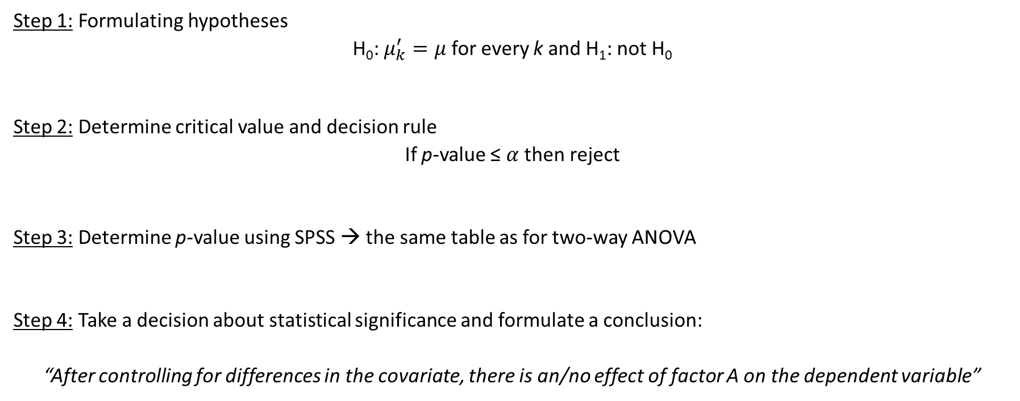
ANCOVA: Steps hypothesis testing
Step 1: Formulating hypotheses
H₀: $μ_{k}^{′}=μ$ for every k and H₁: not H₀
Step 2: Determine critical value and decision rule
If p-value ≤ $α$ then reject
Step 3: Determine p-value using SPSS → the same table as for two-way ANOVA
Step 4: Take a decision about statistical significance and formulate a conclusion:
“After controlling for differences in the covariate, there is an/no effect of factor A on the dependent variable”
Notes:
- READ SLIDE-

Slide 16
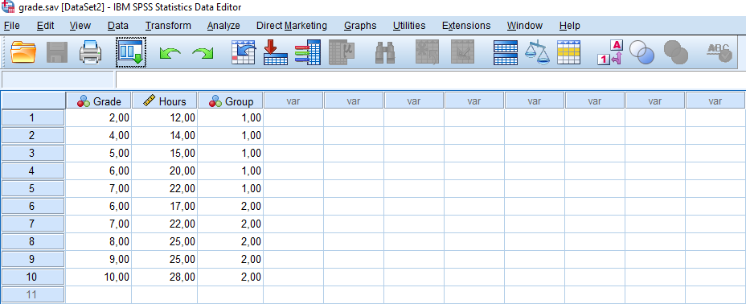
ANCOVA: Example

Slide 17
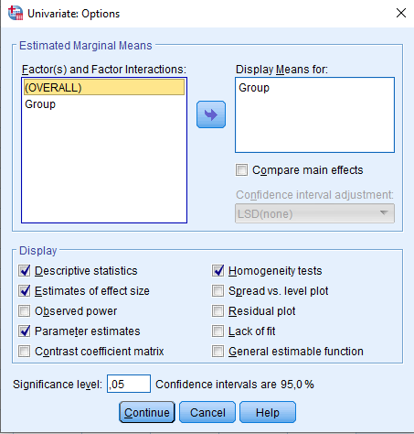
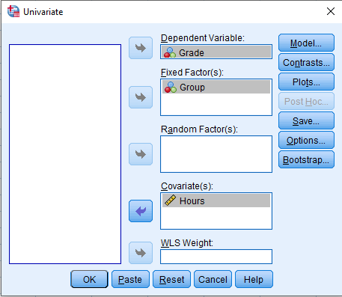
UNIANOVA Grade BY Group WITH Hours
/METHOD=SSTYPE(3)
/INTERCEPT=INCLUDE
/EMMEANS=TABLES(Group) WITH(Hours=MEAN)
/PRINT=ETASQ DESCRIPTIVE PARAMETER HOMOGENEITY
/CRITERIA=ALPHA(.05)
/DESIGN=Hours Group.
Notes:
Robbie: PARAMETER gives the differences between adjusted means

Slide 18
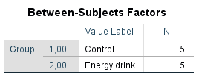

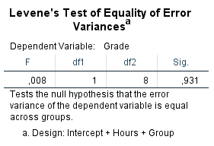
ANCOVA: Example

Slide 19
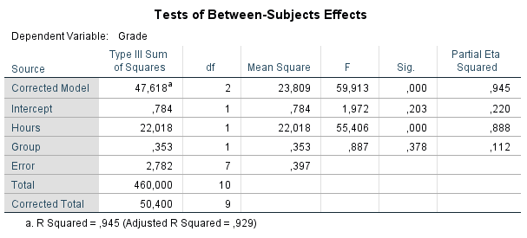
ANCOVA: Example
Conclusion: Controlling for differences in preparation hours, we see that the condition (energy drink) has no significant effect$, F(1,7)=.887$, $p =.378$. (!!!)
Notes:
In this case, we had a significant effect, but if we control for preparation hours, we see that there is no significant difference in adjusted means! If we add a covariate, anything can happen; non-significant effects can become significant or the other way around. OR significant effects stay significant, or non-significant effects stay not significant. Anything is possible.

Slide 20

ANCOVA: Example
SPSS shows by default how much variance can be explained by the factor (Group) and the covariate (Hours) → 94.5% (47.618/50.4) of the variance in Grade can be explained by Group and Hours
SPSS also shows the partial $η^{2}$ → percentage of the variance explained by the factor (Group) that is not yet explained by the covariate Hours
Controlled for Group, Hours explains 88.8% of the remaining unexplained variance
Controlled for Hours, Group explains 11.2% of the remaining unexplained variance
Notes:
Robbie: Adjusted R squared corrects for number of groups and independent variables in a model

Slide 21
ANCOVA: Example
Conclusion in terms of explained variance:
Some variance is explained by group membership only
A larger part is explained by preparation hours only
If we include the covariate, we only focus on what group membership explains in the dependent variable after taking into account what the covariate explains
error
2.782
Group
.353
22.018
Hours
Notes:
This is what the situation looks like. We see, that in the DV, some of the variance is explained by group membership only, some by preparation only, and some of it by group membership and preparation together. If we control for this covariate, we only focus on WHAT group membership explains in the remaining variance of the DV. We see that is less than what group membership explained before.

Slide 22
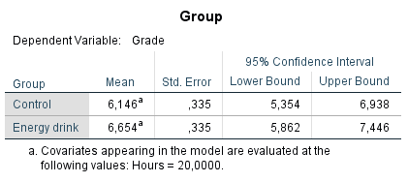
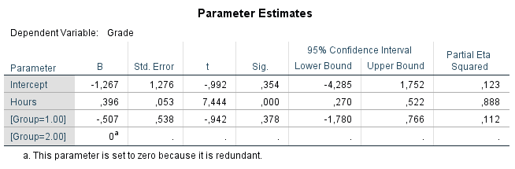
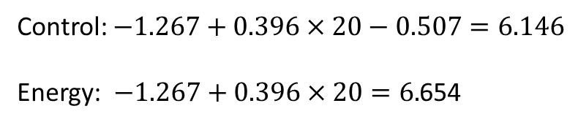
ANCOVA: Example
What are the means in grade when controlling for the covariate Hours?
Unadjusted means: Adjusted means:
Control: $−1.267+0.396×20−0.507=6.146$
Energy: $−1.267+0.396×20=6.$654

Slide 23
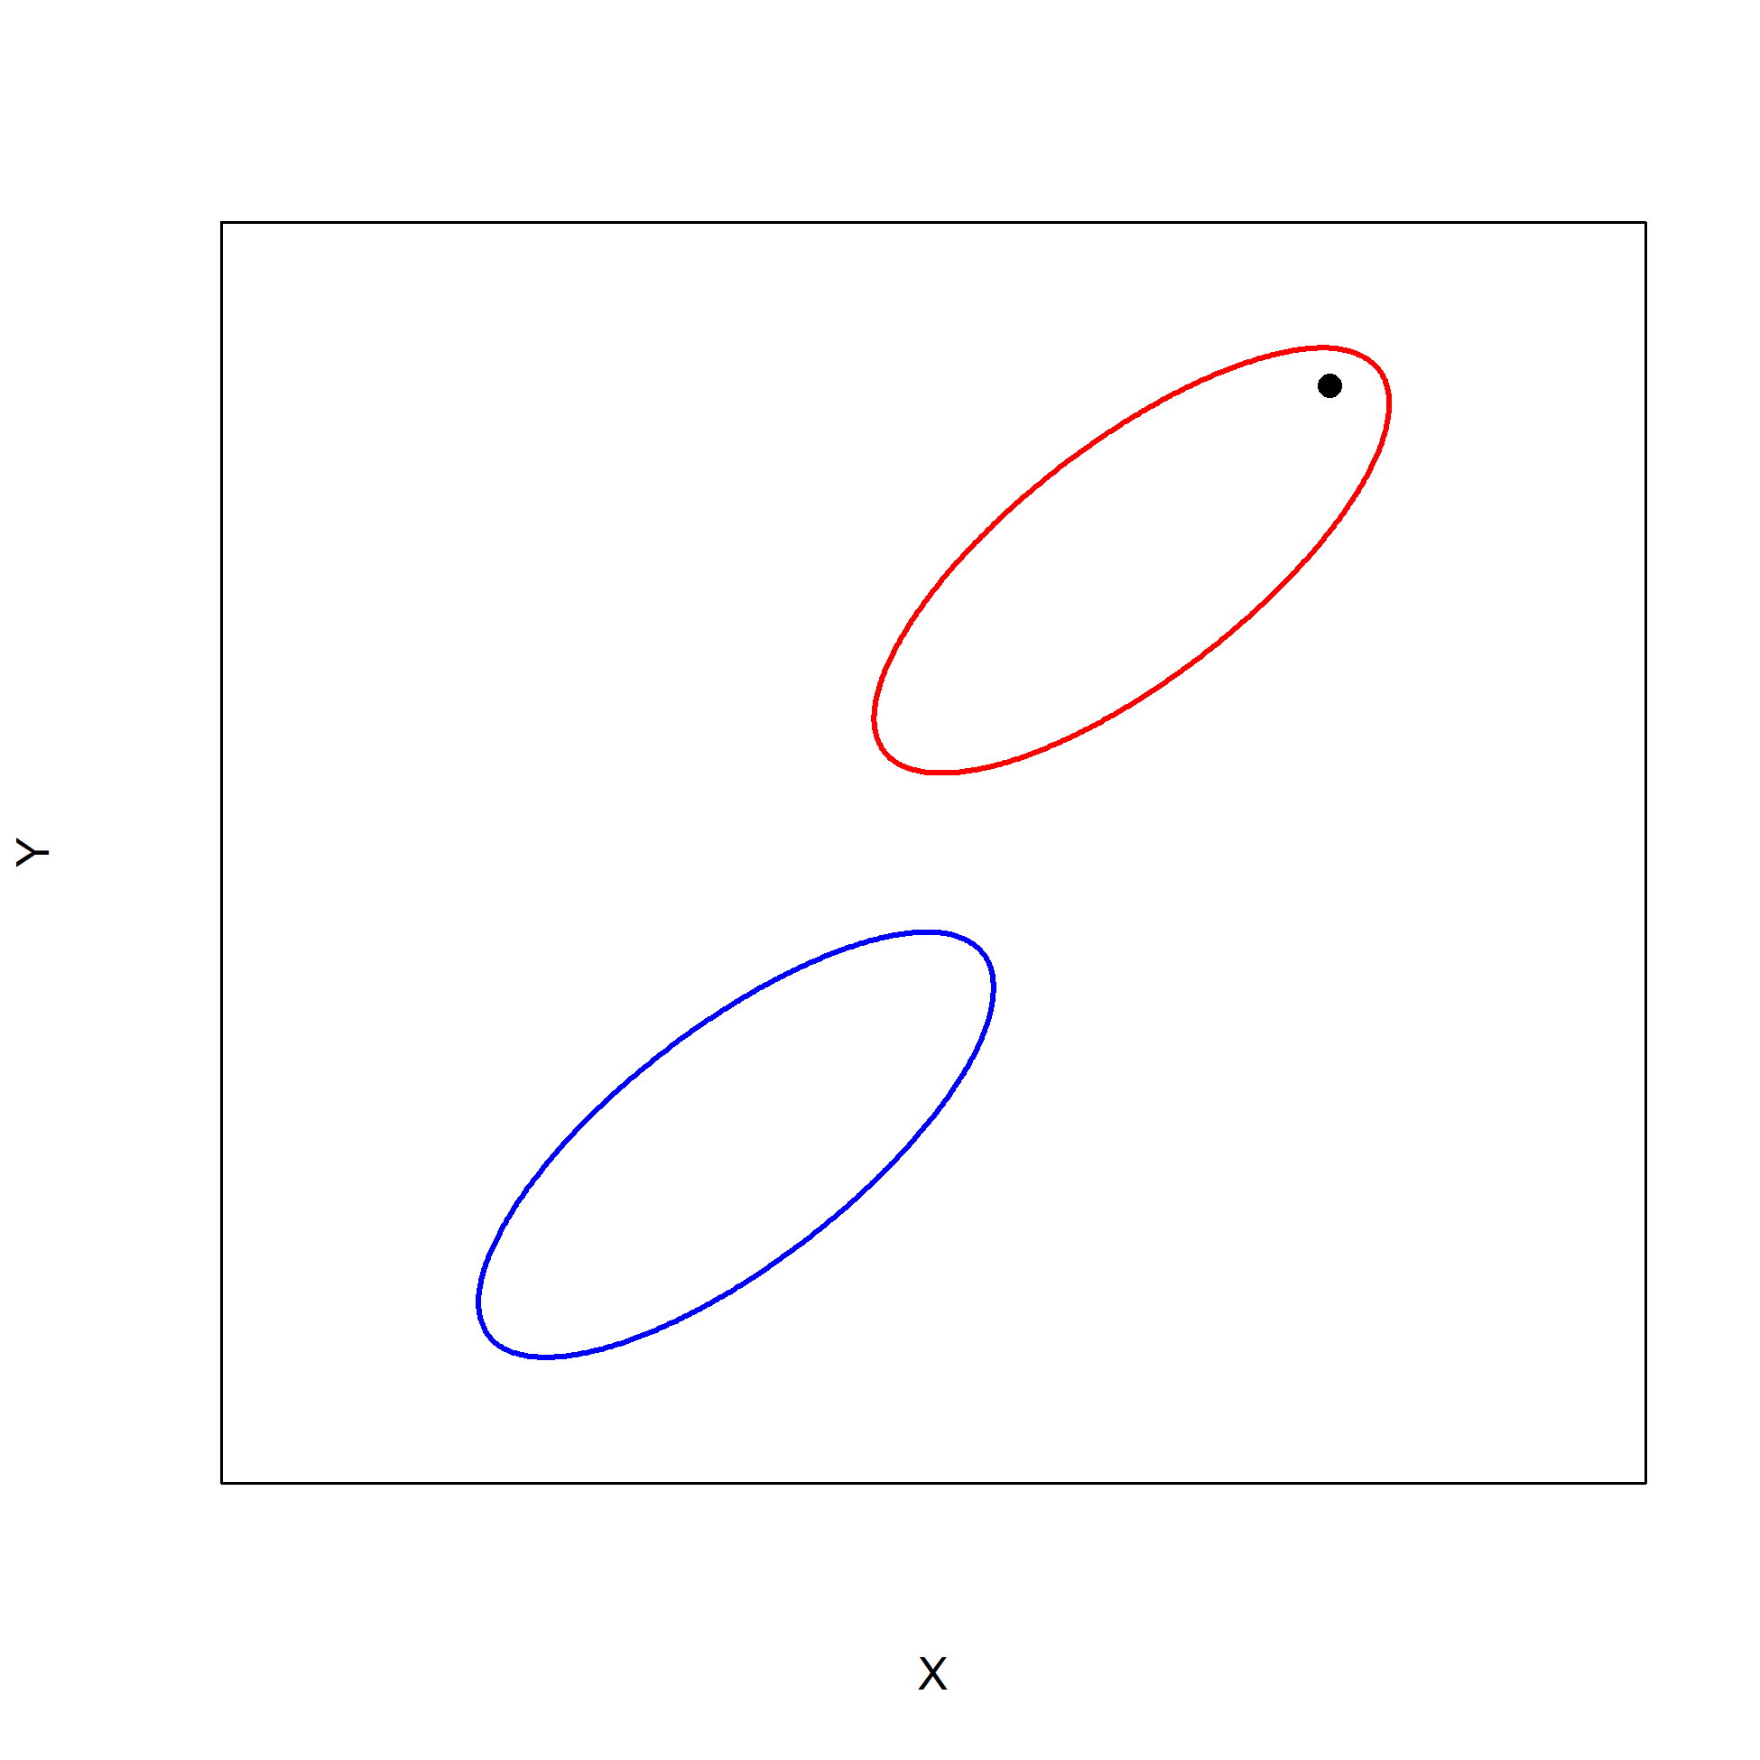
Explanation of eliminating bias using figures
Population data of two groups (1 and 2) on X and Y

Slide 24
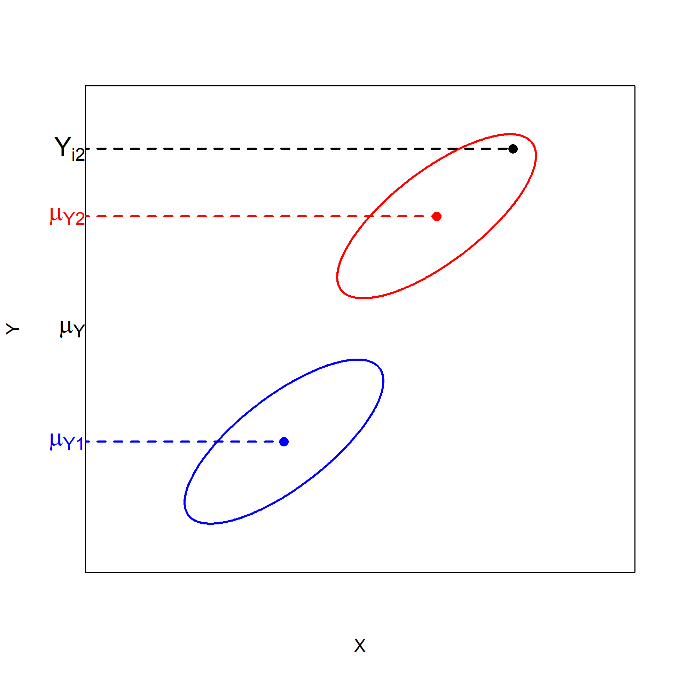

Explanation of eliminating bias using figures
ANOVA model:
$$Y_{i2} = μ_{Y} +α_{2}+ ε_{i2}$$

Slide 25
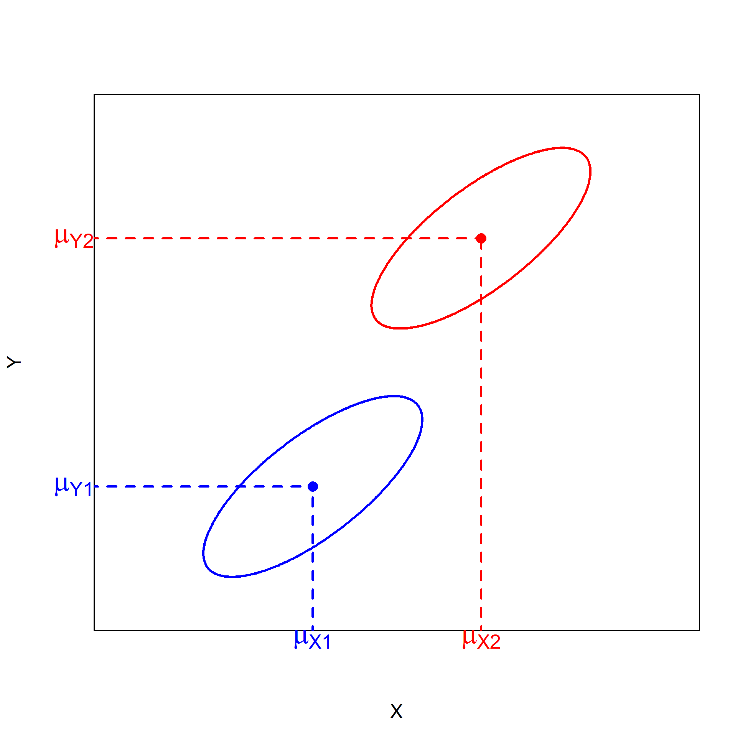

Explanation of eliminating bias using figures
$μ_{Y1} \text{and} μ_{Y2}$ are the unadjusted means for group 1 and 2
$μ_{X1}$ and $μ_{X2}$ are the means on the variable X for group 1 and 2

Slide 26
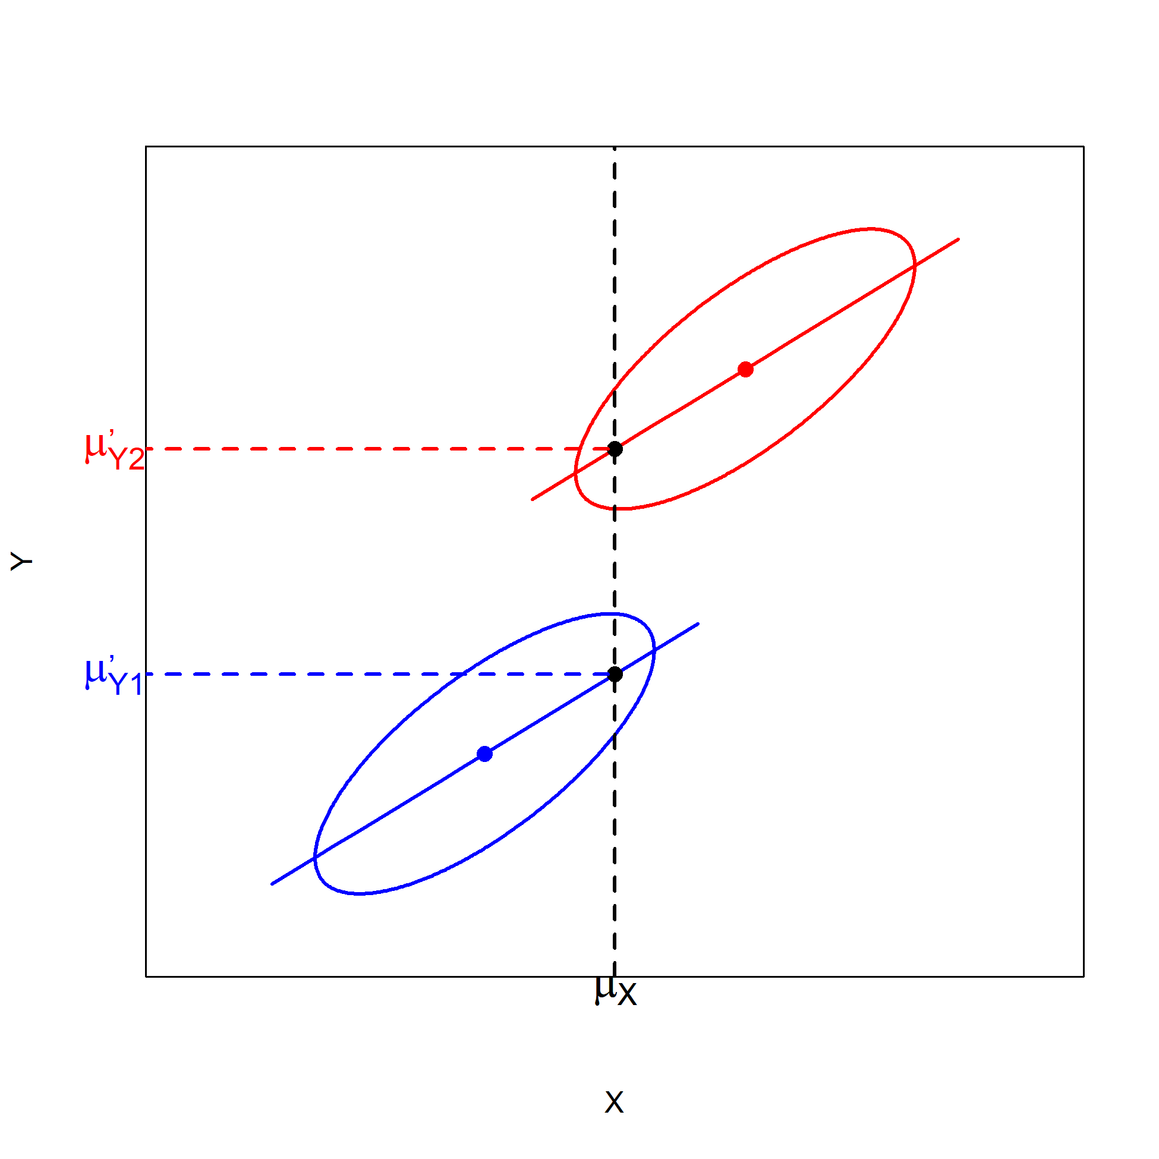
Explanation of eliminating bias using figures
ANCOVA: effect of factor controlled for effect of covariate X
We are now eliminating bias by controlling for covariate X in the ANCOVA

Slide 27
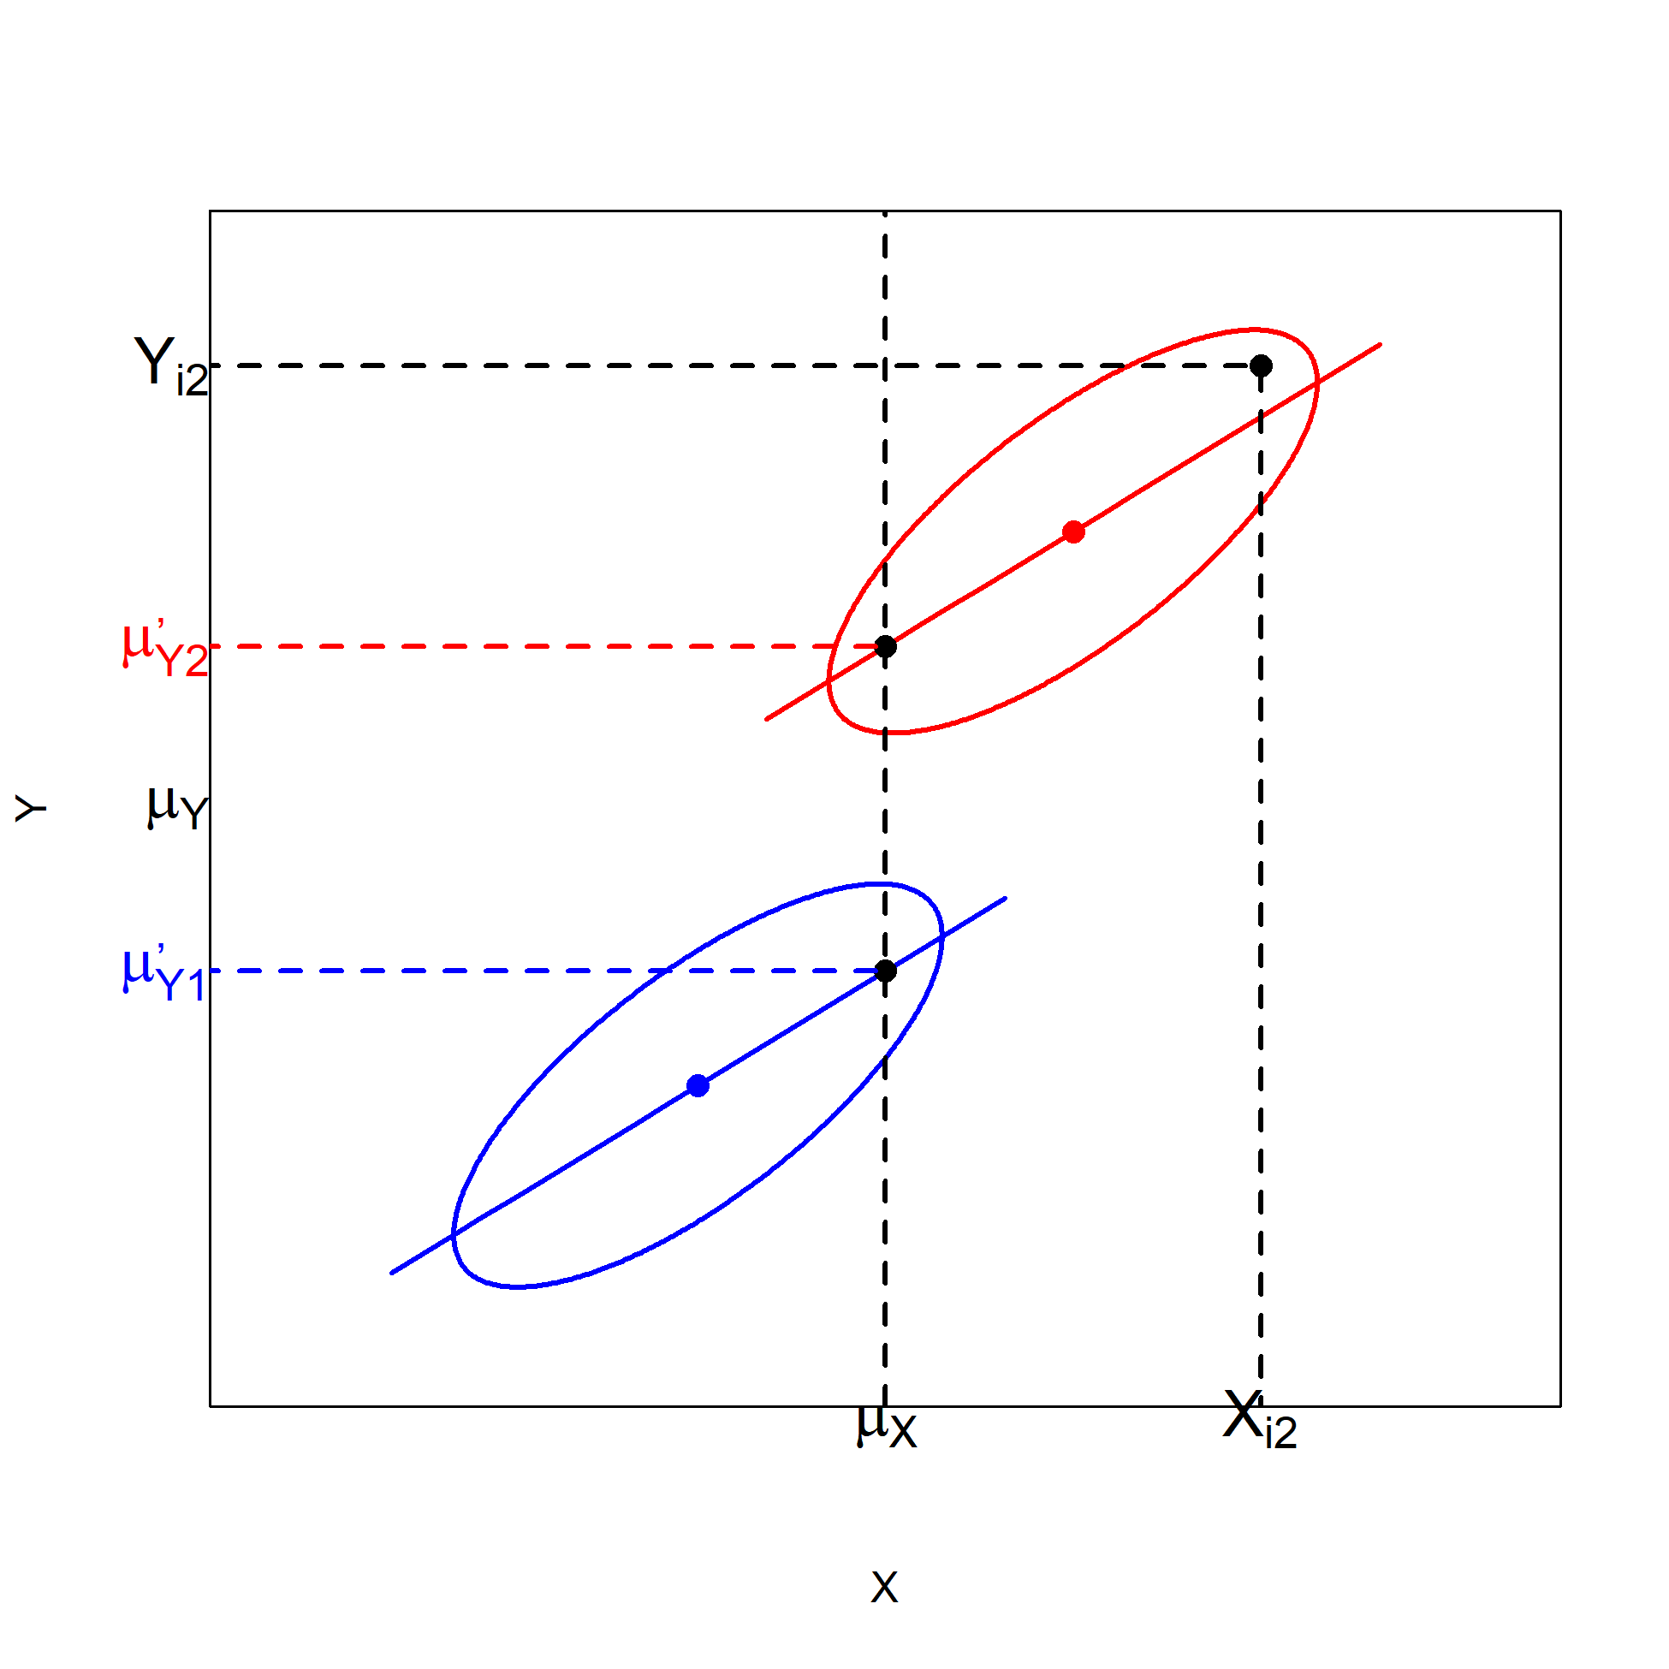

Explanation of eliminating bias using figures
ANCOVA model:
$$Y_{i2} = μ_{Y} +{α′}_{2}+ β_{W}\left(X_{i2}−μ_{X}\right)+ε_{i2}$$

Slide 28
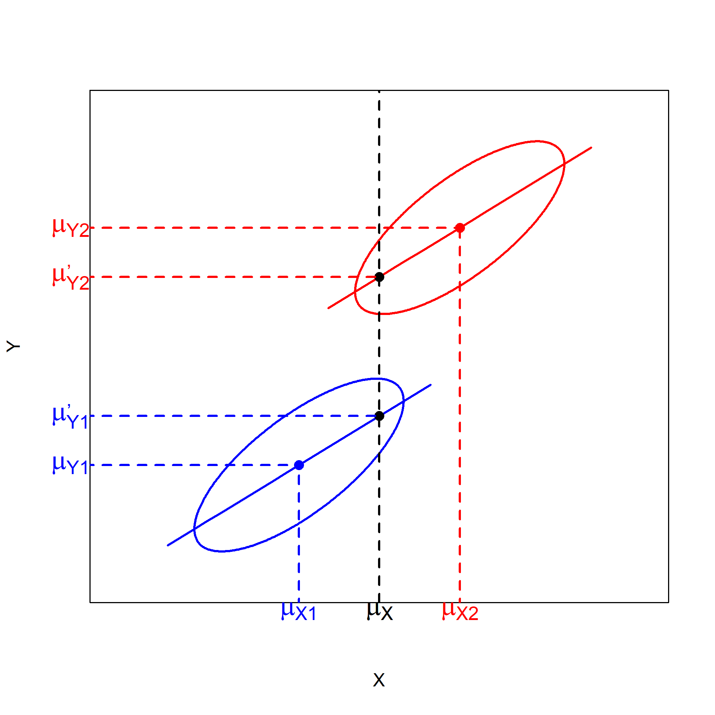
Explanation of eliminating bias using figures
Difference between adjusted means is here smaller than between unadjusted means
However, this does not need to be the case…
Notes:
Robbie: Bias is (mu_y1-mu_y2) - (mu_y1’-mu_y2’) , so eliminating bias causes the adjusted means to be closer to one another than the unadjusted means.

Slide 29
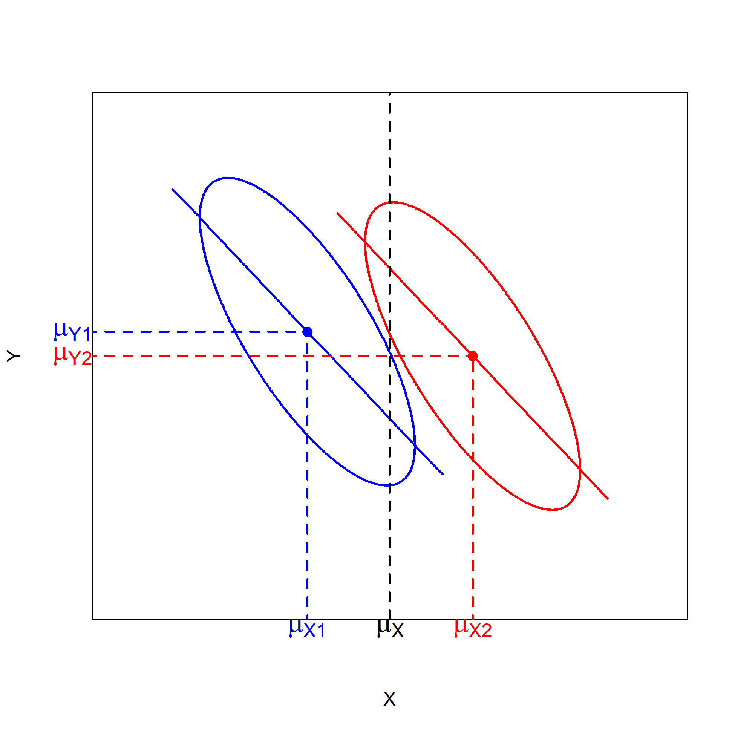
Explanation of eliminating bias using figures
Note that there is a negative relation between X and Y
Difference in adjusted means is now larger than in unadjusted means
Conclusion:
After controlling for the covariate, difference between unadjusted and adjusted means can increase or decrease

Slide 30
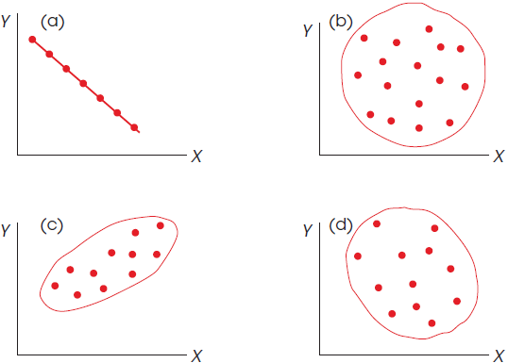
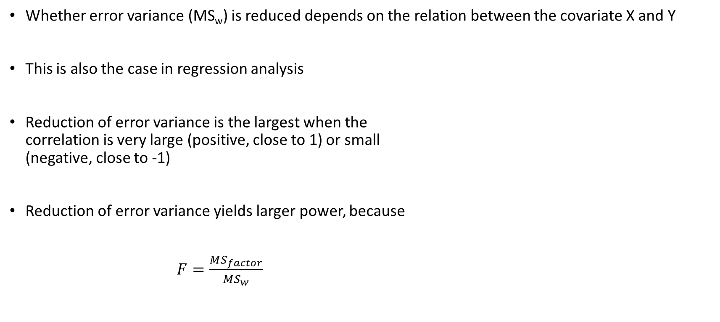
Reduction of error variance
Whether error variance (MS_{w}) is reduced depends on the relation between the covariate X and Y
This is also the case in regression analysis
Reduction of error variance is the largest when the correlation is very large (positive, close to 1) or small (negative, close to -1)
Reduction of error variance yields larger power, because
$F=\frac{MS_{factor}}{MS_{w}}$

Slide 31
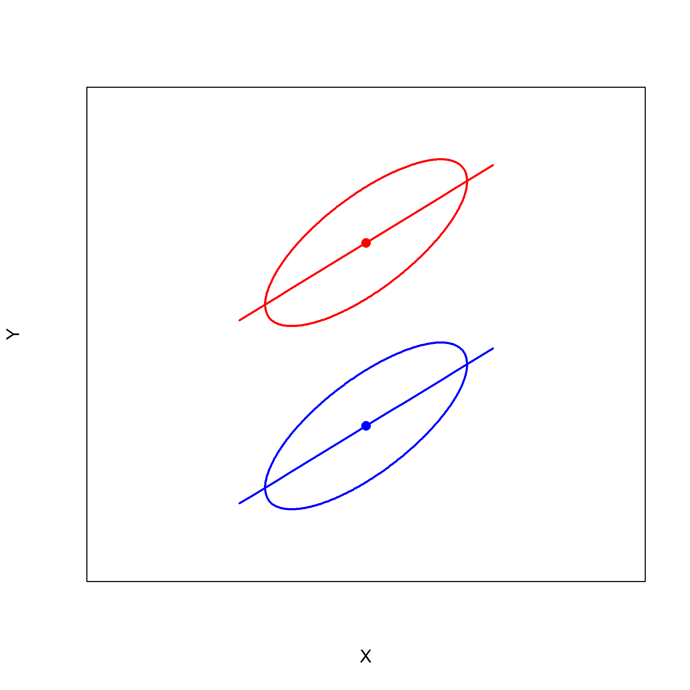
Experiment: Only reduction of error variance
Experimental design, because scores in group 1 (red) are right above those of group 2 (blue)
Unadjusted and adjusted means are equal
Participants are randomly assigned to the groups

Slide 32
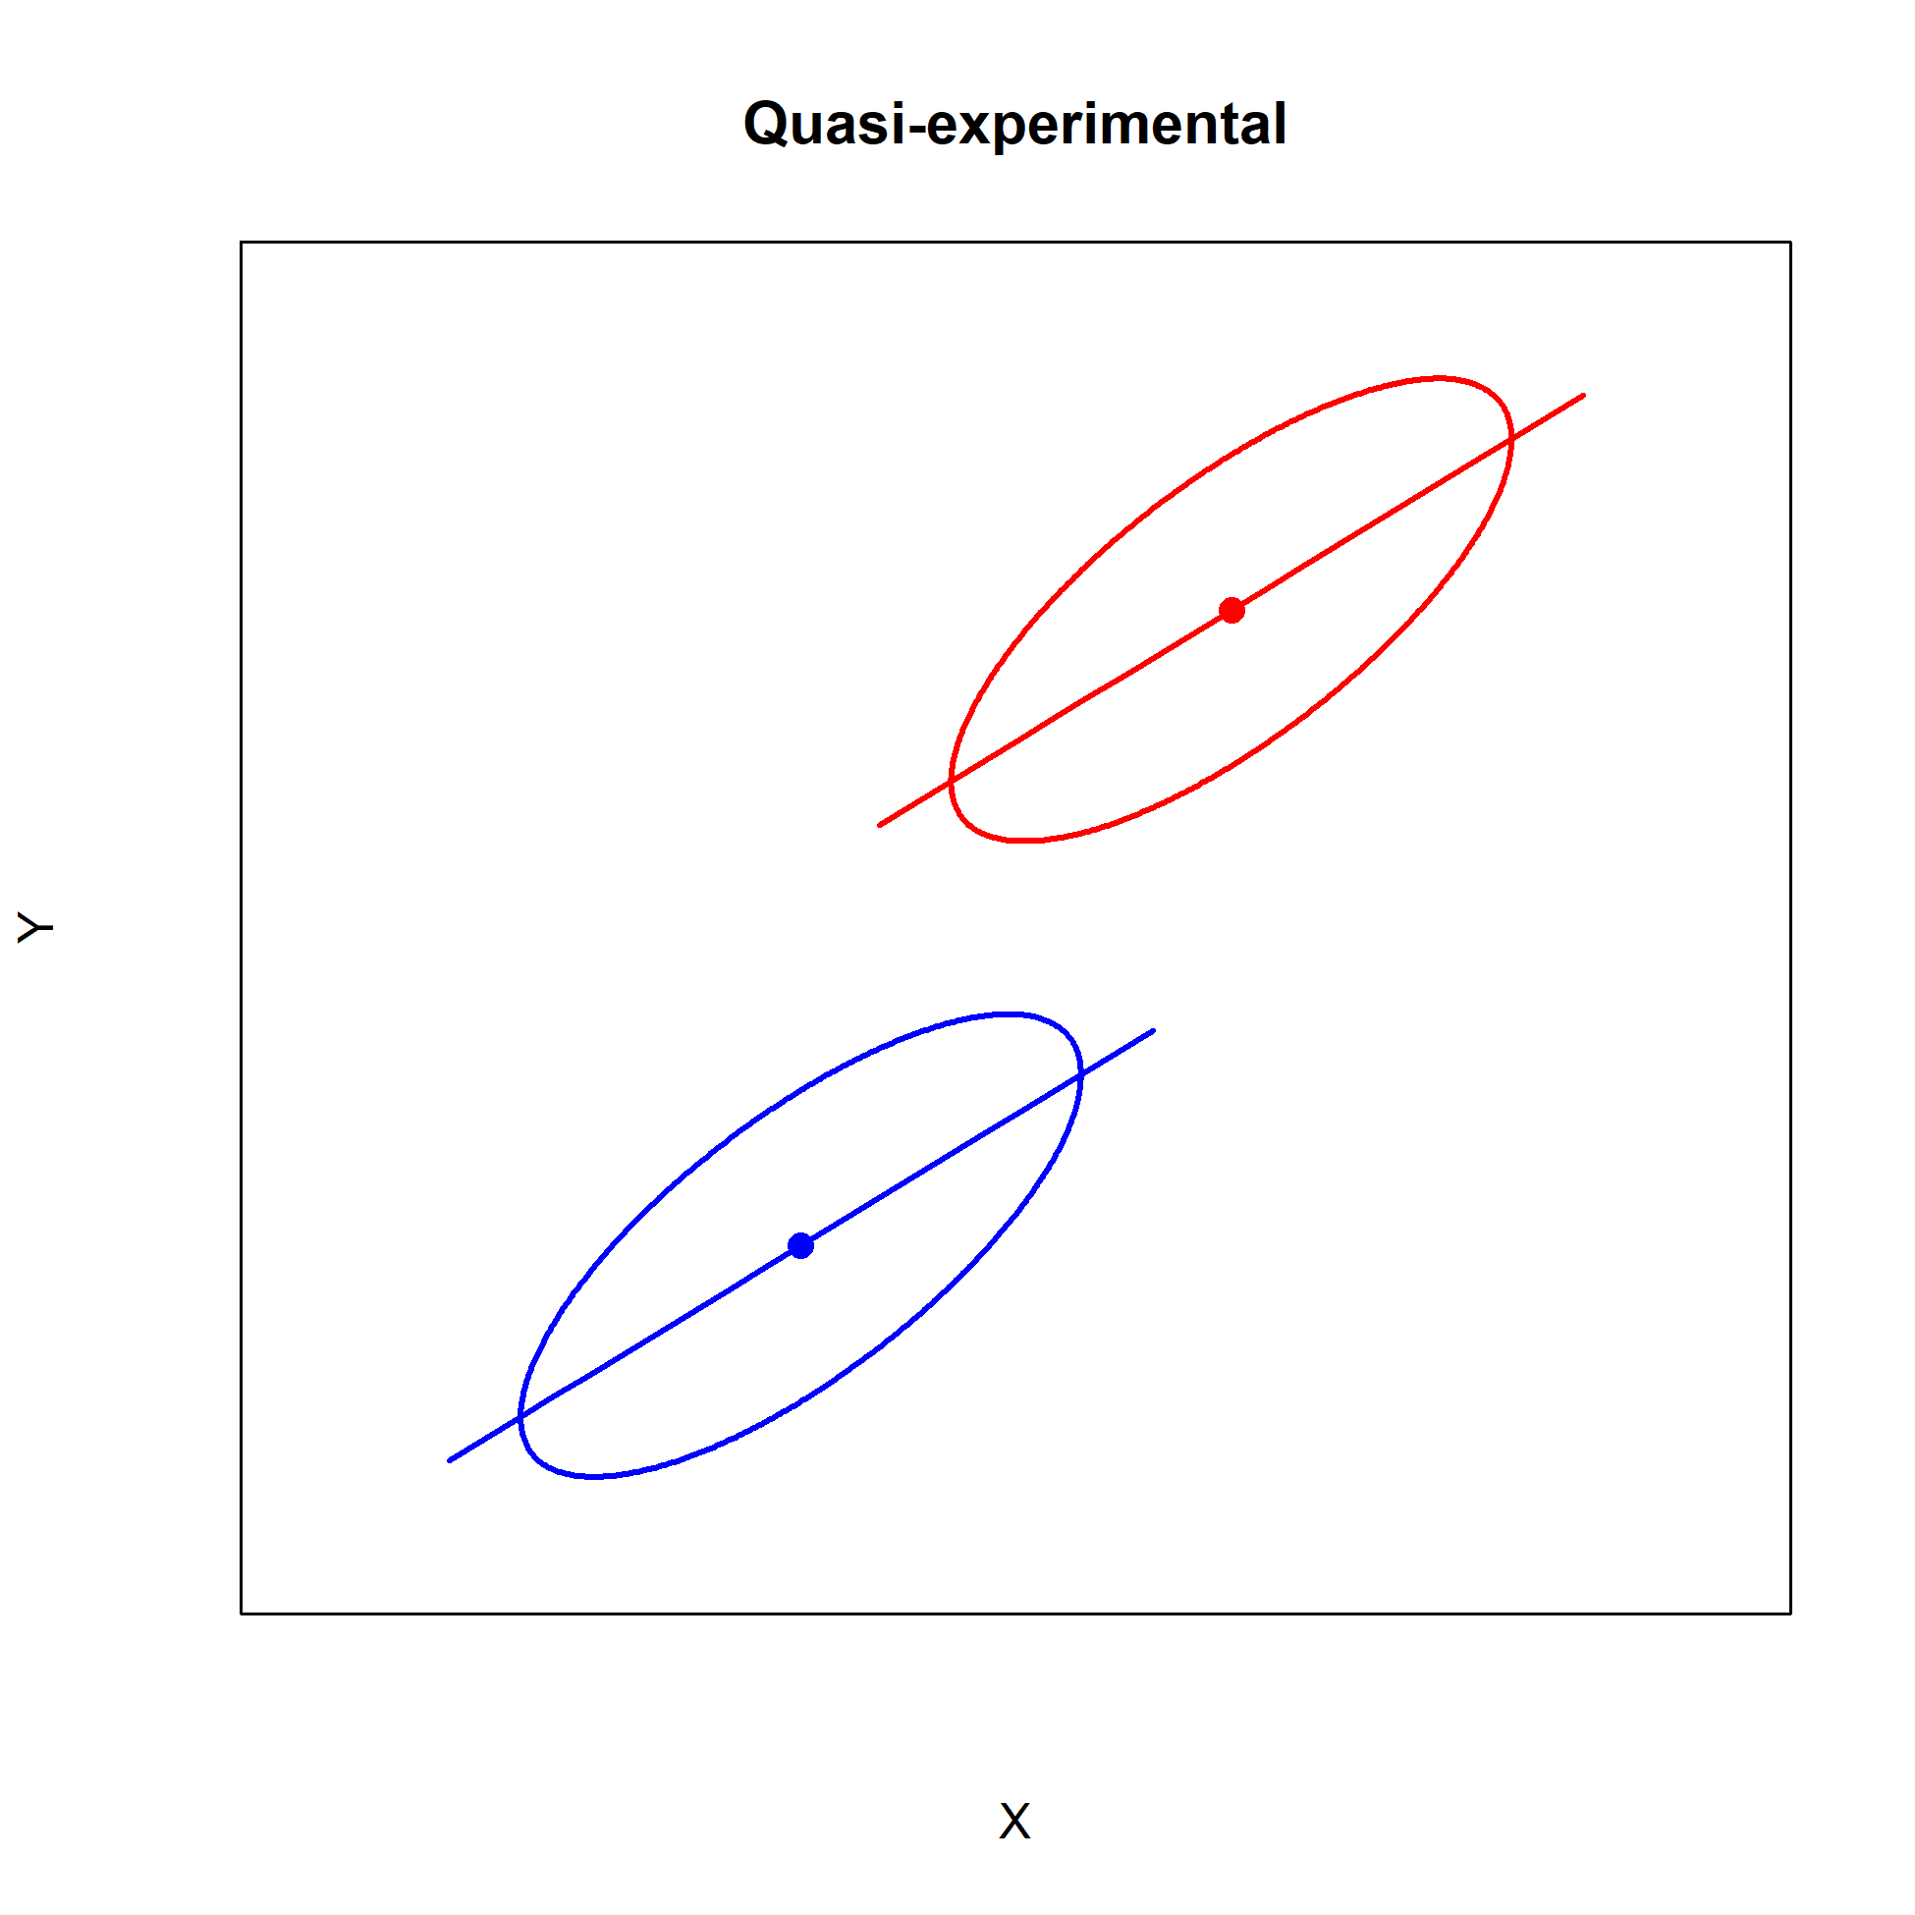
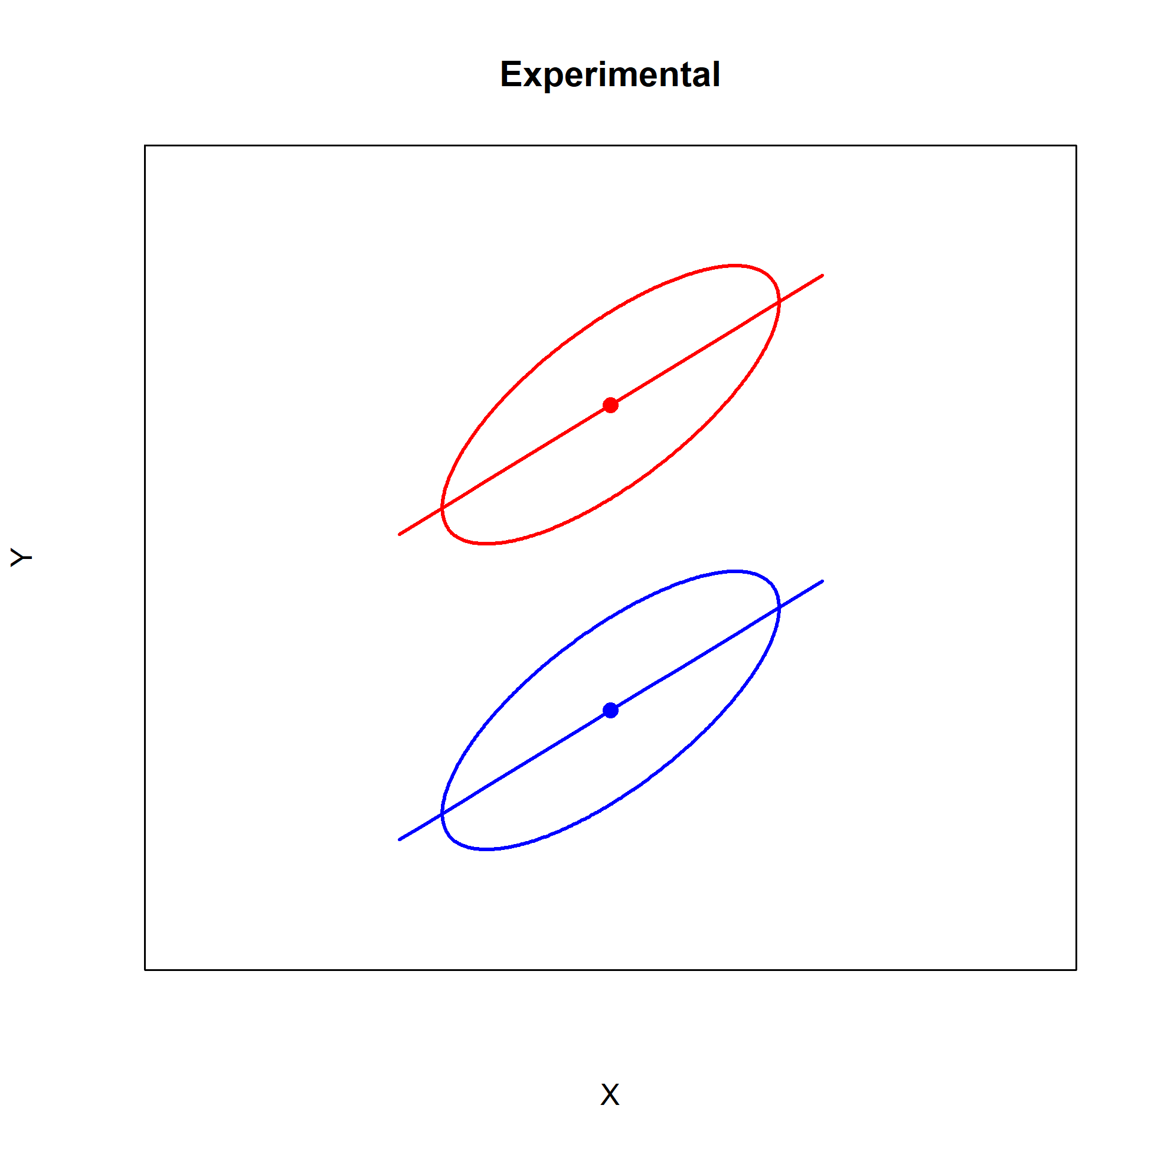
Quasi-experimental vs. Experimental

Slide 33

Interpretation quasi-experiments
There is a danger in the interpretation of statistical analysis (so also of ANCOVA) of existing groups
Internal validity may be low
For example, a quasi-experiment may show that energy drink has an effect on exam grade but not when taking the covariate hours preparation into account
And there might be other confounding variables that explain the difference (“bias”)
Hence, ANCOVA is OK, but keep threats to the internal validity in mind

Slide 34
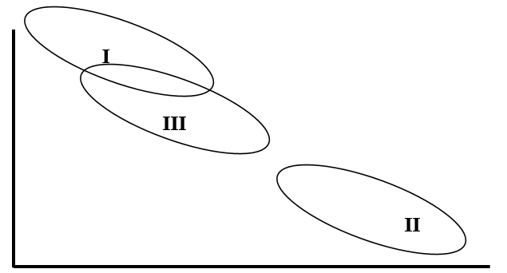
Old exam questions
A researcher conducts an ANCOVA. The factor has 3 levels (I, II, III). You can find the combined scatter plots of the three groups below. The Roman numeral in a scatter plot shows the level to which it belongs.
Statements:
The order of the unadjusted means is different from the order of the adjusted means.
The differences between the adjusted means are larger than the differences between the unadjusted means.

Slide 35
Literature:
Warner II: 8.1-8.2 and 8.4-8.10
ANCOVA in case of an experimental design
Assumptions ANCOVA
Repeated measures ANOVA Part I
Next week…

