Slide 1
Experimental Research Methods Lecture 9

Slide 2
Lecture goals lecture 9
After this lecture and studying the materials, students are able to:
Interpret the SPSS output for an ANCOVA using data of an experimental design
Explain the assumptions of ANCOVA
Assess whether the assumption of homogeneity of regression slopes is violated based on SPSS output
Explain the differences between one-way and two-way ANOVA, ANCOVA, and repeated measures ANOVA

Slide 3
Recap: ANCOVA
ANCOVA:
ANCOVA = ANalysis of COVAriance
Do population means differ from each other controlled for covariate X?
Does factor A have an effect, controlled for covariate X?
Statistical control rather than experimental control
ANCOVA is interpreted in the same way as one-way ANOVA: the main effect of Factor A but then controlled for covariate X
Factor A | A1 | A2 | A3

Slide 4
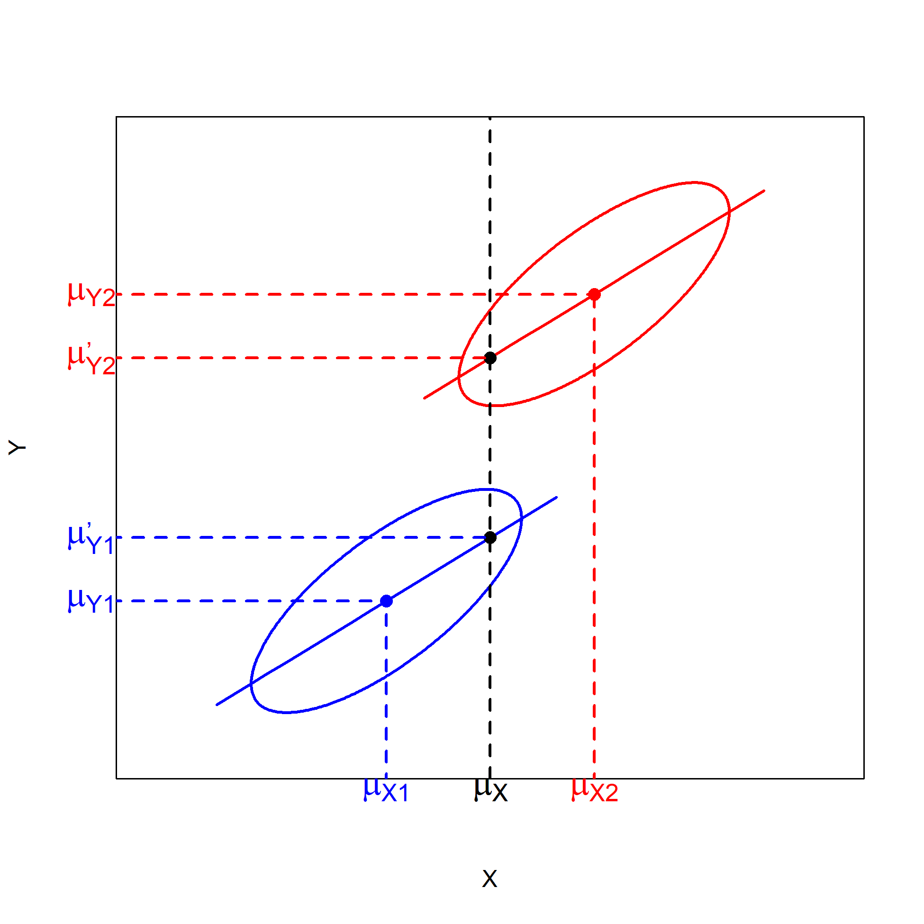
Recap: ANCOVA
ANCOVA: effect of factor controlled for effect of covariate X
We are now eliminating bias by controlling for covariate X in the ANCOVA
… and also reducing error variance, because covariate X is related to Y
Assuming the factor and X are independent causes of Y

Slide 5
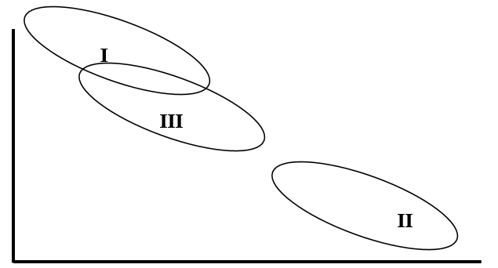
Old exam questions
A researcher conducts an ANCOVA. The factor has 3 levels (I, II, III). You can find the combined scatter plots of the three groups below. The Roman numeral in a scatter plot shows the level to which it belongs.
Statements:
The order of the unadjusted means is different from the order of the adjusted means.
The differences between the adjusted means are larger than the differences between the unadjusted means.

Slide 6


ANCOVA: Example using experimental design
RQ: What is the effect of drinking energy drink on memorizing words?
We use an experimental design for answering the research question → only reduction of error variance
Data:
Observation: Participants who drank energy drink memorized more words
Control Group |  |  | Energy drink
Words | Age |  | Words | Age
10 | 22 |  | 14 | 21
9 | 28 |  | 10 | 25
5 | 32 |  | 11 | 34
6 | 44 |  | 9 | 44
4 | 46 |  | 5 | 48
Mean=6.8 | 34.4 |  | 9.8 | 34.4
Notes:
Say we want to carry out an ANOVA, in which we want to know whether there is an effect of drinking Red Bull on memorizing words. As covariate, we want to include covariate age. We see in the data that the average age for the two groups is equal. By eyeballing the scores, we see that there is a negative relationship between the DV words and the variable age. –READ SLIDE-

Slide 7
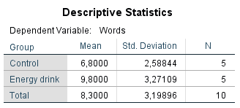
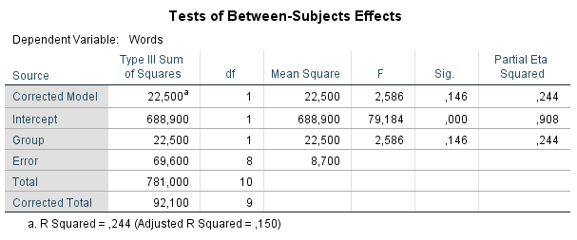
Example: One-way ANOVA
Notes:
What if we would conduct the ANOVA, WITHOUT taking the variable age into account? We see that in the sample there is a difference in means. But we are not allowed to generalize this to the population; the p-value is larger than alpha of .05, so we are not allowed to reject the null hypothesis. So, we failed to find sufficient evidence to believe that the population means differ.
We can check the Sums of Squares between and within and the MSb and MSw. –READ SLIDE

Slide 8
Example: One-way ANOVA
Conclusion: We observe in the sample that participants who drank energy drink memorized on average more words than participants in the control group, but the mean difference is not significant at the 5% significance level, F(1, 8) = 2.586, p = .146. This means that (from this study) we have no convincing evidence that drinking energy drink has an effect on short-term memory.
Words
Group
SS_{w}
SS_{b}
69.6
22.5
Notes:
Again, -READ SLIDE-
In the Venn diagrams, we displayed the variance in the DV. We can split up the total variation in a part that can be explained by group membership (the SS of squares between, this was 22.5) and in a part that cannot be explained by group membership (this is the SS within, 69.6).

Slide 9
Example: Controlling for age
In the previous analysis, we found no significant result for drinking energy drink
Statistically this means that the between-group differences were not large enough in relation to the within-group differences to speak of a significant effect
However, differences in memorizing words may also depend on age; thus, part of the within-group differences may be explained by age differences. This may conceal the genuine effect of energy drink (i.e., the age differences blurs the effect)
What if we were able to control for/remove the influence of these age-related differences; would we then find an effect of energy drink? In other words: What if in our experiment all the persons had exactly the same age: Would the average number of memorized words differ across the conditions?
Notes:
- READ SLIDE-

Slide 10
ANCOVA: Example
RQ:
Do the means on memorizing words differ between the groups when both groups score the same on age?
What is the effect of drinking energy drink on memorizing words controlled for age?
Data:
Observation: Participants who drank energy drink memorized more words, but younger participants also memorized more words!
Control Group |  |  | Energy drink
Words | Age |  | Words | Age
10 | 22 |  | 14 | 21
9 | 28 |  | 10 | 25
5 | 32 |  | 11 | 34
6 | 44 |  | 9 | 44
4 | 46 |  | 5 | 48
Mean=6.8 | 34.4 |  | 9.8 | 34.4
Notes:
Say we want to carry out an ANOVA, in which we want to know whether there is an effect of drinking Red Bull on memorizing words. As covariate, we want to include covariate age. We see in the data that the average age for the two groups is equal. By eyeballing the scores, we see that there is a negative relationship between the DV words and the variable age. –READ SLIDE-

Slide 11
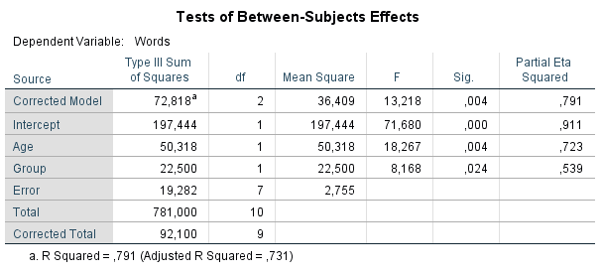
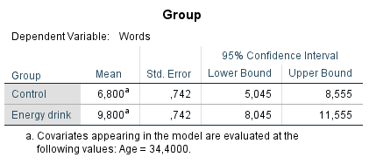
Example: ANCOVA

Slide 12
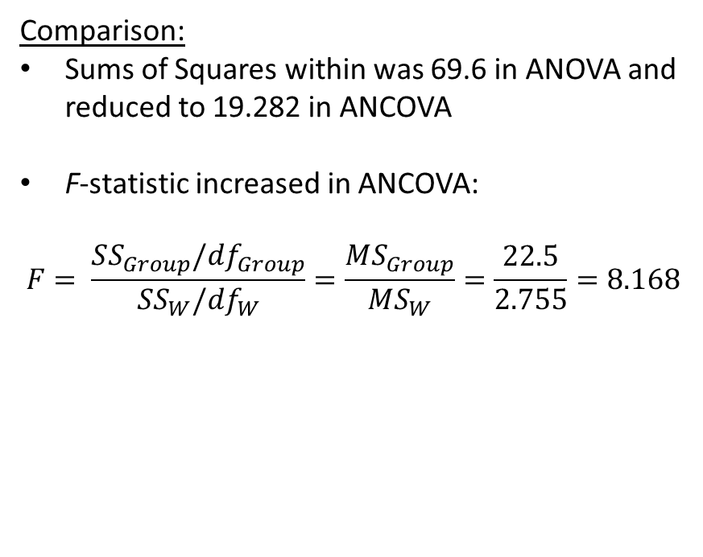
One-way ANOVA:
Comparison:
Sums of Squares within was 69.6 in ANOVA and reduced to 19.282 in ANCOVA
F-statistic increased in ANCOVA:
$$F= \frac{SS_{Group}/df_{Group}}{SS_{W}/df_{W}}=\frac{MS_{Group}}{MS_{W}}=\frac{22.5}{2.755}=8.168$$
ANCOVA:

Slide 13
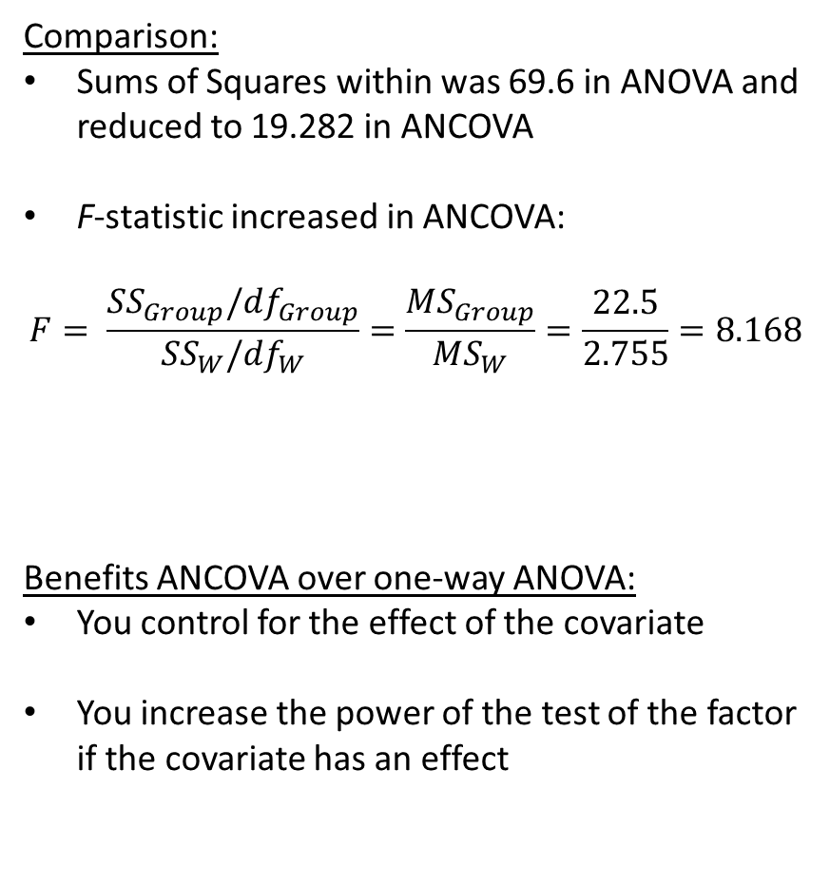
One-way ANOVA:
Comparison:
Sums of Squares within was 69.6 in ANOVA and reduced to 19.282 in ANCOVA
F-statistic increased in ANCOVA:
$$F= \frac{SS_{Group}/df_{Group}}{SS_{W}/df_{W}}=\frac{MS_{Group}}{MS_{W}}=\frac{22.5}{2.755}=8.168$$
Benefits ANCOVA over one-way ANOVA:
You control for the effect of the covariate
You increase the power of the test of the factor if the covariate has an effect
ANCOVA:

Slide 14
Example: ANCOVA
Conclusion: We see in the sample that participants who drank energy drink memorized on average more words than participants in the control group. When controlling for differences in the covariate age, drinking energy drink has an effect on the average number of memorized words (F(1, 7) = 8.168, p = .024).
In terms of explained variance… if we take out the variance explained by age, we can explain a large amount of the remaining variance from drinking energy drink or not. In other words: differences in age have concealed the effect of energy drink.
19.282
50.318
22.500
Group
Age
Words

Slide 15
Assumptions ANCOVA
The first three assumptions of ANCOVA are identical to those of one-way ANOVA:
Independence of observations
Homogeneity of variance → Levene’s test
Normally distributed residuals
Four additional assumptions:
Covariate is measured before the experimental manipulation (= assumption that model is correctly specified)
Covariate is measured without measurement error (= always the case in general linear model, also in regression, t-test et cetera)
Relation between X and Y is linear (= always the case in general linear model)
Relation between X and Y is the same for all levels of Group (“homogeneity of regression slopes”) → no interaction between X and Group (= always the case in general linear model)
ANCOVA is not robust to violations of assumptions 4-7
Notes:
- READ SLIDE-

Slide 16
Assumptions ANCOVA
Covariate is measured before the experimental manipulation
Covariate should not be affected by the manipulation
Covariate is measured without measurement error
Use a reliable measure for the covariate
Relation between X and Y is linear
Inspect the scatter plot
Relation between X and Y is the same for all levels of Group (“homogeneity of regression slopes”) → no interaction between X and Group
Can be tested in SPSS
An extra assumption in case you include more than one covariate → no high correlations among covariates (=multicollinearity. Note that assumption 4 also introduces multicollinearity between factor and covariate)
Notes:
- READ SLIDE-

Slide 17
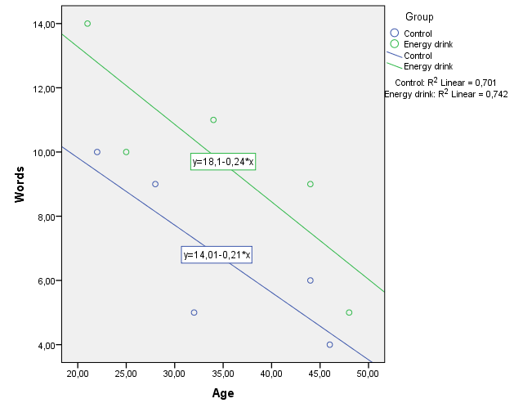
Testing homogeneity of regression slopes
Is the relation between X and Y the same for all levels of Group?
Conduct an ANCOVA with interaction X*Group → if significant ANCOVA cannot be used
UNIANOVA Words BY Group WITH Age /METHOD=SSTYPE(3) /INTERCEPT=INCLUDE /EMMEANS=TABLES(Group) WITH(Age=MEAN) /PRINT=ETASQ DESCRIPTIVE PARAMETER HOMOGENEITY /CRITERIA=ALPHA(.05) /DESIGN=Age Group Age*Group.
Notes:
- READ SLIDE-

Slide 18
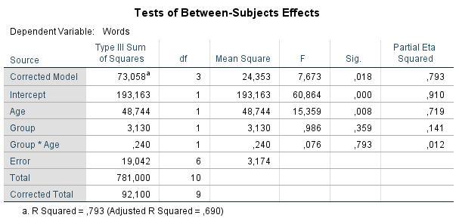
Testing homogeneity of regression slopes
Interaction effect is not significant (F(1, 6) = 0.076, p = 0.793) → assumption is not violated and we can interpret the results of the ANCOVA without the interaction effect
Note that this output is the same as for a two-way ANOVA
Notes:
- READ SLIDE-

Slide 19
ANCOVA: Summary
Do population means differ from each other controlled for covariate X?
Possible consequences of including a covariate that is related to the dependent variable:
Elimination of bias
Reduction of error variance
Especially in a quasi-experimental design bias is eliminated
Conclusion: By including a covariate, anything can happen: Effects may disappear or appear!
Notes:
- READ SLIDE-

Slide 20
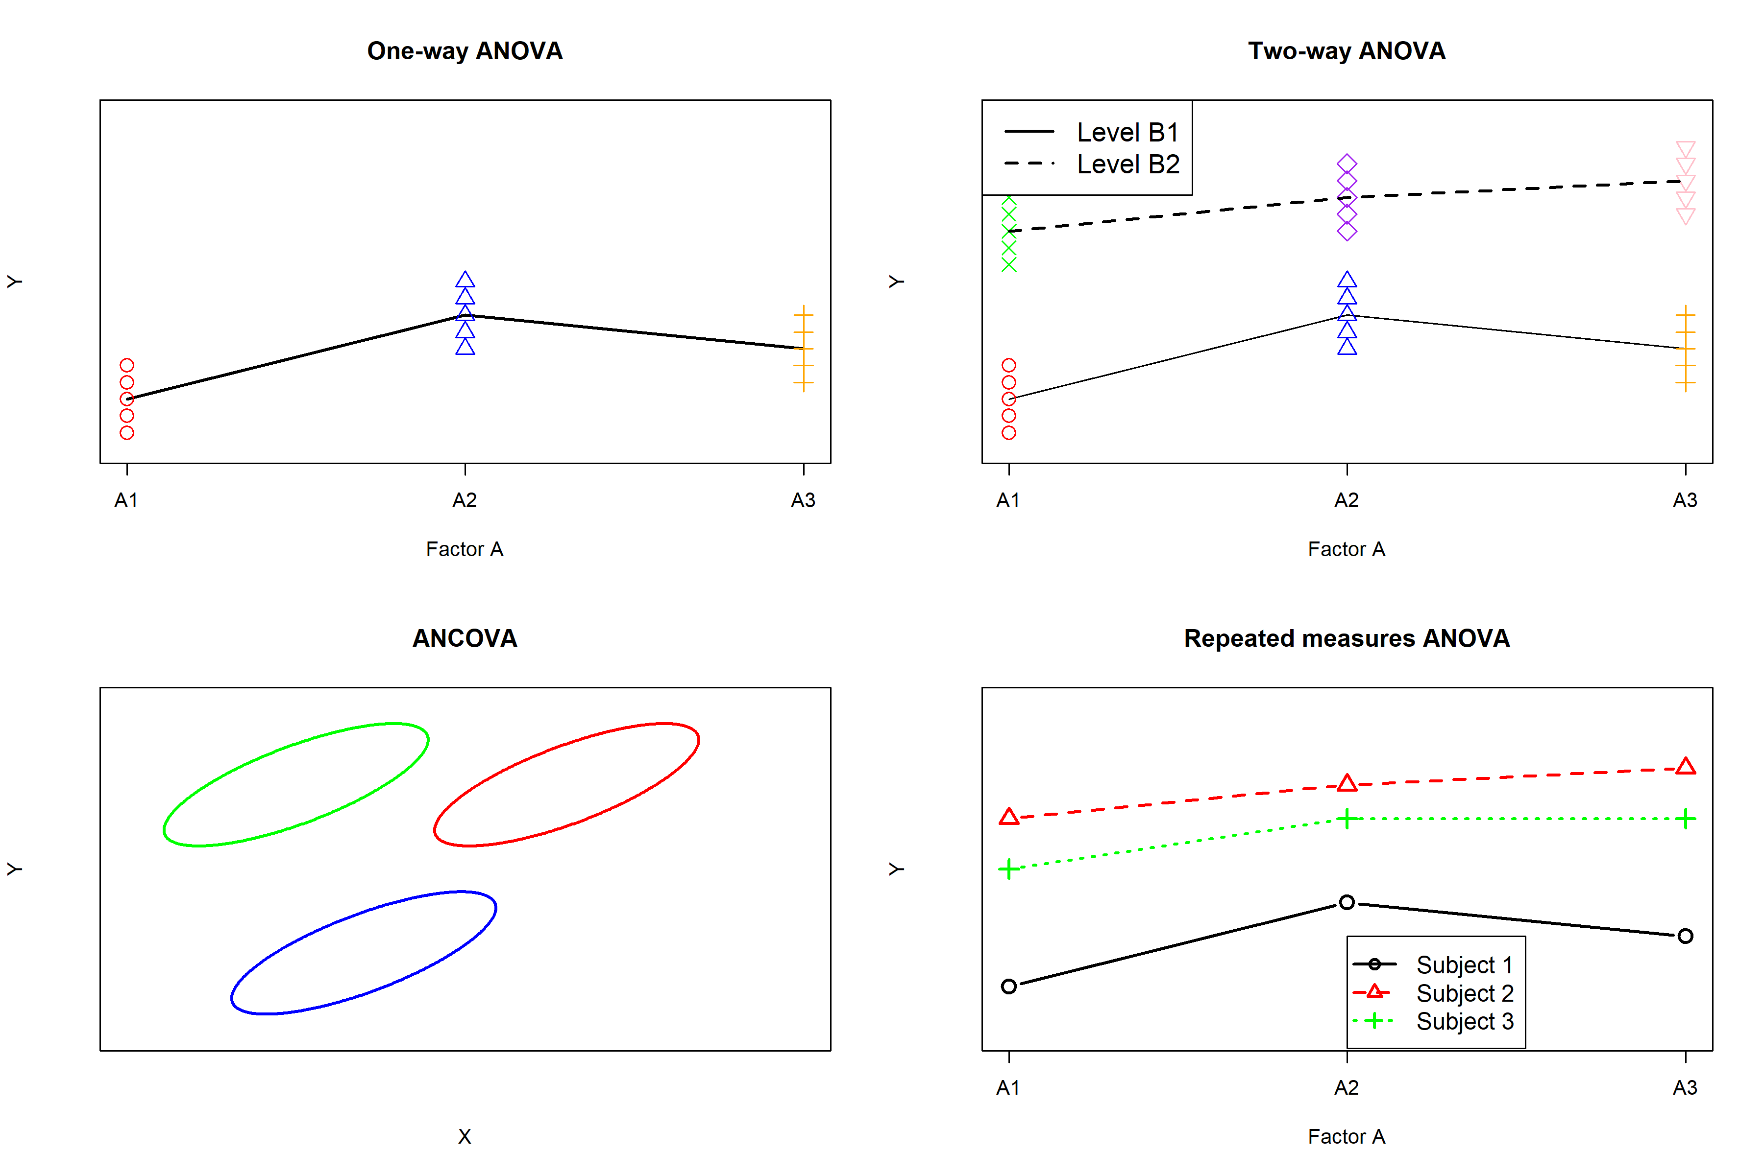

Slide 22
Notes:
Robbie: Observaties in the scatter plots

Slide 23
Summary of learned techniques
Conclusion: In all previous discussed techniques, each person has only one observation of measurement on the dependent variable (univariate)
 | One-way ANOVA | Two-way ANOVA | ANCOVA
#DVs | One | One | One
#IVs | One (nominal) | Two (nominal) | One (nominal)
#Covariates | Zero | Zero | One (continuous)
Data points | 1 per person | 1 per person | 1 per person
Notes:
- READ SLIDE-

Slide 25
Repeated measures ANOVA
Repeated measures ANOVA distinguishes itself from previous techniques because for each person we have more than one data point or observation on Y → multiple dependent variables per person
Subjects/persons are measured at two or more measurement occasions (longitudinal designs)
Repeated measures ANOVA is also called a “within-subjects” design/analysis
Examples:
Test-retest designs
Panel studies
Diary studies
Notes:
Diary studies are a clear example of within subjects design. An example would be that participants get a little questionnaire on their phone every day. They have to fill in this questionnaire every day. So for instance, they have to fill in how happy they are, every day. Then we can check whether this changes over time.

Slide 26
Repeated measures ANOVA
Why do we need different analysis methods in the case of multiple observations per person (repeated measures ANOVA)?
One of the assumptions of the techniques that were already discussed (ANOVA, ANCOVA) is that all observations are independent (errors uncorrelated)
Observations of one person are dependent: a person’s repeated responses are more similar than those of randomly selected individuals.
AN(C)OVA is not robust against violation of the assumption of independence of observations: true p-value strongly deviates from the computed p-value
The more ‘dependent’ (higher correlation between) observations of a person, the larger the violation of assumption, the larger the difference between true p-value and computed p-value

Slide 27

Example: Happiness
A situation you have dealt with before is repeated measures design with two observations per subject
Example: Subjects that suffer from a depression are treated with a novel therapy. Their happiness is measured before the treatment (pretest) and after the treatment (posttest)
Data:
Subject | Pretest | Posttest
1 | 2 | 5
2 | 3 | 4
3 | 4 | 6
4 | 5 | 5
5 | 6 | 8
6 | 7 | 10
7 | 8 | 9
8 | 9 | 11
9 | 10 | 9
10 | 11 | 15
Mean | 6.5 | 8.2

Slide 28
Example: Happiness
RQ: Is the new treatment on average effective? Are the depressed persons on average happier after receiving the treatment?
N = 10, measured 2x
Our first thought may be to do an independent samples t-test, but the person’s happiness is measured twice → dependency! You’d be using each participant twice, t(18).
Hence, we need to conduct a paired-samples t-test a.k.a. dependent samples t-test. You’re using each participant once, so t(9)
Note that a paired-samples t-test is the same as a one-sample t-test on the difference scores

Slide 29
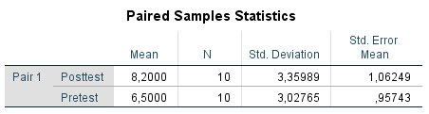

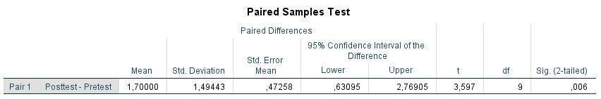

Example: Paired samples t-test
Conclusion: Paired samples t-test is significant, $t(9)=3.597$, $p=0.006$ → subjects were on average happier after receiving the new treatment

Slide 30
Literature:
Warner I: Chapter 14
Warner II: 8.2, 8.11-8.14
Repeated measures ANOVA with more than two observations per subject/person
Next week…

