Slide 1
Experimental Research Methods Lecture 10

Slide 2
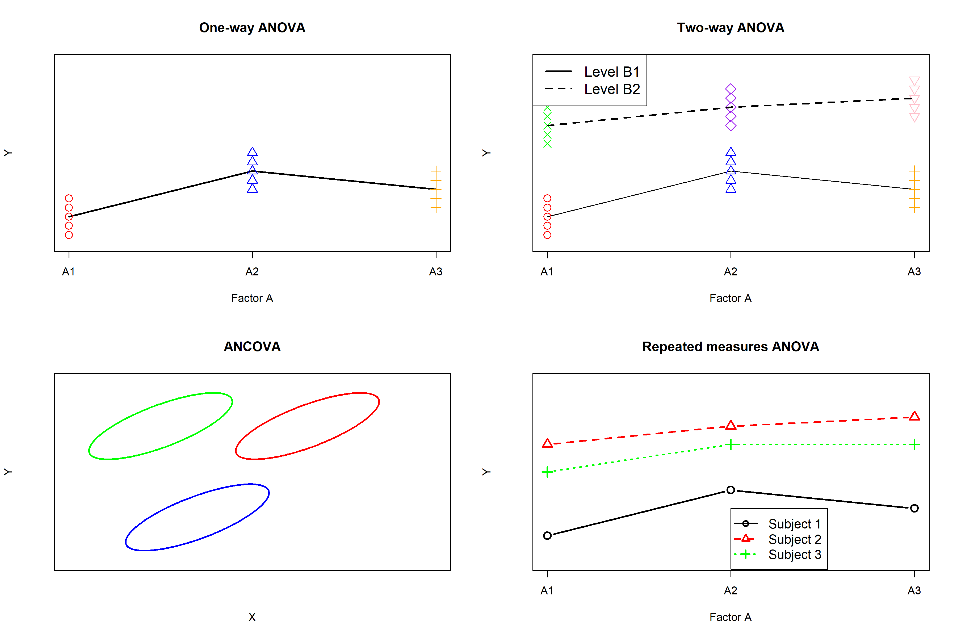

Slide 3
Recap: Summary of learned techniques
In ANOVA and ANCOVA, each person has only one observation of measurement on the dependent variable (univariate)
Repeated measures ANOVA distinguishes itself from previous techniques because for each person we have more than one data point or observation on Y → multiple dependent variables per person
 | One-way ANOVA | Two-way ANOVA | ANCOVA
#DVs | One | One | One
#IVs | One (nominal) | Two (nominal) | One (nominal)
#Covariates | Zero | Zero | One (continuous)
Data points | 1 per person | 1 per person | 1 per person
Notes:
- READ SLIDE-

Slide 4
Lecture goals lecture 10
After this lecture and studying the materials, students are able to:
Explain how a one-way ANOVA is different from a repeated measures ANOVA
Interpret the SPSS output of a repeated measures ANOVA with a within-subjects factor
Interpret the SPSS output of a repeated measures ANOVA with a within-subjects factor and between-subjects factor

Slide 5

Repeated Measures ANOVA: Example
RQ: Does the average stress level of students increase when working on an exam?
Variables:
S = subject
Y = time point
Data:
 | Y₁ | Y₂ | Y₃ | Mean
S₁ | 15 | 16 | 20 | 17
S₂ | 16 | 21 | 20 | 19
S₃ | 15 | 20 | 25 | 20
S₄ | 14 | 19 | 27 | 20
S₅ | 17 | 22 | 24 | 21
S₆ | 18 | 26 | 25 | 23
S₇ | 19 | 24 | 26 | 23
S₈ | 22 | 28 | 25 | 25
Mean | 17 | 22 | 24 | 21

Slide 6
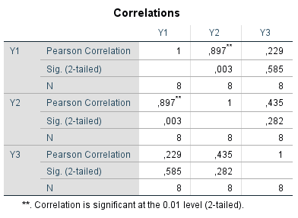
Repeated Measures ANOVA: Example
Hypothesis: Students’ average stress level increases during an exam
Correlations between measurements:
Conclusions:
Scores are dependent Y1, Y2, and Y3
We cannot use one-way ANOVA
We need repeated measures ANOVA

Slide 7
Repeated Measures ANOVA: Example
One-way within-subjects design with 1 fixed factor time and 1 random factor S (subject)
Subjects are exposed to all levels of one or more factors → more than one measurement per subject (repeatedly measured; here Y1, Y2, Y3)
The design contains two factors and is a mixed-effects model (see lecture 7):
Time (Y) is a fixed effect
S is a random effect (random sample of subjects)
You are not interested in the effect of S, but you want to control for it. The participant acts as control for him-/herself (reduction of error variance)
Notes:
Robbie: Subject act as control, because gender, age, etc. does not have an effect in a RM ANOVA

Slide 8
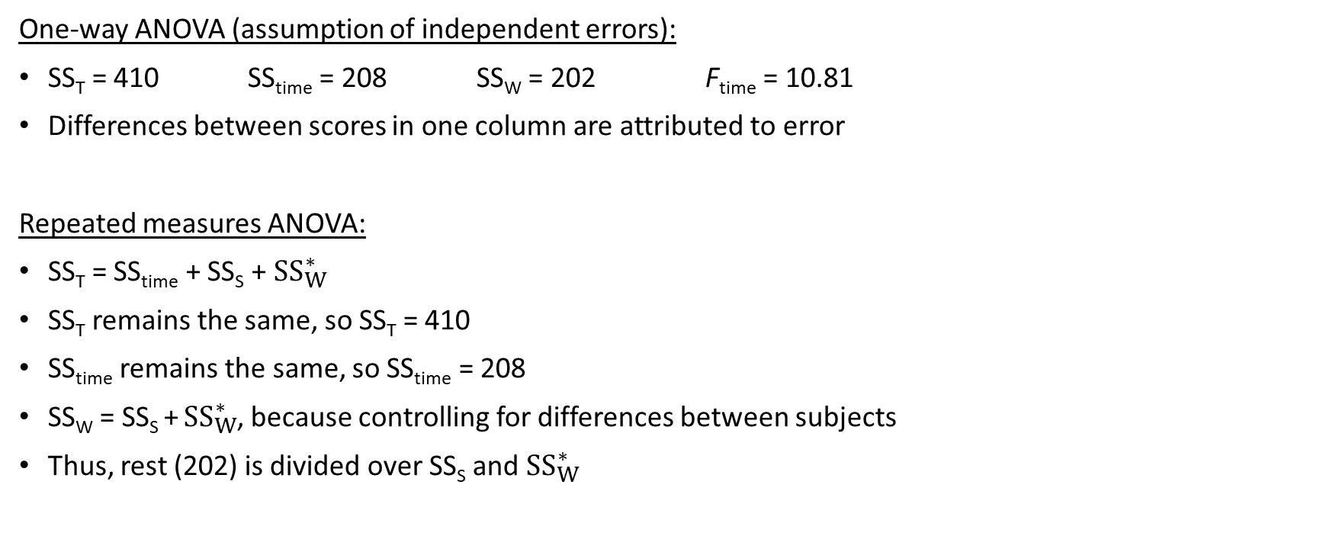
Repeated Measures ANOVA: Example
One-way ANOVA (assumption of independent errors):
SS_{T} = 410 SS_{time} = 208 SS_{W} = 202 F_{time} = 10.81
Differences between scores in one column are attributed to error
Repeated measures ANOVA:
SS_{T} = SS_{time} + SS_{S} + ${SS}_{W}^{∗}$
SS_{T} remains the same, so SS_{T} = 410
SS_{time} remains the same, so SS_{time} = 208
SS_{W} = SS_{S} + ${SS}_{W}^{∗}$, because controlling for differences between subjects
Thus, rest (202) is divided over SS_{S} and ${SS}_{W}^{∗}$
 | Y₁ | Y₂ | Y₃ | Mean
S₁ | 15 | 16 | 20 | 17
S₂ | 16 | 21 | 20 | 19
S₃ | 15 | 20 | 25 | 20
S₄ | 14 | 19 | 27 | 20
S₅ | 17 | 22 | 24 | 21
S₆ | 18 | 26 | 25 | 23
S₇ | 19 | 24 | 26 | 23
S₈ | 22 | 28 | 25 | 25
Mean | 17 | 22 | 24 | 21

Slide 9
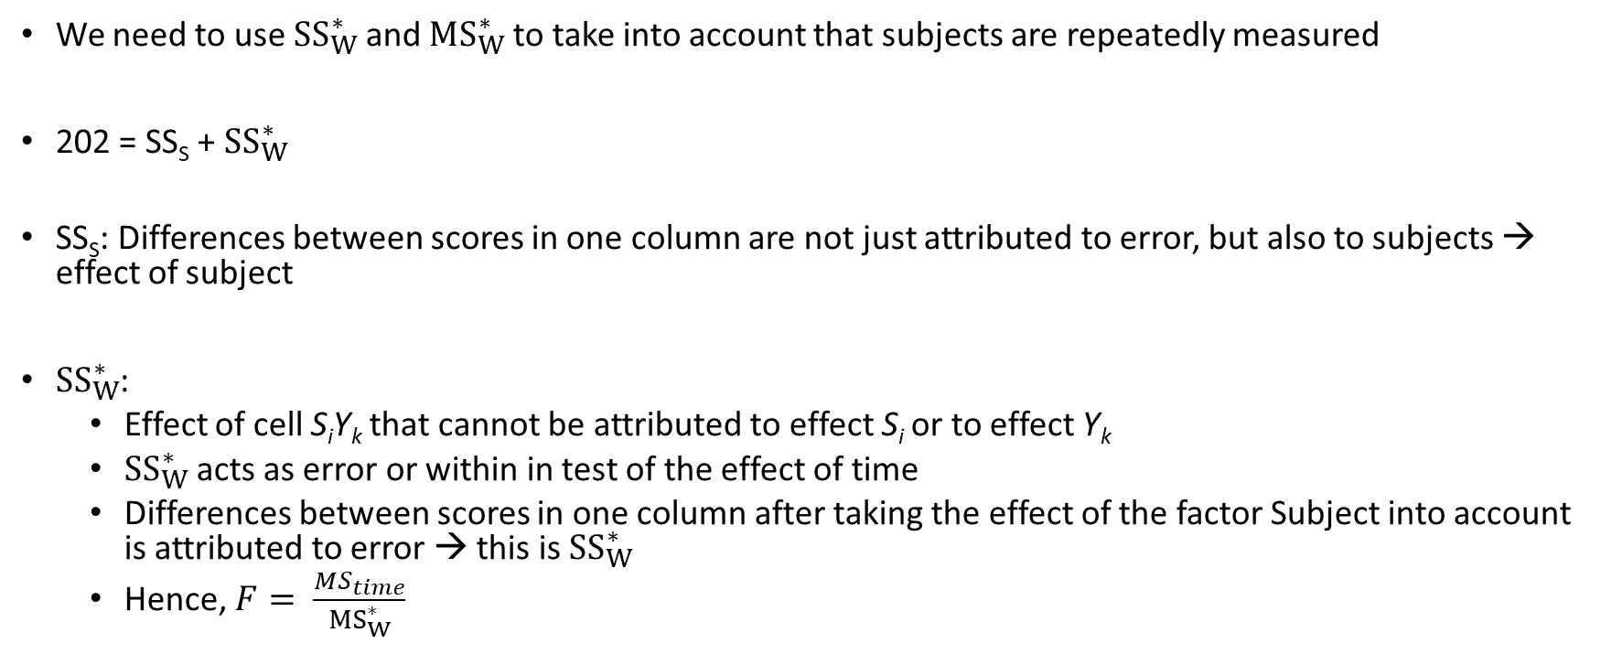
Repeated Measures ANOVA: Example
We need to use ${SS}_{W}^{∗}$and ${MS}_{W}^{∗}$ to take into account that subjects are repeatedly measured
202 = SS_{S} + ${SS}_{W}^{∗}$
SS_{S}: Differences between scores in one column are not just attributed to error, but also to subjects → effect of subject
${SS}_{W}^{∗}$:
Effect of cell S_{i}Y_{k} that cannot be attributed to effect S_{i} or to effect Y_{k}
${SS}_{W}^{∗}$acts as error or within in test of the effect of time
Differences between scores in one column after taking the effect of the factor Subject into account is attributed to error → this is ${SS}_{W}^{∗}$
Hence, $F= \frac{MS_{time}}{{MS}_{W}^{∗}}$

Slide 10
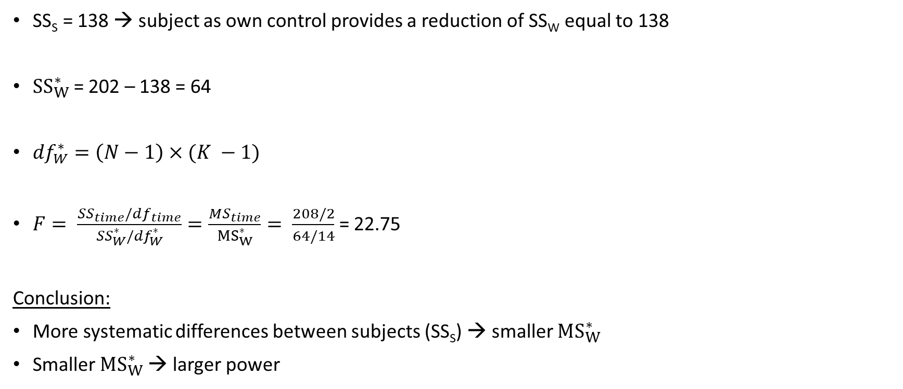
Repeated Measures ANOVA: Example
SS_{S} = 138 → subject as own control provides a reduction of SS_{W} equal to 138
${SS}_{W}^{∗}$ = 202 – 138 = 64
${df}_{W}^{∗}=\left(N−1\right)×(K −1)$
$F= \frac{SS_{time}/df_{time}}{{SS}_{W}^{∗}/{df}_{W}^{∗}}=\frac{MS_{time}}{{MS}_{W}^{∗}}= \frac{208/2}{64/14}$ = 22.75
Conclusion:
More systematic differences between subjects (SS_{S}) → smaller ${MS}_{W}^{∗}$
Smaller ${MS}_{W}^{∗}$ → larger power
 | Y₁ | Y₂ | Y₃ | Mean
S₁ | 15 | 16 | 20 | 17
S₂ | 16 | 21 | 20 | 19
S₃ | 15 | 20 | 25 | 20
S₄ | 14 | 19 | 27 | 20
S₅ | 17 | 22 | 24 | 21
S₆ | 18 | 26 | 25 | 23
S₇ | 19 | 24 | 26 | 23
S₈ | 22 | 28 | 25 | 25
Mean | 17 | 22 | 24 | 21

Slide 11
Repeated Measures ANOVA: Assumptions
Independence of errors → observations at each time point/within each treatment condition must be independent
Population distribution within each treatment must be normal → residuals normally distributed
Relationships among the repeated measures variables have to be linear → positive and at least moderate correlation (r ≥ 0.3) between observations at each time point
No person-by-treatment interaction → the response to a treatment should not differ from person to person
Error covariance matrix meets sphericity assumption
“The variance of the difference score between two levels of the within-subject factor must be the same for any pair of levels”
That is, take two treatment levels and subtract the scores for one level from scores of another level, the resulting difference score must have the same variance for every pair of levels

Slide 12
RM ANOVA: Sphericity assumption
Sphericity assumption is very complicated → understanding is not so important and we focus on interpretation It’s just a generalization of the assumption of homoscedasticity: variances of the differences between all combinations of groups are equal (and normal)
RM ANOVA is not robust against violation of sphericity
The worse the violation, the higher the F-value and the smaller reported p-value (p-value gets too small)
Correction that increases F_{CV} is needed, which results in an increase of the incorrect reported p-value → achieved with correction factor ε

Slide 13

RM ANOVA: Sphericity assumption
Extent to which the assumption is violated is quantified with ε
No violation means ε = 1 and strong violation means ε = 1/(K-1) with K is number of time points
F_{CV} is artificially increased by multiplying both degrees of freedom with ε ≤ 1 (p-value is ok again ☺)
SPSS shows four corrections:
Sphericity assumed (ε = 1)
Greenhouse-Geisser
Huyn-Feldt
Lower-bound (ε = 1/(K-1))

Slide 14
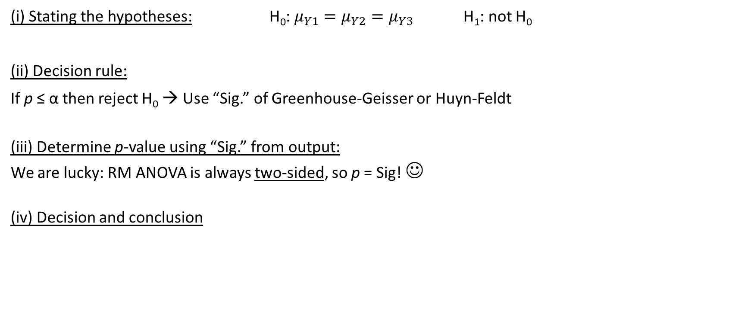
RM ANOVA: Sphericity assumption
(i) Stating the hypotheses: H₀: $μ_{Y1}=μ_{Y2}=μ_{Y3}$ H₁: not H₀
(ii) Decision rule:
If p ≤ α then reject H₀ → Use “Sig.” of Greenhouse-Geisser or Huyn-Feldt
(iii) Determine p-value using “Sig.” from output:
We are lucky: RM ANOVA is always two-sided, so p = Sig! ☺
(iv) Decision and conclusion

Slide 15
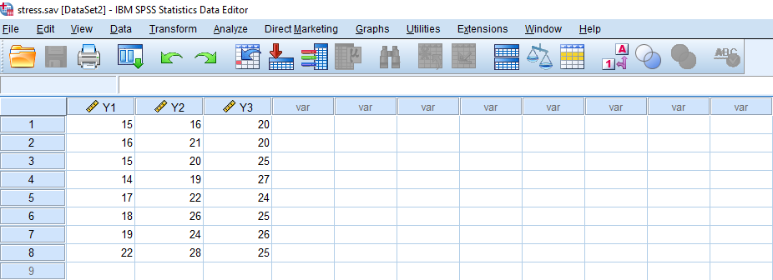
RM ANOVA: SPSS

Slide 16
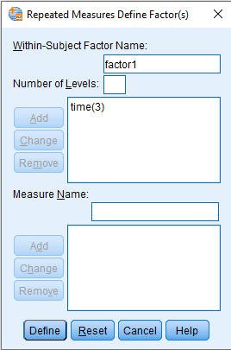
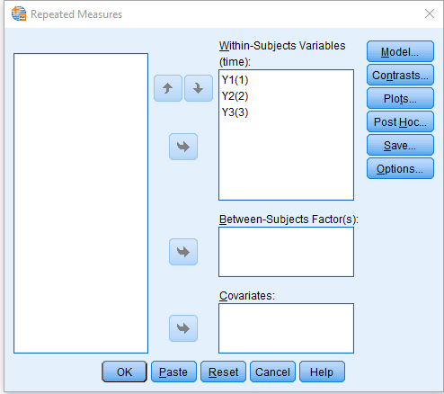
RM ANOVA: SPSS
Using “Analyze”, “General Linear Model”, and “Repeated Measures”
GLM Y1 Y2 Y3 /WSFACTOR=time 3 Polynomial /METHOD=SSTYPE(3) /PLOT=PROFILE(time) /PRINT=DESCRIPTIVE ETASQ HOMOGENEITY /CRITERIA=ALPHA(.05) /WSDESIGN=time.
In /WSFACTOR, you specify the type of contrast → if factor=time, then polynomial (=trend analysis) is a logical option

Slide 17

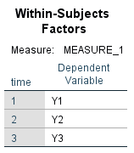
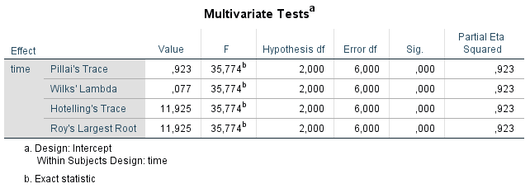
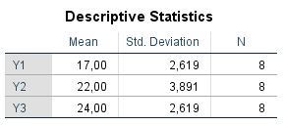
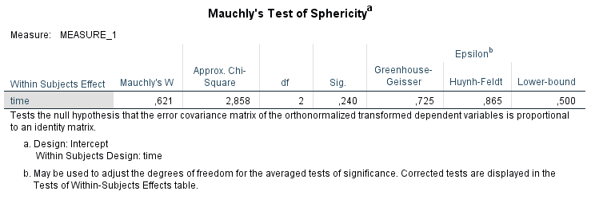

Slide 18
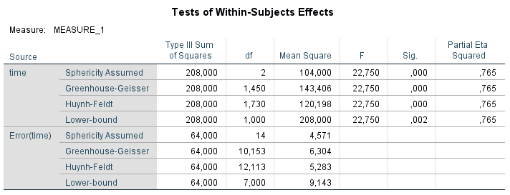
RM ANOVA: SPSS
Conclusion:
Students’ average stress level changes over time
But how does this effect look like, is it: positive or negative and linear or quadratic? Let’s say that we hypothesized that the effect is linear and that it is quadratic → Bonferonni = α/2 = 0.025

Slide 19
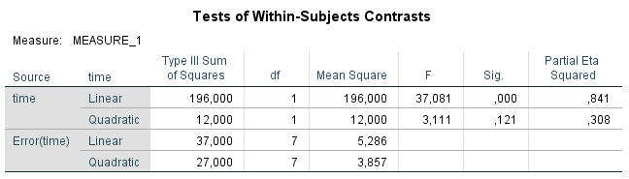
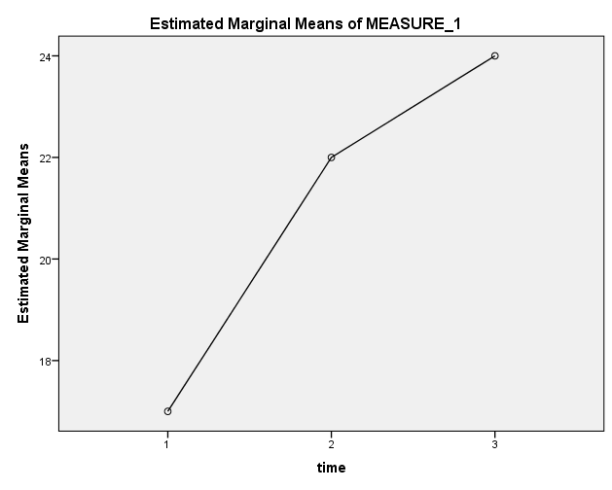
RM ANOVA: SPSS
Conclusion:
There is a linear effect (p < 0.001), but no quadratic effect (p = 0.121) of time

Slide 20
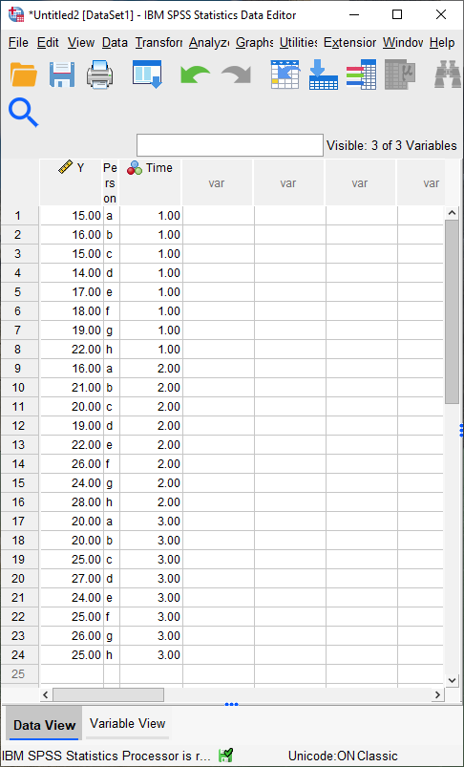
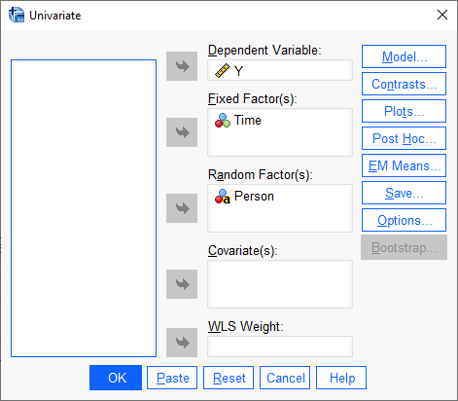
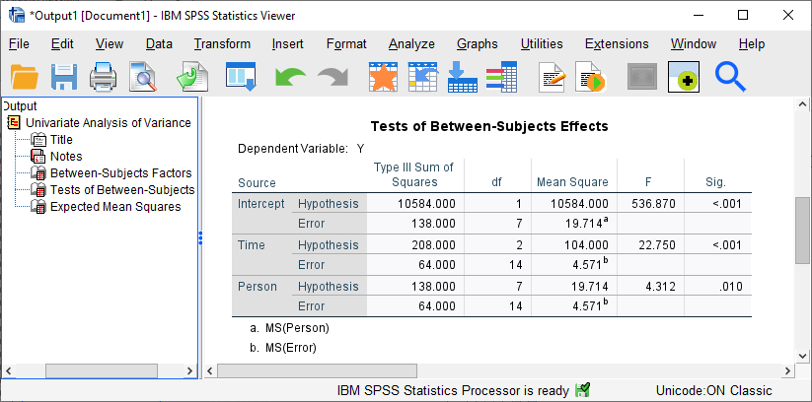

Slide 21
RM ANOVA: SPSS
We have chosen “polynomial” (= trend analysis) for contrasts
If the factor is not time, but “condition” then you have to select another contrast
Options are:
Simple → use a user-defined reference category
Difference → compare each category with all previous categories
Repeated → compare each category with next category
Helmert → Helmert contrasts
Now an example with simple → /WSFACTOR=time 3 Simple

Slide 22
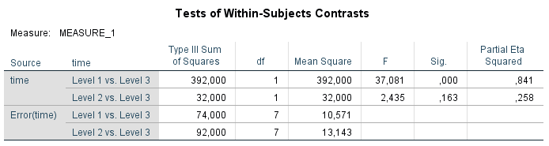
RM ANOVA: SPSS
Conclusion:
Mean of Y1 differs from Y3 (p < 0.001), mean of Y2 does not differ from Y3 (p = 0.163)
Here α/2 = 0.025 is also defendable
No test done of Y1 versus Y2 → do the analysis again with a different option
Notes:
Robbie: Maybe showing again that these contrasts are not orthogonal

Slide 23
Repeated measures ANOVA: Example II
Another example of RM ANOVA now also with a between-subjects factor
Dependent variable: Satisfaction with material position 5 years ago, now, and expected in 5 years
Independent variable:
Within-subjects factor Time (3 levels)
Between-subjects factor Education (4 levels)
Hypotheses:
Time has an effect on satisfaction with material position
Education has an effect on satisfaction with material position
A positive linear effect is expected between time and satisfaction with material position
A quadratic effect is expected between time and satisfaction with material position

Slide 24
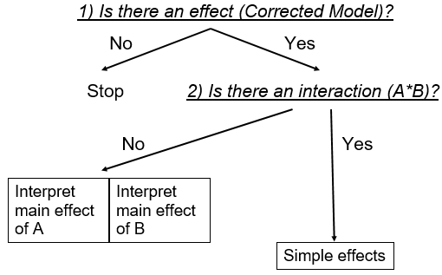
Repeated measures ANOVA: Example II
Two factors, so three effects again
Main effect of between-subjects factor
Main effect of within-subjects factor
Interaction between and within-subjects factor
Hence, we need to apply the logic of two-way ANOVA

Slide 25
Repeated measures ANOVA: Example II
A lot of syntax, but we have seen everything already before:
(1) Is there an effect?
“Corrected model” does not provide a general answer as in two-way ANOVA
Output is divided in between-subjects output (education) and within-subjects output (time and time*education)
We first need to look at the interaction (time * edu)
GLM mat2 mat1 mat3 BY edu /WSFACTOR = time 3 Polynomial /METHOD = SSTYPE(3) /PLOT = PROFILE( time*edu) /EMMEANS = TABLES(edu) /EMMEANS = TABLES(time) /EMMEANS = TABLES(edu*time) /PRINT = ETASQ DESCRIPTIVE HOMOGENEITY /CRITERIA = ALPHA(.05) /WSDESIGN = time /DESIGN = edu.

Slide 26
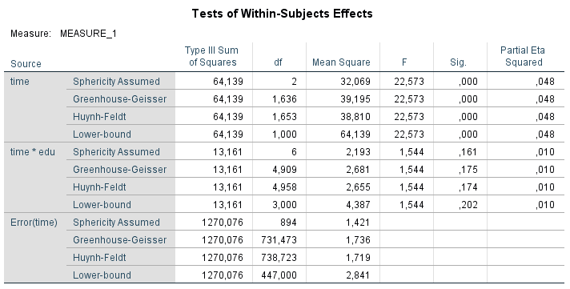
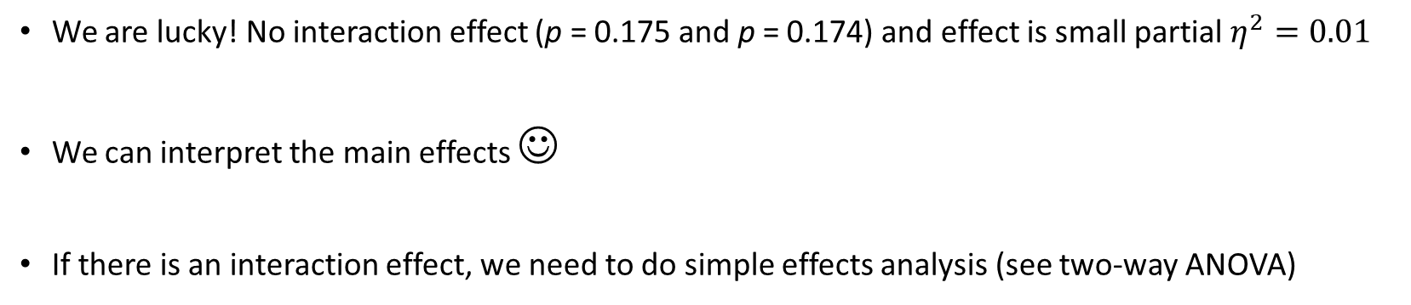
We are lucky! No interaction effect (p = 0.175 and p = 0.174) and effect is small partial $η^{2}=0.01$
We can interpret the main effects ☺
If there is an interaction effect, we need to do simple effects analysis (see two-way ANOVA)

Slide 27
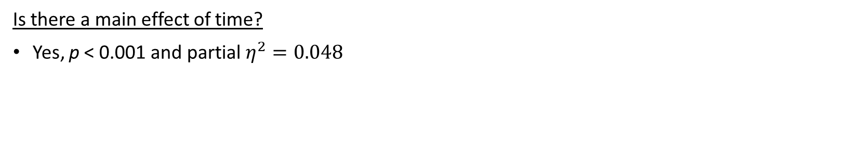
Is there a main effect of time?
Yes, p < 0.001 and partial $η^{2}=0.048$

Slide 28
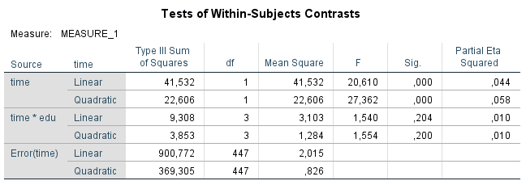
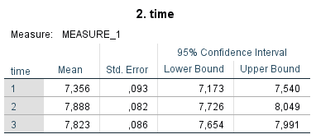
Where is the effect of time? → contrasts
We know already that there is no interaction with time on material position
We expected a positive linear relationship and (undirected) quadratic effect
There is indeed a positive linear effect (p < 0.001) and there is a quadratic effect (p < 0.001), which is negative
Notes:
Robbie: Teken plaatje o.b.v. gemiddelden om te laten zien of het positieve of negatieve effecten zijn

Slide 29
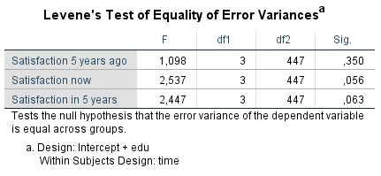
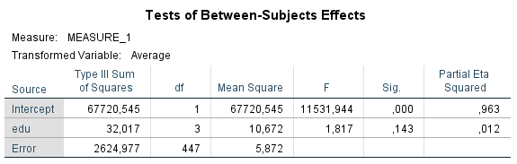
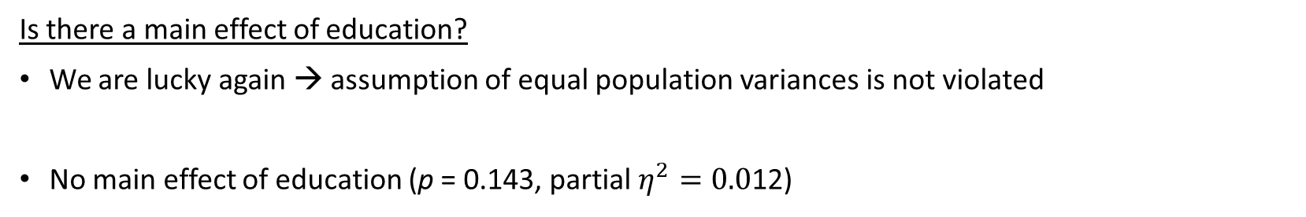
Is there a main effect of education?
We are lucky again → assumption of equal population variances is not violated
No main effect of education (p = 0.143, partial $η^{2}=0.0$12)

Slide 30
Example II: Conclusions
The development of satisfaction with material position does not differ between the four levels of education (no interaction)
Education has no effect on the satisfaction with the material position
There is a positive linear effect of time on the satisfaction with the material position as well as a quadratic effect
Note that only a small selection of output was shown on the slides → SPSS returns a lot of output that we did not need for testing our hypotheses

Slide 31
Literature:
WI: 15.1-15.4 and 15.6-15.17
Complete the practice exam
Watch the recording of the practice exam
Prepare questions
How to design an experiment?
Q&A about the practice exam
Before next lecture…
Next lecture…

