Slide 1
Experimental Research Methods Lecture 12

Slide 2
Exam Experimental Research Methods
No graphing calculator
Booklet with formulas and tables is attached to the exam (do NOT print it yourself)
You are allowed to note your answers at the back of the cover of the exam. The correct answers will be posted on Canvas.
You can share any remarks about the exam via the Canvas Discussions page (until three days after the exam)
The date and time of the exam inspection will be communicated via Canvas

Slide 3
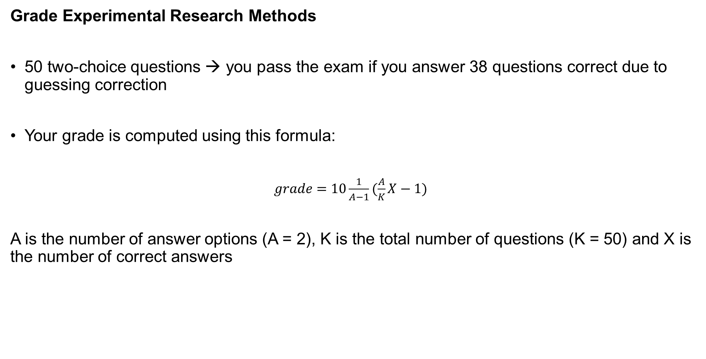
Grade Experimental Research Methods
50 two-choice questions → you pass the exam if you answer 38 questions correct due to guessing correction
Your grade is computed using this formula:
$grade=10\frac{1}{A−1}(\frac{A}{K}X−1)$
A is the number of answer options (A = 2), K is the total number of questions (K = 50) and X is the number of correct answers

Slide 4
Final grade Experimental Research Methods
If exam grade ≥ tutorial grade → final grade = exam grade
If exam grade < tutorial grade → final grade = (3 × exam grade + tutorial grade)/4
The tutorial grade is computed in two ways and the highest grade will be used for computing the final grade. The average tutorial grade is computed using …
… the three highest grades of all four tutorial tests
… the two highest grades of tutorial tests 2, 3, and 4
You pass the course if:
The final grade of the course is at least a 6
You pass the SPSS-test

