Slide 1
Comparison to Poisson: No UV, Month = 1
 | INTEGERDIVISION- S
N of Cases | 6,275
Minimum | 0.000
Maximum | 10.000
Arithmetic Mean | 2.772
Standard Error of Arithmetic Mean | 0.023
Standard Deviation | 1.787
Variance | 3.195
Coefficient of Variation | 0.645
Skewness (G1) | 0.450
Standard Error of Skewness | 0.031
Kurtosis (G2) | -0.288
Standard Error of Kurtosis | 0.062
Lower Limit | Upper Limit | Observed | Expected
. | 0 | 556 | 392.500
1 | 1 | 1,192 | 1,087.928
2 | 2 | 1,249 | 1,507.756
3 | 3 | 1,203 | 1,393.062
4 | 4 | 956 | 965.320
5 | 5 | 652 | 535.133
6 | 6 | 310 | 247.213
7 | 7 | 116 | 97.889
8 | 8 | 34 | 33.916
9 | . | 7 | 14.283
 |  | 6,275 | 6,275.000
Test Results
Expected Kurtosis = 0.361; Expected Skew = 0.130

Slide 2
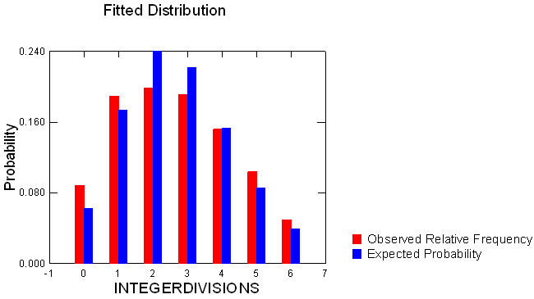
Comparison to Poisson: No UV, Month = 1
Kolmogorov-Smirnov Test Statistic | : | 0.043
p-Value | : | 0.000

Slide 3
Comparison to Poisson: UV, Month = 1
 | INTEGERDIVISION- S
N of Cases | 5,957
Minimum | 0.000
Maximum | 11.000
Arithmetic Mean | 3.267
Standard Error of Arithmetic Mean | 0.026
Standard Deviation | 2.016
Variance | 4.065
Coefficient of Variation | 0.617
Skewness (G1) | 0.361
Standard Error of Skewness | 0.032
Kurtosis (G2) | -0.399
Standard Error of Kurtosis | 0.063
Lower Limit | Upper Limit | Observed | Expected
. | 0 | 430 | 226.990
1 | 1 | 916 | 741.671
2 | 2 | 957 | 1,211.674
3 | 3 | 1,005 | 1,319.681
4 | 4 | 1,036 | 1,077.987
5 | 5 | 766 | 704.446
6 | 6 | 473 | 383.620
7 | 7 | 225 | 179.064
8 | 8 | 119 | 73.134
9 | 9 | 22 | 26.551
10 | . | 8 | 12.183
 |  | 5,957 | 5,957.000
Expected Kurtosis = 0.306 Expected Skew = 0.093

Slide 4
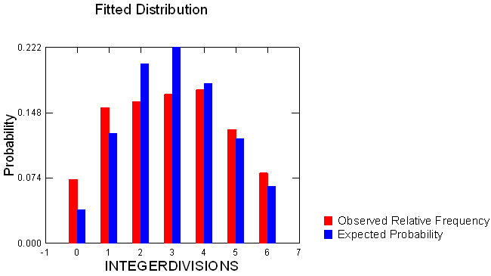
Comparison to Poisson: UV, Month = 1
Kolmogorov-Smirnov Test Statistic | : | 0.063
p-Value | : | 0.000

Slide 5
Comparison to Poisson: No UV, Month = 2
 | INTEGERDIVISION- S
N of Cases | 1,415
Minimum | 0.000
Maximum | 10.000
Median | 3.000
Arithmetic Mean | 3.193
Standard Deviation | 2.038
Variance | 4.152
Coefficient of Variation | 0.638
Skewness (G1) | 0.512
Standard Error of Skewness | 0.065
Kurtosis (G2) | -0.276
Standard Error of Kurtosis | 0.130
Lower Limit | Upper Limit | Observed | Expected
. | 0 | 100 | 58.084
1 | 1 | 222 | 185.461
2 | 2 | 271 | 296.089
3 | 3 | 249 | 315.137
4 | 4 | 207 | 251.558
5 | 5 | 175 | 160.645
6 | 6 | 87 | 85.490
7 | 7 | 61 | 38.996
8 | 8 | 33 | 15.564
9 | . | 10 | 7.976
 |  | 1,415 | 1,415.000
Expected Kurtosis = 0.313; Expected Skew = 0.098

Slide 6
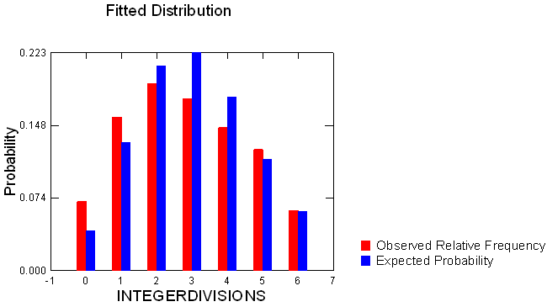
Comparison to Poisson: No UV, Month = 2
Kolmogorov-Smirnov Test Statistic | : | 0.055
p-Value | : | 0.000

Slide 7
Comparison to Poisson: UV, Month = 2
 | INTEGERDIVISION- S
N of Cases | 1,441
Minimum | 0.000
Maximum | 11.000
Median | 3.000
Arithmetic Mean | 3.534
Standard Deviation | 2.254
Variance | 5.081
Coefficient of Variation | 0.638
Skewness (G1) | 0.651
Standard Error of Skewness | 0.064
Kurtosis (G2) | 0.130
Standard Error of Kurtosis | 0.129
Lower Limit | Upper Limit | Observed | Expected
. | 0 | 80 | 42.060
1 | 1 | 217 | 148.639
2 | 2 | 230 | 262.646
3 | 3 | 238 | 309.397
4 | 4 | 236 | 273.352
5 | 5 | 184 | 193.205
6 | 6 | 114 | 113.798
7 | 7 | 58 | 57.452
8 | 8 | 30 | 25.379
9 | 9 | 34 | 9.966
10 | . | 20 | 5.107
 |  | 1,441 | 1,441.000
Expected Kurtosis = 0.283; Expected Skew = 0.080

Slide 8
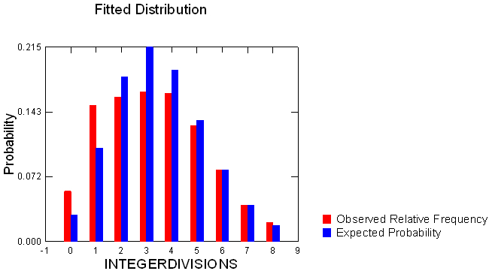
Comparison to Poisson: UV, Month = 2
Kolmogorov-Smirnov Test Statistic | : | 0.074
p-Value | : | 0.000

Slide 9
Comparison to Poisson: No UV, Month = 3
 | INTEGERDIVISION- S
N of Cases | 1,182
Minimum | 0.000
Maximum | 12.000
Median | 3.000
Arithmetic Mean | 3.341
Standard Deviation | 2.167
Variance | 4.694
Coefficient of Variation | 0.648
Skewness (G1) | 0.466
Standard Error of Skewness | 0.071
Kurtosis (G2) | -0.433
Standard Error of Kurtosis | 0.142
Lower Limit | Upper Limit | Observed | Expected
. | 0 | 87 | 41.845
1 | 1 | 182 | 139.803
2 | 2 | 213 | 233.541
3 | 3 | 184 | 260.086
4 | 4 | 173 | 217.237
5 | 5 | 136 | 145.158
6 | 6 | 89 | 80.829
7 | 7 | 74 | 38.578
8 | 8 | 34 | 16.111
9 | . | 10 | 8.812
 |  | 1,182 | 1,182.000
Expected Kurtosis = 0.299; Expected Skew = 0.090

Slide 10
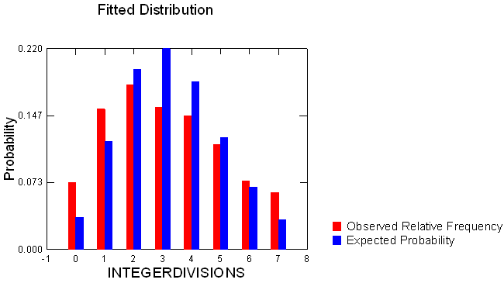
Comparison to Poisson: No UV, Month = 3
Kolmogorov-Smirnov Test Statistic | : | 0.074
p-Value | : | 0.000
Expected Kurtosis = 0.283; Expected Skew = 0.080

Slide 11
Comparison to Poisson: UV, Month = 3
 | INTEGERDIVISION- S
N of Cases | 1,080
Minimum | 0.000
Maximum | 13.000
Median | 3.000
Arithmetic Mean | 3.498
Standard Deviation | 2.431
Variance | 5.911
Coefficient of Variation | 0.695
Skewness (G1) | 0.765
Standard Error of Skewness | 0.074
Kurtosis (G2) | 0.611
Standard Error of Kurtosis | 0.149
Lower Limit | Upper Limit | Observed | Expected
. | 0 | 93 | 32.678
1 | 1 | 160 | 114.309
2 | 2 | 167 | 199.927
3 | 3 | 173 | 233.115
4 | 4 | 145 | 203.859
5 | 5 | 125 | 142.620
6 | 6 | 97 | 83.147
7 | 7 | 61 | 41.550
8 | 8 | 28 | 18.168
9 | . | 31 | 10.627
 |  | 1,080 | 1,080.000
Expected Kurtosis = 0.286; Expected Skew = 0.081

Slide 12
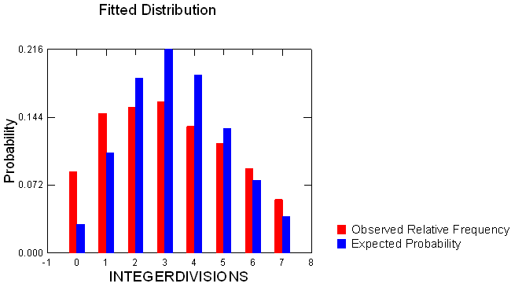
Comparison to Poisson: UV, Month = 3
Kolmogorov-Smirnov Test Statistic | : | 0.098
p-Value | : | 0.000

Slide 13
Comparison to Poisson: No UV, Month = 4
Lower Limit | Upper Limit | Observed | Expected
. | 0 | 72 | 34.260
1 | 1 | 179 | 118.882
2 | 2 | 186 | 206.260
3 | 3 | 180 | 238.574
4 | 4 | 137 | 206.963
5 | 5 | 124 | 143.632
6 | 6 | 94 | 83.067
7 | 7 | 59 | 41.178
8 | 8 | 50 | 17.861
9 | . | 20 | 10.324
 |  | 1,101 | 1,101.000
 | INTEGERDIVISION- S
N of Cases | 1,101
Minimum | 0.000
Maximum | 10.000
Median | 3.000
Arithmetic Mean | 3.470
Standard Deviation | 2.287
Variance | 5.229
Coefficient of Variation | 0.659
Skewness (G1) | 0.513
Standard Error of Skewness | 0.074
Kurtosis (G2) | -0.502
Standard Error of Kurtosis | 0.147
Expected Kurtosis = 0.288; Expected Skew = 0.083

Slide 14
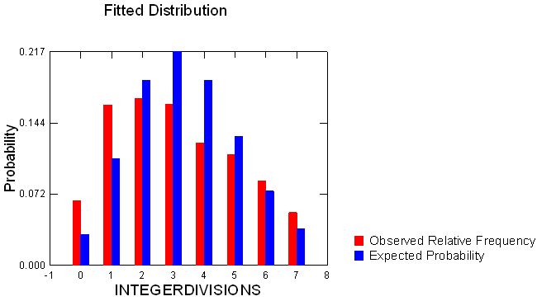
Comparison to Poisson: No UV, Month = 4
Kolmogorov-Smirnov Test Statistic | : | 0.089
p-Value | : | 0.000

Slide 15
Comparison to Poisson: UV, Month = 4
 | INTEGERDIVISION- S
N of Cases | 1,159
Minimum | 0.000
Maximum | 12.000
Median | 3.000
Arithmetic Mean | 3.495
Standard Deviation | 2.573
Variance | 6.618
Coefficient of Variation | 0.736
Skewness (G1) | 0.909
Standard Error of Skewness | 0.072
Kurtosis (G2) | 0.679
Standard Error of Kurtosis | 0.144
Lower Limit | Upper Limit | Observed | Expected
. | 0 | 108 | 35.174
1 | 1 | 174 | 122.934
2 | 2 | 190 | 214.827
3 | 3 | 177 | 250.273
4 | 4 | 163 | 218.676
5 | 5 | 127 | 152.855
6 | 6 | 81 | 89.038
7 | 7 | 51 | 44.455
8 | 8 | 28 | 19.421
9 | . | 60 | 11.346
 |  | 1,159 | 1,159.000
Expected Kurtosis = 0.286; Expected Skew = 0.082

Slide 16
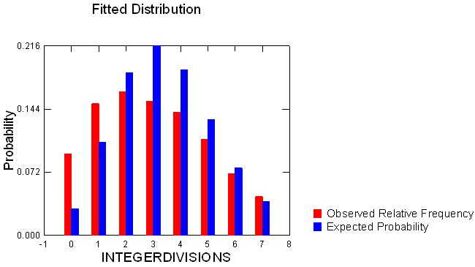
Comparison to Poisson: UV, Month = 4
Kolmogorov-Smirnov Test Statistic | : | 0.107
p-Value | : | 0.000

Slide 17
Comparison to Poisson: No UV, Month = 5
 | INTEGERDIVISION- S
N of Cases | 1,063
Minimum | 0.000
Maximum | 10.000
Median | 3.000
Arithmetic Mean | 3.355
Standard Deviation | 2.366
Variance | 5.598
Coefficient of Variation | 0.705
Skewness (G1) | 0.491
Standard Error of Skewness | 0.075
Kurtosis (G2) | -0.691
Standard Error of Kurtosis | 0.150
Lower Limit | Upper Limit | Observed | Expected
. | 0 | 96 | 37.109
1 | 1 | 195 | 124.500
2 | 2 | 166 | 208.848
3 | 3 | 148 | 233.562
4 | 4 | 134 | 195.900
5 | 5 | 105 | 131.449
6 | 6 | 83 | 73.502
7 | 7 | 69 | 35.228
8 | 8 | 51 | 14.774
9 | . | 16 | 8.129
 |  | 1,063 | 1,063.000
Expected Kurtosis = 0.298; Expected Skew = 0.089

Slide 18
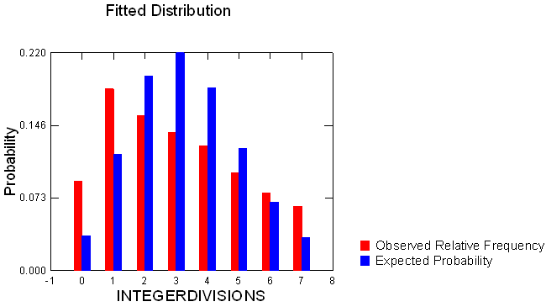
Comparison to Poisson: No UV, Month = 5
Kolmogorov-Smirnov Test Statistic | : | 0.122
p-Value | : | 0.000

Slide 19
Comparison to Poisson: UV, Month = 5
Lower Limit | Upper Limit | Observed | Expected
. | 0 | 69 | 22.622
1 | 1 | 146 | 82.819
2 | 2 | 147 | 151.600
3 | 3 | 104 | 185.003
4 | 4 | 135 | 169.324
5 | 5 | 107 | 123.979
6 | 6 | 62 | 75.648
7 | 7 | 28 | 39.564
8 | 8 | 17 | 18.105
9 | . | 65 | 11.336
 |  | 880 | 880.000
 | INTEGERDIVISION- S
N of Cases | 880
Minimum | 0.000
Maximum | 13.000
Median | 3.000
Arithmetic Mean | 3.661
Standard Deviation | 2.796
Variance | 7.817
Coefficient of Variation | 0.764
Skewness (G1) | 1.110
Standard Error of Skewness | 0.082
Kurtosis (G2) | 1.170
Standard Error of Kurtosis | 0.165
Expected Kurtosis = 0.273; Expected Skew = 0.075

Slide 20
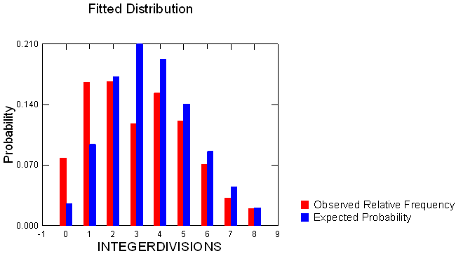
Comparison to Poisson: UV, Month = 5
Kolmogorov-Smirnov Test Statistic | : | 0.124
p-Value | : | 0.000

Slide 21
Comparison to Poisson: No UV, Month = 6
Lower Limit | Upper Limit | Observed | Expected
. | 0 | 88 | 25.498
1 | 1 | 136 | 87.739
2 | 2 | 119 | 150.954
3 | 3 | 99 | 173.144
4 | 4 | 87 | 148.947
5 | 5 | 91 | 102.506
6 | 6 | 69 | 58.787
7 | 7 | 45 | 28.898
8 | 8 | 32 | 12.430
9 | . | 30 | 7.097
 |  | 796 | 796.000
 | INTEGERDIVISION- S
N of Cases | 796
Minimum | 0.000
Maximum | 10.000
Median | 3.000
Arithmetic Mean | 3.441
Standard Deviation | 2.533
Variance | 6.418
Coefficient of Variation | 0.736
Skewness (G1) | 0.536
Standard Error of Skewness | 0.087
Kurtosis (G2) | -0.555
Standard Error of Kurtosis | 0.173
Expected Kurtosis = 0.291; Expected Skew = 0.084

Slide 22
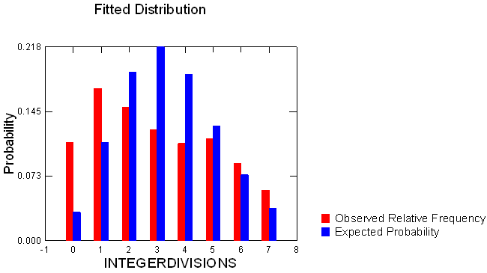
Comparison to Poisson: No UV, Month = 6
Kolmogorov-Smirnov Test Statistic | : | 0.139
p-Value | : | 0.000

Slide 23
Comparison to Poisson: UV, Month = 6
Lower Limit | Upper Limit | Observed | Expected
. | 0 | 81 | 24.046
1 | 1 | 156 | 91.062
2 | 2 | 154 | 172.426
3 | 3 | 137 | 217.659
4 | 4 | 165 | 206.069
5 | 5 | 115 | 156.076
6 | 6 | 102 | 98.510
7 | 7 | 53 | 53.294
8 | 8 | 36 | 25.228
9 | 9 | 21 | 10.615
10 | . | 41 | 6.014
 |  | 1,061 | 1,061.000
 | INTEGERDIVISION- S
N of Cases | 1,061
Minimum | 0.000
Maximum | 12.000
Median | 4.000
Arithmetic Mean | 3.787
Standard Deviation | 2.657
Variance | 7.060
Coefficient of Variation | 0.702
Skewness (G1) | 0.764
Standard Error of Skewness | 0.075
Kurtosis (G2) | 0.279
Standard Error of Kurtosis | 0.150
Expected Kurtosis = 0.264; Expected Skew = 0.070

Slide 24
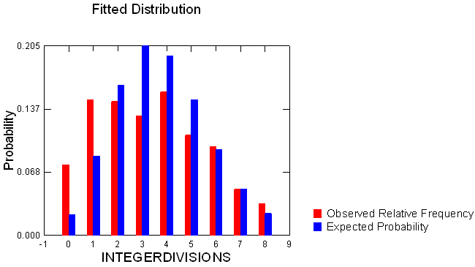
Comparison to Poisson: UV, Month = 6
Kolmogorov-Smirnov Test Statistic | : | 0.115
p-Value | : | 0.000

