Slide 1
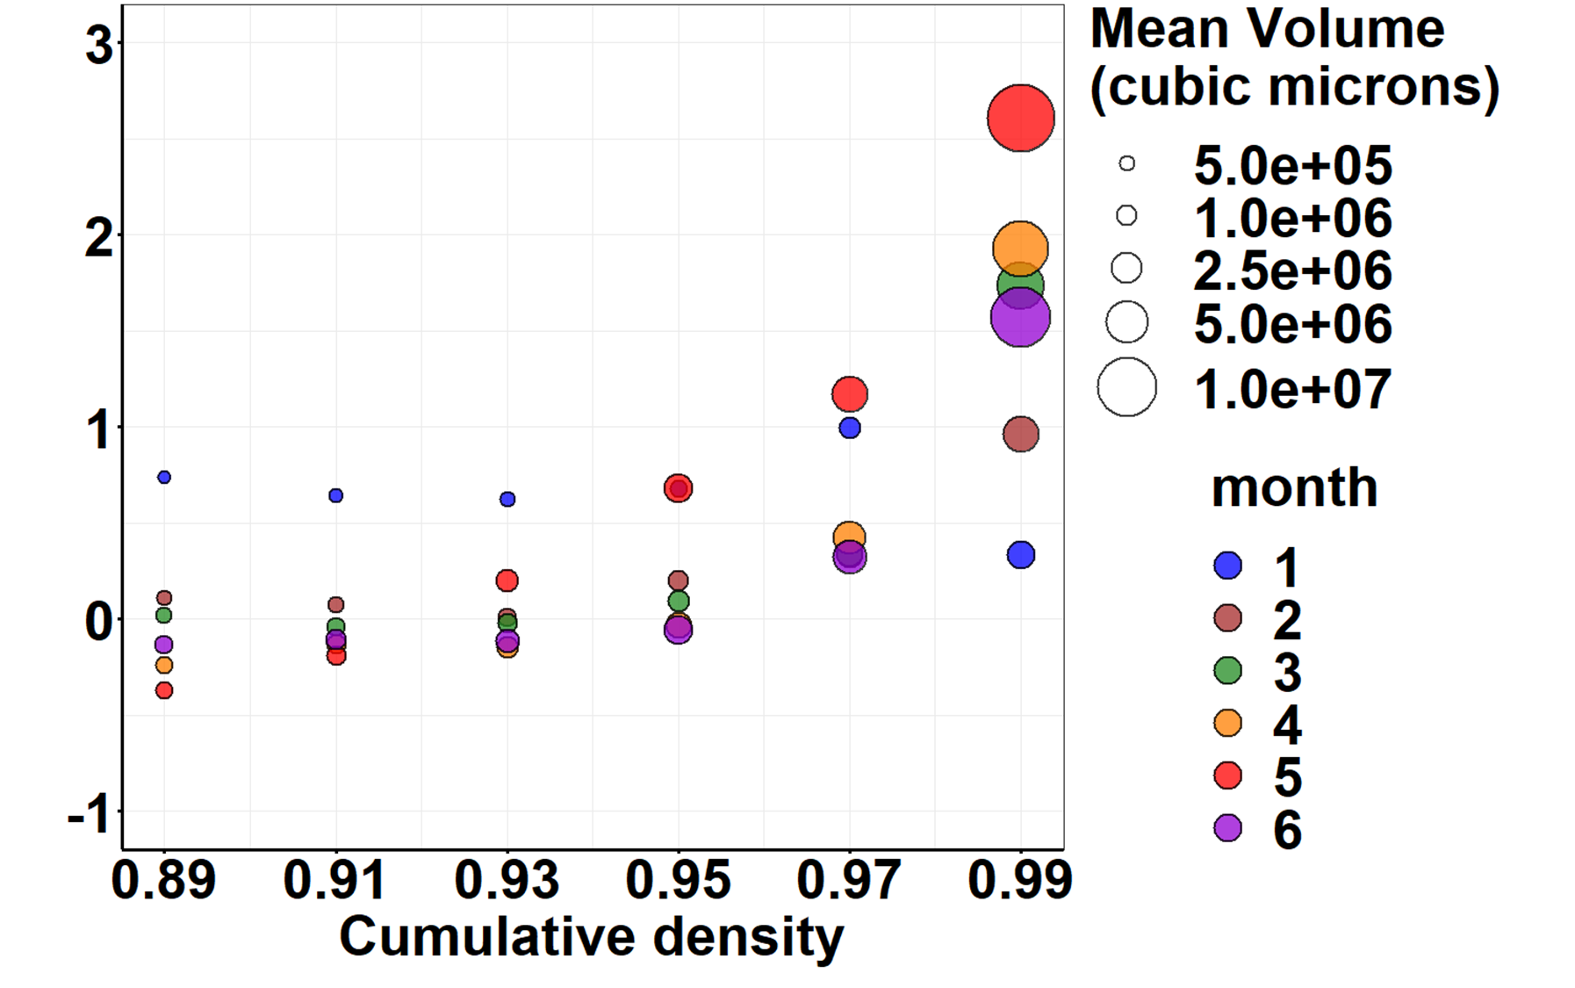
Log₂ volume difference
(UV – No UV)

