Slide 1
Truncated at volume = 13 (n = 7295 and 7437 for No-UV and UV), and 16 (median of 15.90 and 16.24 for No-UV and UV, respectively, and mean of 16.22 and 16.53, respectively)

Slide 2
Truncated at 20 (n = 451 and 603) and 23 (n = 3 and 151); at Vol > 25 n = 0 and 29

Slide 3
Volume 13 – 16; and 16 - 20

Slide 4
Volume 20 – 23; and 23 - 24

Slide 5
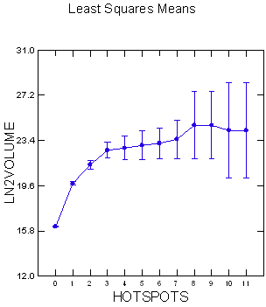
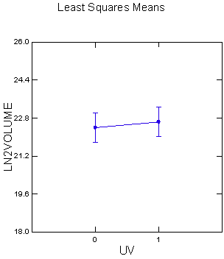
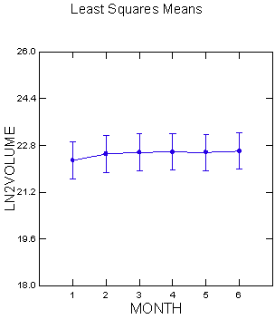
Hotspots range from 0 to 11; for no-UV the range is 0 to 7

Slide 6
Hotspots by range
Volume 13 – 16: Range 0 to 1; mean = 0; n = 7161
Volume 16 – 20: Range 0 to 3; mean = 0.072; n = 6517
Volume 20 -23: Range 0 to 7; mean = 0.524; n = 900
Volume 23 – 24: Range 0 to 7 for UV (n=78) and 0 to 1 for No-UV (n=2); mean = 1.8 for UV.
Volume > 24: Range 0 to 11 for UV (n=73) and 1 for No-UV (n=1); mean = 2.88 for UV
Volume > 25: (only UV occur): Range 1 to 9 (n=29); mean = 3.24

Slide 7
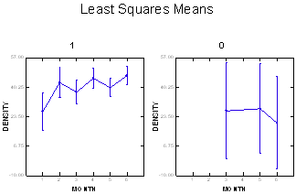
Average density size > 23, by month and by UV

Slide 8
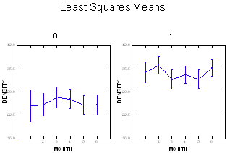
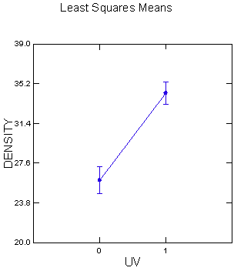
Average density size > 20, by month and by UV

Slide 9
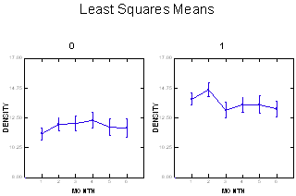
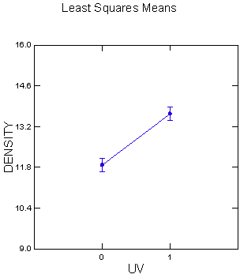
Average density size < 20, by month and by UV

Slide 10
Sample sizes for hotspots > 3
Least Squares Means
Factor | Level | LS Mean | Standard Error | N
MONTH*UV | 2*1 | 49.040 | 2.524 | 10.000
MONTH*UV | 3*1 | 44.610 | 3.945 | 4.000
MONTH*UV | 4*0 | 65.555 | 5.209 | 2.000
MONTH*UV | 4*1 | 63.107 | 4.176 | 4.000
MONTH*UV | 5*1 | 40.379 | 2.524 | 10.000
MONTH*UV | 6*0 | 43.155 | 4.176 | 4.000
MONTH*UV | 6*1 | 58.630 | 1.957 | 15.000

Slide 11
Hotspots > 5
Least Squares Means
Factor | Level | LS Mean | Standard Error | N
MONTH*UV | 2*1 | 50.218 | 2.651 | 3.000
MONTH*UV | 4*1 | 65.842 | 4.973 | 2.000
MONTH*UV | 5*1 | 43.845 | 3.134 | 6.000
MONTH*UV | 6*0 | 45.890 | 4.684 | 2.000
MONTH*UV | 6*1 | 61.625 | 2.651 | 9.000

Slide 12
Hotspots by Volume for No UV and UV
N = 17,837
>3 N = 7
N = 16,572
>3 N = 80

Slide 13
Overlaying graphs Hotspots versus Volume

Slide 14
For UV: Hotpots by Month; > 2
Month N Mean
1 -- 13 3.38
2 -- 31 3.77
3 – 14 3.36
4 – 42 9.07
5 – 16 4.94
6 – 20 5.60

