Slide 1
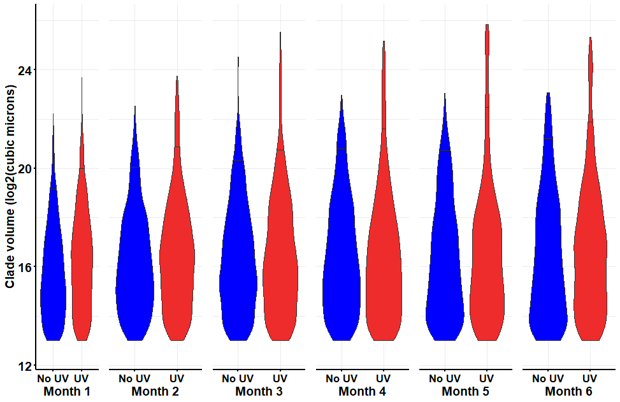
This is the original figure on which I added the horizontal lines at the 95% quantile.
The figure on next slide combines all elements and saves as .png format.

Slide 2


Slide 3
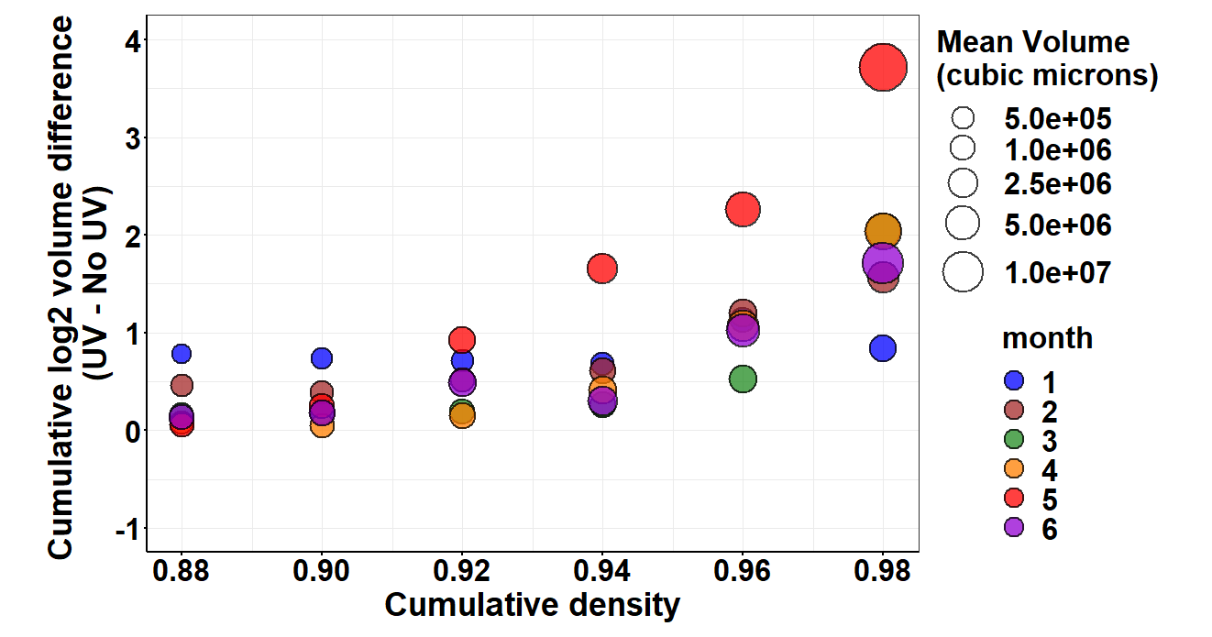

Slide 4
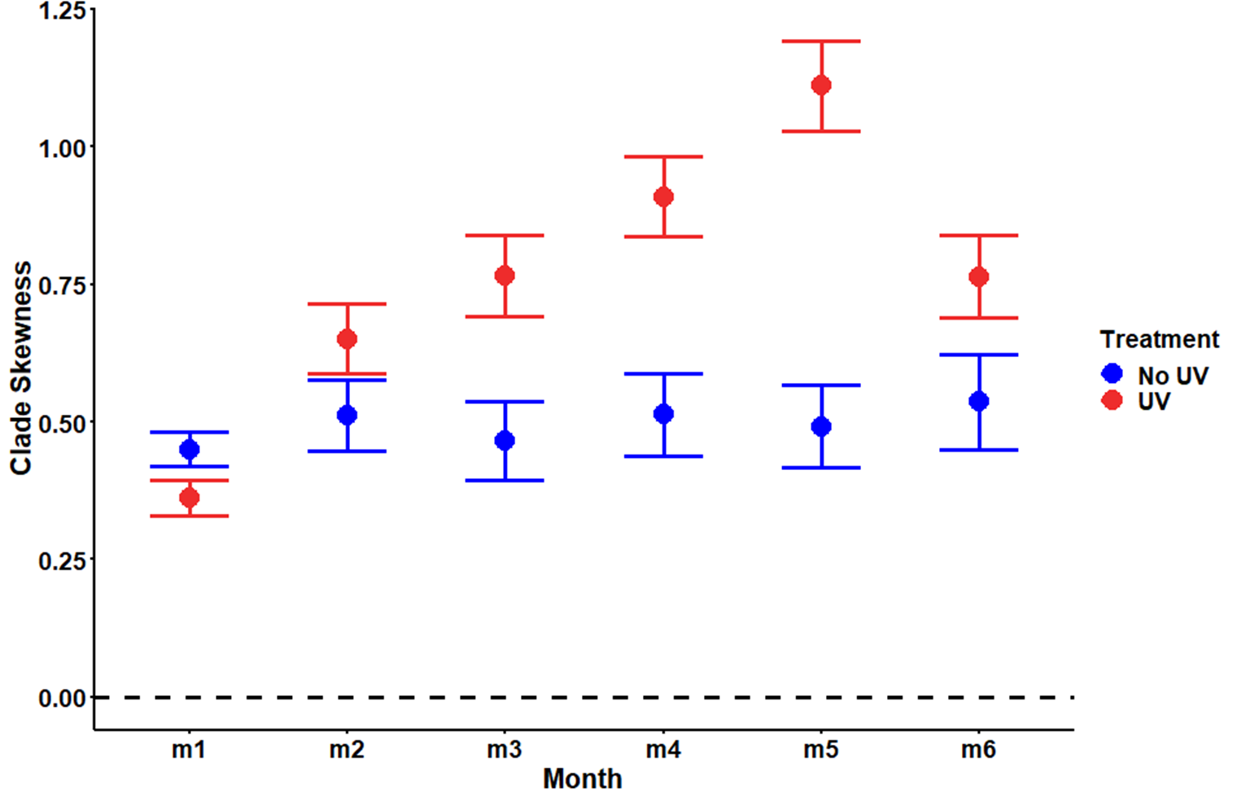

Slide 5
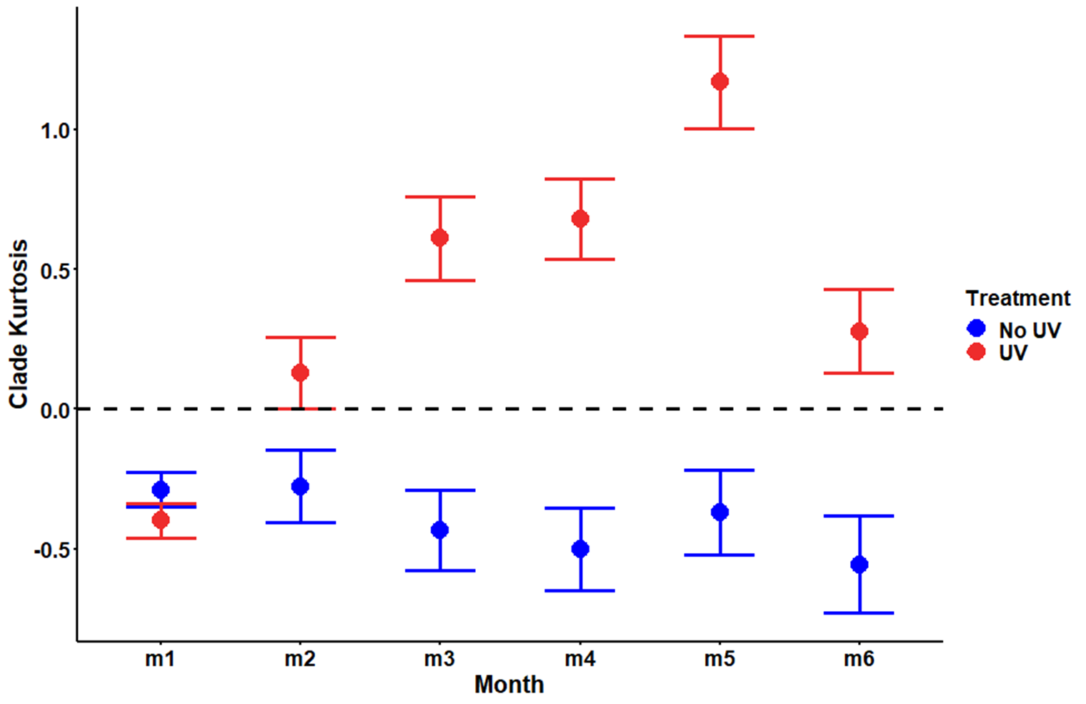

Slide 6
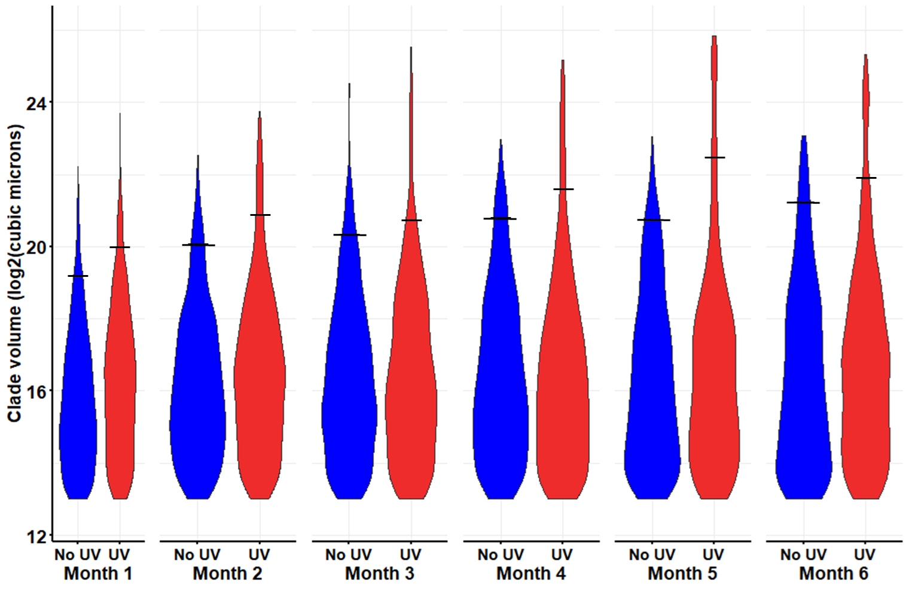



A
B
C
D

Slide 7
