Slide 1
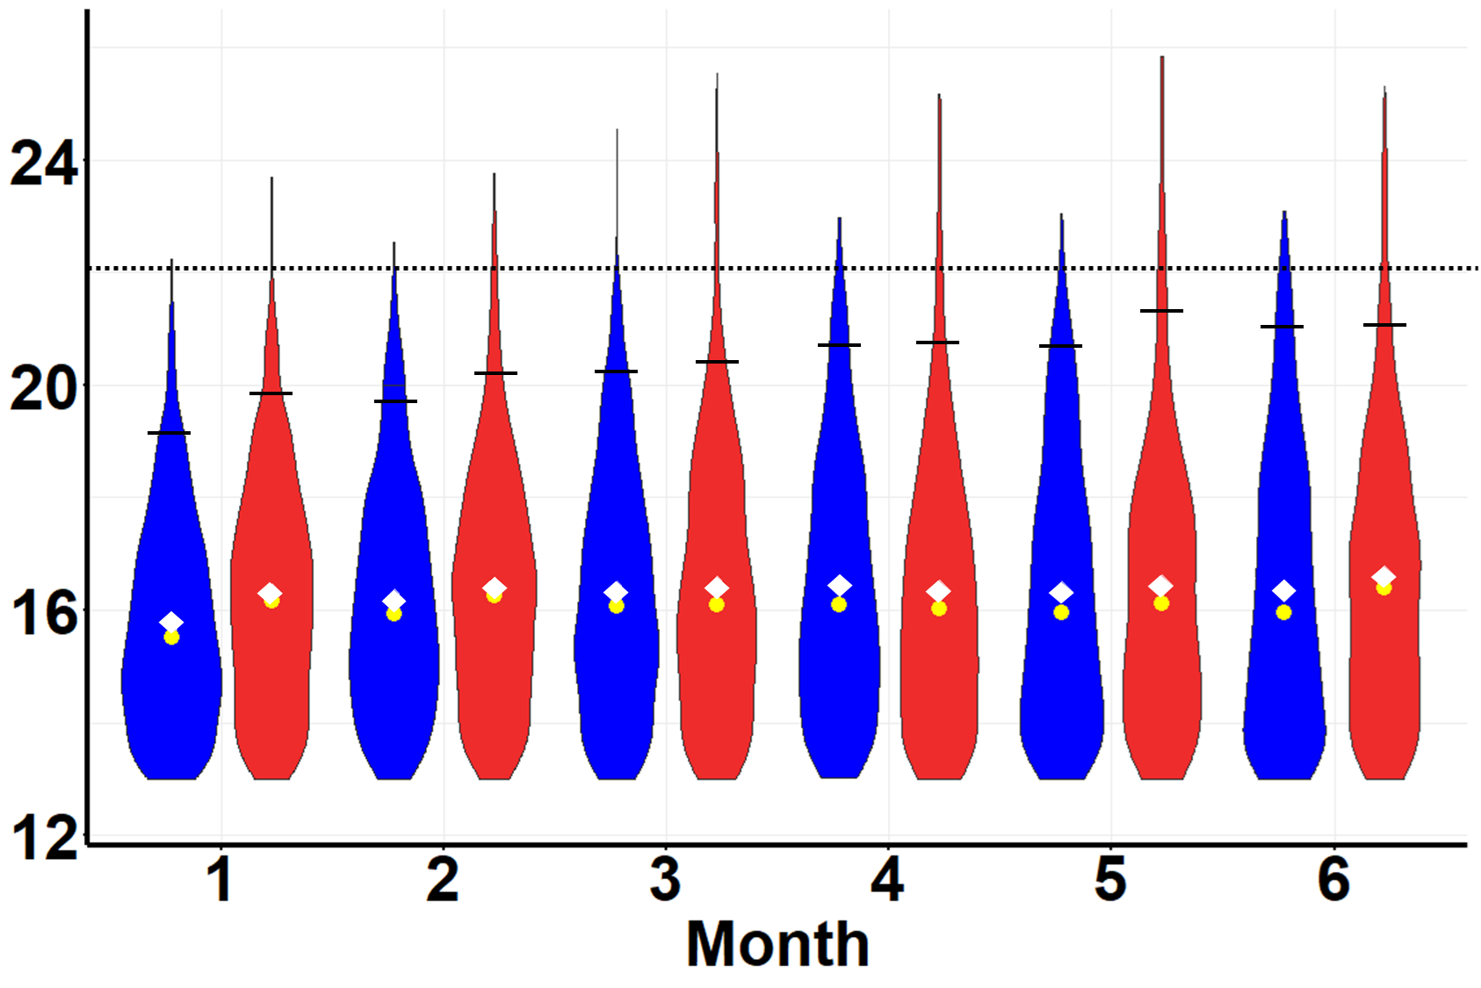
Clade Volume (log₂(μm³))

