Slide 1
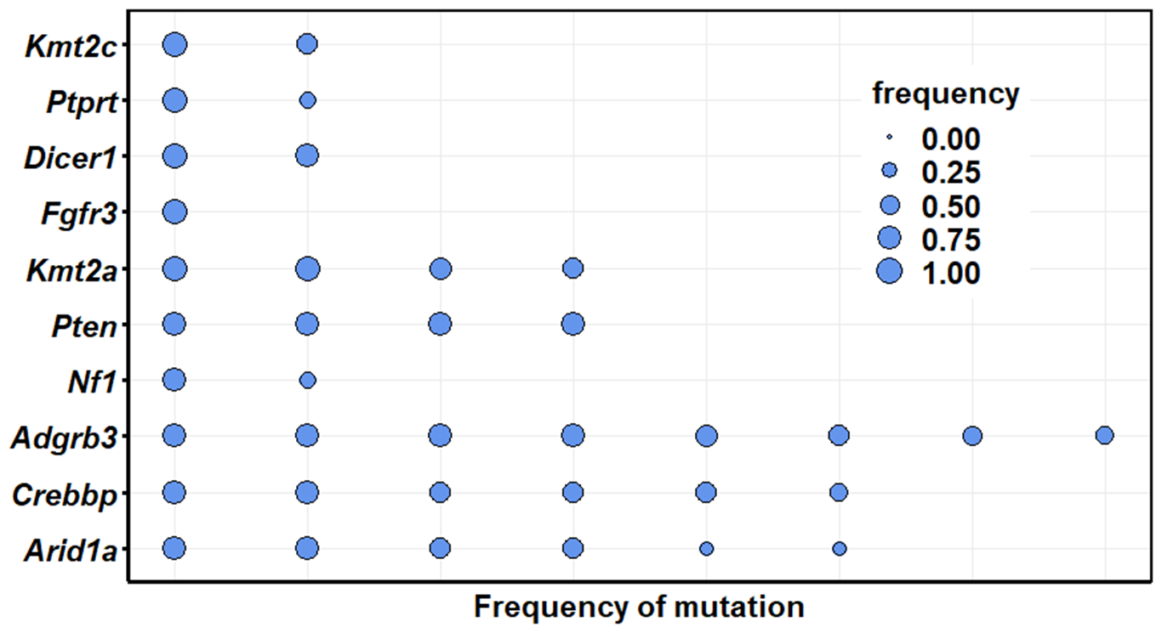
Goliath 006 at 7 months; frequencies range from 0.903-0.198

Slide 2
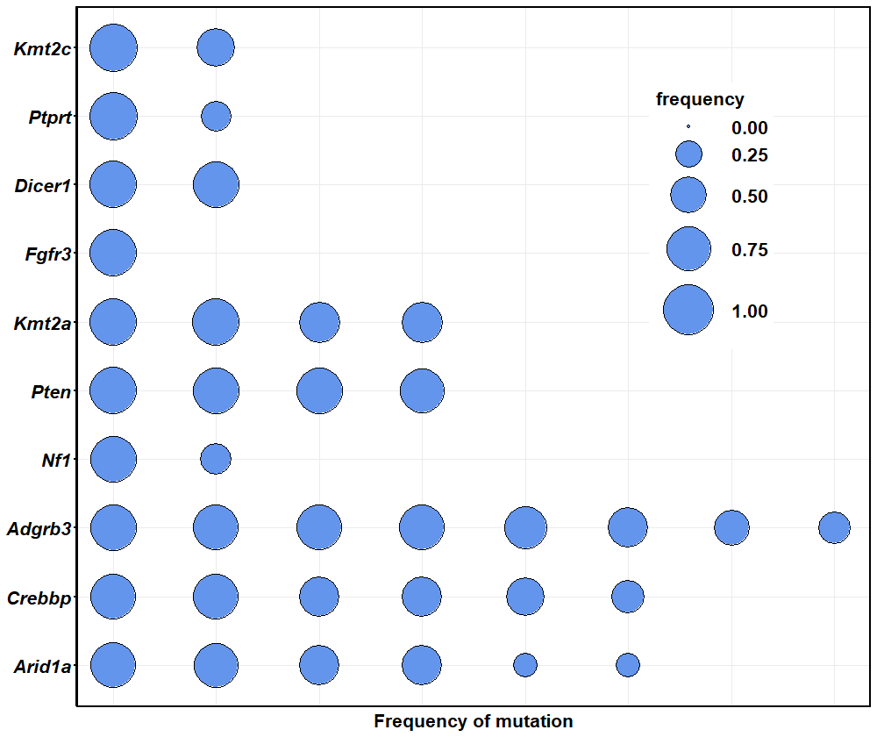

Slide 3
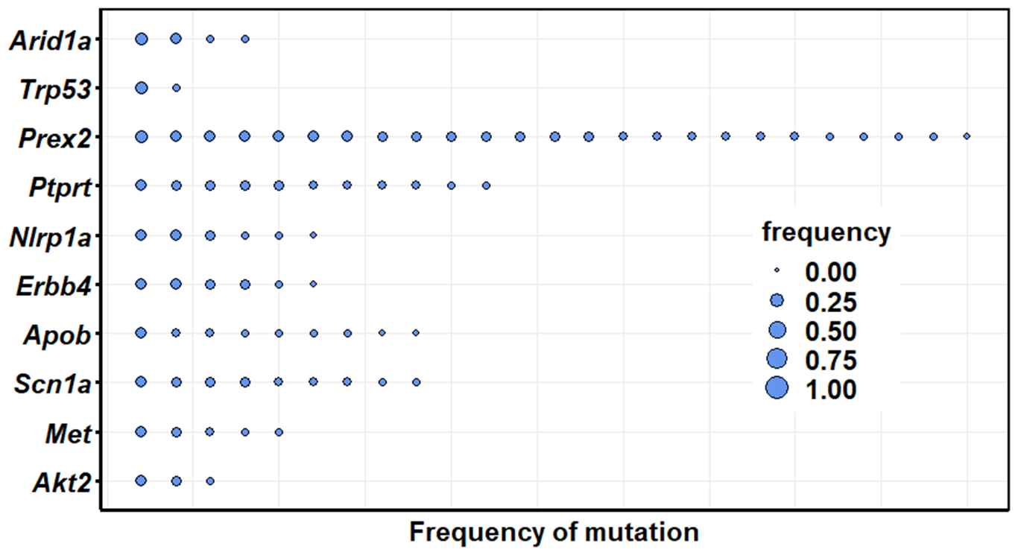
Goliath 444 at 7 months; frequencies range from 0.209-0.042

Slide 4
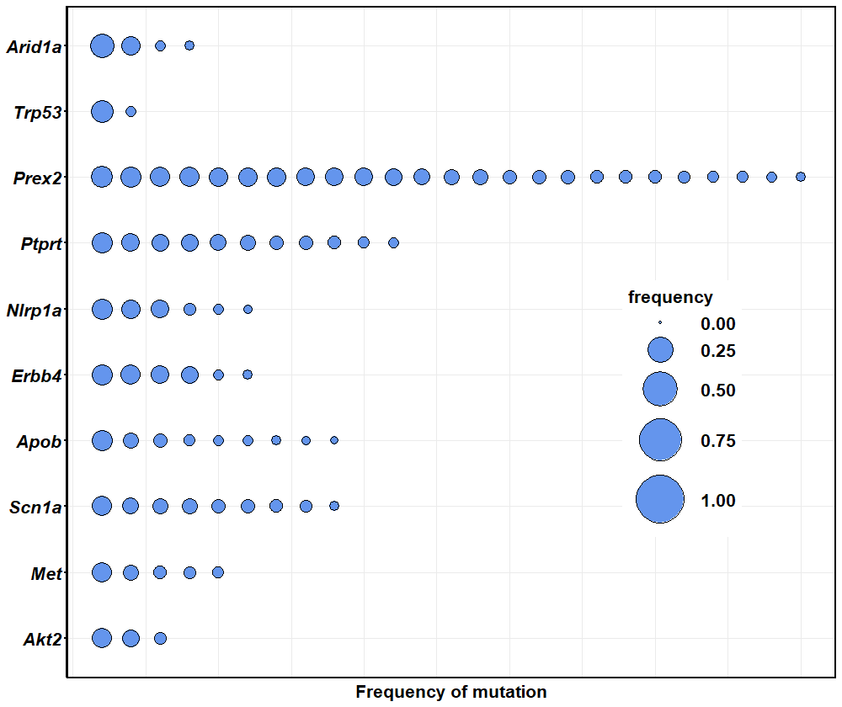

Slide 5
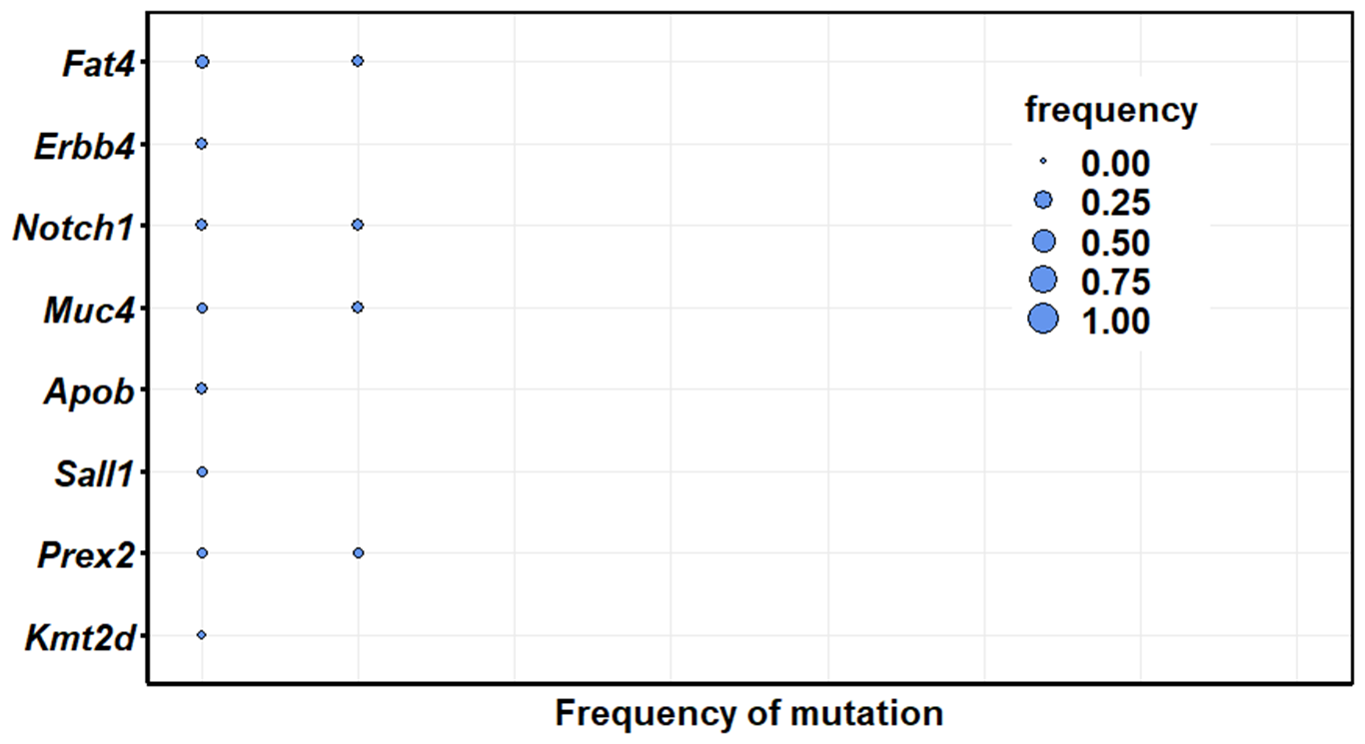
Goliath 445 at 3 months; frequencies range from 0.081-0.017

Slide 6
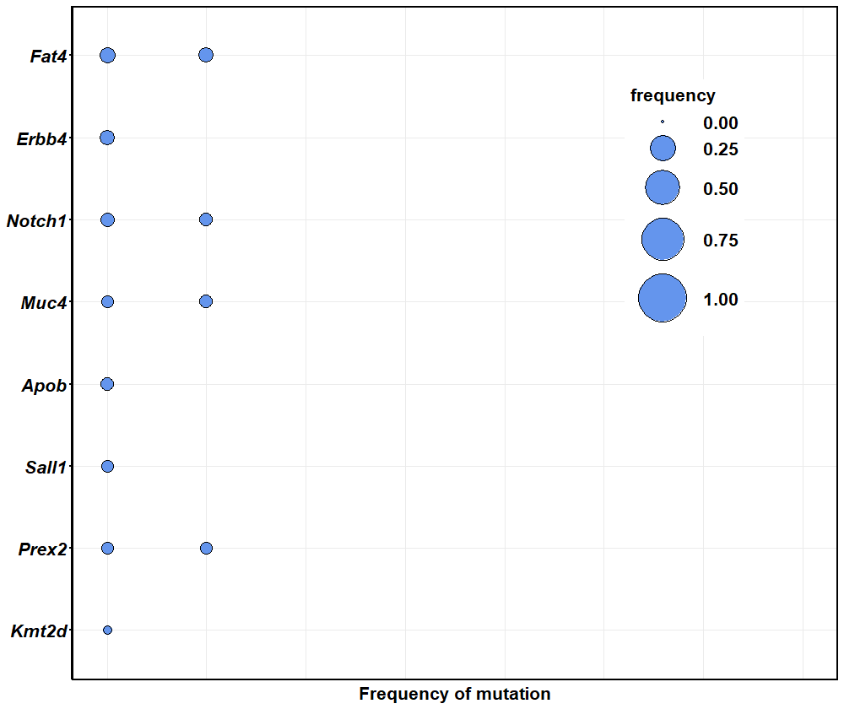

Slide 7
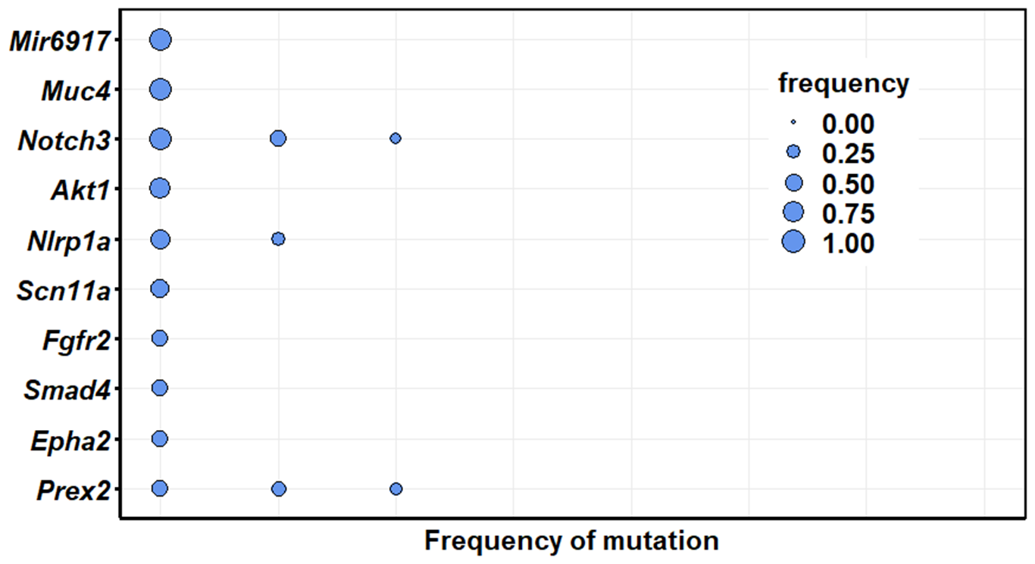
Goliath 9159 at 3 months; frequencies range from 0.923-0.181

Slide 8
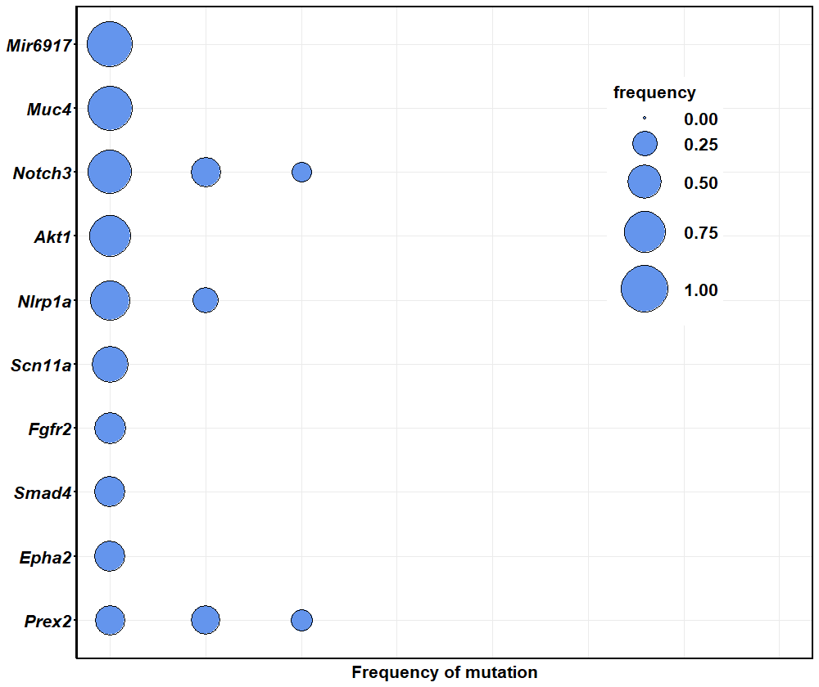

Slide 9
Goliath 445
at 7 months

Slide 10
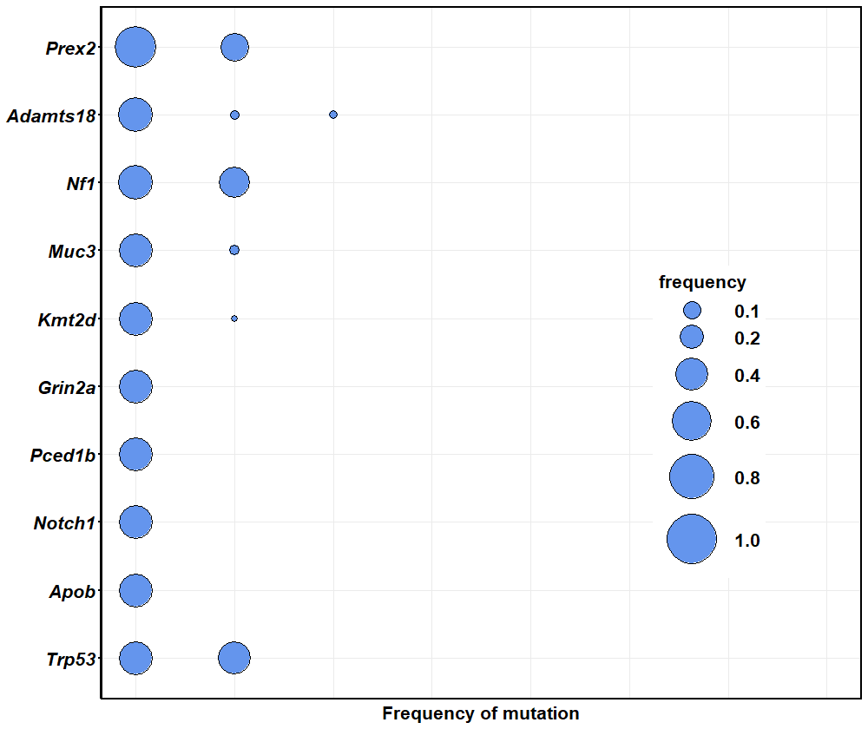
Goliath 446
at 7 months

