Slide 1
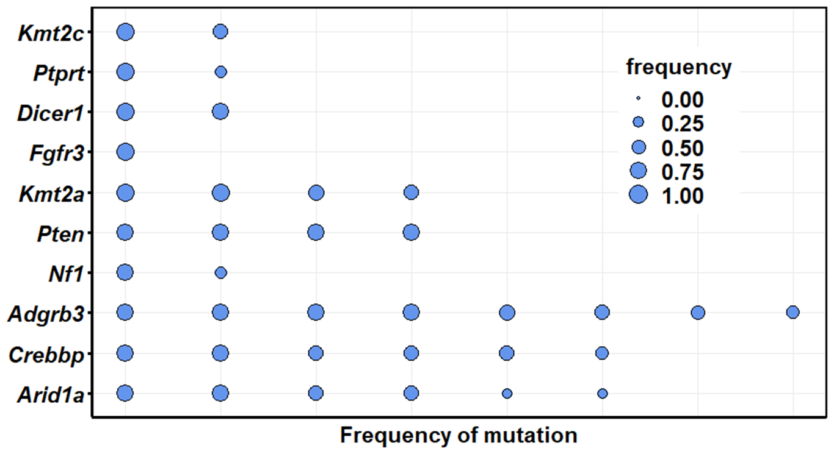
Goliath 006 at 7 months; frequencies range from 0.903-0.198

Slide 2
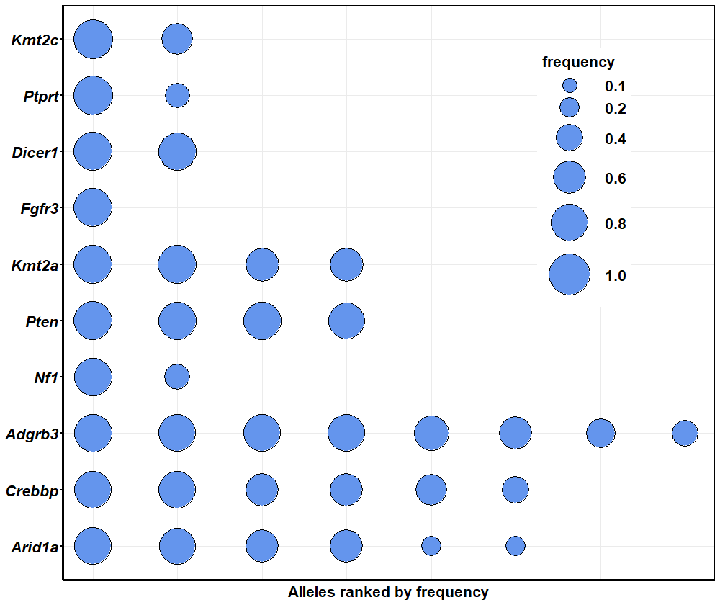
Goliath 006 at 7 months; bubble size controlled with:
“scale_size_continuous”

Slide 3
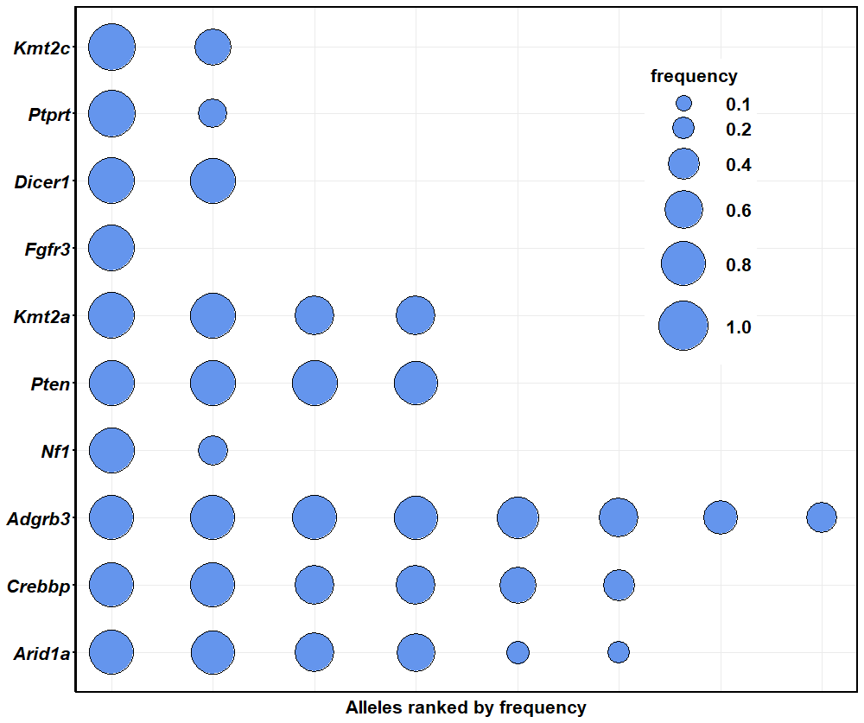
Goliath 006 at 7 months; bubble size controlled with:
“scale_size_area”

Slide 4
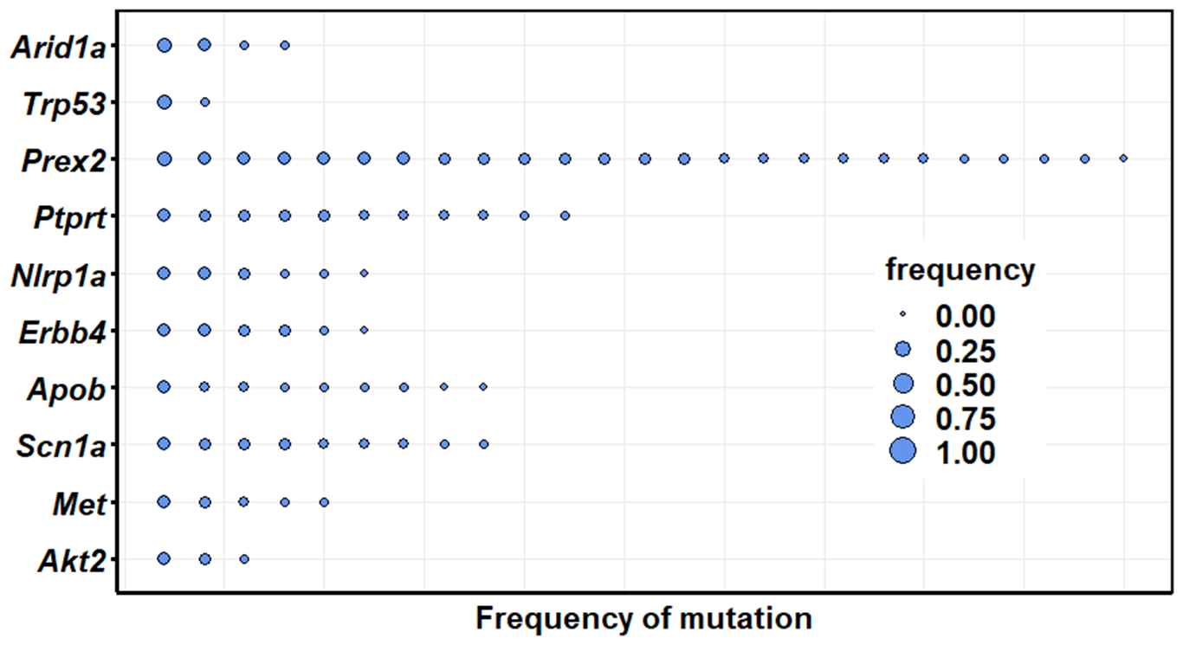
Goliath 444 at 7 months; frequencies range from 0.209-0.042

Slide 5
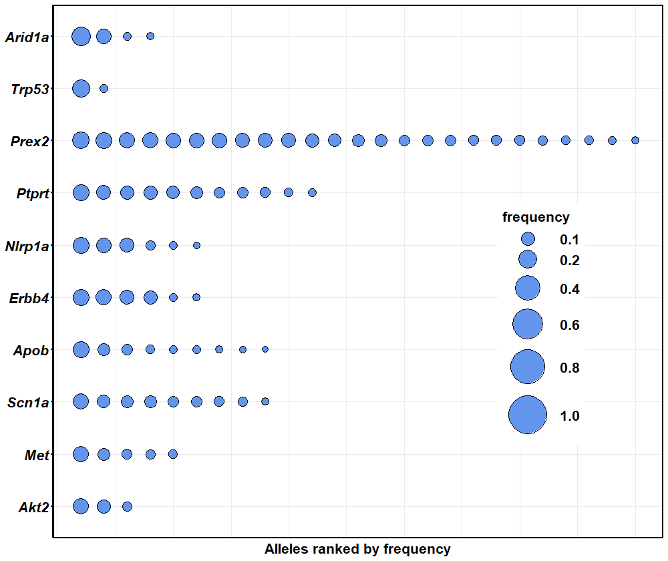
Goliath 444 at 7 months

Slide 6
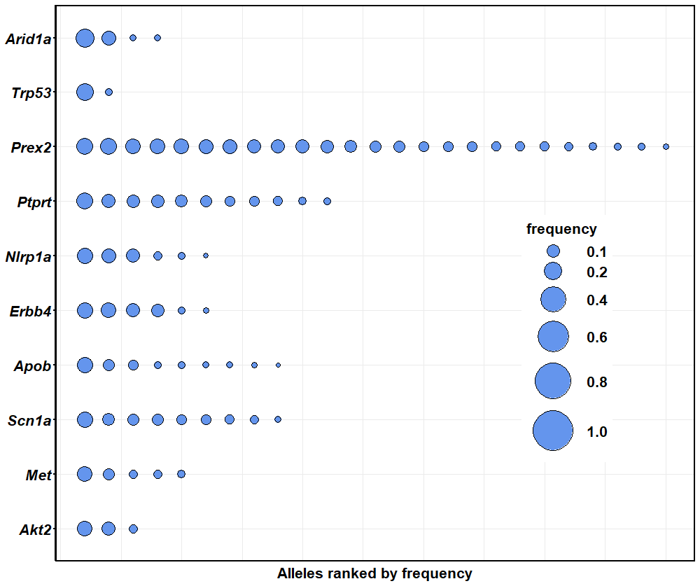

Slide 7
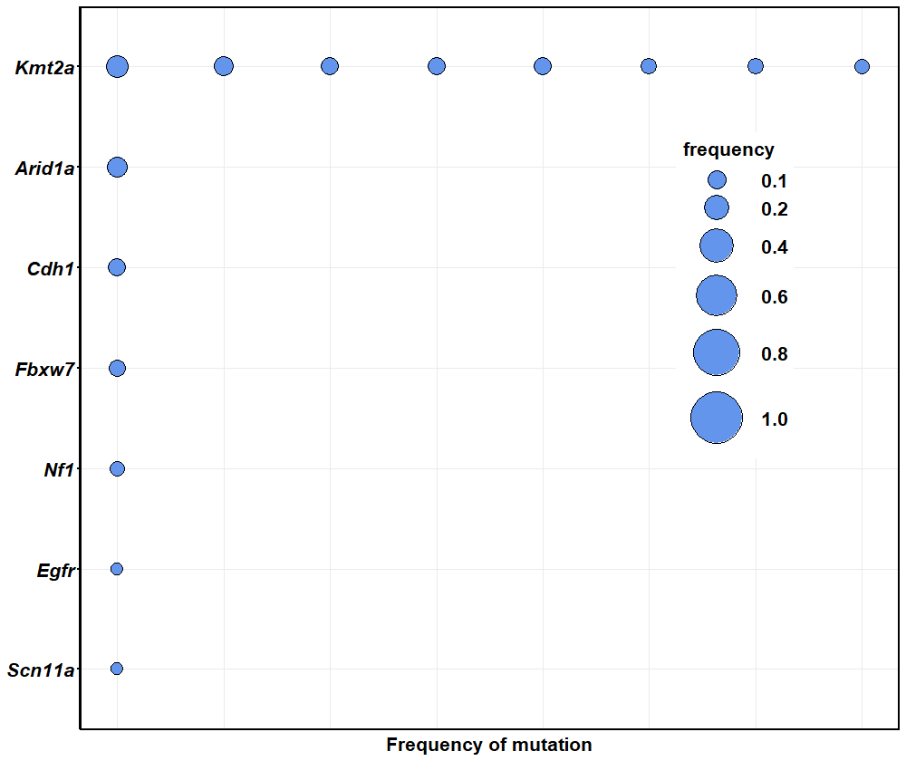
Goliath 445 at 7 months; frequencies range from 0.081-0.017

Slide 8
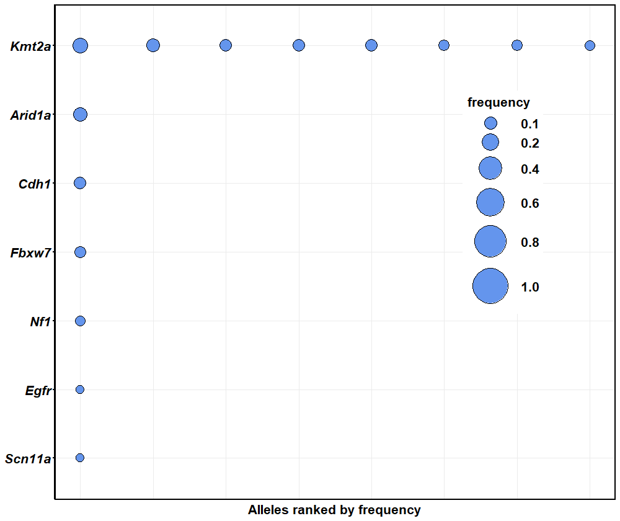
Goliath 445 at 7 months

Slide 9
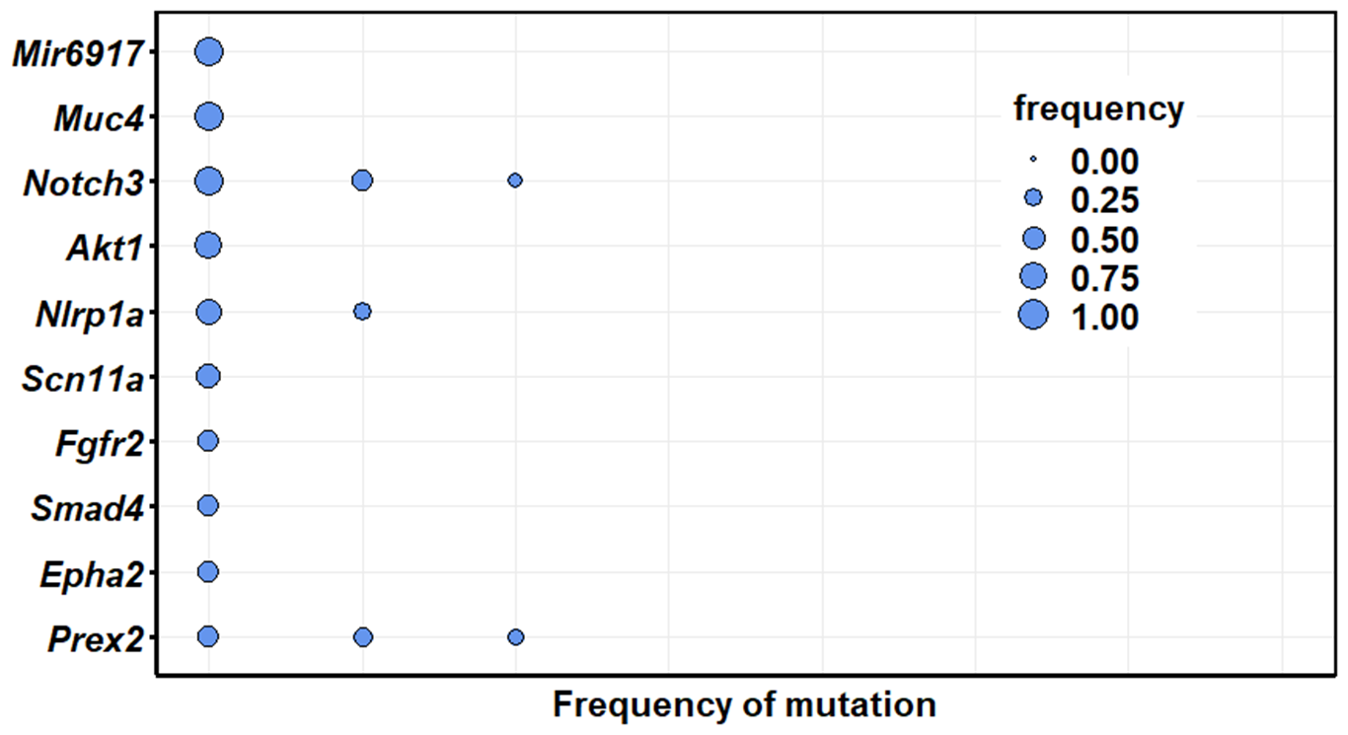
Goliath 9159 at 3 months; frequencies range from 0.923-0.181

Slide 10
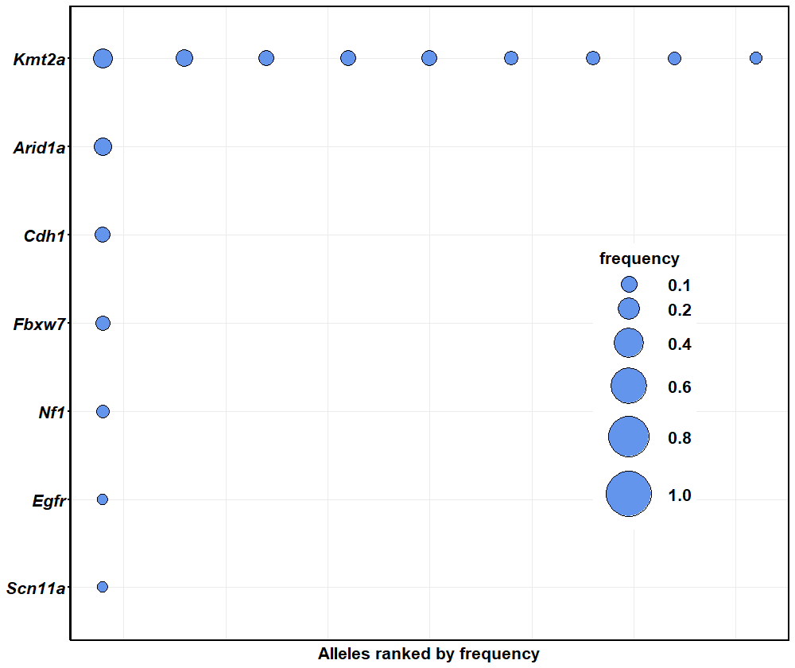
Goliath 445
at 7 months

Slide 11
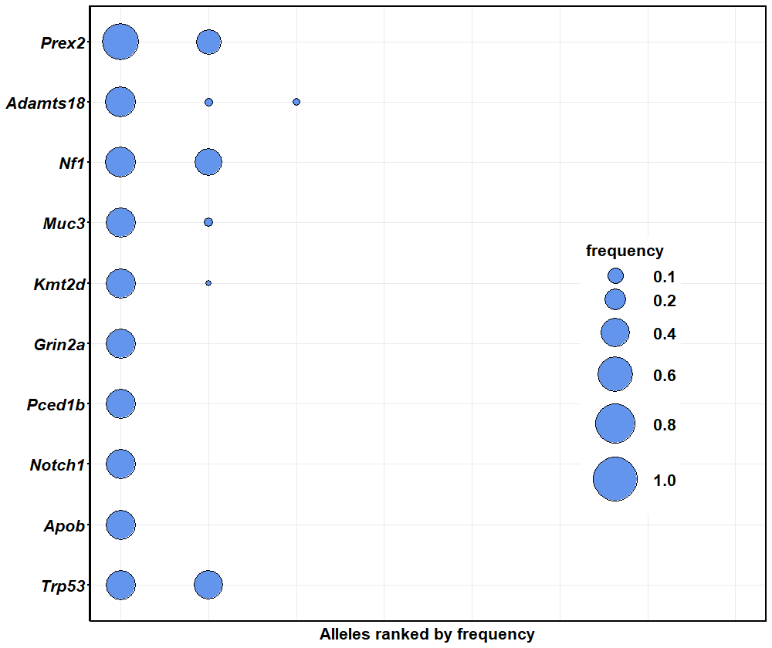
Goliath 446
at 7 months

Slide 12
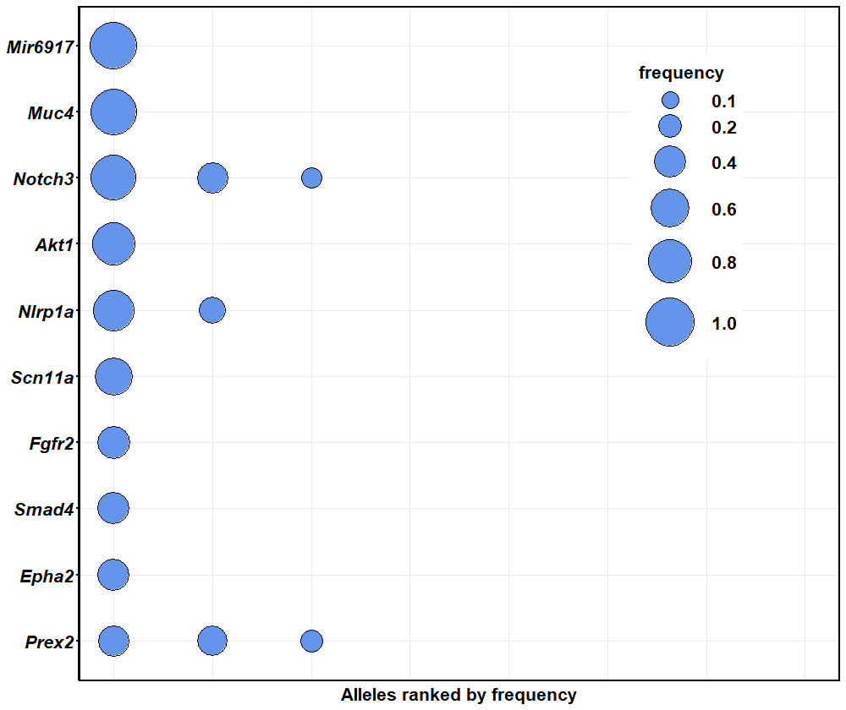
Goliath 9159 at 3 months

Slide 13
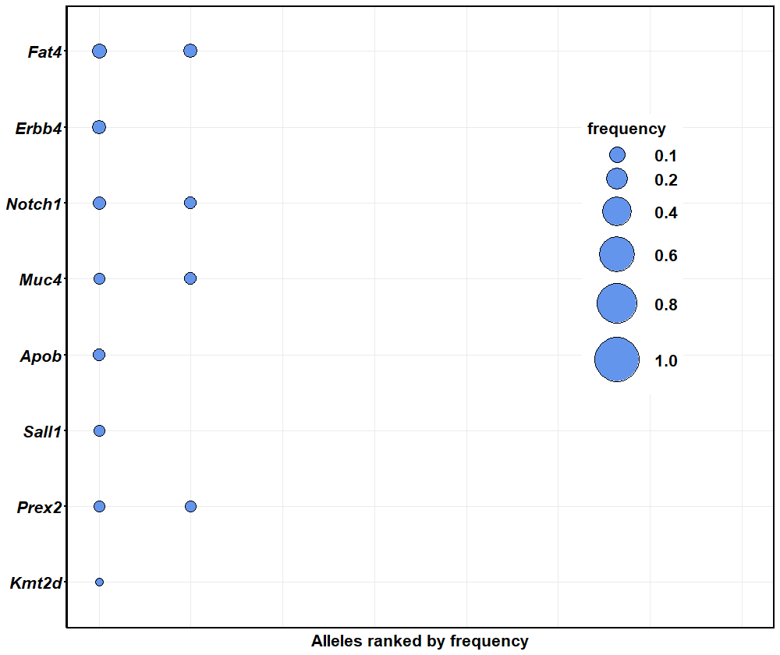
Goliath 445 at 3 months

