Slide 1
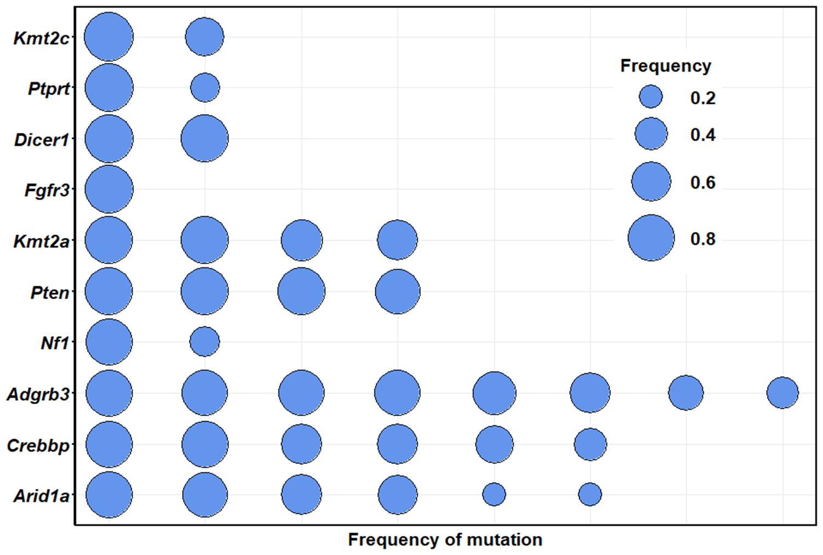
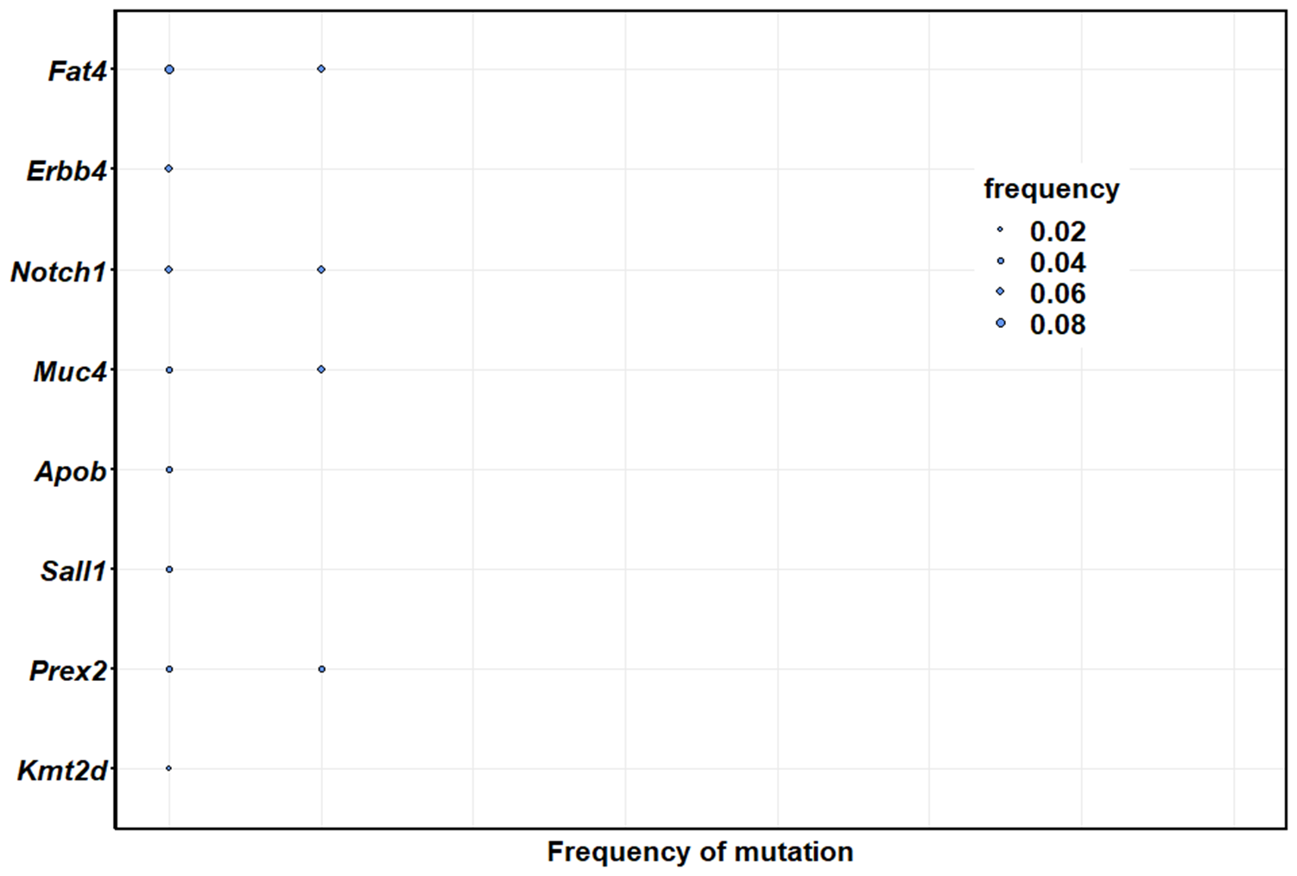


Goliath 006
Goliath 445
To scale the bubbles, I set max size for 006 at 20. The maximum frequency is 0.903; the max frequency for 445 (3 months) is 0.081. To scale the bubbles for 445, I set max size to (0.08*20)/0.8 = 2
That seems to come out with the correct scaling.

