Slide 1
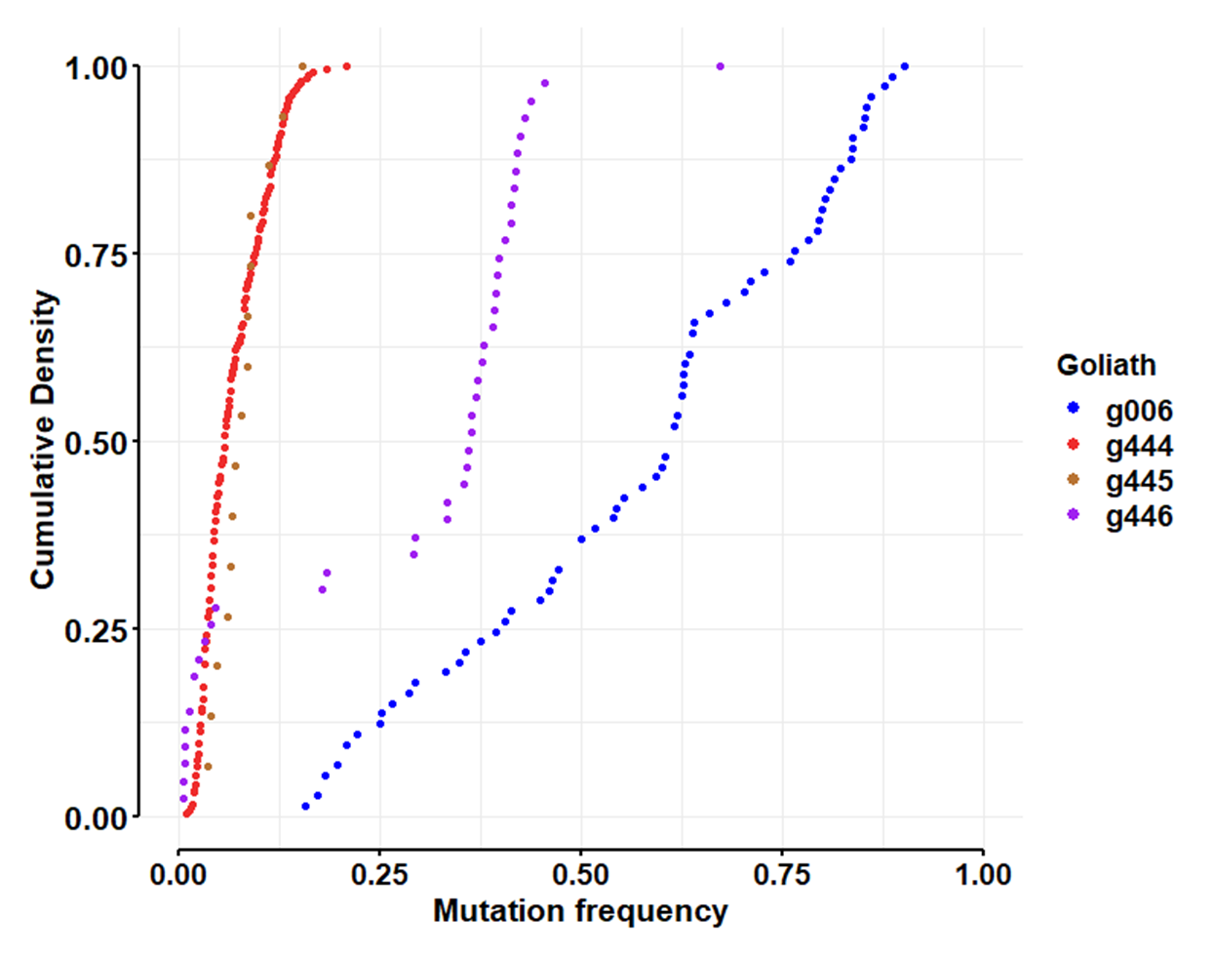
Use KS to test for differences among goliaths
g444 v g445 Two-sample Kolmogorov-Smirnov test
D = 0.33125, p-value = 0.06858
g444 v g446
D = 0.71312, p-value < 2.2e-16
g444 v g006
D = 0.98047, p-value < 2.2e-16
g445 v g446
D = 0.72093, p-value = 4.226e-06
g445 v g006
D = 1, p-value = 5.551e-16
g446 v g006
D = 0.68907, p-value = 6.803e-13
NOTE: results of pairwise Anderson-Darling tests showed comparable levels of significance.
Also, with 6 pairwise tests, we should accept significance at 0.05/6 = 0.0083
All differ except goliaths 444 and 445.

Slide 2
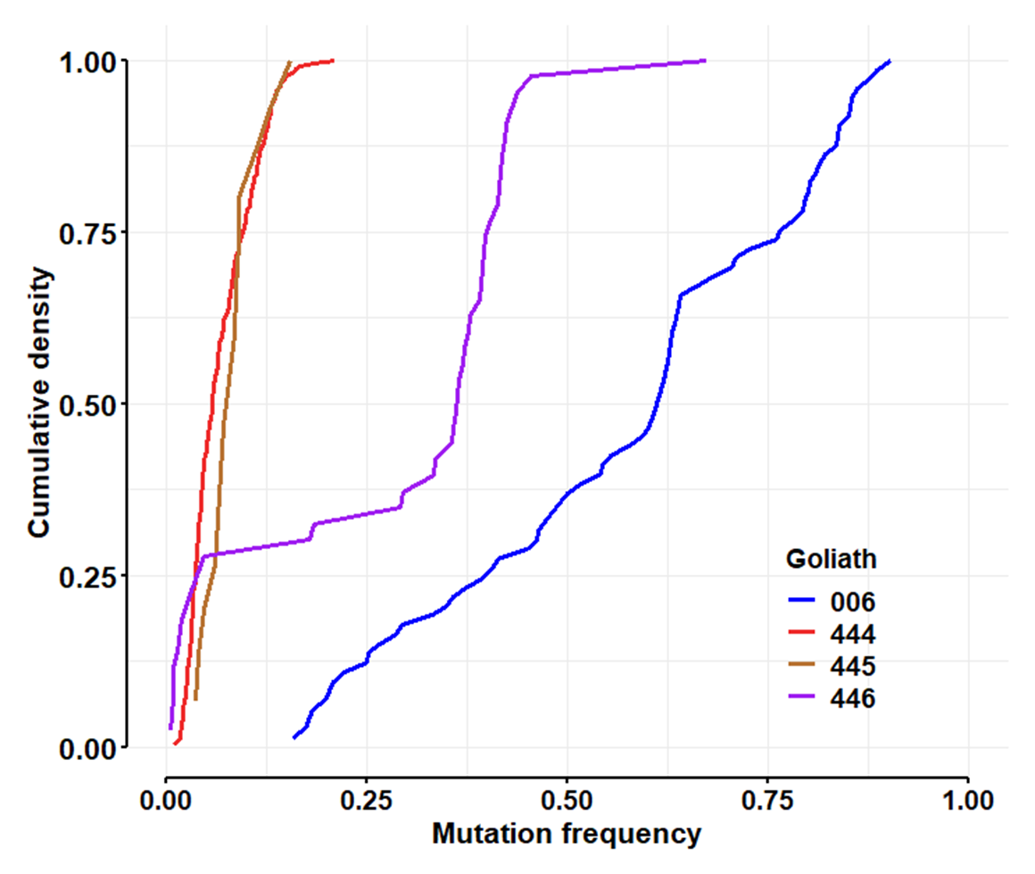

Slide 3
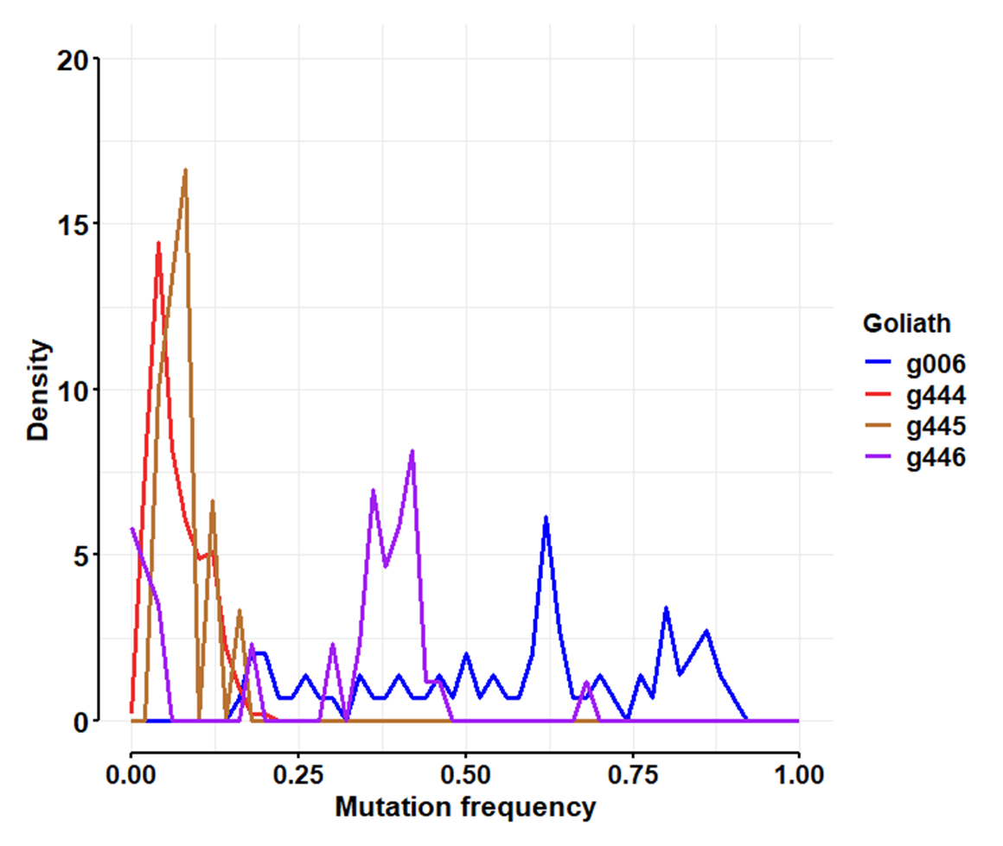

Slide 4
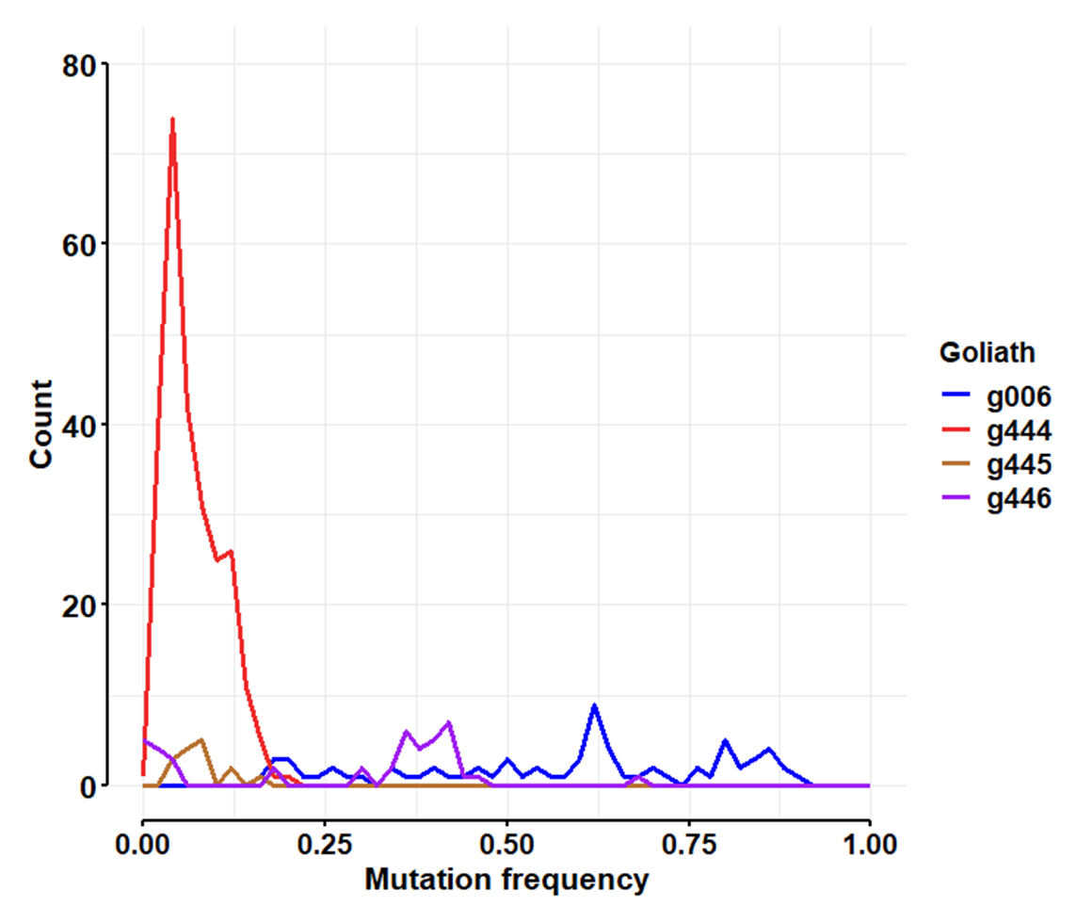

Slide 5
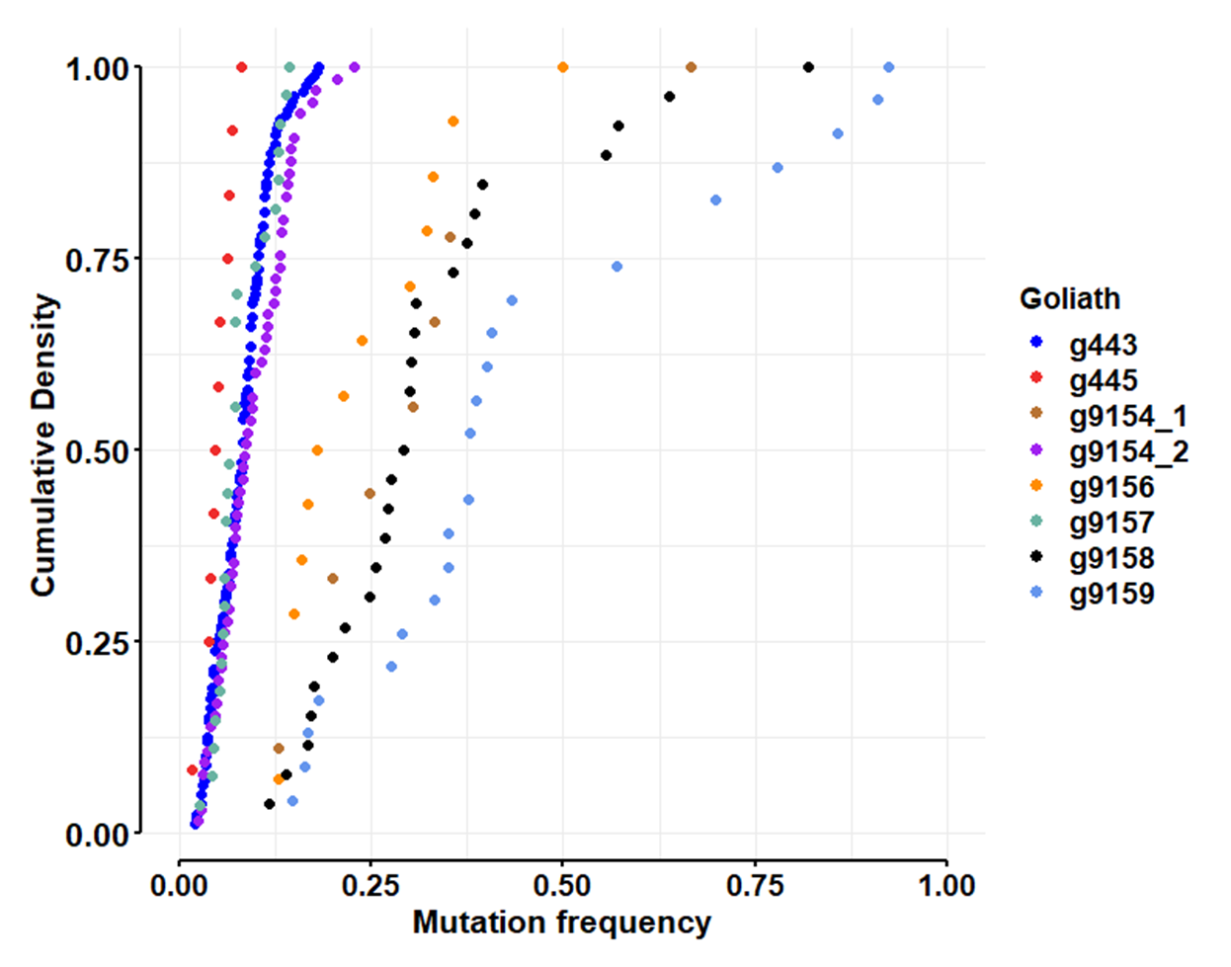
Use KS to test for differences among goliaths
g443 v g445, D = 0.53931, p-value = 0.001506; ad: 0.002
g443 v g9154_1, D = 0.91824, p-value = 4.211e-09; 4.483e-12
g443 v g9154_2 , D = 0.20987, p-value = 0.03435; 0.02672
g443 v g9156, D = 0.92453, p-value = 1.341e-13; 1.282e-14
g443 v g9157, D = 0.27603, p-value = 0.04743; 0.1980
g443 v g9158, D = 0.89865, p-value = 6.661e-16; 6.273e-24
g443 v g9159, D = 0.94969, p-value = 4.441e-16; 7.594e-23
g445 v g9154_1, D = 1, p-value = 6.804e-06; 5.130e-05
g445 v g9154_2, D = 0.59359, p-value = 0.0007108; 0.0008137
g445 v g9156, D = 1, p-value = 2.071e-07; 4.377e-06
g445 v g9157, D = 0.51852, p-value = 0.01443; 0.007664
g445 v g9158, D = 1, p-value = 7.387e-10; 5.912e-08
g445 v g9159, D = 1, p-value = 2.397e-09; 1.492e-07
g9154_1 v g9154_2, D = 0.85812, p-value = 9.254e-07; 7.38e-08
g9154_1 v g9156, D = 0.38889, p-value = 0.2798; 0.2475
g9154_1 v g9157, D = 0.88889, p-value = 5.184e-06; 2.660e-06
g9154_1 v g9158, D = 0.18376, p-value = 0.936; 0.9158
g9154_1 v g9159, D = 0.42995, p-value = 0.1358; 0.1243
g9154_2 v g9156, D = 0.82088, p-value = 1.414e-08; 4.094e-09
g9154_2 v g9157, D = 0.3037, p-value = 0.04586; 0.09762
g9154_2 v g9158, D = 0.86154, p-value = 7.55e-15; 1.760e-15
g9154_2 v g9159, D = 0.89498, p-value = 3.553e-15; 1.486e-15
g9156 v g9157, D = 0.92857, p-value = 2.327e-09; 2.573e-08
g9156 v g9158, D = 0.37363, p-value = 0.1182; 0.08300
g9156 v g9159, D = 0.59627, p-value = 0.00215; 0.001886
g9157 v g9158, D = 0.92308, p-value = 2.831e-12; 2.571e-11
g9157 v g9159, D = 1, p-value = 1.821e-14; 3.592e-11
g9158 v g9159, D = 0.43144, p-value = 0.0142; 0.02476
Note: we did a total of 28 pairwise tests, so we should accept significance only below 0.05/28 = 0.00179

Slide 6
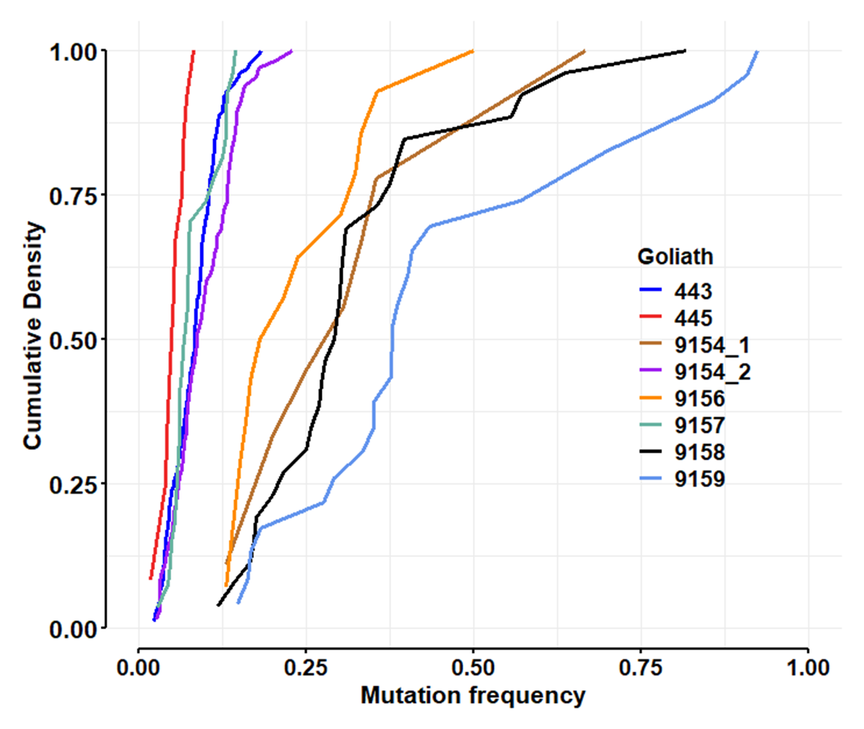

Slide 7
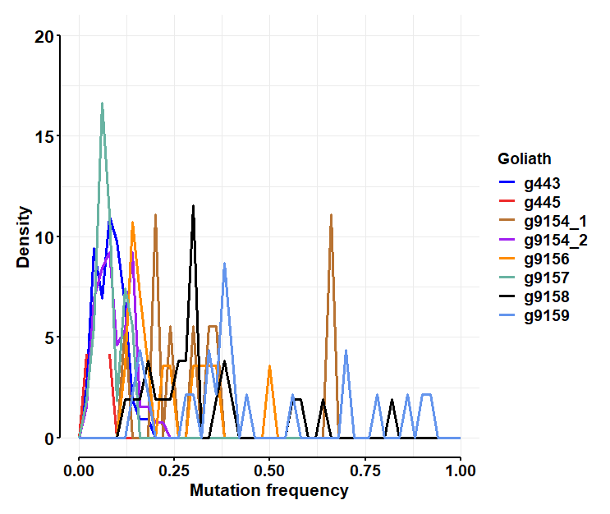

Slide 8
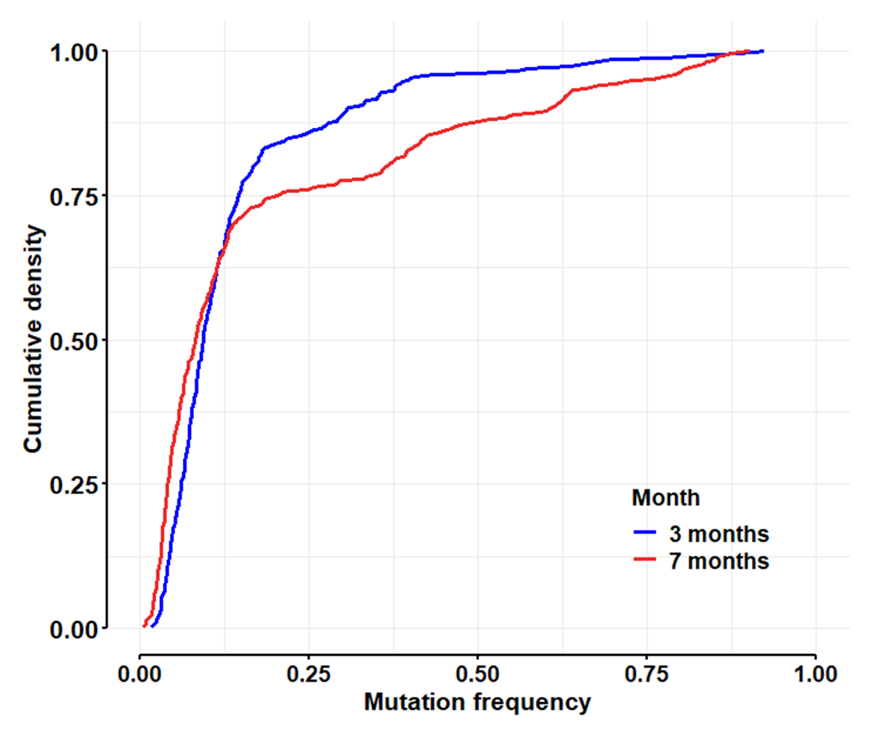
Two-sample Kolmogorov-Smirnov test
D = 0.16073, p-value = 0.0001869
alternative hypothesis: two-sided
Anderson-Darling k-sample test.
Number of samples: 2
Sample sizes: 335, 387
AD T.AD asympt. P-value sim. P-value
11.99 14.47 7.999e-07 0

Slide 9
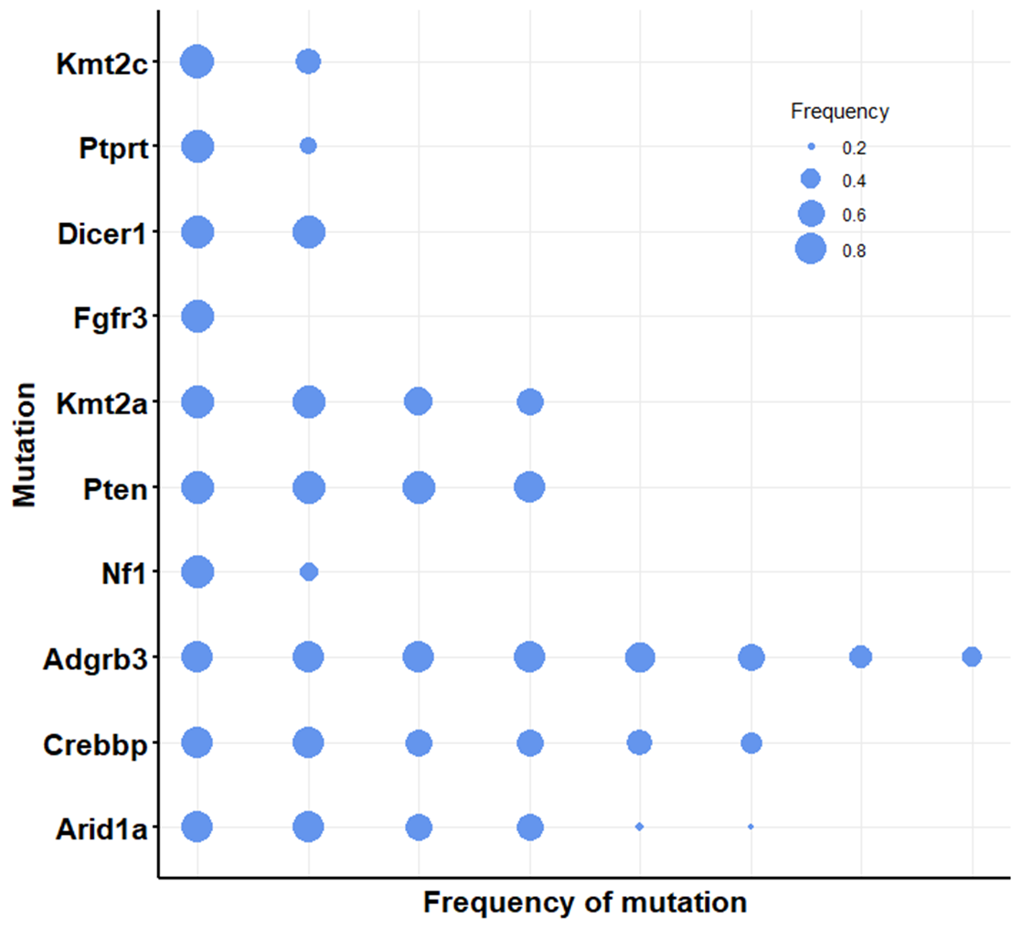
Goliath 006

Slide 10
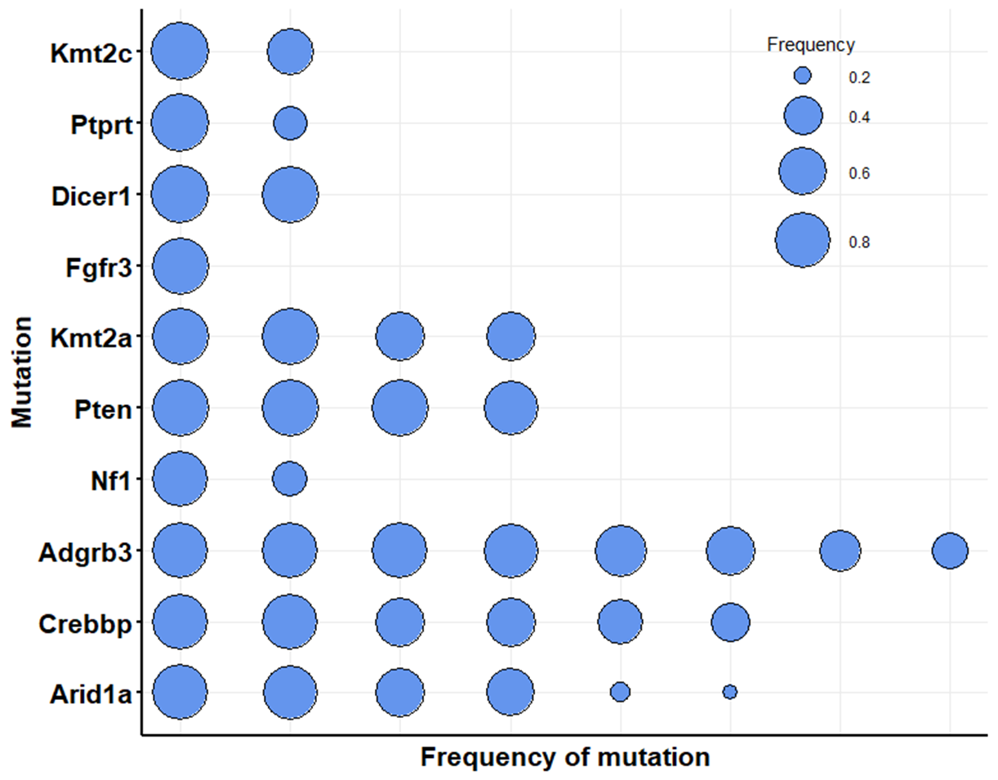
Goliath 006

Slide 11
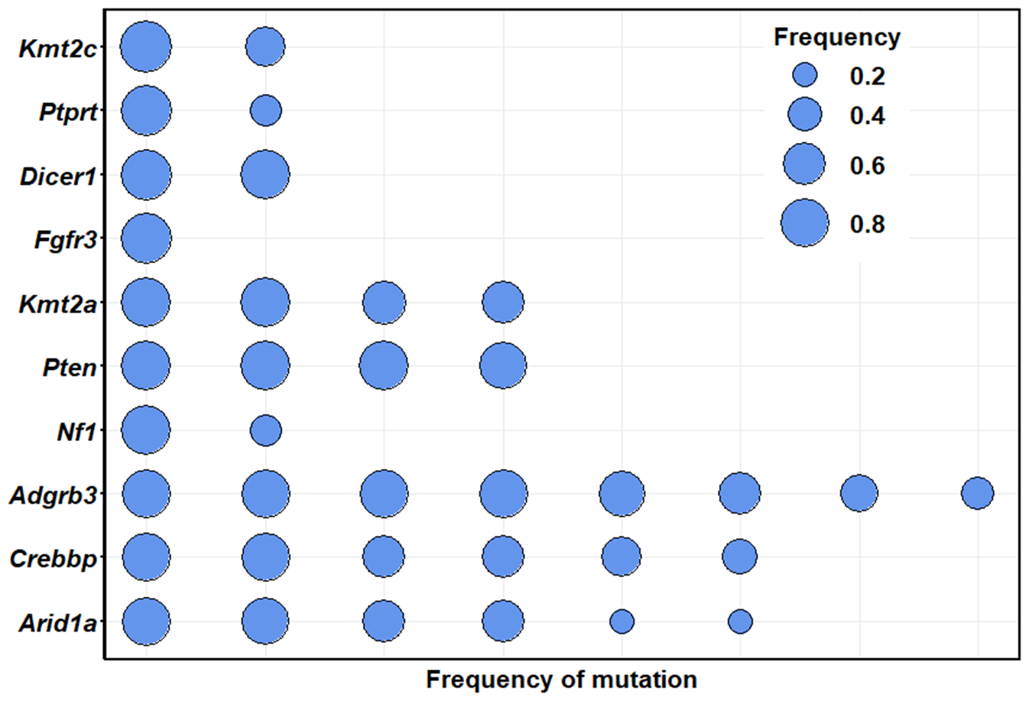
Goliath 006

Slide 12
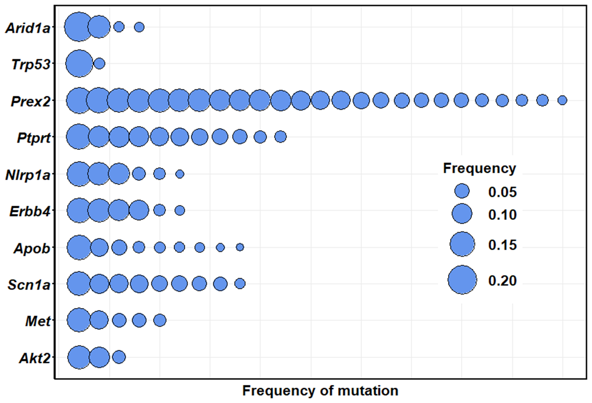
Goliath 444

Slide 13
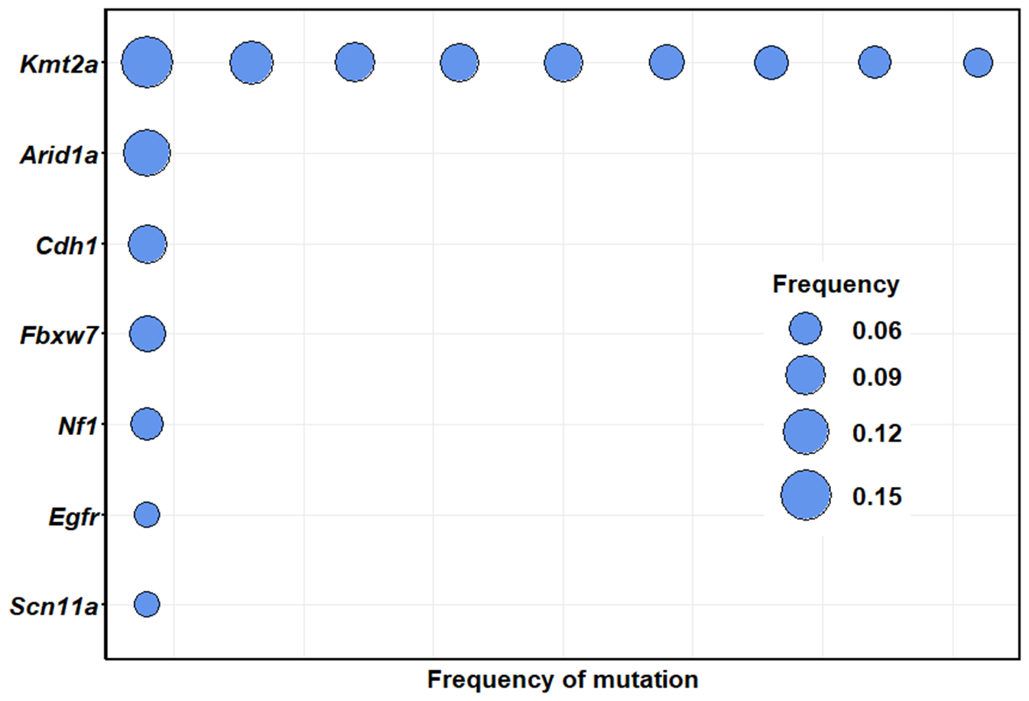
Goliath 445

Slide 14
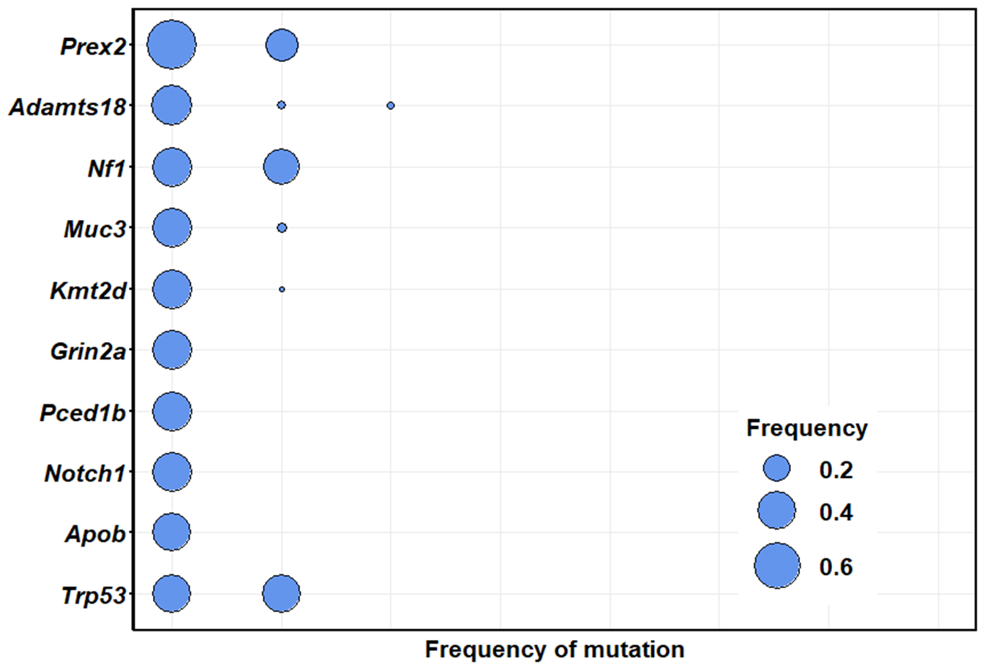
Goliath 446

Slide 15
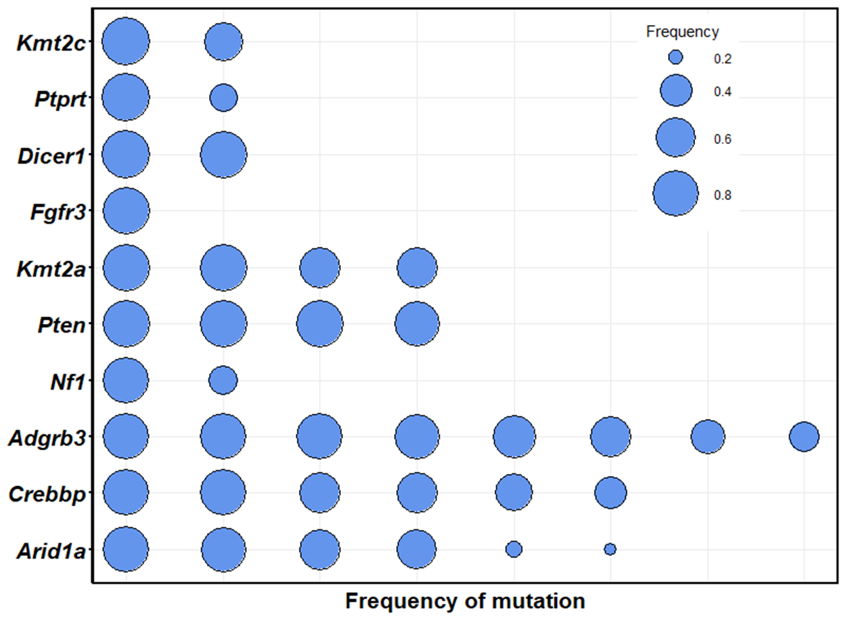

Slide 16
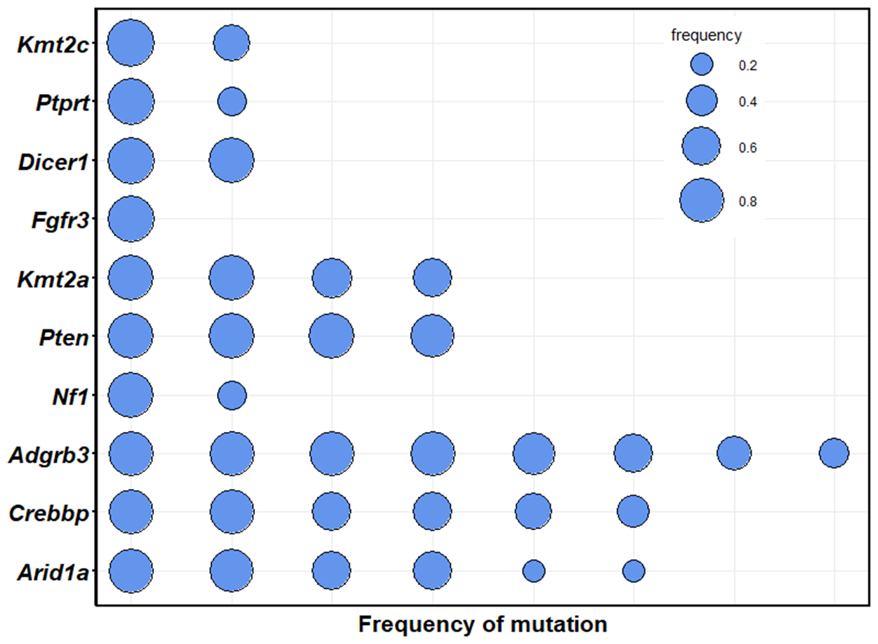

Slide 17
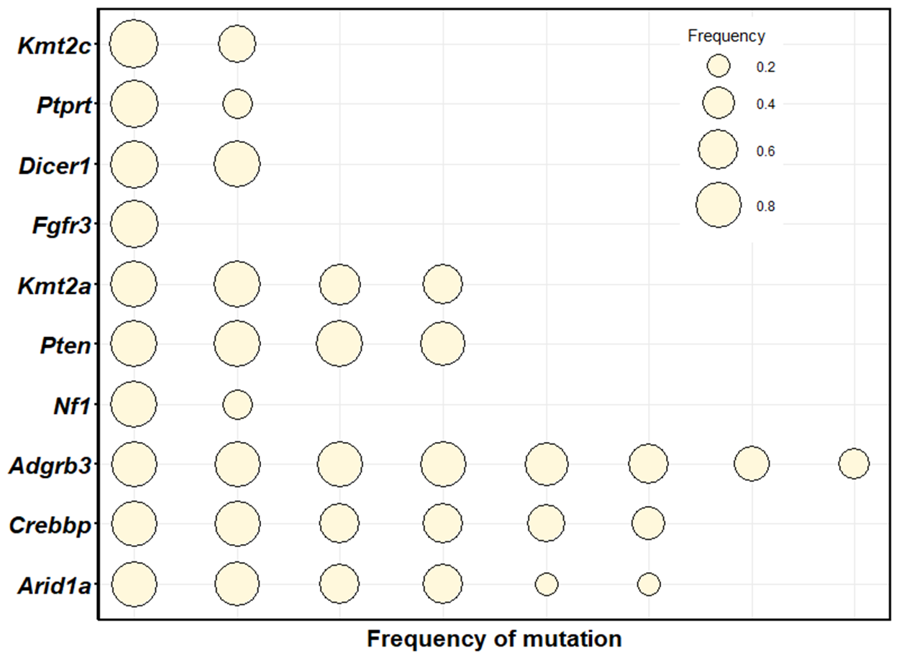
Goliath 006

Slide 18
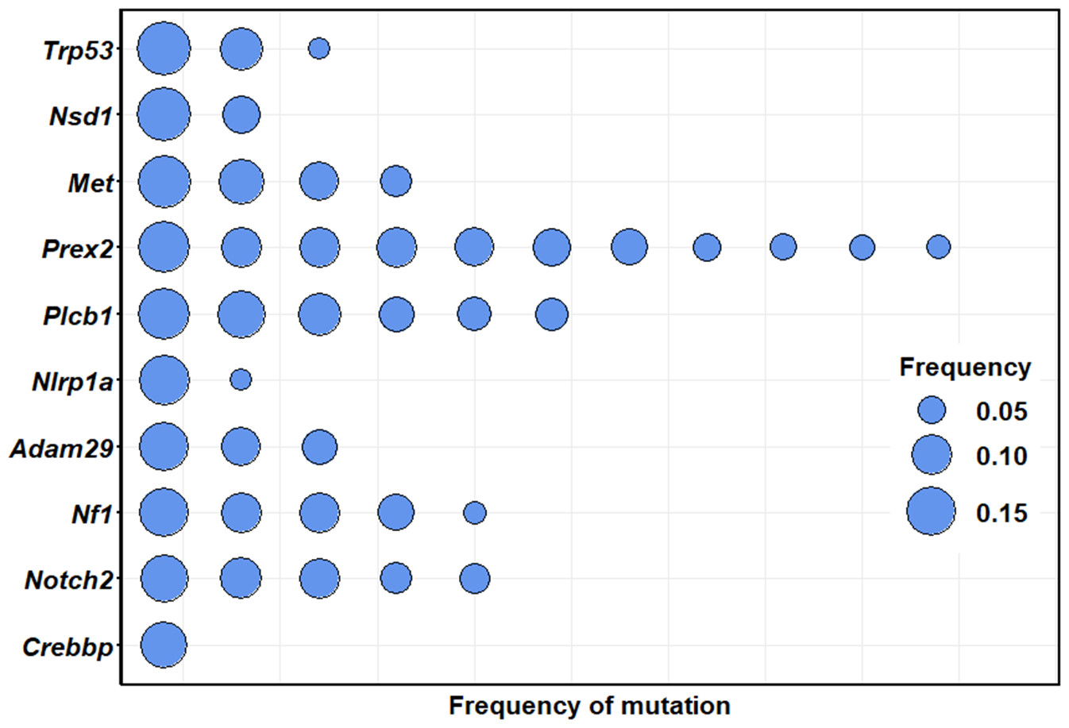
Goliath 443_3m

