Slide 1
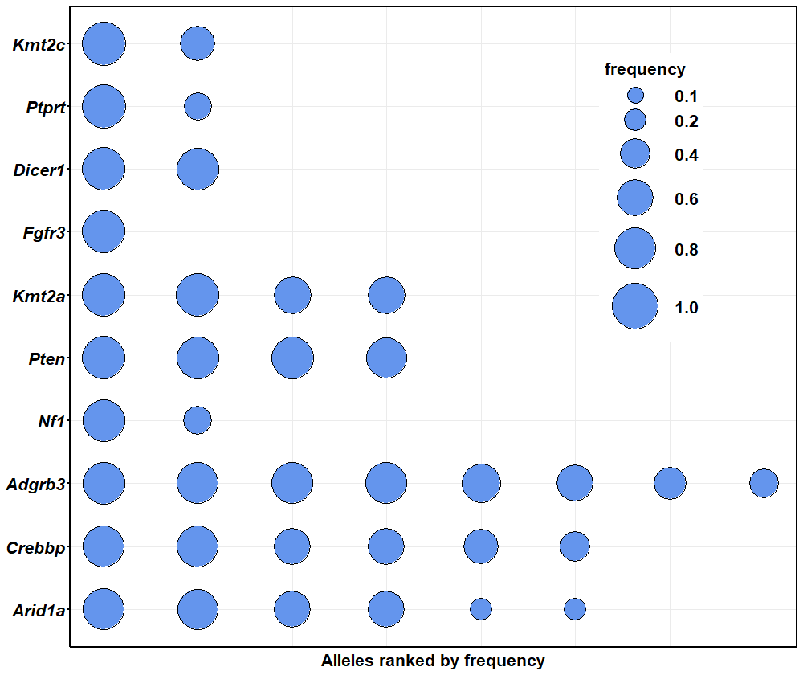
Goliath 006 at 7 months; bubble size controlled with:
“scale_size_continuous”

Slide 2
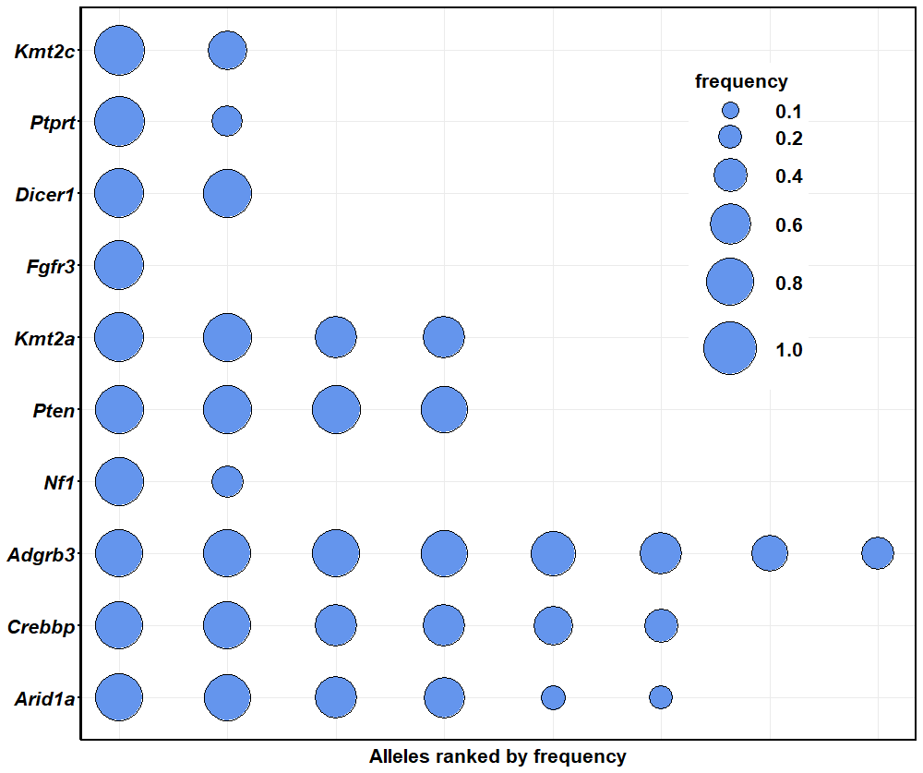
Goliath 006 at 7 months; bubble size controlled with:
“scale_size_area”

