Slide 1
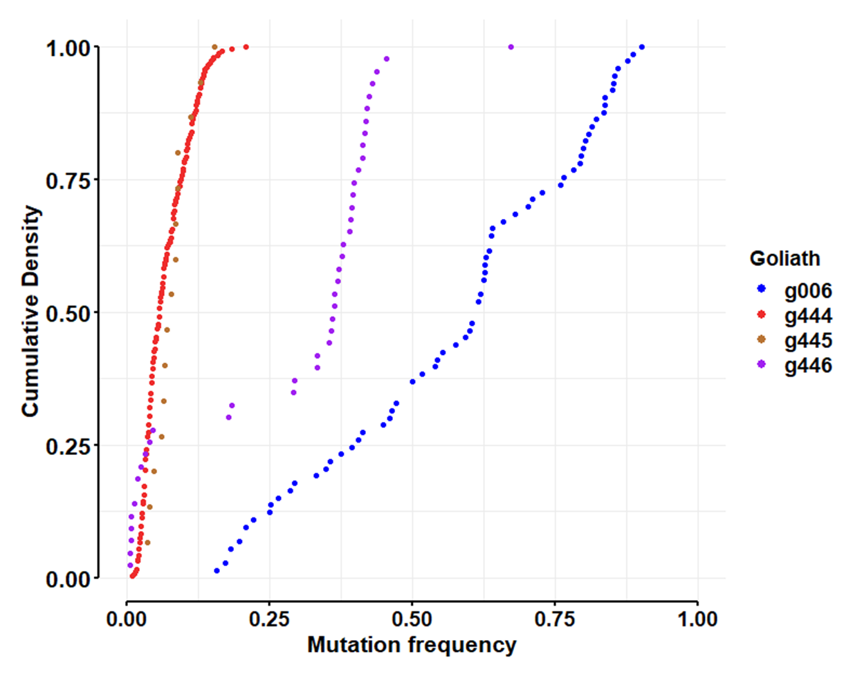
Use KS to test for differences among goliaths
g444 v g445 Two-sample Kolmogorov-Smirnov test
D = 0.33125, p-value = 0.06858
g444 v g446
D = 0.71312, p-value < 2.2e-16
g444 v g006
D = 0.98047, p-value < 2.2e-16
g445 v g446
D = 0.72093, p-value = 4.226e-06
g445 v g006
D = 1, p-value = 5.551e-16
g446 v g006
D = 0.68907, p-value = 6.803e-13
NOTE: results of pairwise Anderson-Darling tests showed comparable levels of significance.
Also, with 6 pairwise tests, we should accept significance at 0.05/6 = 0.0083
All differ except goliaths 444 and 445.

Slide 2
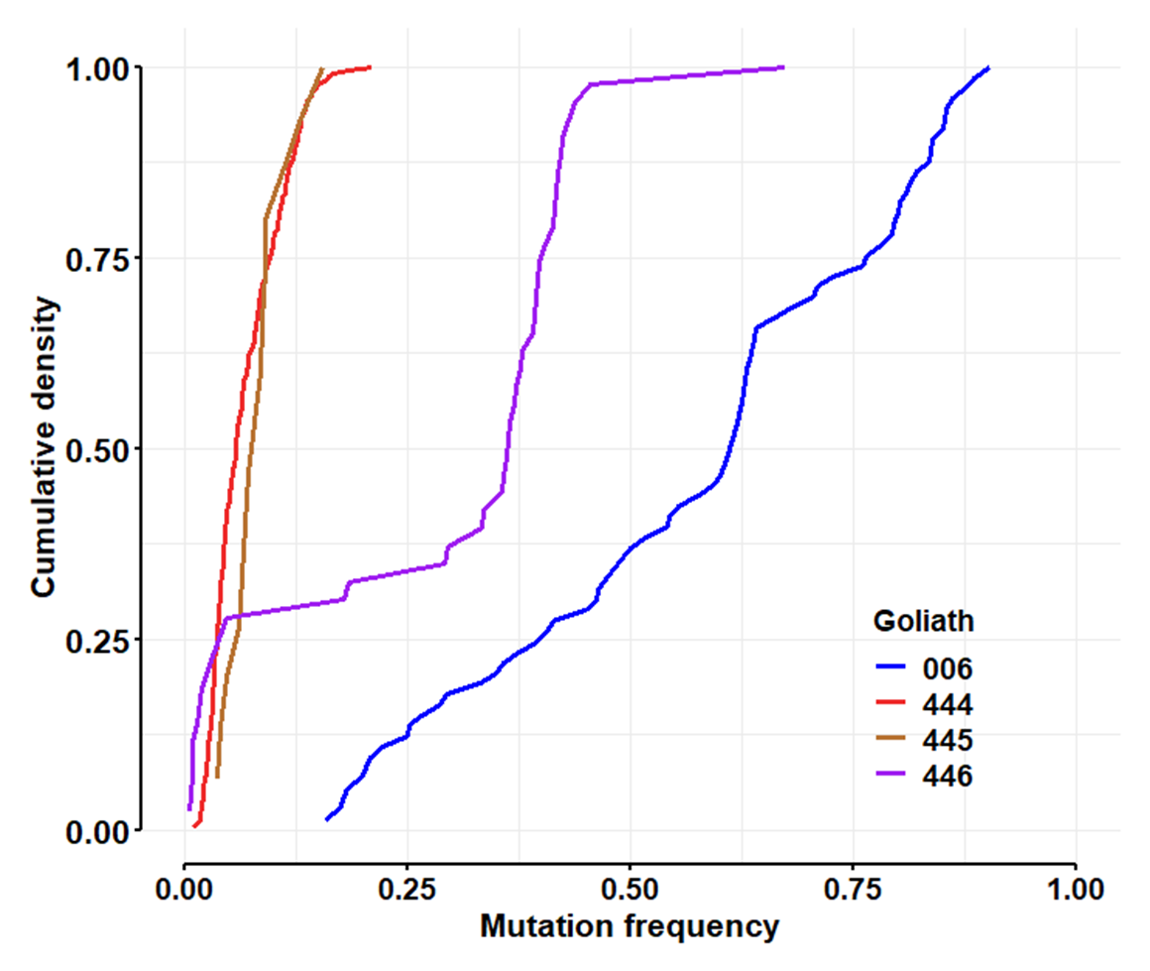

Slide 3
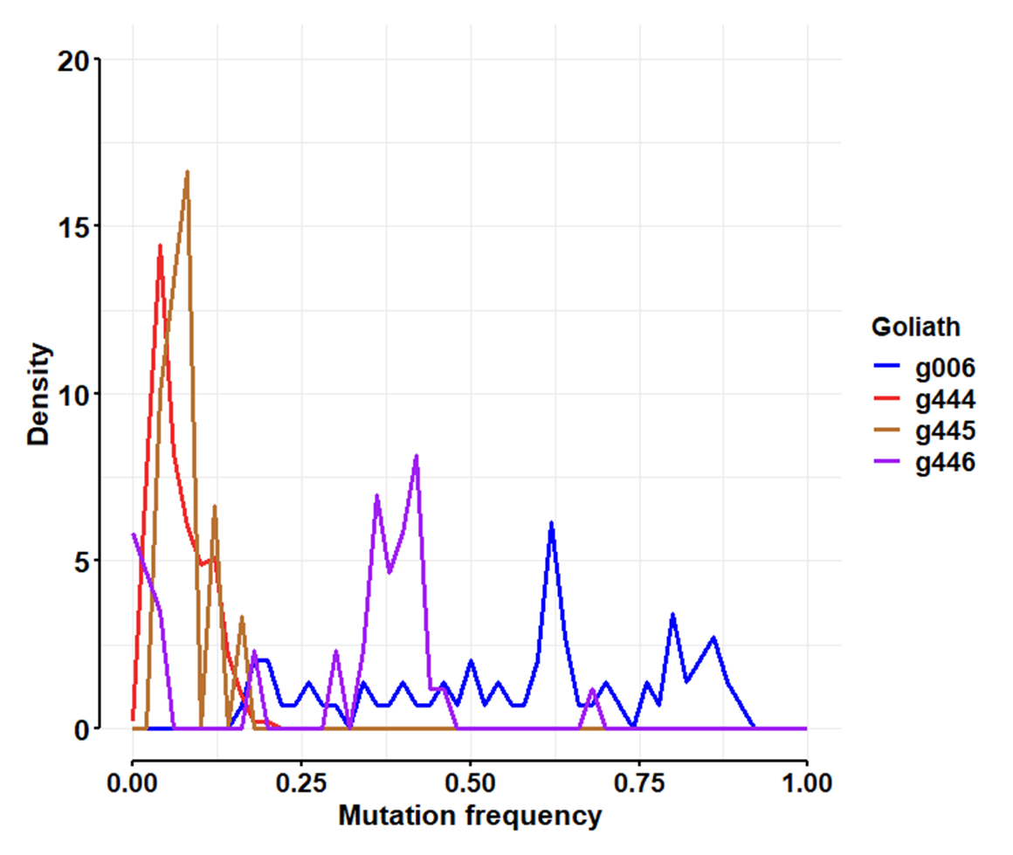

Slide 4
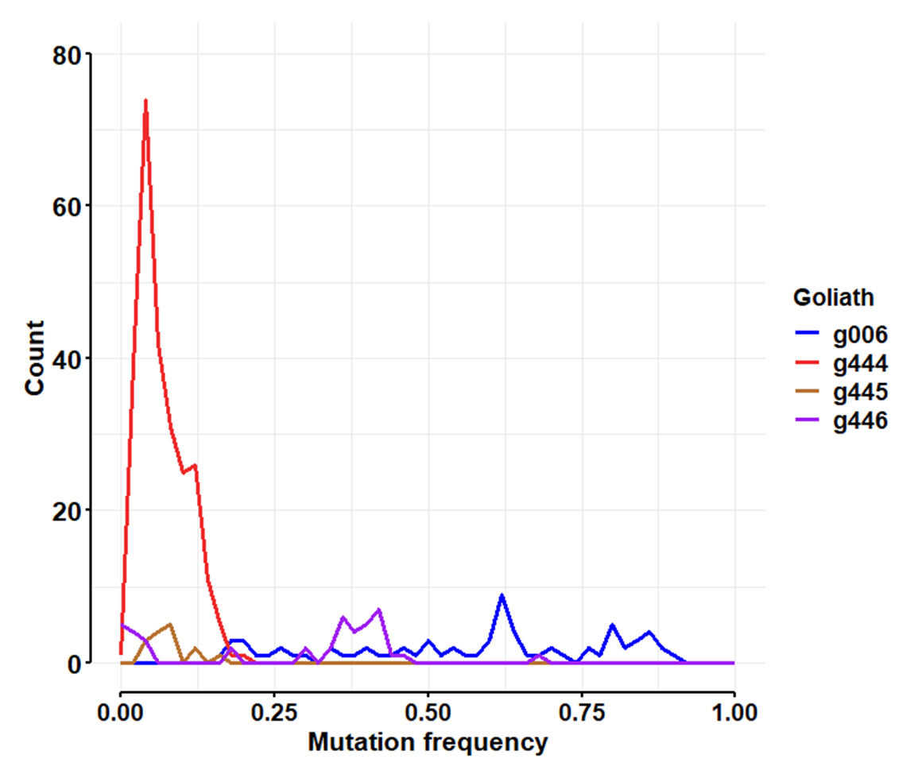

Slide 5
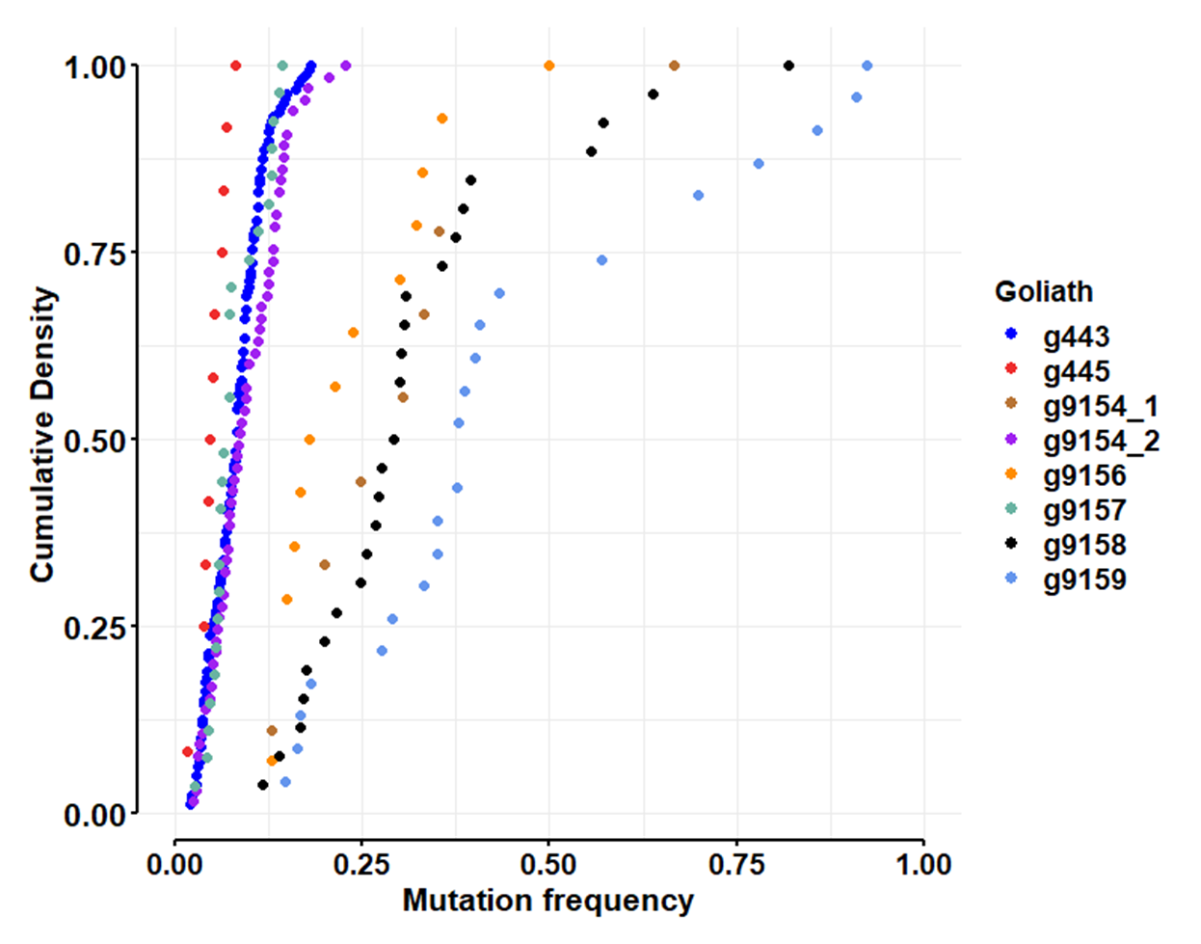
Use KS to test for differences among goliaths
g443 v g445, D = 0.53931, p-value = 0.001506; ad: 0.002
g443 v g9154_1, D = 0.91824, p-value = 4.211e-09; 4.483e-12
g443 v g9154_2 , D = 0.20987, p-value = 0.03435; 0.02672
g443 v g9156, D = 0.92453, p-value = 1.341e-13; 1.282e-14
g443 v g9157, D = 0.27603, p-value = 0.04743; 0.1980
g443 v g9158, D = 0.89865, p-value = 6.661e-16; 6.273e-24
g443 v g9159, D = 0.94969, p-value = 4.441e-16; 7.594e-23
g445 v g9154_1, D = 1, p-value = 6.804e-06; 5.130e-05
g445 v g9154_2, D = 0.59359, p-value = 0.0007108; 0.0008137
g445 v g9156, D = 1, p-value = 2.071e-07; 4.377e-06
g445 v g9157, D = 0.51852, p-value = 0.01443; 0.007664
g445 v g9158, D = 1, p-value = 7.387e-10; 5.912e-08
g445 v g9159, D = 1, p-value = 2.397e-09; 1.492e-07
g9154_1 v g9154_2, D = 0.85812, p-value = 9.254e-07; 7.38e-08
g9154_1 v g9156, D = 0.38889, p-value = 0.2798; 0.2475
g9154_1 v g9157, D = 0.88889, p-value = 5.184e-06; 2.660e-06
g9154_1 v g9158, D = 0.18376, p-value = 0.936; 0.9158
g9154_1 v g9159, D = 0.42995, p-value = 0.1358; 0.1243
g9154_2 v g9156, D = 0.82088, p-value = 1.414e-08; 4.094e-09
g9154_2 v g9157, D = 0.3037, p-value = 0.04586; 0.09762
g9154_2 v g9158, D = 0.86154, p-value = 7.55e-15; 1.760e-15
g9154_2 v g9159, D = 0.89498, p-value = 3.553e-15; 1.486e-15
g9156 v g9157, D = 0.92857, p-value = 2.327e-09; 2.573e-08
g9156 v g9158, D = 0.37363, p-value = 0.1182; 0.08300
g9156 v g9159, D = 0.59627, p-value = 0.00215; 0.001886
g9157 v g9158, D = 0.92308, p-value = 2.831e-12; 2.571e-11
g9157 v g9159, D = 1, p-value = 1.821e-14; 3.592e-11
g9158 v g9159, D = 0.43144, p-value = 0.0142; 0.02476
Note: we did a total of 28 pairwise tests, so we should accept significance only below 0.05/28 = 0.00179

Slide 6
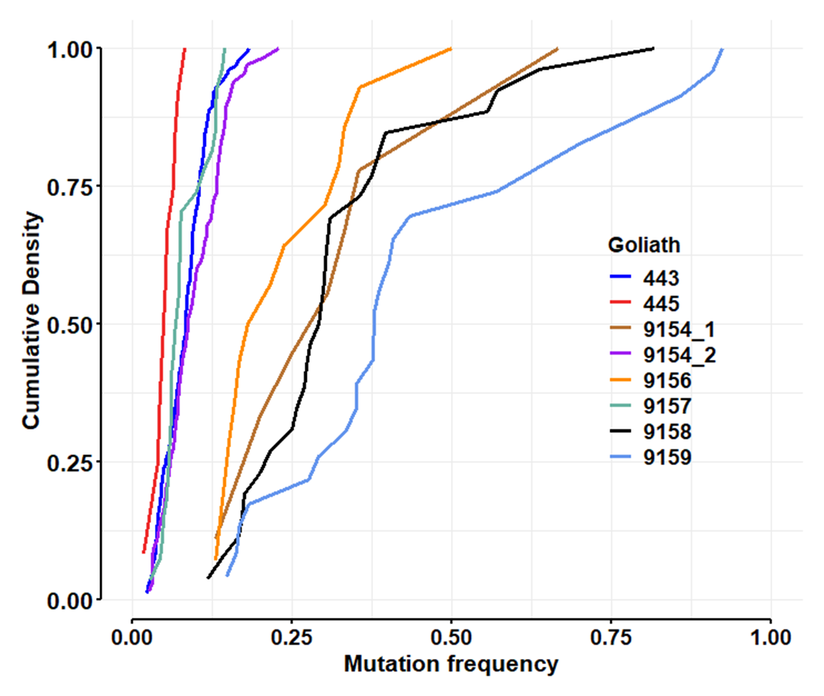

Slide 7
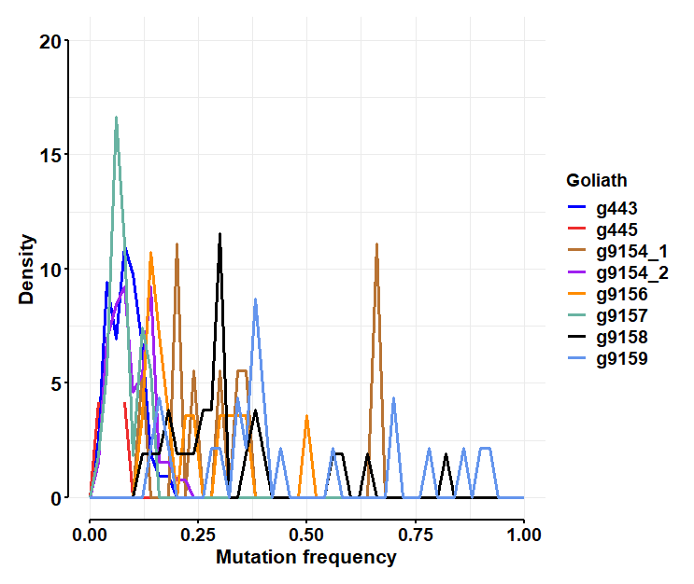

Slide 8
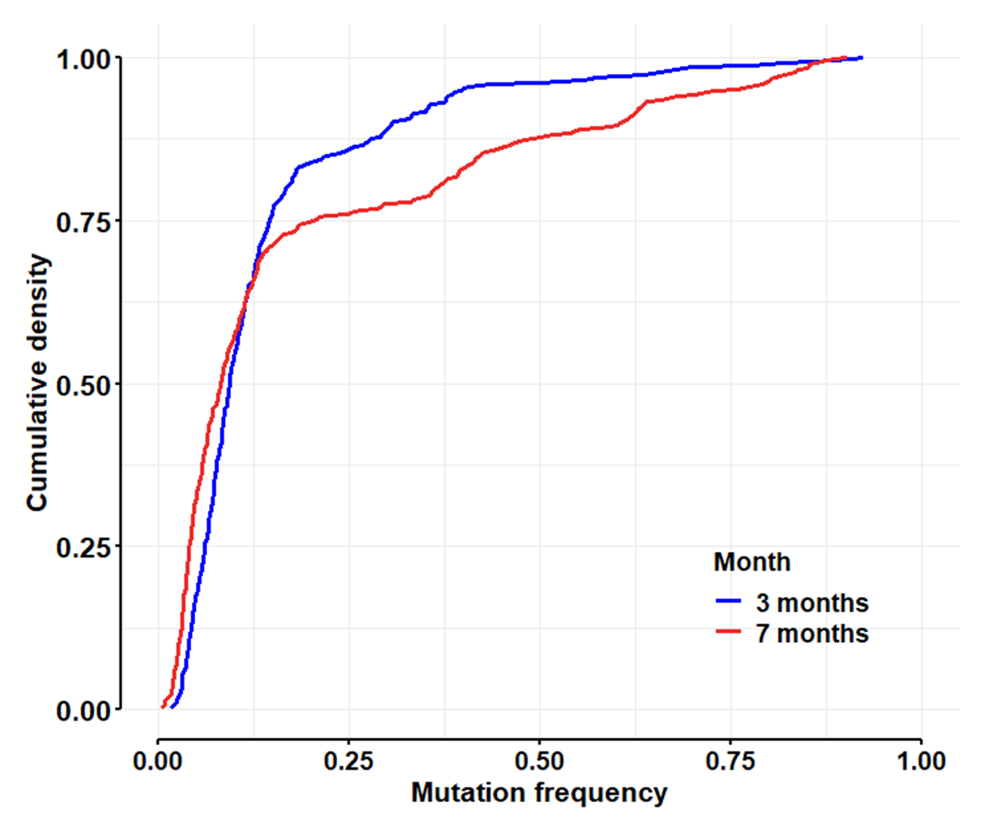
Two-sample Kolmogorov-Smirnov test
D = 0.16073, p-value = 0.0001869
alternative hypothesis: two-sided
Anderson-Darling k-sample test.
Number of samples: 2
Sample sizes: 335, 387
AD T.AD asympt. P-value sim. P-value
11.99 14.47 7.999e-07 0

Slide 9
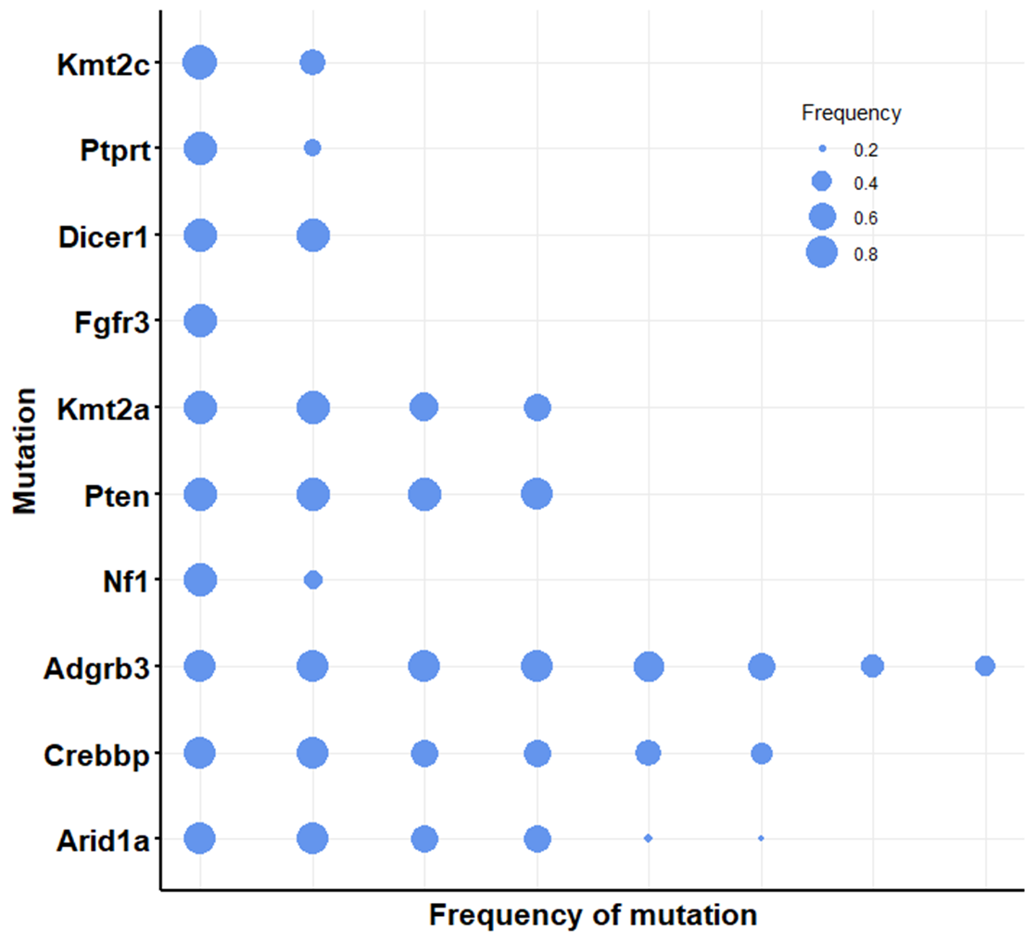
Goliath 006

Slide 10
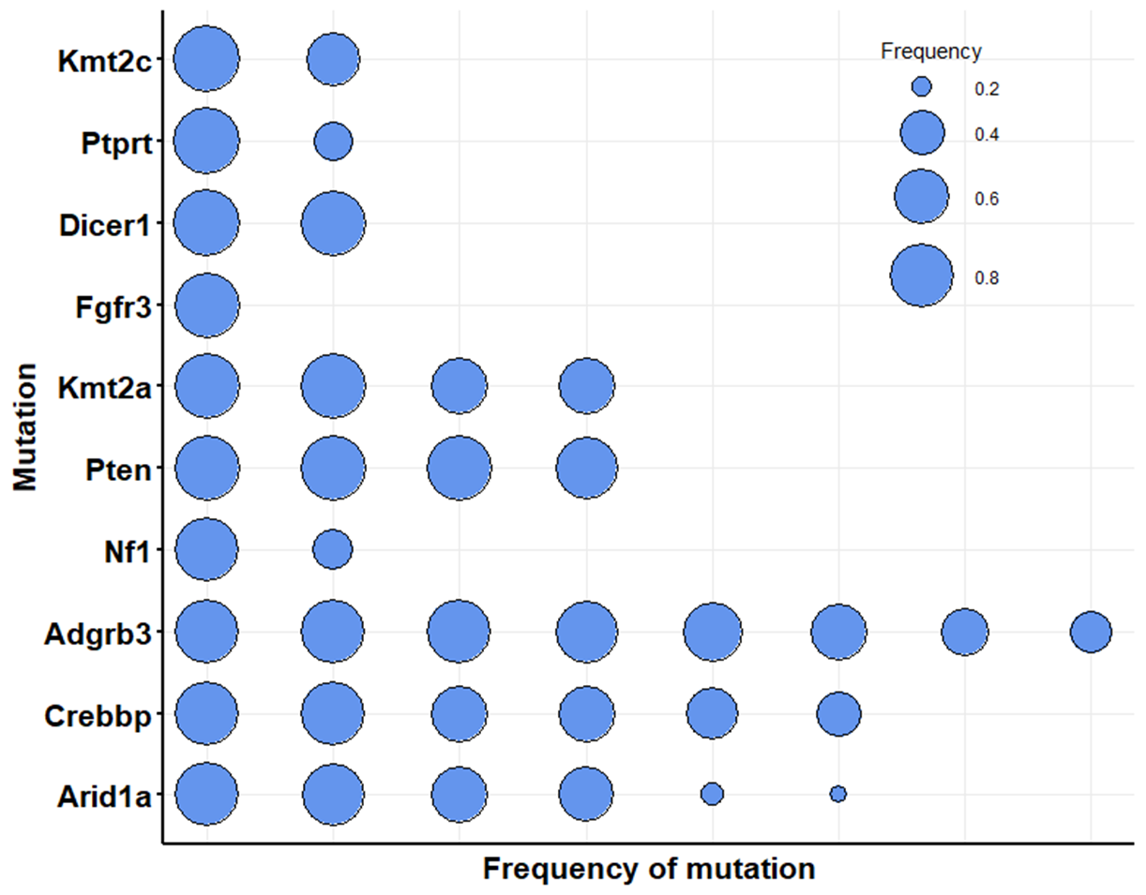
Goliath 006

Slide 11
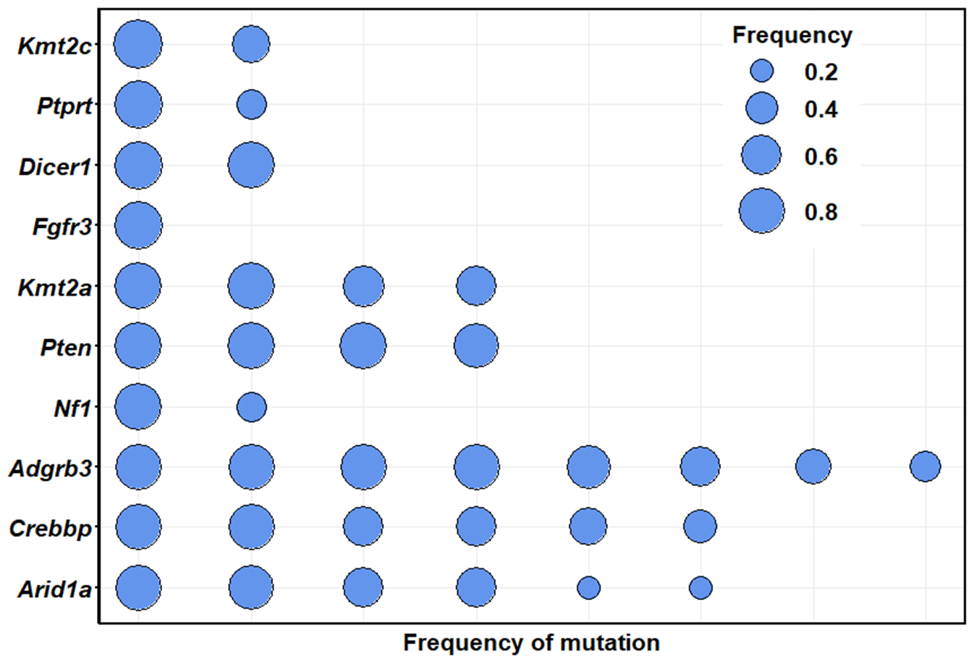
Goliath 006

Slide 12
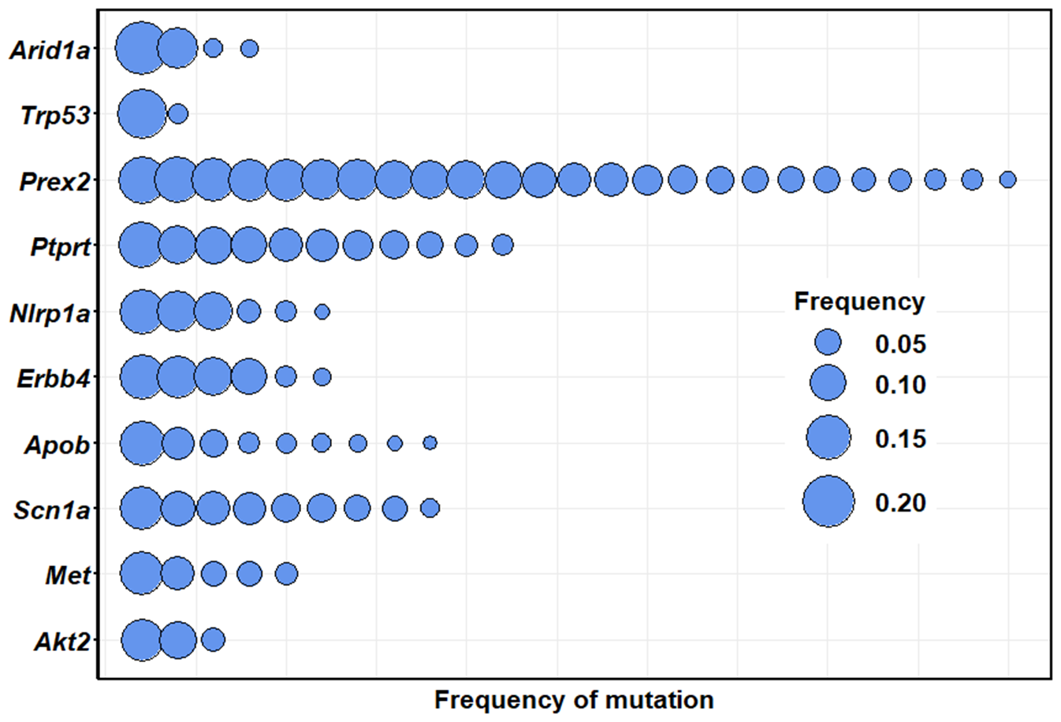
Goliath 444

Slide 13
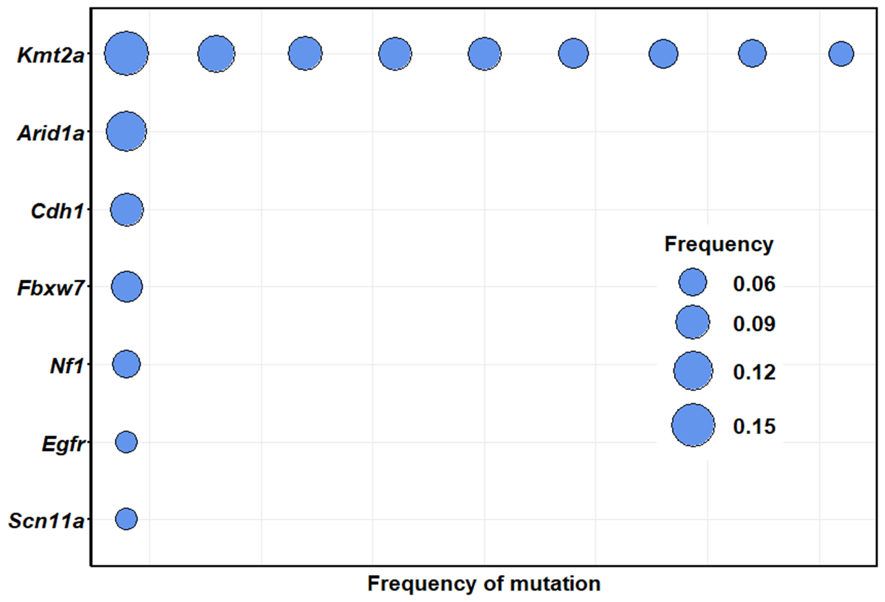
Goliath 445

Slide 14
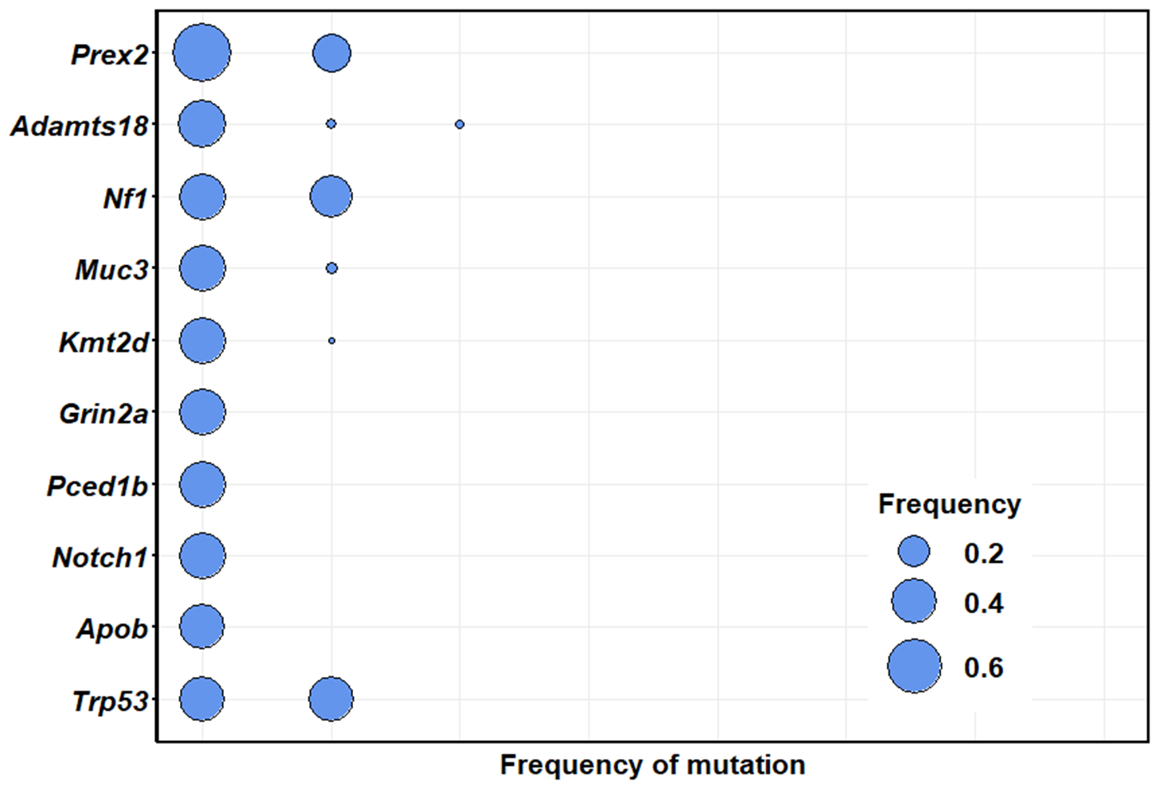
Goliath 446

