Slide 1
嵌入式影像處理

Slide 2
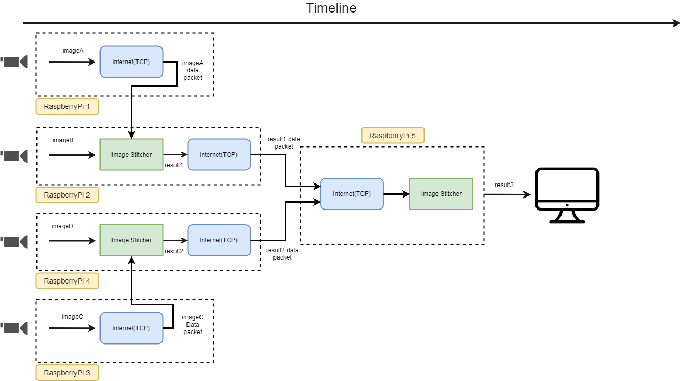
主要架構
detail
detail
detail
detail

Slide 3
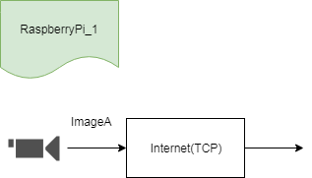
RaspberryPi_1
Class
返回
code
Input:
Cap_1: OpenCV image type BGRA array of u8
Output:
result: OpenCV image type BGRA array(W’*400*4) of u8, W’ = W*(400/H)
Parameter
IP: Self_IP

Slide 4
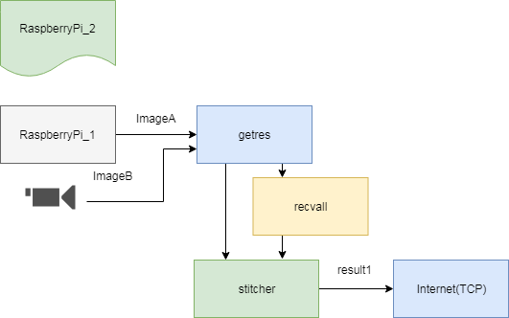
RaspberryPi_2
返回
class
code
code
code
code

Slide 5
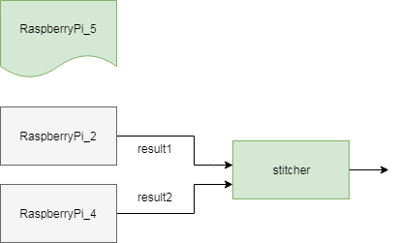
RaspberryPi_5
返回
Class
Input:
result: OpenCV image type BGRA array of u8
Output:
result: OpenCV image type BGRA array(W’*400*4) of u8, W’ = W*(400/H)
Parameter
socket server IP (previous level's RaspberryPi)
code

Slide 6
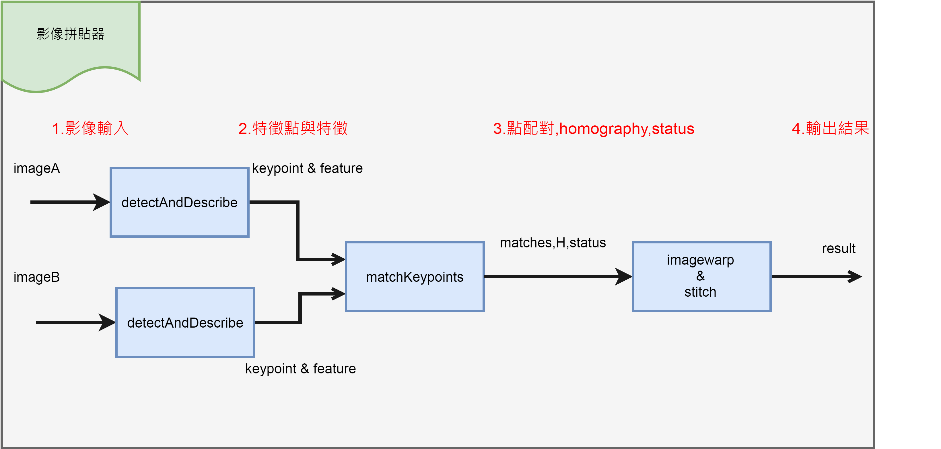
影像拼貼器架構
返回
class
code
code
code
code
code

Slide 7
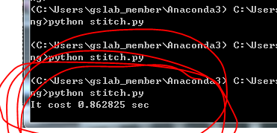
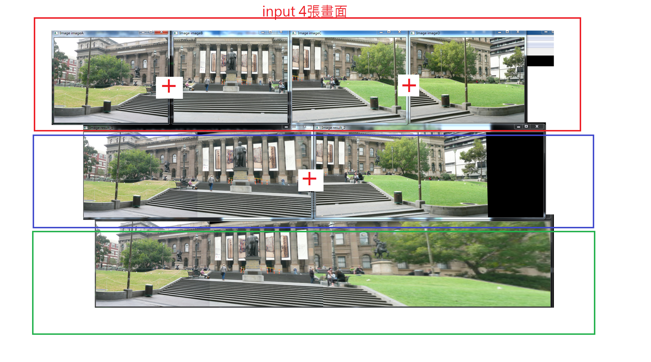
貼圖功能測試(PC)

Slide 8
Internet(TCP)
返回
Input:
imageA: OpenCV image type BGRA array(W’*400*4) of u8, W’ = W*(400/H)
Output:
result: OpenCV image type BGRA array(W’*400*4) of u8, W’ = W*(400/H)
Parameter
IP: socket server IP (previous level's RaspberryPi)
IP: Self_IP
Buffer: temporary store the image array.
method
1.Recvdall: receive data from Socket.
2.getres: open image from the upper level socket, get image from camera, finish stitching.
3.Sendres: send the stitched to the next level.

Slide 9
拼貼
返回
Inputs
imageA, imageB: OpenCV image type BGRA array(W*H*4) of u8
outputs
result: OpenCV image type BGRA array(W’*400*4) of u8, W’ = W*(400/H)
Parameters
Match配對參數: 0.6 SIFT特徵相似度
Methods
特徵擷取器(detectAndDescribe): 擷取兩張輸入影像的SIFT特徵。
特徵配對器(matchKeypoints): 將兩張影像的SIFT特徵進行配對(0.6如何用?)。
影像形變以及貼合器(imageWarp&stitch): 找出homogarphy後，並用affine Transfom形變，
最後直接對齊矩陣作標與貼合。

Slide 10
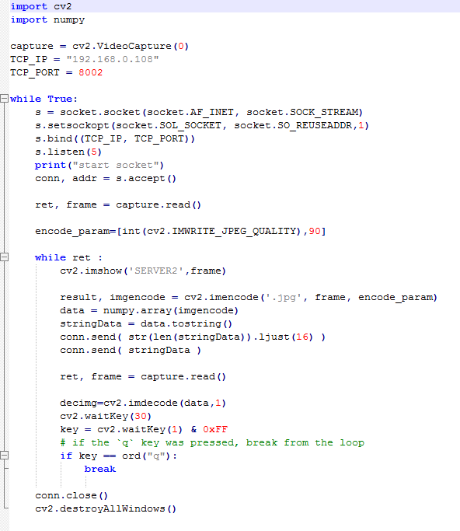
rsp13
返回
html

Slide 11
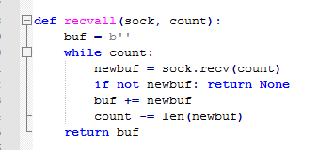
recvall
返回
html

Slide 12
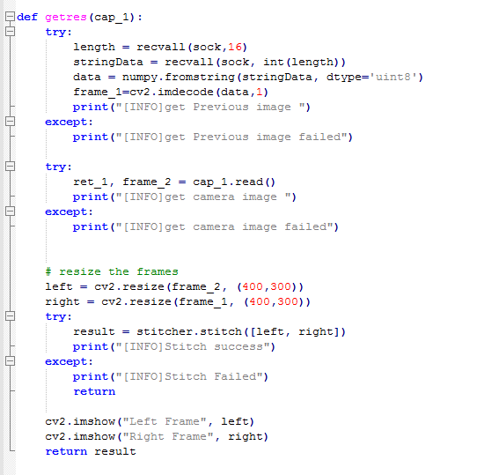
getres
返回
html

Slide 13
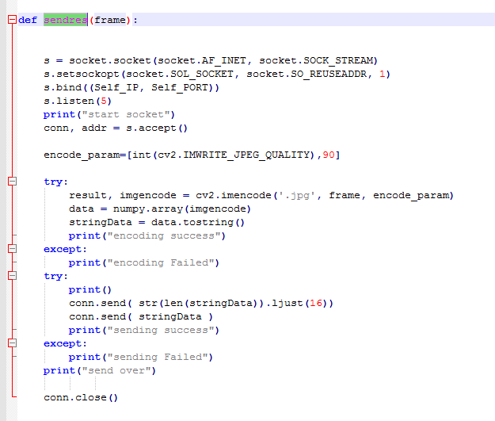
sendres
返回
html

Slide 14
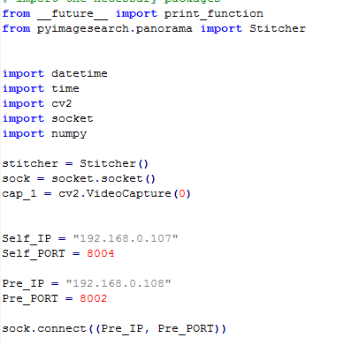
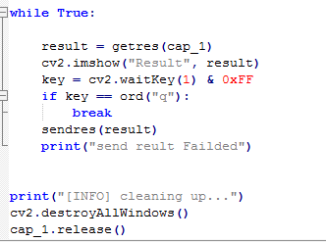
rsp24
返回
html

Slide 15
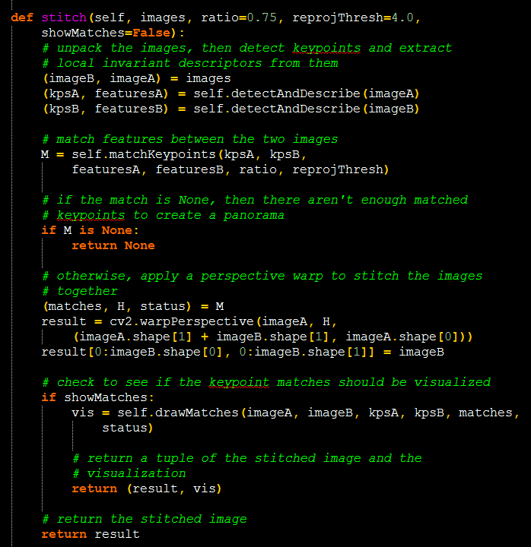
stitch
返回
html

Slide 16
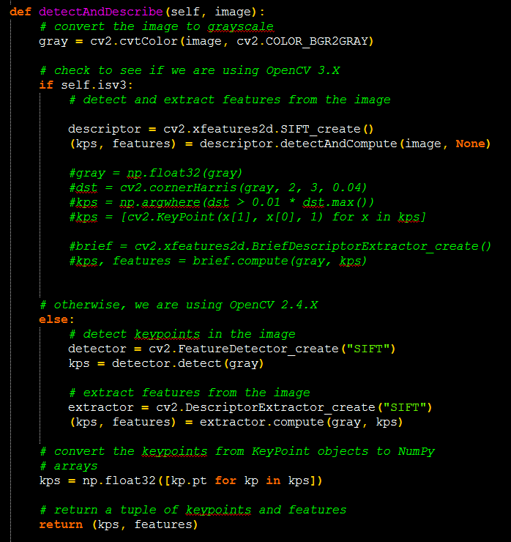
detectAndDescribe
返回
html

Slide 17
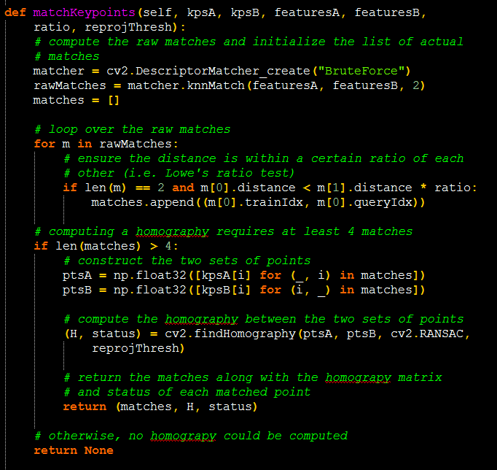
matchKeypoints
返回
html

Slide 18
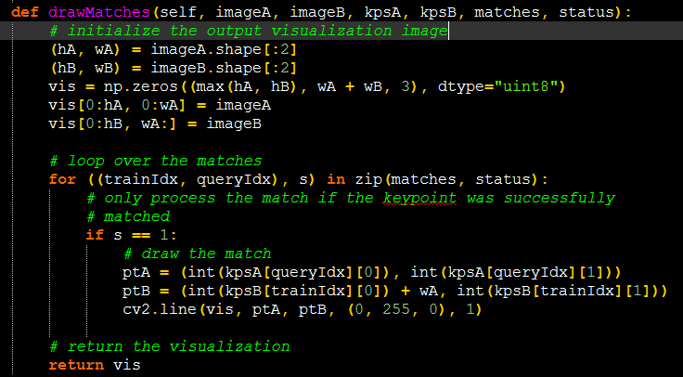
Imagewarp & stitch
返回
html

Slide 19
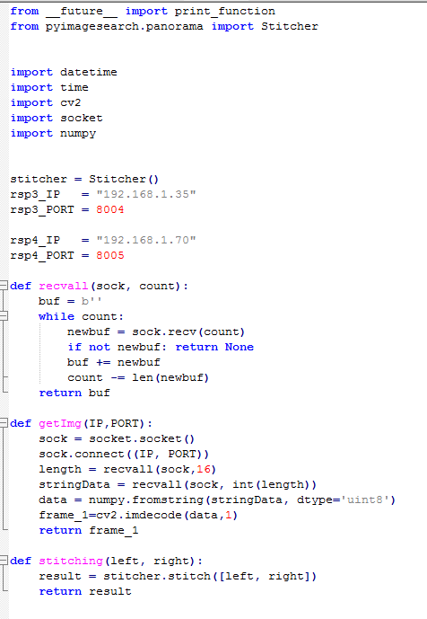
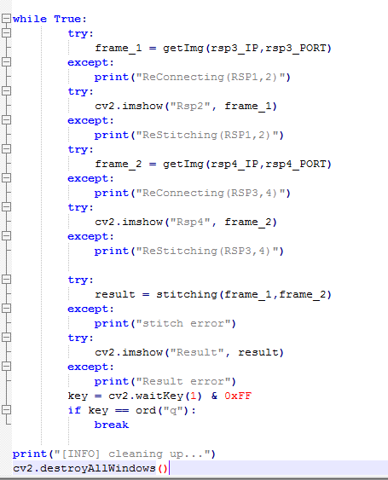
rsp5
返回
html

Slide 20
issue
如何評估效能
速度
畫面結果的好壞如何評估(細縫,亮度,數值)

