Slide 1





www.reallygreatsite.com
SYSTEM ADMINISTRATION AND MAINTENANCE

Slide 2


What is System Administration and Maintenance?
Managing and maintaining computer systems and networks to ensure they run efficiently and effectively.

Slide 3
Importance of System Administration and Maintenance
Ensures IT infrastructure is secure, efficient, and available
Supports smooth digital communication and business processes
Optimizes system performance for increased productivity
Enforces security policies to protect sensitive data
Manages resources effectively to reduce operational costs
Provides technical support to maintain business continuity

Slide 4
www.reallygreatsite.com
What Does System Administrator Do?

Slide 5
www.reallygreatsite.com
Profession of System Administration

Slide 6
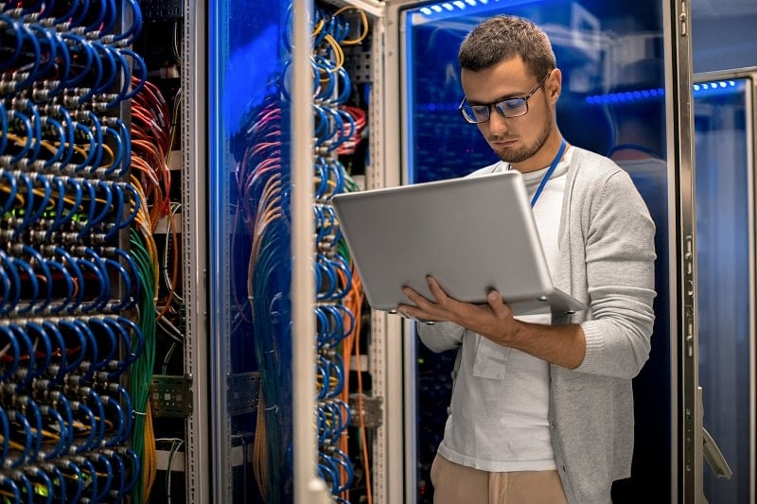
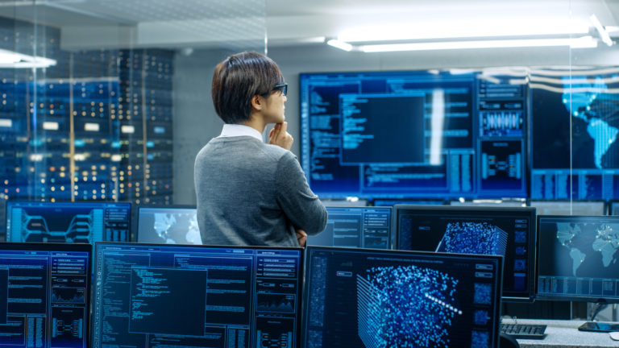
Profession of System Administration

Slide 7

System Set Up and Configuration
Install, update, and maintain operating systems across all devices.

Slide 8
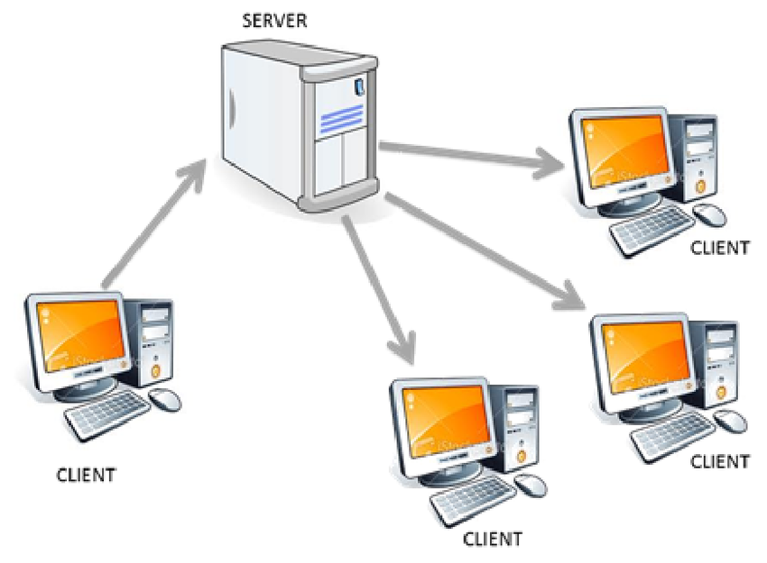
System Set Up and Configuration
  Setting up servers, workstations, and peripheral devices.

Slide 9

Perform Daily Back Up and Restores
Schedule and manage regular backups to prevent data loss.

Slide 10
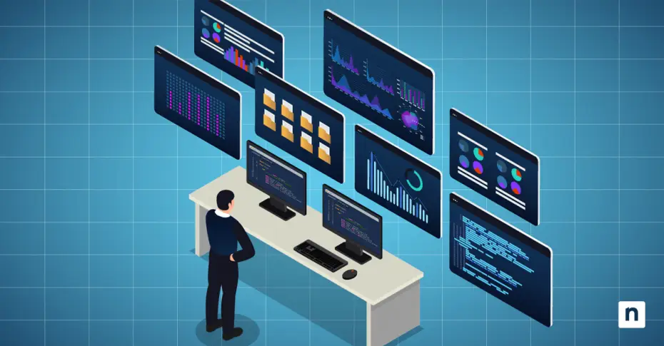
Monitor System Performance
Regularly check system logs, CPU usage, memory usage, and network performance to ensure optimal functioning.

Slide 11

User Administration
  Manage user accounts, permissions, and access rights to ensure appropriate access to resources.

Slide 12
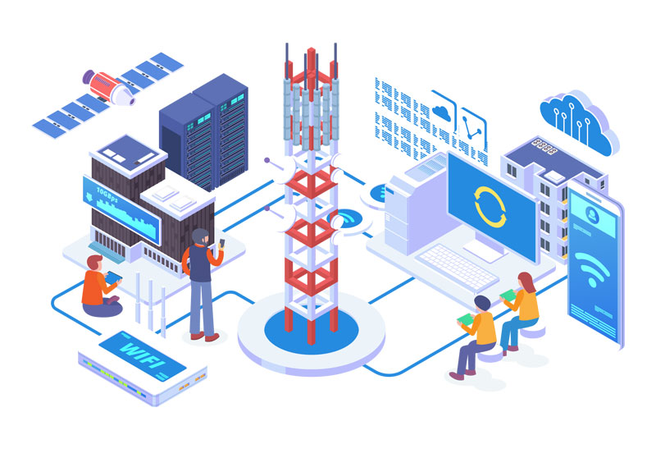
NETWORK MANAGEMENT
Configuring routers, switches and firewall, monitoring network performance and connectivity, troubleshooting network outrages or slowdowns

Slide 13
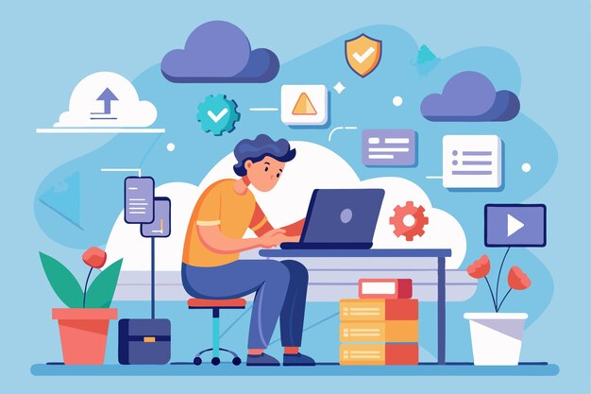
Troubleshooting and Problem Resolution
  Diagnosing and fixing software, hardware and network issues

Slide 14
Troubleshooting and Problem Resolution
  Using system logs , monitoring tools and diagnostic commands

Slide 15
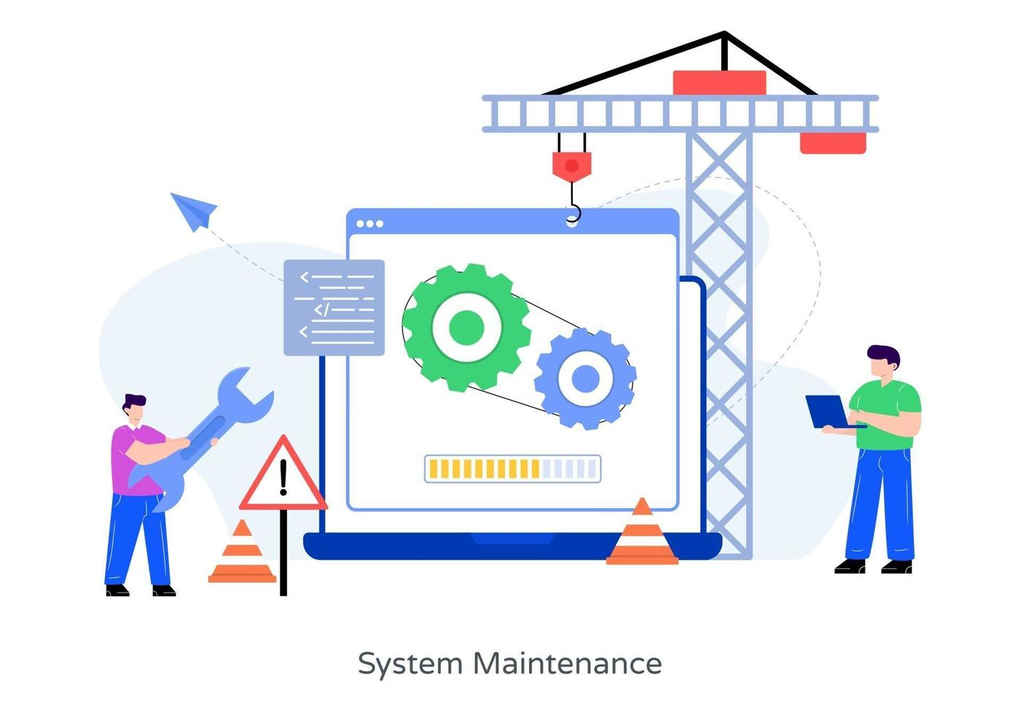
Troubleshooting and Problem Resolution
  Minimizing downtime through quick response

Slide 16
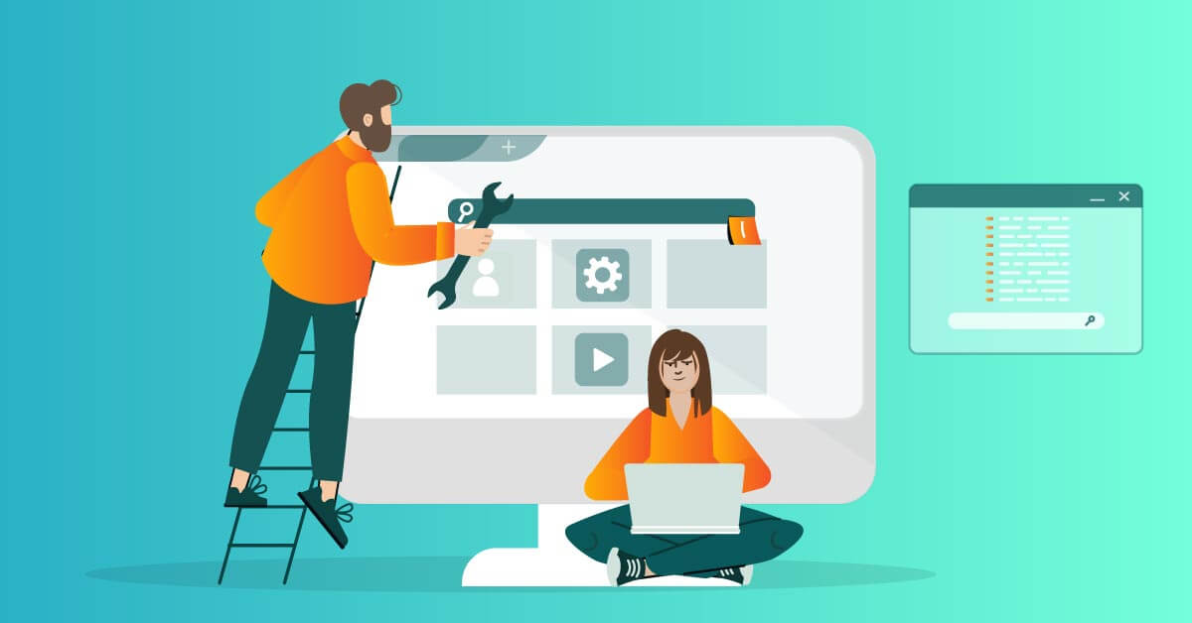
Documentation
  Creating and Maintaining clear documentation of system configurations, procedures and troubleshooting steps

Slide 17
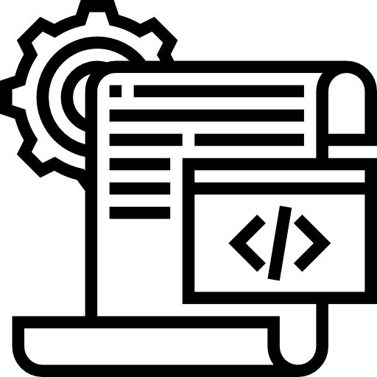
Automation and Optimization
  Using scripts and tools to automate repetitive tasks

Slide 18
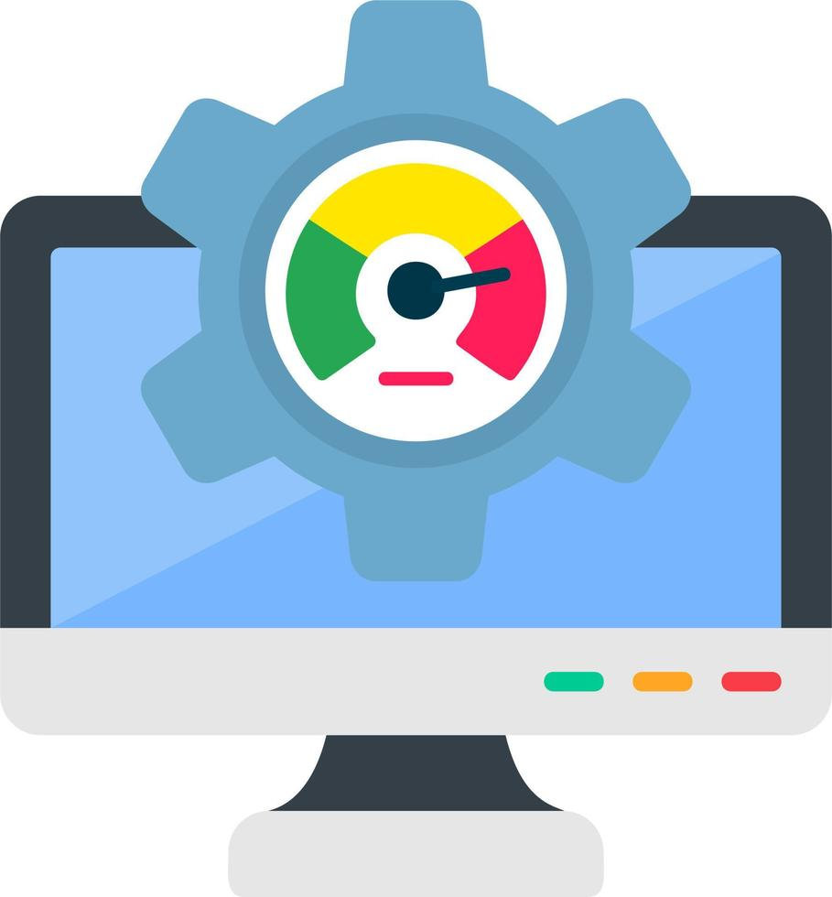
Automation and Optimization
  Optimizing system performance through resource management.

Slide 19

Communication and Collaboration
  Coordinating with other IT staff, departments

Slide 20
Communication and Collaboration
  Explain clearly technical issues to non-technical user

Slide 21
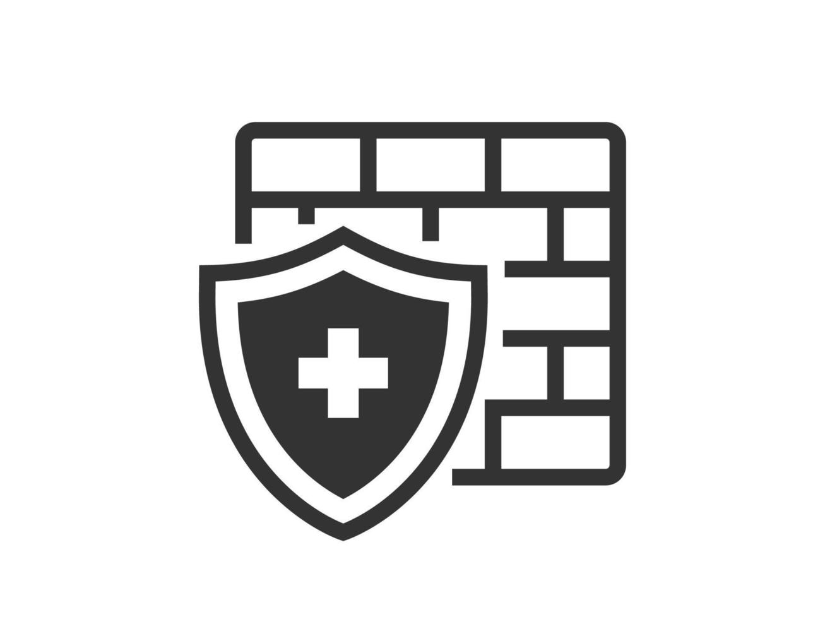
Security and Data Protection
  Installing and maintaining antivirus and firewall systems

Slide 22
Security and Data Protection
  Applying security patches and updates promptly

Slide 23
Essential Skills for System Administration

Slide 24

Technical Skills
  Knowing how to install, configure and troubleshoot Windows Server, Linux, or macOS systems.

Slide 25
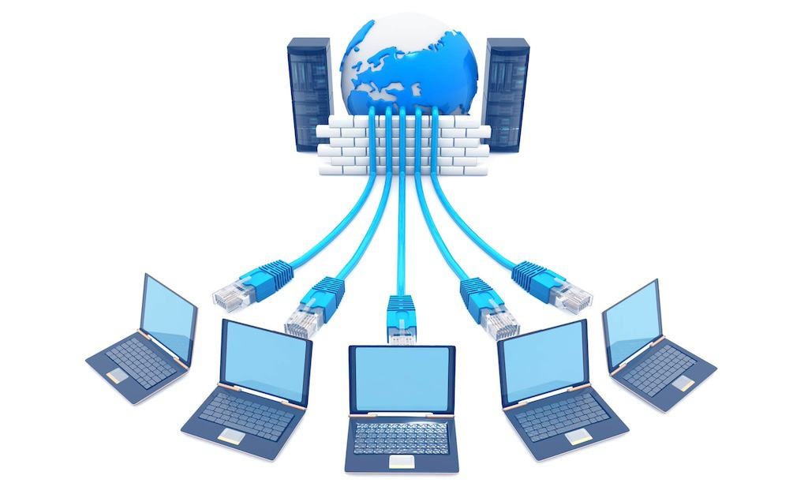
Network Systems
  Understanding IP addresses, DNS, DHCP, VPNs, and network troubleshooting.

Slide 26
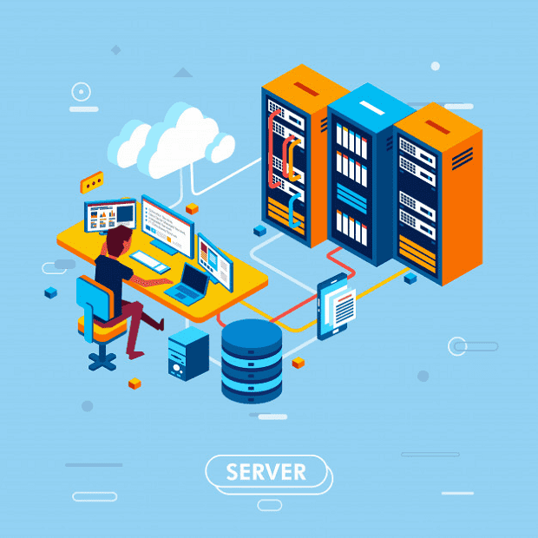
Server Management
  Managing physical and virtual servers, web servers and file servers

Slide 27

Back Up and Disaster Recovery
  Planning and implementing data backup systems to prevent loss.

Slide 28
Scripting and Coding
  Using scripts (Bash, PowerShell, Python) to automate repetitive tasks.

Slide 29
www.reallygreatsite.com
Real Life Scenario of System Administrator

Slide 30
Scenario 1
Server Crash During Office Hours
Scenario:
  It’s Monday morning, and the company’s main file server suddenly goes down. Employees can’t access shared documents, and the system.

Slide 31
Scenario 1
SysAdmin Role:
  Diagnose the cause (hardware failure, power outage, corrupted OS).
  Restore the system from backups.
  Communicate updates to staff while minimizing downtime.

Slide 32
Scenario 2
Phishing Attack Detected
Scenario:
Several employees report suspicious emails asking for login credentials

Slide 33
Scenario 2
SysAdmin Role:
Alert all employees about the phishing attempt
Block the sender's email address and domain
Scan affected systems for malware
Reset passwords for potentially compromised accounts
Conduct a company-wide security awareness training

Slide 34
Scenario 3
Sudden Network Slowdown
Scenario:
Users complain that internet access and internal apps are extremely slow.

Slide 35
Scenario 3
SysAdmin Role:
  Monitor network traffic to identify bandwidth hogs (e.g., large file downloads, streaming).
  Throttle non-essential traffic or block suspicious IPs.
  Optimize network routing or replace faulty switches.

Slide 36
Scenario 4
Employee Onboarding & Offboarding
Scenario:
A new employee joins, and another resigns.

Slide 37
Scenario 4
SysAdmin Role:
  Set up user accounts, email, and permissions for the new hire.
  Securely remove departing employee’s access to systems.
  Transfer important files and archive data.

Slide 38
Scenario 5
The Software Rollout
Scenario:
Your company is upgrading to a new operating system across all departments

Slide 39
Scenario 5
SysAdmin Role:
Create a detailed rollout plan with timeline and milestones
Test the new OS in a controlled environment
Develop a comprehensive training program for employees
Establish a dedicated support team for the transition
Implement a phased rollout to minimize disruption

Slide 40
Scenario 6
The Natural Disaster
Scenario:
A Typhoon is approaching. You have 24 hours to prepare IT systems.

Slide 41
Scenario 6
SysAdmin Role:
Verify and test offsite backups
Ensure remote access systems are functional
Secure physical hardware and infrastructure
Update and distribute emergency contact information

Slide 42
www.reallygreatsite.com
Three Pillars of System Designs

Slide 43
Scalability
Scalability is the ability of a system to handle more users, data, or traffic as demand grows by adding resources without requiring a major redesign.

Slide 44
Reliability
The system should perform its intended function consistently and correctly, even in the face of failures, unexpected inputs, or changing conditions.

Slide 45
Maintainability
The system should be easy to understand, modify, and extend over time, minimizing technical debt.
How easy it is to update, fix, or improve the system over time.

Slide 46
www.reallygreatsite.com
Challenges in System Administration

Slide 47
Keeping Up with Rapidly Evolving Technologies
System administrators must continuously learn and adapt to avoid outdated practices
Failure to stay updated can lead to vulnerabilities, inefficiencies, or missed opportunities for improvement.
  Effect
    If a system adminstrator can’t adapt, the organization might lose its competitive edge, run outdated systems, or suffer security risks from unpatched tools.

Slide 48
Balancing Security with User Accessibility
The stronger the security, the more steps users need to log in or access files.
Users often want convenience while system administrator is at risk
  Effect
    Poor balance can lead to data breaches (too little security) or frustrated employees (too much security), both of which harm the organization.

Slide 49
Dealing with Unexpected Outrages and Emergencies
Requires quick diagnosis and problem-solving under extreme time pressure.
Root cause is not always obvious
Data loss risks
  Effect
    If a company’s cloud-based file server suddenly goes offline due to a data center outage, employees can’t access important project files. This halts ongoing work, delays client deliverables, and may require the IT team to work overtime to restore access — damaging productivity and potentially breaching service contracts.

Slide 50
Communicating Technical Concepts to Non Technical Stakeholder
Complex topics must be explained simply without losing accuracy.
If explained poorly, decisions might be made without understanding risks.
  Effect
    If a sysadmin doesn’t clearly explain the need for regular backups, the company might skip them — until a hard drive fails and critical files are lost.
    If a sysadmin can’t make users understand the reason for strong passwords, employees might keep using “123456” — leading to an account being hacked.

Slide 51
www.reallygreatsite.com
Future of System Administration

Slide 52
Less Manual Work
System administrators will spend less time on repetitive manual tasks like installing software or plugging in cables. These jobs will be automated or handled by cloud services. This frees admins to focus on bigger responsibilities.
Example:
Instead of installing Microsoft Office on 100 computers one by one, an admin uses a single automated tool to install it on all devices at once.

Slide 53
More Strategic Role
Admins will take on a more strategic job, focusing on automation, cybersecurity, and cloud management. They will plan how technology supports the organization’s goals instead of just fixing problems. This makes them decision-makers in IT.
Example:
An admin sets up a cloud system so employees can work from anywhere, helping the company grow faster.

Slide 54
Becoming System Architect
Admins will act like architects, designing systems that are reliable, secure, and scalable. Their role is to ensure that IT can handle growth and adapt to new needs. They’ll think long-term instead of just fixing short-term issues.
Example:
An admin designs a school’s computer system so it can handle more students joining online classes in the future.

Slide 55
Experts in Modern IT
The future sysadmin will be an expert in cloud computing, automation, security, and system design. They won’t just “fix servers” but will make sure the whole system is safe, efficient, and ready to grow. This makes them key players in an organization’s success.
Example:
An admin secures hospital data in the cloud, ensuring it is safe from hackers while still being accessible to doctors anytime.

Slide 56


THANK YOU!
www.reallygreatsite.com

