Slide 1

Machine Learning
RUSBoost

Slide 2
How to remedy it?
Why do need multiple complex algorithms?
It is common to have largely skewed training data
In our case, the fraud firms are unevenly represented.
Model constructed with the goal of detecting a can achieve a correct classification rate of 99% by classifying all firms as being non-fraud
Data Resampling
Oversampling: adding examples to the minority class
Undersampling: removing examples from the majority class
Boosting (ensemble learning)
Adaptive Boosting (Adaboosting)
Initial learners can be weak, but subsequent ones can be tweaked in favor for those wrongly identified observations
Combine the result of multiple “weak learners” based on weight
Notes:
Why not just doing a regression, draw a tree diagram, etc.
Tell subsequent models the information from previously weak learners

Slide 3
RUSBoost: A Hybrid Approach to Alleviate Class Imbalance
Combines both data sampling and boosting techniques, providing a simple and efficient method for improving classification performance when training data is imbalanced.
Comparing to its brother SMOTEBoost, or as being a variant of SMOTEBoost, RUSBoost is more cost effective and less time consuming.
RUSBoost applies Random Undersampling
RUSBoost reconciles undersampling’s problem by using boosting to offset the loss of information
Notes:
SMOTEBoost magnifies the drawbacks of oversampling

Slide 4
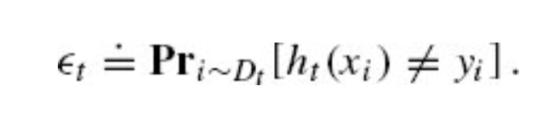

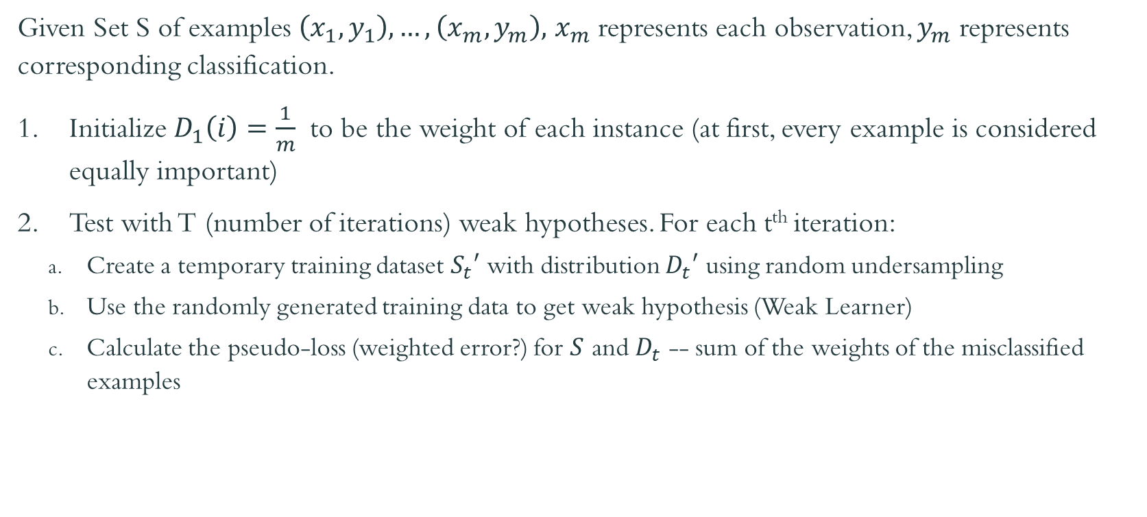
RUSBoost Steps
Given Set S of examples $\left(x_{1},y_{1}\right),…,\left(x_{m},y_{m}\right),$ $x_{m}$ represents each observation, $y_{m}$ represents corresponding classification.
Initialize $D_{1}\left(i\right)=\frac{1}{m}$ to be the weight of each instance (at first, every example is considered equally important)
Test with T (number of iterations) weak hypotheses. For each t^{th} iteration:
Create a temporary training dataset $S_{t}′$ with distribution $D_{t}′$ using random undersampling
Use the randomly generated training data to get weak hypothesis (Weak Learner)
Calculate the pseudo-loss (weighted error?) for $S$ and $D_{t}$ -- sum of the weights of the misclassified examples
Notes:
The weak learner attempts to choose a weak hypothesis h_{t} with low weighted error ∊; minimalize the weighted error
Predicted label to be −1 or +1
Predicted value or probability?
Say that the tth decision tree predicts h(x, 1) = 0.7, h(x, 0)= 0.3

Slide 5
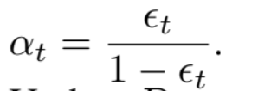
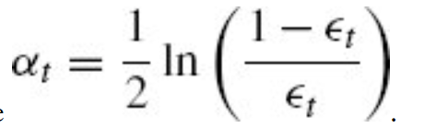
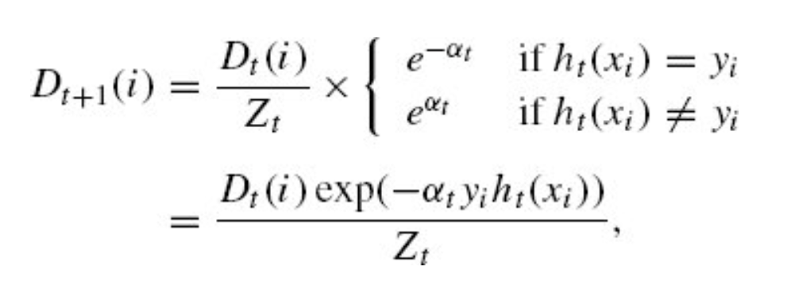
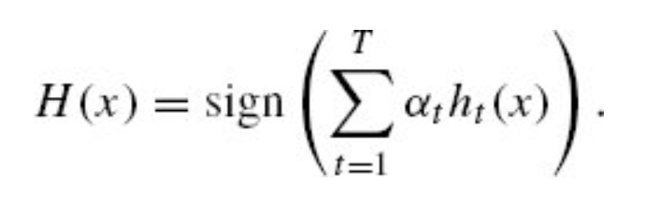
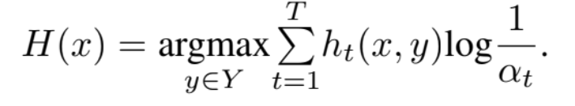
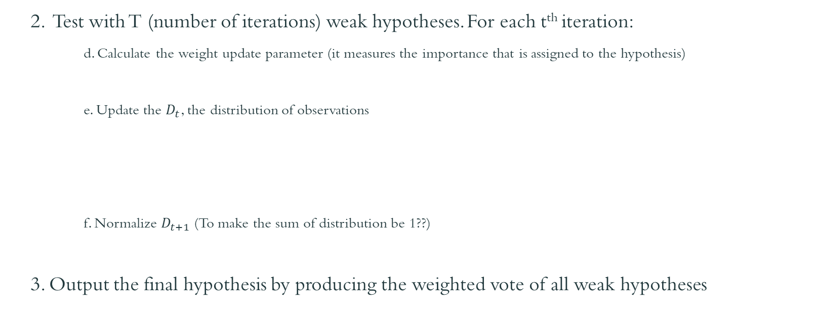
RUSBoost Steps (cont.)
2. Test with T (number of iterations) weak hypotheses. For each t^{th} iteration:
d. Calculate the weight update parameter (it measures the importance that is assigned to the hypothesis)
e. Update the $D_{t}$, the distribution of observations
f. Normalize $D_{t+1}$ (To make the sum of distribution be 1??)
3. Output the final hypothesis by producing the weighted vote of all weak hypotheses
(Given a new instance x, the final classifier evaluates all of the weak learners, and uses the weighted majority of the weak learners’ predicted classification to make a prediction)
Notes:
α_{t} > 0 if ∊_{t}, and that α_{t} gets larger as ∊_{t} gets smaller. Thus, the more accurate the base classifier h_{t}, the more importance we assign to it.

Slide 6
Questions
What is the data under sampling process in RUSBoost?
Difference between weak hypothesis and weak learner
Mathematical notations
Notes:
Simply removes majority class examples (randomly) from the training data.

