Slide 1


FrontEnd Web Development- Assignment 1
LaBamBa: Movie Recommender and Reviews
Chan Jia Yi (P7337992)
Date: 26 June 2022
Github: https://github.com/cjy93/MovieRecommender_FullStack

Slide 2



Agenda
Topic one
Topic two
Topic three
Topic four
Topic five

Slide 3




Introduction
With PowerPoint, you can create presentations and share your work with others, wherever they are. Type the text you want here to get started. You can also add images, art, and videos on this template. Save to OneDrive and access your presentations from your computer, tablet, or phone.

Slide 4

Topic one
Subtitle

Slide 7
Contact.html
Form submission

Slide 8
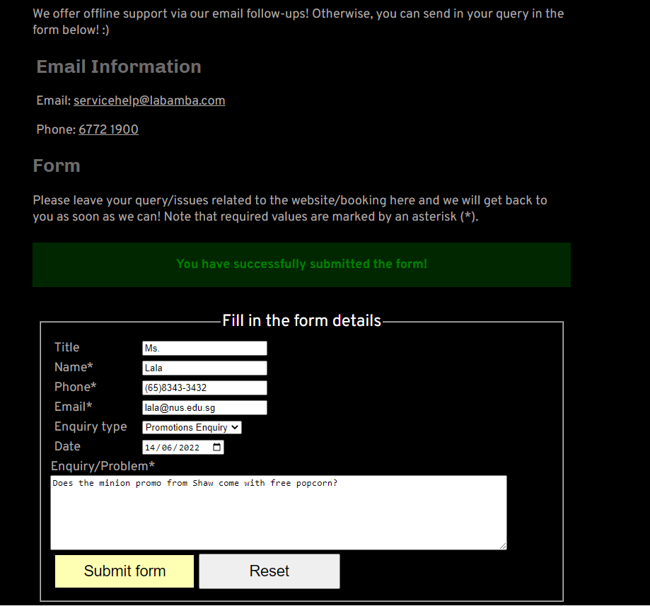
Successful submission will lead to a green success message
User can click on “Reset” to clear page before next submission

Slide 9
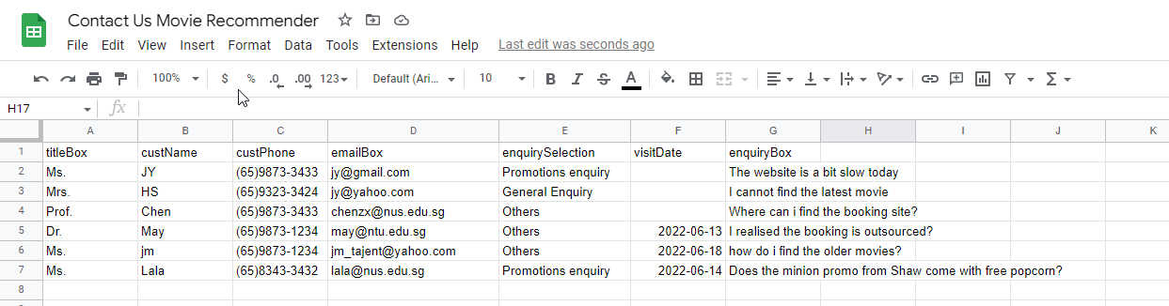
Data is saved directly to my Google sheets, based on address at scriptURL const
And other set up steps from: https://www.youtube.com/watch?v=s9XZui6zRPw

Slide 10

Summary
With PowerPoint, you can create presentations and share your work with others, wherever they are. Type the text you want here to get started. You can also add images, art, and videos on this template. Save to OneDrive and access your presentations from your computer, tablet, or phone.

Slide 11


Thank You
Presenter name
Email address
Website address

