Slide 1

IMDB Movie Recommendations Chatbot Assistant
Chan Jia Yi (P7337992)
14 Feb 2022

Slide 2
Motivation
Basic technical requirements : “hello”, “good morning”, “who are you” and “thank you”.
Others:
Recommend Movie titles based on a plot we write
Find all the top 250 movies in IMDB
Given a movie title, show the IMDB website and display the poster image
Slots to allow for choosing movies based on “Language”,“Genre” and “Date” for date after.
Given a movie title, recommend other similar movies from the top 250 movies (Clustering)

Slide 3
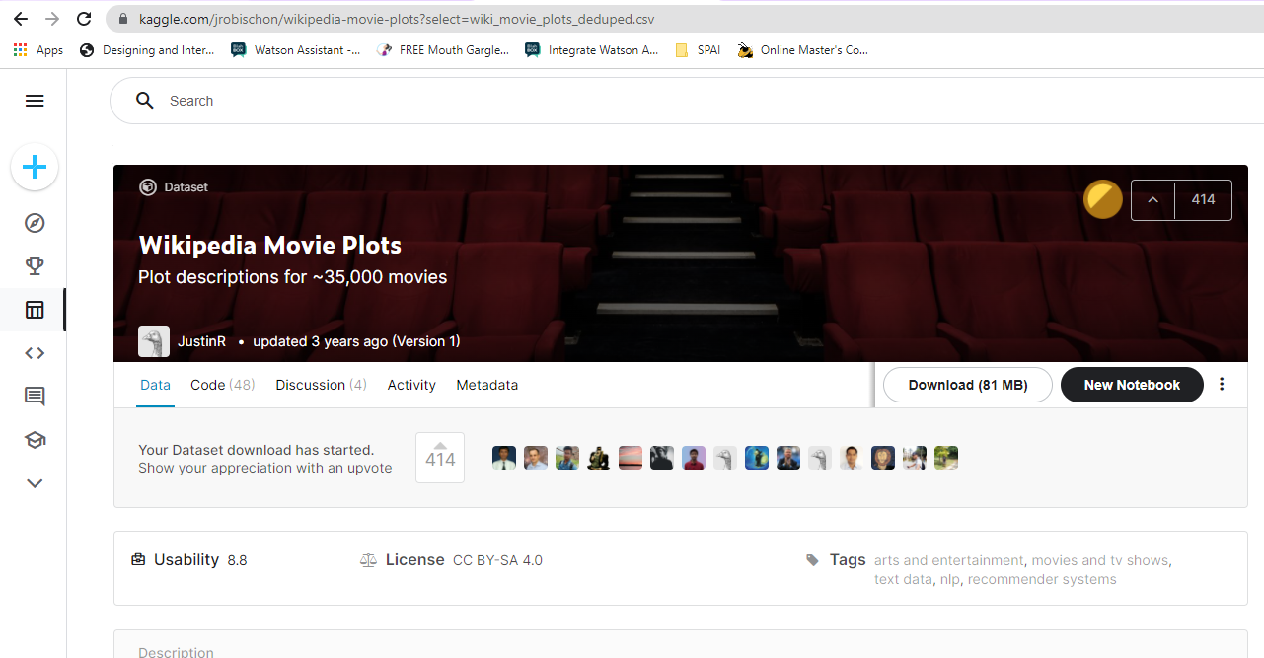
Dataset 1

Slide 4
Dataset 1
Context
Plot summary descriptions scraped from Wikipedia
Content
The dataset contains descriptions of 34,886 movies from around the world. Column descriptions are listed below:
Release Year - Year in which the movie was released
Title - Movie title
Origin/Ethnicity - Origin of movie (i.e. American, Bollywood, Tamil, etc.)
Director - Director(s)
Plot - Main actor and actresses
Genre - Movie Genre(s)
Wiki Page - URL of the Wikipedia page from which the plot description was scraped
Plot - Long form description of movie plot (WARNING: May contain spoilers!!!)

Slide 5
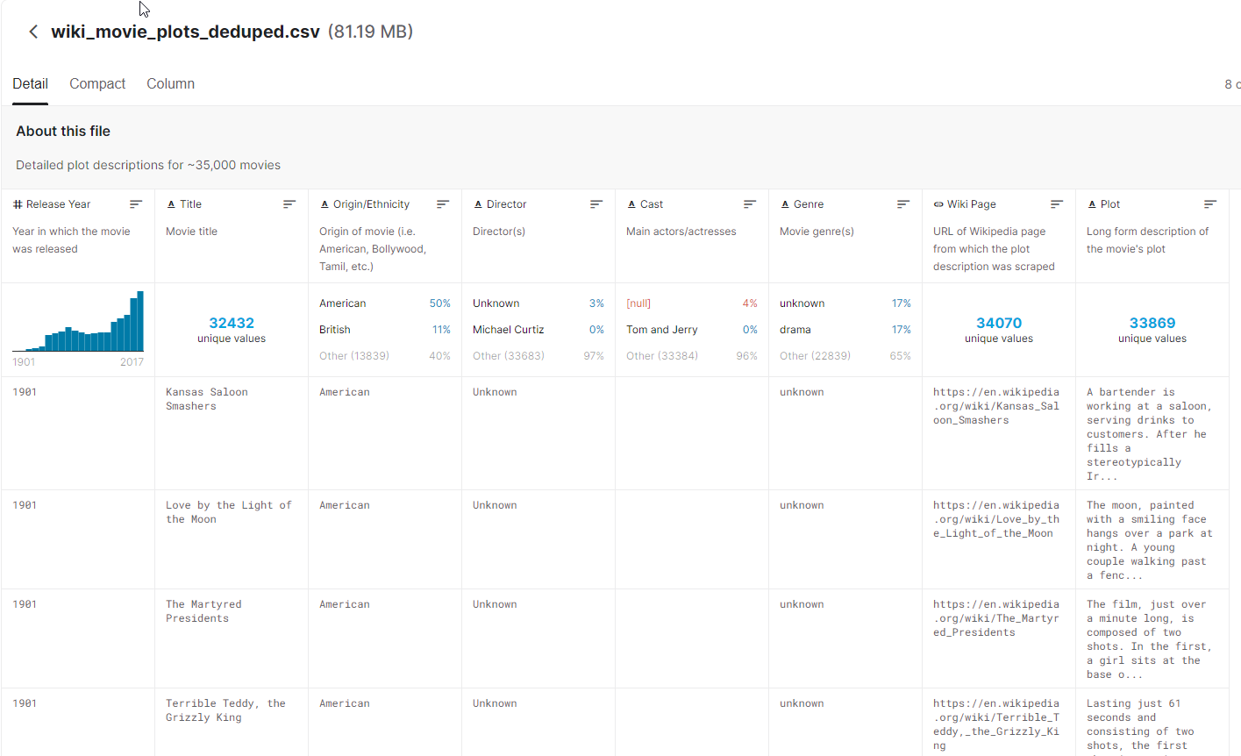
Dataset 1

Slide 6
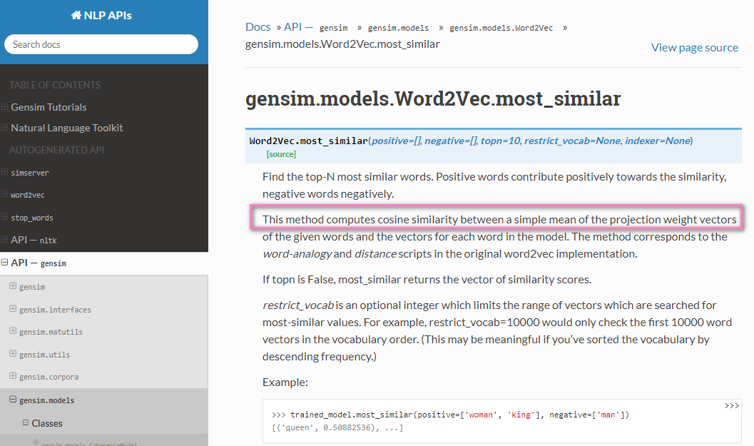
Model1 : gensim.models.Word2Vec.most_similar
Model is pretrained before passing to app

Slide 7
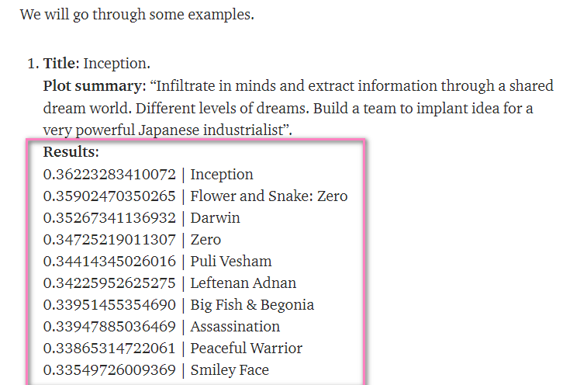
How the model works
You type the Plot Summary as you can see in the chatbot.
The model infer the most_similar scores (cosine similarity) and output the top 10 most popular movie titles

Slide 8
Dataset 2 : Top 250 IMDB movie, refined data
This data is required when used for Slots
Scrape movie feature details from OMBD's API –
Columns includes: 'Title', 'Year', 'Rated', 'Released', 'Runtime', 'Genre', 'Director', 'Writer', 'Actors', 'Plot', 'Language', 'Country', 'Awards', 'Poster', 'Ratings', 'Metascore', 'imdbRating', 'imdbVotes', 'imdbID', 'Type', 'DVD', 'BoxOffice', 'Production', 'Website', 'Response’
Further scrape IMDB website for movie Plot with BeatifulSoup4 (Python)
Scrape IMDB weblink with its ‘movie_Id’ (Movie link pattern consistent)

Slide 9
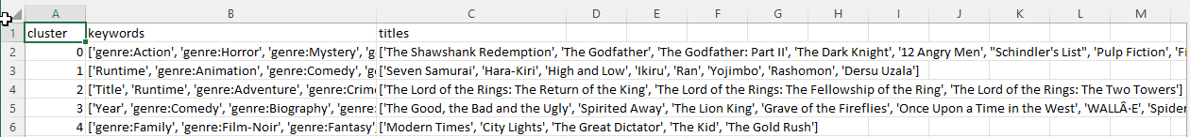
Dataset3: Clustered Top 250 IMDB movie list
Same as dataset 2, but added the steps below
PCA to reduce dimensions (since there were 250 rows with 99 features)
K-Means to get titles in clusters (Based on algo, k=5)

Slide 10
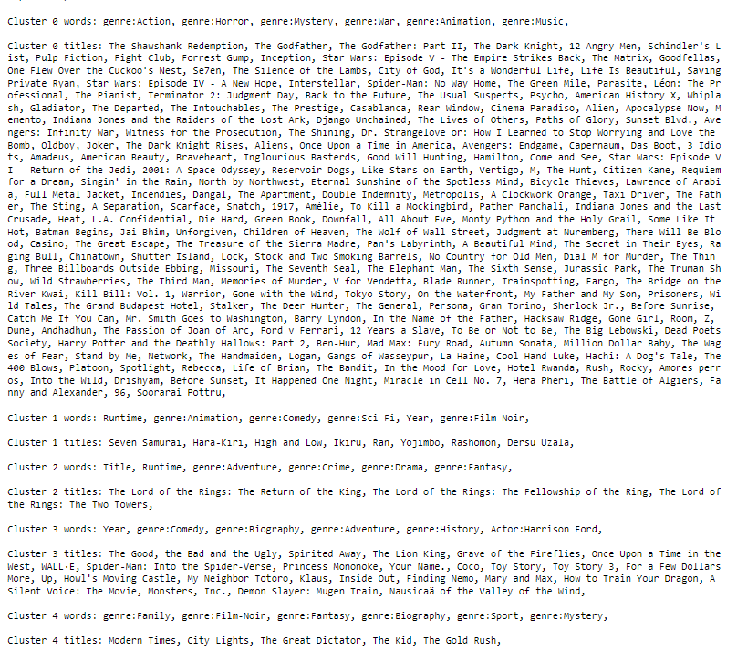
Dataset 3
This data is used when I type the movie title
If movie title appear in cluster 0, then the output will be very big.
Bad news is Facebook character limit is 640, so I had to truncate when pass to FB messenger.

Slide 11
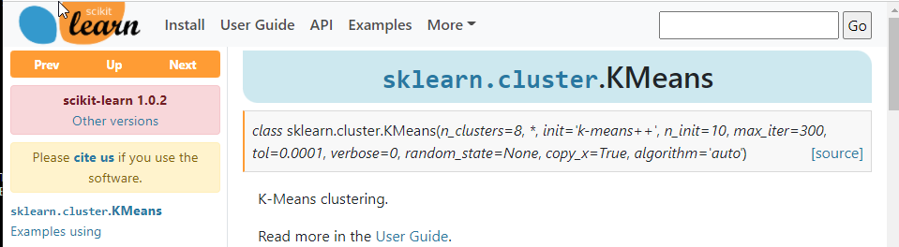
Model 2: K-Means clustering
Feature engineering
Principal Component Analysis for dimension reduction
Train reduced features with K-Means model before passing to RASA

Slide 12
Intents
* Same as lab
- intent: mood_great
examples: |
- perfect
- great
- amazing
- feeling like a king
- wonderful
- I am feeling very good
- I am great
- I am amazing
- I am going to save the world
- super stoked
- extremely good
- so so perfect
- so good
- so perfect
- I am fine
- good
- intent: deny
examples: |
- no
- n
- never
- I don't think so
- don't like that
- no way
- not really
- refuse
- reject
- no need
- do not
- intent: affirm
examples: |
- yes
- y
- indeed
- of course
- that sounds good
- correct
- intent: goodbye
examples: |
- cu
- good by
- cee you later
- good night
- bye
- goodbye
- have a nice day
- see you around
- bye bye
- see you later
- thank you
- thank you for your help!
- intent: ask_name
examples: |
- what is your name?
- may i know your name?
- who are you?
- your name?
- intent: greet
examples: |
- hey
- hello
- hi
- hello there
- good morning
- good evening
- moin
- hey there
- let's go
- hey dude
- goodmorning
- goodevening
- good afternoon

Slide 13
Intents
* Same as lab
- intent: mood_unhappy
examples: |
- my day was horrible
- I am sad
- I don't feel very well
- I am disappointed
- super sad
- I'm so sad
- sad
- very sad
- unhappy
- not good
- not very good
- extremly sad
- so saad
- so sad
- intent: bot_challenge
examples: |
- are you a bot?
- are you a human?
- am I talking to a bot?
- am I talking to a human?
- intent: my_name
examples: |
- my name is [Jia Yi]{"entity":"name", "value":"Jia Yi"}
- my name is [Wilson]{"entity":"name", "value":"Wilson"}
- my name is [Kate]{"entity":"name", "value":"Kate"}
- my name is [Jack]{"entity":"name", "value":"Jack"}
- [Jia Yi]{"entity":"name", "value":"Jia Yi"} is my name
- people call me [Jia Yi]{"entity":"name", "value":"Jia Yi"}
- I am [Jia Yi]{"entity":"name", "value":"Jia Yi"}
- [Wilson]{"entity":"name", "value":"Wilson"} is my name
- people call me [Wilson]{"entity":"name", "value":"Wilson"}
- I am [Wilson]{"entity":"name", "value":"Wilson"}
- [Kate]{"entity":"name", "value":"Kate"} is my name
- people call me [Kate]{"entity":"name", "value":"Kate"}
- I am [Kate]{"entity":"name", "value":"Kate"}
- [Jack]{"entity":"name", "value":"Jack"} is my name
- people call me [Jack]{"entity":"name", "value":"Jack"}
- I am [Jack]{"entity":"name", "value":"Jack"}

Slide 14
Intents
Similar purpose to “movie_title” but phrased
differently
*New intents!
- intent: movie_plot
examples: |
- A blonde bride goes to Japan in search of her former boss and kills many people. She is dress in yellow and uses a katana. bike
- Jedi knight lightsaber starship
- Infiltrate in minds and extract information through a shared dream world. Different levels of dreams. Build a team to inplant idea for a very powerful Japanese industrialist
- Two imprisoned men bond over a number of years, finding solace and eventual redemption through acts of common decency.
- When a beautiful stranger leads computer hacker Neo to a forbidding underworld, he discovers the shocking truth--the life he knows is the elaborate deception of an evil cyber-intelligence.
- The lives of guards on Death Row are affected by one of their charges: a black man accused of child murder and rape, yet who has a mysterious gift.
- intent: movie_title
examples: |
- Fate/stay night: Heaven's Feel Series
- G-Force
- Aalroopangal
- Just Another Margin
- Yu-Gi-Oh! The Movie: Pyramid of Light
- Titanic
- Parasite
- Inside Out
- Finding Nemo
- The Intouchables
- Coco
- 3 Idiots
- Toy Story 3
- Up
- Green Book
- The Grand Budapest Hotel
- Mary and Max
- intent: movie_title_clustering
examples: |
- The movie title is: "[Oldboy]"{"entity":"movie", "value":"Oldboy"}
- The movie title is: "[Django Unchained]"{"entity":"movie", "value":"Django Unchained"}
- The movie title is: "[Das Boot]"{"entity":"movie", "value":"Das Boot"}
- The movie title is: "[Just Another Margin]"{"entity":"movie", "value":"Just Another Margin"}
- The movie title is: "[The Kid]"{"entity":"movie", "value":"The Kid"}
- The movie title is: "[L.A. Confidential]"{"entity":"movie", "value":"L.A. Confidential"}
- The movie title is: "[Spotlight]"{"entity":"movie", "value":"Spotlight"}
- The movie title is: "[Inside Out]"{"entity":"movie", "value":"Inside Out"}
- The movie title is: "[Toy Story 3]"{"entity":"movie", "value":"Toy Story 3"}
- The movie title is: "[Toy Story 3]"{"entity":"movie", "value":"Toy Story 3"}
- intent: give_movie_details
examples: |
- Give movie details
- give more details
- give me details
- Can i have the movie poster
- May i have the movie imdb link
- could you show me the website link

Slide 15
Intents
*New intents!
- intent: my_genre
examples: |
- the genre i am looking for is [Comedy]{"entity":"genre"}
- [Action]{"entity":"genre"}
- [Adventure]{"entity":"genre"}
- [Drama]{"entity":"genre"}
- [Horror]{"entity":"genre"}
- [Romance]{"entity":"genre"}
- [Sci-Fi]{"entity":"genre"}
- [War]{"entity":"genre"}
- intent: my_year
examples: |
- the movies falling after year [1992]{"entity":"year"}
- [2000]{"entity":"year"}
- [2001]{"entity":"year"}
- [2010]{"entity":"year"}
- [1999]{"entity":"year"}
- intent: my_language
examples: |
- the language is [English]{"entity":"language"}
- [Chinese]{"entity":"language"}
- [Malay]{"entity":"language"}
- [Spanish]{"entity":"language"}
- [French]{"entity":"language"}

Slide 16
Entities
entities:
- name
- number
- genre
- year
- language
- movie

Slide 17
Forms
forms:
user_movie_form:
required_slots:
- genre
- year
- language

Slide 18
12 story lines
* Only demo those highlighted in yellow
story: happy path + plot movie
steps:
- intent: greet
- action: utter_greet
- intent: mood_great
- action: utter_happy
- action: utter_movie
- intent: affirm
- action: utter_accept_plot
- intent: affirm
- action: utter_by_plot
- intent: movie_plot
- action: action_movie_search
- intent: goodbye
- action: utter_goodbye
story: happy path + form filling
steps:
- intent: greet
- action: utter_greet
- intent: mood_great
- action: utter_happy
- action: utter_movie
- intent: affirm
- action: utter_accept_plot
- intent: deny
- action: utter_accept_filter
- intent: affirm
- action: user_movie_form
- active_loop: user_movie_form #trigger this loop

Slide 19
12 story lines
- story: happy path + clustering + no give details # Rasa trains and generalise
steps:
- intent: greet
- action: utter_greet
- intent: mood_great
- action: utter_happy
- action: utter_movie
- intent: affirm
- action: utter_accept_plot
- intent: deny
- action: utter_accept_filter
- intent: deny
- action: utter_accept_cluster
- intent: affirm
- action: utter_accept_clustering
- intent: movie_title_clustering
# entities:
# - movie: "Oldboy"
- action: action_movie_cluster
- action: utter_movie_detail
- intent: deny
- action: utter_goodbye
- story: happy path + clustering + give details # Rasa trains and generalise
steps:
- intent: greet
- action: utter_greet
- intent: mood_great
- action: utter_happy
- action: utter_movie
- intent: affirm
- action: utter_accept_plot
- intent: deny
- action: utter_accept_filter
- intent: deny
- action: utter_accept_cluster
- intent: affirm
- action: utter_accept_clustering
- intent: movie_title_clustering
- action: action_movie_cluster
- action: utter_movie_detail
- intent: give_movie_details
- action: utter_affirm_movie

Slide 20
12 story lines
story: happy path + No need help
steps:
- intent: greet
- action: utter_greet
- intent: mood_great
- action: utter_happy
- action: utter_movie
- intent: affirm
- action: utter_accept_plot
- intent: deny
- action: utter_accept_filter
- intent: deny
- action: utter_accept_cluster
- intent: deny
- action: utter_goodbye
story: happy path + no need movie
steps:
- intent: greet
- action: utter_greet
- intent: mood_great
- action: utter_happy
- action: utter_movie
- intent: deny
- action: utter_goodbye

Slide 21
12 story lines
- story: sad path 1 + plot movie
steps:
- intent: greet
- action: utter_greet
- intent: mood_unhappy
- action: utter_cheer_up
- action: utter_did_that_help
- intent: affirm
- action: utter_happy
- action: utter_movie
- intent: affirm
- action: utter_accept_plot
- intent: affirm
- action: utter_by_plot
- intent: movie_plot
- action: action_movie_search
- intent: goodbye
- action: utter_goodbye
- story: greet path + are you a bot
steps:
# cannot start with actions.
- intent: greet
- action: utter_greet
- intent: greet_back
- action: utter_greetback
- intent: ask_name
- action: utter_iamabot
- action: utter_goodbye

Slide 22
12 story lines
4 other story lines are the unhappy version of the happy story lines, no need to show in this presentation

Slide 23
Rules
- rule: Submit movie form
condition:
# condition that form is active.
- active_loop: user_movie_form # only works if this loop active
steps:
# Form is deactivated
- action: user_movie_form
- active_loop: null # end of active_loop
- slot_was_set:
- requested_slot: null
# The actions we want to run when the form is submitted
- action: action_filter_submit
- action: utter_movie_detail
- intent: give_movie_details
- action: utter_affirm_movie
- rule: Submit movie form no give details
condition:
# condition that form is active.
- active_loop: user_movie_form # only works if this loop active
steps:
# Form is deactivated
- action: user_movie_form
- active_loop: null # end of active_loop
- slot_was_set:
- requested_slot: null
# The actions we want to run when the form is submitted
- action: action_filter_submit
- action: utter_movie_detail
- intent: deny
- action: utter_goodbye

Slide 24
Rules
- rule: movie Link and image
steps:
# come in after "utter_affirm_movie"
- intent: movie_title
- action: action_movie_title
- action: utter_goodbye
- rule: out-of-scope
steps:
- intent: nlu_fallback
- action: utter_out_of_scope

Slide 25
5 Actions
class ActionMovieSearch(Action):
def name(self) -> Text:
return "action_movie_search"
def run(
self,
dispatcher: CollectingDispatcher,
tracker: Tracker,
domain: Dict[Text, Any],
) -> List[Dict[Text, Any]]:
userMessage = tracker.latest_message["text"]
# use model to find the movie
new_doc = preprocess_string(userMessage)
test_doc_vector = model.infer_vector(new_doc)
sims = model.dv.most_similar(positive=[test_doc_vector])
# Get first 5 matches
movies = [df["Title"].iloc[s[0]] for s in sims[:5]]
botResponse = f"I found the following movies: {movies}.".replace(
"[", ""
).replace("]", "")
dispatcher.utter_message(text=botResponse)
return []
Given a general movie plot, outputs 5 titles that are most similar in plot content to input words

Slide 26
5 Actions
This is a form which takes in 3 slots namely: 1) genre 2)year 3)language
class ValidateMovieForm(Action):
def name(self) -> Text:
return "user_movie_form"
def run(
self, dispatcher: CollectingDispatcher, tracker: Tracker, domain: Dict
) -> List[EventType]:
required_slots = ["genre", "year", "language"]
for slot_name in required_slots:
if tracker.slots.get(slot_name) is None:
# the slot is not filled yet. Request the user to fill this slot next
return [SlotSet("requested_slot", slot_name)]
# All slots are filled.
return [SlotSet("requested_slot", None)]

Slide 27
5 Actions
class ActionFilterSubmit(Action):
def name(self) -> Text:
return "action_filter_submit"
def run(
self,
dispatcher,
tracker: Tracker,
domain: DomainDict,
) -> List[Dict[Text, Any]]:
genre = tracker.get_slot("genre").lower()
year_after = tracker.get_slot("year").lower()
language = tracker.get_slot("language").lower()
# Load dataframe top250
df_top250 = pd.read_csv("top250.csv", sep=",")
# use model to find the movie
df_top250["Genre"] = df_top250["Genre"].str.lower()
df_top250 = df_top250[df_top250["Genre"].str.contains(genre)]
df_top250[["Year"]] = df_top250[["Year"]].apply(pd.to_numeric)
df_top250 = df_top250[df_top250["Year"] > float(year_after)]
df_top250["Language"] = df_top250["Language"].str.lower()
df_top250 = df_top250[df_top250["Language"].str.contains(language)]
# filtered out titles
titles = ",".join([str(elem) for elem in df_top250["Title"]])
# facebook messenger character limit per message is 640
if len(titles) > 500:
titles = titles[
0:500
] # safe because we have other message component like Genre
else:
titles = titles
dispatcher.utter_message(
template="utter_filter_thanks",
Genre=tracker.get_slot("genre"),
Year_after=tracker.get_slot("year"),
Language=tracker.get_slot("language"),
Titles=titles,
)
return []
Year is referring to “year_after”.
Outputs movies filtered by the 3 inputs from the form.
Limit to 500 characters because FB messenger has threshold of 640 char. I leave 140 extra characters for the extra words from the output of `tracker.get_slot` methods

Slide 28
5 Actions
Format input. Allow input to put more than one movie
Clean input
Check against which cluster the input movie is in. Print out all the movies in the
Cluster. Show top 600 characters
class ActionMovieCluster(Action):
def name(self) -> Text:
return "action_movie_cluster"
def run(
self,
dispatcher: CollectingDispatcher,
tracker: Tracker,
domain: Dict[Text, Any],
) -> List[Dict[Text, Any]]:
df_cluster = pd.read_csv("cluster_top250.csv", sep=",")
# userMessage = next(tracker.get_latest_entity_values("movie"), None)
# userMessage = tracker.get_latest_entity_values("movie")
userMessage = tracker.latest_message["text"]
# convert string representation of list to real list
list_titles = []
for i in range(len(df_cluster["titles"])):
list_titles.append(ast.literal_eval(df_cluster["titles"][i]))
# make the column of "titles" lower case and save it as "titles_list".
# also strip away any spaces infront of each movie title
list_lower_titles = []
for i in range(len(df_cluster)):
list_lower_titles.append([x.lower().strip() for x in list_titles[i]])
# put it to a new column in the dataframe
df_cluster["titles_list"] = list_lower_titles
# split the inputs if there are more than one movie given
# inputs = userMessage
inputs = userMessage.lower()
inputs = inputs.split('"')
print("inputs", inputs)
inputs = inputs[1].replace('"', "")
# inputs = inputs.split('"')[0]
inputs = inputs.split(",")
# remove any empty spaces in the front of each titles
inputs = [x.strip() for x in inputs]
inputs = [i.lower() for i in inputs]
print("inputs new", inputs)
print(df_cluster)
row_index = []
for index in range(len(df_cluster)):
i = set.intersection(set(inputs), set(df_cluster["titles_list"][index]))
if len(i) > 0:
row_index.append(index)
# find the indexes of the columns with the movie names given by input
filtered = df_cluster.loc[row_index, :]["titles"]
titles = (
",".join([str(elem) for elem in filtered]).replace("[", "").replace("]", "")
)
# facebook messenger can only take max 640 characters. So I put 600 as safe figure
if len(titles) > 600:
titles = titles[0:600]
else:
titles = titles
botResponse = f"I found the following movies: {titles}.".replace(
"[", ""
).replace("]", "")
dispatcher.utter_message(text=botResponse)
return []

Slide 29
5 Actions
class ActionMovieTitle(Action): def name(self) -> Text: return "action_movie_title" def run( self, dispatcher: CollectingDispatcher, tracker: Tracker, domain: Dict[Text, Any], ) -> List[Dict[Text, Any]]: # Load dataframe top250 df_top250 = pd.read_csv("top250.csv", sep=",") # do not truncate hyperlinks pd.set_option("display.max_colwidth", None) # take in the typed message userMessage = tracker.latest_message["text"] # use model to find the movie index = df_top250.index # use model to find the movie condition = index[df_top250["Title"].str.lower() == userMessage.lower()] index_list = condition.tolist() image_poster = df_top250["Poster"].loc[index_list[0]] print("image poster: ", image_poster) link = df_top250[df_top250["Title"].str.lower() == userMessage.lower()][ "imdb_link" ] if len(link) > 0: botResponse = f"I found the following link and poster : {link}".replace( "[", "" ).replace("]", "") else: botResponse = f"Movie title is not in list, please find another title" dispatcher.utter_message(text=botResponse) dispatcher.utter_message(image=image_poster) return []
Action:
Is to retrieve the image and hyperlink based on the movie title given

Slide 30
Demo1 : happy path + plot movie
Disclaimer: Only picked 4 scenario to demo in class.
This one uses Dataset1.
Give the general plot of a movie which you want to find the name but only know some details of the movie.
Outputs top 5 movie names based on cosine similarity of the input words with the Plot in IMDB

Slide 31
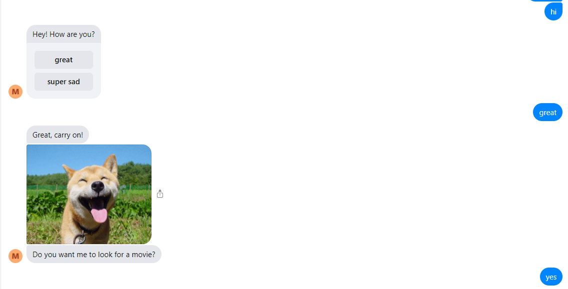
Demo1 : happy path + plot movie

Slide 32
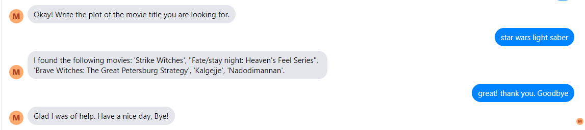
Demo1 : happy path + plot movie
Note I didn’t link this to the Action: action_movie_title because the base of
the dataset is not the same, so some movies are not in the list of top 250 IMDB movies

Slide 33
Demo2: happy path + form filling + movie Link and image
Asks for input to 3 slots put into forms namely 1)genre 2)year (year_after) 3) language
Filters on Dataset 2 which is the top 250 IMDB movies
Displays name, movie link and image
If you don’t want to know the movie link and image, we can also deny it when asked “Give movie details”

Slide 34
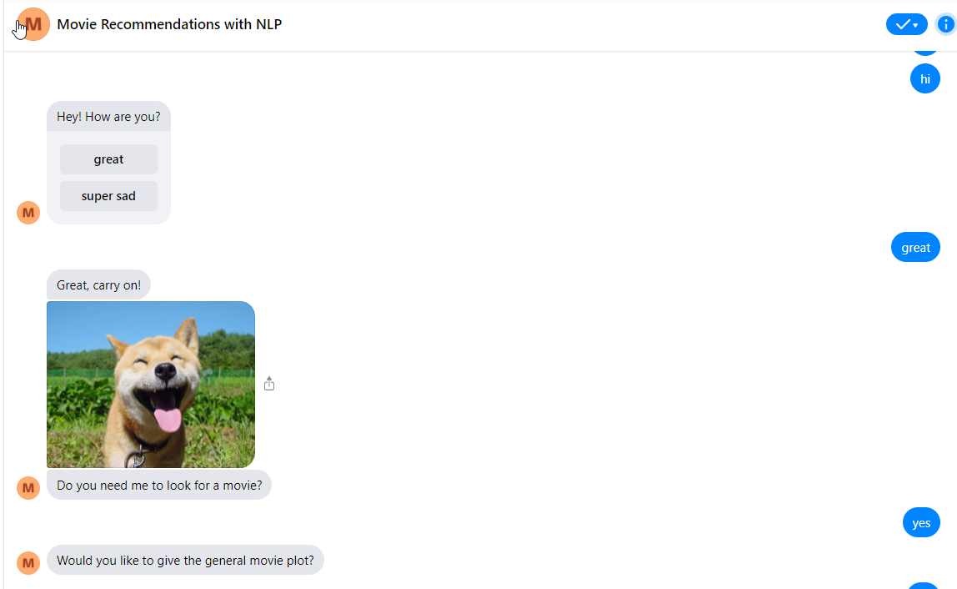
Demo2: happy path + form filling + movie Link and image

Slide 35
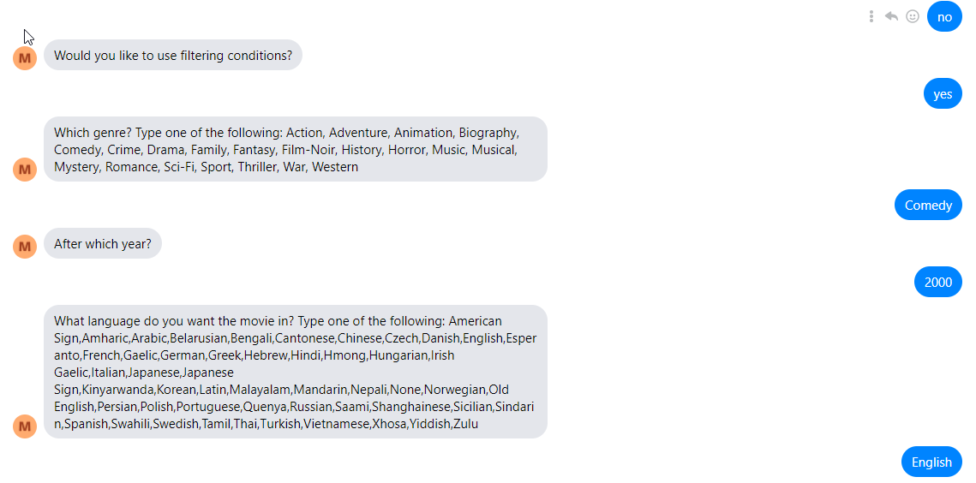
Demo2: happy path + form filling + movie Link and image

Slide 36
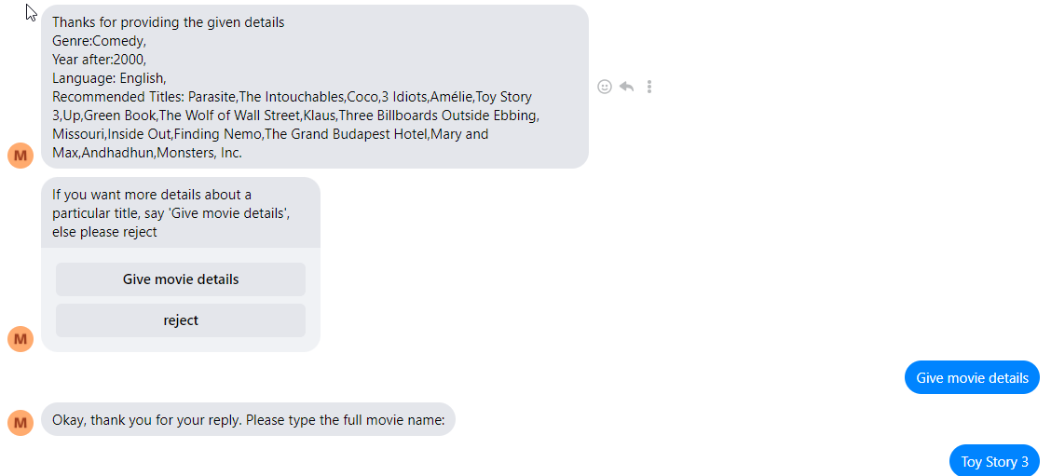
Demo2: happy path + form filling + movie Link and image

Slide 37
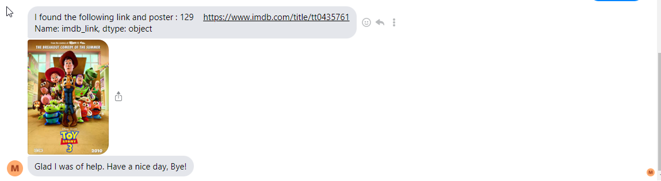
Demo2: happy path + form filling + movie Link and image

Slide 38
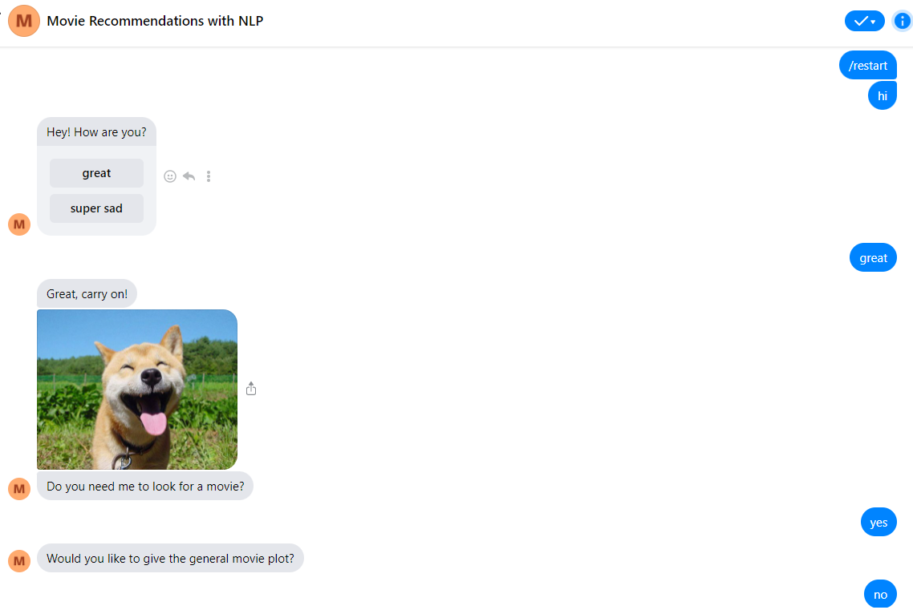
Demo3: happy path + clustering + give details

Slide 39
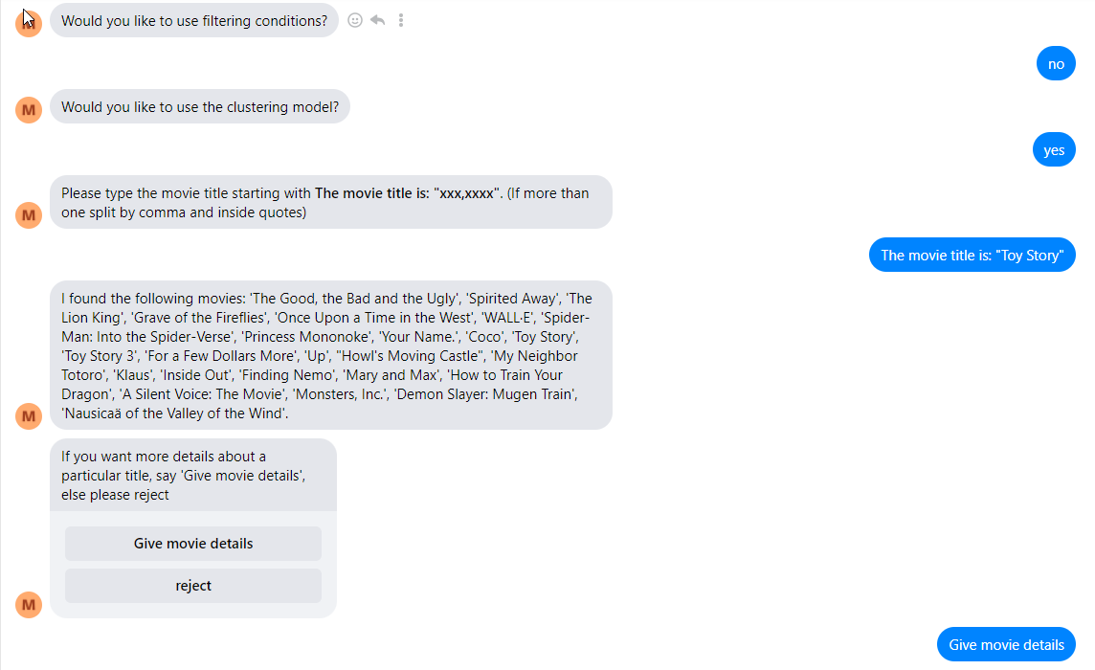
Demo3: happy path + clustering + give details

Slide 40
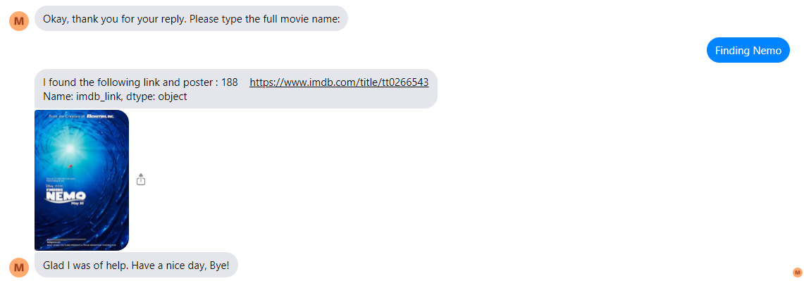
Demo3: happy path + clustering + give details

Slide 41
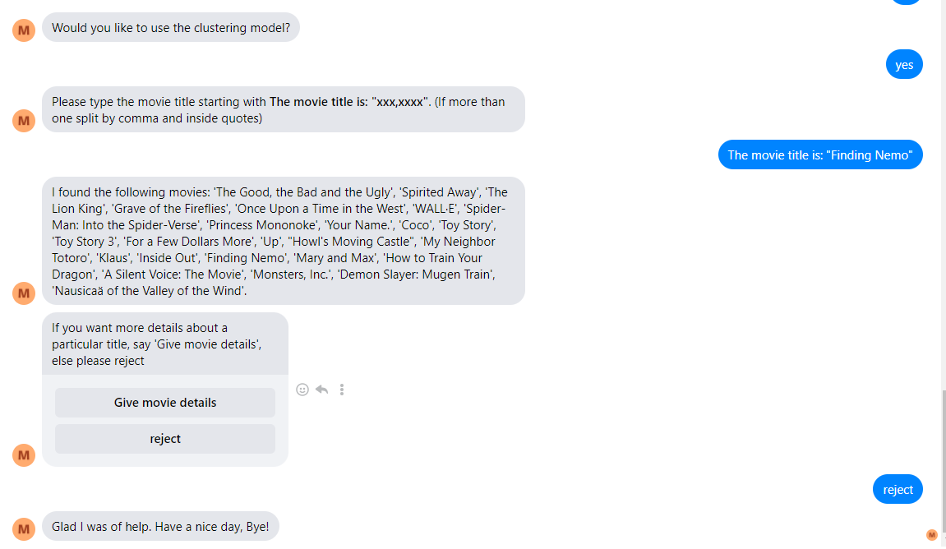
Demo4: happy path + clustering + no give details
Above is similar to Demo 3, screenshot the last part:

Slide 42
Deployment
Deployed on Facebook Messenger with Ngrok connector
Deploy on Google Cloud Platform linked to Facebook Messenger

Slide 43
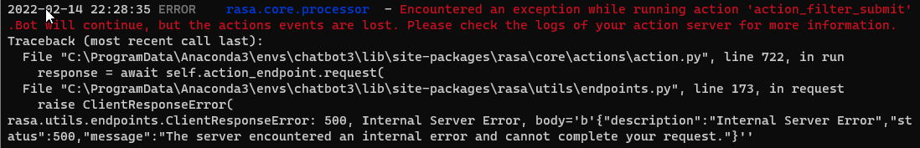
Challenges and Solutions
Difficult to reuse intents if it is used both in rules and stories, as rules will dominate the next action
Need to use ways to “disguise” similar intents which are used in stories and rules.
Rules only allow one intent each, but the path will always terminate in rules and not able to continue back in stories. Hence, need to break rules into multiple smaller rules
Building NLP outputs and scrapping data
A lot of trial and errors to get features working on RASA!
The forms are not able to use with buttons, it will not register the input:

Slide 44
Challenges part 2 (On deployment to GCP)
File too big, cannot use `gcloud app deploy`. Need use App Engine `gcloud builds submit --config cloudbuild1.yaml`
Need use a renamed version of `cloudbuild.yaml` to something like `cloudbuild1.yaml` because you want to deploy with App Engine instead of `gcloud app deploy`. It default to `gcloud app deploy` when `app.yaml` file is detected, which contains the `runtime`
The folder is too big, need to set the timeout value inside `cloudbuild1.yaml`. Thus, must use App Engine, not the default
GCP still default at Python 2.7. Need to make conda environment
Need to enable all API engine.
Overall took more than 24 hours to debug – End up still have bug, abandoned

Slide 45
References
https://github.com/hassaanseeker/Rasa-GCP
https://medium.com/@muhammadhassaanrafique/deploying-rasa-powered-chatbot-to-google-cloud-platform-f4ee2eee5be4
https://forum.rasa.com/t/slots-set-by-clicking-buttons/27629/24

Slide 46


Slide 47
Buttons in forms RASA
I found how to do buttons in forms, need to use action.py
https://forum.rasa.com/t/custom-buttons-in-action-py-file/6970

