Slide 1


WMD CA1- Add Song App
Chan Jia Yi (P7337992)
Date: 26 Jun 2022

Slide 2
Index.html

Slide 3


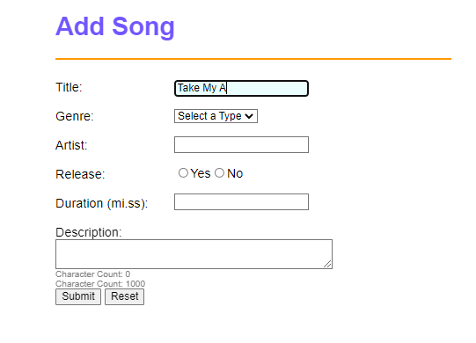
Features
As you are typing in the text box, the in focus features kicks in, highlighting the text box that you are typing on in blue

Slide 4
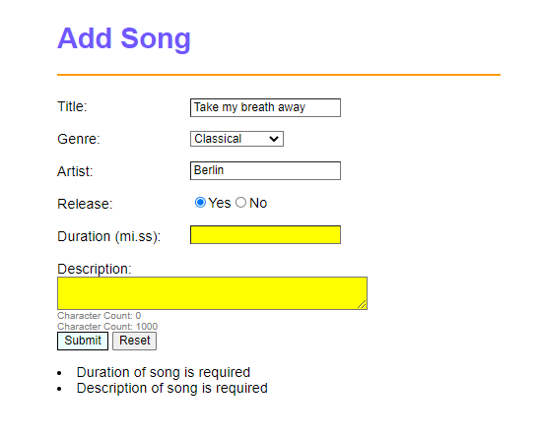
Features
2. If you leave any component blank/ type only spaces, the app will highlight it in yellow and give reminder messages at the bottom

Slide 5
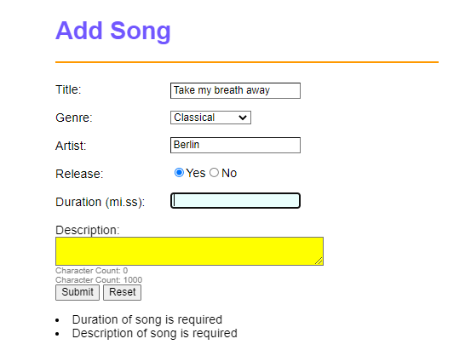
Features
3. You will not be able to type any non numeric numbers in "Duration" input

Slide 6
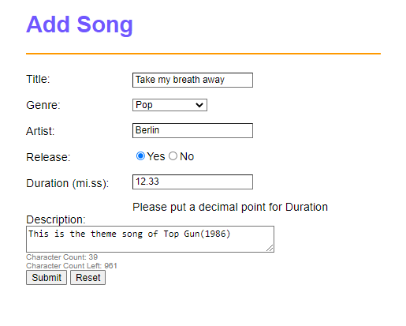
Features
4. Added Word count and remaining word count under the "Description" Textbox.
5. Reset button allows you to clear all the inputs, remove the yellow highlighting and also the reminder messages.
6. Once you have successfully completed the form(by clicking submit), you will be brought to "process.html" Here is what a completed form should look like:

Slide 7
Features

Slide 8
process.html

Slide 9
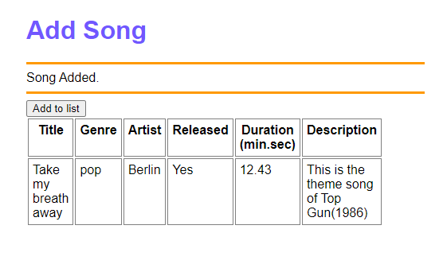
Features
If there is a successful submission from index.html, it wil lead to process.html You can then click "Add to list“→ this will append the data to the table

Slide 10
Thank you!

