Slide 1

This post was detected as fake by the AI robot
Click here to check details
This post was detected as fake by the AI robot

Slide 2
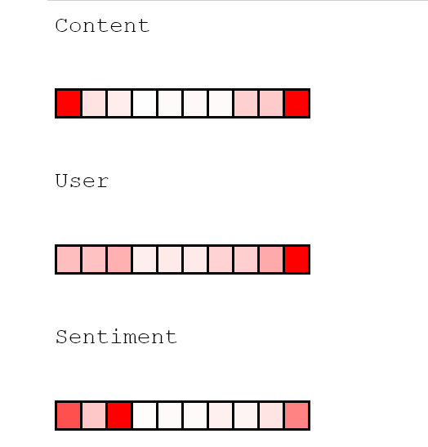
news1

