Slide 1
Analysis on elections contributions data

Slide 2
AGENDA
Overview
Dashboard
Feature Importance
Closing Thoughts

Slide 3
overview

Slide 4
Quick history on elections contributions/donations
Since 2003, all corporate and union donations have been banned and caps on donations were introduced.
Additional regulations and changes have been added in to further enforce and reduce the caps to limit the impact of large donors on elections.
Elections Canada keeps an open database on all contributions over $200 as part of their attempt to keep all donations transparent since the 38th general election (2004).

Slide 5
goals
Utilize available data to analyze potential impact of donations/contributions for elections.
Create a visualization dashboard to illustrate additional key insights on the data.

Slide 6
dashboard

Slide 7
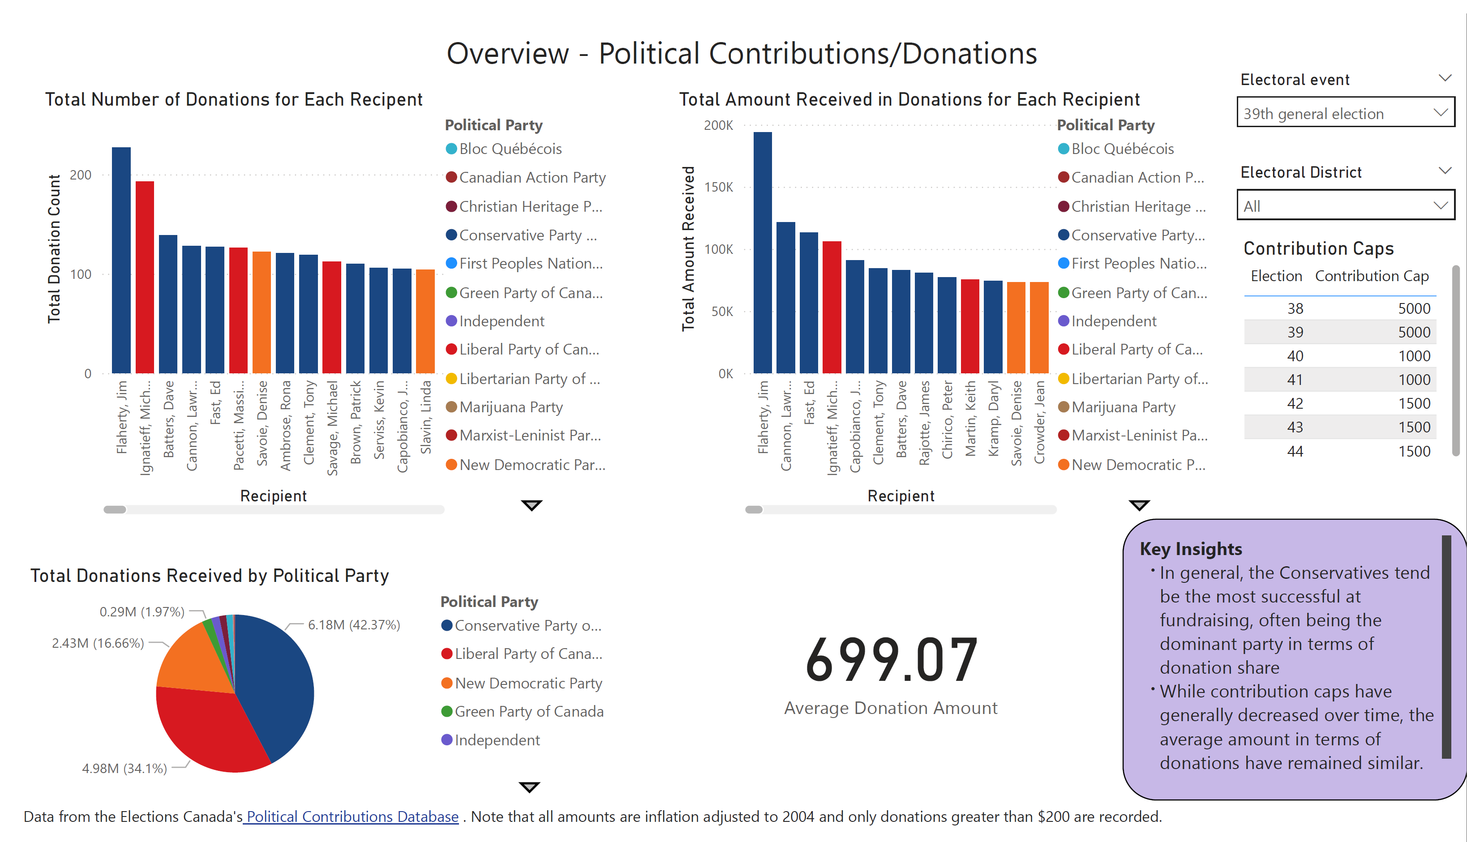

Slide 8
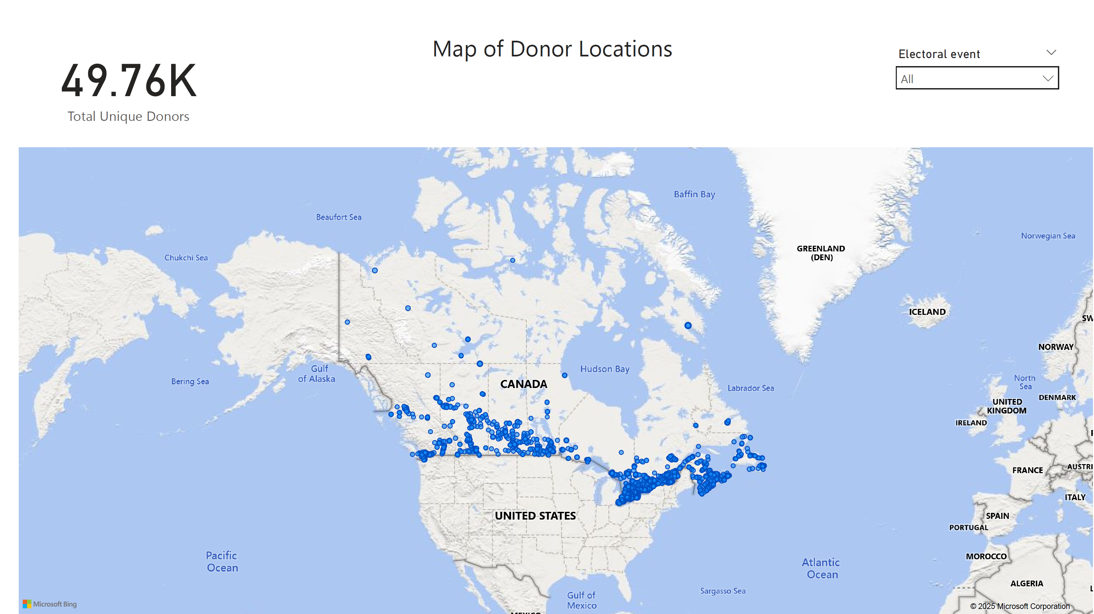

Slide 9
Feature importance

Slide 10
Model choice and explanation
Gradient-Boosted Random Forest
SHAP Values (SHapley Additive exPlanations)
Machine learning model that combines many “decision trees” to make more accurate predictions:
Handles both numerical and categorical data well
Run both classification and regression models
Method for explaining ML model decisions
Shows which inputs have the most influence on the prediction output
Game theory-based calculations to divide up the “credit” on the input’s influence on the result

Slide 11
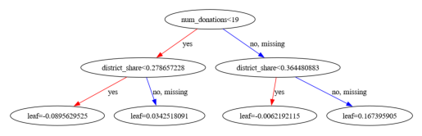
Example tree

Slide 12
Features analyzed
District share (i.e. what % of donations recorded was captured by the candidate)
Highest donation amount received
Total donation amount received
Number of donations
Which election this happened in
Which district the candidate was based in
Which political party the candidate was in

Slide 13
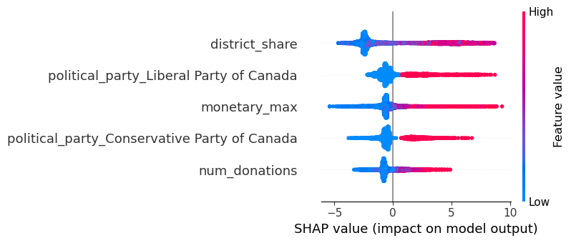
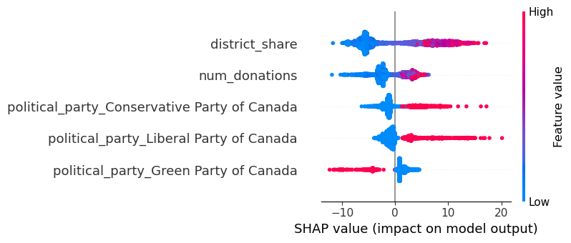
Shap graphs
Classification
Regression

Slide 14
Key insights
The model results aren’t stellar – about 50% accuracy in terms of prediction, and ~10% error in vote share.
However, this level of performance is expected: the goal wasn't to predict accurately, but to test whether donation patterns relate to outcomes.
Based on the results, it shows that fundraising/donation support does have some potential influence on election results.
It could represent meaningful proxy for voter support and potentially used in combination with other data to elevate models.

Slide 15
closing thoughts

Slide 16
Final takeaways
While it may seem obvious as a conclusion, this suggests that tracking donations can be a signal for campaign momentum.
This signals that strong grassroots campaigns that really work to interact and engage within the members of a district to be financially engaged could lead to better election results
While the pool of generous donors is small, this group alone shows the potential influence of fundraising on results.
The reduced contribution caps in general does not seem to have detrimentally affected average donation size.
Canada has established a transparent system of tracking contributions but needs to better translate this to the public in a more accessible way.

Slide 17
THANK YOU!

Slide 18
references
Bill c-24: An act to amend the canada elections act and the income tax act (political fi-nancing) [Accessed August 2, 2025]. (2003). https://publications.gc.ca/Collection-R/LoPBdP/LS/372/372c24-e.htm
Elections Canada. (n.d.-a). Open data. https://www.elections.ca/content.aspx?section=fin&dir=oda&document=index&lang=e
Elections Canada. (n.d.-b). Understanding contributions. https : / / www . elections . ca /content.aspx?section=fin&dir=cont&document=index&lang=e
Fair elections act (bill c-23) [Accessed August 2, 2025]. (2014). https://laws-lois.justice.gc.ca/eng/annualstatutes/2014 12/FullText.html
Federal accountability act (bill c-2) [Accessed August 2, 2025]. (2006). https://lop.parl.ca/sites/PublicWebsite/default/en CA/ResearchPublications/LegislativeSummaries/391LS522E
Garnett, H. A. (2024). Where do donors come from? using census data to predict donationsto canadian federal election candidates. Political Geography, 110, 103077. https://doi.org/https://doi.org/10.1016/j.polgeo.2024.103077
Government of Canada, S. C. (2025, January). Consumer Price Index, annual average,not seasonally adjusted. https://www150.statcan.gc.ca/t1/tbl1/en/tv.action?pid=1810000501
MacDermid, R. (2007). Campaign finance and campaign success in municipal elections inthe Toronto region. https://www.cpsa-acsp.ca/papers-2007/MacDermid.pdf
Political fundraisers transparency (bill c-50) [Accessed August 2, 2025]. (2017). https://lop.parl.ca/sites/PublicWebsite/default/en CA/ResearchPublications/LegislativeSummaries/421C50E
Scarrow, S. E. (2016). The state of political finance regulations in Canada, the UnitedKingdom and the United States (tech. rep.). International Institute for Democracyand Electoral Assistance. International IDEA. https://www.idea.int/sites/default/files/publications/the-state-of-political-finance-regulations-in-canada-uk-usa.pdf
Young, L. (2025). Royal Commission on Electoral Reform and Party Financing, report(tech. rep.). Royal Commission on Electoral Reform and Party Financing. https:/ / foreigninterferencecommission . ca / fileadmin / foreign interference commission /Documents / Policy Consultation Documents / Summaries / 7 YOUNG - Summaryreport.pdf

