Slide 1
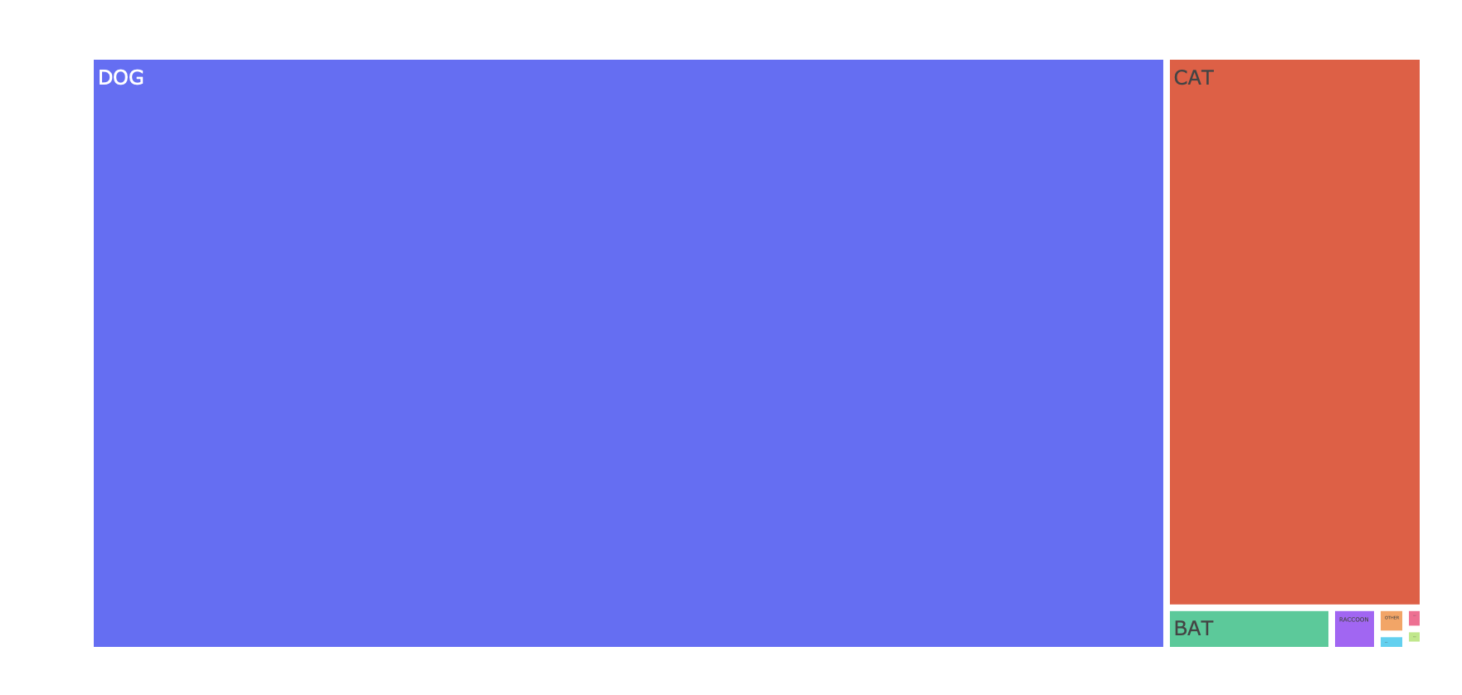


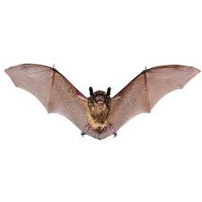
What animal is responsible for most bites?
DOGS
Notes:
Notes:
Dogs appear to be the main culprits here, with the most bites representing 80% of total animal bites.

Slide 2
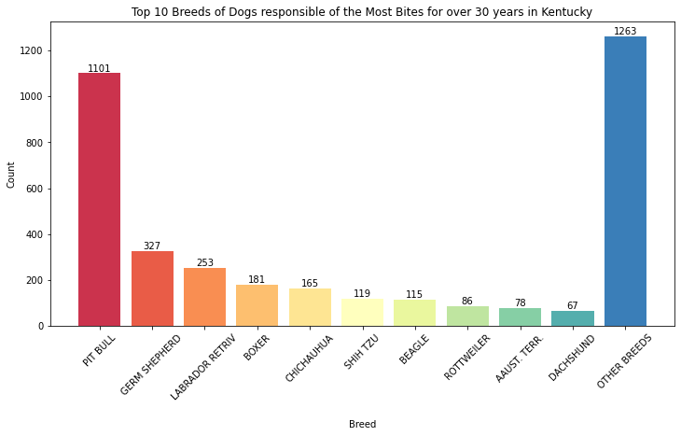
Pit Bulls:
most aggressive biters
Notes:
Notes:
Pit bulls represent almost 30% of total dog bites with more than 100 breeds are represented in this data set.

Slide 3
Dogs target the head more than any other animal
Notes:
Notes:
They also seem to target the face more than other animals, making them perhaps even more dangerous than animals with high numbers of bites.
Within dogs it would be interesting to see the impact of size of dog, as many of the dogs with the most bites are larger, but there were some noticeable smaller dogs in there as well.
If someone got bitten by an animal that they knew had been vaccinated then they were less likely to go for a test for rabies.
Thanks for taking the time to have a look at my analysis. If you have any feedback or advice, then I would love to hear it.

Slide 4

Male dogs are twice more likely to bite than female dogs
Notes:
Notes:

Slide 5
Cases of Rabies
SPECIES | BITES | RABIES | %
DOG | 6925 | 1 | 0%
CAT | 1532 | 0 | 0%
BAT | 76 | 3 | 4%
RACCOON | 21 | 0 | 0%
OTHER | 8 | 0 | 0%
HORSE | 5 | 0 | 0%
FERRET | 4 | 0 | 0%
RABBIT | 3 | 0 | 0%
SKUNK | 1 | 0 | 0%

Slide 6
When a dog bites you, can you get rabies?
SPECIES
BITES
RABIES
%
DOG
6925
1
0%
Chances are extremely low
Notes:
This only case of a dog that had rabies was not vaccinated. In the data it shows that 58 dogs were vaccinated and 979 cases it was unknown.

Slide 7
What about when a bat bites you?
SPECIES
BITES
RABIES
%
BAT
76
3
4%
There our chances skyrocket
given that most bats the bit didn’t get tested because you’d have to catch first

