Slide 1

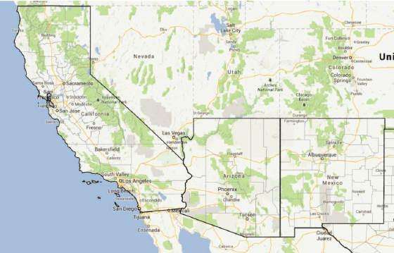
Solar Energy Storage Project
What’s the best location?
By Claudia Zaffaroni

Slide 2
Problem
Predict the GHI index (key indicator of solar energy systems) with weather indicators using machine learning (ML) model to be able to install solar panels
In which of the three locations can the GHI be predicted with a higher accuracy ?

Slide 3
Solution
After training the models for the different locations, the results were very similar so the decision can be based solely on the land cost and other costs specific to each state

Slide 4
Data Source
Country: USA
Collection Methodology: Satellite Observations, Ground-Based Measurements and Reanalysis Models.
Source link: https://power.larc.nasa.gov/data-access-viewer/

Slide 5
Data Wrangling
Original data set had over 175,000 rows and 16 columns or features with data collected every 60 minutes for over 20 years.
Many -999 values that needed to be replaced with N/A values
Needed to create a date column with the information of year, month, day and hour provided in 4 different features
Target Variable: All Sky Surface Shortwave Downward Irradiance

Slide 6
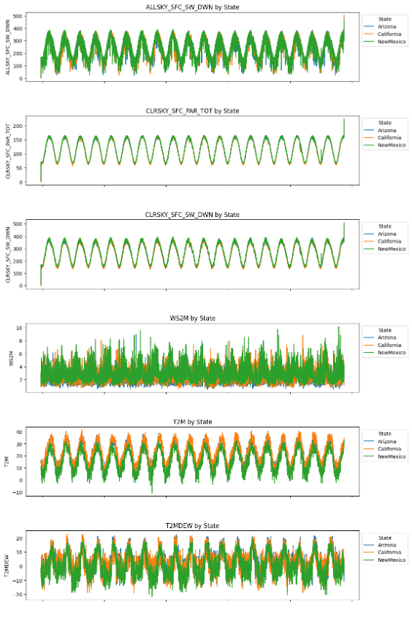
Exploratory Data Analysis GHI and Temperature
Clear seasonality in the data of the GHI (ALLSKY_SFC_SW_DWM) and temperature (T2M) feature for all three locations
While the GHI is similar among the three location, it was interesting that New Mexico, on average, is less hot than both Arizona and California

Slide 7
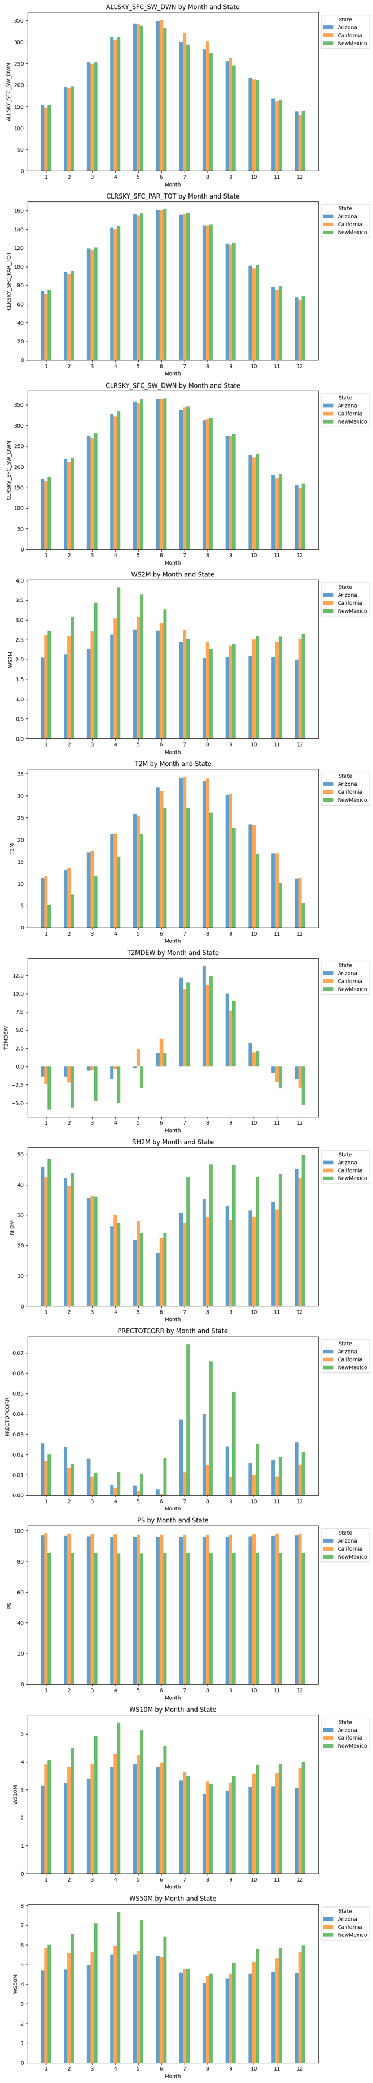
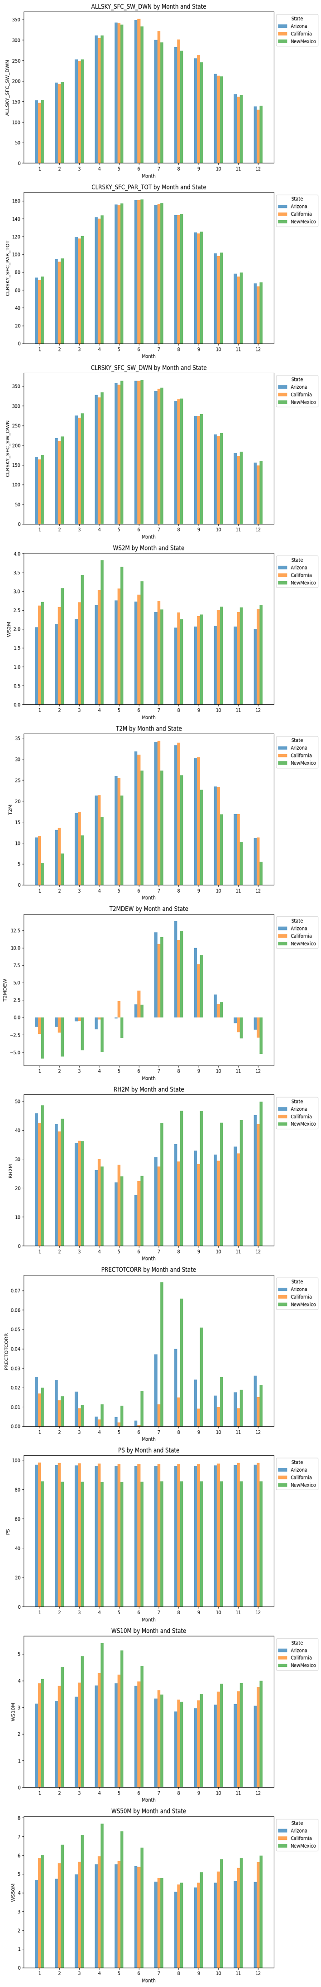
Exploratory Data Analysis Monthly Data – select charts
New Mexico is by far the windiest state of the 3
Arizona and California are roughly 5 or more Celsius degrees hotter on average than New Mexico
New Mexico is also the most humid every month, on average, except for May and June where California is the most humid
Surface pressure is highest for California followed very closely by Arizona

Slide 8
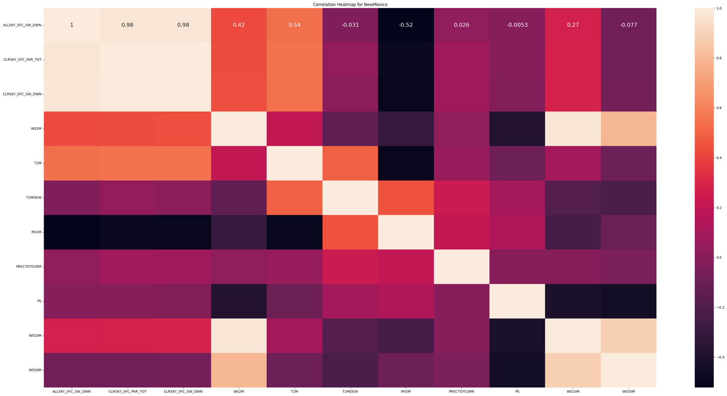
Exploratory Data Analysis Correlation Heatmap for New Mexico
Highest positive correlation across all three locations is the GHI index with the temperature, with correlations in the range of 60%

Slide 9
Model Selection
Neural Network 2-layer
Neural Network 3-layer

Slide 10
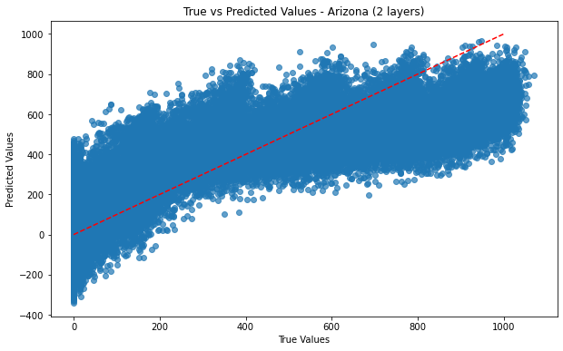
Model Comparison: Arizona Neural Network 2-layer
Key parameters:
units=64, units=1 & epochs=10
Model evaluation:
Train MSE: 31766.3
Test MSE: 31935.11
RMSE: 178.7
r2 score: 0.70

Slide 11
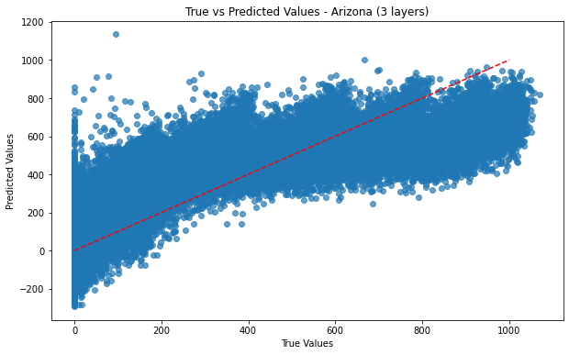
Model Comparison: Arizona Neural Network 3-layer
Key parameters:
units=64, units=4,units=1 &
epochs=20
Model evaluation:
Train MSE: 32673.16
Test MSE: 32921.79
RMSE: 181.44
r2 score: 0.69

Slide 12
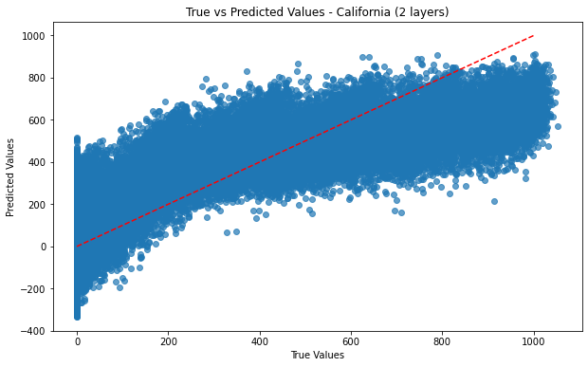
Model Comparison: California Neural Network 2-layer
Key parameters:
units=64, units=1 & epochs=30
Model evaluation:
Train MSE: 30612.33
Test MSE: 30797.69
RMSE: 175.49
r2 score: 0.71

Slide 13
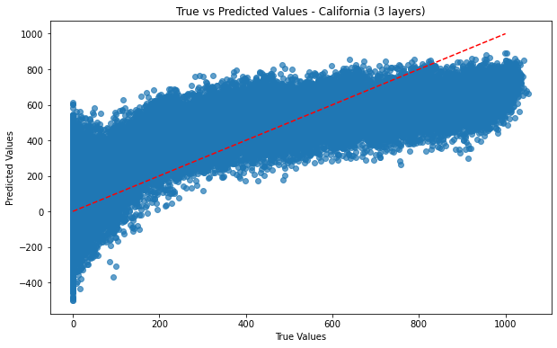
Model Comparison: California Neural Network 3-layer
Key parameters:
units=64, units=4,units=1 &
epochs=20
Model evaluation:
Train MSE: 35290.72
Test MSE: 35539.16
RMSE: 188.52
r2 score: 0.66

Slide 14
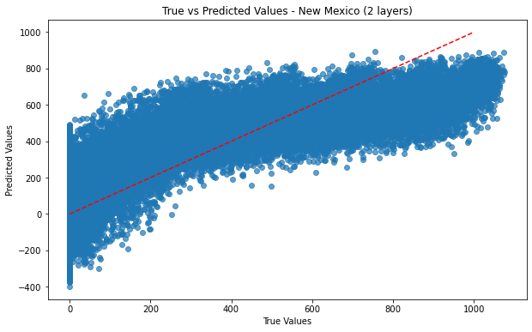
Model Comparison: New Mexico Neural Network 2-layer
Key parameters:
units=64, units=1 & epochs=30
Model evaluation:
Train MSE: 30397.05
Test MSE: 30197.81
RMSE: 173.78
r2 score: 0.71

Slide 15
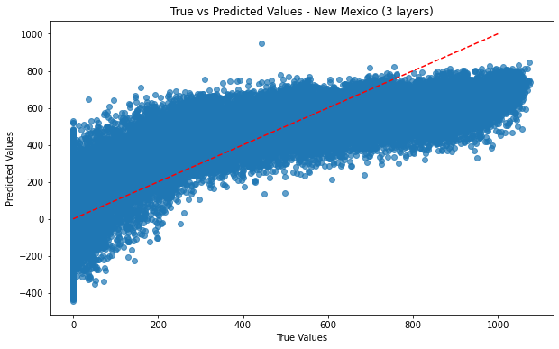
Model Comparison: New Mexico Neural Network 3-layer
Key parameters:
units=64, units=4,units=1 &
epochs=20
Model evaluation:
Train MSE: 31488.28
Test MSE: 31327.87
RMSE: 177.0
r2 score: 0.70

Slide 16
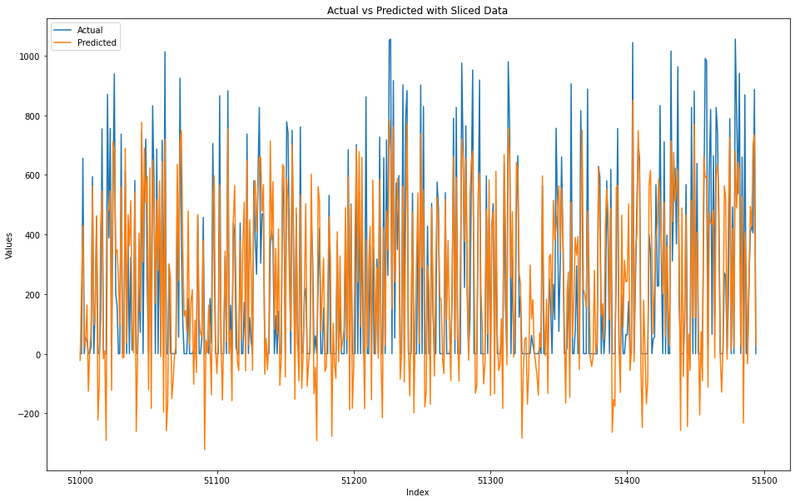
Model Comparison: True vs. Predicted True vs Predicted Values (2-layer Neural Network model)
Considering the inherent volatility in the GHI index hourly values, achieving an R squared value of 0.70 is commendable.
This pattern was observed across all three locations chosen.

Slide 17
Takeaways
The 2-layer neural network models were best suited for our regression problem
New Mexico had the lowest RMSE in both the 2-layer models and the 3-layer models.
Given the similarities in the evaluation of the 2-layer models for all three locations, the decision of to where to locate the field of solar panels can be based solely on the land cost and other costs specific to each state

Slide 18
Future Research
Look into the linear multivariate model results for this problem
Consider placing a constraint for non-negative predicted values
Look into the pattern in the residuals where the model constantly underestimated the higher GHI values

Slide 19
Questions ?

