Slide 1

Energy consumption and Weather Conditions
By Claudia Zaffaroni

Slide 2
Problem
How does the changing weather conditions affect energy consumption?
Could weather patterns help us predict the renewable energy demand?

Slide 3
Solution
Sun irradiation (GHI) helps us predict the energy consumption and is a key indicator for renewable energy possibilities

Slide 4
Data Source
Country: Poland
Collection Methodology: OpenWeatherMap API
Source link: https://www.kaggle.com/datasets/samanemami/renewable-energy-and-weather-conditions

Slide 5
Data Wrangling
Original data set had almost 200,000 rows and 17 columns or features with data collected every 15 minutes for 6 years.
No missing data but many zero values
Needed to adjust the data column to be able to make calculation and aggregate the data by day or month if needed
Target Variable: Energy Consumption

Slide 6
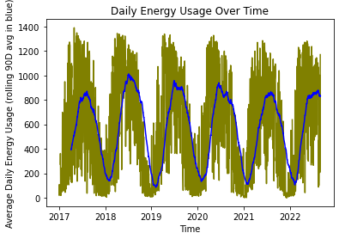
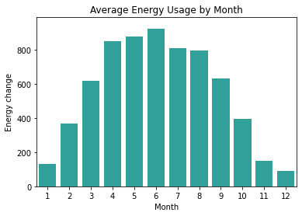
Exploratory Data Analysis Energy consumption
Seasonality of data shown with 3M moving average. Peaks falling for past 5 years
Lowest consumption: winter months
Highest consumption: summer months

Slide 7
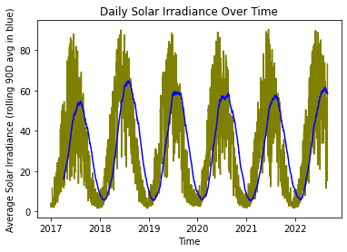
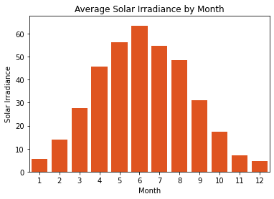
Exploratory Data Analysis Solar Irradiation (GHI)
The solar irradiation has a very similar pattern to the energy consumption. This is important since it will be the source of energy for the renewable energy receptors.

Slide 8
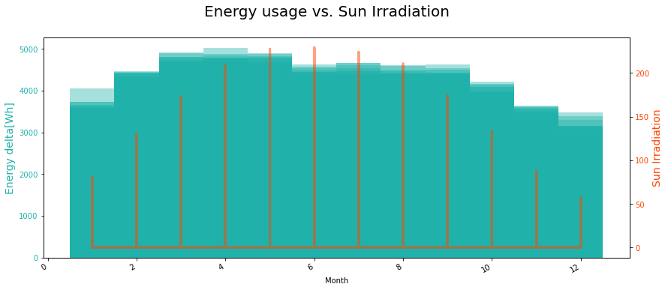
Exploratory Data Analysis

Slide 9
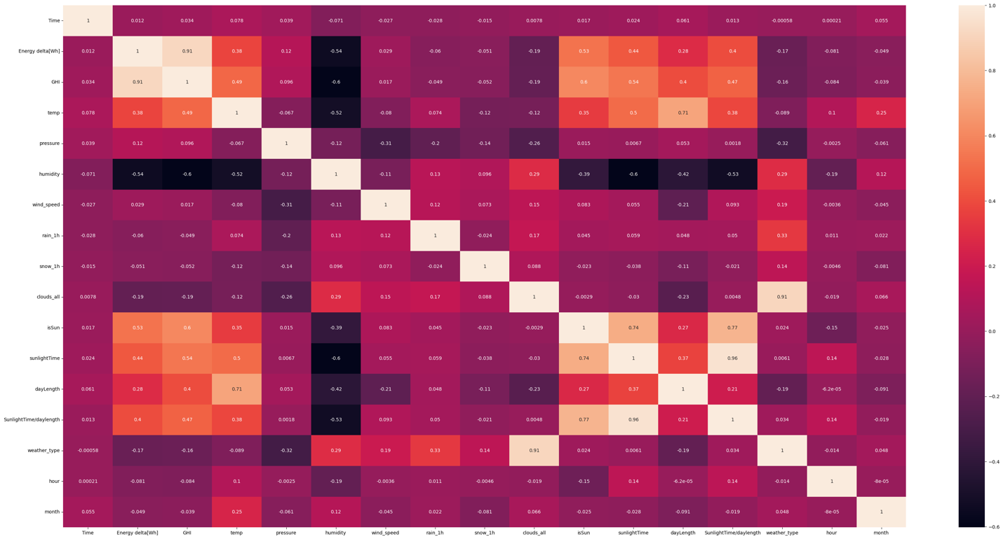
Exploratory Data Analysis Correlation Heatmap
As expected from the trends in previous slides, high correlation between energy usage and Solar Irradiance (GHI) of 91%

Slide 10
Model Selection
Linear Regression Model
Random Forest Model
Long Short Term Memory Model

Slide 11
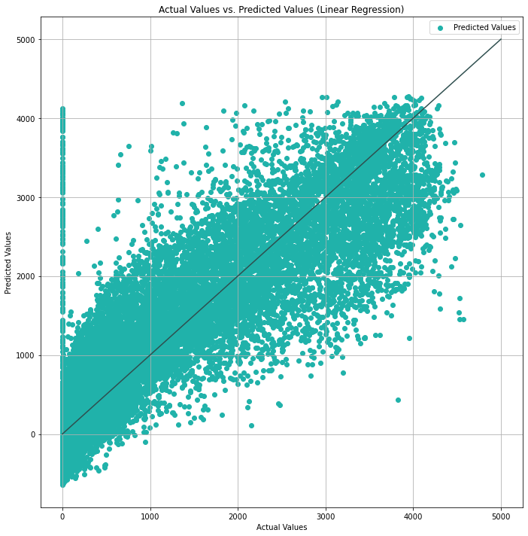
Model Comparison Linear Regression Model
Mean Absolute Error: 243.72
Mean Squared Error: 183462.87
R-squared: 0.83

Slide 12
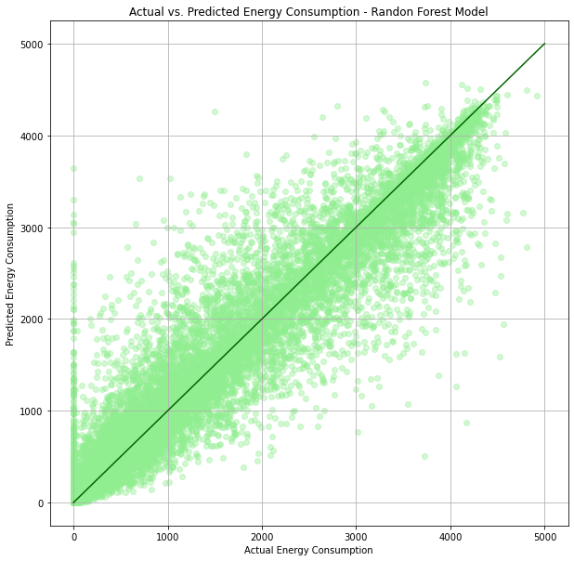
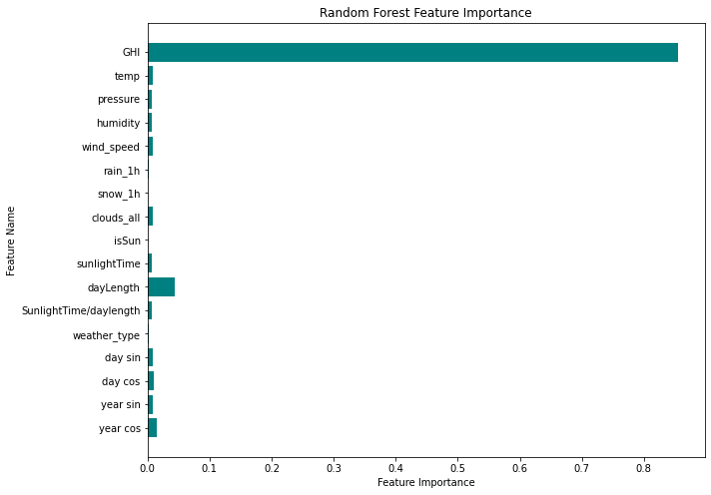
Model Comparison Random Forest Model
Mean Absolute Error: 104.77
Mean Squared Error: 68848.37
R-squared (R2) Score: 0.94

Slide 13
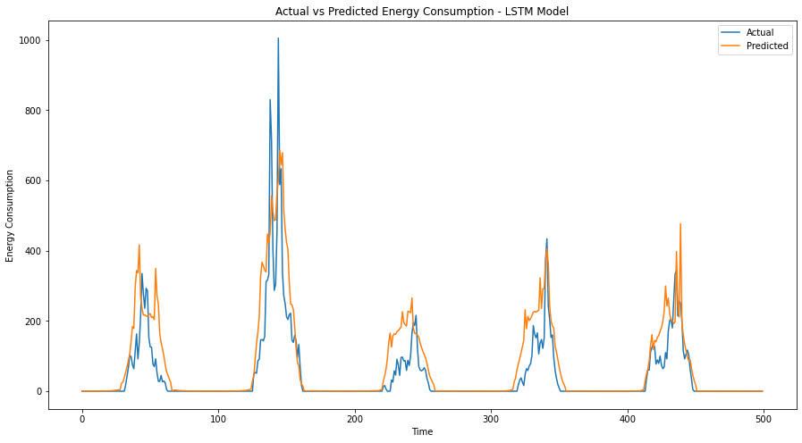
Model Comparison Random Forest Model
Mean Absolute Error: 172.22
Mean Squared Error: 167313.45
R-squared (R2) Score: 0.94

Slide 14
Takeaways
Random Forest Model was best model
Solar irradiation (GHI) was the most important feature
This an important fact because the renewable energy industry utilizes that information to calculate the amount of solar irradiation of a place to verify the viability of a renewable energy plant

Slide 15
Future Research
Look at other countries/areas to see if pattern is repeated
Explore the weather type feature by finding more information on them
Explore a SARIMA model given the strong seasonality in the data

Slide 16
Questions ?

