Slide 1
Presentation on Solving Rubik cube
Name: Bimal khatri
London Met ID: 20048661
Group: C4
Module: Artificial Intelligence
Module Leader: Mr. Abhinav Dahal

Slide 2
Explanation of AI concept used:
Artificial Intelligence (AI) is a modern engineering method for making machines or computers to think or use their intelligence like people do by copying qualities and by learning to take appropriate decisions and to perform assigned tasks properly. Simply, an artificial intelligence is the the replication of human intelligence processes by machines, especially computer systems.
According to computer science, problem-solving refers to artificial intelligence techniques, including various techniques such as forming efficient algorithms, heuristics, and performing root cause analysis to find desirable solutions. In this coursework I have used Heuristic search for solving the Rubik’s cube.

Slide 3
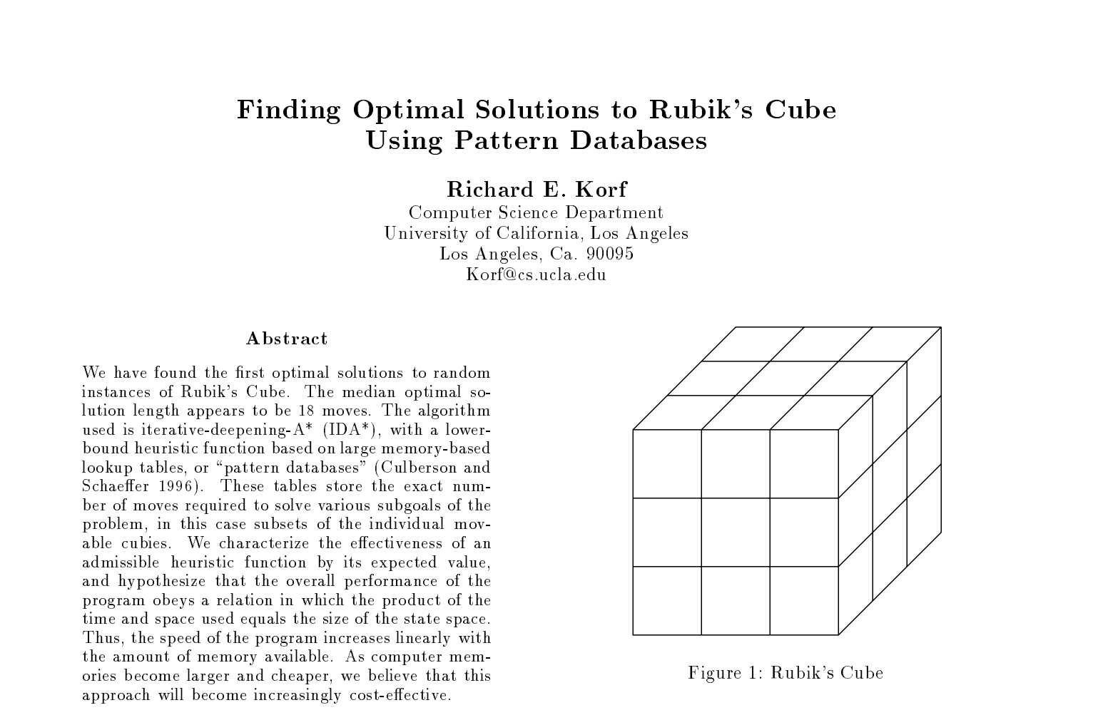
Research Evidences
Finding Optimal Solutions to Rubik’s Cube using pattern Databases
In this Journal, Richard E. Korf claims to found the optimal solution to random instances of Rubik's Cube which appears to be 18 moves. The algorithm used is iterative-deepening-A* (IDA*), with a lower- bound heuristic function based on large memory-based lookup tables, or “pattern databases". These tables store the exact number of moves required to solve various subgoals of the problem, in this case subsets of the individual movable cubies.

Slide 4
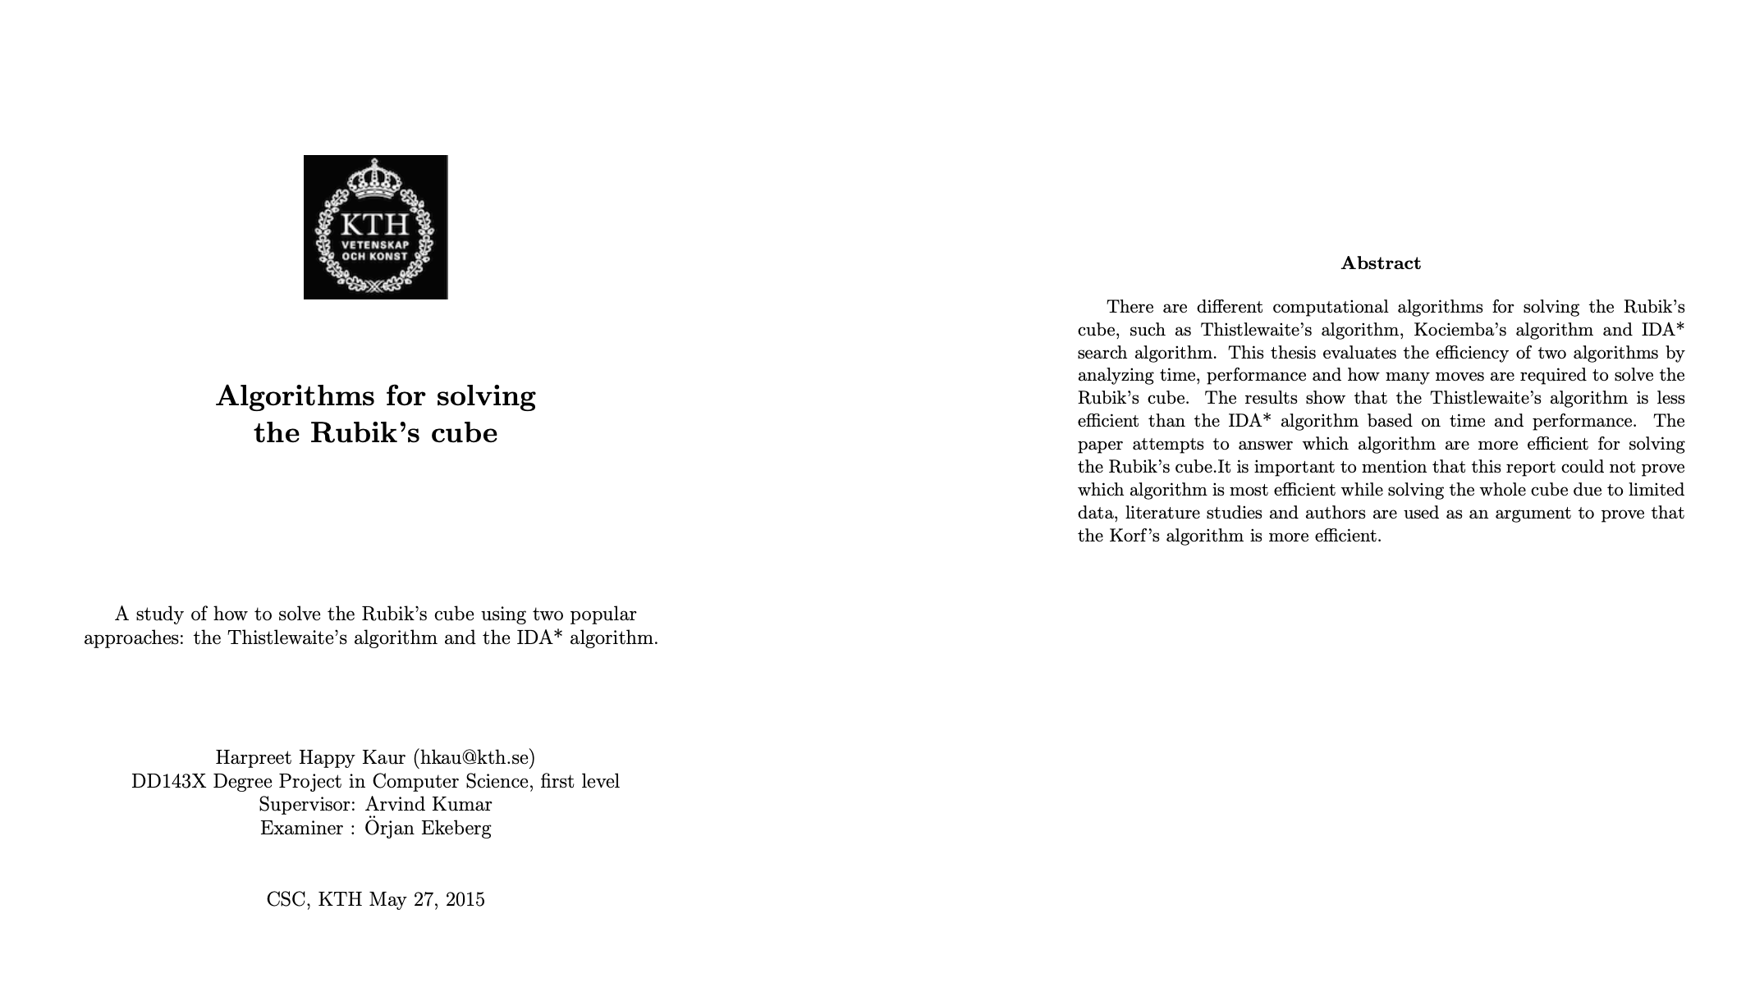
Research Evidences
Algorithms for solving Rubik’s cube
In this Journal, Harpreet Happy kaur, explains about different algorithm used to solve Rubik’s cube such as Thistlewaite's method, Kociemba's algorithm. Also, he compares different algorithm used to solve the Rubik’s cube based on time, performance and movement needed to solve the cube.

Slide 5
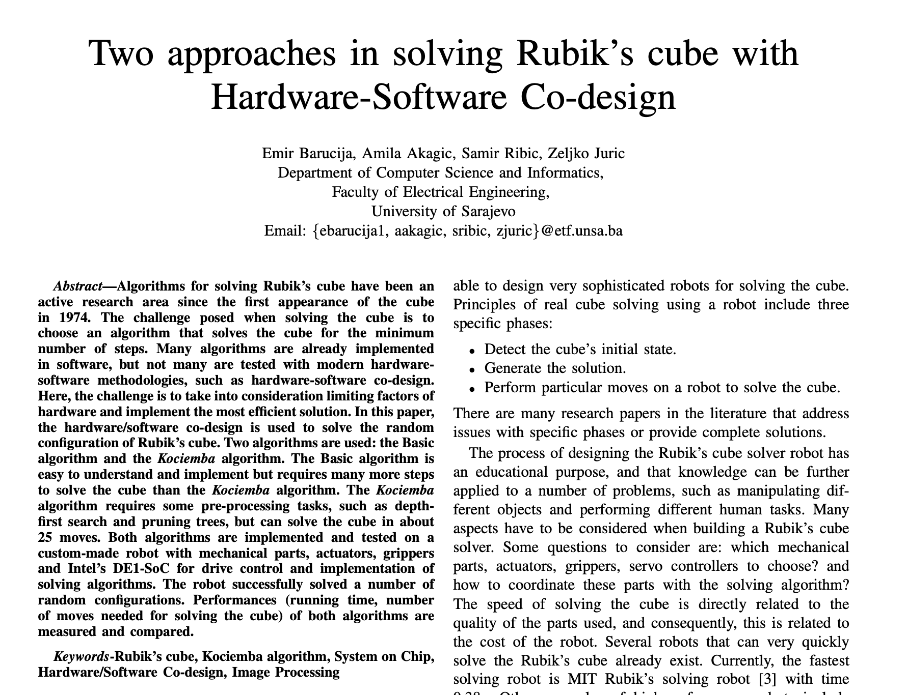
Research Evidences
Approaches in solving Rubik’s cube with Hardware-Software Co-design
In this study, the random configuration of the Rubik's cube is solved through hardware/software co-design. The Basic algorithm and the Kociemba algorithm are the two employed. Both algorithms are implemented and tested on a custom-made robot with mechanical parts, actuators, grippers and Intel’s DE1-SoC for drive control and implementation of solving algorithms. The robot successfully solved several random configurations. Performances (running time, number of moves needed for solving the cube) of both algorithms are measured and compared.

Slide 6
Reason for selection of topic
According to computer science, problem-solving refers to artificial intelligence techniques, including various techniques such as forming efficient algorithms, heuristics, and performing root cause analysis to find desirable solutions. In Artificial intelligence, problem-solving often involves investigating a solution to a problem using logical algorithms, making use of polynomial and differential equations, and executing them using modeling paradigms.
After learning about the different search algorithm and problem technique in lecture and tutorial. I personally want to learn something different in the field of searching and solving problem. For this, the coursework was very beneficial to me as I can research about the search algorithm and same research can be used in the coursework. The reason for selection of topic was:
To research about problem solving.
To use search algorithm to solve problem.
To learn about various symmetries of cube.
To solve the cube with less moves.

Slide 7
Explanation of Solution and its working mechanism
The final solution of Rubik’s cube solver is based on the solution derived by Herbert Kociemba. The kociemba’s algorithm is used to solve the Rubik’s cube in this coursework.
Kociemba’s algorithm uses two phase to solve the entire cube with only one subgroup G1 = <U,D,R2,L2,F2,B2>
In phase 1, this algorithm gets the cube into one of the state in G1. In this state, all the corners and edges are oriented and all the middle layer edges are already in the middle layer.
In phase 2, the cube in G1, is solved by using only <U, D, F2, B2, R2, L2> moves. Also, In this phase, all of the permutation of edge and corner are oriented and the Udslice is sorted.

Slide 8
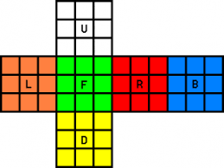
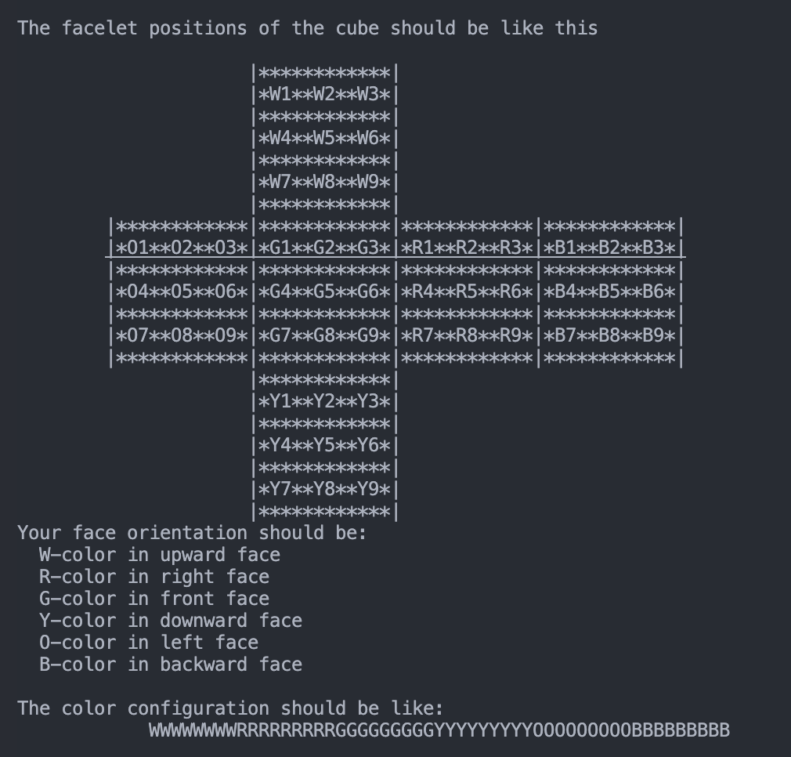
Explanation of Solution and its working mechanism
To solve the scrambled cube, at first color configuration of the scrambled cube needs to be entered. For this the cube should be aligned in such a way that, white, red and green center piece lies in up, right and down face. Similarly, the yellow, orange and blue center piece lies in down, left and back face.
After aligning the cube as described above, the color configuration should be made entered as shown in the second picture.

Slide 9
Explanation of Solution and its working mechanism
To use the solver to solve the scrambled cube, following steps are done:
Step 1: First, the main.py file is run through the terminal.
- open terminal in the folder where the main.py file is located.
- Enter python main.py to run the main.py file
- if the table for storing the manuver is not created then it is created. In this table, heuristic search is performed to find the shortest path for solving the cube.
Step 2: Enter the scrambled cube’s valid color configuration in string format.
Step 3: The solution generated is performed in the cube to solve the scrambled cube.

Slide 10


Achieved Results
Tables to search the manuever was created and loaded.
fig: loading tables
A random scrambled cube was solved in about 20 moves
fig: solving randomly scrambled cube

Slide 11
Solving real world problem
Solving rubik cube serves as an example of what the complex counting equations can be used for while studying the permutations.
The pattern of solving the rubik’s cube can also be used in other fields like path finding
Professors and scientists around the world used the Rubik’s cube as a case for studying optimal solutions, creating new algorithms.
Different cubes can also be solved using this techniques.
IDA* search algorithm which is used in the Kociemba’s algorithm is also extremely beneficial when the problem is memory constrained as IDA* does not remember any node except the ones on the current path

Slide 12
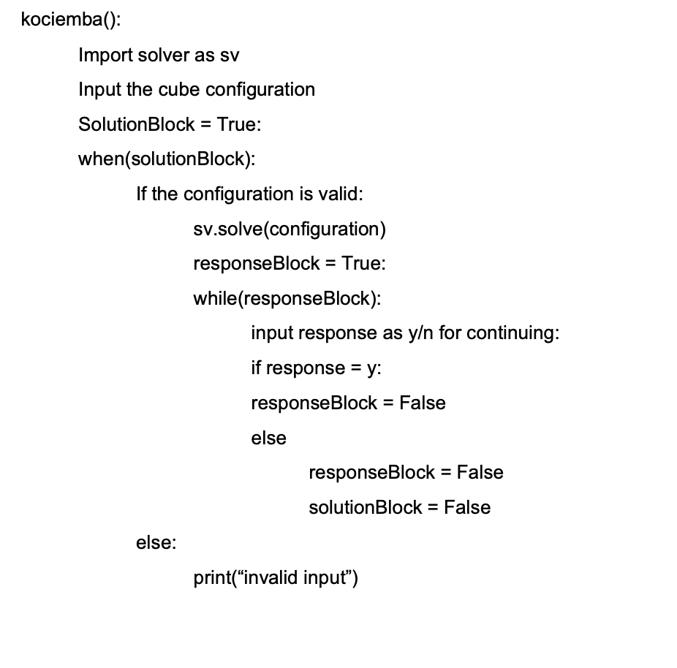
Pseudo code of the solution

Slide 13
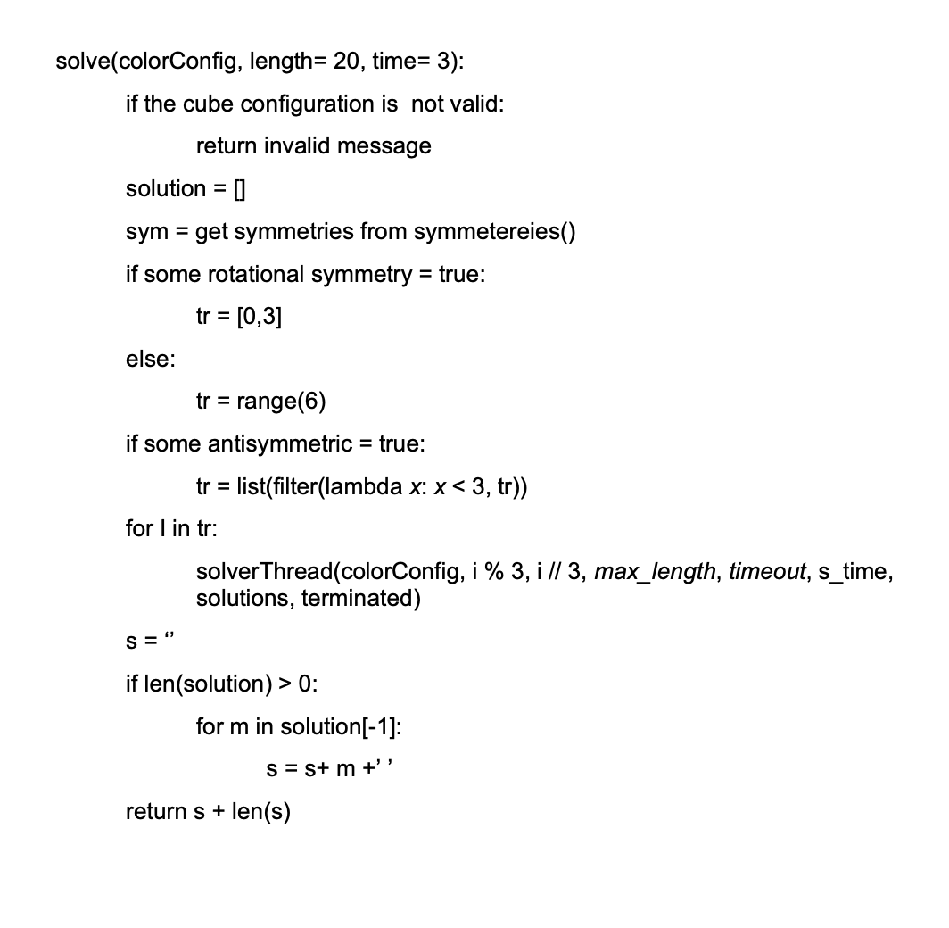
Pseudo code of the solution

Slide 14
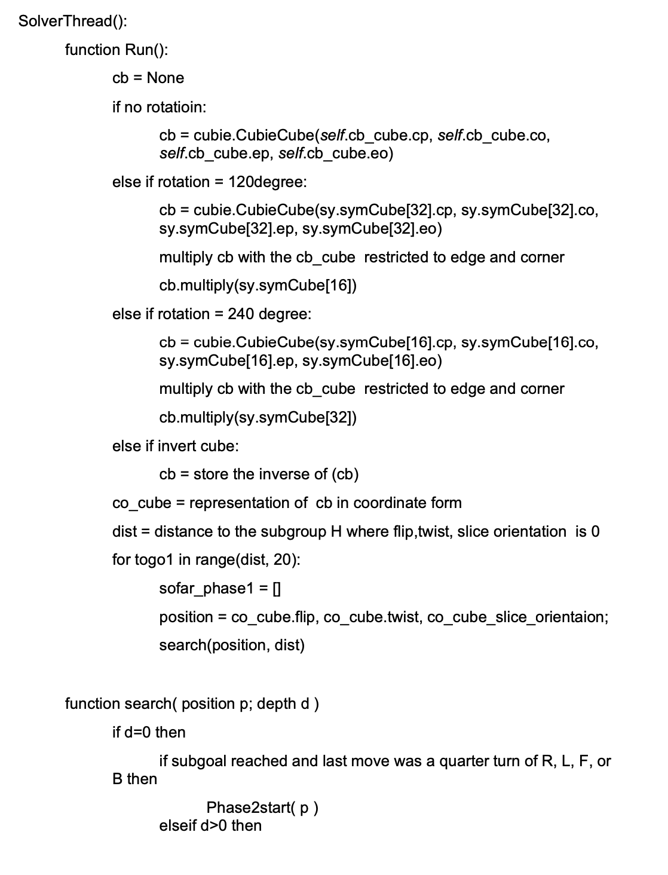
Pseudo code of the solution

Slide 15
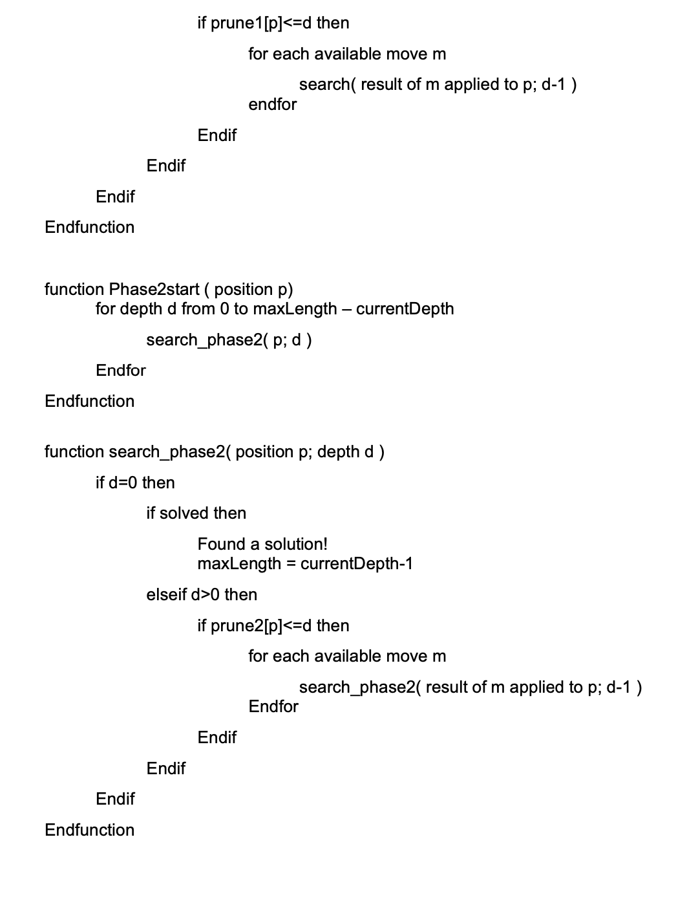
Pseudo code of the solution

Slide 16
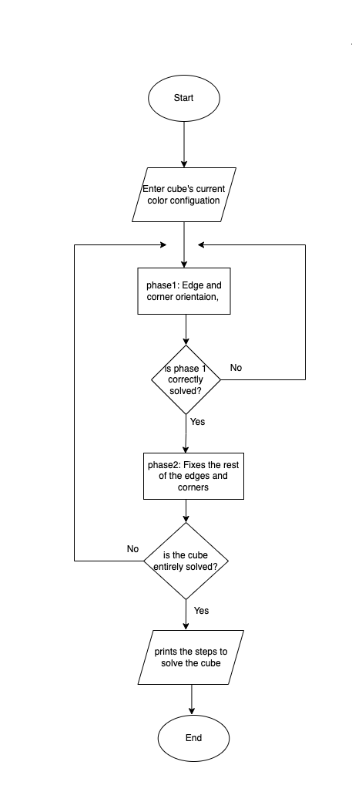
Flowchart of the solution

Slide 17
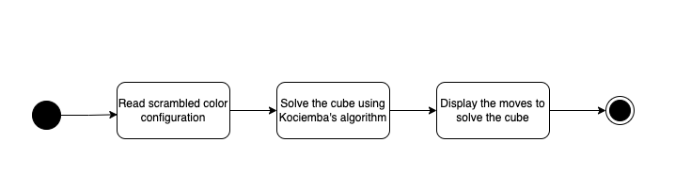
State transition diagram of the solution

Slide 18
Thank You

