Slide 1
Flag Classification
By: Kun Cheng

Slide 2
Main Idea
Use blender’s physical simulation to make flag images which are like the real-world flag image.
Train the model, do the flag classification, see the performance.
Problems:
Different types and shapes of flag.
Different methods and algorithms.
How to evaluate the model.

Slide 3
Dataset
3 different class of flags, each of them has 250 images. All the images are resized to 400 x 300, PNG files.
Training Set: 175 images(70%)
Test Set: 37 images(15%)
Validation Set: 38 images(15%)

Slide 4
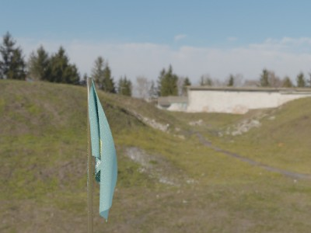
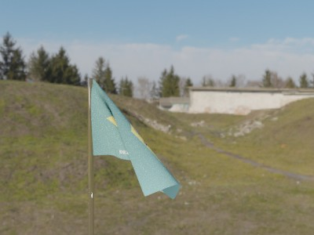
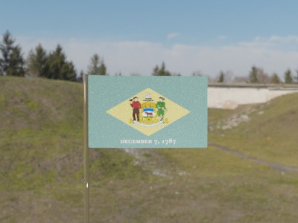
Dataset
Blender
Physical simulation flag + HDRI background + animation
Different strength of the wind
Use keyframes to set different location, rotation and strength, to simulate the flag’s shape under different wind situation.

Slide 5
Algorithm and Method
Neural Network
Convolutional Neural Network(CNN)
Detectron2
All of these method and algorithm we can use Pytorch to implement.

Slide 6
Algorithm and Method
Neural Network
Input layer nodes: sizeW * sizeH * 3(400*300*3)
2 Hidden layers nodes: 84,50
Output layer: 3

Slide 7
Algorithm and Method
Convolutional Neural Network(CNN)

Slide 8
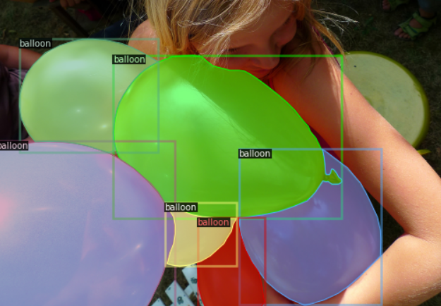
Algorithm and Method
Detectron2
It trains much faster
Colab & Tutorial

