Slide 1
Asthma Treatment Step: Longitudinal Analysis
Longitudinal Data Analysis Project
Chong Kim

Slide 2
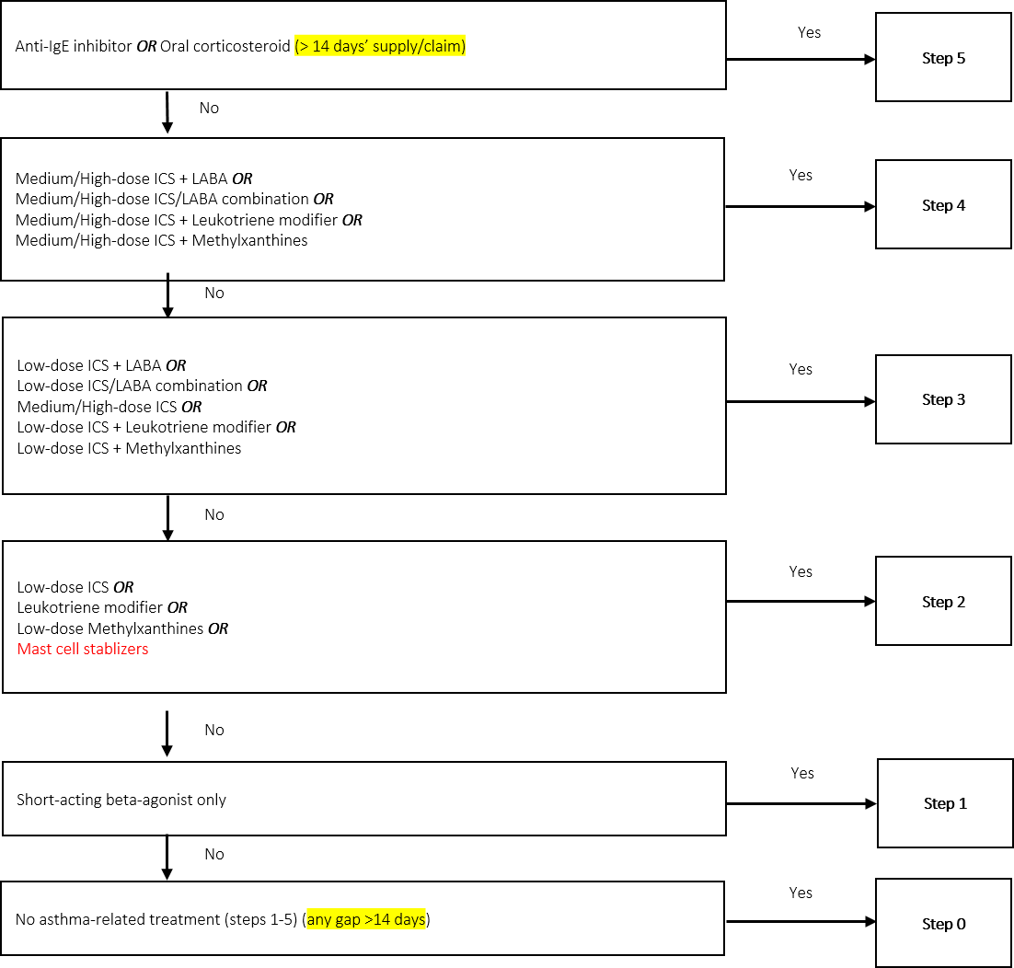


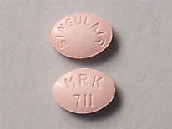


Background

Slide 3
Research Questions
What are the demographic variables that are associated with treatment steps?
Hypothesize that likelihood of asthma treatment step will be different for different patient characteristics (i.e. age, cci, gender, region, and insurance)
Probability of treatment step (ref. step 0) for 1 unit increase in cci?
Probability of treatment step for females vs. male?
Probability of treatment step by insurance type?
What are the treatment steps associated with event probability?
Hypothesize that likelihood of asthma exacerbation event will be different for different treatment steps

Slide 4
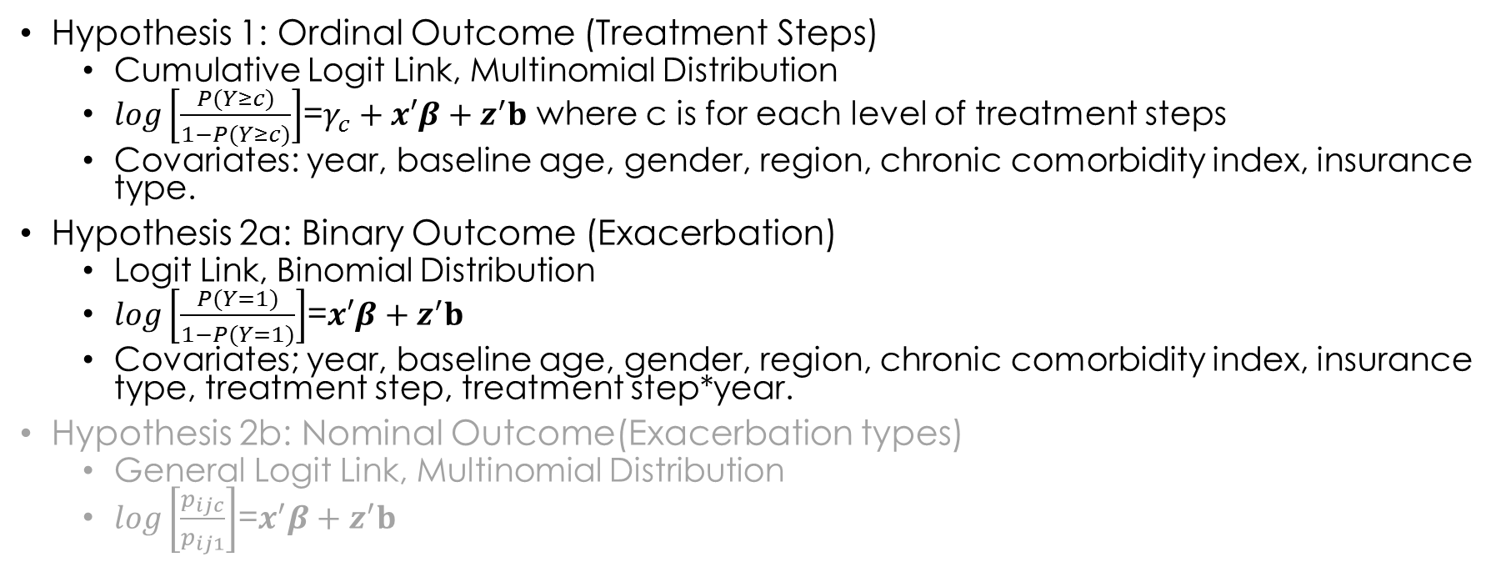
method
Hypothesis 1: Ordinal Outcome (Treatment Steps)
Cumulative Logit Link, Multinomial Distribution
$log\left[\frac{P(Y≥c)}{1−P(Y≥c)}\right]$=$γ_{c}+x′β+z^{′}b$ where c is for each level of treatment steps
Covariates: year, baseline age, gender, region, chronic comorbidity index, insurance type.
Hypothesis 2a: Binary Outcome (Exacerbation)
Logit Link, Binomial Distribution
$log\left[\frac{P(Y=1)}{1−P(Y=1)}\right]$=$x′β+z^{′}b$
Covariates; year, baseline age, gender, region, chronic comorbidity index, insurance type, treatment step, treatment step*year.
Hypothesis 2b: Nominal Outcome(Exacerbation types)
General Logit Link, Multinomial Distribution
$log\left[\frac{p_{ijc}}{p_{ij1}}\right]$=$x^{′}β+z^{′}b$

Slide 5
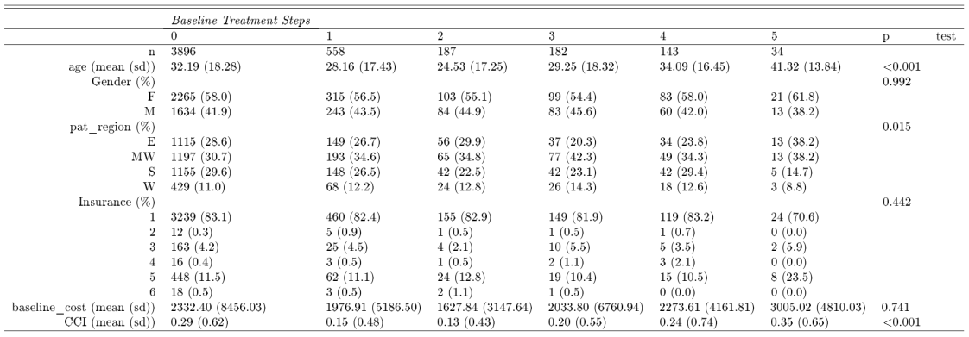
Results

Slide 6
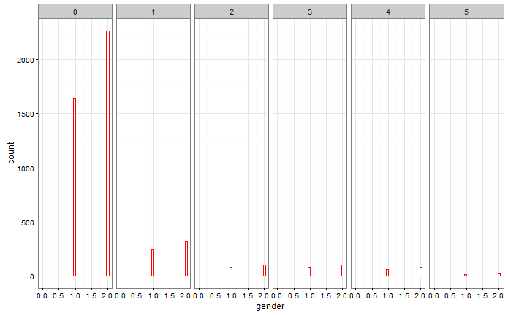
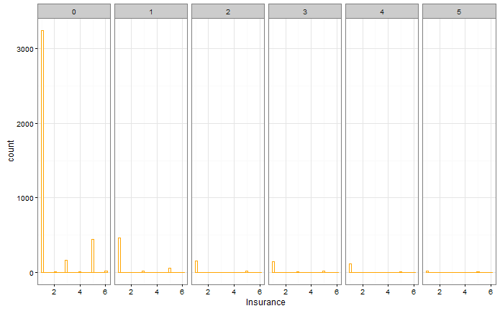
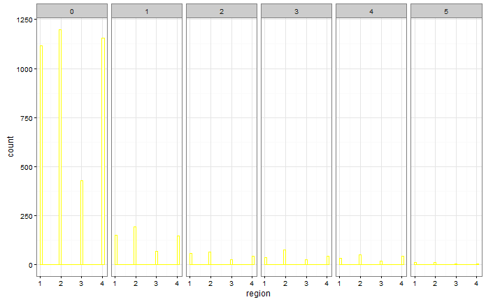
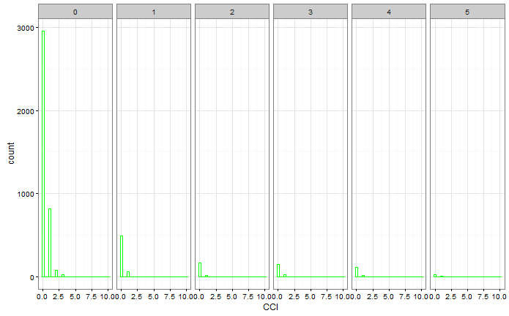
Results

Slide 7
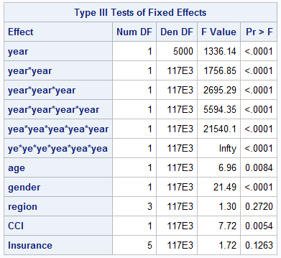
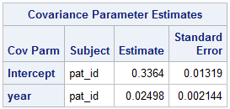

Hypothesis 1
Year, age, gender, CCI (p<0.05)
*ICC=$??$

Slide 8
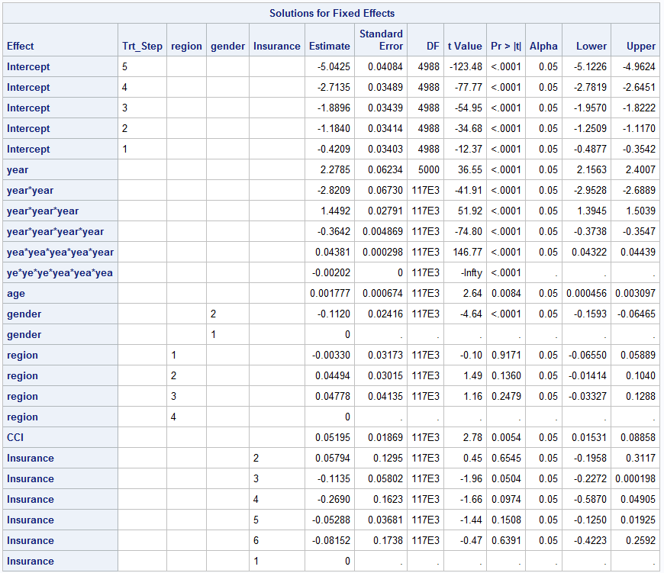
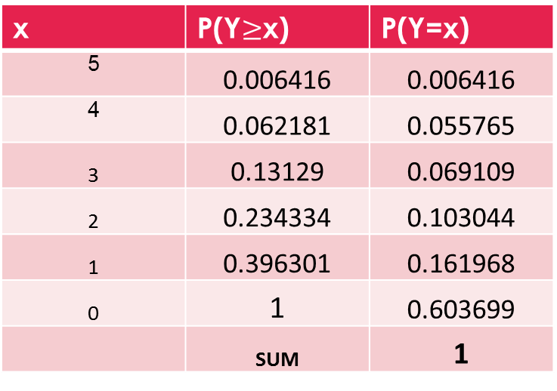
Hypothesis 1
x | P(Y$≥$x) | P(Y=x)
5 | 0.006416 | 0.006416
4 | 0.062181 | 0.055765
3 | 0.13129 | 0.069109
2 | 0.234334 | 0.103044
1 | 0.396301 | 0.161968
0 | 1 | 0.603699
 | SUM | 1

Slide 9
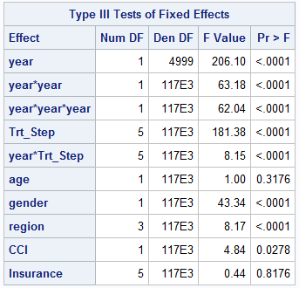
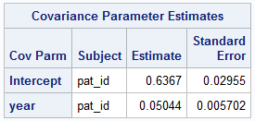
Hypothesis 2
Year, Treatment step, Gender, Region, and CCI are associated with event probability (p<0.05).

Slide 10
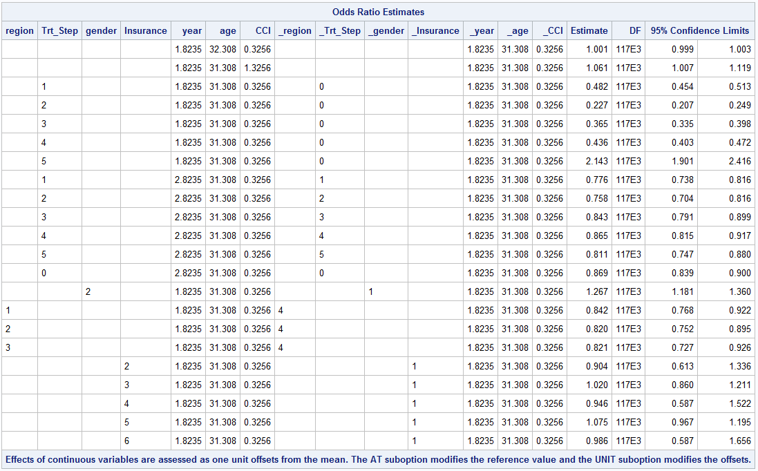

Slide 11
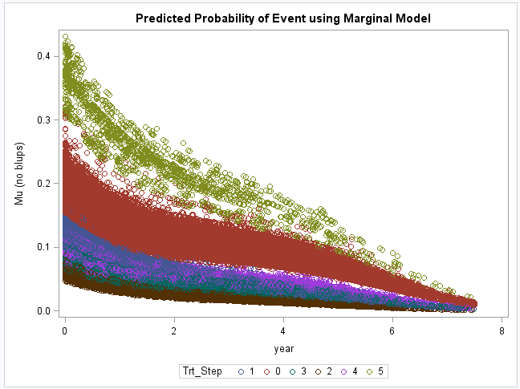
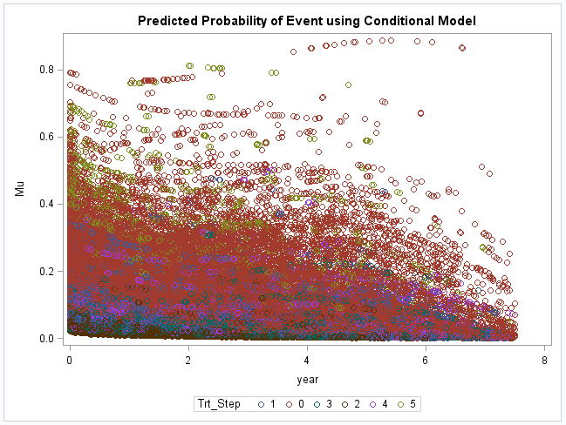
Population Avg vs. Subject specific Predicted Probabilities

Slide 12
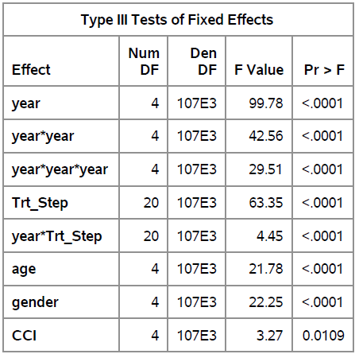
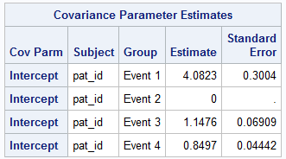
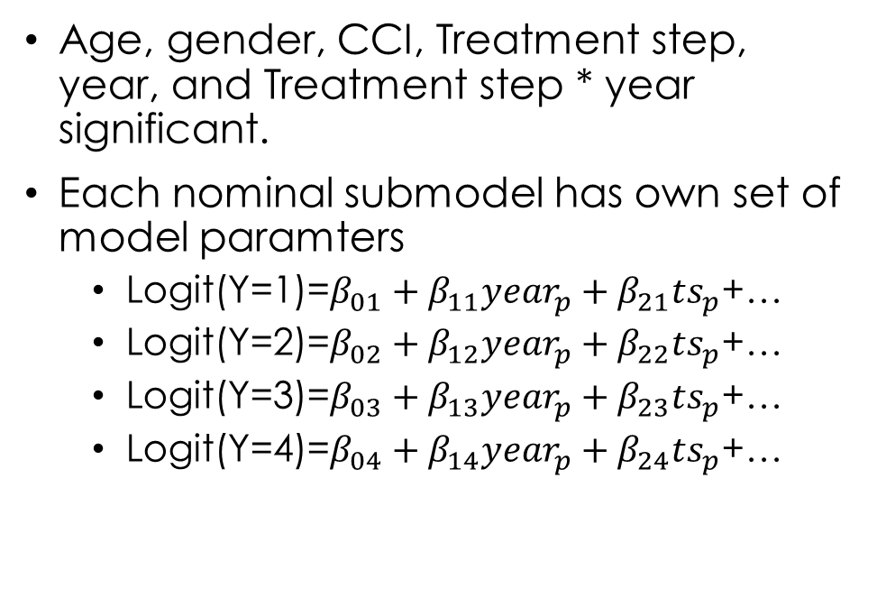
Hypothesis 2b
Age, gender, CCI, Treatment step, year, and Treatment step * year significant.
Each nominal submodel has own set of model paramters
Logit(Y=1)=$β_{01}+β_{11}{year}_{p}+β_{21}{ts}_{p}$+…
Logit(Y=2)=$β_{02}+β_{12}{year}_{p}+β_{22}{ts}_{p}$+…
Logit(Y=3)=$β_{03}+β_{13}{year}_{p}+β_{23}{ts}_{p}$+…
Logit(Y=4)=$β_{04}+β_{14}{year}_{p}+β_{24}{ts}_{p}$+…

Slide 13
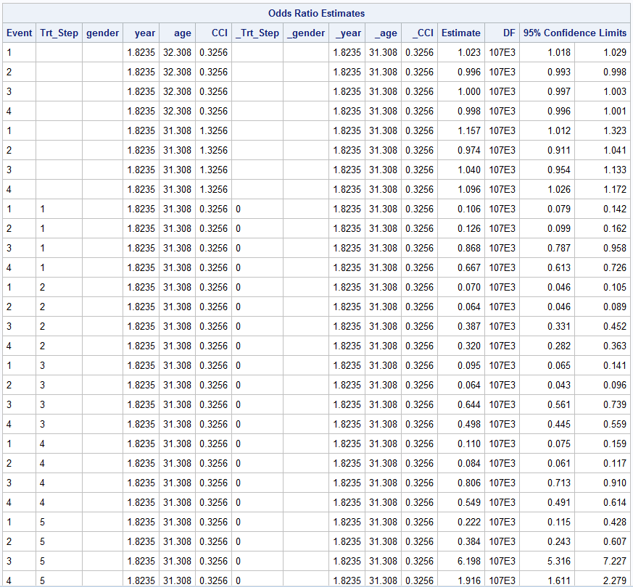
Main effect not interaction

Slide 14
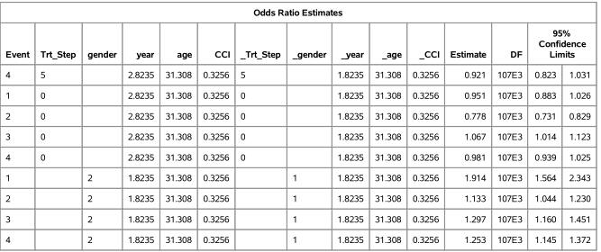
Odds of exacerbation event decreases over time for those in step 5

Slide 15
Conclusion
Age and CCI are associated with the asthma treatment step.
The probability of subject being in treatment step 0 is pretty high (0.67) given fixed effects and random intercept
Treatment step, gender, and CCI are strongly associated with asthma exacerbation event.
1.17x greater odds of event for 1 unit increase in CCI
Treatment steps 1-4 have lower odds of event compared to step 0 but step 5 has higher odd (1.97x) of event compared to step 0
Treatment step*year indicates that each steps have lower odds of event per 1 year increase in time.
Females have a higher odds of event (1.25x) compared to men.

Slide 16
Limitations
Proportional odds assumption for Hypothesis 1.
Fixed slopes for each predictor effects to be the same for each submodel.
Nominal Mixed Model: estimating separate intercept, fixed, and random effects variances for each sub model
Ordinal Mixed Model: Vary fixed effects but not random effects.
Adherence to treatment not adjusted for
Use Proportion of day covered (PDC) or Medication possession ratio (MPR)
Only used 5k due to taking more than 24 hours to run with full cohort (n ~55,000)
Perhaps borrow Watson for a couple of days and run the total cohort

Slide 17
Questions?

