Slide 1



Multilevel Discrete-time Event History Analysis
Centre for Multilevel Modelling
Graduate School of Education
University of Bristol
13-14 September 2007
Instructor: Fiona Steele

Slide 2
Course Outline
Discrete-time methods for modelling time to a single event
Multilevel models for recurrent events and unobserved heterogeneity
Modelling transitions between multiple states
Modelling competing risks
Multiprocess models for correlated histories
Multilevel Discrete-Time Event History Analysis

Slide 3
Discrete-time Methods for Modelling the Time to a Single Event

Slide 4
What is Event History Analysis?
Methods for analysis of length of time until the occurrence of some event. The dependent variable is the duration until event occurrence.
EHA also known as:
Survival analysis (particularly in biostatistics and when event is not repeatable)
Duration analysis
Hazard modelling
Multilevel Discrete-Time Event History Analysis

Slide 5
Examples of Applications
Education – time to leaving full-time education (from end of compulsory education); time to exit from teaching profession
Economics – duration of an episode of unemployment or employment
Demography – time to first birth (from when?); time to first marriage; time to divorce
Psychology – duration to response to some stimulus
Multilevel Discrete-Time Event History Analysis

Slide 6
Special Features of Event History Data
Durations are always positive and their distribution is often skewed
Censoring – there are usually people who have not yet experienced the event when we observe them
Time-varying covariates – the values of some covariates may change over time
Multilevel Discrete-Time Event History Analysis

Slide 7
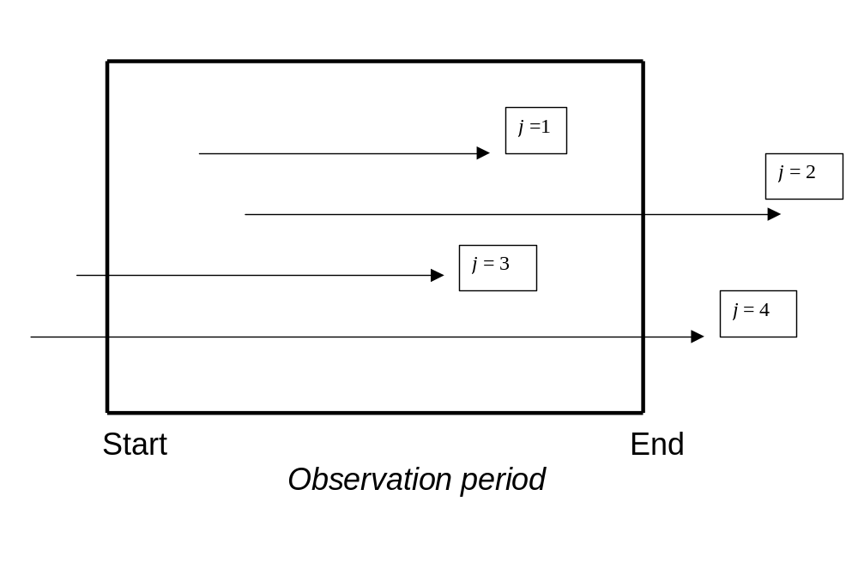
Censoring (1)
Multilevel Discrete-Time Event History Analysis

Slide 8
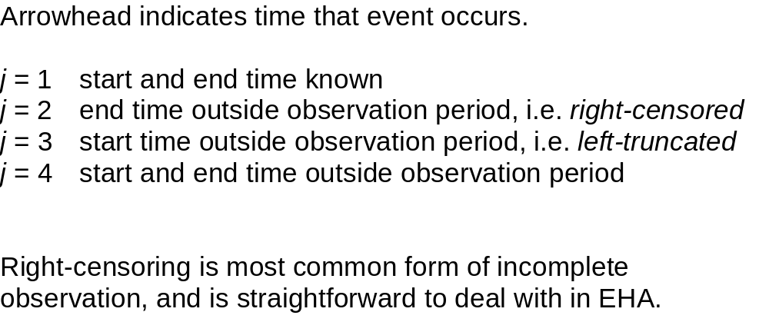
Censoring (2)
Multilevel Discrete-Time Event History Analysis

Slide 9
Right-censoring: Non-informative Assumption
Excluding right-censored observations leads to bias and may drastically reduce sample size. In EHA we retain these observations and usually make the assumption that censoring is non-informative, i.e. event times are independent of censoring mechanism (like the ‘missing at random’ assumption).
Assume individuals are not selectively withdrawn from the sample because they are more or less likely to experience an event. May be questionable in experimental research, e.g. if more susceptible individuals were selectively withdrawn from a ‘treatment’ group.
Multilevel Discrete-Time Event History Analysis

Slide 10
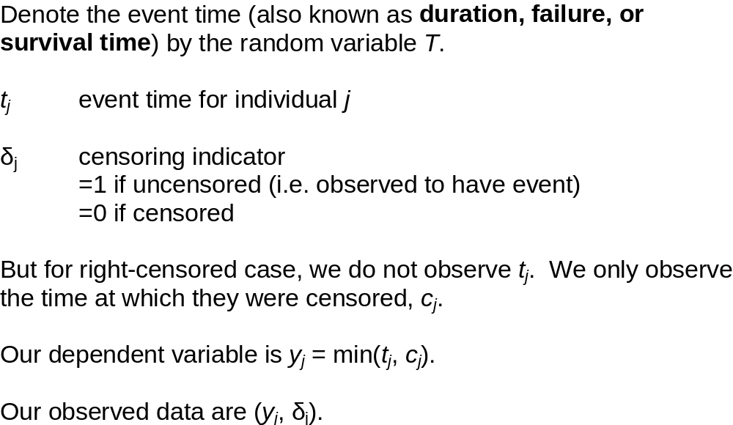
Event Times and Censoring Times
Multilevel Discrete-Time Event History Analysis

Slide 11
The Discrete-time Approach
Event times measured in discrete intervals t=1, 2, 3, . . . (e.g. months, years).
Can think of event history as a series of independent success/failure trials. In each interval t we observe a binary response indicating whether an event has occurred.
Multilevel Discrete-Time Event History Analysis

Slide 12
Main Advantages of the Discrete-time Approach
Events times often measured in discrete-time units, particularly when collected retrospectively
Allows proportional hazards assumption to be tested straightforwardly. Straightforward to allow for non-proportional hazards.
Analysis straightforward as we can use models for discrete response data – important for more complex data structures and processes
Multilevel Discrete-Time Event History Analysis

Slide 13
Disadvantages of the Discrete-time Approach
Data must first be restructured so that for each individual we have a sequence of observations, one for each time interval until event occurrence or censoring.
If observation period is long relative to the width of the time intervals in which durations are measured, the dataset may become very large.
Multilevel Discrete-Time Event History Analysis

Slide 14
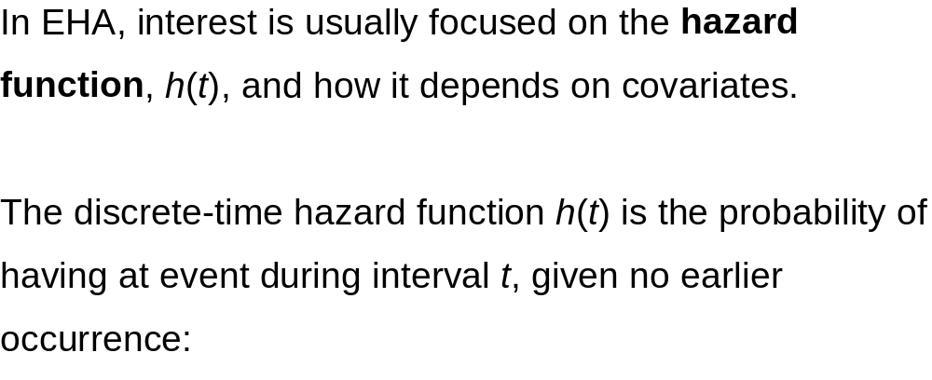

Discrete-time Hazard Function
where T is the event time.
Discrete-time hazard often denoted by h_{t}
Multilevel Discrete-Time Event History Analysis

Slide 15
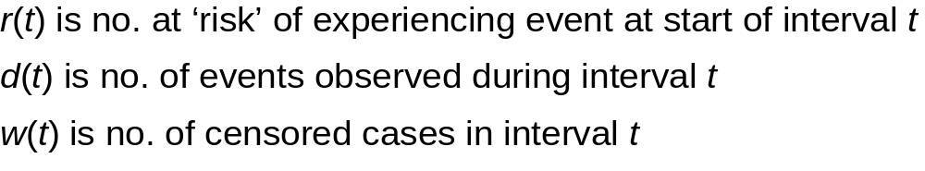
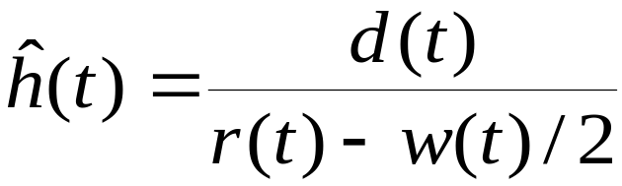
Non-parametric Estimation of h(t)
The life table (or actuarial estimator) of h(t) is
Note: assume censoring times are spread uniformly across interval t. Some estimators ignore censored cases.
Multilevel Discrete-Time Event History Analysis

Slide 16
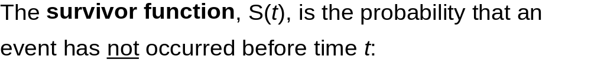

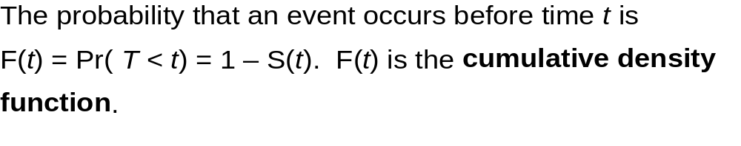
Discrete-time Survivor Function
Multilevel Discrete-Time Event History Analysis

Slide 17
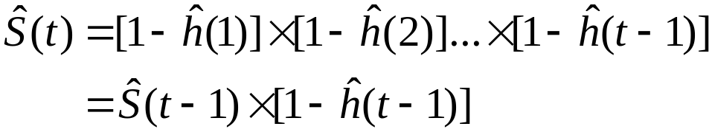
Estimation of S(t)
Estimator of survivor function for interval t is
Note: Sometimes survivor function defined as S(t)=Pr(T>t).
Multilevel Discrete-Time Event History Analysis

Slide 18
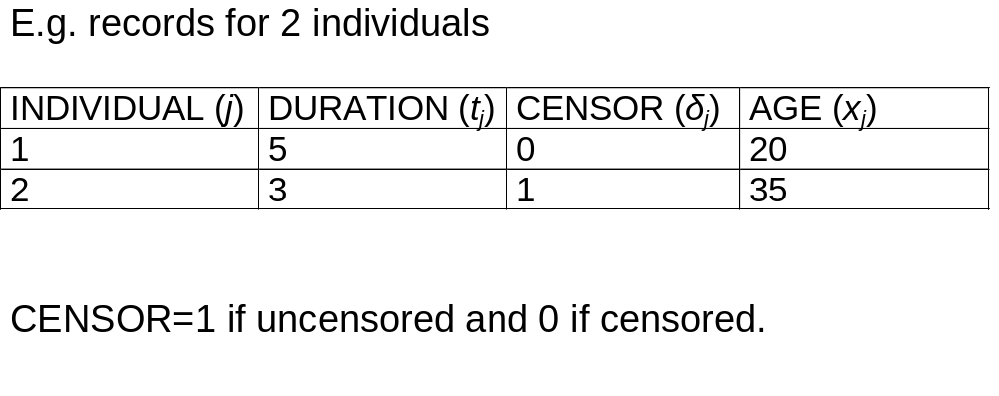
Restructuring Data for a Discrete-time Analysis: Individual-based File
Multilevel Discrete-Time Event History Analysis

Slide 19
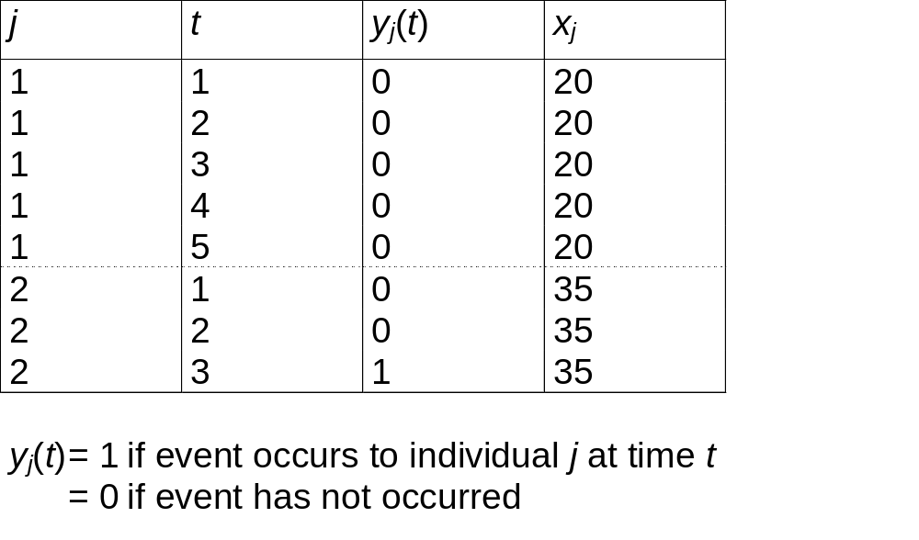
Restructuring Data for a Discrete-time Analysis: Discrete-time (Person-period) File
Multilevel Discrete-Time Event History Analysis

Slide 20
The Discrete-time Logit Model (1)
The response variable for a discrete-time model is the binary indicator of event occurrence y_{j}(t).
The hazard function may be written as
Multilevel Discrete-Time Event History Analysis

Slide 21
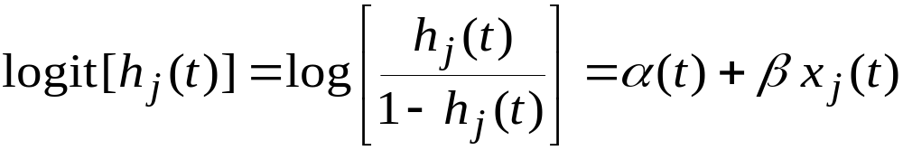
The Discrete-time Logit Model (2)
We can fit a logit regression model of the form:
(*)
The covariates x_{j}(t) can be constant over time or time-varying.
α(t) is some function of time, called the logit of the baseline hazard function. This needs to be specified.
Multilevel Discrete-Time Event History Analysis

Slide 22

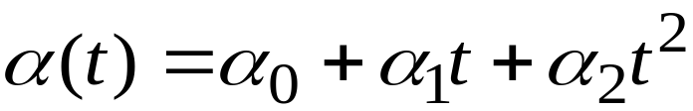
Modelling the Time-dependency of the Hazard (1)
Changes in h(t) over time are captured by α(t). This might be a linear or quadratic function.
Linear:
Quadratic:
Multilevel Discrete-Time Event History Analysis

Slide 23
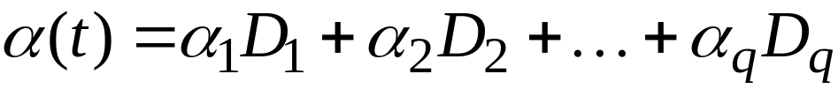
Modelling the Time-dependency of the Hazard (2)
In the most flexible model, time is treated as a categorical variable with a category for each time interval, leading to a step function:
where D₁, D₂, . . ., D_{q} are dummies for time intervals t=1, 2, . . ., q, and q is the maximum observed event time. (Alternatively we can choose one time interval as the reference and fit an overall intercept term.)
If q is very large, categories can be grouped together – piecewise constant hazard model.
Multilevel Discrete-Time Event History Analysis

Slide 24
The Proportional Hazards Assumption
Model (*) assumes that the effects of covariates x(t) are constant over time. This is known as the proportional hazards assumption. (Strictly it is the odds that are assumed proportional as we are fitting a logit model.)
We can relax this assumption by introducing interactions between x(t) and α(t).
Multilevel Discrete-Time Event History Analysis

Slide 25
Grouping Time Intervals
When we move to more complex models, a potential
problem with the discrete-time approach is that creating one
record per discrete time unit may lead to a large dataset.
It may be possible to group time intervals, e.g. using
6-month rather than monthly intervals. In doing so, we have
to assume that the hazard and values of covariates are
constant within the grouped intervals.
Multilevel Discrete-Time Event History Analysis

Slide 26
Analysing Grouped Time Intervals
If we have grouped time intervals, we need to allow for
different lengths of exposure time within these intervals.
For example, for any 6-month interval, some individuals
will have the event or be censored after the first month while
others will be exposed for the full 6 months. Denote by n_{j}(t)
the exposure time for individual j in grouped interval t.
We then define a new response y*_{j}(t)=y_{j}(t)/ n_{j}(t) and declare
n_{j}(t) as a denominator for this proportion.
Note: intervals do not need to be the same width.
Multilevel Discrete-Time Event History Analysis

Slide 27
Example of Grouped Time Intervals
Suppose an individual is observed to have an event during
the 17th month, and we wish to group durations into 6-month
intervals (t).
j | t | n_{j}(t) | y_{j}(t) | y*_{j}(t)
1 | 1 | 6 | 0 | 0
1 | 2 | 6 | 0 | 0
1 | 3 | 5 | 1 | 0.2
Multilevel Discrete-Time Event History Analysis

Slide 28
Example: Singer & Willett (1993)
Longitudinal data following career paths of 3,941 special educators in Michigan, hired between 1972 and 1978.
Event of interest is stopping teaching by 1985 (end of observation period). So maximum duration is 12 years. Minimum censoring time is 7 years.
Multilevel Discrete-Time Event History Analysis

Slide 29
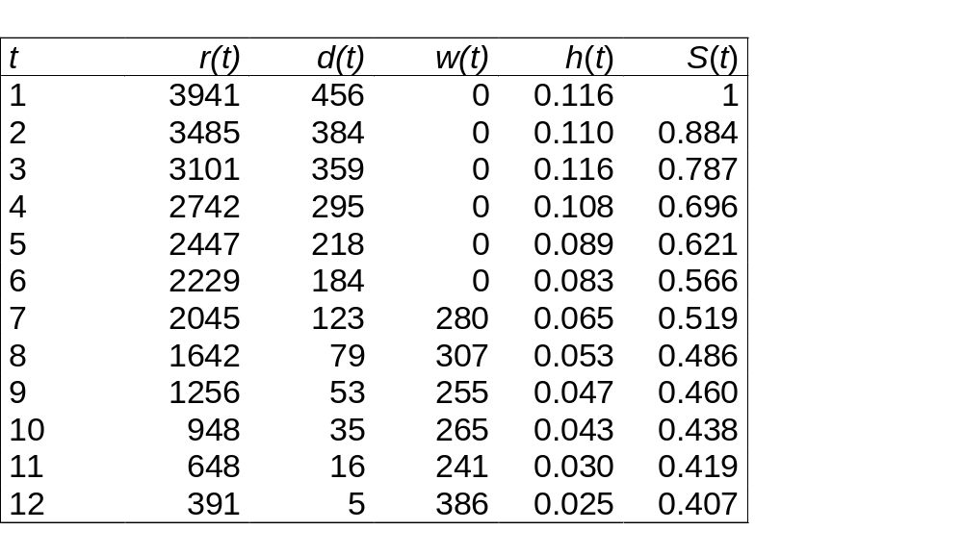
Hazard and Survivor Functions
Multilevel Discrete-Time Event History Analysis

Slide 30
Examples of Interpretation
10.8% of teachers who were still teaching at the start of their 4th year, left during their 4th year [h(4)].
40.7% of teachers were still teaching at the start of their 12th year [S(12)].
Multilevel Discrete-Time Event History Analysis

Slide 31
Discrete-time Logit Model
The following results are from fitting a model of the form
logit[h(t)] = α(t) + β FEMALE
where α(t) = α₁D₁ + α₂D₂ + . . . + α₁₂D₁₂
D₁, D₂, . . ., D₁₂ are dummies for years 1, 2, . . . 12
(no overall intercept)
FEMALE is a dummy for sex.
Multilevel Discrete-Time Event History Analysis

Slide 32
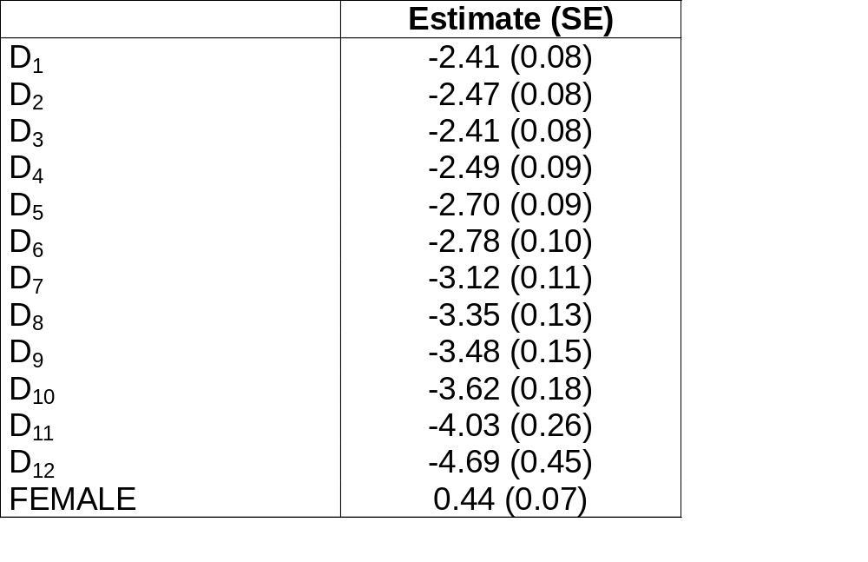
Results from Fitting Logit Model
Multilevel Discrete-Time Event History Analysis

Slide 33
Unobserved Heterogeneity

Slide 34
Introduction
Some individuals will be more at risk of experiencing an event than others, and it is unlikely that the reasons for this variability in the hazard will be fully captured by covariates.
The presence of unobserved (or unobservable) individual-specific risk factors leads to unobserved heterogeneity in the hazard.
Unobserved heterogeneity is also referred to as frailty, particularly in biostatistics (more ‘frail’ individuals have a higher mortality hazard).
Multilevel Discrete-Time Event History Analysis

Slide 35
Consequences of Unobserved Heterogeneity
If there are individual-specific unobserved factors that affect the
hazard, the observed form of the hazard function at the aggregate
population level will tend to be different from those at the individual
level.
Even if the hazards of individuals in a population are constant over
time the aggregate population hazard may be time-dependent,
typically decreasing. This may be explained by a selection effect
operating on individuals.
Multilevel Discrete-Time Event History Analysis

Slide 36
Selection Effect
If a population is heterogeneous in its susceptibility to
experiencing an event, high risk individuals will tend to have the event first, leaving lower risk individuals in the population.
Therefore as t increases the population is increasingly depleted of those individuals most likely to experience the event, leading to a decrease in the population hazard.
Because of this selection, we may see a decrease in the population hazard even if individual hazards are constant (or even increasing).
Multilevel Discrete-Time Event History Analysis

Slide 37
Impact of Unobserved Heterogeneity on Parameter Estimates
If unobserved heterogeneity is incorrectly ignored:
A positive duration dependence will be underestimated,
while a negative duration dependence will be
overestimated.
(ii) The magnitude of regression coefficients will be
underestimated. BUT note that estimates from a frailty
model have a different interpretation – see later.
Multilevel Discrete-Time Event History Analysis

Slide 38
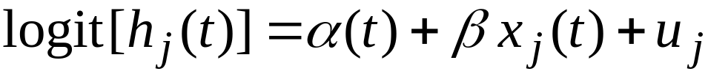
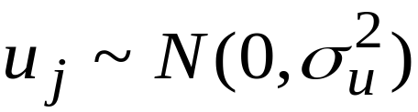

Allowing for Unobserved Heterogeneity in a Discrete-Time Model
We can introduce a random effect which represents individual-specific unobservables:
Usually assume
represents unobserved heterogeneity or frailty.
Multilevel Discrete-Time Event History Analysis

Slide 39
Interpretation of Coefficients from a Frailty Model
Suppose we have a continuous covariate x, with coefficient β.
In model without frailty, exp(β) is an odds ratio. It compares the odds of an event for two randomly selected individuals with x-values 1 unit apart (and the same values for other covariates in the model). exp(β) is the population averaged effect of x.
In model with frailty, exp(β) is an odds ratio only when the random effect is held constant, i.e. if we are comparing two hypothetical individuals with the same random effect value. exp(β) is the individual-specific effect of x.
Multilevel Discrete-Time Event History Analysis

Slide 40
Example
Time to first partnership (Practical Exercise 1)
2 dichotomous covariates:
FEMALE
FULLTIME (in full-time education), time-varying
Consider models with and without frailty.
Multilevel Discrete-Time Event History Analysis

Slide 41
Results from Fitting Models Without (1) and With (2) Unobserved Heterogeneity
 | Model 1 Est. (SE) | Model 2 Est. (SE)
t | 0.04 (0.01) | 0.11 (0.04)
FEMALE | 0.43 (0.10) | 0.59 (0.15)
FULLTIME | -1.51 (0.18) | -1.56 (0.19)
σ_{u} | - | 0.72 (0.22)
LR test statistic for comparison of models = 6.09 on 1 d.f.
Multilevel Discrete-Time Event History Analysis

Slide 42
Time to First Partnership: Interpretation of Coefficients from the Frailty Model
For a given individual, the odds of entering a partnership at age t
when in full-time education are exp(-1.56)=0.21 times the odds
when not in full-time education. This interpretation is useful
because FULLTIME is time-varying within an individual.
For 2 individuals with the same random effect value, the odds
are exp(0.59)=1.8 times higher for a woman than for a man. This
interpretation is less useful. We could, however, obtain a
population average effect of sex as follows.
Multilevel Discrete-Time Event History Analysis

Slide 43
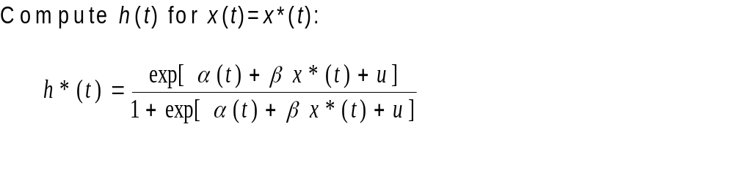
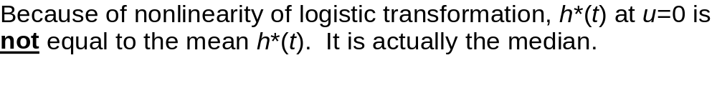
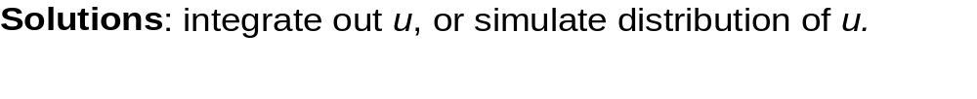
Obtaining Population Average Effects from a Frailty Model: Predicted Hazards
Multilevel Discrete-Time Event History Analysis

Slide 44
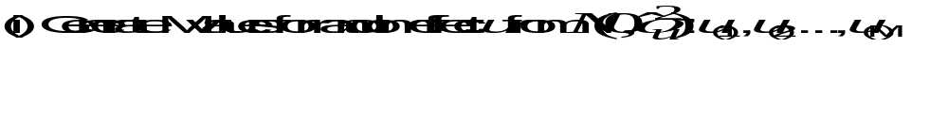
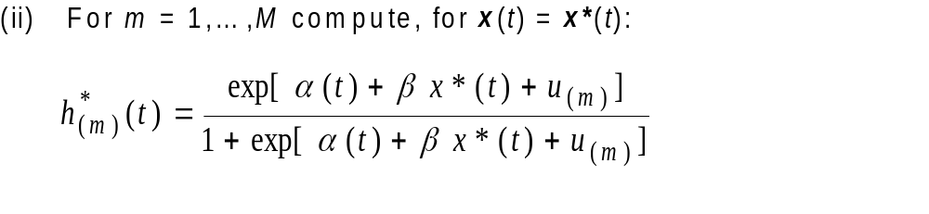
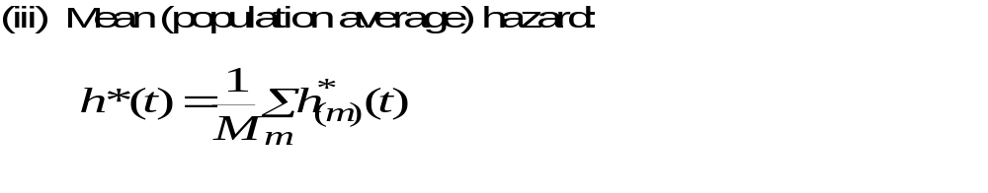
Predicted Hazards by Simulation
Multilevel Discrete-Time Event History Analysis

Slide 45
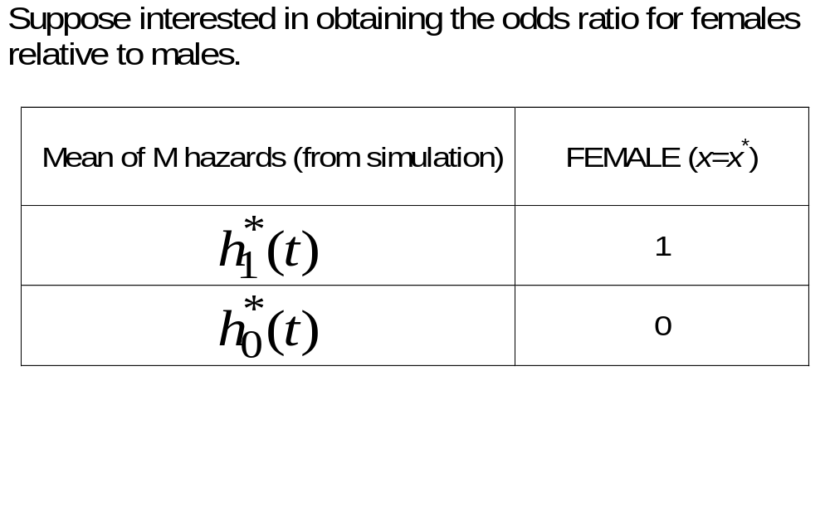
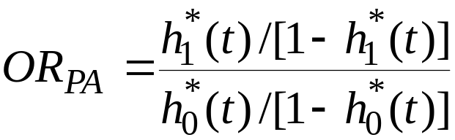
Population Average Odds Ratio from Predicted Hazards
Multilevel Discrete-Time Event History Analysis

Slide 46
Estimation of Model with Unobserved Heterogeneity
Estimate using any software for random effects (multilevel) logit models. Options include:
  SAS (proc nlmixed), Stata (xtlogit), aML (all use numerical quadrature)
  MLwiN (quasi-likelihood, MCMC)
  WinBUGS (MCMC)
Multilevel Discrete-Time Event History Analysis

Slide 47
Markov Chain Monte Carlo (MCMC) Estimation (1)
Bayesian formulation that puts priors on parameters and generates a (correlated) chain of sample draws from the posterior distribution of the parameters.
WinBUGS is the most flexible software – MLwiN tailored to multilevel data and uses ‘good’ starting values.
Consider the 2-level variance components model for Normal response data:
Multilevel Discrete-Time Event History Analysis

Slide 48

MCMC Estimation (2)
The basic idea is that we require the joint (posterior)
distribution of the parameters given the data y and
(independent) prior distributions for each of the parameters.
A ‘prior’ represents information about a parameter before
we collect data. For example a ‘diffuse’ prior is
This is then combined with the data (via the likelihood for the
data) to produce a ‘posterior’ distribution for the parameter.
MCMC works by drawing a random sample of sets of parameter
values, say 5,000 sets, and basing inference on these ‘chains’.
Multilevel Discrete-Time Event History Analysis

Slide 49
MCMC Estimation (3)
At iteration n we want to sample from the posterior
distribution of each parameter in turn. If we can write down
an analytical expression for the posterior – as is the case
for Normal models - then Gibbs sampling is available and
efficient.
Otherwise we need an alternative – MLwiN uses
Metropolis-Hastings sampling, e.g. for binary response
models.
Multilevel Discrete-Time Event History Analysis

Slide 50
MCMC Estimation (4)
The MCMC procedure for a 2-level binary response model
is as follows:
Choose starting values (quasi-likelihood)
2. Sample a new set of fixed effects given the current
values of all the other parameters and the data
Sample a new set of random effects given other
parameters and data
4. Sample new random effect variance
….etc.
Multilevel Discrete-Time Event History Analysis

Slide 51
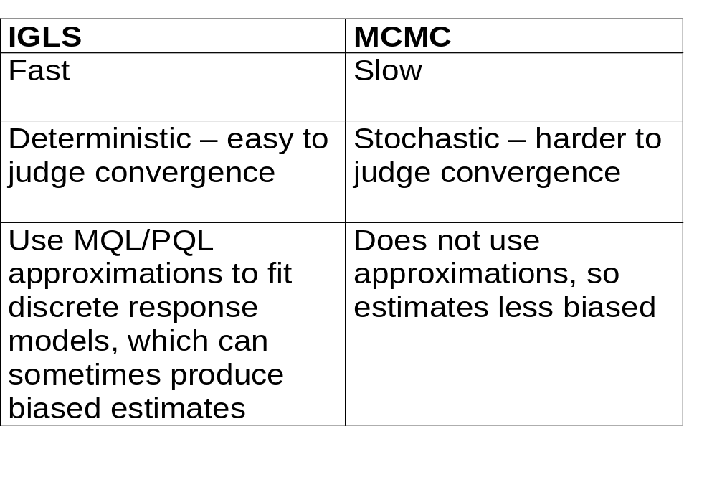
Maximum likelihood (IGLS) vs. MCMC (1)
Multilevel Discrete-Time Event History Analysis

Slide 52
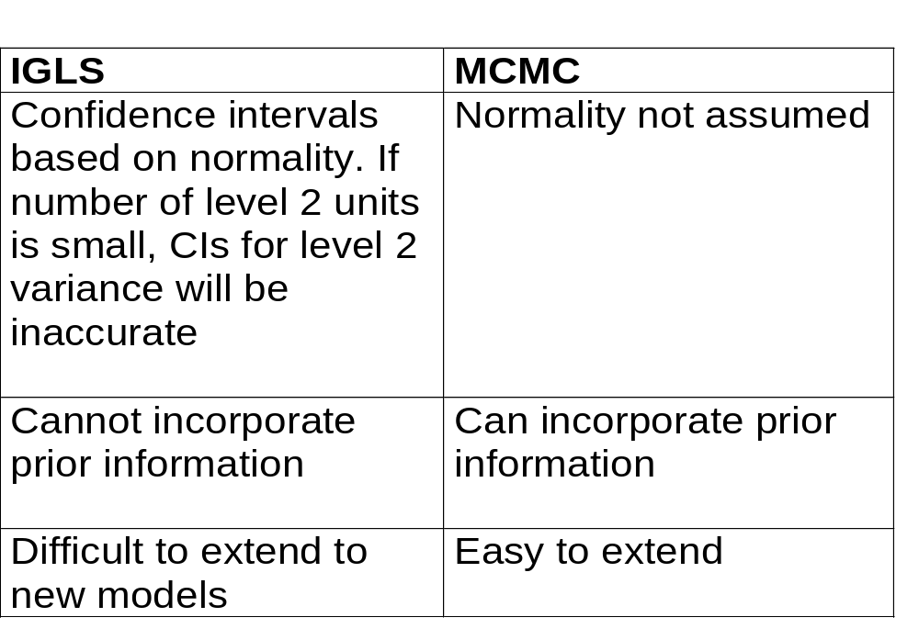
Maximum likelihood (IGLS) vs. MCMC (2)
Multilevel Discrete-Time Event History Analysis

Slide 53
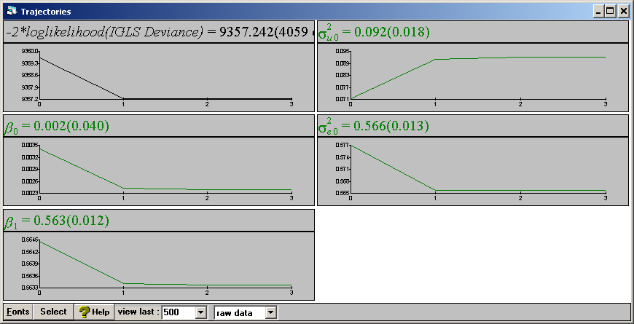
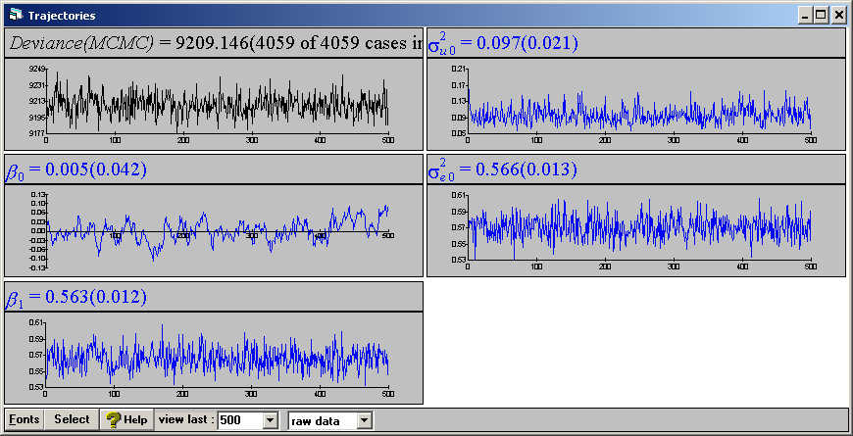
IGLS vs. MCMC Convergence
IGLS algorithm converges deterministically to a point.
MCMC algorithm converges on a distribution. Parameter estimates and intervals are then calculated from the simulation chains.
Multilevel Discrete-Time Event History Analysis

Slide 54
Obtaining Parameter Estimates in MCMC
For each parameter, we have a large number of simulated draws called a chain. The period when the chains are settling down (converging) to the posterior distribution is called the burn-in; these samples are discarded.
Summary statistics of the chains can then be calculated. Means and standard deviations (analogous to frequentist standard errors) are shown in the MLwiN Equations window.
95% interval estimates can be obtained by taking the 2.5% and 97.5% points of the ordered chain values.
Multilevel Discrete-Time Event History Analysis

Slide 55
Other MCMC Issues
By default MLwiN uses flat, uninformative priors (see p.5 of MCMC Estimation in MLwiN, downloadable from www.cmm.bris.ac.uk/MLwiN/download/manuals.shtml)
To specify informative priors, see Ch. 6
For model comparison in MCMC using the DIC statistics, see Ch. 3 & 4
For description of MCMC algorithms used in MLwiN, see Ch.2
Multilevel Discrete-Time Event History Analysis

Slide 56
When to Consider using MCMC in MLwiN
Discrete response data (categorical, counts). PQL often gives quick and accurate estimates but a good idea to check against MCMC, especially if you have small clusters.
If you have few level 2 units and want to make accurate inferences about level 2 variances.
Some advanced models only estimated using MCMC (e.g. multilevel factor analysis)
Some models can be fitted more easily using MCMC (e.g. multiple imputation, cross-classified models)
Multilevel Discrete-Time Event History Analysis

Slide 57
Modelling Recurrent Events

Slide 58
Examples of Recurrent Events
Many types of event can occur more than once to an individual. Define an episode as the time between the start of the ‘risk’ period and the occurrence of an event or censoring.
Examples
Employment episode: duration from starting a new job to leaving that job.
Marriage episode: duration of a marriage.
Multilevel Discrete-Time Event History Analysis

Slide 59
Problem with Analysing Recurrent Events
We cannot assume that the durations of episodes from the same individual are independent.
There may be unobserved individual-specific factors (i.e. constant across episodes) which affect the hazard of an event for all episodes. Presence of such unobservables, and failure to account for them in the model, will lead to correlation between the durations of episodes from the same individual.
Multilevel Discrete-Time Event History Analysis

Slide 60
Hierarchical Data Structure
Recurrent events lead to a two-level hierarchical structure.
Level 2: Individuals
Level 1: Episodes
Multilevel Discrete-Time Event History Analysis

Slide 61
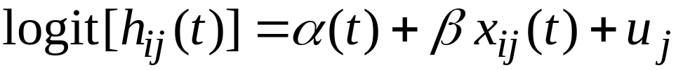
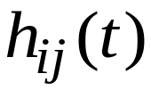
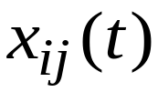

Simple Two-level Model for Recurrent Events (1)
is hazard of event in time interval t during episode i
of individual j
are covariates which might be time-varying or defined at
the episode or individual level
random effect representing unobserved characteristics
of individual j – shared ‘frailty’ (common to all episodes)
Assume
Multilevel Discrete-Time Event History Analysis

Slide 62
Simple Two-level Model for Recurrent Events (2)
The model for recurrent events is essentially the same as the model for unobserved heterogeneity, and is therefore estimated in exactly the same way.
Recurrent events allow better identification of the random effect variance.
The expansion of data to discrete-time format is carried out for each episode within an individual.
Multilevel Discrete-Time Event History Analysis

Slide 63
Episode-specific Effects
We can allow the duration and covariate effects to vary between episodes. E.g. we might expect factors affecting the timing of the first event to differ from those affecting timing of subsequent events (or the same factors to have different effects).
Include dummy variable(s) for order of the event and interact with t and covariates.
Multilevel Discrete-Time Event History Analysis

Slide 64
Example
Repeated birth intervals for Hutterite women, a natural fertility (no contraceptive use) population in North America.
Data on 944 birth intervals from 159 women. Interval is duration between a birth and conception of next child.
Only closed intervals (i.e. ending in a conception before the survey). Long open intervals may be due to primary or secondary sterility. Therefore there is no censoring.
Multilevel Discrete-Time Event History Analysis

Slide 65
Duration and Covariates
Duration of a birth interval is represented by a categorical variable (in a piecewise constant hazards model):
MONTH Month of exposure to risk of conception
[<6, 6-11, 12-23, 24-35, 36+ (ref.)]
Consider one covariate:
AGE Age at start of birth interval (years)
Multilevel Discrete-Time Event History Analysis

Slide 66
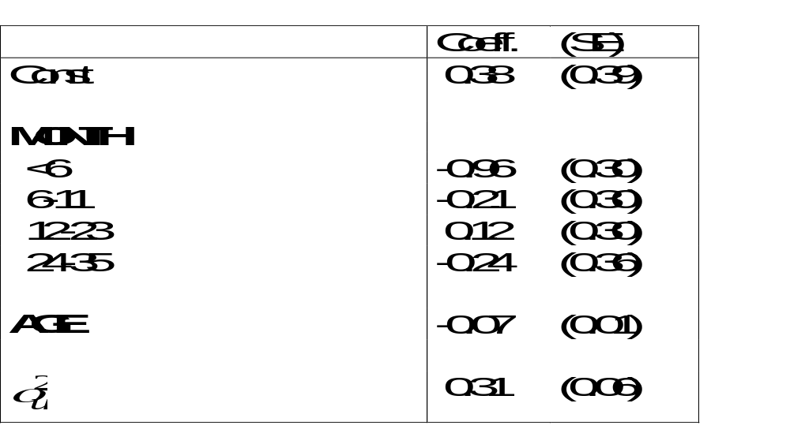
Results
Multilevel Discrete-Time Event History Analysis

Slide 67
Random Coefficient Models
The model we have considered so far assumes that unobserved heterogeneity is constant. Using multilevel modelling terminology, this model is a random intercept model. The form of the hazard is assumed the same across individuals, but is shifted up or down by an amount u_{j} on the logit scale. The duration and covariate effects are assumed to be the same for each individual.
To test these assumptions, we can consider random coefficient models (called random slope models for continuous covariates with linear effects). Note, however, that there may be insufficient information to estimate random coefficients if the number of individuals with recurrent events is small.
Multilevel Discrete-Time Event History Analysis

Slide 68
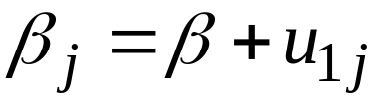
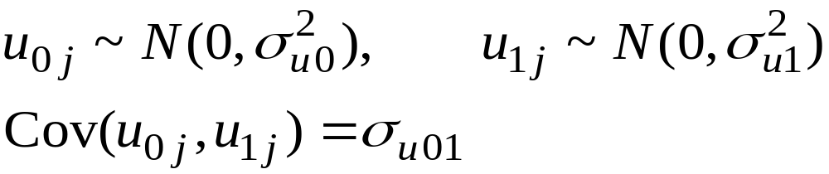
Random Coefficient for AGE
Suppose we suspect that the effect of AGE varies across women. We explore this using a random coefficient model:
where
Also written as
Assume
Multilevel Discrete-Time Event History Analysis

Slide 69
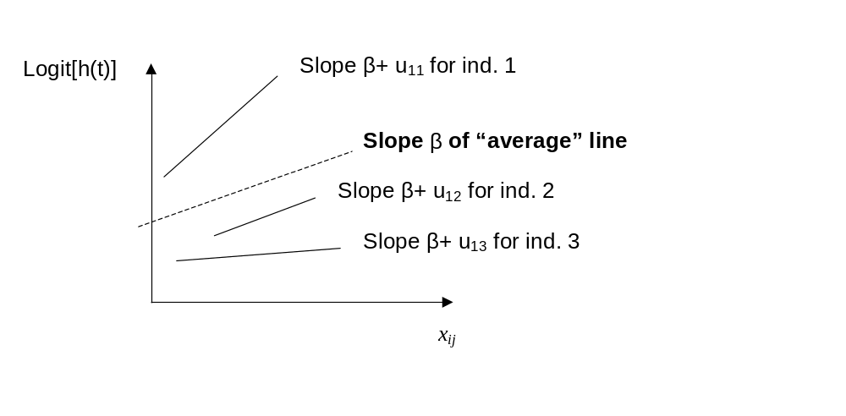
Graphical Representation of a Random Coefficient Model
For any time interval t:
Multilevel Discrete-Time Event History Analysis

Slide 70
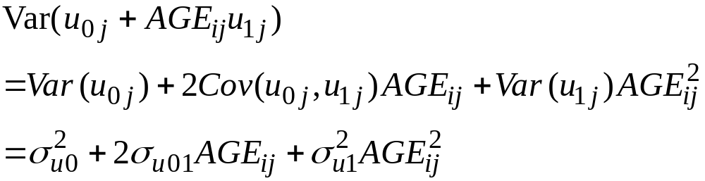
Unobserved Heterogeneity as a Function of AGE
In the model with a random coefficient for AGE, the unobserved heterogeneity between women is:
i.e. a quadratic function in AGE.
Multilevel Discrete-Time Event History Analysis

Slide 71
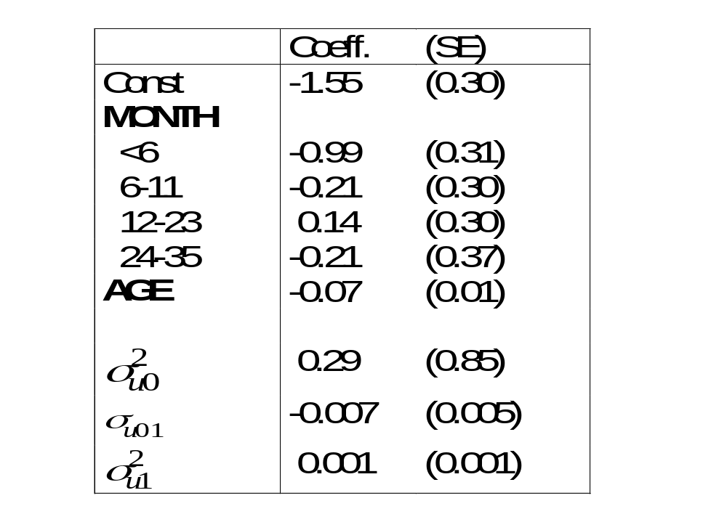
Results from Random Coefficient Model
(AGE centred around mean)
Multilevel Discrete-Time Event History Analysis

Slide 72
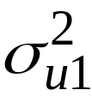

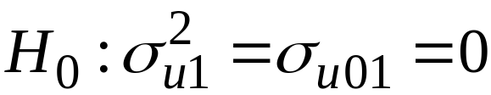
Testing Significance of Random Coefficient
2 additional parameters introduced to random intercept model:
and
Test the null hypothesis that
The (approximate) Wald test statistic is 2.84 on 2 d.f.
So fail to reject null and conclude that the effect of AGE is constant across women.
Multilevel Discrete-Time Event History Analysis

Slide 73
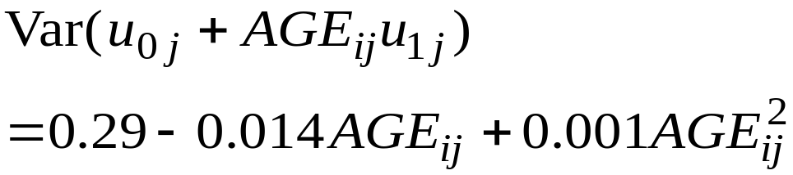
Interpretation of Random Coefficient for AGE
In practice, we would revert to the random intercept model after finding little evidence of a random coefficient. But, for illustration, we consider the interpretation of the random coefficient model.
The between-woman variance in the logit-hazard of conception (after accounting for duration effects) is:
We can plot the between-woman variance as a function of AGE.
Multilevel Discrete-Time Event History Analysis

Slide 74
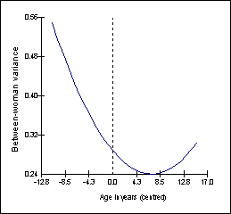
Between-woman Unobserved Heterogeneity as a Function of AGE
Multilevel Discrete-Time Event History Analysis

Slide 75
Multiple States

Slide 76
States in Event Histories
In the models we have considered so far, there is a single
event of interest. We model the duration to this event from
the point at which an individual becomes “at risk”. We can
think of this as the duration spent in the same state.
E.g. in a study of marital dissolution we model the duration
in the marriage state.
In a study of birth intervals we model the duration spent
in the non-pregnant state (up to age 45 say).
Multilevel Discrete-Time Event History Analysis

Slide 77
Multiple States
Usually individuals will move in and out of different states
over time, and we wish to model these transitions.
Examples
Partnership states: marriage, cohabitation, single
(unpartnered)
Employment states: employed, unemployed, out of the
labour market
Multilevel Discrete-Time Event History Analysis

Slide 78
Possible Partnership Transitions
(S=single, M=marriage, C=cohabitation)
M
S
etc.
C
M
M
C
Note that censoring can occur in any state, at which point no further transitions are observed.
S
S
S
M
C
C
M
S
C
Multilevel Discrete-Time Event History Analysis

Slide 79
Example: Transitions Between Partnership States
For simplicity, group marriage and cohabitation into one
‘partnership’ state (P), and model transitions between this
state and the ‘single’ state (S).
Need to estimate two equations: (1) duration spent in P,
where event is moving to S; (2) duration spent in S, where
event is moving to P.
Multilevel Discrete-Time Event History Analysis

Slide 80




Model for Transitions Between Partnership and Single States
(Adapted from Goldstein et al. 2004, Understanding Statistics)
Transitions from P to S (may be multiple transitions per individual):
Transitions from S to P (actually fit separate eq. for first S-P transition):
Allow correlation between
and
Multilevel Discrete-Time Event History Analysis

Slide 81
Why Allow Correlation Between Random Effects Across States?
There may be time-invariant individual-specific
unobservables that affect each type of transition.
E.g. individuals with a strong desire to be in a partnership
might have a low hazard of moving from P to S, and a high
hazard of moving from S to P, i.e. a tendency towards long
partnerships and short periods in the single state.
This would lead to a negative random effect correlation.
Multilevel Discrete-Time Event History Analysis

Slide 82
Random Effect Covariance Matrix
(from Goldstein et al. 2004)
 | P | S
P | 0.462 (0.061)
S | -0.313 (0.095) -0.524 | 0.773 (0.141)
Source: National Child Development Study (NCDS), age 16-33
Note: Standard errors in parentheses; correlation estimate.
Multilevel Discrete-Time Event History Analysis

Slide 83
Interpretation of Random Effect Correlation (Men only)
The estimated correlation of –0.524 implies that there is a
moderate negative association between the duration in a
partnership and the duration spent without a partner.
We can, tentatively, classify men as long partnership/
short-time single or short partnership/ long-time single.
Multilevel Discrete-Time Event History Analysis

Slide 84
Estimation of a Multiple State Model
Specify a single equation model with dummy variables for each state. Interact dummies with duration and covariates to obtain state-specific duration and covariate effects.
Allow coefficient of each dummy to vary and covary randomly across individuals.
Multilevel Discrete-Time Event History Analysis

Slide 85
Data Structure I
Start with an episode-based file, e.g.
j | i | State_{ij} | t_{ij} | δ_{ij} | Age_{ij}
1 | 1 | S | 3 | 1 | 16
1 | 2 | P | 2 | 0 | 19
Notes: (1) t in years; (2) δ_{ij} =1 if uncensored, 0 if censored;
(3) age, in years, at start of episode.
Multilevel Discrete-Time Event History Analysis

Slide 86
Data Structure II
Convert to discrete-time format:
t | y_{ij}(t) | S_{ij} | P_{ij} | S_{ij}*Age_{ij} | P_{ij}*Age_{ij}
1 | 0 | 1 | 0 | 16 | 0
2 | 0 | 1 | 0 | 16 | 0
3 | 1 | 1 | 0 | 16 | 0
1 | 0 | 0 | 1 | 0 | 19
2 | 0 | 0 | 1 | 0 | 19
S_{ij} dummy for Single, P_{ij} dummy for Partnership.
Multilevel Discrete-Time Event History Analysis

Slide 87
Model Specification
Specify a 2-level logit model. Include S_{ij}, P_{ij}, S_{ij}*Age_{ij} and P_{ij}*Age_{ij} as explanatory variables. Also include interactions between P_{ij}, S_{ij} and some function of duration t.
Coefficients of S_{ij} and S_{ij}*Age_{ij} are intercept and effect of age on log-odds of forming a partnership. Coefficients of P_{ij} and P_{ij}*Age_{ij} are intercept and effect of age on log-odds of dissolving a partnership.
Allow coefficient of S_{ij} and P_{ij} to vary randomly across individuals.
Multilevel Discrete-Time Event History Analysis

Slide 88
Competing Risks

Slide 89
Examples
There will often be more than one way of (or reason for)
exiting a particular state; we call these “competing risks”.
We assume these are mutually exclusive.
Event | Competing risks
Death | Different causes
End of employment spell | Sacked, redundancy, switch job, out of labour market
Partnership formation | Marriage or cohabitation
Contraceptive discontinuation | Different reasons, e.g. failure, side effects
Multilevel Discrete-Time Event History Analysis

Slide 90
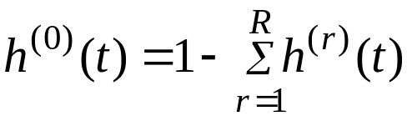
Cause-Specific Hazard Functions
The hazard is defined as for single types of event, but now
we have one for each competing risk.
Suppose there are R competing risks, then the hazard of
event type r at time t is:
h^{(r)}(t) = Pr(event of type r at time t | T ≥ t)
The hazard that no event of any type occurs at t
(given ‘survival’ to t) is:
Multilevel Discrete-Time Event History Analysis

Slide 91
Calculation of the Survivor Function
The probability of survival is the probability that no event
of any type occurs before time t:
Multilevel Discrete-Time Event History Analysis

Slide 92
Modelling Approaches I
In discrete time, we can distinguish between two main
modelling approaches:
Model the cause-specific hazards simultaneously
using a multinomial logistic model
E.g. for partnership formation, estimate 2 contrasts:
marriage vs. single (“no event”), cohabitation vs. single.
(The remaining contrast, marriage vs. cohabitation, may
be estimated from the other two.)
c.f. Multiple decrement life table
Multilevel Discrete-Time Event History Analysis

Slide 93
Modelling Approaches II
(2) Model each competing risk separately, treating all
other events as censored
E.g. for partnership formation, estimate 2 separate
binary logistic models:
(i) Model hazard of marriage, treating transitions to
cohabitation as censored;
(ii) Model hazard of cohabitation, treating transitions to
marriage as censored.
c.f. Associated single decrement life table
Multilevel Discrete-Time Event History Analysis

Slide 94
Modelling Approaches III
Rates estimated using approach (2) represent the underlying
(or theoretical) risk of a particular event in the absence of all
other risks.
E.g. “What would be the risk of dying from cancer if there
were no other causes of death?”
Useful for comparing rates across time or populations.
E.g. Comparison of death rates due to cancer in 1900 and
1990, adjusting for changes in life expectancy.
Multilevel Discrete-Time Event History Analysis

Slide 95
Data Structure for Multinomial Model
For each discrete time interval t define a multinomial
response, y_{ij}(t), indicating occurrence and type of event.
The response categories are 0 (“no event”), 1, 2, . . ., R.
Note: Further data restructuring needed to fit model in
MLwiN – see practical.
Multilevel Discrete-Time Event History Analysis

Slide 96
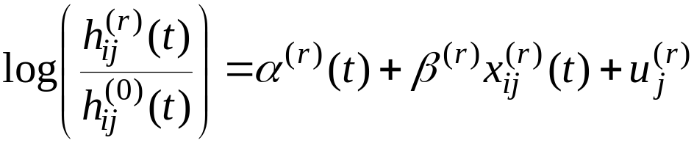

The Multinomial Logit Model
(Multilevel Version for Recurrent Episodes)
R equations contrasting event type r with “no event”.
where
~ multivariate normal, variance Ω_{u}
Random effects are correlated to allow for shared
unobserved risk factors.
Multilevel Discrete-Time Event History Analysis

Slide 97
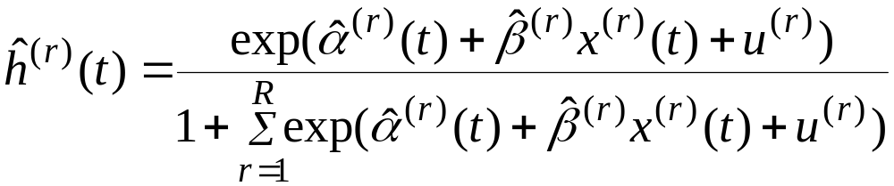


Estimation of Cause-Specific Hazards
Usual formula for calculating predicted probabilities
from a multinomial logit model:
Need to substitute some value for
Could simulate values from
Multilevel Discrete-Time Event History Analysis

Slide 98
Competing Risks: Example
Data from NCDS, women age 16-42
Outcomes of cohabitation
  Separation (r=1)
  Marriage to cohabiting partner (r=2)
  Staying cohabiting, i.e. “no event” (r=0)
α^{(r)}(t) cubic polynomials
Multilevel Discrete-Time Event History Analysis

Slide 99
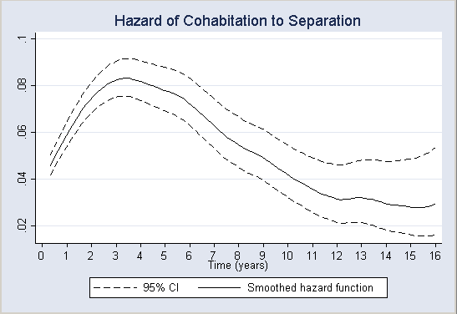
Multilevel Discrete-Time Event History Analysis

Slide 100
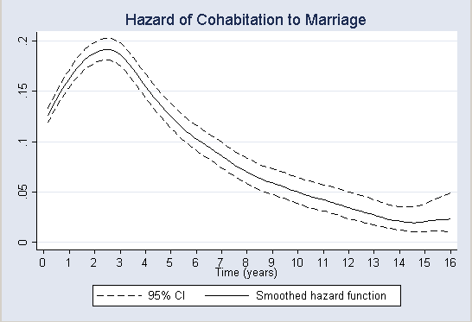
Multilevel Discrete-Time Event History Analysis

Slide 101
Years to Partnership Transitions: Quartiles
 | 25% | 50% | 75%
Cohab → Separation | 3.5 | 9.1 | -
Cohab → Marriage | 1.3 | 2.9 | 10.3
Marriage → Separation | 13.8 | - | -
Multilevel Discrete-Time Event History Analysis

Slide 102
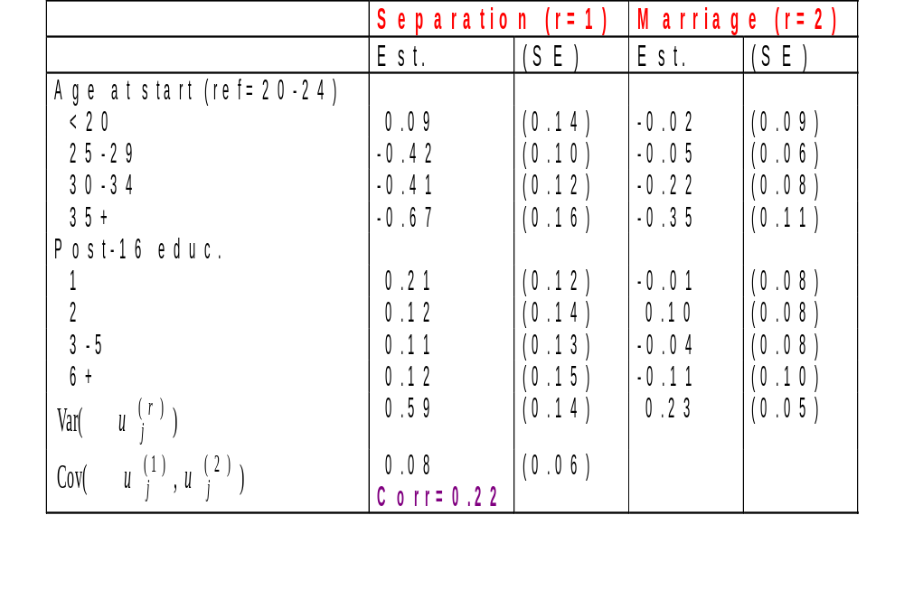
Cohabitation Outcomes: Selected Results
Multilevel Discrete-Time Event History Analysis

Slide 103
Competing Risks and Multiple States: Example
Jointly model outcomes of marital and cohabiting partnerships:
  Marriage → separation
  Cohabitation → separation
  Cohabitation → marriage
Multiple states: marriage and cohabitation
Competing risks: 2 outcomes of cohabitation
Model can be extended to consider all possible partnership transitions. Here we omit partnership formation (single → marriage, single → cohabitation)
Multilevel Discrete-Time Event History Analysis

Slide 104
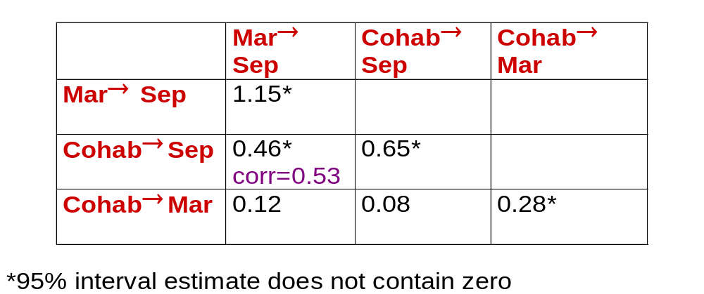
Random Effects Covariance Matrix
Multilevel Discrete-Time Event History Analysis

Slide 105
Interpretation of Random Effect Correlation
Correlation between random effects for dissolution of
marriage and cohabitation is estimated as 0.53.
Women with a high (low) risk of separation from marriage
tend also to have a high (low) risk of separation from
cohabitation.
Multilevel Discrete-Time Event History Analysis

Slide 106
Competing Risks and Multiple States: Another Example
(Steele et al. 2004, Statistical Modelling)
Contraceptive use dynamics in Indonesia. Define episode of use as a continuous period of using the same method of contraception.
  2 states: use and nonuse
  An episode of use can end in 2 ways: a transition to nonuse (discontinuation), or a switch to another method (a transition within the same state).
Estimate 3 equations jointly: binary logit model for transition from nonuse to use, and multinomial logit model for transitions from use
Multilevel Discrete-Time Event History Analysis

Slide 107
Selected Results: Fixed Effects
 | Use→nonuse Est. (SE) | Use →other method Est. (SE) | Nonuse →use Est. (SE)
Urban (ref.=rural) | 0.13 (0.04) | 0.06 (0.05) | 0.26 (0.04)
SES (ref.=low)
Medium | -0.12 (0.05) | 0.35 (0.07) | 0.24 (0.05)
High | -0.20 (0.05) | 0.29 (0.08) | 0.45 (0.05)
Multilevel Discrete-Time Event History Analysis

Slide 108
Random Effect Correlations from Two Different Models
 | Use→nonuse | Use →other method | Nonuse →use
Use→nonuse | 1
Use →other method | 0.020 0.011 | 1
Nonuse →use | -0.783* -0.052 | 0.165* 0.095 | 1
Model 1: Duration effects only
Model 2: Duration + covariate effects
*Correlation significantly different from zero at 5% level
Multilevel Discrete-Time Event History Analysis

Slide 109
Random Effect Correlations: Interpretation
In “duration effects only” model, there is a large negative correlation between random effects for nonuse → use and use → nonuse
  Long durations of use associated with short durations of nonuse
This is due to short episodes of postnatal nonuse followed by long episodes of use (to space or limit future births)
  Correlation is effectively zero when we control for whether episode of nonuse follows a live birth (one of the covariates)
Multilevel Discrete-Time Event History Analysis

Slide 110
Independence of Irrelevant Alternatives (IIA)
One potential problem of the multinomial logit model is the IIA assumption.
The IIA assumption is that the hazard of one event relative to “no event” is independent of the hazards of each of the other events relative to “no event”.
This may be unreasonable if some events can be regarded as similar.
Multilevel Discrete-Time Event History Analysis

Slide 111
Example: Partnership Formation (Marriage vs. Cohabitation)
Under IIA, assume the hazard of cohabitation vs. staying single is uncorrelated with the hazard of marriage vs. staying single.
E.g. If there is something unobserved (not in X’s) that made marriage unfeasible, we assume those who would have married distribute themselves between cohabitation and single in the same proportions as those who originally chose not to marry.
But as marriage and cohabitation are similar in some respects, we might expect those who are precluded from marriage to be more likely to cohabit rather than remain single (Hill, Axinn and Thornton, 1993, Sociological Methodology).
Multilevel Discrete-Time Event History Analysis

Slide 112
IIA: Solutions
The random effects multinomial logit offers some protection against the IIA assumption. The correlation between the cause-specific random effects allows for similarity between alternatives due to time-invariant individual characteristics. It does not control for unmeasured factors that vary across episodes (e.g. whether respondent or partner is already married).
Another approach is to use a multinomial probit model (e.g. using aML). Or nested logit model (Hill et al. 1993).
Multilevel Discrete-Time Event History Analysis

Slide 113
Multiple Processes

Slide 114

Endogeneity (1)
Consider a 2-level random effects model for a Normal response:
One assumption of the model is that the predictors x_{ij} are
uncorrelated with the residuals (u_{j},e_{ij}), i.e. we assume that x_{ij}
are exogenous.
This may too strong an assumption for some predictors,
particularly “choice” variables.
Multilevel Discrete-Time Event History Analysis

Slide 115
Endogeneity (2)
E.g. suppose y_{ij} is birth weight of child i of woman j, and z_{ij}
(an element of x_{ij}) is number of antenatal visits during pregnancy.
Some of the factors that influence birth weight may also influence
the uptake of antenatal care; these may be characteristics of the
particular pregnancy (e.g. woman’s health during pregnancy) or of
the woman (health-related behaviour). Some of these may be
unobserved.
i.e. y and z are to some extent jointly determined. z is said to be
endogenous.
This will lead to correlation between z and u and/or e, and a biased
estimate of the coefficient of z.
Multilevel Discrete-Time Event History Analysis

Slide 116

Simultaneous Equations Model
One approach to allow for endogeneity is to model y and z jointly.
Estimate two equations:
where we allow residuals at the same level to be correlated
across equations:
Because of these correlations, the equations must be estimated
simultaneously (or in 2-stages in single-level case).
Multilevel Discrete-Time Event History Analysis

Slide 117


Simultaneous Equations Model: Identification
In order to identify the model, some exclusion restrictions must
be placed on the covariates and/or random effect covariances:
If covariances at both levels are permitted to be nonzero
must contain at least one variable not contained in
If one covariance is assumed to equal zero, covariate
exclusions are not strictly necessary for identification.
Multilevel Discrete-Time Event History Analysis

Slide 118
Simultaneous Equations Model: Estimation
Treat (y_{ij}, z_{ij}) as a bivariate response, and estimate multilevel
bivariate response model (e.g. in MLwiN, Chapter 14 in manual).
Model can be extended to handle categorical responses (e.g.
bivariate probit model) or mixture of Normal and categorical
responses.
MLwiN can handle mixture of binary and Normal, and binary and
multinomial (if zero covariance assumed at lowest level). aML can
handle other mixtures.
Multilevel Discrete-Time Event History Analysis

Slide 119
Simultaneous Equations Model for Correlated Event Histories (1)
Suppose y is a duration variable and z is either also a duration
or the outcome of an event history.
E.g. (Lillard 1993; Lillard and Waite, 1993)
y_{ij} is duration of marriage i of person j
z_{ij}(t) is number of children from marriage i at time t (outcome of birth
history)
The unobserved individual characteristics that affect hazard of
marital separation may be correlated with those that affect hazard
of birth (or conception) during marriage.
Multilevel Discrete-Time Event History Analysis

Slide 120


Simultaneous Equations Model for Correlated Event Histories (2)
Hazard of marital separation at time t
Hazard of conception (leading to live birth) at time t
P – partnership process
F – fertility process
Model hazards jointly using simultaneous (multiprocess)
event history model.
Multilevel Discrete-Time Event History Analysis

Slide 121


Discrete-time Model
where
Multilevel Discrete-Time Event History Analysis

Slide 122



Discrete-time Model: Estimation
For each time interval t define a bivariate response
indicates partnership transition (e.g. marital separation)
- could be binary or multinomial (competing risks)
indicates fertility transition (conception)
Fit multilevel bivariate response model to allow for correlation
between random effects.
Multilevel Discrete-Time Event History Analysis

Slide 123



Example: Lillard (1993)
Effect of Children from Current Marriage on Log-Hazard of Marital Separation
No. children (ref.=none)
1 | -0.56 (0.10) | -0.33 (0.11)
2+ | -0.01 (0.05) | 0.27 (0.07)
Multilevel Discrete-Time Event History Analysis

Slide 124
Multiprocess Models with Multiple States and Competing Risks
Suppose we consider outcomes of cohabiting partnerships
together with marital separation. This leads to multiple
states (marriage & cohabitation) and competing risks
(separation & marriage).
Partnership transition indicator will be binary for marriage
and multinomial for cohabitation. Include state dummies and
their interactions with covariates as before.
Add binary fertility response, leading to bivariate data with
mixture of binary and multinomial responses.
Multilevel Discrete-Time Event History Analysis

Slide 125
Example: Steele et al. (2005)
Estimate 5 hazards equations for following transitions:
- marriage → separation
- cohabitation → separation
- cohabitation → marriage
- conception (leading to live birth) in marriage
- conception in cohabitation
Each equation includes a woman-specific random effect.
Random effects correlated across equations.
Multilevel Discrete-Time Event History Analysis

Slide 126

Random Effects Covariance Matrix: Partnership Transitions
Multilevel Discrete-Time Event History Analysis

Slide 127

Random Effects Covariance Matrix: Fertility
Multilevel Discrete-Time Event History Analysis

Slide 128
Selected Random Effect Correlations Across Processes
Separation from marriage and cohabiting conception
  r = 0.42* (*sig. at 5% level)
Separation from cohabitation and cohabiting conception
  r = 0.32*
Cohabitation to marriage and cohabiting conception
  r = 0.30*
Multilevel Discrete-Time Event History Analysis

Slide 129

Effect of Selected Fertility Variables on Log-odds of Separation from Cohabitation
Multilevel Discrete-Time Event History Analysis

Slide 130
Other Examples of Potentially Correlated Event Histories
Partnership formation and childbearing
Partnership formation and education
Partnership formation/outcomes and employment
Childbearing and employment
Housing and employment
Multilevel Discrete-Time Event History Analysis

Slide 131
Bibliography:
Modelling the Time to a Single Event
Allison, P.D. (1982) “Discrete-time methods for the analysis of event
history data.” In Sociological Methodology (Ed. S. Leinhardt). San
Francisco: Jossey-Bass.
Singer, J.D. and Willet, J.B. (1993) “It’s about time: Using discrete-time
survival analysis to study duration and the timing of events.” Journal
of Educational Statistics, 18: 155-195.
Multilevel Discrete-Time Event History Analysis

Slide 132
Bibliography:
Models for Recurrent Events and Unobserved Heterogeneity
Davis, R.B., Elias, P. and Penn, R. (1992) “The relationship between
a husband’s unemployment and a wife’s participation in the
labour-force.” Oxford Bulletin of Economics and Statistics, 54:145-71.
Kravdal, Ø. (2001) “The high fertility of college educated women in
Norway: An artefact of the separate modelling of each parity
transition.” Demographic Research, 5, Article 6.
Multilevel Discrete-Time Event History Analysis

Slide 133
Bibliography:
Modelling Transitions Between Multiple States
Enberg, J., Gottschalk, P. and Wolf, D. (1990) “A random-effects logit model of work-welfare transitions.” Journal of Econometrics, 43: 63-75.
Goldstein, H., Pan, H. and Bynner, J. (2004) “A flexible procedure for analysing longitudinal event histories using a multilevel model.” Understanding Statistics, 3: 85-99.
Steele, F., Goldstein, H. and Browne, W. (2004) “A general multistate competing risks model for event history data, with an application to a study of contraceptive use dynamics.” Journal of Statistical Modelling, 4: 145-159.
Steele, F., Kallis, C., Goldstein, H. and Joshi, H. (2005) “The relationship between childbearing and transitions from marriage and cohabitation in Britain.” Demography, 42: 647-673.
Multilevel Discrete-Time Event History Analysis

Slide 134
Bibliography:
Modelling Competing Risks
Enberg, J., Gottschalk, P. and Wolf, D. (1990) “A random-effects logit model of work-welfare transitions.” Journal of Econometrics, 43: 63-75.
Hill, D.H., Axinn, W.G. and Thornton, A. (1993) “Competing hazards with shared unmeasured risk factors.” Sociological Methodology, 23: 245-277.
Steele, F., Diamond, I. and Wang, D. (1996) “The determinants of the duration of contraceptive use in China: A multilevel multinomial discrete hazards modelling approach.” Demography, 33: 12‑33.
Steele, F., Goldstein, H. and Browne, W. (2004) “A general multistate competing risks model for event history data, with an application to a study of contraceptive use dynamics.” Journal of Statistical Modelling, 4: 145-159.
Multilevel Discrete-Time Event History Analysis

Slide 135
Bibliography:
Multiprocess Models for Correlated Histories
Brien, M.J., Lillard, L.A. and Waite, L.J. (1999) “Interrelated family-building behaviors: Cohabitation, marriage, and nonmarital conception.” Demography, 36: 535-551.
Steele, F., Kallis, C., Goldstein, H. and Joshi, H. (2005) “The relationship between childbearing and transitions from marriage and cohabitation in Britain.” Demography, 42: 647-673.
Upchurch, D.M., Lillard, L.A. and Panis, C.W.A. (2002) “Nonmarital childbearing: Influences of education, marriage, and fertility.” Demography, 39: 311-329.
Waite, L.J. and Lillard, L.A. 1991. “Children and marital disruption.” American Journal of Sociology, 96: 930-53.
Multilevel Discrete-Time Event History Analysis

